Slide 1


Human mobility and the spatial transmission of influenza
Cécile Viboud¹,Vivek Charu^{1,2}, Julia Gog^{1,3}, Stephen Kissler³,
Lone Simonsen^{1,4}, Ottar Bjørnstad^{1,5}, Bryan Grenfell^{1,6}
¹Fogarty International Center, National Institutes of Health, USA
²Johns Hopkins University, USA
³University of Cambridge, UK
⁴ George Washington University, USA
⁵ Pennsylvania State University, USA
⁶Princeton University, USA
RAPIDD (Research And Policy in Infectious Diseases Dynamics)

Slide 2
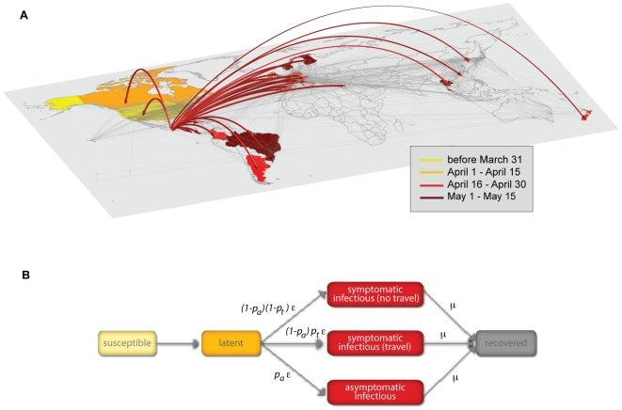
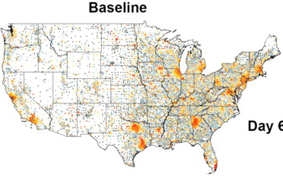
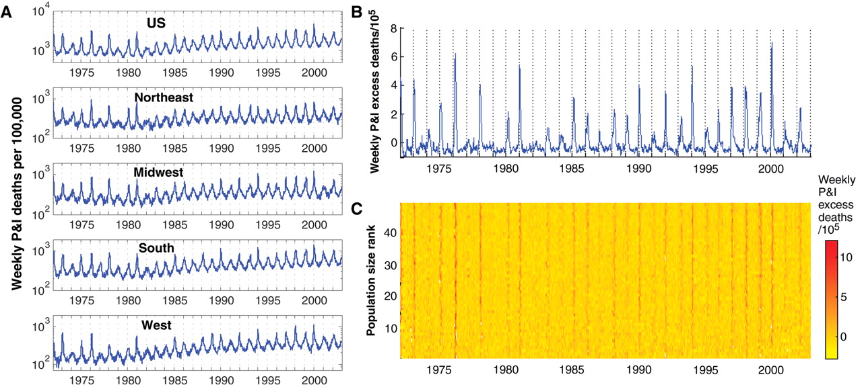
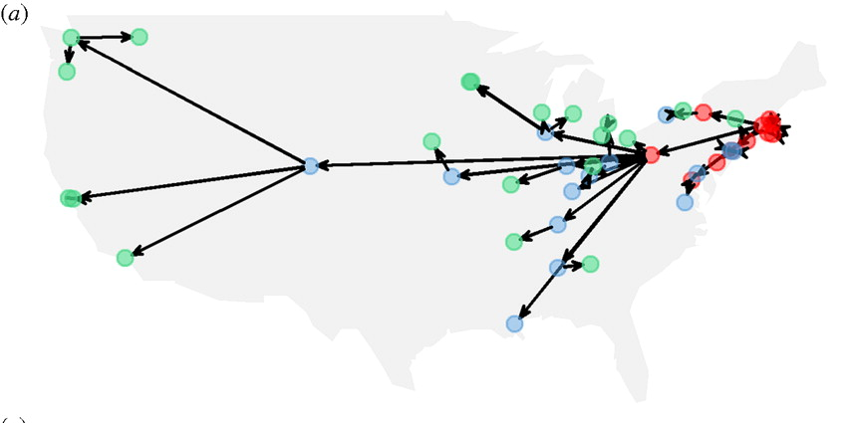
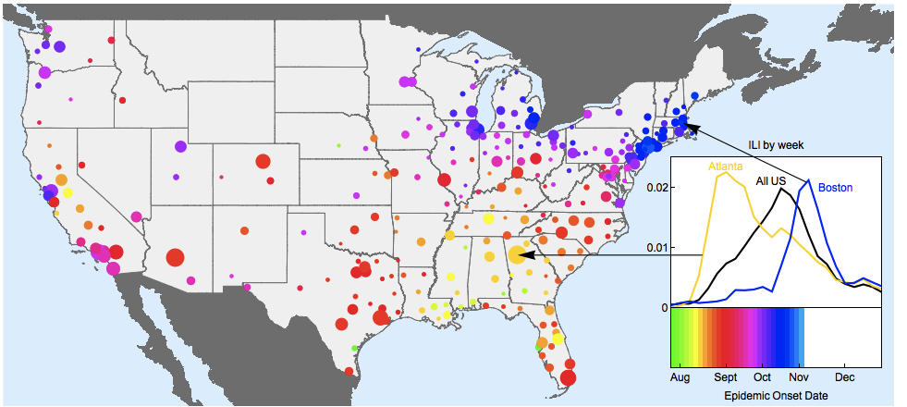
Brief history of spatial flu transmission models
mid 2000s
1960s-early 2000s
late 2000s
2009 pandemic
1918 pandemic
Seasonal flu

Slide 3
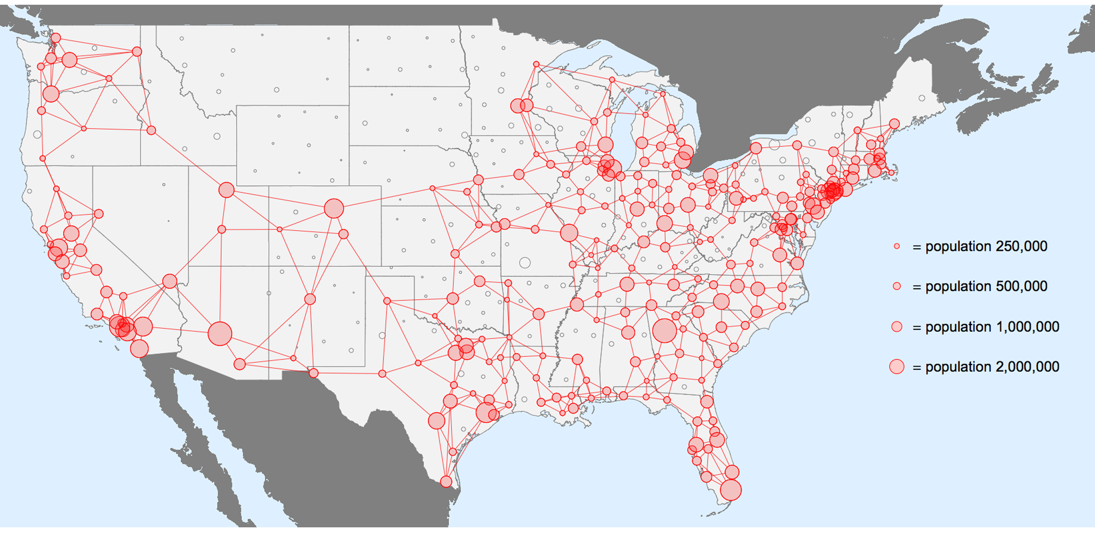
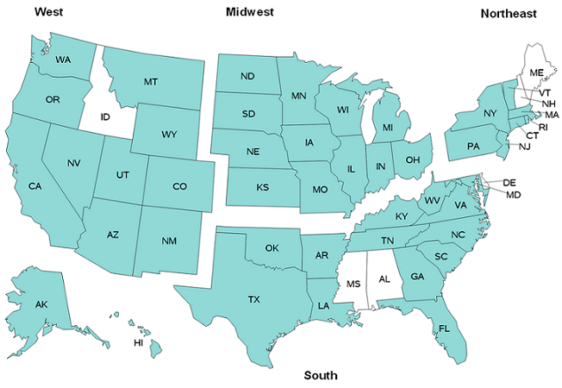
Data sources
Medical claims ILI data
IMS Health
~300 cities/counties reporting weekly ILI visits (2002-2010)
Covers ~80% of the US population
Aligns well with other influenza indicators
Previously utilized to characterize disease spread
Influenza-coded hospitalization data
State Inpatient Databases
All counties for available states (24 in 2000 to 45 in 2014)
Covers 60-90 % of the US population
Weekly influenza rates, previously utilized to characterize disease spread
Notes:
Goals: characterize relationships between cities in the network (connectivity) to transmission.
Claims data are sourced from the practice management software vendors directly from the physician's office, or from the intermediary billing systems that coordinate the insurance claim transactions.
In 2009, there were 560,433 active physician practices in the US of which IMS Health collected data from 354,402, or an approximate coverage rate of 61.5%.

Slide 4
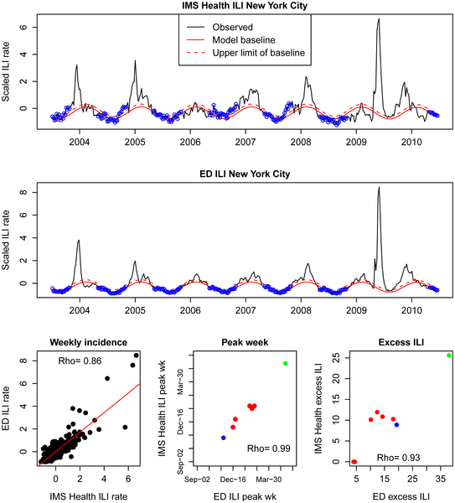
Medical claims track local influenza epidemics
Medical claims data works better than Google Flu Trends in New York
Viboud et al, Plos One, 2014; Olson et al, Plos Comp Bio 2013

Slide 5
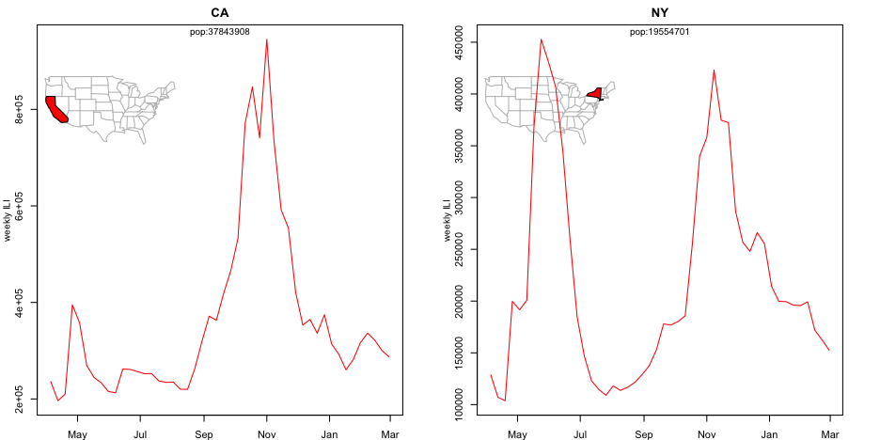

Geographic variation between states,
2009 pandemic
2009
2009
Spring wave
Fall
wave
Fall
wave
Spring wave
Gog et al, Plos Comp Bio 2014

Slide 6
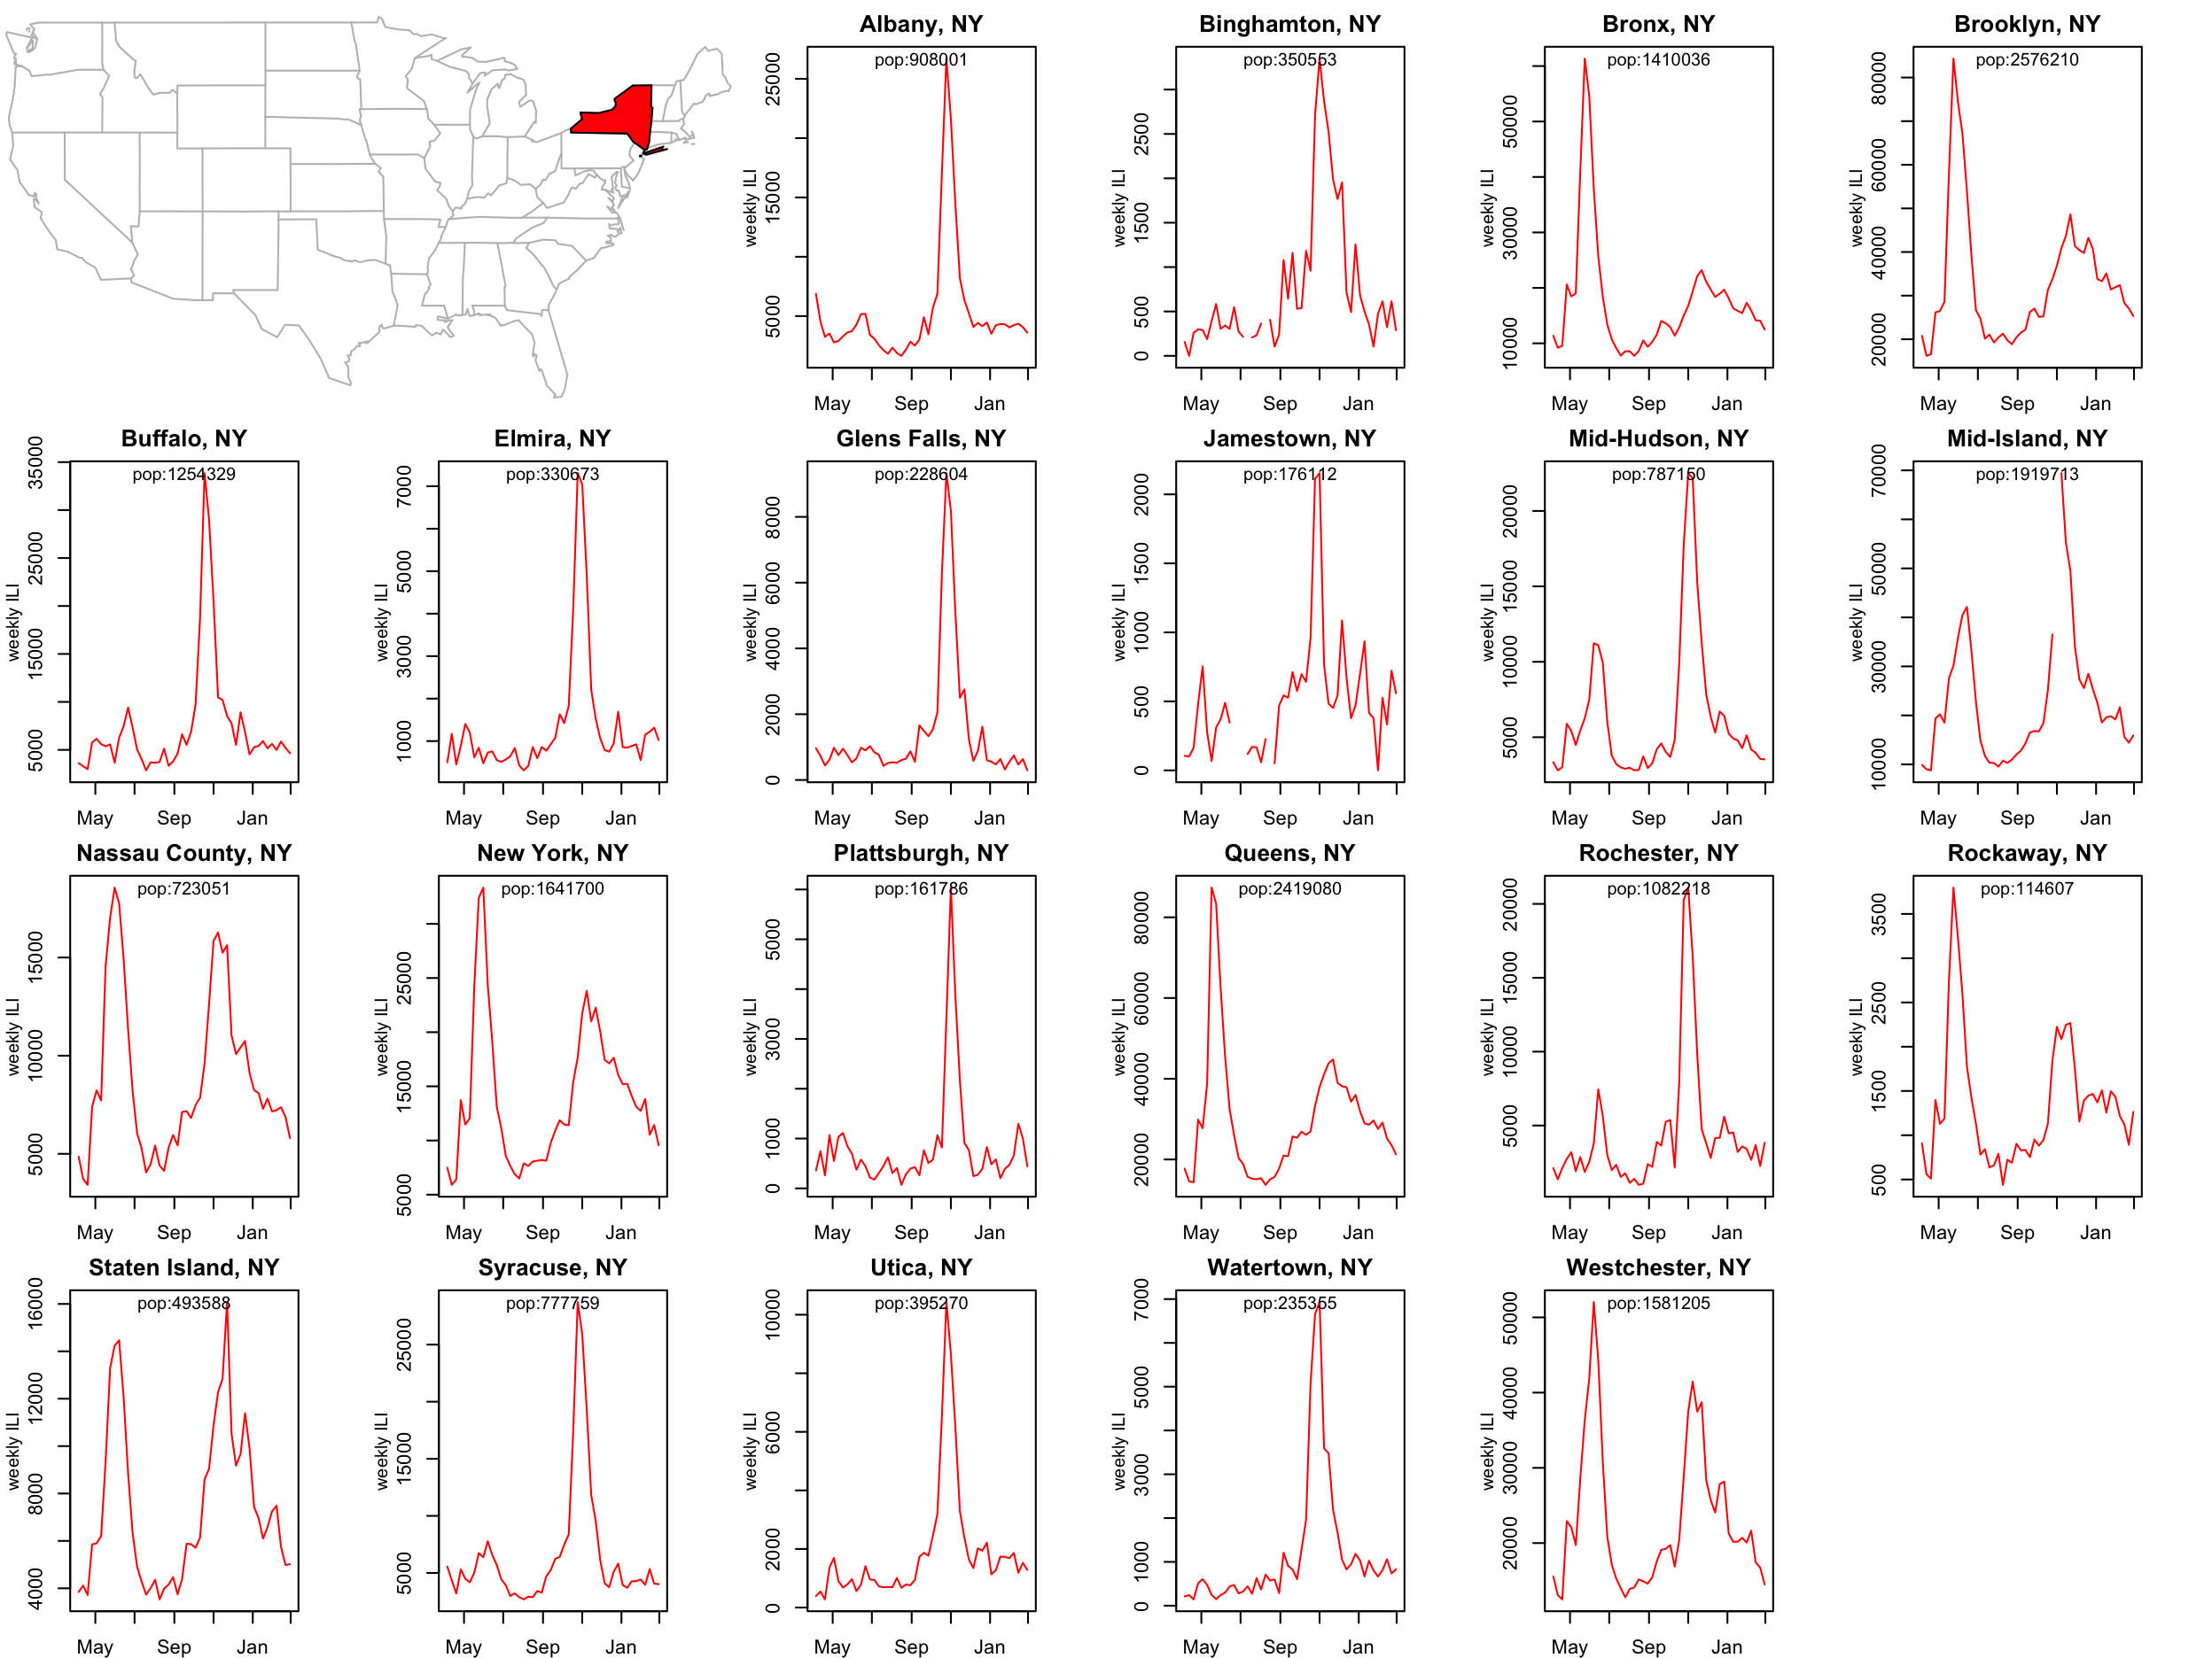
NY State
Viboud et al, Plos One, 2014

Slide 7
Weekly ILI time series 2002/03 to 2009/10
Standardized ILI incidence
2003
2005
2007
2009
Notes:
Figure 1. Standardized influenza-like-illness time series from four locations (Spencer, IA; Bryan, TX; Roanoke, VA; Denver, CO) for which onset times for all eight seasons (2002/2003-2009/2010) were extracted. The 2003/2004 epidemic and 2009/2010 pandemic are highlighted to indicate that in these seasons >99% of viruses in circulation were the same subtype (A/H3N2 in 2003/2004 and A/H1N1 in 2009/2010). Onset times for each season are depicted as dashed lines, demarcating conceptually the time in each season at which a city-level influenza epidemic is sparked by external seeding.

Slide 8
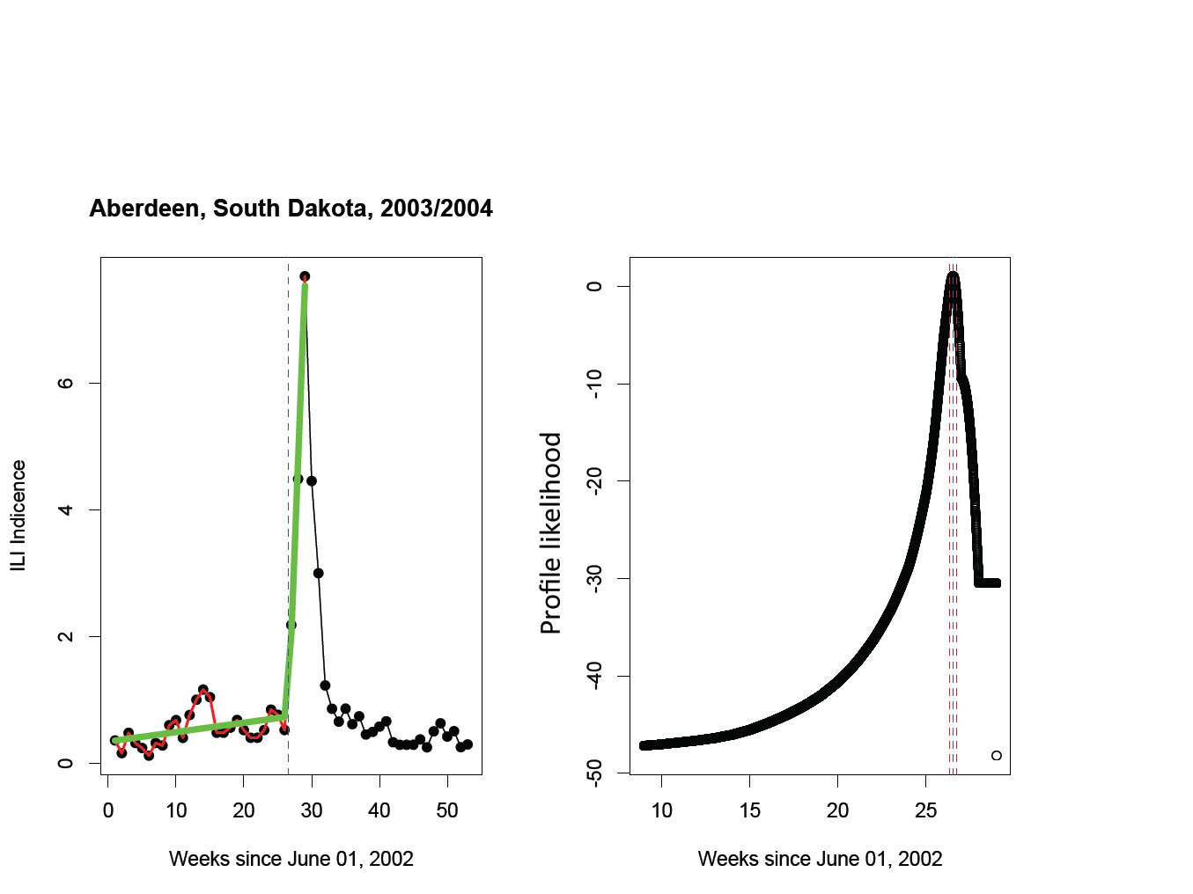
Disease onset in each city: broken stick method
Charu et al, Plos Comp Bio 2017

Slide 9
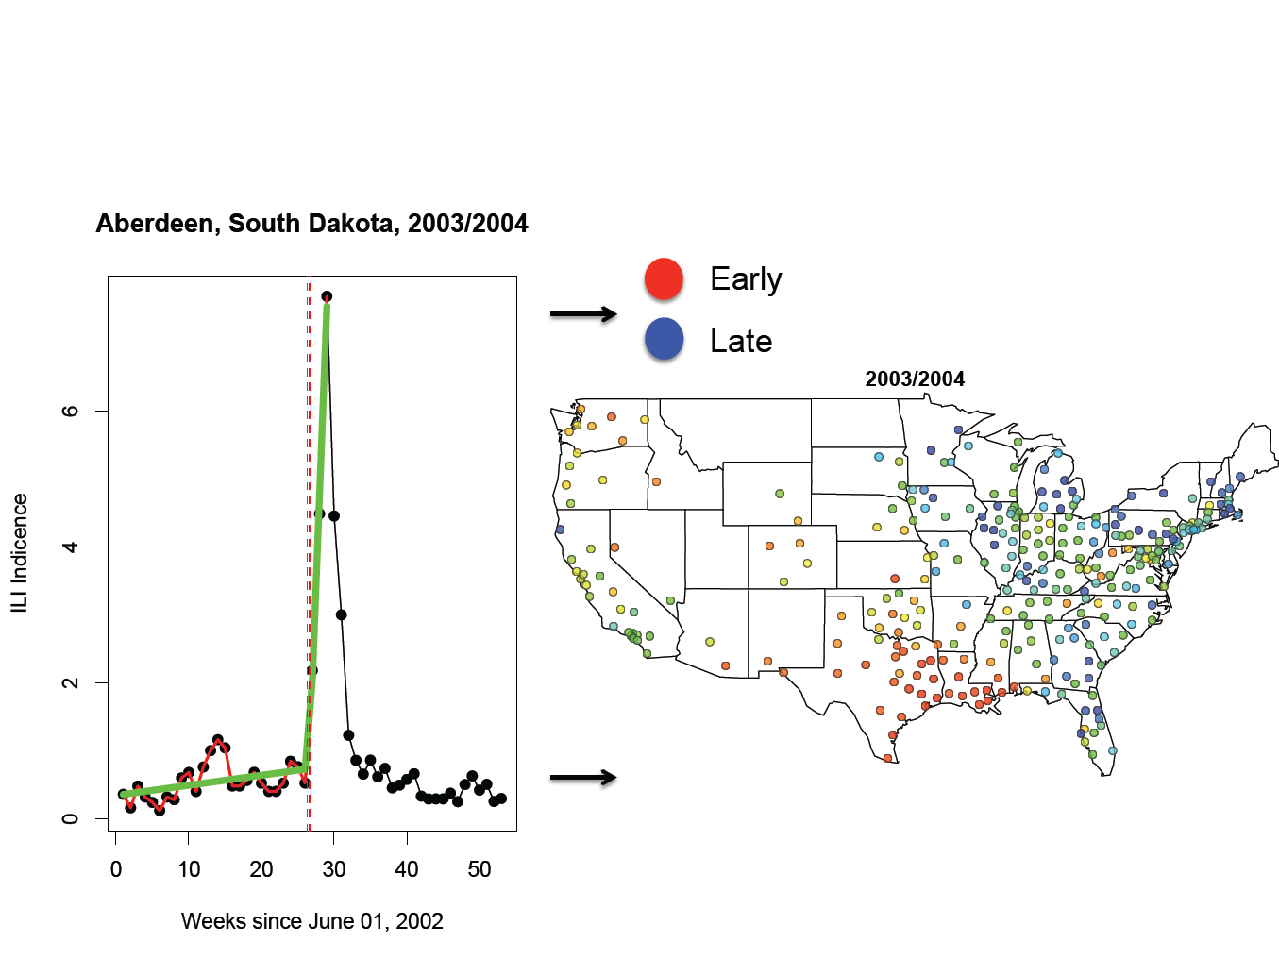
Disease onset in each city: broken stick method
Charu et al, Plos Comp Bio 2017

Slide 10
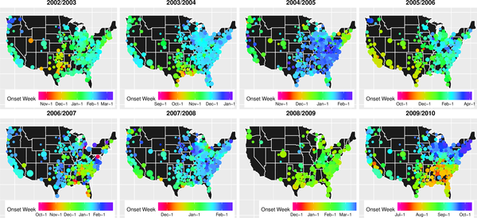
Patterns of spread, 2002-2010
early
late
Charu et al, Plos Comp Bio 2017

Slide 11
Distance?
2002-03
2003-04
2004-05
2005-06
Pairwise onset difference
2006-07
2007-08
2008-09
2009 pandemic

Slide 12
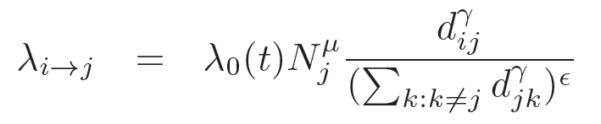

Semi-parametric mechanistic model
infectious
susceptible
city i
city j
Force of infection on susceptible city j:
Distance
Baseline risk
Normalization:
e=0, density-dependant (# neighbors)
e=1, density-independant (% neighbors)
Recipient population size
Seeding term
Diggle Stat Meth Med Res 2006, Eggo et al, JRSI 2012; Gog et al Plos CB, 2014; Charu et al Plos CB 2017

Slide 13
Use of different mobility proxies
Air traffic
Work commutes
Balcan et al PNAS 2005

Slide 14
Model comparison with different mobility proxies
Season | # cities
 |  | AIC Best model | ΔAIC Distance | ΔAIC Work commutes | ΔAIC Air traffic
2002-03 | 221 | 1815.65 | 0 | 25.46 | 78.87
2003-04 | 290 | 2478.19 | 0 | 30.16 | 105.13
2004-05 | 270 | 2303.46 | 0 | 24.53 | 129.61
2005-06 | 218 | 1703.73 | 0 | 45.32 | 161.8
2006-07 | 198 | 1623.43 | 9.27 | 0 | 66.32
2007-08 | 270 | 2365.40 | 0 | 8.31 | 59.81
2009-10 | 281 | 2306.22 | 0 | 57.42 | 247.09
Work commutes always outperform air traffic
Distance-based model performs best in most years
Charu et al, Plos Comp Bio 2017

Slide 15
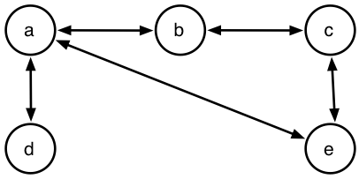
Using effective distance metric (minimum path), wave-like epidemic fronts appear
Simple relationship between arrival time and effective distance (wave speed)

Slide 16
Re-analysis of the 2003-04 epidemic by combining datasets (662 locations)
Charu et al, In prep

Slide 17
Gravity model fits (seasonal flu)
Connectivity matrix | Distance exp. | Population exp. | Normalization exp. | Seeding term | ΔAIC with best model
Geographic distance | 1.97 (0.26) | 0.13 (0.18) | 0.97 (0.22) | -16.12 (11.8) | 18
Minimum path workflows | 3.16 (0.26) | -0.32 (0.23) | 0.31 (0.25) | -19.4 (26.1) | 0
Pairwise workflows | 0.67 (0.04) | 0.08 (0.10) | 0.9 (0.05) | -0.022 (0.16) | 62
Effective distance identifies Victoria County, Southern TX as putative US origin of 2003-04 epidemics.
7 of 8 epidemics originate in the South
Charu et al, In Prep

Slide 18
Gravity model fits (2009 pandemic)
Connectivity index | Distance exp. | Population exp. | Normalization exp. | Seeding term | ΔAIC with best model
Geographic distance | 1.97 | 0.11 | 0.99 | 5.08 | 0
Minimum path workflows | 2.97 | 0.27 | 0.31 | 19.46 | 20
Pairwise workflows | 0.03 | 0.09 | 0.04 | 0.38 | 37
Effective distance identifies Dougherty Co., GA as putative US origin of 2009 pandemic.
Charu et al, In prep

Slide 19
Relationship between connectivity matrices
Minimum path workflows
Geographic distance
Min path distance
Distance (km)
Pairwise workflows
 | Distance | Work commutes
Effective distance | 0.26 | (-) 0.45
Work Commutes | (-) 0.21
85% of zeros
Flow of workers (log)
Charu et al, In Prep

Slide 20
Variation in epidemic intensity across the US
Dalziel et al, submitted; Lee et al Plos Comp Bio 2018

Slide 21
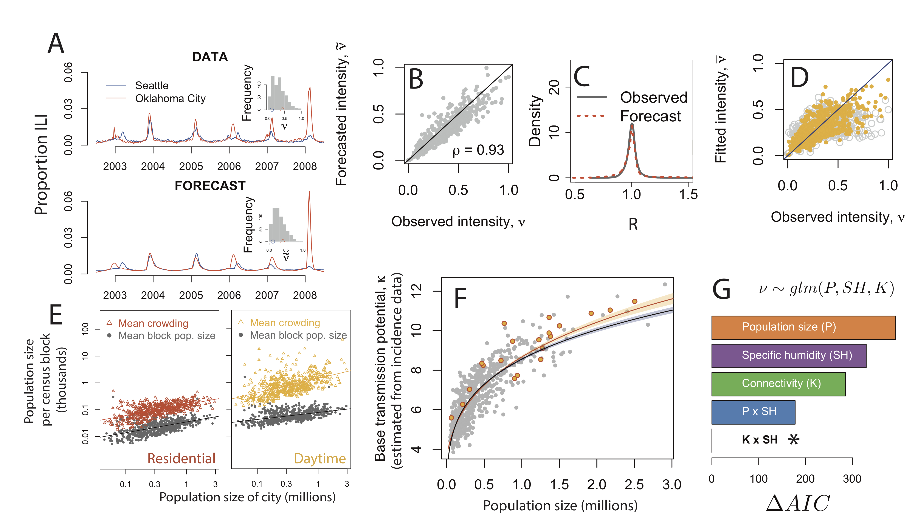
Drivers of epidemic intensity
Dalziel et al, submitted

Slide 22
Influenza spread at the scale of the US: summary
Heterogeneity between seasons
Local mode of spread
  Distance and/or effective distance
  Recipient pop size
  Proportion of neighbors infected
  Strongest with antigenic change
Southern origin
Epidemics shaped by specific humidity and pop structure
Combining modes of population movements
Granularity of data matters; data availability
Spatial patterns in influenza sequence data

Slide 23













Infectious disease modeling,
DIEPS, Fogarty International Center
Research, data collection and sharing, workshops and training activities.
Network of 350+ collaborators in >50 countries
>1200 publications describing the global epidemiology and evolutionary dynamics of infectious diseases
THANK YOU!
Notes:
23
23
4/16/2018
23
23

