Slide 1
Targeting Vulnerable children to optimize mortality reduction azithromycin
Judd L Walson, MD, MPH
Professor
Departments of Global Health, Medicine (Infectious Disease), Pediatrics and Epidemiology
University of Washington

Slide 2
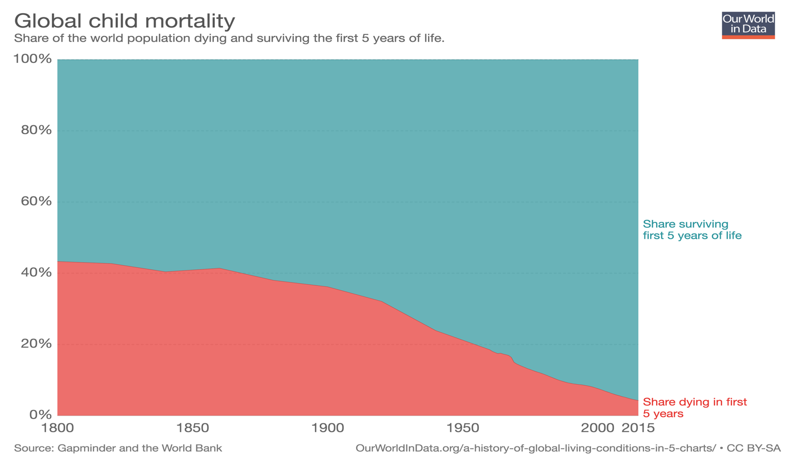
Notes:
This simple graph illustrates the incredible progress that has been made in reducing child deaths globally. In red you can see the proportion of children dying before their 5th birthday over the last two centuries. While we should remain concerned about the remaining 6 million child deaths that continue to occur annually, we should also celebrate this remarkable reduction in suffering that has been observed across the globe.

Slide 3
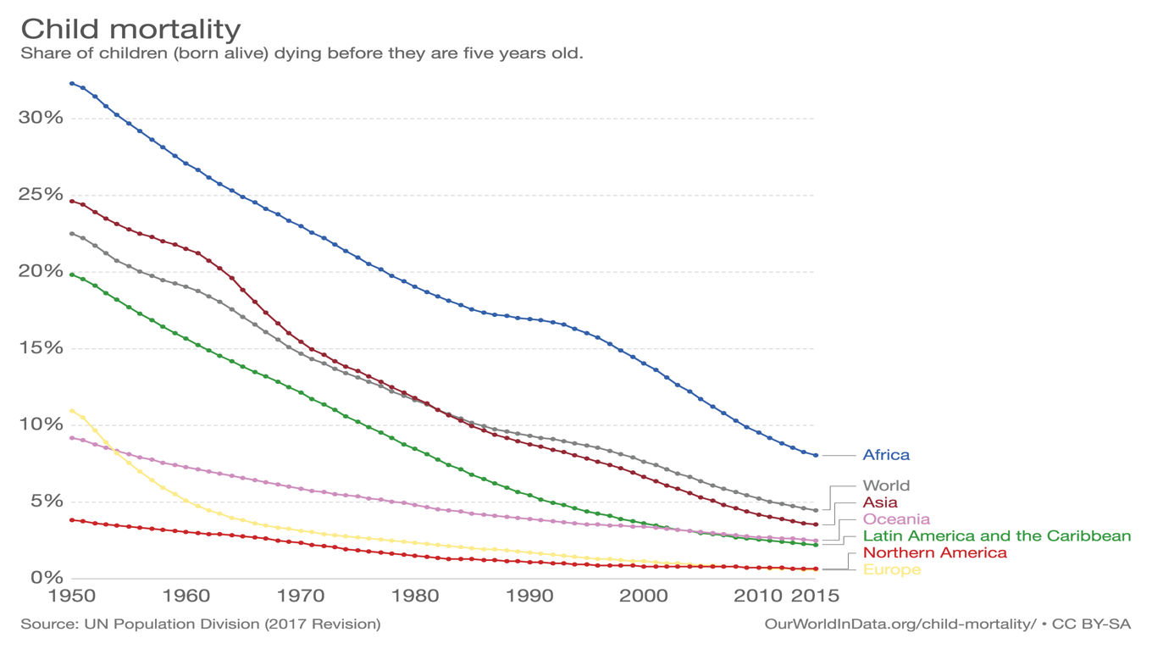
Notes:
However, there is still inequity in child mortality. While all regions of the world have seen notable reductions in mortality. Rates of child mortality in Africa continue to exceed those in any other region of the world.

Slide 4
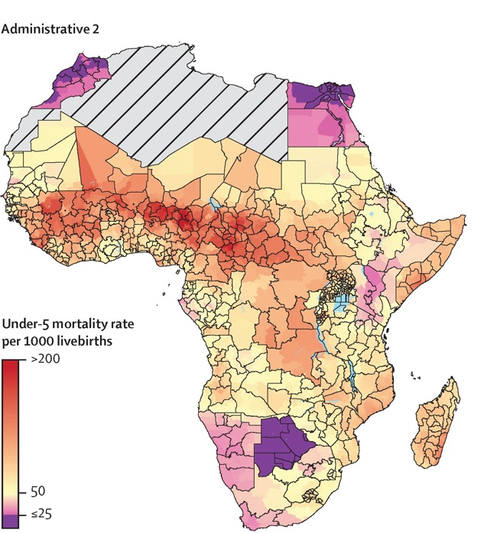
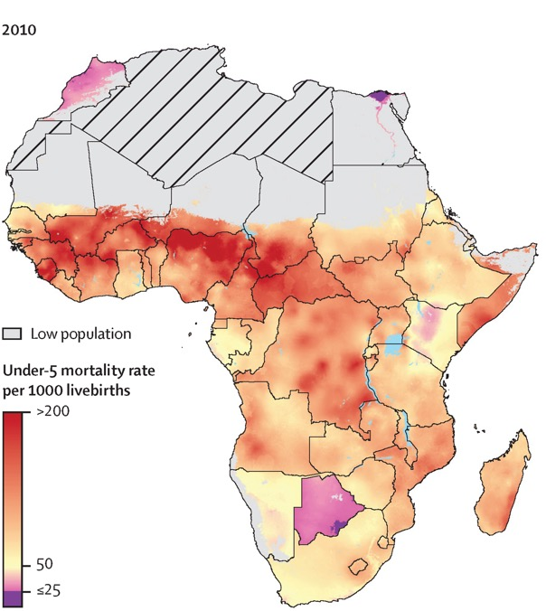
Figure 2
Under 5 Mortality
Lancet 2017 390, 2171-2182
Notes:
Here we see sub-national U5M data from IHME at the 5km x5km resolution on the right with administrative units within countries overlayed on the right. The areas in dark red have U5M rates approaching or exceeding 200 deaths per 1000 live births. So, we clearly have some work to do to meet the SDG target of all countries reaching under 5 mortality of 25 deaths or less per 1000 live births by 2030. In fact, the target of 25 deaths per 1000 is represented here by areas in dark purple and there are unfortunately not a lot of them

Slide 5
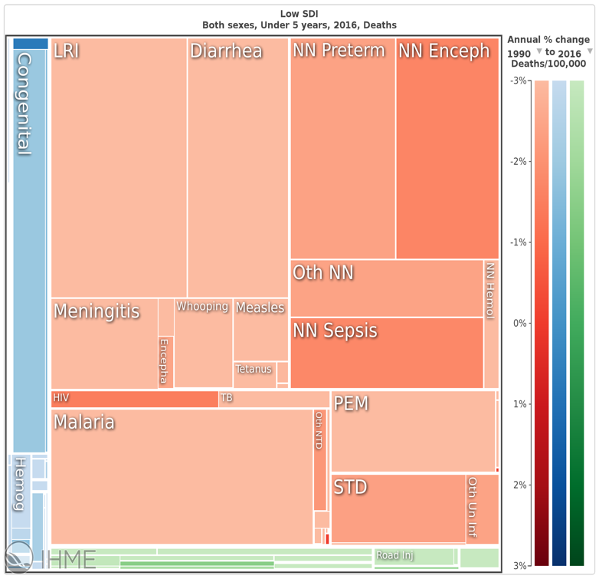
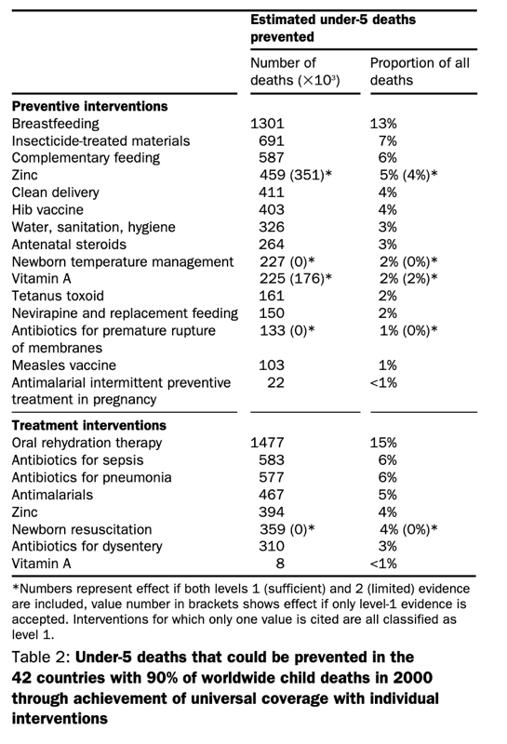
Why are children in low-resource settings dying?
https://vizhub.healthdata.org/gbd-compare/
Jones G. Lancet. 2003 Vol 362: 65-71

Slide 6
Impact of AZM - Pooled Analysis of MDA
Oldenburg CE. Am J Trop Med Hyg. 2019 Mar;100(3):691-695.

Slide 7
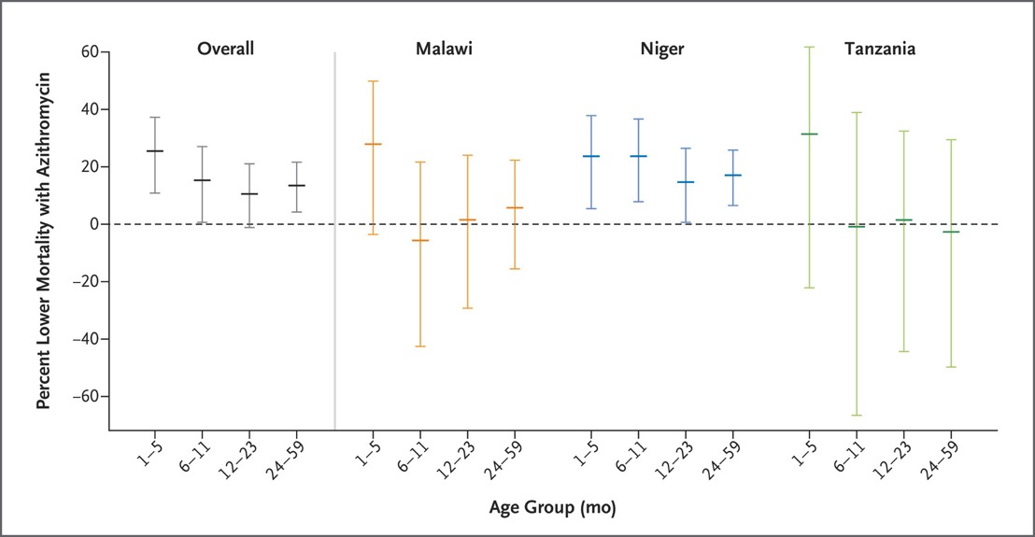
Where would MDA with azithromycin provide maximum benefit
Determine
JD Keenan et al. N Engl J Med 2018;378:1583-1592.

Slide 8
Where would MDA with azithromycin provide maximum benefit
Childhood mortality |  |  |  | Trachoma |  |  |  | Disease burden |  |  |  | Competing Interventions to Reduce Mortality
Mortality rank | Country | Absolute childhood deaths (1–5 years) | Childhood Mortality Rate | Trachoma Endemicity | % pop in non-endemic areas | UIG-A% | Target date for elimination | Diarrhea burden | Pneumonia burden | Malaria burden | HIV burden | Measles vaccine coverage | DTP (first dose) vaccine coverage | Polio vaccine (third dose) coverage | Hib vaccine coverage | Planned introduction of rotavirus vaccine | Planned introduction pneumococcal vaccine
1 | Niger | 70,346 | 95 | Endemic | 41.7% | 77.7% | 2015 | 20.3 | 0.484 | 14.1 | 0.8 | 73 | 82 | 71 | 70 | 2013* | 2012*
2 | Equatorial Guinea | 1,862 | 84 | Non-endemic | 100.0% | N/A | N/A | 9.4 | 0.316 | 3.4 | 5 | 51 | 65 | 39 | 0
3 | Chad | 38,242 | 84 | Endemic | 57.3% | No data available | 2015 | 21.9 | 0.441 | 2.0 | 3.4 | 23 | 45 | 36 | 22
4 | Nigeria | 467,326 | 84 | Endemic | 61.2% | 2.0% | 2015 | 18.7 | 0.340 | 4.9 | 3.6 | 41 | 52 | 54 | 0 |  | 2013*
5 | Mali | 90,136 | 82 | Endemic | 92.2% | 87.1% | 2015 | 19.2 | 0.412 | 17.9 | 1 | 71 | 85 | 74 | 74 | 2016* | 2011
6 | Guinea-Bissau | 10,584 | 77 | Endemic | 10.0% | 76.7% | 2020 | 19.1 | 0.362 | 22.9 | 2.5 | 76 | 85 | 72 | 68 | 2015* | 2012*
7 | Burkina Faso | 99,219 | 69 | Endemic | 55.5% | 83.2% | 2015 | 18.9 | 0.445 | 50.7 | 1.2 | 75 | 89 | 84 | 81 | 2016* | 2014*
8 | Burundi | 37,100 | 69 | Endemic | 89.6% | 100.0% | 2020 | 23.6 | 0.328 | 8.6 | 3.3 | 91 | 98 | 96 | 92 | 2013* | 2011
9 | Guinea | 53,637 | 59 | Endemic | 65.3% | 0.0% | Unknown | 13.8 | 0.395 | 5.8 | 1.3 | 51 | 75 | 53 | 58 | 2012 | 2012*
11 | Angola | 108,143 | 57 | Non-endemic | 100.0% | N/A | N/A | 25.0 | 0.430 | 56.9 | 2 | 77 | 93 | 73 | 73 | 2014 | 2012*
10 | Congo, the Democratic Republic of the | 388,545 | 57 | Endemic | 93.1% | No program | Unknown | 18.5 | 0.388 | 31.7 | 0 | 76 | 91 | 74 | 77 | 2017* | 2011
13 | Central African Republic | 21,509 | 54 | Endemic | 95.1% | 29.1% | 2015 | 17.3 | 0.391 | 15.1 | 4.7 | 62 | 64 | 47 | 54 | 2013* | 2011
12 | Zambia | 65,107 | 54 | Endemic | 55.3% | No program | 2020 | 14.6 | 0.313 | 29.9 | 13.5 | 85 | 92 | 83 | 81 | 2013 | 2012
15 | Cameroon | 82,057 | 52 | Endemic | 79.0% | 100.0% | 2020 | 16.2 | 0.342 | 25.3 | 5.3 | 74 | 88 | 79 | 80 | 2014* | 2011
14 | Sierra Leone | 32,325 | 52 | Non-endemic | 100.0% | N/A | N/A | 20.9 | 0.446 | 30.4 | 1.6 | 71 | 87 | 74 | 75 | 2013* | 2011
16 | Uganda | 176,806 | 49 | Endemic | 69.7% | 88.5% | 2020 | 16.0 | 0.268 | 19.2 | 6.5 | 68 | 90 | 59 | 64 | 2015 | 2013
17 | Somalia | 45,616 | 46 | Endemic | 100.0% | No program | Unknown | 21.8 | 0.319 | 0.5 | 0.7 | 24 | 40 | 28 | 0
18 | Benin | 35,783 | 44 | Endemic | 98.1% | No data available | Unknown | 13.0 | 0.340 | 15.4 | 1.2 | 72 | 99 | 83 | 83 | 2014* | 2011
19 | Congo | 13,538 | 44 | Endemic | No data available | No data available | Unknown | 14.3 | 0.378 | 3.1 | 3.4 | 76 | 92 | 91 | 91 | 2013 | 2011
20 | Rwanda | 42,709 | 44 | Non-endemic | 100.0% | N/A | N/A | 22.6 | 0.228 | 8.1 | 2.9 | 92 | 98 | 97 | 97 | 2013* | 2009
28 | Malawi | 59,743 | 38 | Endemic | 79.5% | No program | 2020 | 10.9 | 0.312 | 42.8 | 11 | 92 | 97 | 93 | 93 | 2013 | 2011
33 | Afghanistan | 161,004 | 35 | Endemic | 98.0% | 0.0% | Unknown | 28.9 | 0.454 | 0.1 | 0 | 76 | 94 | 83 | 83 | 2014* | 2013
37 | Liberia | 14867 | 31 | Non-endemic | 100.0% | N/A | N/A | 17.2 | 0.300 | 43.1 | 1.5 | 64 | 75 | 74 | 64 | 2015* | 2012*
45 | Lao People's Democratic Republic | 12,035 | 19 | Endemic | 100.0% | No program | Unknown | 7.4 | 0.421 | 0.1 | 0.2 | 59 | 76 | 67 | 0 | 2016* | 2013*
47 | Timor-Leste | 2,963 | 17 | Non-endemic | 100.0% | N/A | N/A | 13.5 |  | 4.7 | 0 | 70 | 76 | 78 | 0
49 | Papua New Guinea | 17,422 | 15 | Endemic | 100.0% | No program | Unknown | 5.2 | 0.298 | 9.0 | 0.9 | 58 | 84 | 70 | 64 | 2028* | 2012*
50 | Myanmar | 57,012 | 14 | Endemic | 99.7% | 100.0% | 2010 | 12.8 | 0.429 | 1.9 | 0.6 | 87 | 93 | 90 | 0 | 2019* | 2017*
52 | India | 1,707,643 | 14 | Endemic | 64.2% | No data available | Unknown | 13.0 | 0.376 | 0.1 | 0.3 | 71 | 83 | 67 | 0 |  | 2016*
56 | Cambodia | 22,173 | 12 | Endemic | 94.0% | 80.0% | 2015 | 7.1 | 0.469 | 1.9 | 0.5 | 92 | 99 | 95 | 0 | 2017* | 2015*
Matheson AI. PLoS ONE 2014 Vol 9 (5) e96658.
Notes:
Absolute childhood deaths: Total number of deaths in 1-5 year olds in 2010
Childhood mortality: Mortality rate per 1,000 1-5 year olds
Trachoma endemicity: Endemic implies 10% prevalence of follicular trachoma inflammation
% pop in non-endemic areas: 100-percent of total population living in trachoma-endemic areas
UIG-A%: The proportion of the number of people needed to be treated with AZM to eliminate blinding trachoma (UIG-A) who were actually treated
Diarrhea burden: proportion of childhood(<5) deaths due to diarrhea
Pneumonia burden: Episodes per child (<5) per year
Malaria burden: Malaria deaths per 100,000 people (all ages) per year
HIV burden: Prevalence in 15-49 year olds
Measles vaccine coverage: National coverage %
DTP (first dose) vaccine coverage: National coverage %
Polio vaccine (third dose) coverage: National coverage %
Hib vaccine coverage: National coverage %
Planned intervention of rotavirus vaccine: Date of anticipated introduction (*estimated or applied for GAVI funding)
Planned introduction of pneumococcal vaccine: Date of anticipated introduction (*estimated or applied for GAVI funding

Slide 9
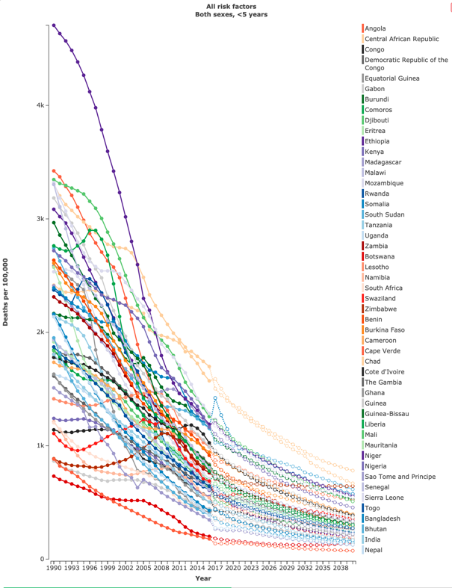
Projected impact
Country | 2016 U5 Mortality/100,000 | Projected 2030 U5 Mortality/100,000
Malawi | 805 | --
Tanzania | 664 | --
Niger | 1190 | 750
https://vizhub.healthdata.org/gbd-foresight/#

Slide 10

What is the optimal interventional approach?
Mass Drug Administration targeting populations at highest risk
OR
Targeted treatment to highest risk individuals within populations
Notes:
Many highly successful public health interventions rely on broad population coverage to ensure that vulnerable children are protected from infectious disease. For example, if we think of the population as a mix of high risk (in red), medium risk (in grey) and low risk (in blue) children, we can see that providing broad population coverage of an intervention should effectively cover those at risk. Of course some interventions, such as vaccination, provide indirect benefits to all children, not just those receiving the vaccine. However, for many interventions, this approach may not be the most effective method of delivery. In fact, by attempting to reach all with an intervention designed to only benefit a few, we may actually find that the individuals who receive the intervention are not those in greatest need.

Slide 11
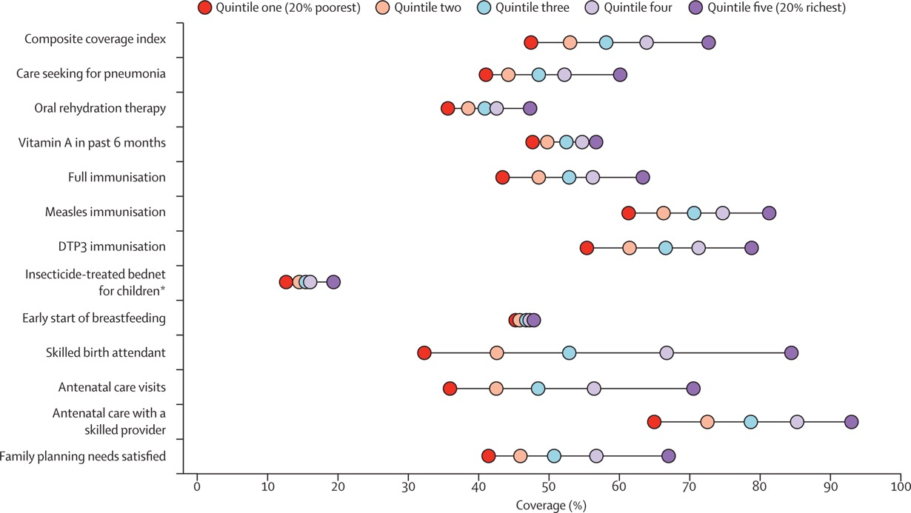
What level of coverage can we expect with MDA?
Lancet, 2012 Vol. 379, issue 9822, p. 1225-1233
Notes:
Some of the most commonly utilized public health interventional platforms achieve profoundly lower coverage amongst those populations in greatest need. On the top left, you can see coverage of the third dose of DTP as a percent of the eligible pediatric population disaggregated by country and by wealth index within that country. What is striking is not only how low some of the coverage rates are in countries with high mortality such as Nigeria and Pakistan, but also how inequitably coverage is distributed.
On the bottom right, you can see another chart depicting global coverage of common public health interventions stratified by wealth quintile. Again, while some interventions achieve high coverage, these are almost always inequitably distributed. The most equitable interventions are equitable only because they achieve universal poor coverage.

Slide 12
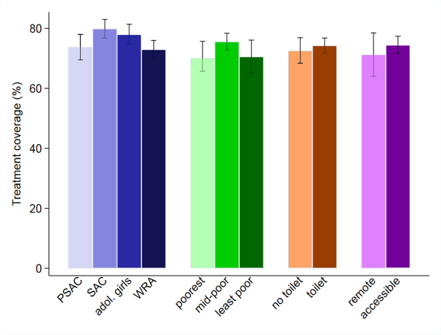
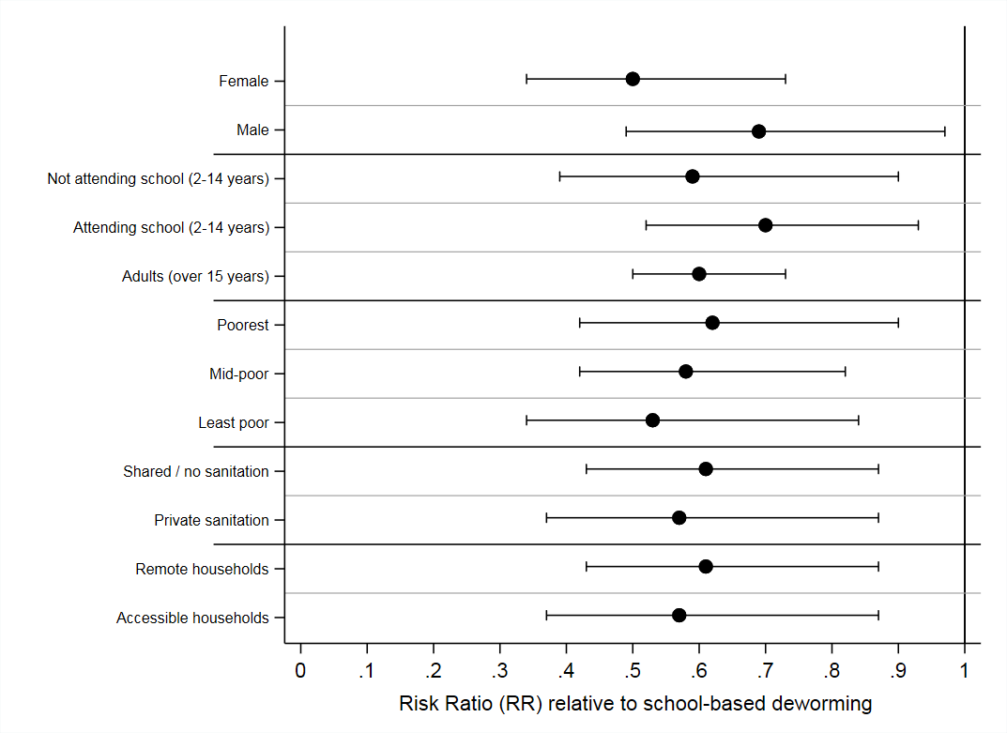
Mass Drug Administration: equitable coverage and impact
  Comparable MDA coverage of community-based deworming among SES groupings
  No evidence of variation in impact between different SES groupings
Coverage (95% CIs) of albendazole coverage among different SES strata in ~150,000 households, coastal Kenya
Impact of community-based MDA on hookworm infection among different SES strata, expressed as a risk ratio with 95% CIs
Note: Remote households are those > 4km from a road
Pullan et al. (in press). TUMIKIA project
Slide courtesy of Simon Brooker, PhD

Slide 13
Prevalence of resistance after MDA of Azithromycin
Key factors that determine timeframe
  Proportion of the population that receives AZM
  Duration of the antibiotic course and frequency of prescription
  Duration of colonization of the bacteria of interest
  Frequency of mutation or plasmid transfer
  Fitness costs associated with acquisition of resistance
O’Brien KS. Lancet Infect Dis 2019; 19: e14-25
Notes:
Consequences for MDA of abx are much higher – for others limited consequneces
These studies also are looking at limited time of exposure – if MDA was widely rolled out we may not see this decline. Also now being rolled out for lots of diseases

Slide 14
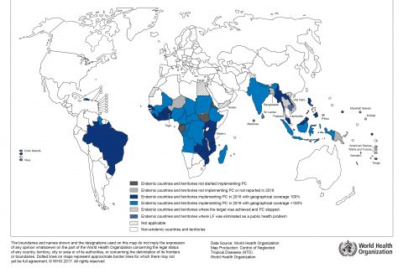

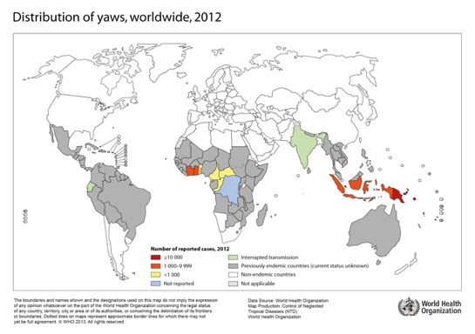
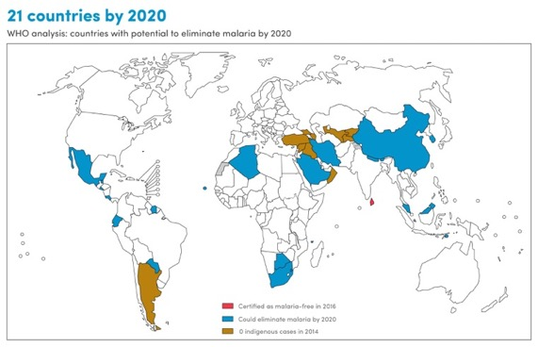
Learning from experience: is there an end game in sight for MDA

Slide 15
Can we target the most vulnerable?
Low anthropometry
Acute illness
Young age

Slide 16

Illness severity is a good predictor of mortality risk
Illness severity is a critical determinant of risk
Illness severity adds to the mortality risk associated with MUAC
Children without severe illness rarely die, even those with low MUAC
This finding is in line with the success of community-based nutrition programs for uncomplicated SAM where mortality is low

Slide 17
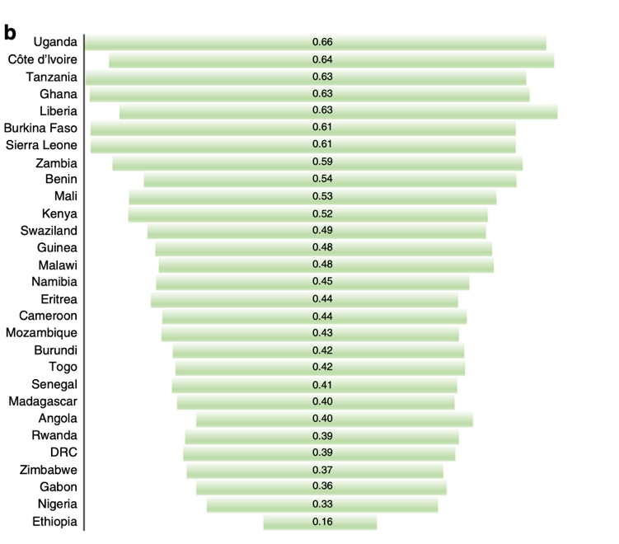
Can we reach those in greatest need through health facilities?
Less than half of children with febrile illness in Africa seek care
National Median probability of seeking fever treatment
Alegana VA. Nature Communications 2018 (9):4994

Slide 18
Can we reach those who are going to die through health facilities?
Less than half of children with febrile illness in Africa seek care
BUT
Most children who die seek care in the weeks prior to death
Alegana VA. Nature Communications 2018 (9):4994
Sodemann M. Bulletin of the WHO, 1997, 75 (3): 205-212
Kagabo DM. PLoS ONE 13(1) e0190739.

Slide 19


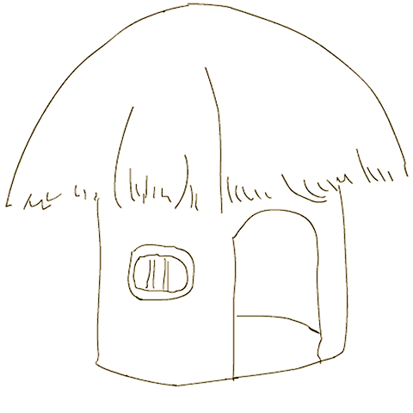
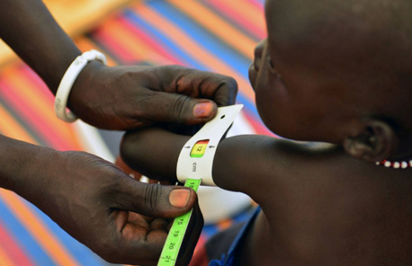
PI: James Berkley
PI: Judd Walson
CHAIN Cohort
Admission | Acute Care | Discharge | Day 45 | Day 90 | Day 180
Each Site 500 Children
200 A
200 B
100 C
Group | N | Age >6 months | Age 1 - 6 months | Age < 1 month
A | 1800 | MUAC <11.5cm or kwashiorkor | MUAC <11cm or kwashiorkor | MUAC <9.5cm or kwashiorkor
B | 1800 | MUAC 11.5 to <12.5cm | MUAC 11 to <12cm | MUAC 9.5-10.4cm
C | 900 | MUAC of ≧12.5cm | MUAC ≧12cm | MUAC ≧10.5cm

Slide 20
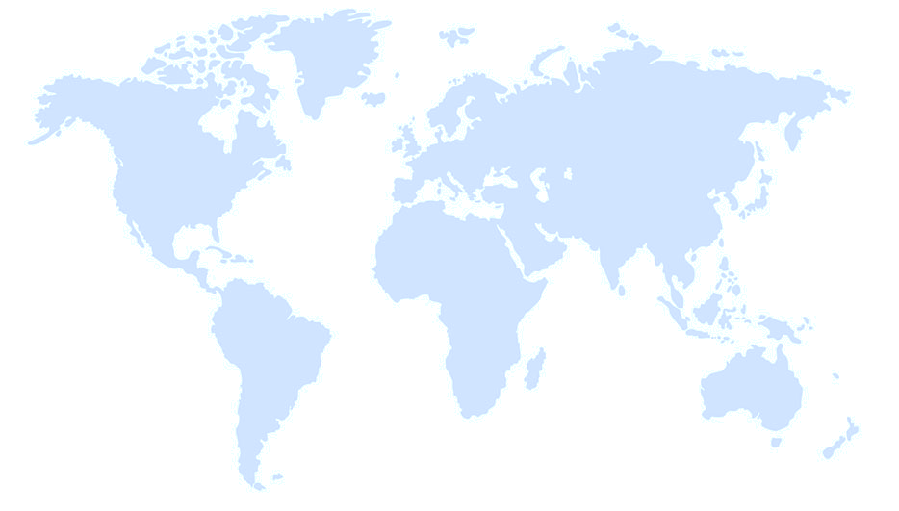

Pakistan
1 site
Bangladesh
2 sites
Burkina Faso
1 site
Uganda
1 site
Kenya
3 sites
Malawi
1 site
CHAIN Coordination Centre
CHAIN Enrolment Site
CHAIN Collaborating Centre

Slide 21
CHAIN Cohort
 | Admission | Acute Care | Discharge | Day 45 | Day 90 | Day 180
Demographics | ●
Biomedical findings | ● |  | ● | ● | ● | ●
Pre-hospital care | ●
Nutrition, food security | ● |  | ● | ● | ● | ●
Social circumstances | ● |  | ●
Economic circumstances | ● |  | ●
Daily inpatient progress |  | ●
Maternal mental health |  | ● |  | ●
Household assessment |  |  | ●
Biological samples | ● |  | ● | ● | ● | ●
Scheduled follow up |  |  |  | ● | ● | ●
Qualitative social science
Unscheduled visit
Mortality audit, verbal autopsy

Slide 22
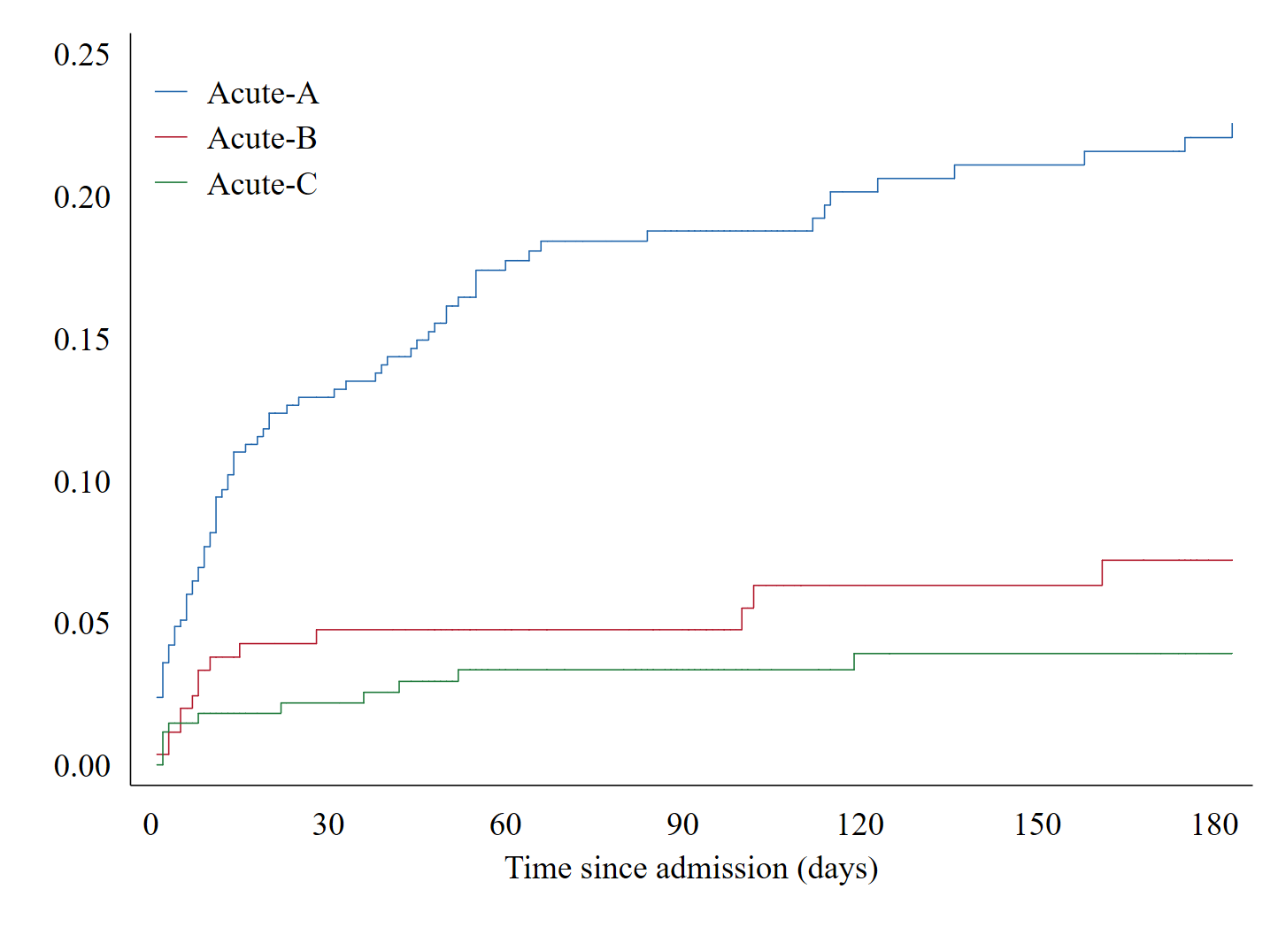


Slide 23
Admission Data
Cap. refill
Age > 6mo
Age
Site
Gender
MUAC
WHZ
WAZ
HAZ
Head circumference
Conscious
N: 503, Mortality: 0.4%
MUAC B/C
Unconscious
Presenting compliant
  IMCI classification
  Clinician diagnosis
Pmhx
  Previous hospitalization
  Chronic conditions
  Birth history
  TB risk
  Breast feeding history
  Vaccination history
Clinical examination
  Vital signs, resp, cardio, gastro, neuro, derm, ENT
Bedside investigations
  Malaria RDT, HIV status
  blood glucose
No chronic disease
HIV -
Chronic
disease
Normal breathing
HIV +
Stunted
N: 195 Mortality: 33%
Conscious
Diag. anemia
MUAC A
Fast breathing
Heart rate
Unconscious
Notes:
Re did this with new dataset - quite consistent.
Lots of CART modelling going on for the main analysis.

Slide 24

Methods: SHapley Additive exPlanations (SHAP) value
SHAP – standardized method to compare the contribution of each variable to an individuals predicted risk, then cluster participants by variables that drive their risk
Notes:
Innovation.
The explanation is a matrix that is the same size as the data. If there are n subjects and d covariates, then there is an explanation value for each subject and covariate combination. Roughly speaking, the SHAP value for subject i and covariate j is how much the ith covariate contributes to the model's prediction for subject i.
We perform the entire analysis pipeline twice: once with the covariate sev_norm and once with it removed. The rest of this post will present results for the pipeline without sev_norm, and the results for models with sev_norm are in the files/results folder.

Slide 25
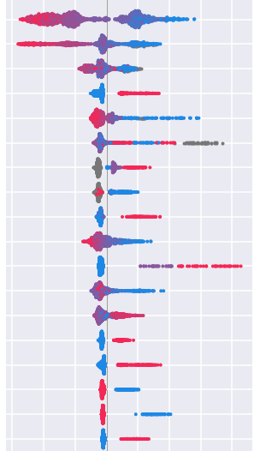
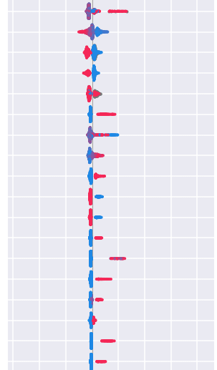

Results: SHAP values (Diagnosis)
Clinician impression
High
MUAC
Age (months)
WAZ
Polio vaccine
WHZ
Asia/Africa
Diagnosis: sepsis
Oxygen saturation
Excl. breast feeding
Blood glucose
Diagnosis: Anemia
Doses of rota vaccine
Temperature
Age BF stopped
Respiratory rate
Lethargic
Difficulty breathing
Heart rate
BCG Vaccine
Conscious level
Normal mouth
HAZ
HIV exposed
Head circumference
Neurological tone
Capillary refill
Rash on buttocks
Blantyre
Received rota vaccine
Normal abdomen
Vomiting
Low
Cold peripheries
Acidotic breathing
Missing
Migori
HIV infected
Notes:
Line. dots. Circles around the parts.

Slide 26
Results: Participant Clusters
Based on the predictive model children were clustered into group with similar predicted risk for the same reasons
Cluster | N | Died | Mortality
0 | 352 | 20 | 5.7%
1 | 407 | 22 | 5.1%
2 | 52 | 8 | 15.4%
3 | 59 | 21 | 35.6%
4 | 214 | 75 | 35.1%
5 | 452 | 3 | 0.7%

Slide 27
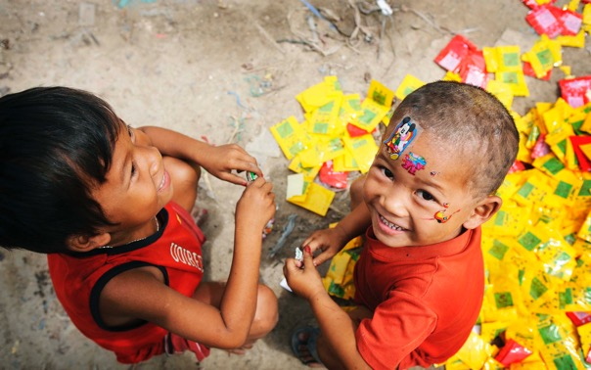
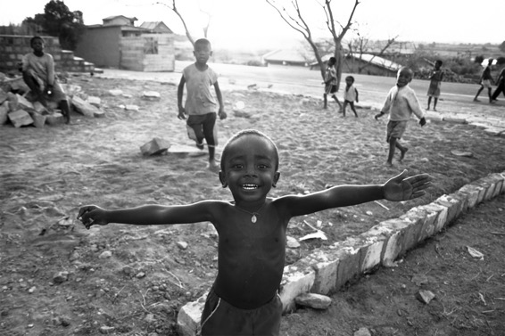
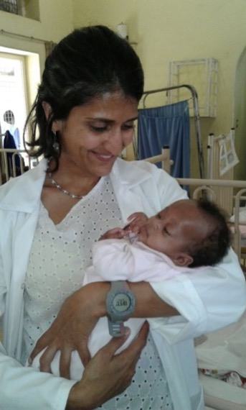
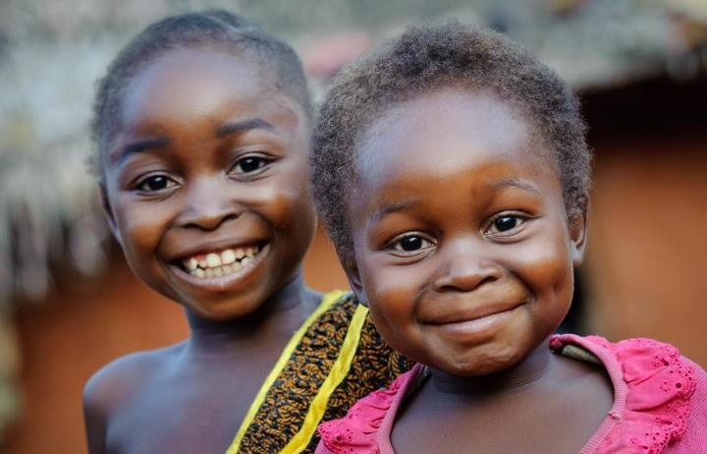
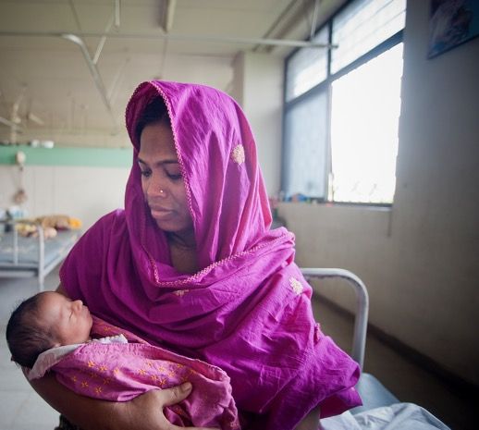
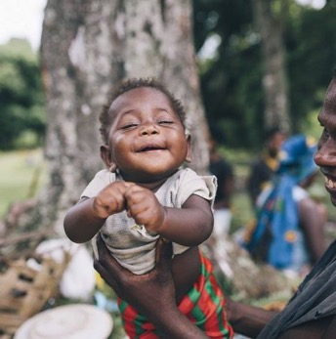
Notes:
Special thanks to all of the children and families who have participated in these studies.

