Slide 1
Social and Behavioral Analysis in Ebola Epidemics: Aligning Qualitative Realities with Quantitative Analysis
2019 7th Annual IDM Disease Modeling Symposium
Wednesday, April 17, 2019

Slide 2
Why do we care about qualitative data?
Quantitative data:
Who
What
Where
When
Qualitative Data:
Why
How
We need to do better are needed for effective planning, coordination, and resource allocation
Pruyt E, Auping WL, Kwakkel JH. Ebola in West Africa: Model-Based Exploration of Social Psychological Effects and Interventions: Ebola in West Africa. Syst Res Behav Sci 2015; 32: 2–14.

Slide 3
What are we missing in current practice?
Current constructions of mixed methods analysis in Ebola modeling are insufficient.
Introduction: Context/qualitative information
Findings: Modeling, maybe some qualitative details
Discussion: Maybe there’s a relationship between the two, let’s do further investigation.
This structure has implications for research and response.

Slide 4
Current Barriers
Non-science:
Funding priorities
Response priorities
Publication biases
Science:
Lack of protocols
Lack of training
Lack of methods
Lack of access to data collection and data analysis resources: field access, teams, software, time

Slide 5
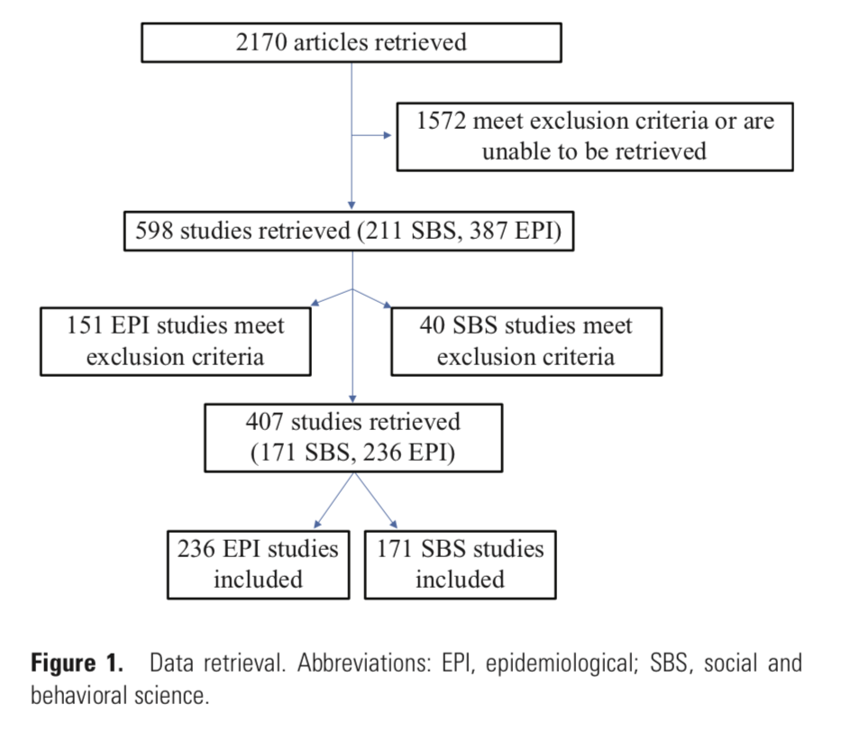
Review of Epidemiological and SBS Data from West Africa Ebola Epidemic

Slide 6
Current gaps that need to be integrated (1)
Abramowitz SA, Hipgrave DB, Witchard A, Heymann DL. Lessons from the West Africa Ebola Epidemic: A Systematic Review of Epidemiological and Social and Behavioral Science Research Priorities. J Infect Dis 2018. DOI:10.1093/infdis/jiy387.

Slide 7
Current gaps that need to be integrated (2)
Abramowitz SA, Hipgrave DB, Witchard A, Heymann DL. Lessons from the West Africa Ebola Epidemic: A Systematic Review of Epidemiological and Social and Behavioral Science Research Priorities. J Infect Dis 2018. DOI:10.1093/infdis/jiy387.

Slide 8
Unexplored Avenues for Integration: A Few Suggestions
RISK BUCKETS
SCENARIO SIMULATIONS
CONTEXT AND KAP SCORES
TARGETED VALIDATION
ECOLOGICAL APPROACHES (EG. COMMUNITY ENGAGEMENT)

Slide 9
Unexplored Avenues for Integration: A Few Suggestions
Risk Buckets
Targeted Validation
Routinized approaches to transmisson, infection, and mortality risk profiling that can be aligned with prevention and response packages.
Structured approaches to using field-based qualitative data to assess accuracy of modeling assumptions.

Slide 10
Unexplored Avenues for Integration: A Few Suggestions
Context and KAP scales/scores
Scenario Simulations
Providing quantitative markers for continuously collected qualitative data for integration into models
Real-world qualitative accounts informing SEIR analyses, including contradictory signals

Slide 11
Unexplored Avenues for Integration: Community Engagement.
Findings from UNICEF Minimum Quality Standards and Indicators for Community Engagement
There are no gold standard indicators for community engagement.
Indicators can be interchanged and interchangeable.
It’s likely that community engagement actions are part of multifactorial human ecologies of response.
We can model community engagement inputs, but cannot assess dosage/response.
We also are not currently able to assess negative consequences of intervention.
ECOLOGICAL APPROACHES (EG. COMMUNITY ENGAGEMENT

Slide 12
Acknowledgements
Benjamin Althouse
Laurent Hébert-Dufresne
Laura Skrip
Jamie Bedson David Hipgrave Ketan Chitnis Rafael Obregon Rania Elassawi
Contact me at: Sharon Abramowitz, saabramowitz@gmail.com, 617-599-0191

