Slide 1
Aging of the HIV-1 epidemic in sub-Saharan Africa, historical trends and future predictions
Adam Akullian, PhD
Research Scientist, IDM
Affiliate Assistant Professor, University of Washington

Slide 2
Swaziland HIV prevalence by age and sex 2016

Slide 3
Shifting age of the HIV epidemic across SSA
Swaziland (prevalence increasing in men > 34 and women >29
KwaZulu-Natal, RSA (prevalence increasing in ages 25-49)
Zimbabwe (prevalence increased in 44+, decreased in younger)
Kenya (prevalence shifts older)
PLOS ONE 2013,8:e77101; AIDS (London, England) 2013,27:2301-2305.
PLOS ONE 2016,11:e0162967.
J Acquir Immune Defic Syndr 2014,66 Suppl 1:S13-26.
AIDS 2014,28 Suppl 4:S453-459.

Slide 4
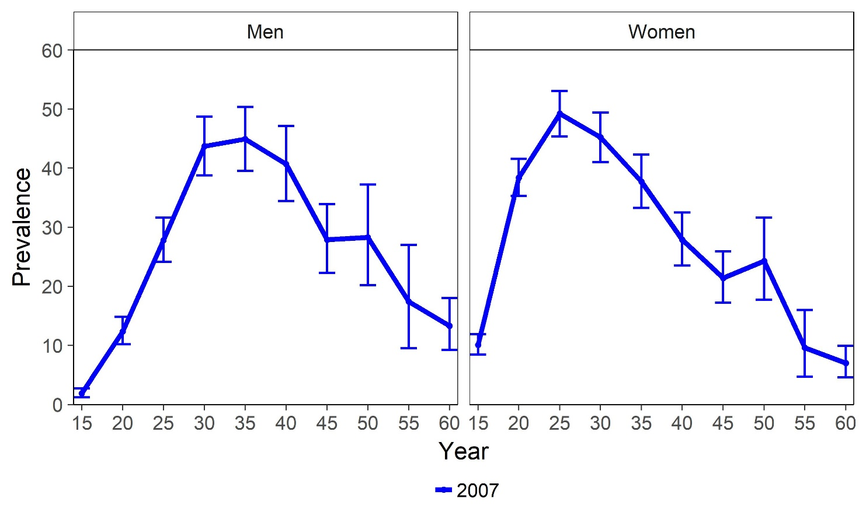
The HIV epidemic is aging: evidence from eSwatini
DHS, 2007; PHIA, 2011; PHIA, 2016

Slide 5
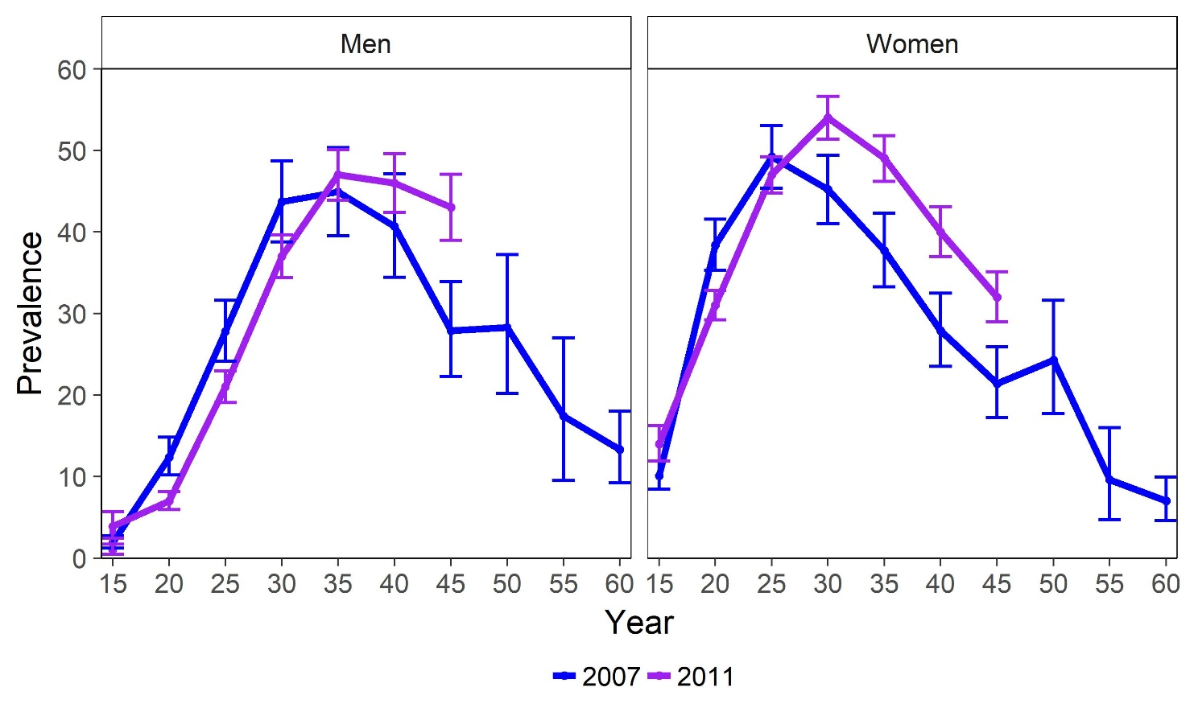
The HIV epidemic is aging: evidence from eSwatini
DHS, 2007; PHIA, 2011; PHIA, 2016

Slide 6
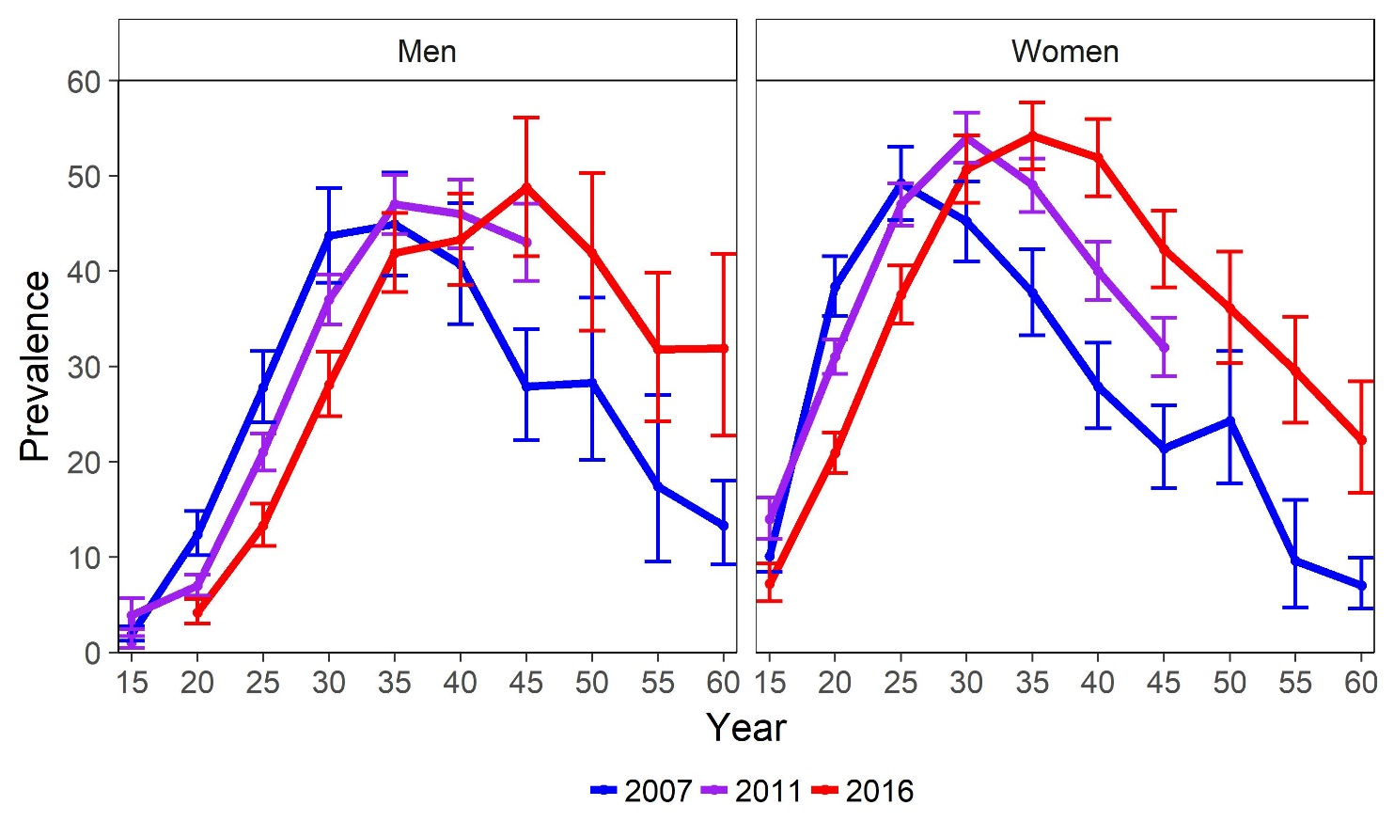
The HIV epidemic is aging: evidence from eSwatini
DHS, 2007; PHIA, 2011; PHIA, 2016

Slide 7
The HIV epidemic is aging: evidence from eSwatini
DHS, 2007; PHIA, 2011; PHIA, 2016

Slide 8
The HIV epidemic is aging: evidence from eSwatini
DHS, 2007; PHIA, 2011; PHIA, 2016

Slide 9
Drivers of aging prevalence
Increased survival of PLWHA with expansion of ART
Accumulation of infections in older age groups (natural history of HIV)
Declining incidence
  Delayed age at seroconversion with declining risk (indirect effects)
  Prevalence ≈ incidence at young ages
  Shifting distribution of sources of infections older (indirect effects)

Slide 10
Is incidence shifting older in the ART era?
Will it continue to shift older?
Was it shifting older pre-ART?
What are the implications?

Slide 11

Overview of methods and data
Simulation Model
Model of HIV epidemic in eSwatini (formerly Swaziland)
Simulation model fit to prevalence and ART coverage by age, gender and year (2007, 2011, 2016)
90-90-90 achieved by 2016
Large incidence decline from 2011 - 2016
Population-based cohort in KwaZulu-Natal, RSA
Hyper-epidmic setting
40% ART coverage in 2016
Little incidence declines
Cohort data

Slide 12
Modeling the HIV epidemic in eSwatini
PHIA, 2011; PHIA, 2016

Slide 13
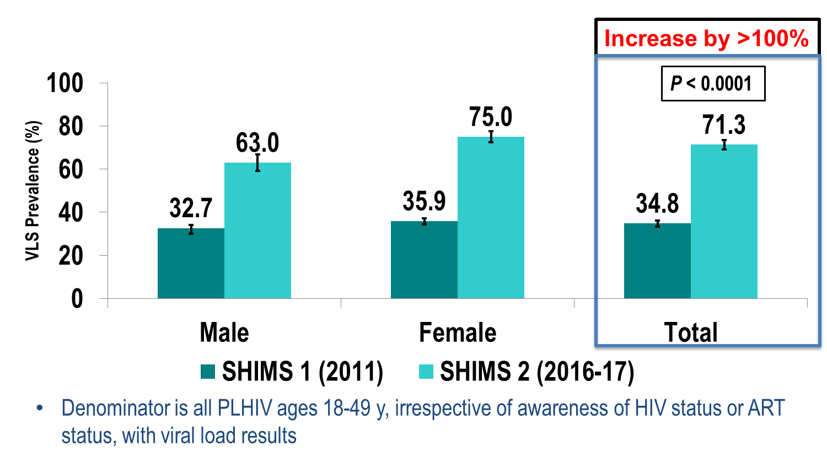
Change in viral-load suppression % (2011-2016)
PHIA, 2011; PHIA, 2016

Slide 14
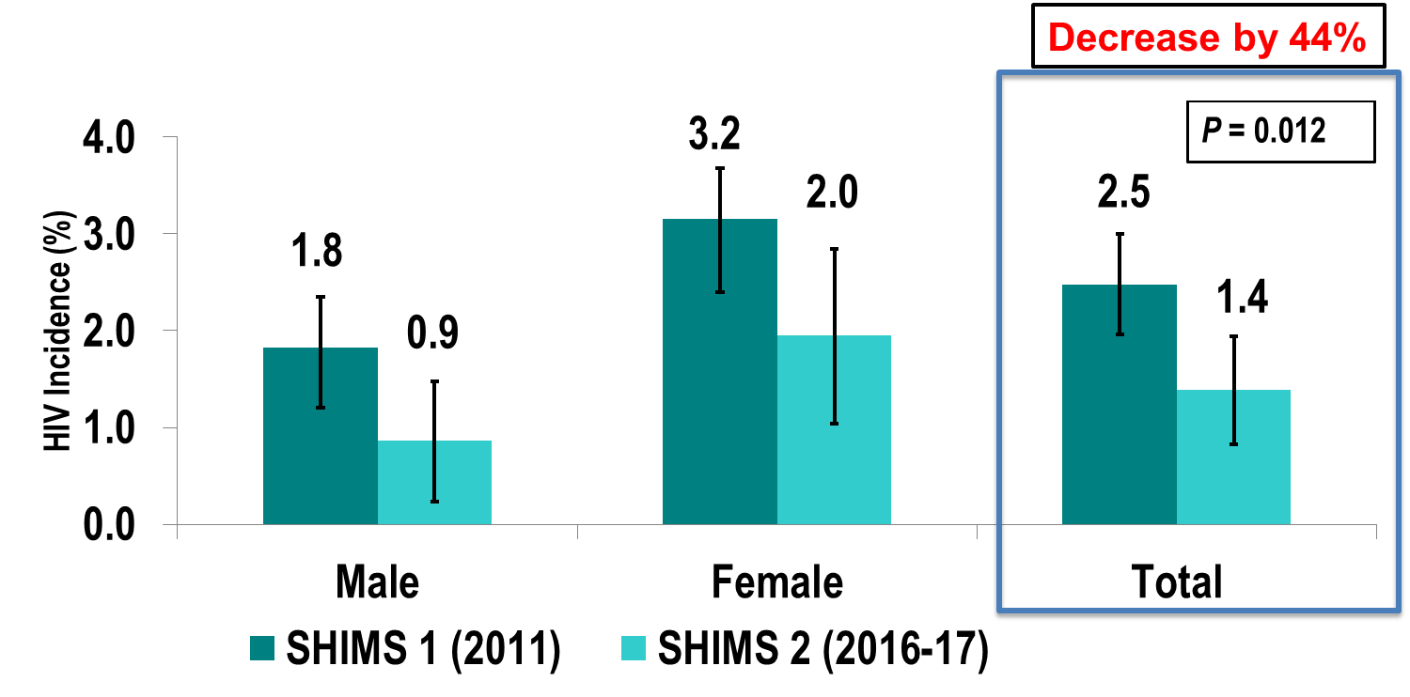
Change in incidence (2011-2016)
PHIA, 2011; PHIA, 2016

Slide 16
Pair formation algorithm
Informal relationship type
Age-gaps in sexual partnerships: seeing beyond ‘sugar daddies’, M.Q. Ott, T. Barnighausen, F. Tanser, M.N. Lurie. and M.L. Newell, AIDS, v25, n6, p861, 2011.

Slide 17
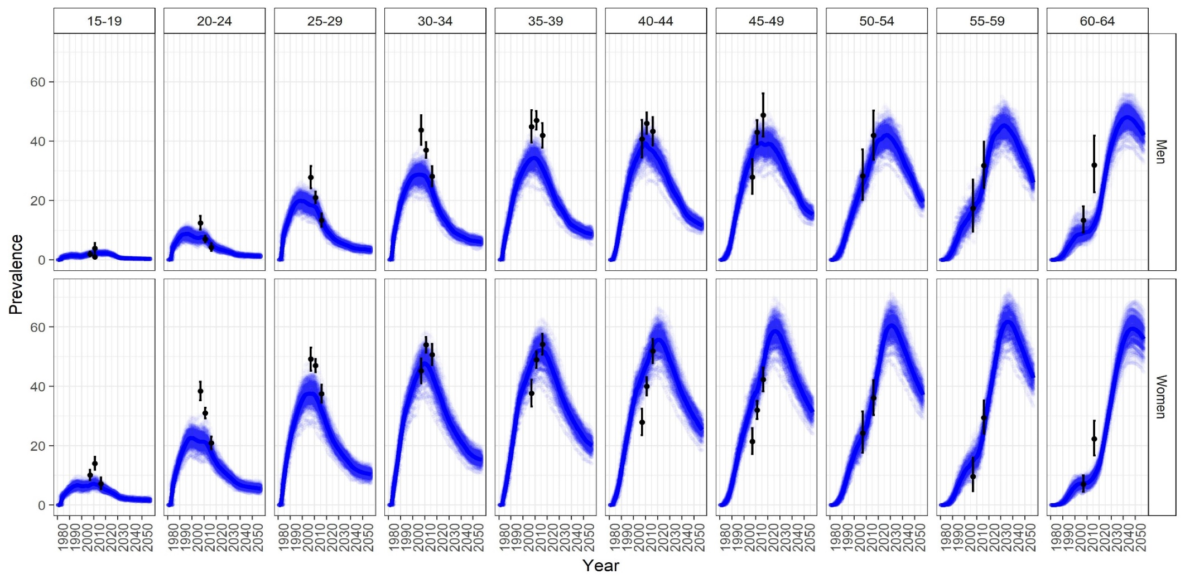
HIV prevalence by age and gender fit to survey data

Slide 18
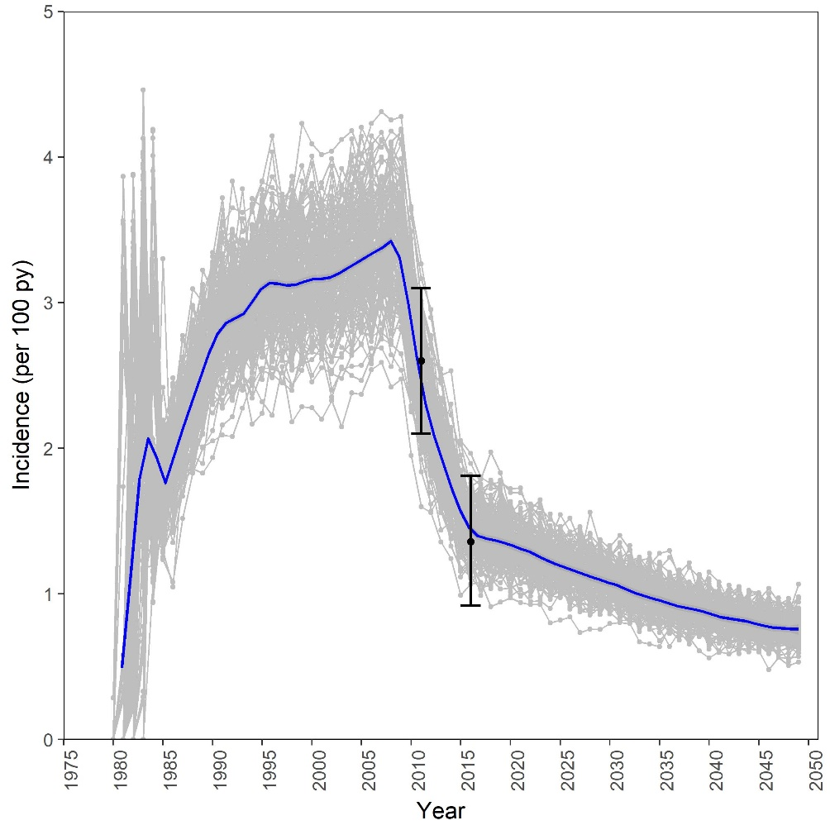
Modeled 15-49 incidence (with survey incidence overlaid)

Slide 19
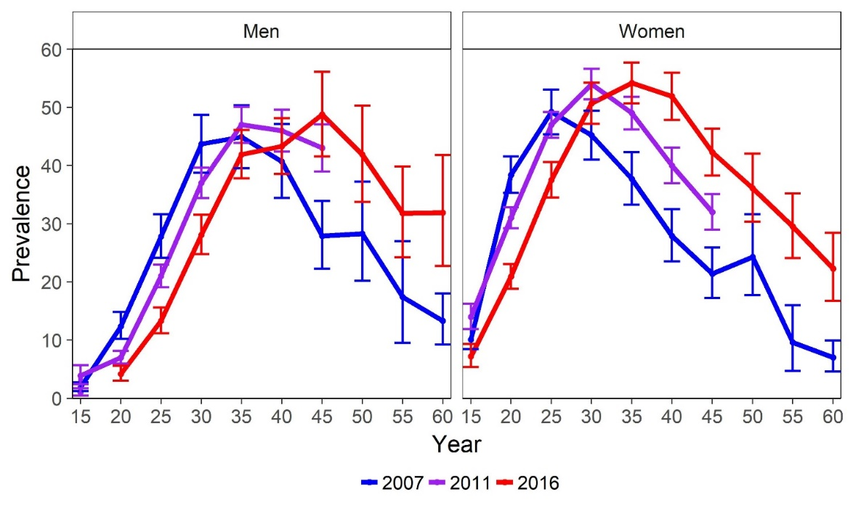
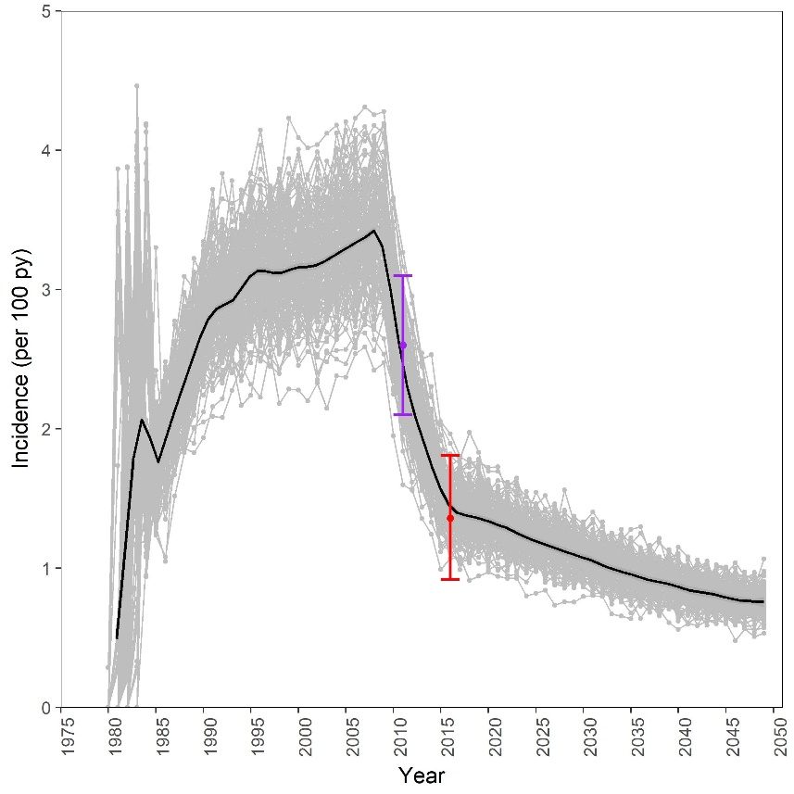
eSwatini model-based evidence
HIV Prevalence by age (survey data 2007, 2011, 2016)
Modeled incidence 1980 - 2050
Pre-ART scale-up
ART
Scale-up
Maintain ART
DHS, 2007; PHIA, 2011; PHIA, 2016

Slide 20
Was the epidemic aging in the pre-ART era?
Modeled incidence 1980 - 2050
Pre-ART scale-up
ART
Scale-up
Maintain ART
EMOD eSwatini simulations

Slide 21
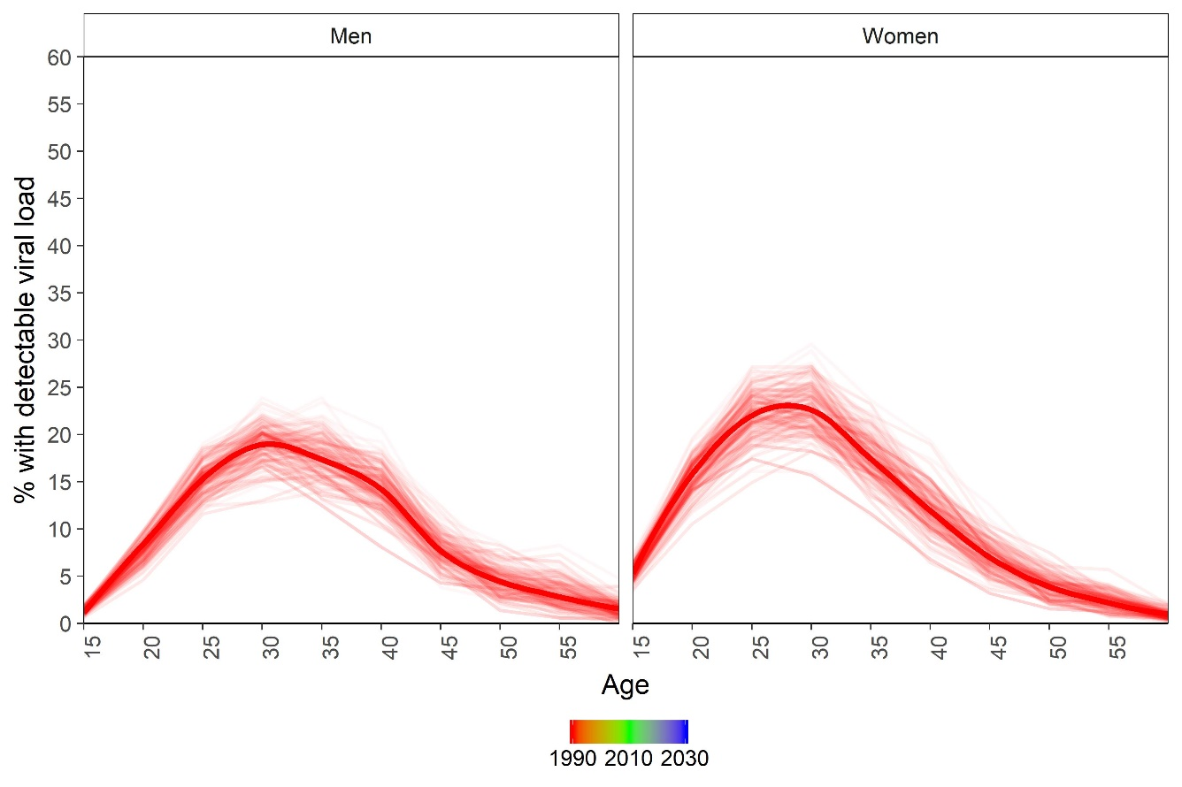
Pre-ART: Prevalence of detectable viremia aging
$$PPDV= \frac{\text{ART} \text{na}\text{ï}\text{ve}}{\text{Population}}$$
1990
EMOD eSwatini simulations

Slide 22
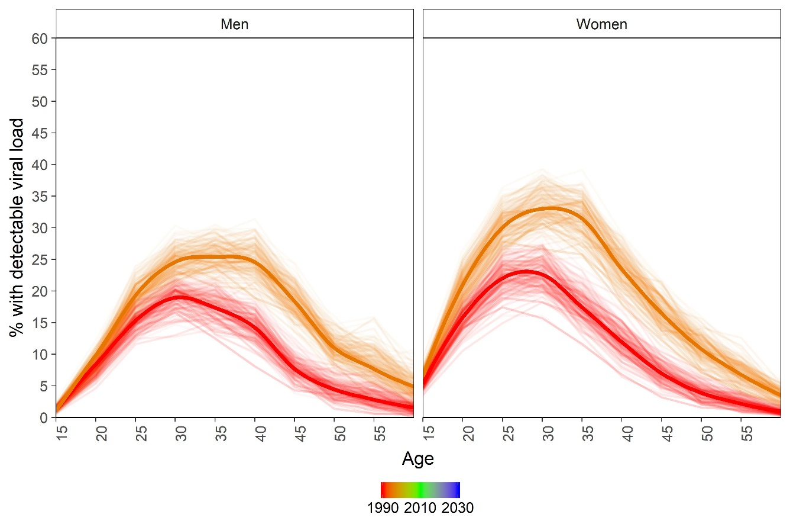
Pre-ART: Prevalence of detectable viremia aging
$$PPDV= \frac{\text{ART} \text{na}\text{ï}\text{ve}}{\text{Population}}$$
1990
1995
EMOD eSwatini simulations

Slide 23
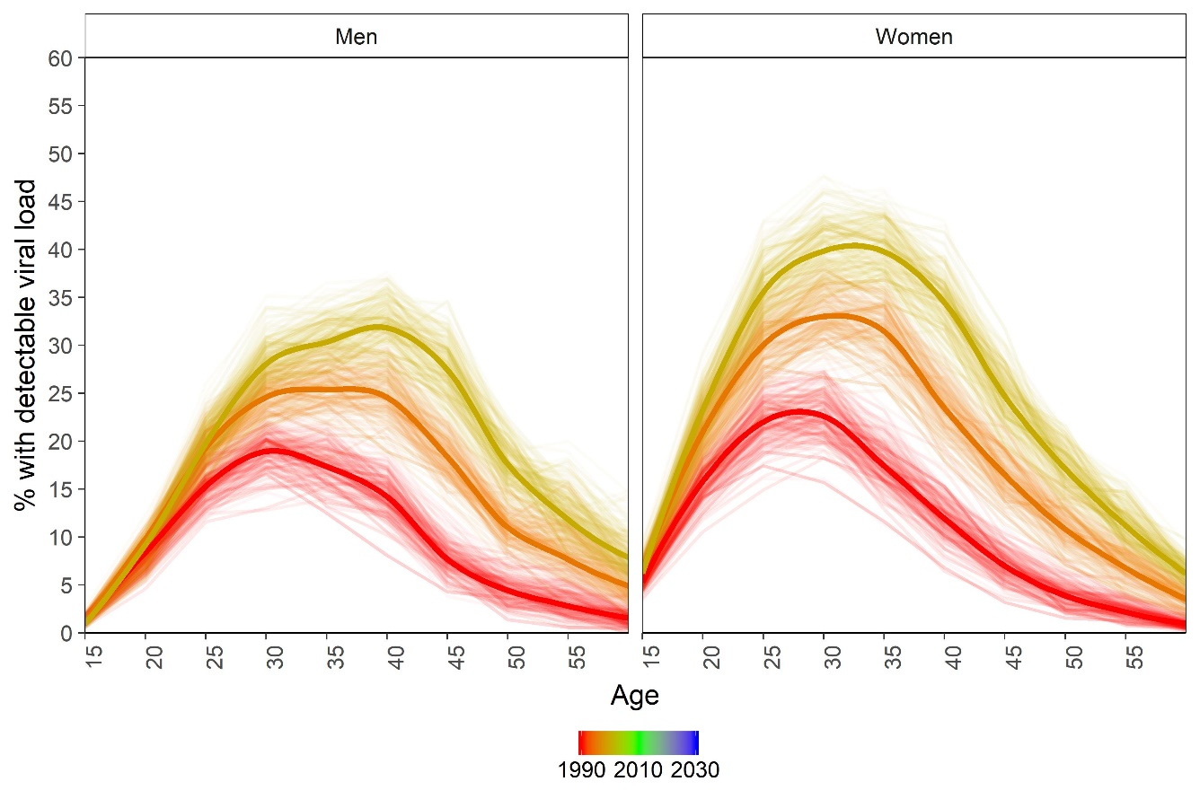

Pre-ART: Prevalence of detectable viremia aging
$$PPDV= \frac{\text{ART} \text{na}\text{ï}\text{ve}}{\text{Population}}$$
1990
1995
2000
EMOD eSwatini simulations

Slide 24
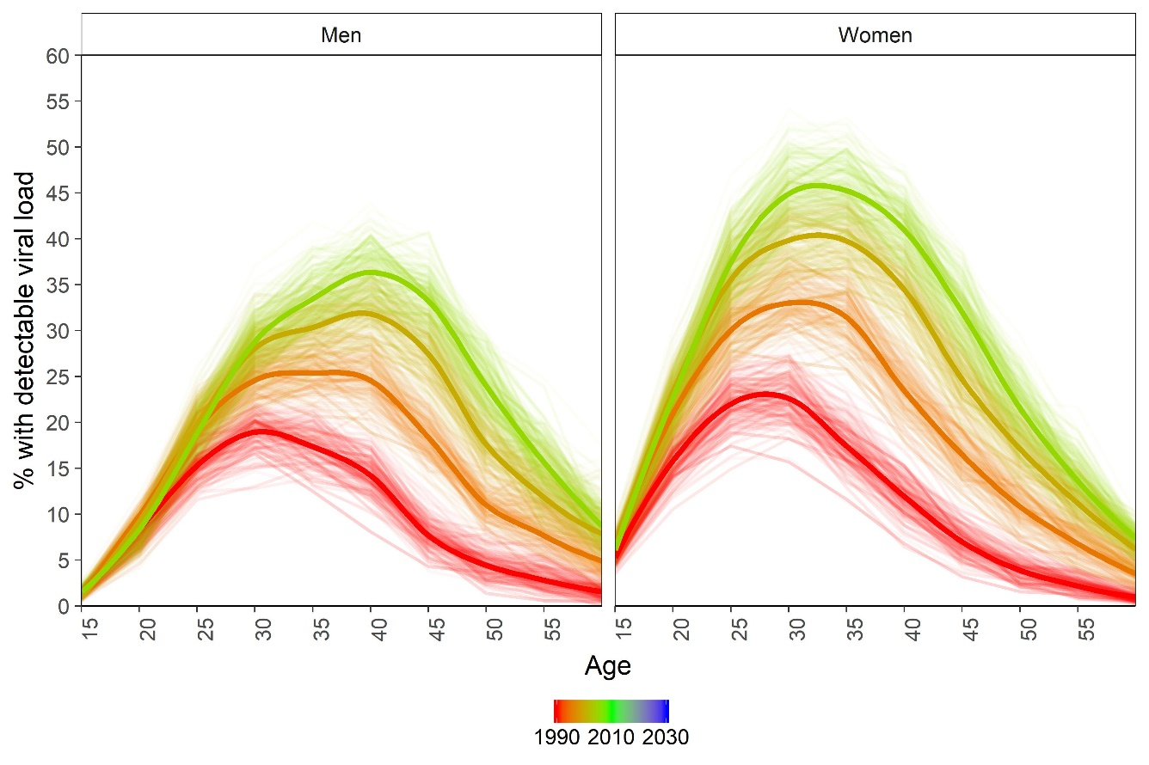
Pre-ART: Prevalence of detectable viremia aging
$$PPDV= \frac{\text{ART} \text{na}\text{ï}\text{ve}}{\text{Population}}$$
1990
1995
2000
2005
EMOD eSwatini simulations

Slide 25
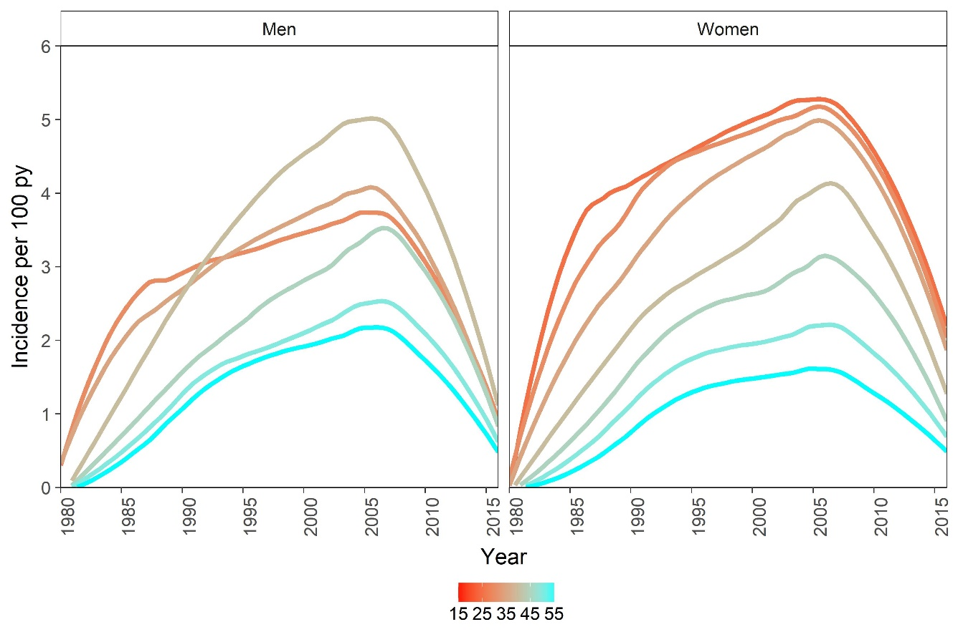
Pre-ART: Incidence increasing in older age-groups
25-29
40-44
30-34
35-39
35-39
40-44
30-34
45-49
45-49
50-54
55-59
50-54
55-59
EMOD eSwatini simulations

Slide 26
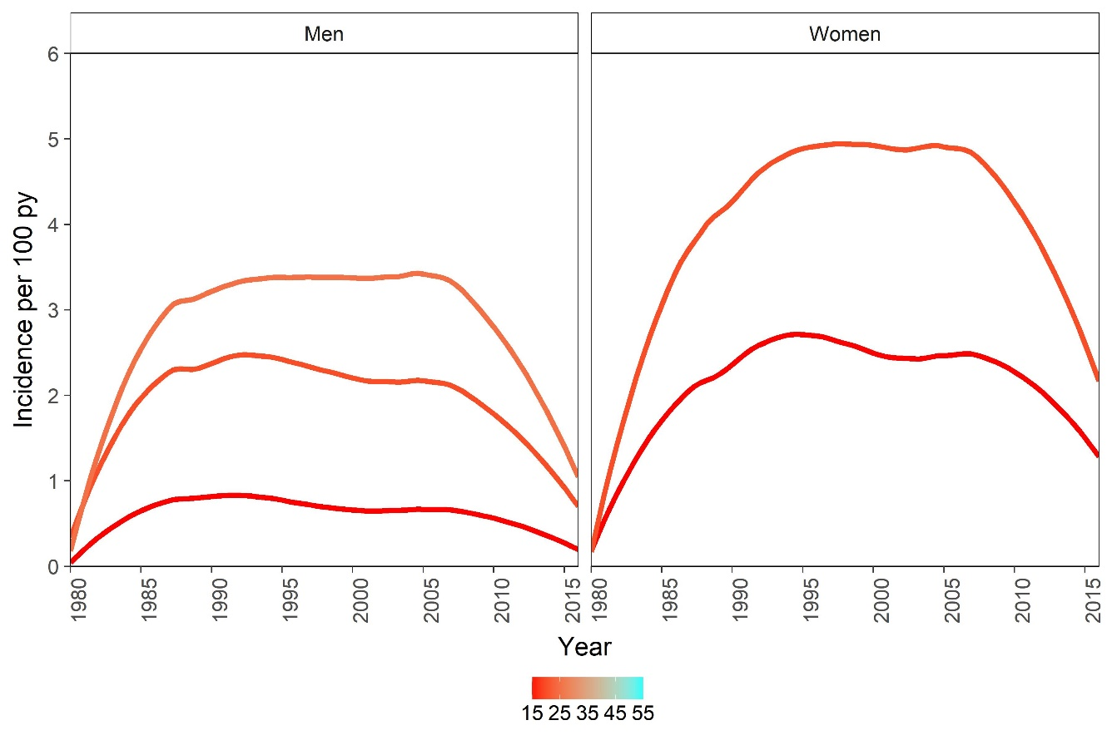
Pre-ART: Flattening/falling incidence in younger ages
20-24
25-29
20-24
15-19
15-19
EMOD eSwatini simulations

Slide 27
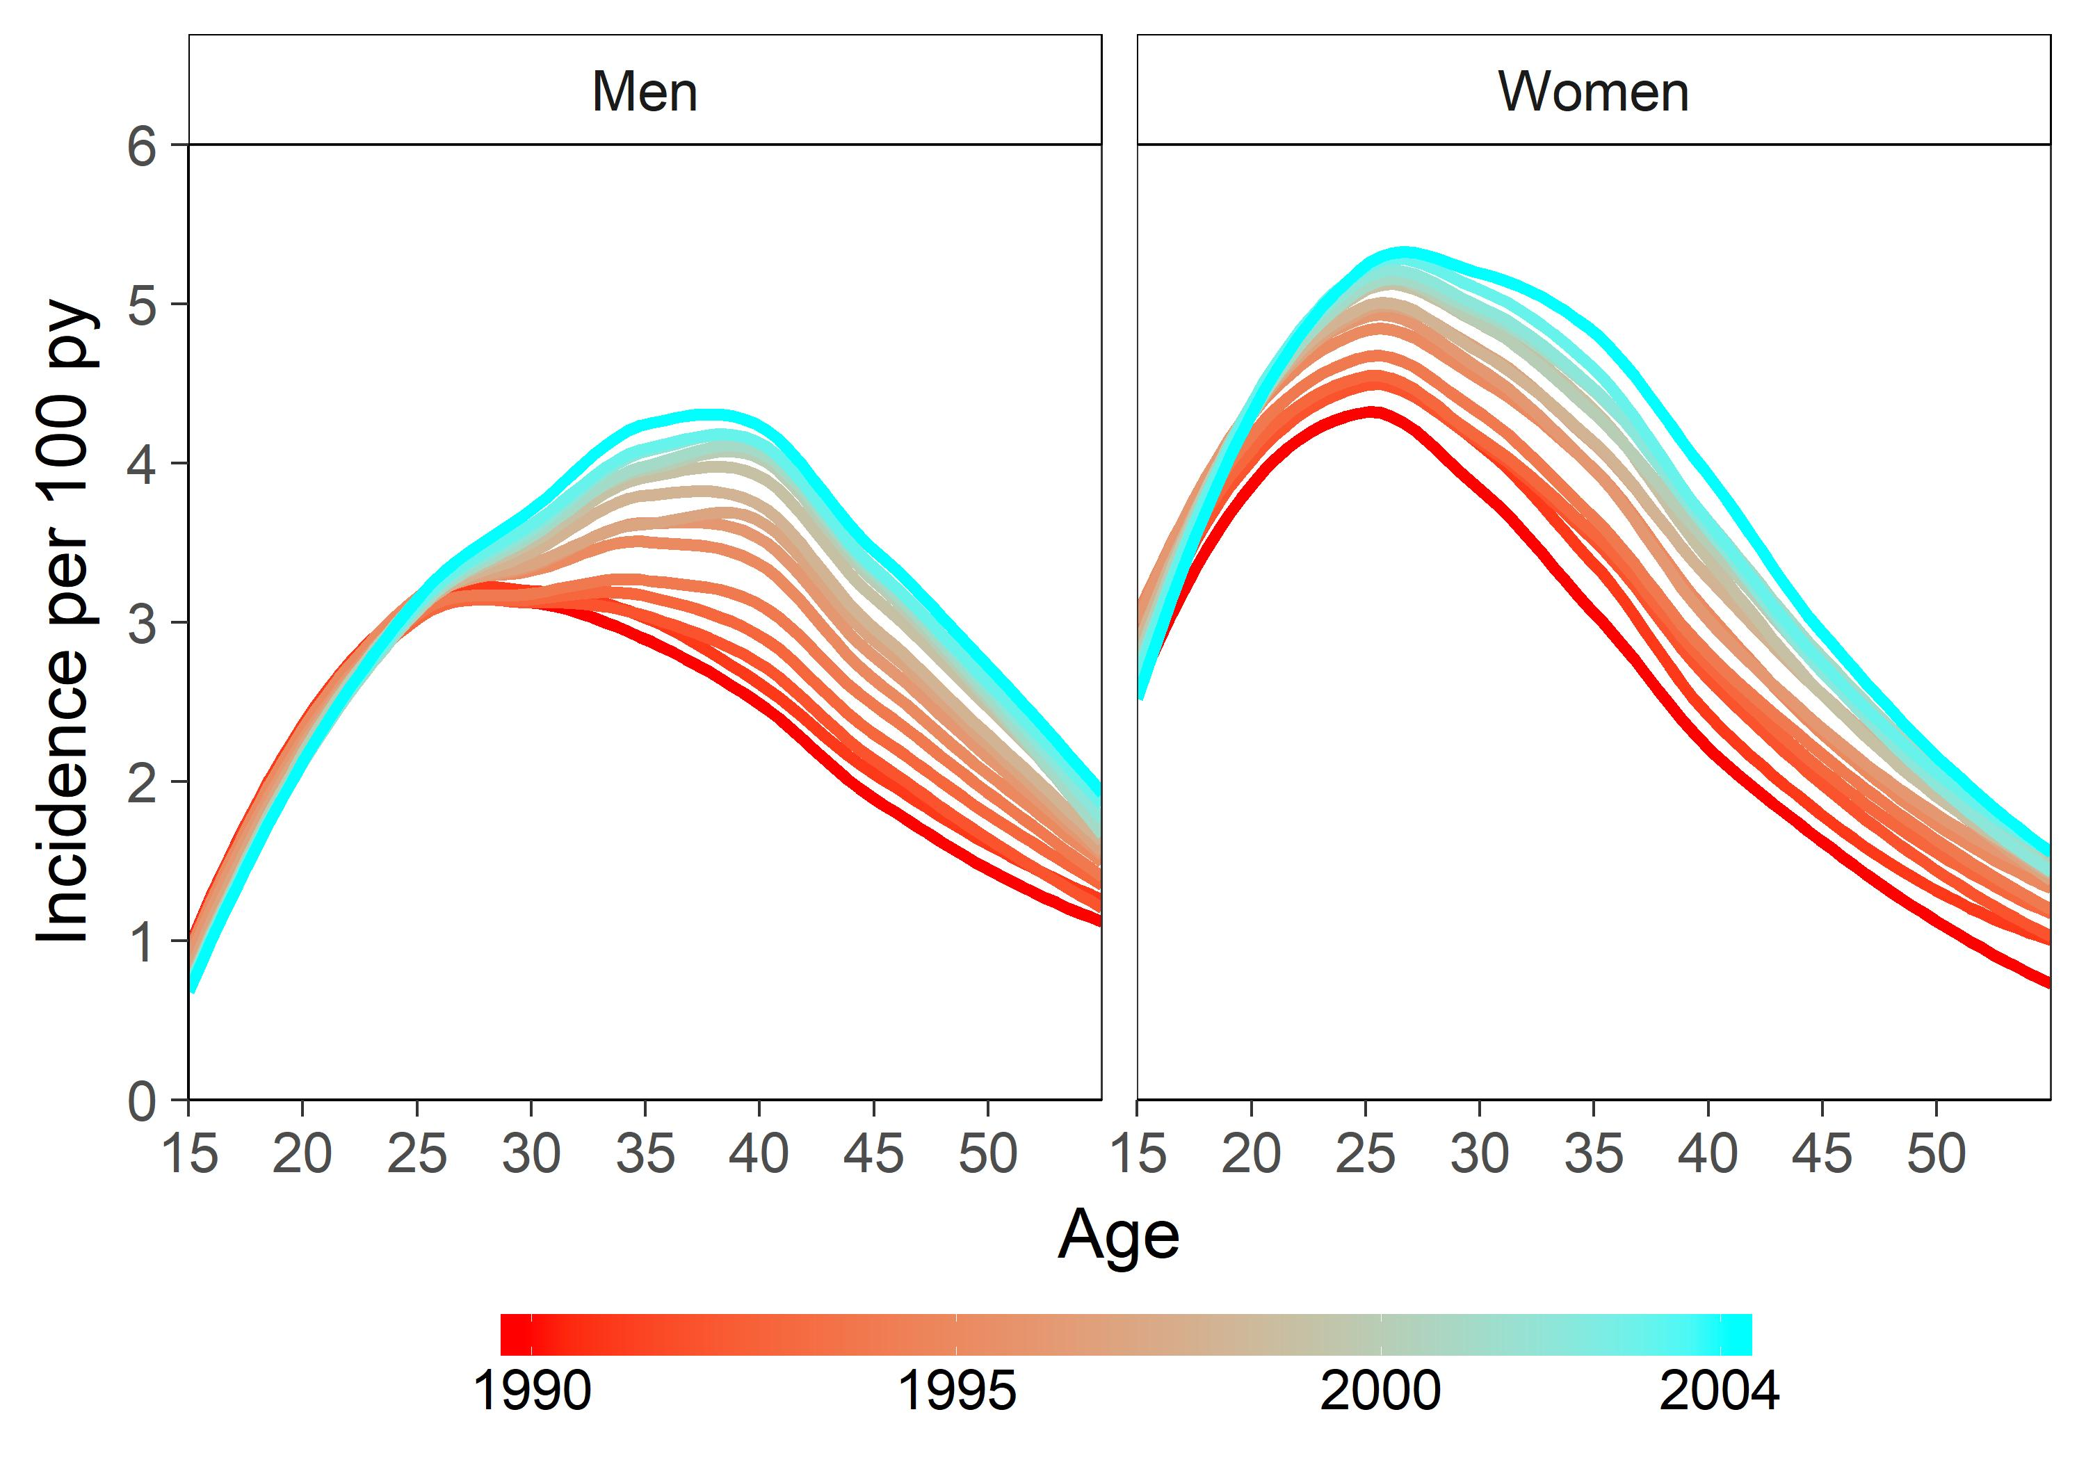
Pre-ART: Incidence shifts older in men and women
EMOD eSwatini simulations

Slide 28
eSwatini model-based evidence
Modeled incidence 1980 - 2050
Pre-ART scale-up
ART
Scale-up
Maintain ART

Slide 29
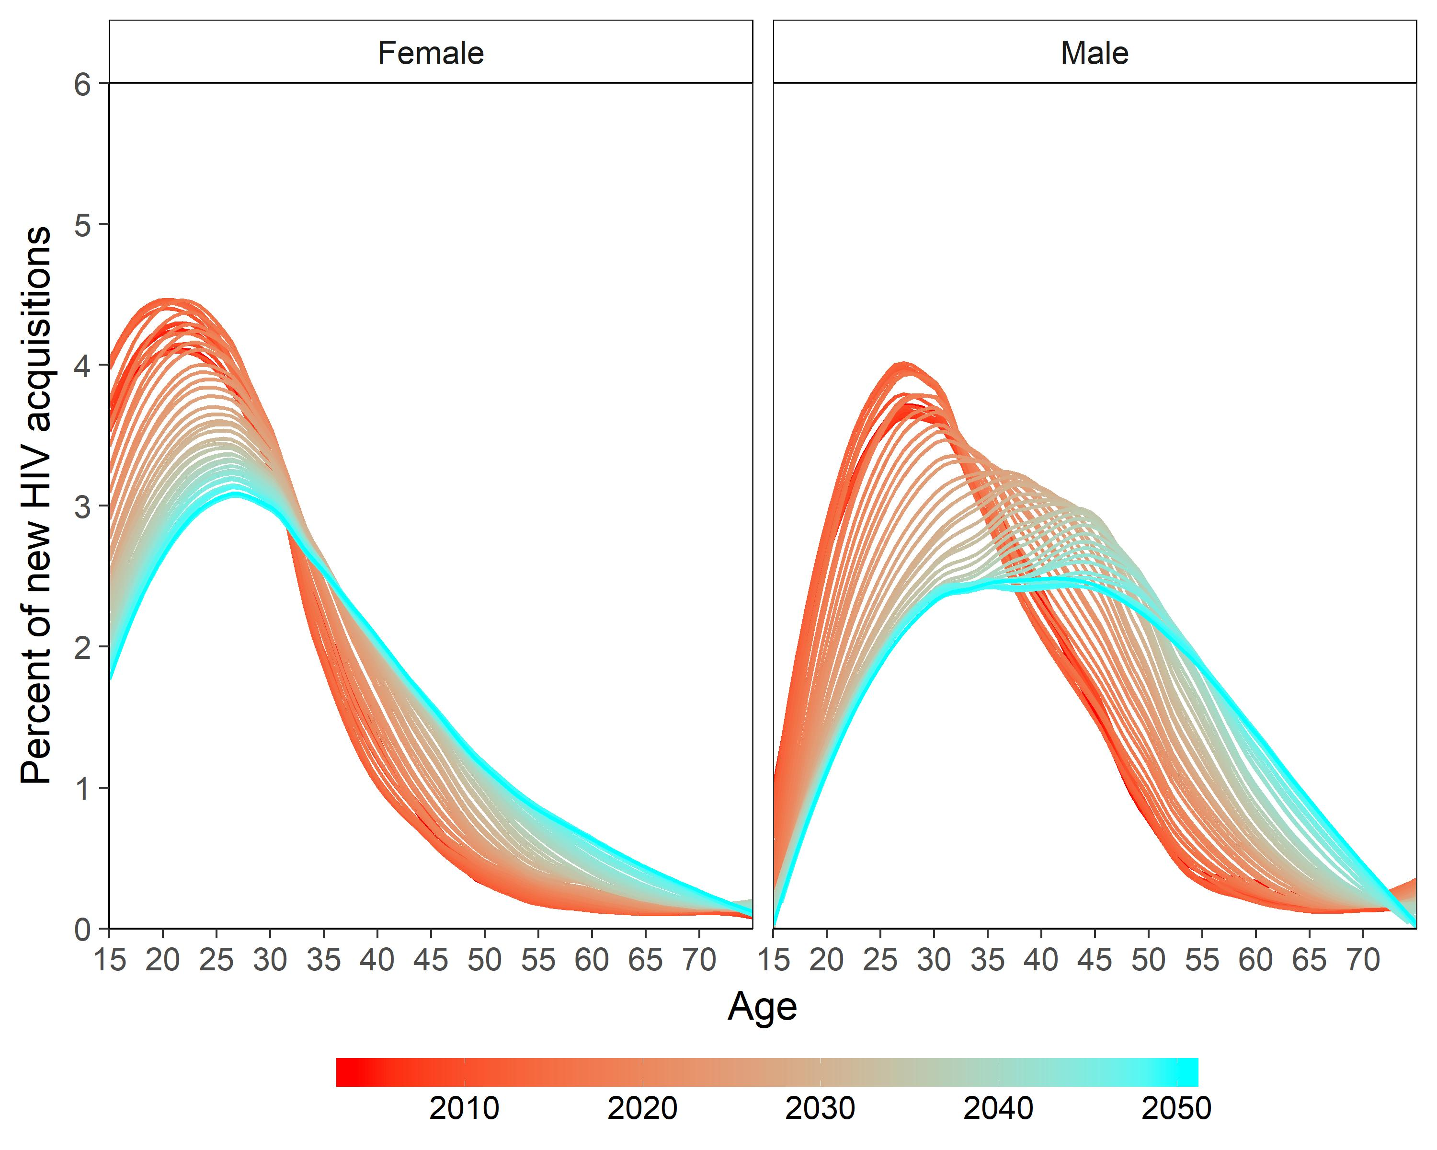
New infections shift older in era of ART
Lower force of
infection under ART
Delayed age at infection
More new infections at older ages
EMOD eSwatini simulations

Slide 30
New infections shift older in era of ART
Lower force of
infection under ART
Delayed age at infection
More new infections at older ages
EMOD eSwatini simulations

Slide 31
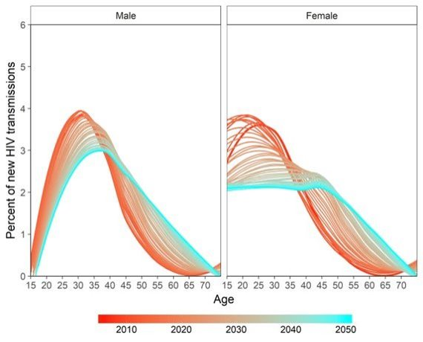
Sources of transmission also shift older
More new infections at older ages
Prevalence shifts older
Sources of transmissions
shift older
EMOD eSwatini simulations

Slide 32
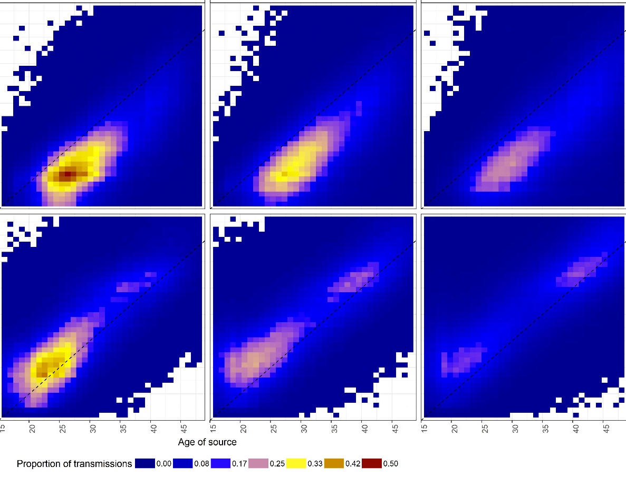
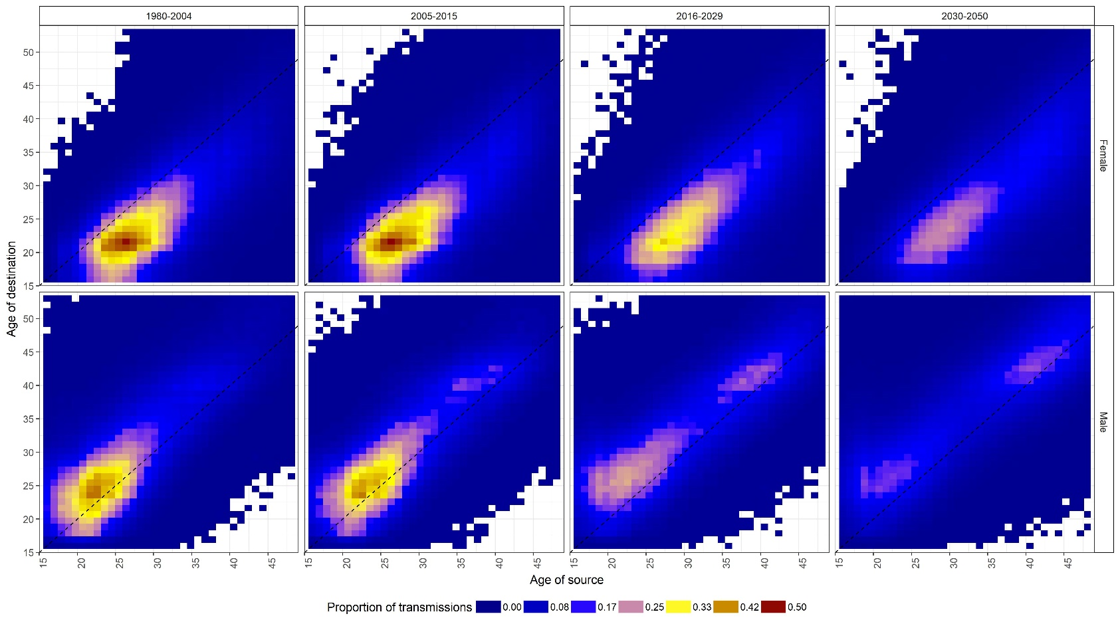
More transmissions in older partnerships
2005 - 2015
2016 - 2029
2030 - 2050
Male to female
Age of destination
Female to male
Age of source
Percent of transmissions
EMOD eSwatini simulations

Slide 33
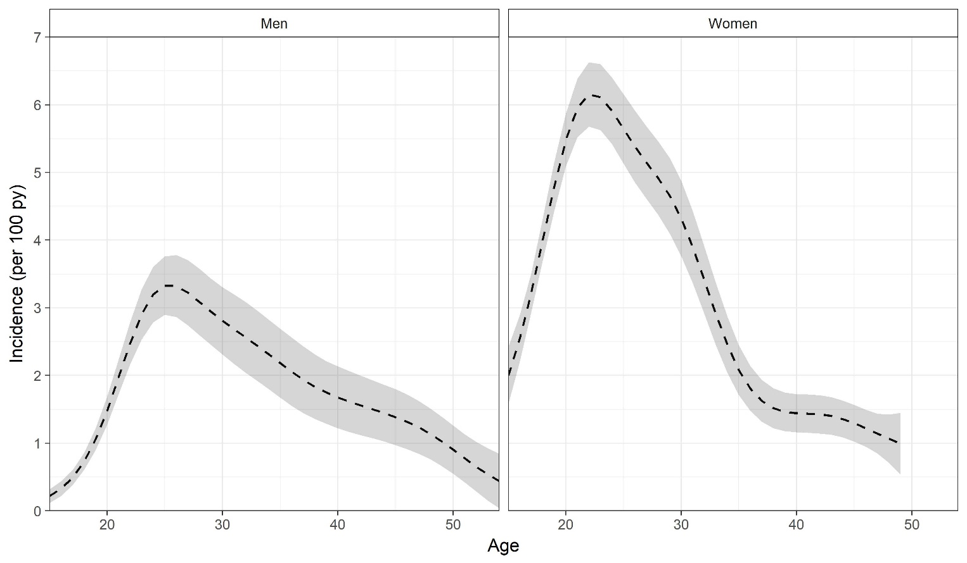
Age distribution of incidence (averaged 2004-2016)
AHRI cohort data, 2005-2016, fit to non-linear statistical model with age and sex interaction

Slide 34
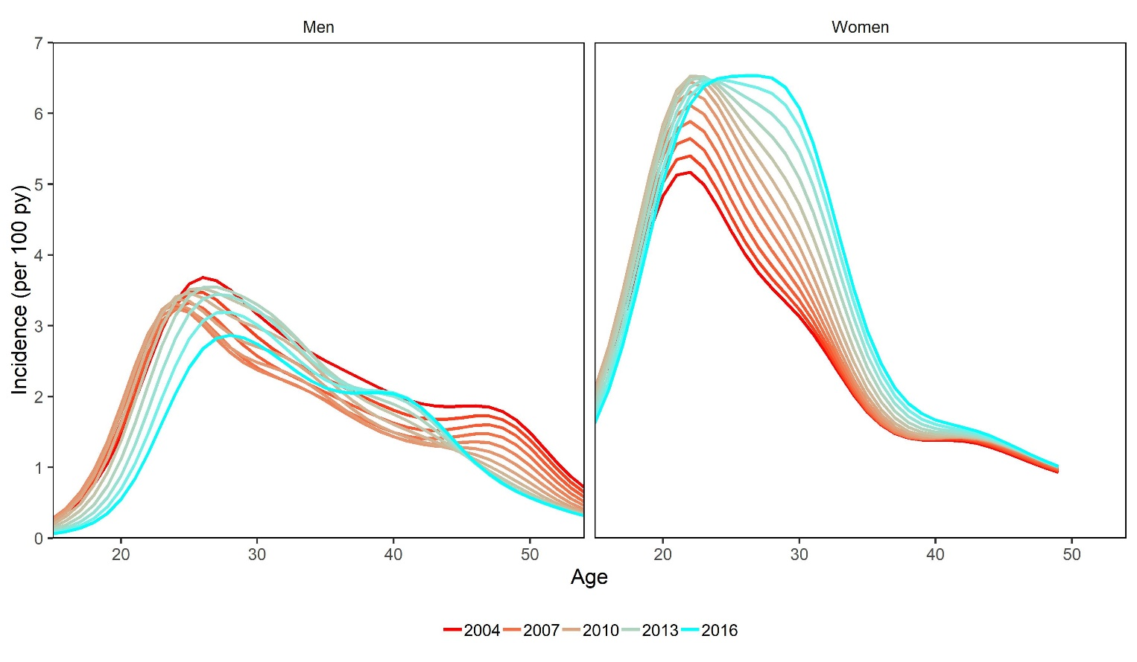
Age-specific incidence over time
AHRI cohort data, 2005-2016, fit to non-linear statistical model with age, sex, and year interaction

Slide 35
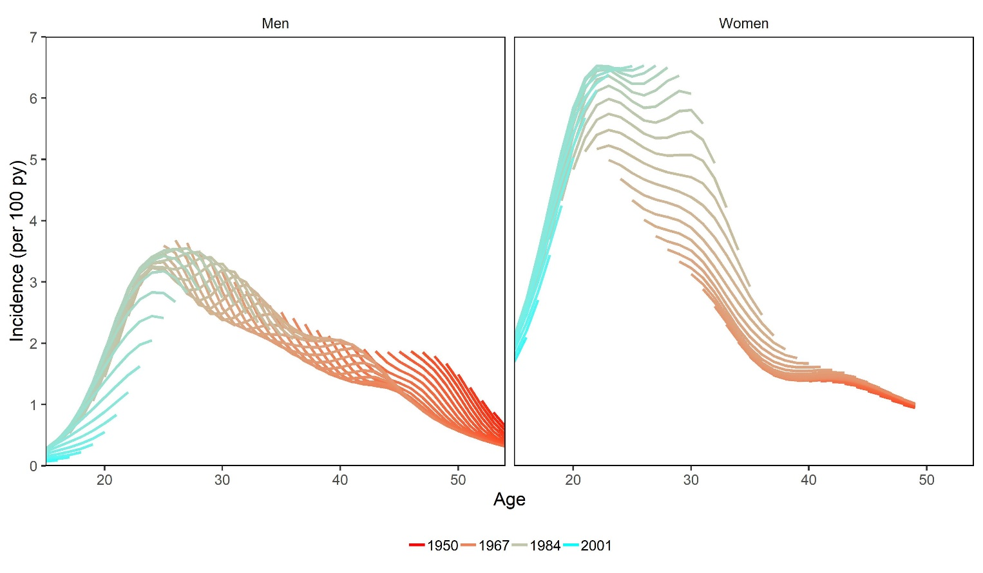
Age-specific incidence over time
Women born in 1988, age 25 in 2013
Women born in 1980, age 25 in 2005
And 30 in 2010
AHRI cohort data, 2005-2016, fit to non-linear statistical model with age, sex, and year interaction

Slide 36
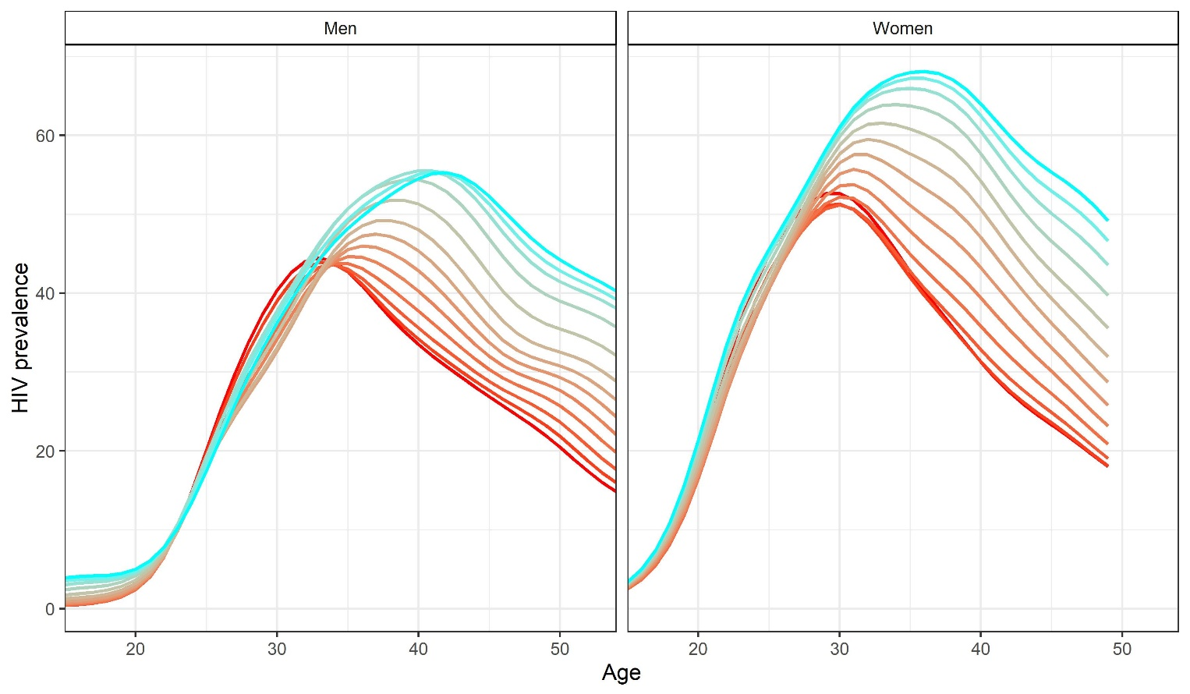
Age-specific prevalence over time
Male partners > 35
Male partners < 35

Slide 37
Summary of eSwatini model and KZN data
Epidemic starts young and spreads to older age groups
ART and VMMC will shift incidence older over time
Implications:
  Transmission will become more important across broader age groups
  Planning for risk reduction to include >25 y/o needed

