Slide 1

Looking under the streetlight? Understanding delays and TB transmission
Nim Arinaminpathy
Imperial College London
IDM Symposium, 20 Apr 2017

Slide 2
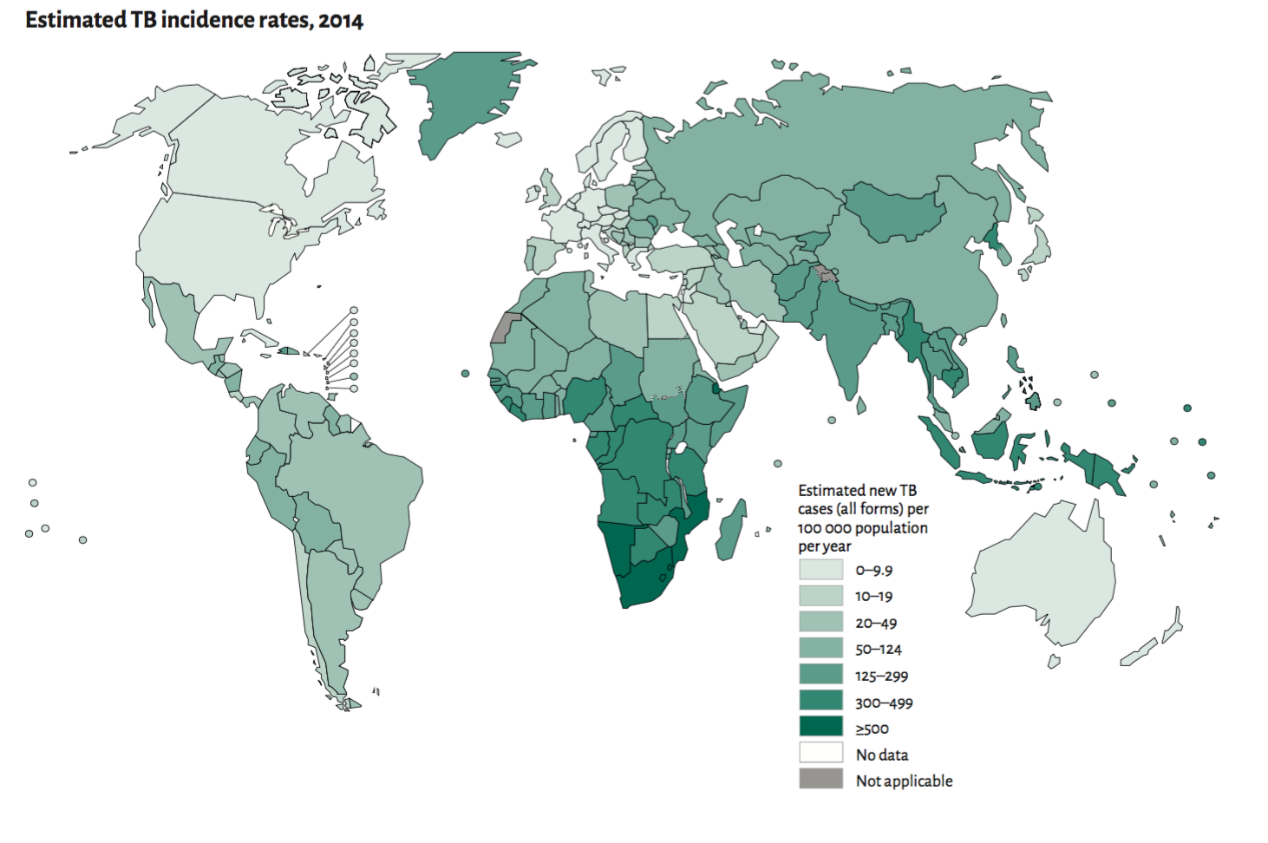
Tuberculosis today
An estimated 9.6 million cases of TB occurred globally in 2014
25% of this burden occurred in India alone, the highest of any country
Global Tuberculosis Report, 2015
Notes:
22 high-burden countries
Drugs are really the mainstay of TB control today. The processes that lead to this young boy taking his tablets depend crucially on: (i) drug availability, and (ii) well-functioning health systems that rapidly diagnose TB and initiate timely treatment. I’ll say a bit about both in turn.

Slide 3
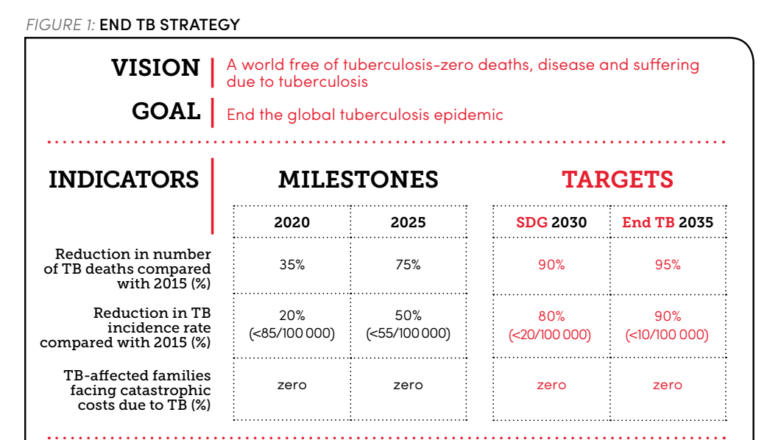
End TB Strategy

Slide 4
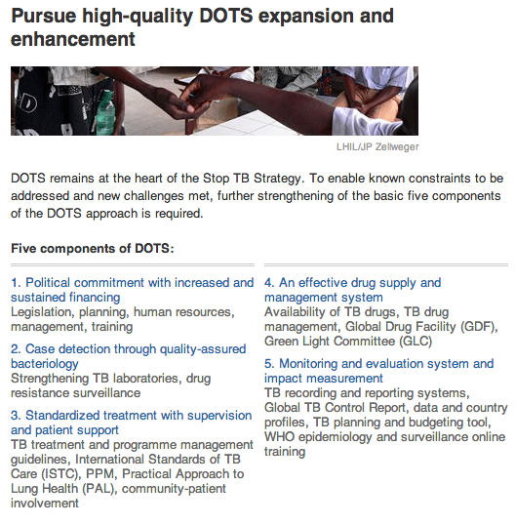
At present
No transmission-blocking vaccine, but cost effective chemotherapy

Slide 5
We need to understand where transmission is happening

Slide 6
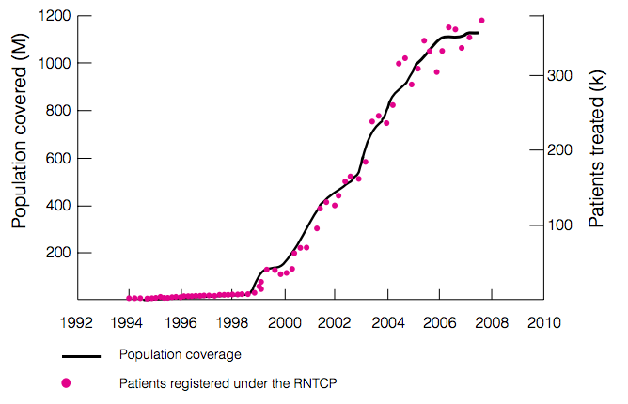
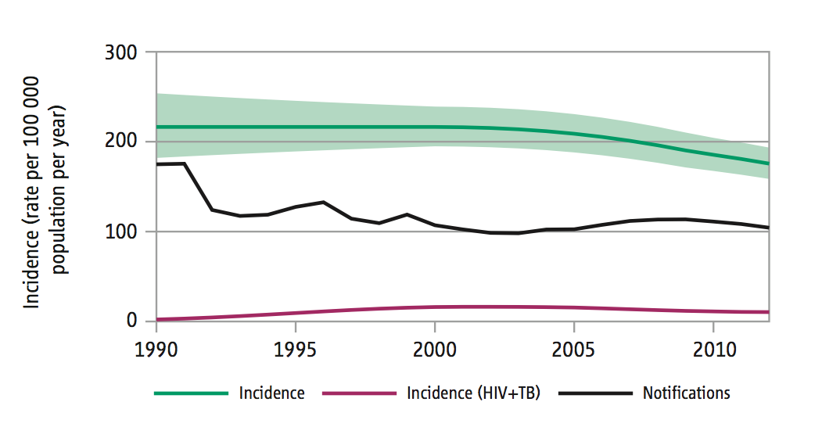
TB control in India: a brief retrospective
DOTS: treatment outcomes and case detection
Public-sector services (Revised National TB Control Programme) scaled up from 1997
But problems remain
Vast and unregulated private sector
2012 NSP: “The extension of RNTCP services to patients diagnosed and treated in the private sector”

Slide 7
A possible mechanism
Public-Private Interface Agency (PPIA)
Pilot PPM scheme funded by Bill and Melinda Gates Foundation
Engage with private providers, incentivising to improve:
  Quality of TB diagnosis
  Notification to public sector
  Treatment outcomes
Financial incentives vs Training and engagement

Slide 8
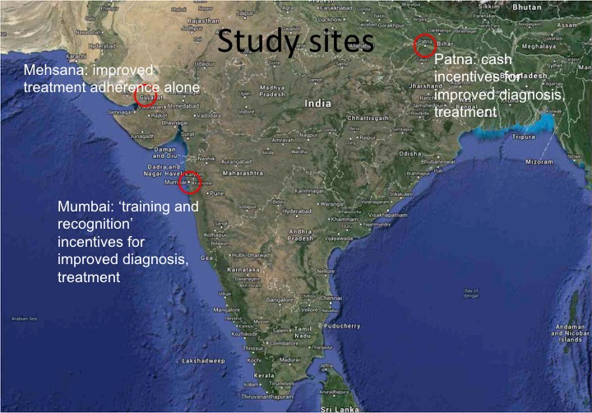
The setting

Slide 9
The setting
What is the potential epidemiological impact of a PPIA at scale?

Slide 10
βI
Latent
infection
Active disease,
Pre-care-seeking
Uninfected
Patient
delay
d
Diagnostic
delay
Cure, HIGH
relapse risk
(Default)
Treatment
initiation
Quality of
TB treatment
Cure, LOW
relapse risk
(Success)
Treatment
completion
Notes:
Figure 1. Schematic illustration of the transmission model. The figure shows two important parameters to be estimated in the model, the annual infections per active TB case (beta) and the mean, per-capita rate of careseeking once a patient develops active TB (d), which are calibrated to yield the correct ARTI and prevalence (see Table 1). The ‘bubble’ in orange denotes the sequence of providers that a patient visits before receiving a TB diagnosis. Here, we distinguish the associated ‘diagnostic delay’ with the initial ‘patient delay’. This model also includes the acquisition and transmission of multi-drug-resistant (MDR) TB, not shown here for clarity. In this schematic, private sector engagement aims to minimise the diagnostic delay by improving the standard of TB diagnosis, and to improve long-term treatment outcomes by maximising the proportion of patients successfully completing treatment (bottom row).

Slide 11
βI
Latent
infection
Active disease,
Pre-care-seeking
Uninfected
Patient
delay
d
Diagnostic
delay
Pathway
surveys
Cure, HIGH
relapse risk
(Default)
Treatment
initiation
Quality of
TB treatment
Cure, LOW
relapse risk
(Success)
Treatment
completion
Notes:
Figure 1. Schematic illustration of the transmission model. The figure shows two important parameters to be estimated in the model, the annual infections per active TB case (beta) and the mean, per-capita rate of careseeking once a patient develops active TB (d), which are calibrated to yield the correct ARTI and prevalence (see Table 1). The ‘bubble’ in orange denotes the sequence of providers that a patient visits before receiving a TB diagnosis. Here, we distinguish the associated ‘diagnostic delay’ with the initial ‘patient delay’. This model also includes the acquisition and transmission of multi-drug-resistant (MDR) TB, not shown here for clarity. In this schematic, private sector engagement aims to minimise the diagnostic delay by improving the standard of TB diagnosis, and to improve long-term treatment outcomes by maximising the proportion of patients successfully completing treatment (bottom row).

Slide 12
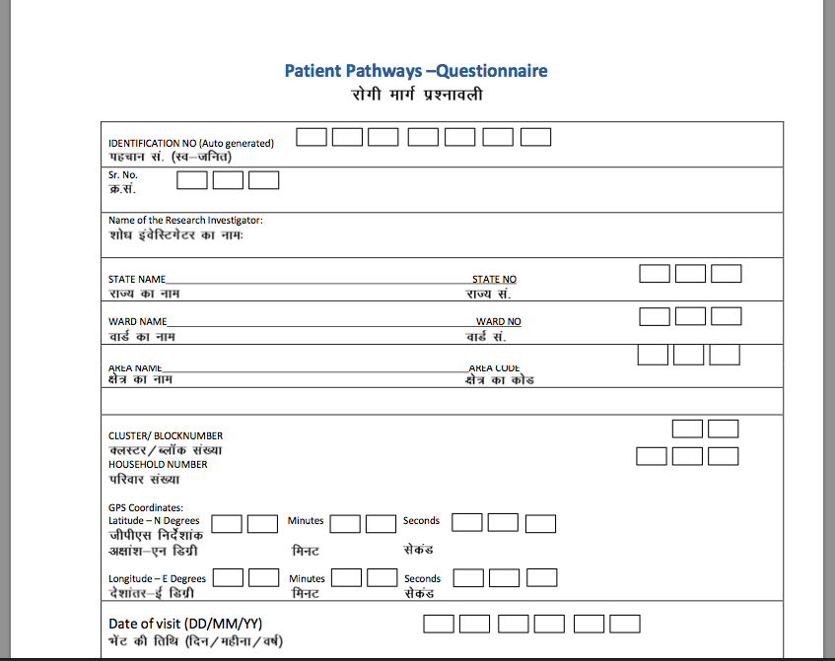
Key data inputs

Slide 13
βI
Latent
infection
Active disease,
Pre-care-seeking
Uninfected
Patient
delay
d
ARTI,
Prevalence
Diagnostic
delay
Pathway
surveys
Cure, HIGH
relapse risk
(Default)
Treatment
initiation
Quality of
TB treatment
Cure, LOW
relapse risk
(Success)
Treatment
completion
Notes:
Figure 1. Schematic illustration of the transmission model. The figure shows two important parameters to be estimated in the model, the annual infections per active TB case (beta) and the mean, per-capita rate of careseeking once a patient develops active TB (d), which are calibrated to yield the correct ARTI and prevalence (see Table 1). The ‘bubble’ in orange denotes the sequence of providers that a patient visits before receiving a TB diagnosis. Here, we distinguish the associated ‘diagnostic delay’ with the initial ‘patient delay’. This model also includes the acquisition and transmission of multi-drug-resistant (MDR) TB, not shown here for clarity. In this schematic, private sector engagement aims to minimise the diagnostic delay by improving the standard of TB diagnosis, and to improve long-term treatment outcomes by maximising the proportion of patients successfully completing treatment (bottom row).

Slide 14
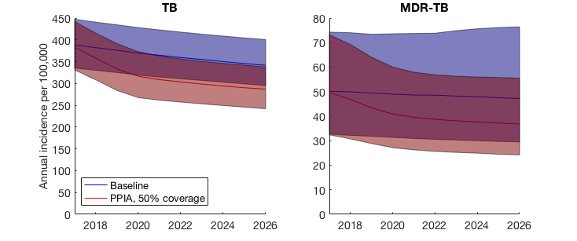
Potential epidemiological impact
Arinaminpathy et al, In prep
Notes:
Figure 4. Illustration of the TB dynamics under scale-up of a PPIA, taking Mumbai as an example. These results capture the scenario of a PPIA being scaled up (over three years from 2017) to cover 50% of patient-provider interactions.

Slide 15
βI
Latent
infection
Active disease,
Pre-care-seeking
Uninfected
Patient
delay
d
Diagnostic
delay
Cure, HIGH
relapse risk
(Default)
Treatment
initiation
Quality of
TB treatment
Cure, LOW
relapse risk
(Success)
Treatment
completion
Notes:
Figure 1. Schematic illustration of the transmission model. The figure shows two important parameters to be estimated in the model, the annual infections per active TB case (beta) and the mean, per-capita rate of careseeking once a patient develops active TB (d), which are calibrated to yield the correct ARTI and prevalence (see Table 1). The ‘bubble’ in orange denotes the sequence of providers that a patient visits before receiving a TB diagnosis. Here, we distinguish the associated ‘diagnostic delay’ with the initial ‘patient delay’. This model also includes the acquisition and transmission of multi-drug-resistant (MDR) TB, not shown here for clarity. In this schematic, private sector engagement aims to minimise the diagnostic delay by improving the standard of TB diagnosis, and to improve long-term treatment outcomes by maximising the proportion of patients successfully completing treatment (bottom row).

Slide 16
βI
Latent
infection
Active disease,
Pre-care-seeking
Uninfected
Patient
delay
d
Diagnostic
delay
~ 1 – 2 months
(reported)
Cure, HIGH
relapse risk
(Default)
Treatment
initiation
Quality of
TB treatment
Cure, LOW
relapse risk
(Success)
Treatment
completion
Notes:
Figure 1. Schematic illustration of the transmission model. The figure shows two important parameters to be estimated in the model, the annual infections per active TB case (beta) and the mean, per-capita rate of careseeking once a patient develops active TB (d), which are calibrated to yield the correct ARTI and prevalence (see Table 1). The ‘bubble’ in orange denotes the sequence of providers that a patient visits before receiving a TB diagnosis. Here, we distinguish the associated ‘diagnostic delay’ with the initial ‘patient delay’. This model also includes the acquisition and transmission of multi-drug-resistant (MDR) TB, not shown here for clarity. In this schematic, private sector engagement aims to minimise the diagnostic delay by improving the standard of TB diagnosis, and to improve long-term treatment outcomes by maximising the proportion of patients successfully completing treatment (bottom row).

Slide 17
βI
Latent
infection
Active disease,
Pre-care-seeking
Uninfected
Patient
delay
~ 4 – 5 months
(fitted)
d
M.A.N.E.
Diagnostic
delay
~ 1 – 2 months
(reported)
Cure, HIGH
relapse risk
(Default)
Treatment
initiation
Quality of
TB treatment
Cure, LOW
relapse risk
(Success)
Treatment
completion
Notes:
Figure 1. Schematic illustration of the transmission model. The figure shows two important parameters to be estimated in the model, the annual infections per active TB case (beta) and the mean, per-capita rate of careseeking once a patient develops active TB (d), which are calibrated to yield the correct ARTI and prevalence (see Table 1). The ‘bubble’ in orange denotes the sequence of providers that a patient visits before receiving a TB diagnosis. Here, we distinguish the associated ‘diagnostic delay’ with the initial ‘patient delay’. This model also includes the acquisition and transmission of multi-drug-resistant (MDR) TB, not shown here for clarity. In this schematic, private sector engagement aims to minimise the diagnostic delay by improving the standard of TB diagnosis, and to improve long-term treatment outcomes by maximising the proportion of patients successfully completing treatment (bottom row).

Slide 18
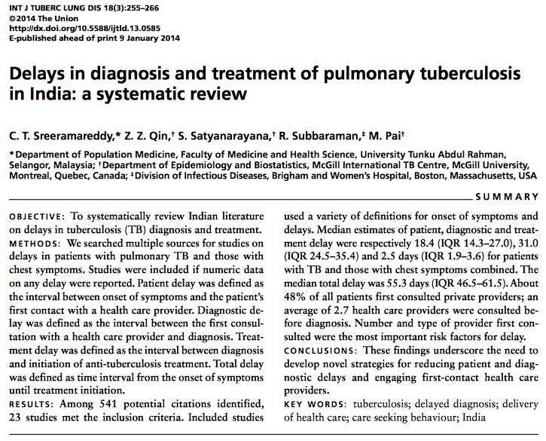
What the data suggests (i)

Slide 19
What the data suggests (ii)
Gujarat prevalence survey, 2011

Slide 20
What the data suggests (ii)
Gujarat prevalence survey, 2011
Courtesy of Dr Kiran Rade,
Central TB Division

Slide 21
We need to understand where transmission is happening

Slide 22
Chest symptomatics seeking care

Slide 23
Key burden indicators
(ARTI etc)
Chest symptomatics seeking care
Cross-sectional (prevalence) surveys

Slide 24
Most patients wait for several months before seeking care?
Some TB cases never contacting the healthcare system?
Key burden indicators
(ARTI etc)
Chest symptomatics seeking care
Cross-sectional (prevalence) surveys

Slide 25

What is going on?
  We may be missing transmission as long as we’re missing the sociological perspective
  Increasing awareness?
  Addressing stigma?
  Lowering barriers to care?
  What would be the impact on TB incidence?
Is there evidence that TB patients defer careseeking?
    Upcoming work with NIRT (Chennai), FMR (Mumbai)
Also evidence from other prevalence surveys in the region
  Ongoing work: modelling TB in WHO/SEARO
Notes:
This is now getting into the realm of the social sciences, to really try and understand what drives these barriers, and whether we can do anything about them – and as modellers, the questions we’re interested in is whether we can out numbers on these aspects.

Slide 26
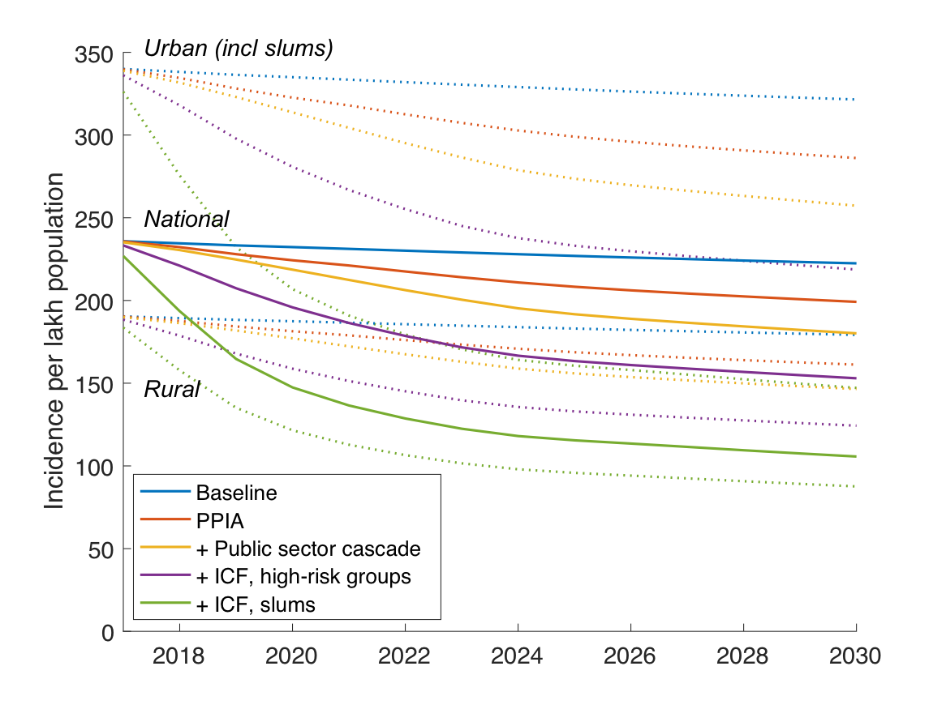
India’s next National Strategic Plan
…but more ‘real’ evidence now needed...

Slide 27
Thank you

Slide 28
Spare slides

Slide 29
Many reasons for engaging the private sector
Surveillance: India’s public TB programme covers only estimated ~60% of TB cases
  Burden of TB managed by the private sector is much higher than previously recognised (Arinaminpathy et al, 2016)
Extending public-sector quality of care to the private sector
  ’Saving lives’ through improved outcomes
  Free TB drugs and adherence support
Reducing opportunities for transmission ….?
  Not without demand generation

Slide 30
Movement in a fragmented healthcare system
Kapoor, Raman, Sachdeva, Satyanarayana (2012) PLoS ONE
Notes:
The private healthcare sector is important, because over 70% of patients are thought to visit a provider in this sector first

Slide 31
Aside: fresh views on patient pathways
Mumbai
Patna
FQ
LTFQ
FQ
LTFQ
Chemist
Public
Chemist
Public
Arinaminpathy et al, In prep
Notes:
Figure 2. Summary of the contrasting patient careseeking pathways in Mumbai and Patna. Circle areas are proportional to the importance of providers as first point of patient contact (for example, patients in Patna tend to seek care first amongst fully qualified providers). Arrows denote how patients switch providers on subsequent visits, with arrow widths proportional to frequency.

Slide 32
What the data suggests (ii)
Of microbiologically positive TB
 | Gujarat prevalence survey | Mumbai model, cross-section
Not yet visited a provider | 69% | 36%
Have sought care, but not on treatment | 17% | 21%
Have sought care, been diagnosed, and on treatment | 11% | 42%
Patient delay
Diagnostic delay

Slide 33
Demand generation: what does it mean?
  Increasing awareness?
  Addressing stigma?
  What are the barriers to patient careseeking?
  And how might they be addressed?
  What would be the impact on TB incidence?
Notes:
This is now getting into the realm of the social sciences, to really try and understand what drives these barriers, and whether we can do anything about them – and as modellers, the questions we’re interested in is whether we can out numbers on these aspects.

Slide 34
What the data suggests (i)
Early TB symptoms are too subtle for patients to report
Diagnosed patients are ‘telling the truth’: there is another population that never access care
Of several careseeking episodes, only the most recent is reported

