Slide 1
DTK-Tools
Benoit Raybaud, Research Software Manager

Slide 2
Objective
What is DTK-Tools?
General concepts
Creating a simulation
Creating a sweep
Analysis
Calibration
Input files

Slide 3
What is DTK-Tools?
Python framework providing tools and helpers to create, commission, manage and analyze experiments.
Written in Python 2.7
Supports Windows, Linux and Mac
Three main packages:
simtools: Provides the tools to interact with COMPS or local installation, manage experiments, book keeping
calibtool: Calibration utilities providing sites, analyzers and algorithms
dtk: helpers and functions specific to the EMOD model (creation of config and campaign files, demographics, vectors, etc.)
Notes:
Empower the user to configure diverse simulations and arbitrarily complex campaigns built up from a standardized library of configuration fragments and utility functions
Facilitate transparent switching between local and remote HPC commissioning, job-status queries, and output analysis
Speed up the creation, commissioning and management of large experiments
Collect a library of reusable post-processing analysis functionality, e.g. filtering, averaging, plotting
Provide calibration mechanism (Incremental Mixture Importance Sampling, Optimization, user defined)
Abstracts a lot of minutia (staging input files, staging of exe, creation of input files, etc.)

Slide 4
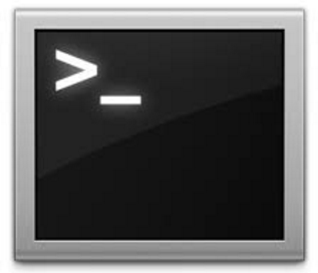
What is DTK-Tools? - Overview
On premise
Meta data DB
Internet
DTK-Tools
In the cloud
COMPS
Local Computer

Slide 5
Why DTK-Tools?
Bring a scripting way to interact with the model
Command line quicker than website
Easy to reproduce and share
Supports both running simulations locally or on COMPS
Speed up the creation of large experiments
Create reusable visualizations / analysis
Provide calibration mechanisms and algorithms
Abstracts a lot of minutia (staging/ creation of files)

Slide 6
First simulation
Everything is defined into the script called by the function.
The configuration file
The campaign file
Which input files to target
The name of the experiment
DTKConfigBuilder is the main object holding configuration / campaign
cb = DTKConfigBuilder.from_defaults('VECTOR_SIM') configure_site(cb, 'Namawala') run_sim_args = {'config_builder': cb, 'exp_name': 'ExampleSim‘
}
Local config/campaign
Modifications
Model input files
DTKConfigBuilder
DTKConfigBuilder
Built-in defaults

Slide 7
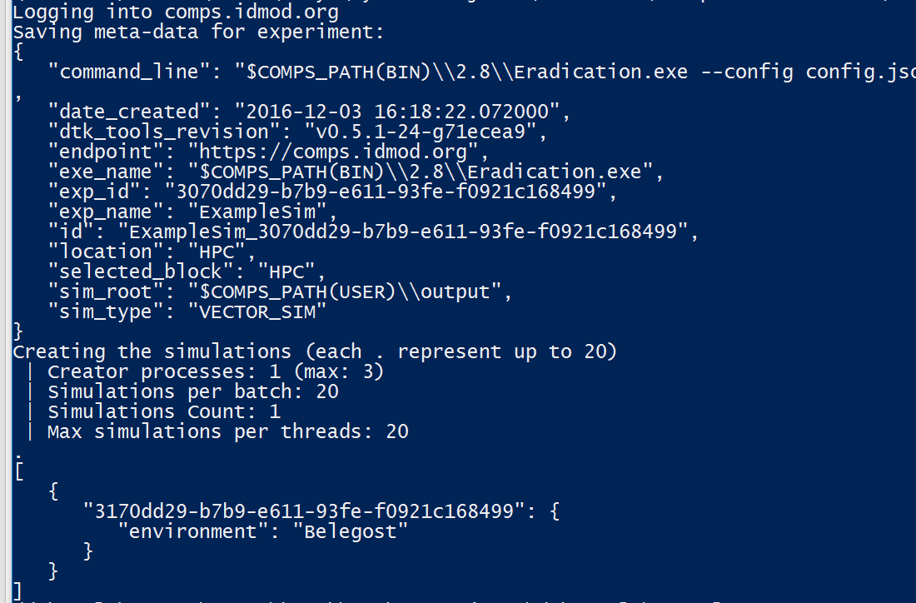
First simulation
dtk run example_sim.py --HPC

Slide 8
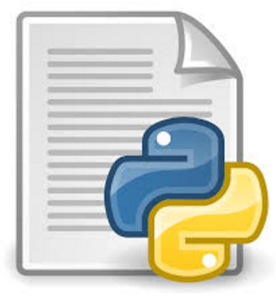
What just happened?
DTKConfigBuilder
DTK-Tools CLI
Experiment
Config/campaign files
Default VECTOR_SIM values
Namawala weather and vector species
Sim
Sim
Sim
Sim
…
Model inputs
Config/campaign files
Links to climate/demographics
Extra files
EMOD Model

Slide 9
Creating a sweep
Run combinations of parameters
For example:
Param A: 1, 2, 3
Param B: A, B
Resulting simulations:
DTK Tools sweep feature provides:
Easy way to identify location in the parameter space
Creation of complex sweeps (more than just simple parameter)
Automated creation of large sweeps
Param A | Param B
1 | A
1 | B
2 | A
2 | B
3 | A
3 | B

Slide 10
Logic of a sweep
Base config builder
Parameter set
Function
Tags
Parameter set
Function
Tags
Parameter set
Function
Tags
…

Slide 11
Creating a sweep
cb = DTKConfigBuilder.from_files(os.path.join(input_dir,'config.json'), os.path.join(input_dir,'campaign.json')) cb.set_param('Simulation_Duration', 5*365) def set_larvicides(cb, start): add_larvicides(cb,start) return {"larvicide_start": start} builder = ModBuilder.from_combos( [ModFn(set_larvicides, start_time ) for start_time in (0, 5,10, 365, 730)], [ModFn(DTKConfigBuilder.set_param, 'Run_Number', seed) for seed in range(5)], ) run_sim_args = {'config_builder': cb, 'exp_name': 'Sample larvicides epxeriment', 'exp_builder': builder}

Slide 12
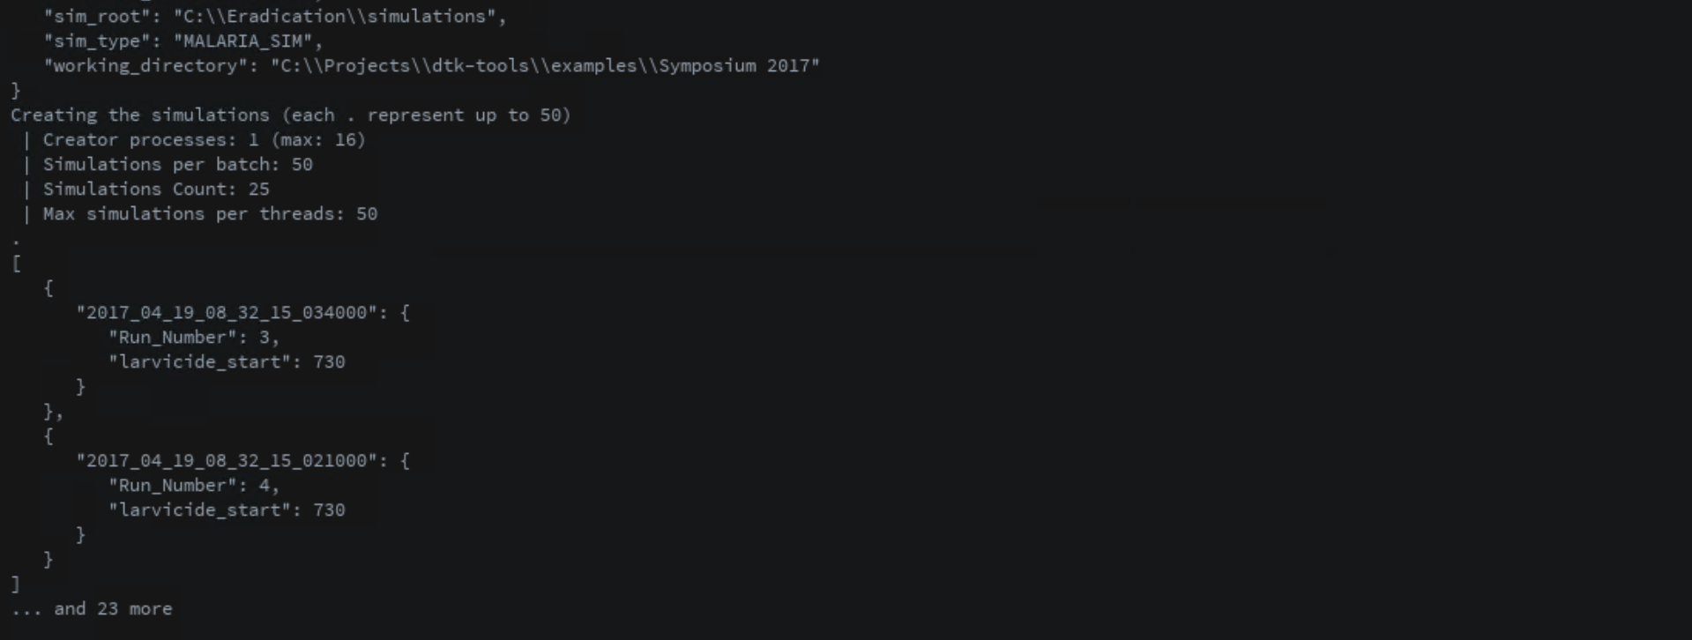
Running the sweep
dtk run example_sweep.py

Slide 13
Analyzers
Code used to analyze experiments
Usually generate plots but can virtually generate anything
Convenient way to access file from COMPS
Reusable on other experiments
An analysis can have multiple analyzers

Slide 14
Analyzers cont.
All analyzers inherit from the BaseAnalyzer class
You can redefine any of the functions
Filter: Filters the simulations base on their meta data
Apply: retrieve the data needed on a per simulation basis
Combine: cross-simulations calculations
Finalize: Extra processing at the end of the analysis
Plot: Plotting

Slide 15
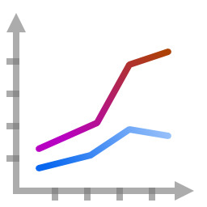
Analyzers – How does it work?
Sim
Sim
Sim
Sim
Sim
Sim
Analyzer
Output files
Filter
OP
OP
OP
raw_data
Apply
selected_data
Combine
Finalize
Plot

Slide 16
Create an analyzer
from dtk.utils.analyzers.BaseAnalyzer import BaseAnalyzer
class PopulationAnalyzer(BaseAnalyzer): filenames = ['output/InsetChart.json'] def __init__(self): super(PopulationAnalyzer, self).__init__() self.pop_data = {} def apply(self, parser): self.pop_data[parser.sim_id] = parser.raw_data[self.filenames[0]]["Channels"]["Statistical Population"]["Data"]
def plot(self): import matplotlib.pyplot as plt map(plt.plot, self.pop_data.values()) plt.legend(self.pop_data.keys()) plt.show()

Slide 17
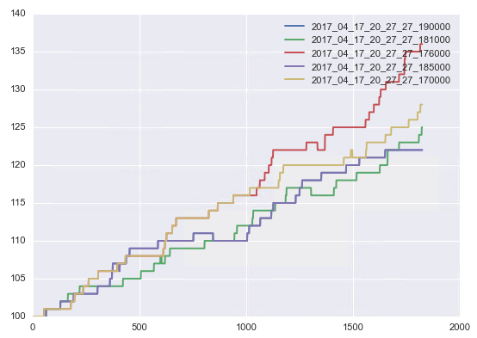
Create an analyzer
dtk analyze –a pop.py
# Configure a default 5 years simulation cb = DTKConfigBuilder.from_defaults(
'MALARIA_SIM', Simulation_Duration = 365 * 5
) # Create a builder to sweep over the birth rate multiplier builder = GenericSweepBuilder.from_dict({
‘x_Birth': np.arange(1, 1.5, .1)
})

Slide 18
Command line interface
Dtk commands
dtk run: Run an experiment
dtk list: List the experiments present in the database
dtk analyze: Run analysis
dtk kill: Kill an experiment
dtk exterminate: Kill all experiments
dtk status: Get the status of an experiment

Slide 19
Command line interface
dtk status: Get the status of an experiment
With no arguments: returns the status of the most recent experiment
With a name or an experiment id: returns the status of the given experiment
With --active: returns the status of all active experiments

Slide 20
Command line interface
dtk list: List the experiments present in the database
With no arguments: returns the most recent 20 experiments
With a name or an experiment id: returns the matching list of experiments
-n: limits the number of results displayed

Slide 21
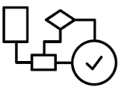
Calibration – Overview
Study Site
EMOD Model
Climate data
Demographics data
Disease specifics
Reference data
Climate files
Demographics files
Parameters
Produces outputs
New parameters
Calibration
Likelihoods
Output visualizations
Next point state
Next point algorithm
Compare

Slide 22
Calibration – Overview
Fit the model based on a site with reference data
Defines which input parameters to vary
Boundaries
Rounding
Change the model
Can explore a large parameter space
Used to set parameters that cannot be measured
Reasonable model configuration when data is sparse

Slide 23
Calibration – How does it work?
Calibration Site
Plotters
Reference data
Calibration Manager
Likelihood
Analyzers
Site Data
Site setup
Base Config Builder
Parameters
ParamA
Map sample to model function
ParamB
Next point algorithm

Slide 24
Initialize a calibration
cb = DTKConfigBuilder.from_defaults('MALARIA_SIM') sites = [DielmoCalibSite()]
plotters = [LikelihoodPlotter(combine_sites=True), OptimToolPlotter() ]

Slide 25
Initialize a calibration
params = [ { 'Name': 'Clinical Fever Threshold High', 'Dynamic': True, 'Guess': 1.75, 'Min': 0.5, 'Max': 2.5 }, { 'Name': 'MSP1 Merozoite Kill Fraction', 'Dynamic': False, 'MapTo': 'MSP1_Merozoite_Kill_Fraction', 'Guess': 0.65, 'Min': 0.4, 'Max': 0.7 } ]

Slide 26
Initialize a calibration
def map_sample_to_model_input(cb, sample): return cb.update_params(sample)

Slide 27
Initialize a calibration
optimtool = OptimTool(params, mu_r = r, # <-- radius for numerical derivatve sigma_r = r/10., # <-- stdev of radius center_repeats = 2, # <-- Number of times to replicate the current guess samples_per_iteration = 4 # <-- Actual number of sims run is this number times number of sites. )

Slide 28
Initialize a calibration
calib_manager = CalibManager(name='ExampleOptimization', setup = SetupParser('HPC'), config_builder = cb, map_sample_to_model_input_fn = map_sample_to_model_input, sites = sites, next_point = optimtool, sim_runs_per_param_set = 1, max_iterations = 3, plotters = plotters)

Slide 29
Calibtool CLI
Calibtool commands
calibtool run: Run a calibration
calibtool resume: Resume a calibration
Resume at any iteration and iteration step
Resume in case of failure
Change of calibration parameters (OptimTool only)
calibtool kill: Kill a calibration

Slide 30
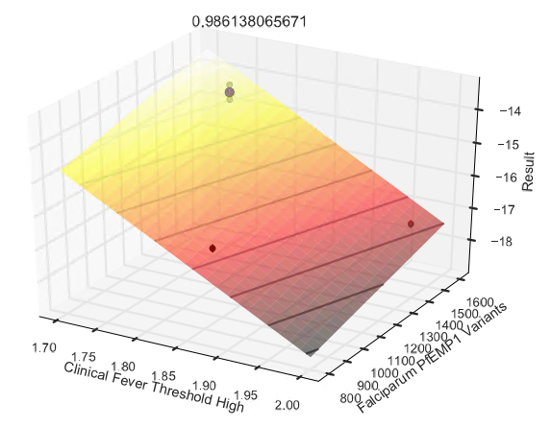
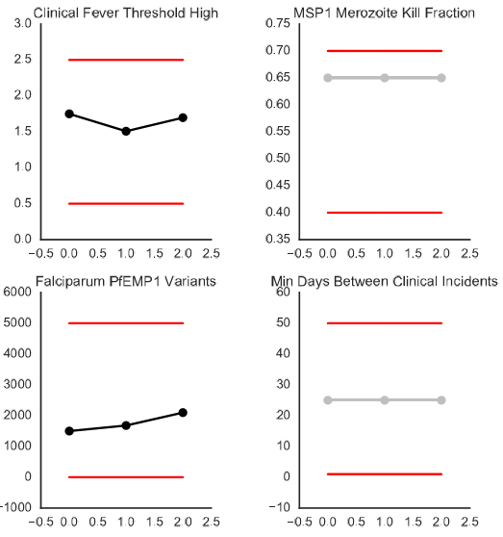
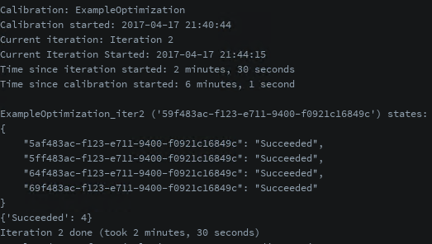
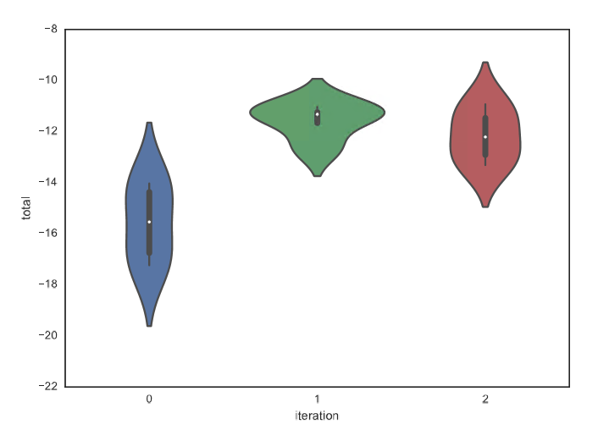
Run the calibration
calibtool run calib.py

Slide 31
Model Input files
Ensemble of utilities for:
Retrieval of weather and demographics files from the COMPS platform
Creation of DTK weather files from a user supplied CSV
Creating migrations
Decoding/editing of Model formatted input files
Refer to the examples/climate folder for more information

Slide 32
Example – Create some migrations
demog = DemographicsFile.from_file('inputs/demographics_for_migration.json') base = demog.get_node('base') extra_1 = demog.get_node('extra_1') extra_2 = demog.get_node('extra_2') local_migrations = { base: { extra_1: .01 }, extra_2: { base: .02, extra_1: .03 } } mig = MigrationFile(demog.idref, local_migrations) mig.generate_file(os.path.join(output_path, 'local_migrations.bin'))

Slide 33
Roadmap
New next point algorithms
Allow user to upload their custom executable and input files
Better support for spatial simulations
UI
Simpler, more generic calibration process
Make the tools model/disease agnostics

Slide 34
How to get the tools?
GitHub repository:
https://github.com/InstituteforDiseaseModeling/dtk-tools
Invitation only
Contact us: IDM-SW-Research@intven.com
Available diseases from model download: Malaria and HIV
Works best in conjunction with a COMPS environment

Slide 35
Acknowledgments

