Slide 1
Improving mortality surveillance data in high mortality settings: cHAMPS and COMSA
Kathy Banke, Ph.D.
IDM Symposium
April 15, 2019

Slide 2
CHAMPS & COMSA
CHAMPS
Child Health and Mortality Prevention Surveillance
High-precision cause of death identification
Fine-grained data on causes of death among children under five, supported by analyzing samples collected using the Minimally Invasive Tissue Sampling (MITS) procedure.
COMSA
Countrywide Mortality Surveillance for Action
Representative sample to provide high quality information on births and deaths
A robust sample registration system that captures the data that allows for calculation of mortality rates, birth rates, and cause-specific mortality fractions at the national and sub-national levels.
Precise &
Scalable
Mortality
Surveillance

Slide 3
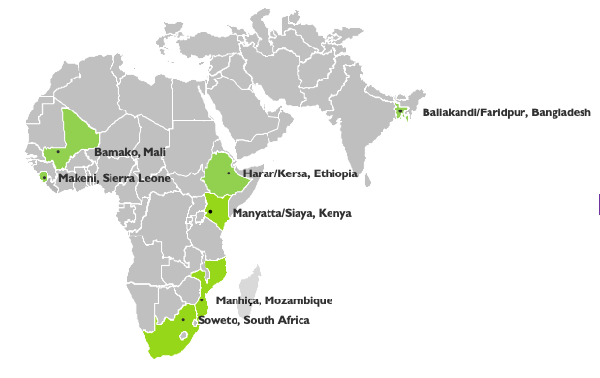
The child health and mortality prevention surveillance (champs) network
Provides accurate, timely and reliable data on the causes of death for children under five
Collects Minimally Invasive Tissue Samples (MITS), verbal autopsies, and medical records within a CHAMPS site
Panel of specialists reviews MITS and all available information for each CHAMPS case and determines the most likely cause of death
MITS data provide a more accurate and specific cause of death than would otherwise be available
CHAMPS data are made available rapidly and shared openly with a range of stakeholders
3
Confidential
Notes:
Laser focus on child mortality
Central component: CHAMPS – first of its kind histopathology based determination of child mortality

Slide 4
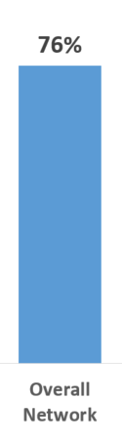

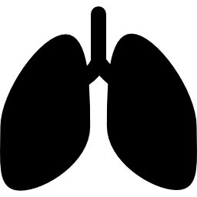




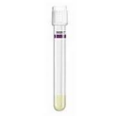
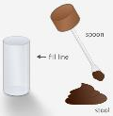
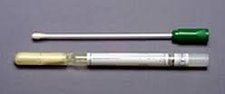
How does Minimally Invasive Tissue Sampling (MITS) work?
Brain
Lung
Heart
Liver
Bone Marrow
Blood
CSF
Stool
NP/OP swab
Abdominal approach - spleen / kidney
Placenta, umbilical cord if stillbirth or death immediately following birth
Skin lesion if present and lymph node if palpable
High MITS consent

Slide 5

CHAMPS DETERMINATION OF CAUSE OF DEATH (DECODE) PANEL
Data from site
Linked maternal data
Demographic and clinical data
Verbal autopsy cause of death and raw data
Microbiology, molecular biology (TAC), HIV, TB, malaria findings
Site histopathology findings
Data packet produced centrally
Central certifier review
Panel Members
Clinician
Pathologist
Microbiologist
Epidemiologist
Panel Causes of Death
Recorded in CHAMPS database, shared with clinicians and family (aggregate results shared with community)
Central Pathology Lab (CPL)
CPL histopathology
Special stains
Immunohistochemistry
PCR findings

Slide 6
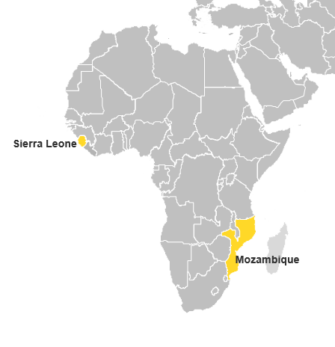
What is COMSA?
Mortality surveillance gaps remain but CHAMPS’ technical and financial investments limit its widespread delivery
To complement CHAMPS, Countrywide Mortality Surveillance for Action (COMSA) was developed
COMSA continuously records data on pregnancy outcomes, deaths, and cause of death from a population in a nationally representative sample of geographic areas
Verbal autopsies conducted on all deaths
MITS is conducted in a subsample of under five deaths to calibrate the cause of death information nationally from verbal autopsies
or why

Slide 7
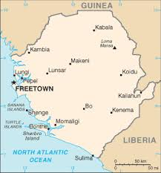
comsa demonstration projects in Mozambique and Sierra leone
Status of Mozambique
Status of Sierra Leone
700 clusters (~300 households each):
Phase I: 5 provinces, 422 clusters
Phase II: remaining 6 provinces, 278 clusters
Pilot in Bo district, May 2019
Expand to all districts by end of 2019
COMSA cluster
Phase I
Phase II
Parks and reserves

Slide 8
COMSA approach
Led by national statistics organizations with close collaboration from ministries of health, national civil registration authorities, national public health institutes
  Four years of BMGF support for external technical assistance
  Low running costs
Select representative enumeration areas across a country
  Cover ~ 3-8% of entire population
  Identify and report pregnancies outcomes and deaths (including stillbirths)
  Conduct verbal autopsy (VA) on all deaths
  Conduct MITS on some U5 deaths from COMSA (outside of CHAMPS site)
Assemble all data across the country and calculate statistics at the national and subnational levels
  National and subnational crude birth and death rates
  Age-group specific mortality rates and cause-specific mortality fractions and rates
  Use MITS-VA pairs from CHAMPS and COMSA to calibrate national VA-based COD
Integrate with existing data systems and share data promptly and continuously with local, national, and international stakeholders

Slide 9
Compared to other sources of cause of death, comsa can provide comprehensive data at low cost
Comprehensiveness of information
 | HDSS Site | Post-DHS or post-MICS VA survey | Post-census VA surveys (like INCAM in Mozambique) | COMSA-Like SRS (using VA for community deaths and integrating facility data) | CRVS
Nationally Representative | N | Y | Y | Y | Y
Adequately Powered | N | Y | Y | Y | Y
Frequent Data Collection | Y | N (every ~5 years) | N (every ~10 years) | Y | Y
Cause of Death Included | Y (but often just mothers and children) | Y (but only when follow-on VA survey done) | Y (but only when follow-on VA survey done) | Y | Y
Country-Run | N | N | N | Y | Y
Cost | $250k annually (population of 60k in rural setting) | ~$2-3M for VA survey, ~$2-4M for original DHS survey | ~$2M for VA survey, $1-8M for original census | ~$1-2M annually | ~$4-7M annually or more
Only SRS and CRVS contain all 5 attributes
5 attributes of mortality surveillance
Traditional DHS, MICS, and censuses only include fact of death, not cause of death. Cause of death must be gathered through an additional survey.

Slide 10
Srs can be implemented while building universal crvs
SRS can help countries build capacity for future surveillance efforts…
…and serve as an important catalyst for a full CRVS system
Establish government buy-in
Help ensure government agencies are willing to invest resources in improving country data
Produce statistics that demonstrate proof-of-concept for nation-wide surveillance
Build capacity
Provide in-country groups with skills and experience for accurate data collection
Build a network of collaboration and data sharing across groups within the country
Sites can serve as lighthouse areas for business process innovation in surveillance
SRS can help build capacity for all components of a CRVS system, but particularly help fill a data gap in the area of community deaths
CRVS System
Facility-based deaths and cause of death recording
Community deaths and cause of death recording
Universal birth registration
Source: Based on interview with Dr. Philip Setel, Vice President and Director of Civil Registration / Vital Statistics Program at Vital Strategies

Slide 11
Comsa Mozambique results (as of March 2019)

Slide 12
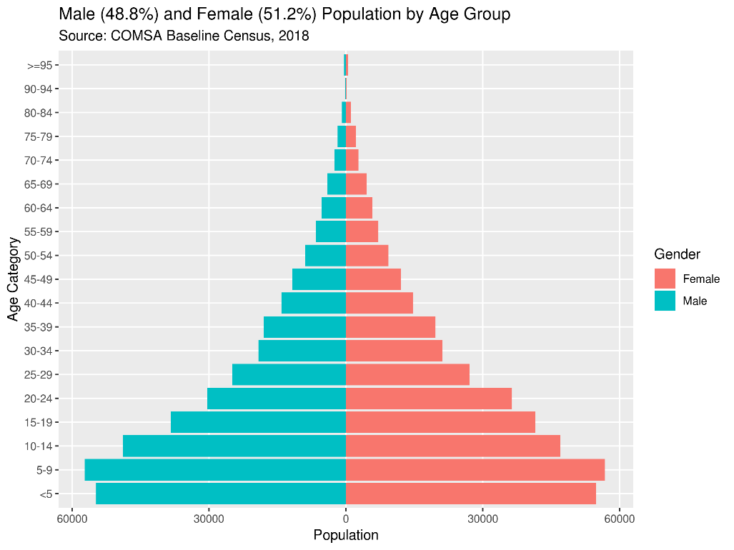
Population by age and sex
Percent Distribution of the COMSA Population by Age and Sex and Sex Ratio
Population pyramid

Slide 13
Current listing* of COMSA Population by province
Total Population: 726,315
Males: 354,358
Females: 371,957
Phase 1 (Since April 2018)
Phase 2 (Since October 2018)
*Listing still underway in some COMSA clusters

Slide 14
Births by Province
Total Births: 6,935
Phase 1 (Since April 2018)
Phase 2 (Since October 2018)

Slide 15
Proportion of Births by Place of Delivery and Province
Phase 1 (Since April 2018)
Phase 2 (Since October 2018)

Slide 16
Number of Deaths by Age and Province
2,910 deaths
1,941 VAs
(67%)
Phase 1 (Since April 2018)
Phase 2 (Since October 2018)
Data through March 29, 2019. Includes stillbirths.

Slide 17
Proportion of Health Facility Deaths by Province
Phase 1 (Since April 2018)
Phase 2 (Since October 2018)

Slide 18
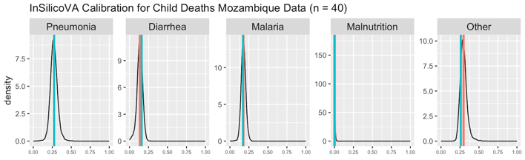
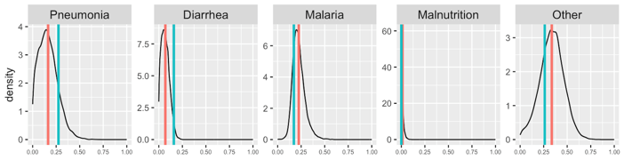

new approach enables USE OF MITs/VA pairs to incrementally adjust VAs and Improve CAUSE OF DEATH DATA
Current State: Verbal Autopsies (VAs) are the standard approach to evaluate cause of death (COD) in 226 child deaths from COMSA Mozambique
The challenge: How many gold standard MITS paired with VAs do we need to start adjusting our understanding of COD from the thousands of current and historical VAs?
Calibrated COMSA VAs based on Bayesian hierarchical approach with MITS-VA error matrix*
VAs calibrated based on 40 child deaths from CHAMPS Mozambique
Density
Impact of MITS: MITS and VA done blindly on the same 167 CHAMPS deaths (1-59-month-olds) confirms and quantifies VA misclassification
Verbal Autopsy
 |  | Pneumonia | Malaria | Diarrhea | Other infections | HIV | Malnutrition | Other | Total
 | Pneumonia | 42% | 8% | 25% | 8% | 0% | 0% | 17% | 24
 | Malaria | 13% | 33% | 13% | 20% | 0% | 0% | 20% | 15
 | Diarrhea | 31% | 0% | 38% | 6% | 19% | 6% | 0% | 16
 | Other infections | 50% | 0% | 5% | 15% | 0% | 0% | 30% | 20
 | HIV | 30% | 4% | 26% | 4% | 22% | 4% | 9% | 23
 | Malnutrition | 15% | 10% | 15% | 5% | 20% | 15% | 20% | 20
 | Other | 29% | 4% | 14% | 12% | 0% | 0% | 41% | 49
 | Total |  |  |  |  |  |  |  | 167
Cause-Specific Mortality Fraction
VAs calibrated based on 167 child deaths from CHAMPS network
Decoded MITS
Density
Cause-Specific Mortality Fraction
*Datta A, Fiksel J, Amouzou A, and Zeger S. Local calibration of verbal autopsy algorithms. Submitted to the Journal of the American Statistical Association (Oct 2018). arXiv:1810.10572 [stat.ME]. Note: The data on this slide are preliminary; please do not share.

Slide 19
Thank you!
Special thanks to:
Mozambique: National Institute of Statistics (INE), National Institute of Health (INS), Ministry of Health (MISAU), Ministry of Justice, CISM (Manhica)
Sierra Leone: Statistics Sierra Leone, Ministry of Health and Sanitation, National Civil Registration Authority, CDC Sierra Leone
Grantees: Institute for International Programs – Johns Hopkins University (COMSA Mozambique), Centre for Global Health Research (COMSA Sierra Leone)

