Slide 1



Utilizing Implementation Science to Address Barriers along the HIV Care Continuum
Ruanne V Barnabas, MBChB, DPhil
Departments of Global Health and Medicine
University of Washington

Slide 2
Outline
Background - HIV care continuum
HIV prevention continuum
Implementation Science - Strategies to address barriers along the care continuum
Health economic modeling
Discussion

Slide 3





Background: HIV care continuum
Link
ART
Eligible
McNairy et al AIDS 2012
High coverage and retention is required at each stage of the HIV care continuum to prevent HIV associated disability, death and incident HIV cases – underpinning the UNAIDS 90-90-90 goals

Slide 4
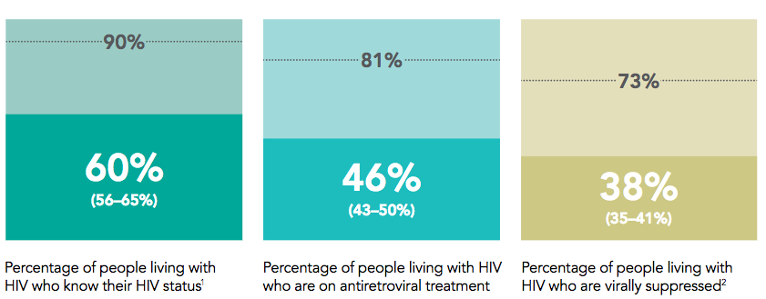
Progress: Reaching 90-90-90 targets
To reach these UNAIDS targets, we need scalable strategies for testing, linkage, ART initiation, and monitoring

Slide 5
Background
Barriers along the HIV care continuum include:
  Testing not reaching HIV+ persons esp. men, young persons, key populations including CSWs, IVDU
  Logistics for linkage to clinic: transportation, wait times, clinic hours
  Limited slots and capacity for ART initiation, monitoring and refills at clinic
  Challenges with retention over time - migration
Implementation Science facilitates innovation and evaluation of strategies to address these barriers

Slide 6
Continuum adapted to individuals
Antigen/PCR testing
Rapid ART initiation - guidelines
Partner testing priority
Acute HIV
Unaware HIV+
ART eligibility
Link to care/ART
Known HIV+ not virally suppressed
ART eligibility
Facilitated linkage (peers/lay counselors)/ART initiation
If on ART - adherence support/viral resistance testing
Adapted from McNairy et. al. AIDS, 2012

Slide 7
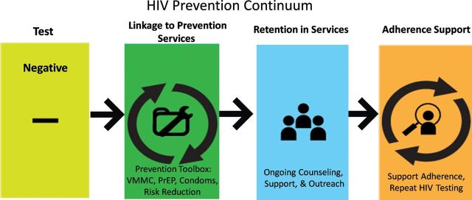
Integrating HIV prevention and care
For HIV+ and HIV- persons, integration of biomedical, behavioral and structural interventions are needed
McNairy et. al. CID 2014

Slide 8
Outline
Background - HIV care continuum
HIV prevention continuum
Implementation Science - Strategies to address barriers and optimize retention along the HIV care continuum
Health economic analyses
Discussion

Slide 9
Strategies to increase coverage and impact
Decentralize testing
  Testing outside the facility achieves higher coverage
  Identifies persons who would not otherwise test
Simplify ART initiation and retention
  Reduce time in pre-ART care
  Rapid ART initiation
  Integrate care for retention
Integrate health economic modeling
  Estimate cost, cost-effectiveness and budget impact

Slide 10
1) Decentralize testing
HIV Testing
Community based HIV testing and counseling achieved higher coverage (>70%) and linkage to care compared to facility based HTC (<20%)
Mobile testing achieved highest coverage among men (50%)
Self-testing reached the highest proportion of young persons (66%)
Few studies evaluated HIV testing for key populations (CSW and MSM), but these interventions yielded high HIV positivity (38%) and the highest proportion of first-time testers (78%)
Sharma et. al. Systematic review and meta-analysis of community and facility-based HIV testing to address linkage to care gaps in sub-Saharan Africa. Nature 528, S77-S85 (03 December 2015)

Slide 11
Community HTC achieves higher testing coverage compared to facility-based testing
Test
At population level, community HTC:
Achieved higher coverage than facility HTC, with home (70%) and campaign (76%) having the highest population coverage compared to 15% and 18%
Sharma et. al. Systematic review and meta-analysis of community and facility-based HIV testing to address linkage to care gaps in sub-Saharan Africa. Nature 528, S77-S85 (03 December 2015)

Slide 12
Community HTC diagnoses HIV+ persons at higher CD4 counts, allowing for earlier linkage to care

Slide 13
2) Simplify ART Initiation
x
Link
ART
Eligible
McNairy et al AIDS 2012
WHO guidelines for ART at all CD4 counts removes need for pre-ART care and allows rapid ART initiation
Rapid ART initiation following testing increases ART uptake by 36% and viral suppression by 25% ¹
Still need pre-ART care for OIs and persons waiting to start
¹Rosen S, Fox M, Rohr J, RapIT Study, PLoS Med, 2016

Slide 14
What’s needed to simplify?
Linkage + ART
Eligibility + Initiation
Adapted from McNairy et al AIDS 2012
Need protocols for rapid/fast-track ART initiation in the clinic and from HIV testing in clinic and community settings
Simplify number of pre-ART visits needed
Provide 3-6 month refills & fewer clinical visits¹
¹Govindasamy D, et. al. Review, JIAS, 2014

Slide 15
Rosen S, PLoS Med, in press, 2016

Slide 16
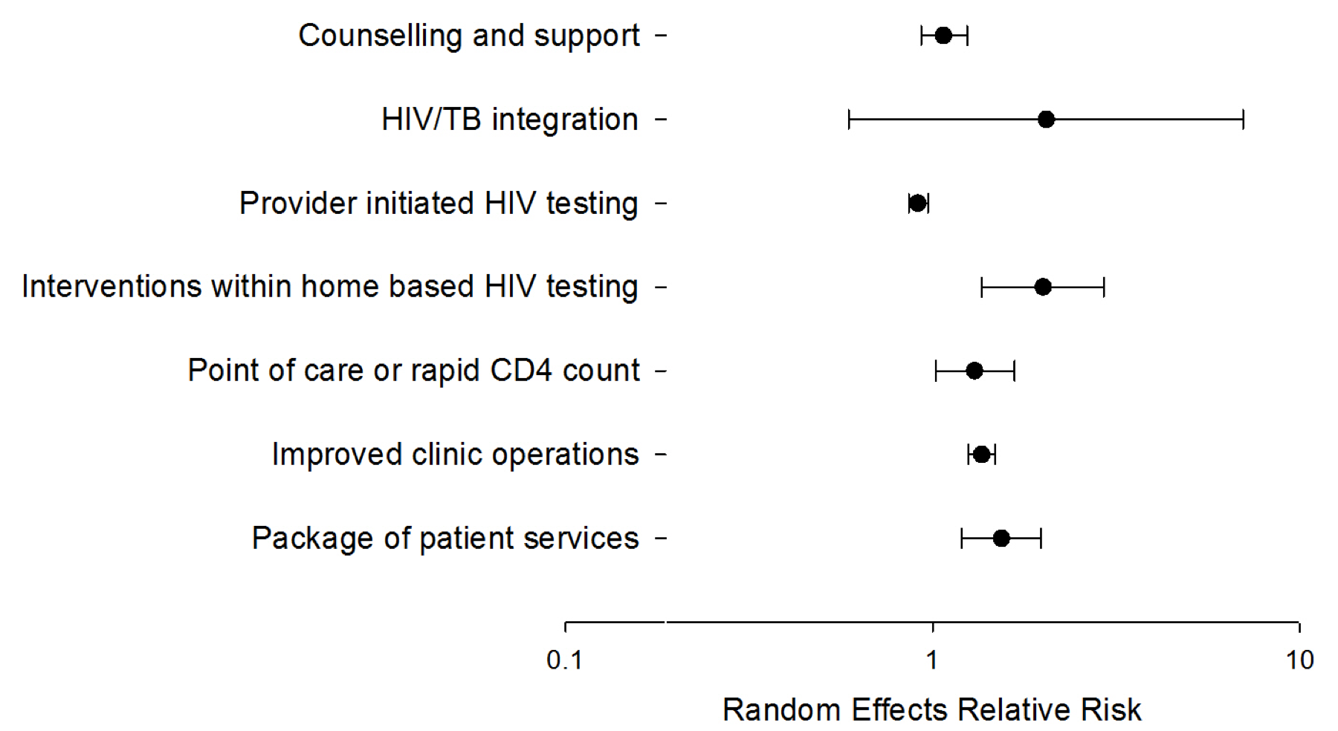
Interventions to improve ART initiation
ART initiation increased with:
Interventions with home HTC (RR=2.00)
POC CD4 (RR=1.3)
Improved clinic operations (RR=1.36)
Package of patient services (1.54)
Fox M, et. al. Interventions to improve rate or timing of ART initiation, Meta-analysis, JIAS

Slide 17
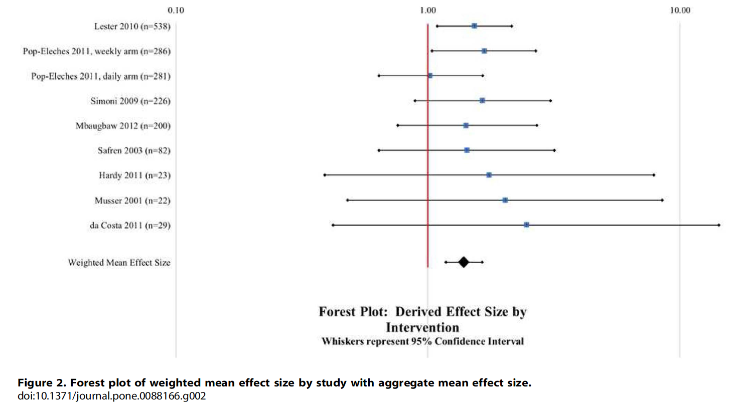
Interventions to improve retention
Community support groups
Uganda & Kenya – home delivery of ART by CHWs or volunteers
Mozambique – self-formed community-based ART groups
South Africa – ART clubs
Text message interventions to promote ART adherence
Increased adherence with SMS (OR=1.39)
Improved with two-way, less frequently than daily, included personalized message content & matched participant ART schedule
Improved VL and/or CD4 outcome (OR=1.56)
OR=1.39
Decroo T, Rasschaert F, Telfer B, et. al. Community ART programs review, Int Health, 2013
Finitsis D, Pellowski J, Johnson B, et. al. SMS interventions meta-analysis, PLoS One, 2014

Slide 18
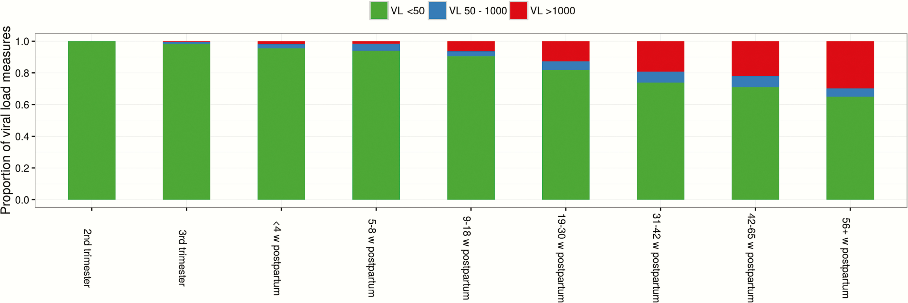
Viremia increases post-partum
Myer et. al. Frequency of Viremic Episodes in HIV-Infected Women Initiating Antiretroviral Therapy During Pregnancy: A Cohort Study
Clin Infect Dis. 2017;64(4):422-427. doi:10.1093/cid/ciw792
Distribution of viral load (VL) test results during select intervals of time during pregnancy and postpartum; each column shows results for all tests conducted in the cohort during that interval.

Slide 19
Integration of HIV and MCH services increases VS
Intervention arm: Integrated MCH and ART until the end of breastfeeding (referred at median 9 months)
SOC: Referred to ART clinic postpartum (median 9 days)
Integration improves VS and retention in care
 | Intervention | Control | Absolute Risk Difference Intervention – Control (95% CI) | p-value
Primary outcome (n=412)
Retained in care AND VL<50 copies/mL at 12m postpartum | 155 (77) | 117 (56) | 21% (12-30%) | <0.001
Myer, et. al. CROI, 2017

Slide 20

Integrated care improves health outcomes
HIV-infection
Tuberculosis
Opioid dependence
ТB
OST
ART
TB
ART/OST/ТB
OST
ART
Partial integration
Specialized services integrate some key services
Full integration & co-location
Patients receive all the required services in one site
Separate
Patients receive services in different facilities
Methadone improved health outcomes including retention in ART
For PWID from
Anna Deryabina, ICAP, Director for Central Asia

Slide 21
Key objectives
Integrated care for PWID
For all patients enrolled in OST:
optimal dosing of methadone
regular HIV testing for patients and their sex partners
routine screening for TB symptoms and further examination
information about HIV and TB prevention
For all PLHIV:
enrollment in care and clinical assessment
timely initiation and monitoring of antiretroviral therapy (ART)
ART adherence support and monitoring
isoniazid preventive therapy (IPT)
cotrimoxazole (CTX) prophylaxis
For all OST patients with TB:
TB treatment (DOTS in continuation phase)
high retention
For PWID from
Anna Deryabina, ICAP, Director for Central Asia

Slide 22
Intermediate results (2)
2) Integrated services increased retention in care
KYRGYZSTAN
% of patients
For PWID; similar data from Kazakhstan and Tajikistan
Anna Deryabina, ICAP, Director for Central Asia

Slide 23
Strategies to strengthen HIV continuum of care
McNairy et al AIDS 2012
Linkage + ART
Eligibility + Initiation
Test
Link
Link & Retain
Retain
1)Decentralize testing
2) Simplify/rapid ART initiation/integrate
-Initiation algorithm
-Home HTC
-Package services
-Improved clinic operations
-Peer support groups
-Two way SMS
-Outreach
-Integrated services

Slide 24
Outline
Background
HIV care continuum
HIV prevention continuum
Implementation Science - Strategies to optimize retention in the care continuum
Integrate health economic modeling
Discussion

Slide 25
Model: community structure & partnerships
Outside community – no intervention
Community – receives home HTC
Key
Household
Woman
Man
Stable
partnership
Temporary
partnership
Explicitly tracks testing, clinic visits, ART initiation, & suppression
Smith, et. al, Lancet HIV, 2015
Notes:
Preferentially choose short-term partners within community, but may go outside if none available (opposite gender, matched age)

Slide 26
Micro-costing results
 | HIV- | HIV +
 |  | Clinic referral | Counselor meeting patient at clinic | Counselor follow up at 1, 3, & 6 months
Mobile HTC (clinic referral) | 5.45 | 8.28 | 8.43 | 15.22
Mobile HTC (PIMA) | 5.51 | 14.78 | 14.94 | 21.78
Home HTC (Clinic referral) | 8.22 | 12.13 | 12.42 | 21.64
Home HTC (PIMA) | 8.32 | 18.69 | 18.97 | 28.29
Sharma, et. al. R4P, 2014

Slide 27
Incremental cost per DALY averted
All ICERs per DALY averted are <20% of South African GDP per capita (2012), and therefore considered very cost-effective
Reducing ART cost to CHAI target reduces ICER per DALY averted by 36-76%
Threshold: South Africa GDP per capita: $7350
All ICERs per DALY averted are <20% of South African GDP per capita (2012), which by WHO standards are very cost-effective
Reducing ART cost to CHAI target reduces ICER per DALY averted by 36-76%
All ICERs per DALY averted are <20% of South African GDP per capita (2012), which by WHO standards are very cost-effective
Reducing ART cost to CHAI target reduces ICER per DALY averted by 36-76%

Slide 28
HTC total program costs over 10 years
ART costs far outweigh all other costs
J. Smith, Lancet HIV, 2015

Slide 29
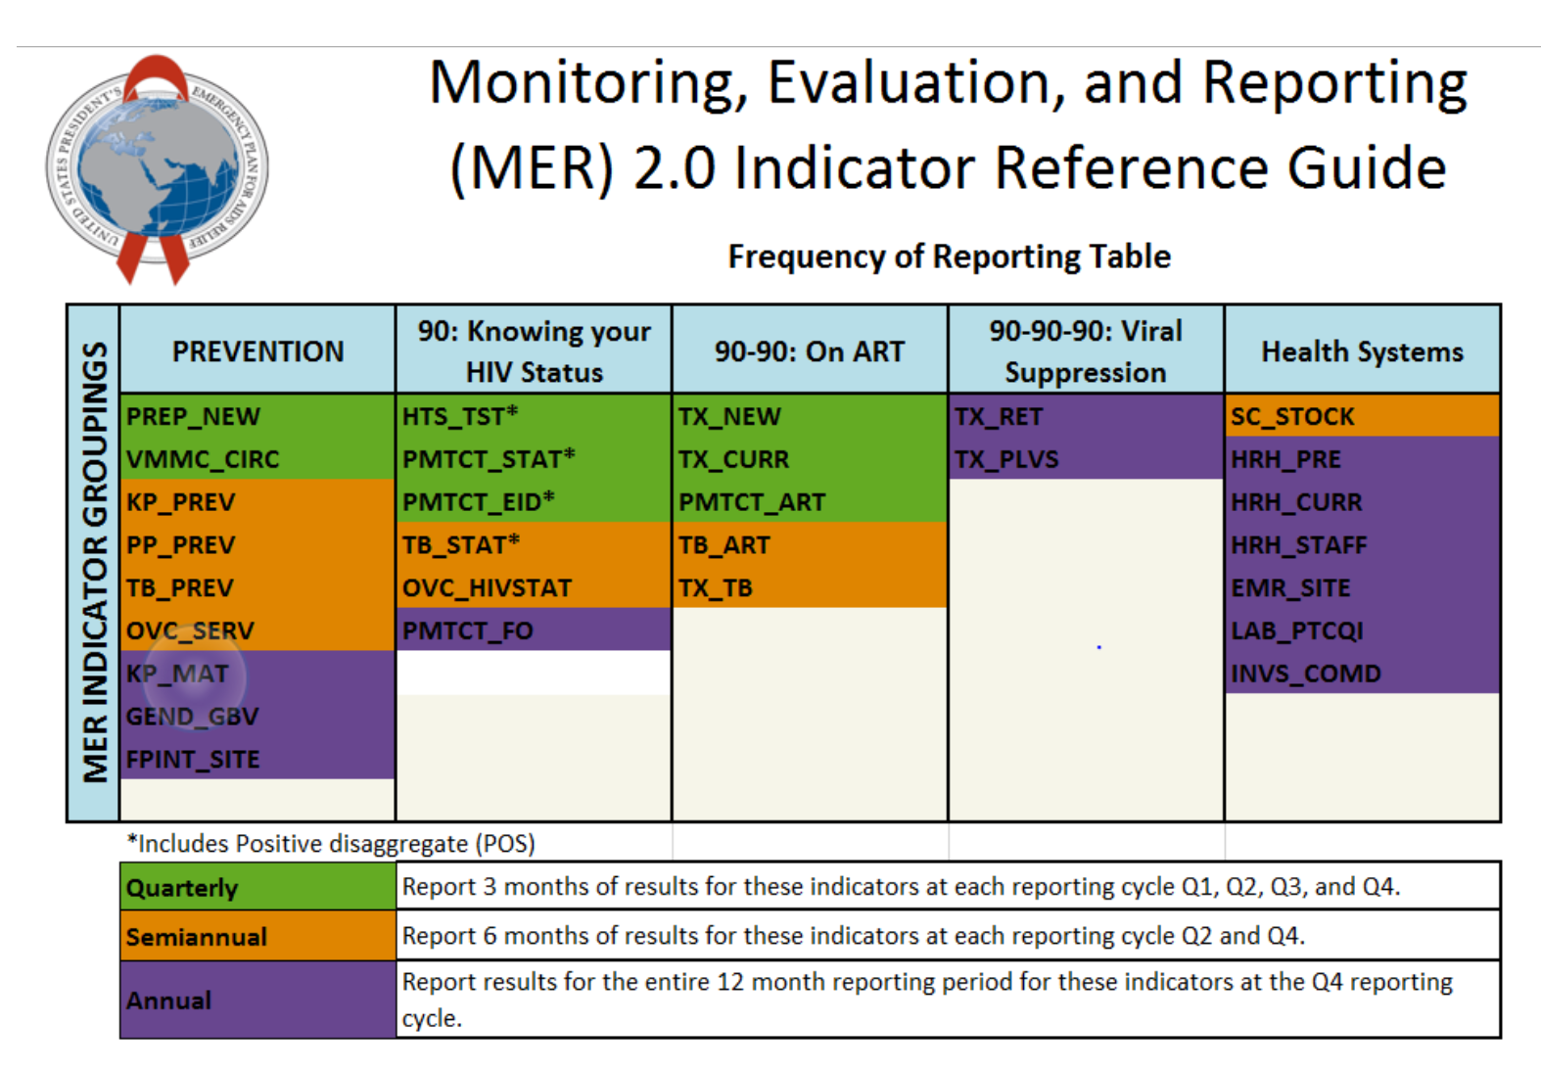

Evaluate and report
Routine collection and reporting of outcomes data to support uptake of best practices
  Report proportion virally suppressed and cost
  At facility level, in real time
Support innovation

Slide 30
Discussion
Review of implementation science evidence for HIV care continuum:
  Decentralize: Community-based HTC increases coverage, linkage, and ART initiation
  Simplify: Rapid ART eligibility assessment and ART initiation reduces the loss between HIV testing and treatment, Integrate care
  Integrate health economic analyses: Estimate cost, cost-effectiveness and budget impact
Our findings from rural South Africa - Community-based home HTC, POC CD4 testing, referral to care, and follow-up visits :
  Following WHO guidelines, this approach has the potential to cost-effectively avert ~50% of incident infection
  The cost of ART is the largest proportion of program costs over ten years – a variable cost

Slide 31
Key questions
How to measure and report outcomes:
  For HIV+: proportion suppressed over time
  For HIV-: proportion linked to MC, PrEP
What innovations are needed?
What impact will decentralized testing and simplified strategies for ART initiation, monitoring and resupply have on HIV-associated disease?
What is the cost and cost-effectiveness of decentralized testing, linkage, simplified ART initiation & retention strategies?

Slide 32
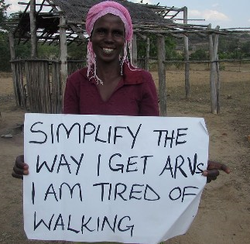
Community-based HIV services increase access
MSF Client

Slide 33

Thank you
Wafaa El-Sadr, Margaret McNairy, Matthew Fox, Sydney Rosen, Anna Deryabina, Landon Myer
HSRC, ICOBI, Harvard, and UW Partners
Heidi van Rooyen, Stephen Asiimwe, Jared Baeten, Jennifer Smith, Adam Szpiro, Norma Ware, Meighan Krows, Torin Schaafsma, Paul Drain, Alastair van Heerden, Monique Wyatt, Bosco Turyamureeba, Elioda Tumwesigye, Monisha Sharma, Allen Roberts, Anna Bershteyn, and Connie Celum
Funding: NIH Directors Award RC4 AI092552, BMGF #OPP1134599

