Slide 1
April 20, 2016
Caitlin Bever

Slide 2
Goal:
Provide operational recommendations for region-specific elimination by modeling intervention scenarios.

Slide 3
Goal:
Provide operational recommendations for region-specific elimination by modeling intervention scenarios.
Plan:
Run model. Assess impact. Select best scenarios.

Slide 4
Goal:
Provide operational recommendations for region-specific elimination by modeling intervention scenarios.
Plan:
Run model. Assess impact. Select best scenarios.
Heterogeneity
Complexity
Lack of historical knowledge of the system
Lack of current knowledge of the system

Slide 5
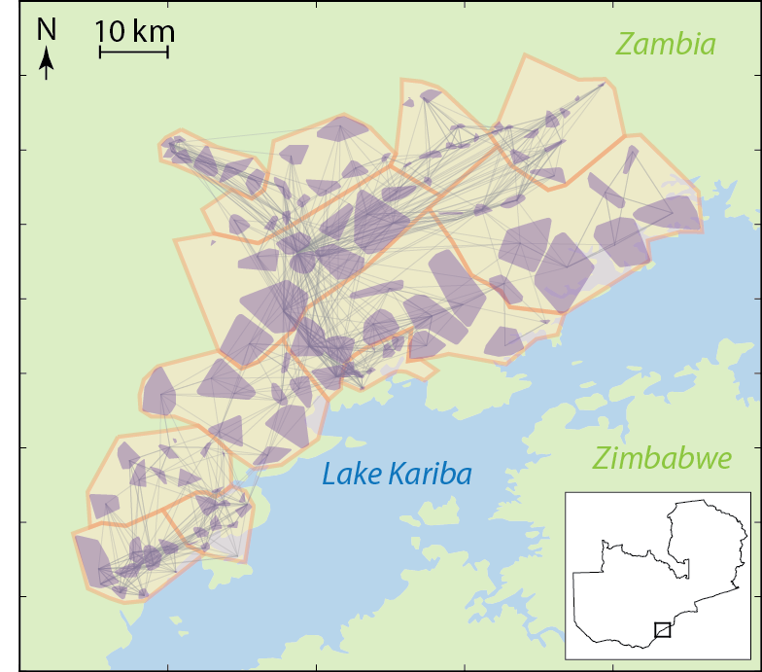
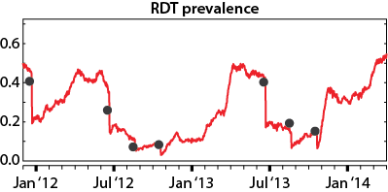
Simulation of the MACEPA/Zambia NMCC elimination campaign in Lake Kariba region
MTAT
M Nikolov, J Gerardin

Slide 6
Simulation of the MACEPA/Zambia NMCC elimination campaign in Lake Kariba region
Demographics
ITN coverage
IRS coverage
MTAT coverage
Migration
Case management
MTAT
M Nikolov, J Gerardin

Slide 7
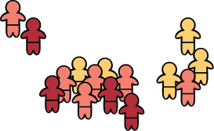
Simulation of the MACEPA/Zambia NMCC elimination campaign in Lake Kariba region
Demographics
ITN coverage
IRS coverage
MTAT coverage
Migration
Case management
MTAT
M Nikolov, J Gerardin

Slide 8
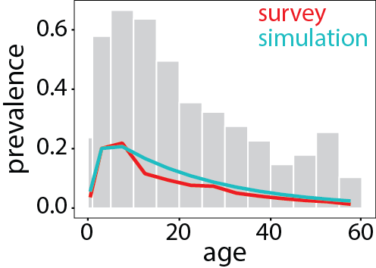
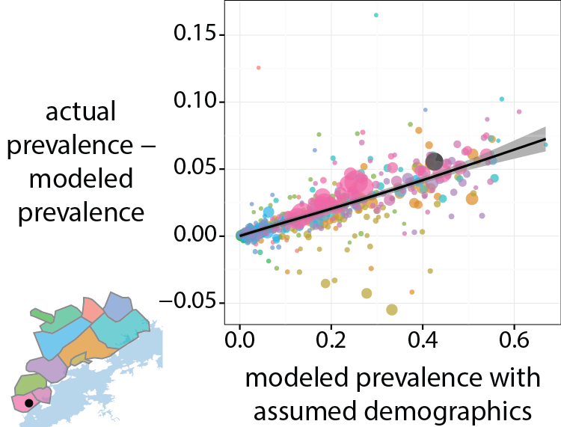
Specific regional demographics influence prevalence

Slide 9
Demographics also show an overall gender bias

Slide 10
Particular clusters show (unexpected) seasonal demographic changes

Slide 12
Constructing a longitudinal dataset from a cross-sectional one
Cross-sectional data analysis relies on external estimates of population
Cross-sectional data make it more difficult to evaluate long-term impact of interventions
Cross-sectional data don’t indicate how individuals move within the region of interest
…Longitudinal data would be nice…

Slide 13
Identifying unique individuals
PersonID | Round | (Lat, Lon) | Name | Age | Gender
73FF8BCC-1136-489B-976F-902E203D58F4 | 1 | -16.93, 27.59 | Owen Mweene | 2 | 1
FC16DEAB-62F4-47B2-BCE5-ED8FA5286CE8 | 1 | -16.92, 27.58 | Abraham Mutinda | 14 | 1
B4148EE4-508A-49F8-82F4-C1F658D1D8F5 | 1 | -16.94, 27.60 | Grace Siambata | 9 | 2
✰ | ✰ | ✰ | ✰ | ✰ | ✰
86F2F810-70A0-4197-B42D-F61C8E9FA635 | 2 | -16.93, 27.58 | Syambwata Grace | 9 | 2
D9B40515-41A7-492A-A447-439D05F1CD32 | 2 | -16.94, 27.60 | Elenora M Dobola | 3 | 2
55CC5FFA-1A71-4C93-8AEA-BB263A91BDCF | 2 | -16.93, 27.59 | Tommy Moonga | 35 | 1
✰ | ✰ | ✰ | ✰ | ✰ | ✰
AFA77A28-D30D-42D0-B653-F92A11431E7B | 3 | -16.94, 27.60 | Elin Dobola | 5 | 2

Slide 14
Identifying unique individuals
PersonID | Round | (Lat, Lon) | Name | Age | Gender
73FF8BCC-1136-489B-976F-902E203D58F4 | 1 | -16.93, 27.59 | Owen Mweene | 2 | 1
FC16DEAB-62F4-47B2-BCE5-ED8FA5286CE8 | 1 | -16.92, 27.58 | Abraham Mutinda | 14 | 1
B4148EE4-508A-49F8-82F4-C1F658D1D8F5 | 1 | -16.94, 27.60 | Grace Siambata | 9 | 2
✰ | ✰ | ✰ | ✰ | ✰ | ✰
86F2F810-70A0-4197-B42D-F61C8E9FA635 | 2 | -16.93, 27.58 | Syambwata Grace | 9 | 2
D9B40515-41A7-492A-A447-439D05F1CD32 | 2 | -16.94, 27.60 | Elenora M Dobola | 3 | 2
55CC5FFA-1A71-4C93-8AEA-BB263A91BDCF | 2 | -16.93, 27.59 | Tommy Moonga | 35 | 1
✰ | ✰ | ✰ | ✰ | ✰ | ✰
AFA77A28-D30D-42D0-B653-F92A11431E7B | 3 | -16.94, 27.60 | Elin Dobola | 5 | 2

Slide 15
Identifying unique individuals
PersonID | Round | (Lat, Lon) | Name | Age | Gender
73FF8BCC-1136-489B-976F-902E203D58F4 | 1 | -16.93, 27.59 | Owen Mweene | 2 | 1
FC16DEAB-62F4-47B2-BCE5-ED8FA5286CE8 | 1 | -16.92, 27.58 | Abraham Mutinda | 14 | 1
B4148EE4-508A-49F8-82F4-C1F658D1D8F5 | 1 | -16.94, 27.60 | Grace Siambata | 9 | 2
✰ | ✰ | ✰ | ✰ | ✰ | ✰
86F2F810-70A0-4197-B42D-F61C8E9FA635 | 2 | -16.93, 27.58 | Syambwata Grace | 9 | 2
D9B40515-41A7-492A-A447-439D05F1CD32 | 2 | -16.94, 27.60 | Elenora M Dobola | 3 | 2
55CC5FFA-1A71-4C93-8AEA-BB263A91BDCF | 2 | -16.93, 27.59 | Tommy Moonga | 35 | 1
✰ | ✰ | ✰ | ✰ | ✰ | ✰
AFA77A28-D30D-42D0-B653-F92A11431E7B | 3 | -16.94, 27.60 | Elin Dobola | 5 | 2

Slide 16
Find linkages based on
Levenshtein distance between first & last names
Perfect gender match
Age difference
PersonID | Round | (Lat, Lon) | Name | Age | Gender
73FF8BCC-1136-489B-976F-902E203D58F4 | 1 | -16.93, 27.59 | Owen Mweene | 2 | 1
FC16DEAB-62F4-47B2-BCE5-ED8FA5286CE8 | 1 | -16.92, 27.58 | Abraham Mutinda | 14 | 1
B4148EE4-508A-49F8-82F4-C1F658D1D8F5 | 1 | -16.94, 27.60 | Grace Siambata | 9 | 2
✰ | ✰ | ✰ | ✰ | ✰ | ✰
86F2F810-70A0-4197-B42D-F61C8E9FA635 | 2 | -16.93, 27.58 | Syambwata Grace | 9 | 2
D9B40515-41A7-492A-A447-439D05F1CD32 | 2 | -16.94, 27.60 | Elenora M Dobola | 3 | 2
55CC5FFA-1A71-4C93-8AEA-BB263A91BDCF | 2 | -16.93, 27.59 | Tommy Moonga | 35 | 1
✰ | ✰ | ✰ | ✰ | ✰ | ✰
AFA77A28-D30D-42D0-B653-F92A11431E7B | 3 | -16.94, 27.60 | Elin Dobola | 5 | 2

Slide 17
Linkage generates a master list of unique individuals
UniqueID | Round 1 | Round 2 | Round 3 | ✪ | Round 6
B4148EE4-508A-49F8-82F4-C1F658D1D8F5 | Grace Siambata, 2 | Syambwata Grace, 2 | N/A | ✪ | N/A
D9B40515-41A7-492A-A447-439D05F1CD32 | N/A | Elenora M Dobola, 5 | Elin Dobola, 3 | ✪ | N/A
55CC5FFA-1A71-4C93-8AEA-BB263A91BDCF | N/A | N/A | Tommy Moonga, 35 | ✪ | N/A
73FF8BCC-1136-489B-976F-902E203D58F4 | Owen Mweene, 1 | N/A | N/A | ✪ | Oren Mweene, 2
FC16DEAB-62F4-47B2-BCE5-ED8FA5286CE8 | Abraham Mutinda, 14 | N/A | N/A | ✪ | N/A
4EAC21FC-E181-40D7-BD91-51DF55B11A24 | N/A | N/A | N/A | ✪ | Felix Chembo, 44
264F9889-D463-43BF-A446-A0D2D7B31E18 | N/A | N/A | N/A | ✪ | Janet Nyambe, 2

Slide 18
Linkage generates a master list of unique individuals
UniqueID | Round 1 | Round 2 | Round 3 | ✪ | Round 6
B4148EE4-508A-49F8-82F4-C1F658D1D8F5 | 1 | 1 | 0 | ✪ | 0
D9B40515-41A7-492A-A447-439D05F1CD32 | 0 | 1 | 1 | ✪ | 0
55CC5FFA-1A71-4C93-8AEA-BB263A91BDCF | 0 | 0 | 1 | ✪ | 0
73FF8BCC-1136-489B-976F-902E203D58F4 | 1 | 0 | 0 | ✪ | 1
FC16DEAB-62F4-47B2-BCE5-ED8FA5286CE8 | 1 | 0 | 0 | ✪ | 0
4EAC21FC-E181-40D7-BD91-51DF55B11A24 | 0 | 0 | 0 | ✪ | 1
264F9889-D463-43BF-A446-A0D2D7B31E18 | 0 | 0 | 0 | ✪ | 1

Slide 19
Patterns of recurrence are informative of total population
Round 1
Round 2
Round 3
…

Slide 20
Infer coverage using binomial model for repeat observation of individuals
Round 1 | Round 2 | Round 3 | ✪ | Round 6 | # individuals observed
1 | 1 | 1 | ✪ | 1 | 1204
0 | 1 | 1 | ✪ | 1 | 1006
1 | 0 | 1 | ✪ | 1 | 728
1 | 0 | 0 | ✪ | 1 | 1320
1 | 0 | 0 | ✪ | 0 | 11,325
0 | 1 | 0 | ✪ | 0 | 11,881
0 | 0 | 0 | ✪ | 1 | 15,053
Fit each to
$$N_{tot}\prod_{i=1}^{6}{\left(x_{i}p_{i}+{(1−x}_{i})(1−p_{i})\right)}$$
where
$$N_{tot}≈\frac{\sum{\text{\#} \text{indiv}\text{. }\text{obs}.}}{1−\left(1−p_{1}\right)\left(1−p_{2}\right)\left(1−p_{3}\right)\left(1−p_{4}\right)\left(1−p_{5}\right)\left(1−p_{6}\right)}$$
$$p_{1}$$ | $$p_{2}$$ | $$p_{3}$$ | ✪ | $$p_{6}$$

Slide 21
Infer coverage using binomial model for repeat observation of individuals
Round 1 | Round 2 | Round 3 | ✪ | Round 6 | # individuals observed
1 | 1 | 1 | ✪ | 1 | 1204
0 | 1 | 1 | ✪ | 1 | 1006
1 | 0 | 1 | ✪ | 1 | 728
1 | 0 | 0 | ✪ | 1 | 1320
1 | 0 | 0 | ✪ | 0 | 11,325
0 | 1 | 0 | ✪ | 0 | 11,881
0 | 0 | 0 | ✪ | 1 | 15,053
$${N_{tot}p_{1}(1−p}_{2}) p_{3}p_{4}p_{5}p_{6}$$
$${N_{tot}{(1−p}_{1})(1−p}_{2})(1−p_{3})(1−p_{4})(1−p_{5})p_{6}$$
$$p_{1}$$ | $$p_{2}$$ | $$p_{3}$$ | ✪ | $$p_{6}$$

Slide 22
Resulting coverage maps demonstrate variability across survey region

Slide 23
Resulting coverage maps demonstrate variability across survey region

Slide 24
Migration mapping also follows from linkage

Slide 25
Migration mapping also follows from linkage

Slide 26
Recall Chipepo Secondary School…

Slide 28
Goal:
Provide operational recommendations for region-specific elimination by modeling intervention scenarios.
Plan:
Extract everything you can from the data. Run model. Assess impact. Select best scenarios.

Slide 29
Goal:
Provide operational recommendations for region-specific elimination by modeling intervention scenarios.
Plan:
Extract everything you can from the data. Run model. Assess impact. Select best scenarios.
Investing in the analysis of your inputs can:
Improve the quality of recommendations from the model.
Highlight survey characteristics to monitor or change.

Slide 30
Thank you to many
Zambia National Malaria Control Centre
Busiku Hamaiza and his team
MACEPA/PATH
John Miller, Ruben Conner, Duncan Earle, Kafula Silumbe
IDM malaria team
Edward Wenger, Jaline Gerardin, Milen Nikolov, André Lin Ouédraogo, Philip Eckhoff
Alex Upfill-Brown

Slide 31
Extra Slides

Slide 33
MACEPA/NMCC Zambia campaign for malaria elimination
2014 2015
2014 2015
Low prevalence
High prevalence
Replotted data from Thom Eisele (Tulane)

