Slide 1
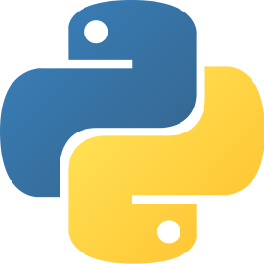
Advanced EMOD
Jonathan H.H. Bloedow, Software Engineer
4/18/2016

Slide 2
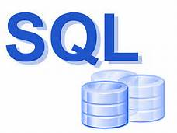



Overview
Enhancing the EMOD software experience with embedded Python
New in v2.5!
  Pre-processing
    Transform input data from user-oriented formats to EMOD format
    Without writing any C++
    Without a compiler, Visual Studio, or build tools
  Post-processing
    Transform output data from EMOD formats to user-oriented formats
    “Built-in” Data Analysis
  New Model Development
    Come to my other presentation (Wednesday afternoon)
Oh, EMOD will be available on Linux (in the cloud) within weeks

Slide 3

Architectural View (now)
XML
X
YAML
EMOD
(v2.5)
X
BIG Defaults. JSON
X
Tiny.
JSON
X
JSON
JSON
X
JSON
JSON
(v1.0)

Slide 4



Architectural View (with Embedded Python)
XML
YAML
EMOD
(v2.5)
BIG Defaults. JSON
Tiny.
JSON
JSON
JSON
JSON
JSON
(v1.0)

Slide 5
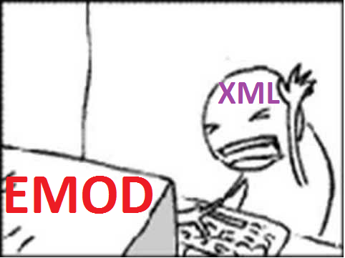
The Problem
EMOD’s native language is: Big JSON Files.
EMOD users don’t always like “Big JSON Files”.
  “I like XML”
  “I like YAML”
  “I like a bunch of files”
  “I like a parameters-of-interest file & defaults”
  “I don’t want my demographics parameters split between config and demographics.”
  “All our input files are incompatible with the latest version.”
  “Our post-processing tools all talk CSV”.
Different EMOD users have different needs: no one-size-fits-all solution.

Slide 6

What is Python?
Very popular
Easy to use
Powerful
Cross-platform
Scripting language (no build step)
Created by Guido van Rossum in 1991
Lets you focus on what you want to do without
worrying about semi-colons and curly-braces
Object-oriented
Extensible

Slide 7
Embedding Python in Pictures
C++
C++
C++
vs
C++
Py
time
C++
Py
Py
C++
Eradication executable over time

Slide 8
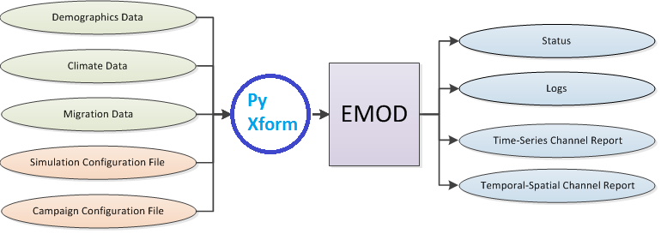
What Does It Mean to “Embed” Python in EMOD?
C/C++ program can call (temporarily) into python code, and then resume C/C++.
Can pass simple variables back
& forth.
  But not sharing memory.
Let’s you do certain things by just
writing Python code. Yay.
Many tutorials exist: e.g., http://realmike.org/blog/wp-content/uploads/2012/07/slides.pdf
Official Documentation: python.org

Slide 9
What Does This Get Me?
More than you might think!
  Input data can be in any format (yaml, xml, csv, xls).
  Input files can be structured to suit your workflow – not the tool’s.
  Familiar tools can become
  UIs (e.g., MS Excel).
  Output data can be produced in your favourite
  format, not just what EMOD natively supports.
  Post-processing of output data can be done as
  “part of” EMOD:
    Reduction (bandwidth)
    Validation
    Analysis
    SQL!

Slide 10
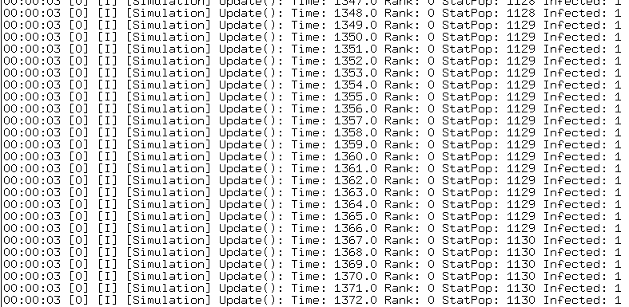
But First… (EMOD on Linux)
Linux… (in the cloud)
CentOS (7.1)
2.5.1 (Coming VERY Soon)
Near feature-parity with Windows
Build with SCons
GUI-less
  Executable is called Eradication
  -C config.json -I <input path> -O <output directory>
  Expected output (stdout)
Python tools
Come to Christopher Lorton’s talk Tuesday

Slide 11
Example #1: YAML
YAML
config.yaml instead of config.json
parameters:
    Acquisition_Blocking_Immunity_Decay_Rate: 0.1
    Acquisition_Blocking_Immunity_Duration_Before_Decay: 60
    Age_Initialization_Distribution_Type: "DISTRIBUTION_SIMPLE"
    Animal_Reservoir_Type: "NO_ZOONOSIS“
    …
vs.
  {
  "parameters": {
  "Acquisition_Blocking_Immunity_Decay_Rate": 0.1,
  "Acquisition_Blocking_Immunity_Duration_Before_Decay": 60,
  "Age_Initialization_Distribution_Type": "DISTRIBUTION_SIMPLE",
  "Animal_Reservoir_Type": "NO_ZOONOSIS",
  …
EMOD doesn’t need to natively support multiple formats, or pick “one ring to rule them all”.
“10 lines of Python”.
DEMO…
  Follow along if you have ssh.

Slide 12
Some Technical Details
#include “Python.h”.
Link to single python library.
API
  PyImport_Import, etc.
Not using:
  Boost Python
    …and won’t.
  Simplified Wrapper and Interface Generator
    …but might.

Slide 13
Embedding Python in EMOD: Key Details
Let’s Step Back
3 Key Constraints:
  --python-script-path
    It’s a switch and a place.
  Filename: “dtk_pre_process.py”
    Function name: application( config_file_path )
  Filename: “dtk_post_process.py”
    Function name: application( output_file_path )

Slide 14
Common Mistakes & Error-Handling
Sorry, there are lots of ways to mess up. ☹
Path
  Where do these Python scripts go?
Filename
  What should they be called?
Permissions
  Do I have read and execute perms on the scripts?
Function name
  What can my function be called?
Bad Python
  What happens if I write bad code?
Param passing
  What if my function signature is wrong?
Debugging?
  Print()
  PDB

Slide 15
Example #2: Multi-File Config (.json)
JSON
JSON
JSON
JSON
Can break input files into multiple files, stitch together in Python just before running.
  {
  "paths":
  [
  "config_commissioning.json",
  "config_demographics.json",
  "config_epi.json",
  "config_migration.json",
  "config_reporting.json",
  "config_main.json",
  "config_sampling.json"
  ]
  }
DEMO…

Slide 16
Example #3: Param’s of Interest/Defaults
BIG Defaults. JSON
Tiny.
JSON
Can break input configuration files into small file with just parameters of interest and place other parameters into a background “default” file.
  {
  "Default_Config_Path": "defaults/vector_calibration_defaults_04152012.json",
  "parameters": {
  "Config_Name": "27_Vector_Sandbox",
  "Run_Number": 35,
  "x_Temporary_Larval_Habitat" : 0.001
  }
  }
DEMO…

Slide 17
Example #4: Input File Version Migration
2->2.5
Py script
Deprecated input files can still be used.
Python scripts can be used (almost invisibly) to auto-migrate files from older versions to the current EMOD version.
DEMO…
V2.0
Config.json file
EMOD V2.5

Slide 18
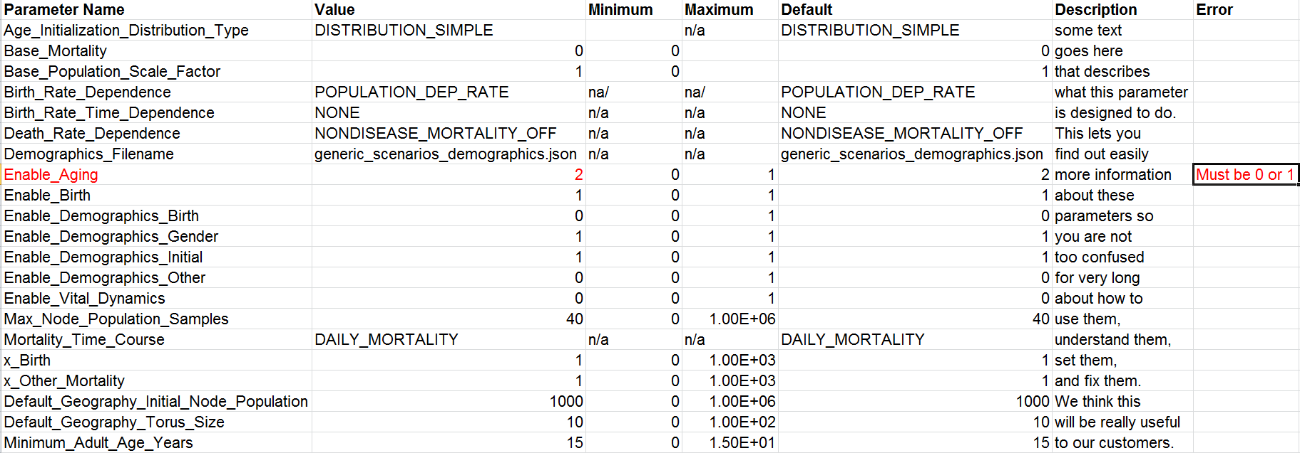
Example #5: Excel
Xlsx, Xlsm –> json
ExcelFE
  Off-the-shelf, math-rich, spreadsheet Graphical User Interface
Oh, json -> CSV (later slide)
Future Potential:
  Parameter descriptions
  Range checking
  Defaults
  Outputs as Inputs

Slide 19
Post-Processing
File Reformatting
  E.g., JSON -> CSV
Data Reduction & Analysis
  EMOD dumps large file with raw data
  Py ingests, populates temp database
  Execute SQL queries to produce final report
  SQLite DEMO…
asdf,asdf,
asdf,asdf
BigReport
(CSV)
EMOD V2.5
Tiny
Report
PySQL

Slide 20
Best Practices
Start small
Test Python code standalone
PDB & Print() are your friends
Still Learning

Slide 21
Way Ahead
Our hope is you will be inspired to develop these or other Python solutions yourselves.
  Excel UI is the only one we’ve taken from concept to product.
Failing that, we can develop them for you.
Second way is SLOWER. ☺
Previously: EMOD users & EMOD C++ developers.
Now: Added EMOD Python developers.

Slide 22
Questions?

Slide 23
Python Fever
Jonathan H.H. Bloedow, Software Engineer
4/18/2016

Slide 24

Python Fever: Sneak Peak

Slide 25
Prototyping New Disease Models Entirely in Python
This presentation builds on “Advanced EMOD”
Embedding Python in C/C++ Applications
Intrahost Only
Undocumented Preview in Regression/149_PyDemo
Will Cover:
  Design
  API
  How-To
  Gotchas
  Example

Slide 26
New Simulation Type
Generic
SEIRS
Airborne
Vector
Environ-mental
STD
Py
{
…
"Simulation_Type": "PY_SIM",
…
}
TB
Dengue
Malaria
Polio
Typhoid
HIV

Slide 27
Architectural View
Simulation
Node n
Node 2
Node 1
Individual n
Individual 2
Individual 1
Infection
Infection
Infection
Susceptibility
Migration

Slide 28



Data Flow View
PythonFever
create
IndividualPy
Node
destroy
Simulation
update
acquire
get infectiousness
expose

Slide 29
EMOD C++/Py Interface
def create( new_id, new_mcw, new_age, new_sex ):
population[new_id] = PythonFeverIndividual( new_id, new_mcw, new_age, new_sex )
def destroy( dead_id ):
del population[ dead_id ]
def update( update_id, dt ):
return population[update_id].Update( dt )
def update_and_return_infectiousness( update_id, route ):
return population[ update_id ].GetInfectiousnessByRoute( route )
def acquire_infection( update_id ):
population[ update_id ].AcquireInfection( )
def expose( update_id, contagion_population, dt, route ):
return population[ update_id ].Expose( contagion_population, dt, route )

Slide 30
Python Fever: API
Help on module dpi:
NAME
dpi
FILE
/home/idmguest/EMOD/src/Regression/149_PyDemo/dpi.py
CLASSES
PyIndividual
PythonFeverIndividual
class PyIndividual
| Methods defined here:
|
| AcquireInfection(self)
| This function is called when the C++ layer has determined that this individual is becoming infected.
| The default Py functionality is to initialize the infectiousness timer (to value of infectious period).
|
| Expose(self, contagion_population, dt, route)
| Expose is called by the C++ layer for each individual for each time step. The function can use
| the input parameters (contgion_population, timestep, and route) to determine if the individual
| becomes infected. The C++ layer isn't suppose to call this function if the individual is already
| infected.
|
| GetInfectiousnessByRoute(self, route)
| The GetInfectiousnessByRoute is called by the C++ layer for each _infected_ individual for each
| timestep and determines how much contagion this individual deposits into the contagion pool.
| This can be constant, or a function of infection timers and mechanistic immunological functionality.
|
| Update(self, dt)
| Update timers, including age. Return state.
| __del__(self)
| The PyIndividual destructor doesn't do anything yet. Add tear-down functionality as needed.
|
| __init__(self, new_id_in, new_mcw_in, new_age_in, new_sex_in)
| The PyIndividual constructor initializes the id, age, sex, and monte carlo weight (how many model
| humans does this instance represent?) It also initializes the infectiousness timer at -1 (not infectious).
|
| ageInYearsAsInt(self)
| Trivial little helper function to convert age from default units (days) to more human-readable
| units (years).
|
| getInfectiousnessByAgeAndSex(self)
| The getInfectiousnessByAgeAndSex is an _internal_ utility function used by the GetInfectiousnessByRoute
| function.
FUNCTIONS
acquire_infection(update_id)
create(new_id, new_mcw, new_age, new_sex)
destroy(dead_id)
expose(update_id, contagion_population, dt, route)
start_timestep()
update(update_id, dt)
update_and_return_infectiousness(update_id, route)

Slide 31
Example: “Pythoid”
Internally we have used this architecture to develop our (unreleased) Typhoid model.
Proven technology
Lessons learned
  Performance
    Can be close to parity with C++
  Ease of use
  Debugging
    A little harder for folks who like fully integrated IDE experience
  Prototype or Long-Term?

Slide 32
Questions?

