Slide 1
Managing antimalarial drug-resistance across high-transmission and low-transmission settings
Maciej F Boni
Center for Infectious Disease Dynamics (CIDD), Dept of Biology, Penn State
Nuffield Dept of Medicine, University of Oxford
IDM Symposium
Apr 15-17 2019

Slide 2
Penn State Malaria Modeling Team
Thanks to Nick White, Jeremy Farrar, Piero Olliaro, Arjen Dondorp, Dang Duy Hoang Giang, Ha Minh Lam, J Kevin Baird, and many others
Tran Dang Nguyen
Postdoc
Thu Tran
PhD student

Slide 3
Many unanswered questions in drug-resistance management
In general, how should anti-malarial drugs be distributed to minimize/delay/prevent future risks of drug resistance?
How should African countries best prepare for the arrival of kelch13 mutants?
Will longer treatment courses (e.g. 5 days ACT) reduce the fitness advantage of kelch13 mutants?
Does mass-drug administration in low-transmission settings risk rapid fixation of drug resistance?

Slide 4
Title here
Key question in drug-resistance management
How can we treat and cure as many people as possible, as effectively as possible, without driving drug resistance too strongly?

Slide 5
Many unanswered questions in drug-resistance management
In general, how should anti-malarial drugs be distributed to minimize/delay/prevent future risks of drug resistance?

Slide 6
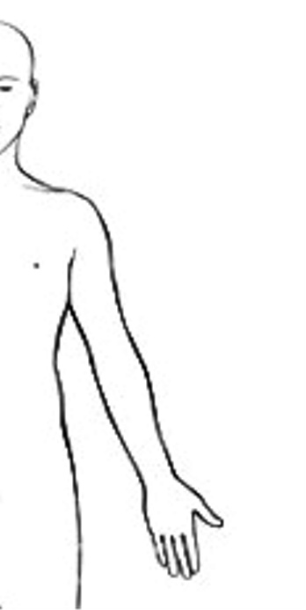
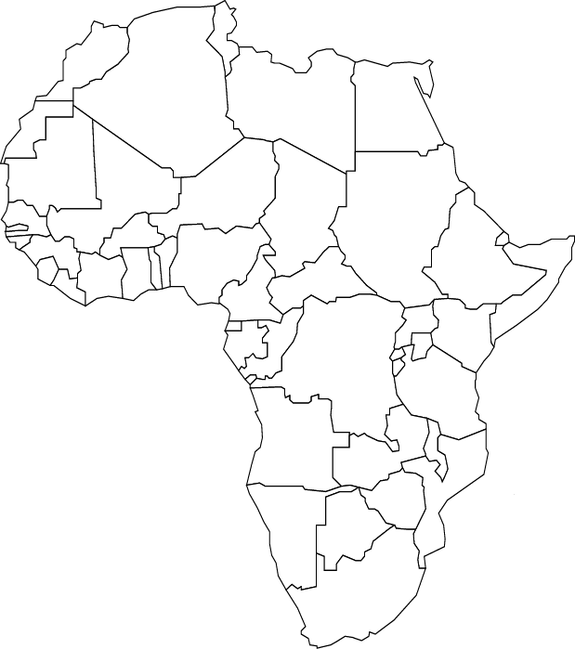
Drug diversity makes it difficult for parasites to evolve
combination
therapy
multiple first-line
therapies (MFT)

Slide 7
Which strategies work best at reducing detrimental effects of drug resistance?
Combination Therapy
Multiple First-Line Therapies
Cycling
… and in models, this ordering of strategies is true in the majority of explored scenarios (>80%).
Key frame to view this in is the time scale at which parasites experience different drugs.
Notes:
Under cycling the parasites will see all three drugs in 15 years.
Under MFT in 15 weeks.
Under Combination Therapy in 15 minutes.
We’ve done the simulation work.

Slide 8
Criteria for evaluating strategies
Number of Treatment Failures over 20 years (NTF)
Arrival time of C580Y mutants (kelch13 gene)
Protection of Artemisinin by Partner Drugs

Slide 9
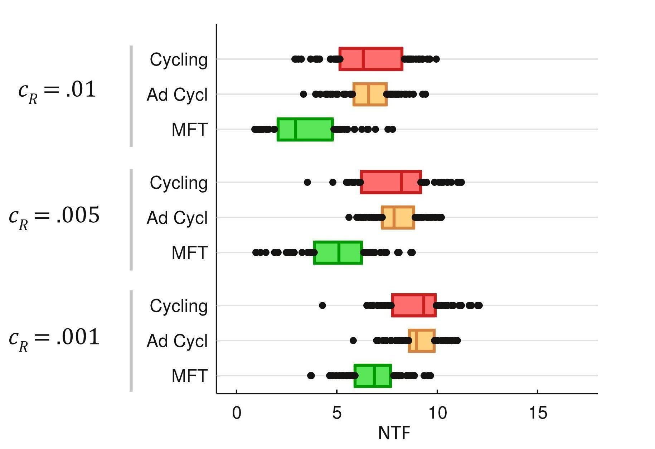
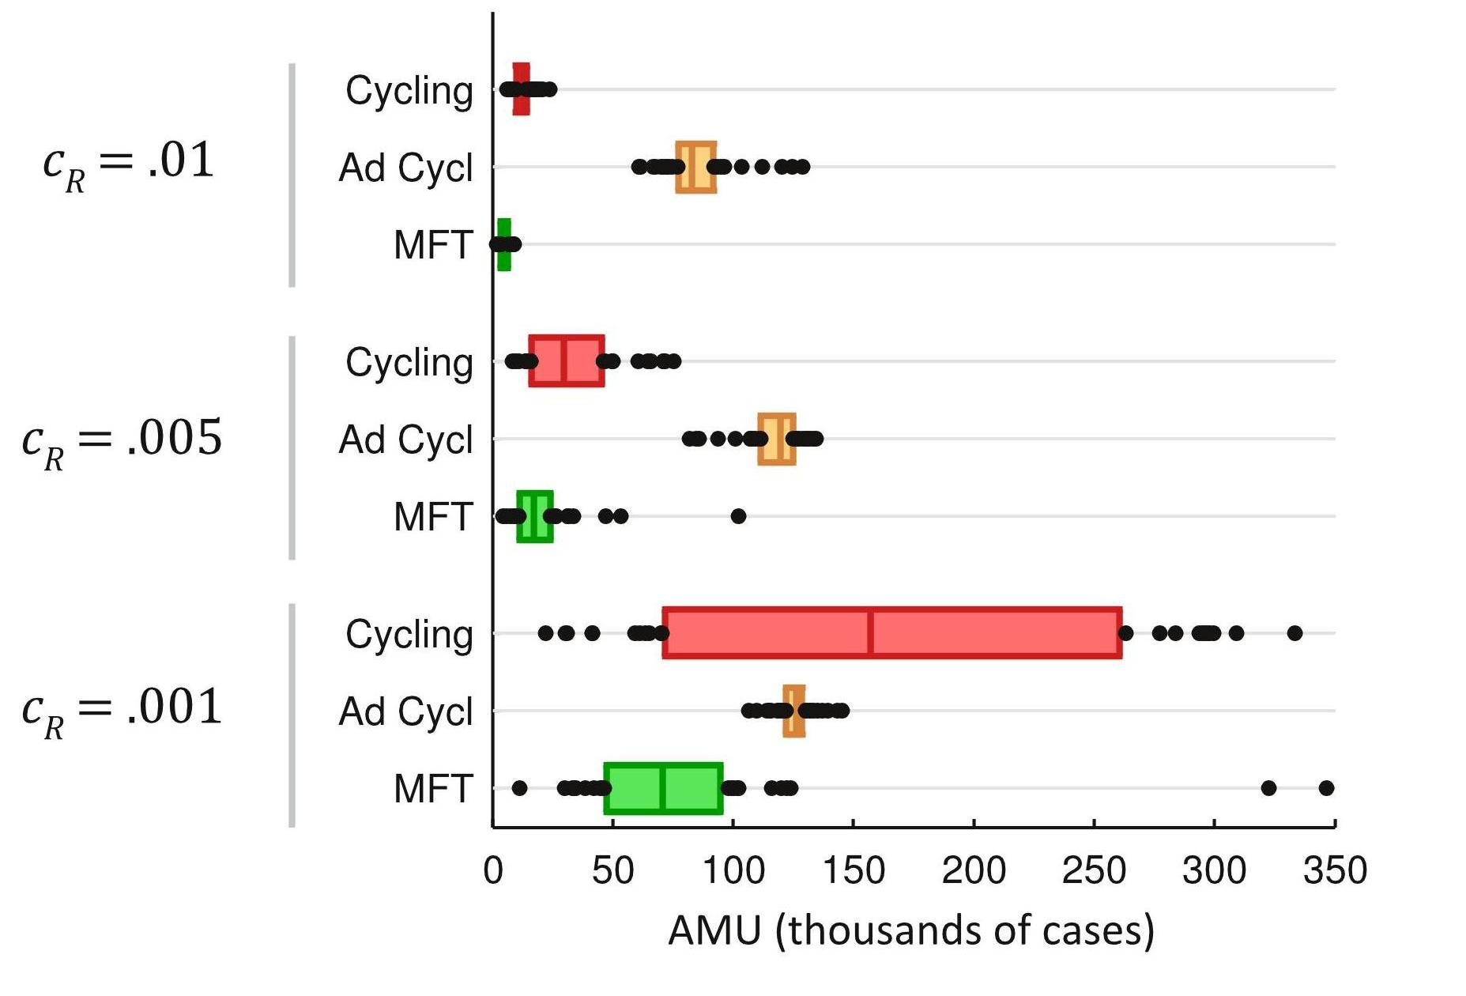
Results with 3 artemisinin-combination therapies (ACTs)
Number of Treatment Failures
( Per 100 Persons, Per Year )
A risk measure of de facto “artemisinin monotherapy use”
Nguyen et al, Lancet Global Health, 2015

Slide 10
Two new directions
High and low transmission scenarios
Realistic treatment patterns (African settings)
Notes:
Our bias has been towards low-trans scenarios bc
I lived in SE Asia,
Drug res seems to evolve in low-trans scenarios.

Slide 11
Treatment in Public Health System
- “Recommended First-line Therapy” (RFT)
Private Market Drug Purchases
- “Off-Policy Purchases” (OPP)

Slide 12
Assumptions about drug usage 2006 - 2040
We assume that AL / ASAQ was not widely used in 2006, and that gradually the usage of AL/ASAQ increased from 2006 to 2020 to 2040
Drug Usage by Year:
 |  | 2006 | 2020 | 2040
Recommended First-line Therapies (RFT) (AL / ASAQ) |  | 2.50% | 17.86% | 40.00%
Off-policy Purchase (OPP) |  | 47.50% | 32.14% | 10.00%
 | AQ | 14.25% | 9.64% | 3.00%
 | CQ | 14.25% | 9.64% | 3.00%
 | SP | 14.25% | 9.64% | 3.00%
 | AL | 4.75% | 3.21% | 1.00%
No Treatment |  | 50.00% | 50.00% | 50.00%

Slide 13
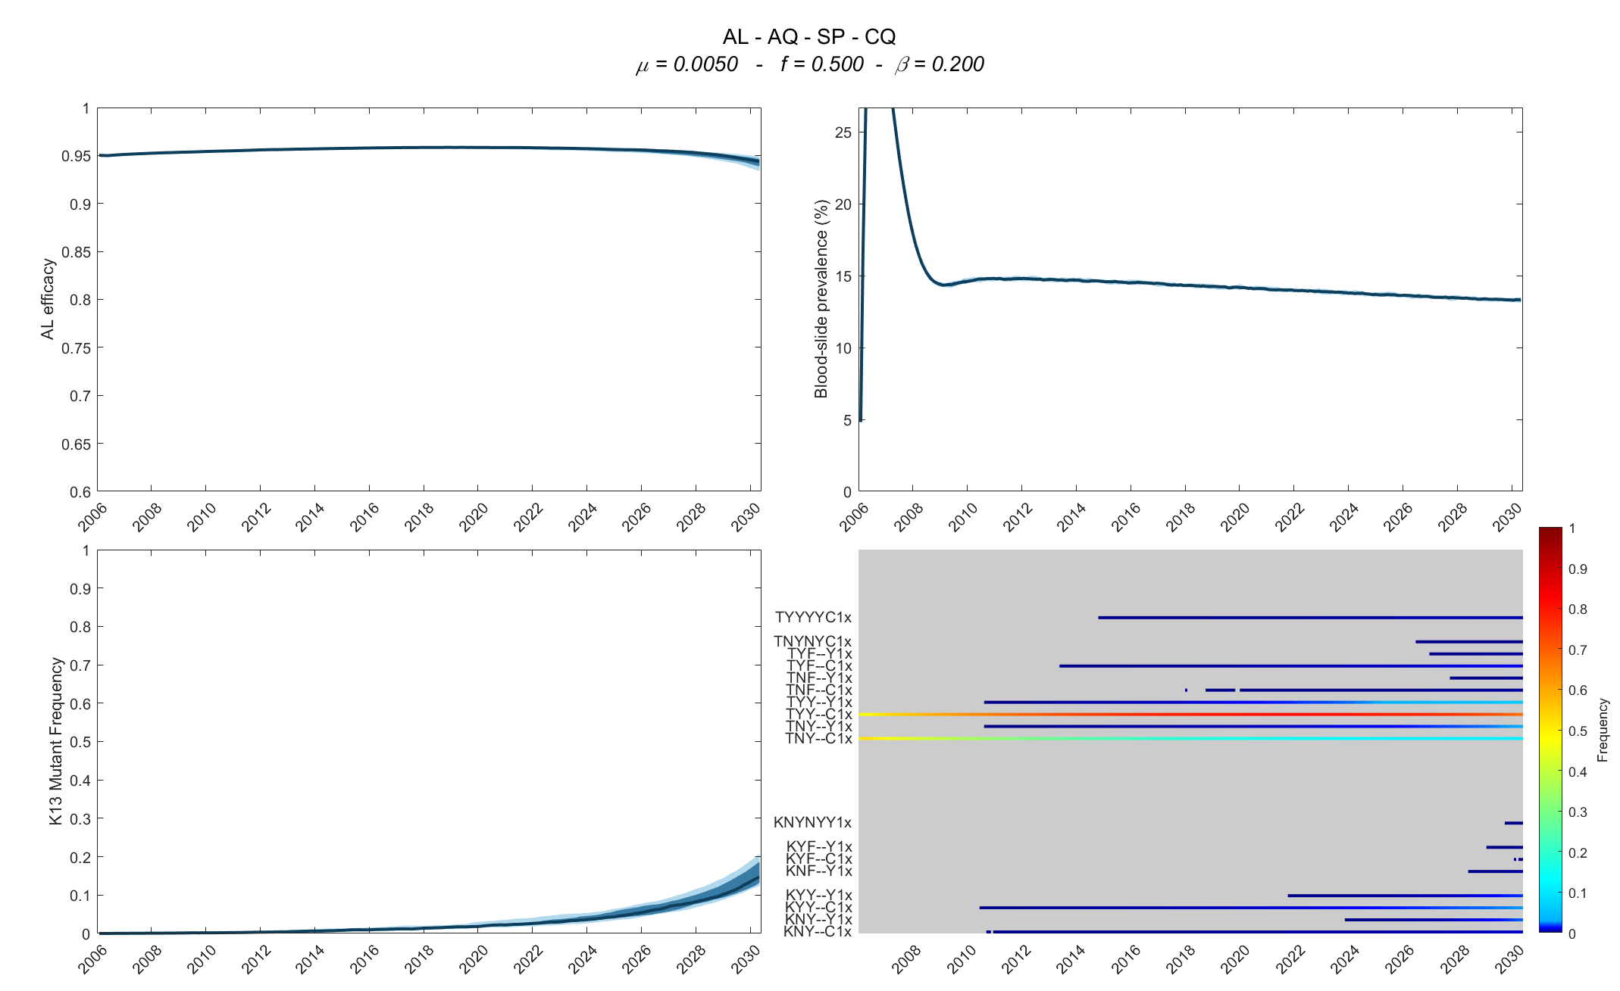
Hypothetical AL Country
AL efficacy
Frequency of 580Y

Slide 14
Hypothetical AL Country
AL efficacy
AL efficacy stays at around 95% for these 24 years
Frequency of 580Y

Slide 15
Hypothetical AL Country
AL efficacy
Prevalence stays between 13% and 15% from 2008 to 2030
Frequency of 580Y

Slide 16
Hypothetical AL Country
AL efficacy
Frequency of 580Y
The frequency of the C580Y mutation rises to about 15% by 2030

Slide 17
Genotype:
TYY--C1x
The positions in order are:
pfcrt 76T
pfmdr1 86Y
pfmdr1 Y184
pfmdr1 (no second copy)
pfmdr1 (no second copy)
kelch13 C580
plasmepsin, 1 copy
no extra mutations

Slide 18
Genotype:
TYY--C1x
This genotype rises from 50% frequency to around 80% frequency because of early (2006-2015) pressure from Amodiaquine in the population.
The positions in order are:
pfcrt 76T
pfmdr1 86Y
pfmdr1 Y184
pfmdr1 (no second copy)
pfmdr1 (no second copy)
kelch13 C580
plasmepsin, 1 copy
no extra mutations

Slide 19
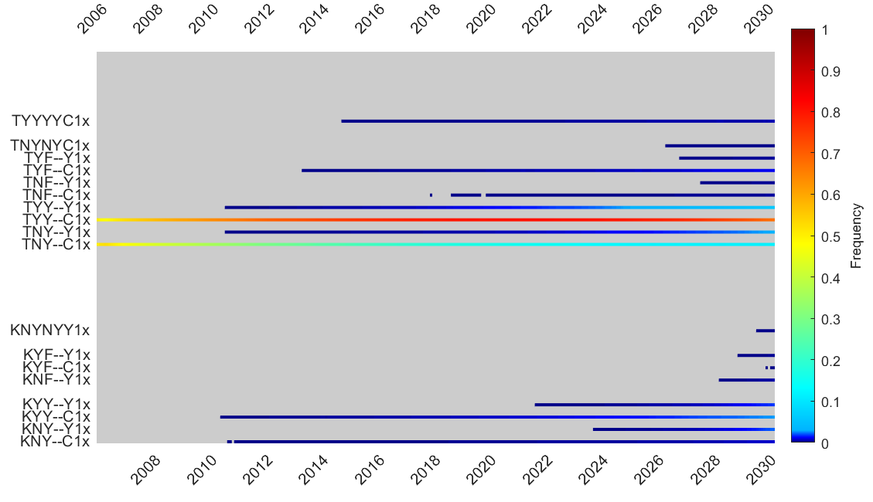
Each of these lines shows you the evolution of a genotype over 24 years. If its frequency is lower than 0.1%, it is not plotted.

Slide 20
Here, you see the first evolution of the of the 580Y allele, which increases from about 1% in 2020 to about 15% frequency in 2030

Slide 21
Hypothetical AL Country with 3% prevalence
( previous scenario was 14% )

Slide 22
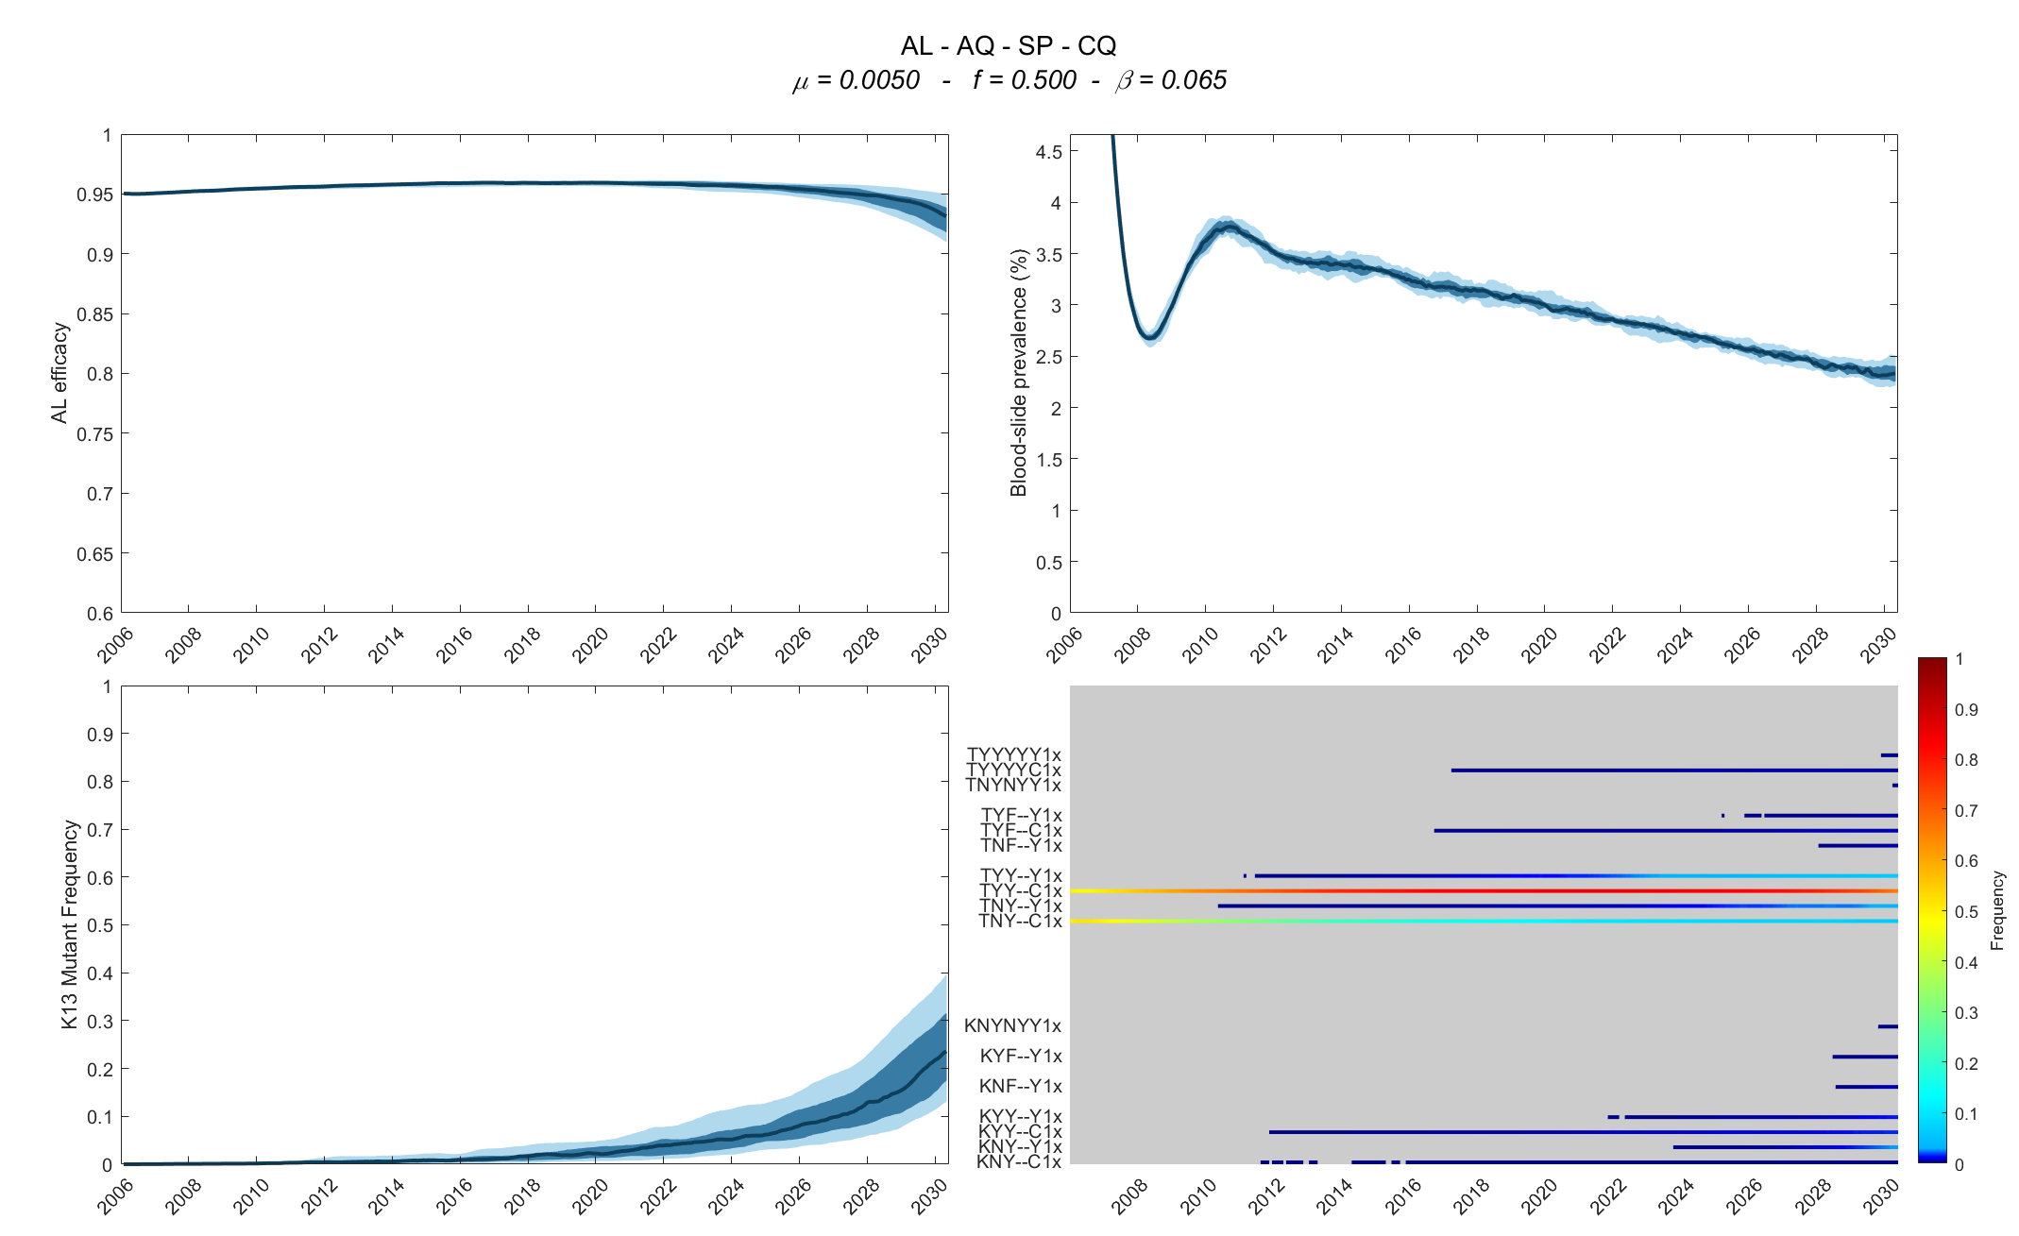
Hypothetical AL Country
AL efficacy
Low transmission, 3% prevalence, so 580Y evolution is faster
Frequency of 580Y

Slide 23
Reminder:
High transmission areas can also have low coverage

Slide 24
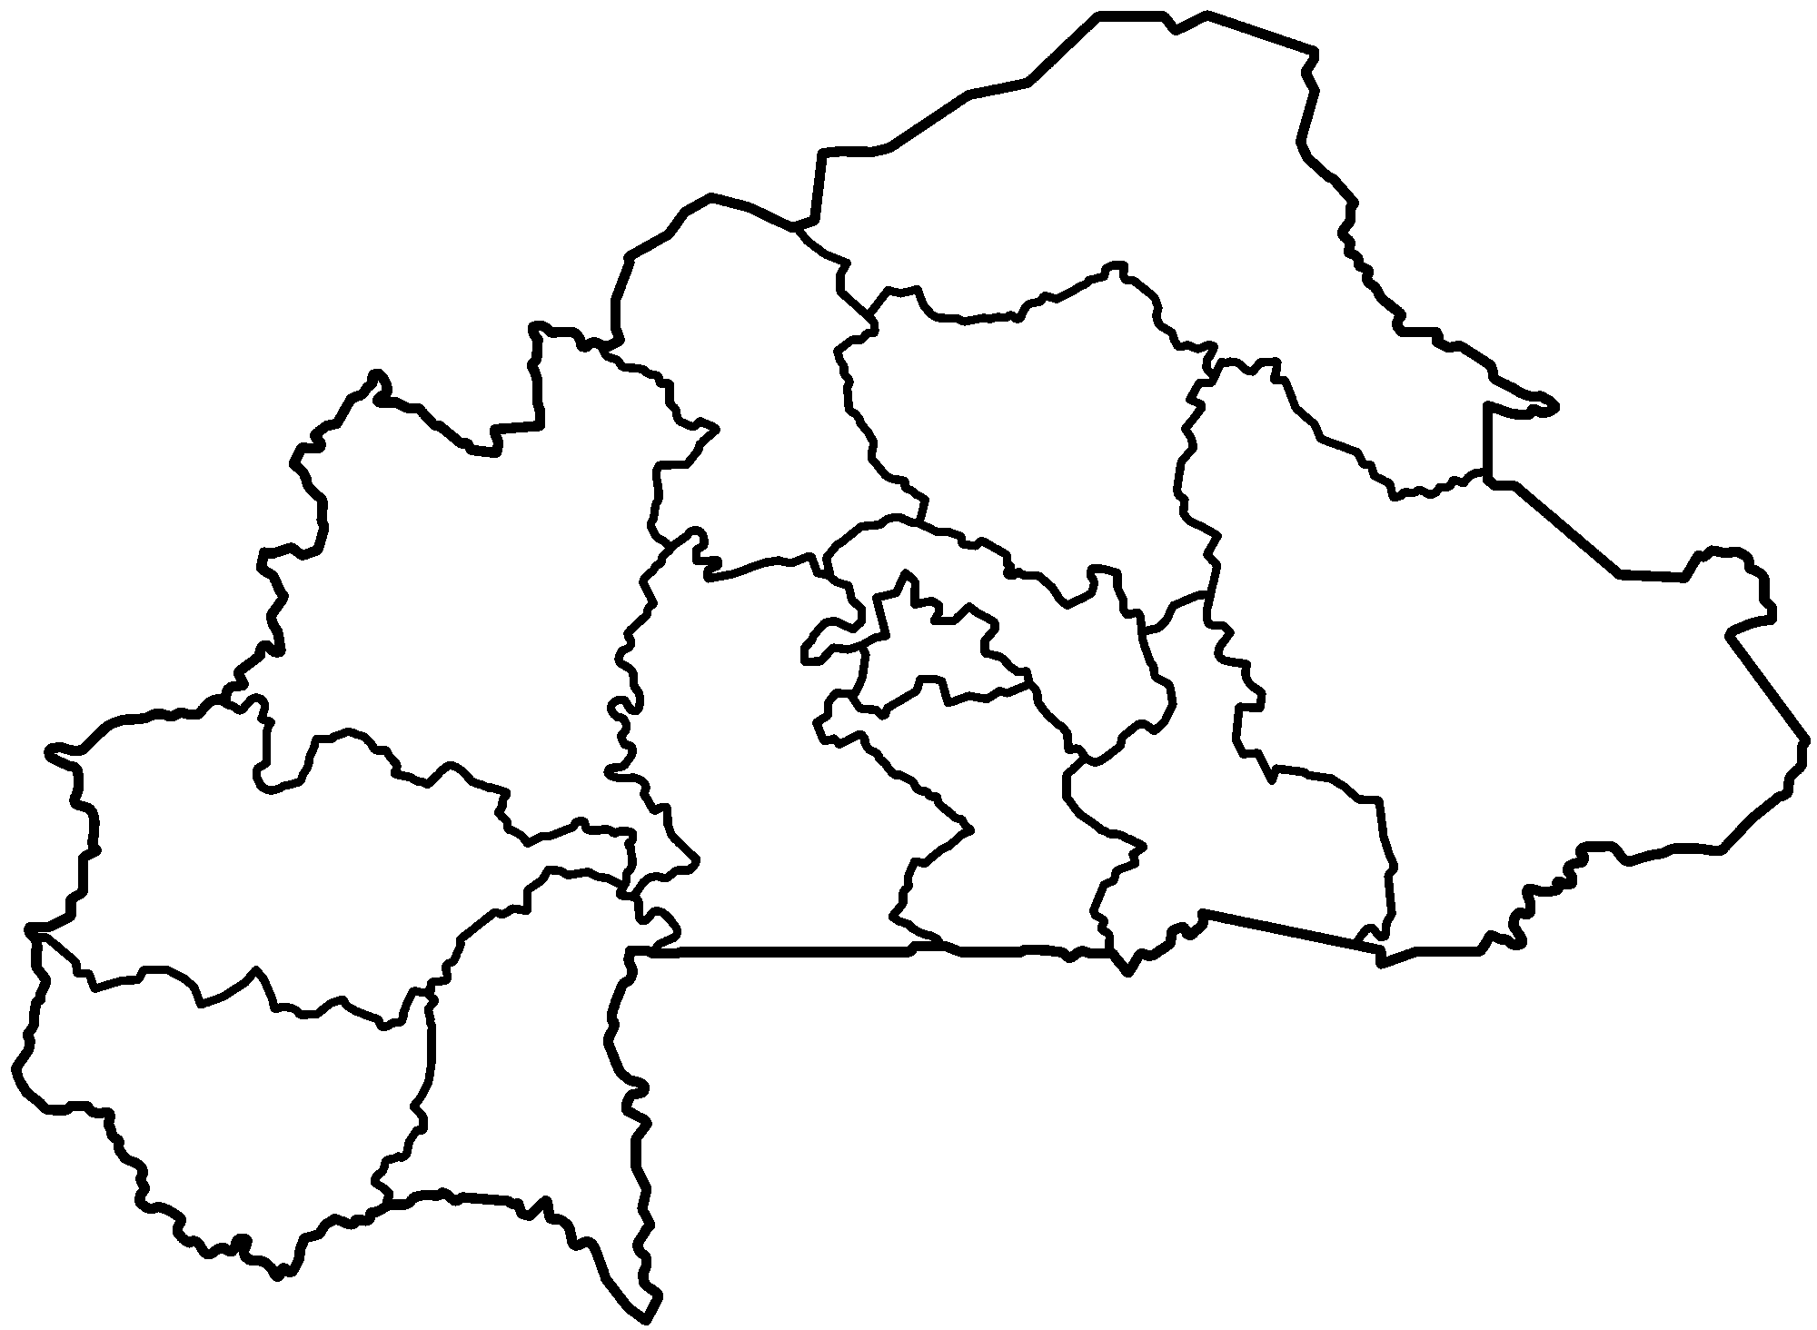
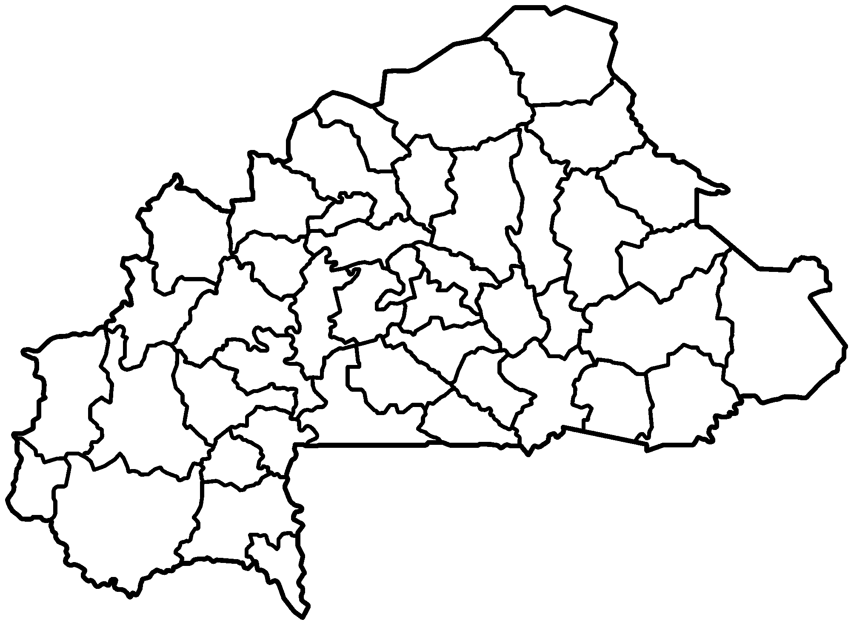
Calibrating malaria epidemiology of Burkina Faso
Treatment seeking/preference behavior available by region, from DHS data 2014.
Between 23% (Sahel) and 69% (Centre-Ouest) of children under 5 are give an antimalarial if malaria is suspected.
Prevalence data available by province (MIS Data, 2010) published in Diboulo et al (Mal J, 2016)
23%
63%
57%
48%
47%
56%
40%
46%
69%
64%
62%
52%
40%
Notes:
Sales data (broken down by pediatric and adult formulations) indicate that adults are more likely to receive an antimalarial than children. Is this true?
In our simulations we assume these numbers are the same.

Slide 25
One of our current most important statistical needs:
Accurate measure of the percentage of malaria-positive febrile individuals who seek and receive an antimalarial drug.

Slide 26
Calibrating malaria epidemiology of Burkina Faso
Percentage of treated children (0-5) that take an ACT
39%
28%
10%
39%
24%
13%
13%
43%
17%
15%
17%
74%
47%
Notes:
74% is Cascades

Slide 27
Calibrating malaria epidemiology of Burkina Faso
Percentage of treated children (0-5) that take an Amodiaquine
37%
Amodiaquine use is very geographically heterogeneous, and this will have a big impact on selection pressure when used alongside Artemether-Lumefantrine.
68%
6%
39%
21%
81%
75%
22%
49%
24%
31%
19%
31%
Notes:
Selection pressure in Centre-Nord and Cascades should be very low….. And selection pressure in Est and Plateau-Central by AQ should be very high.

Slide 28
Calibrating malaria epidemiology of Burkina Faso
Percentage of treated children (0-5) that take SP
10%
1%
73%
16%
18%
0%
4%
0%
22%
52%
46%
0%
8%

Slide 29
Calibrating malaria epidemiology of Burkina Faso
Percentage of treated children (0-5) that take “another antimalarial”
13%
1%
2%
2%
32%
5%
0%
33%
8%
4%
5%
6%
6%

Slide 30
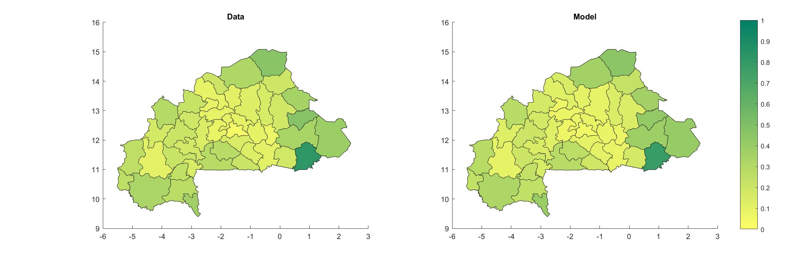
Comparing models and data
Prevalence data available by province (MIS Data, 2010) published in Diboulo et al (Mal J, 2016)
Kadiogo: 4.0%
5.6%
Data
Model
Komandjari: 47.2%
41.9%
blood-slide prevalence
9.7%
77.9%
Houet: 10.7%
Kompienga: 81.7% blood-slide prevalence in children <5
Notes:
Model-fitting with IBMs is hard. 30 simulations with 1.8 million people were input into a deep neural network (inside Google’s Colaboratory) and run on a GPU that used a neural network to perform the data fitting.
This is a fit of a baseline scenario to the MIS data from 2010.

Slide 31
https://prototype.visualization.vpr.psu.edu/mboni/MalariaBurkinaFaso/S1_60/
Username: mboni
Password: paludsm

Slide 32
Conclusions
Low selection pressure is not a moment for complacency!
Low selection pressure due to poor access & low coverage
Must increase coverage
High selection pressure

Slide 33
Conclusions
Diversity in drug use helps delay resistance evolution.
Private market drug use in Africa will likely have a noticeable effect kelch13 evolution.

Slide 34
Thanks. Questions.

