Slide 1
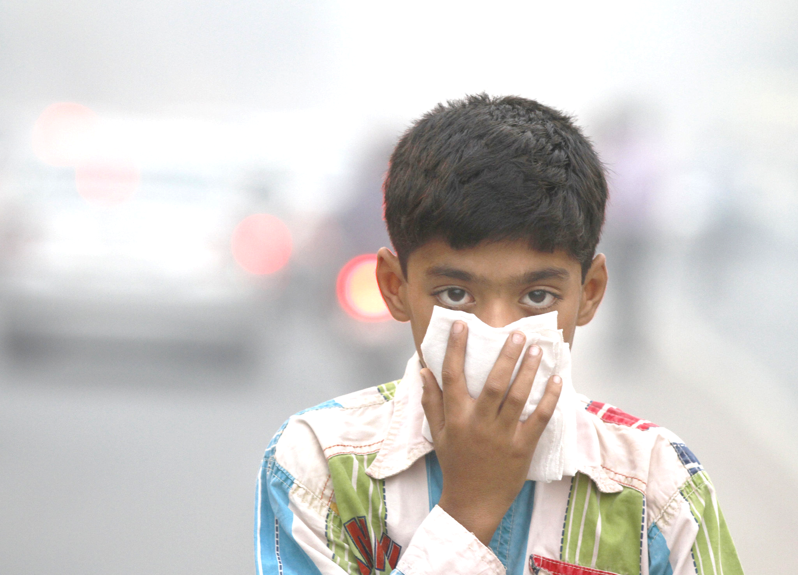

Estimating the burden of disease from environmental risk factors
Michael Brauer
School of Population and Public Health
IDM Disease Modelling Symporium
Bellevue WA, April 17, 2019
Photo: Sanjeev Verma/Hindustan Times, via Getty Images
Notes:
https://www.nytimes.com/2015/05/31/opinion/sunday/holding-your-breath-in-india.html
The presentation will include an overview of the methodology used to estimate the global burden of disease from environmental risk factors, with an emphasis on ambient and household air pollution and impacts on childhood infectious disease.
Dear Michael,
Thank you very much for accepting the invitation. There will be 4 speakers in this session. Each speaker has 15 minutes to talk and 5 minutes for questions.
It would be great if your talk will be within the context of linkage between environmental risk factors and infectious disease transmission/burden and overall child mortality pattern.
The audience will be modelers/researchers in the field of infectious diseases.

Slide 2
Overview
Environmental Risk factors in the Global Burden of Disease
Methods & challenges (particulate air pollution)
  What’s missing?
Future prospects

Slide 3
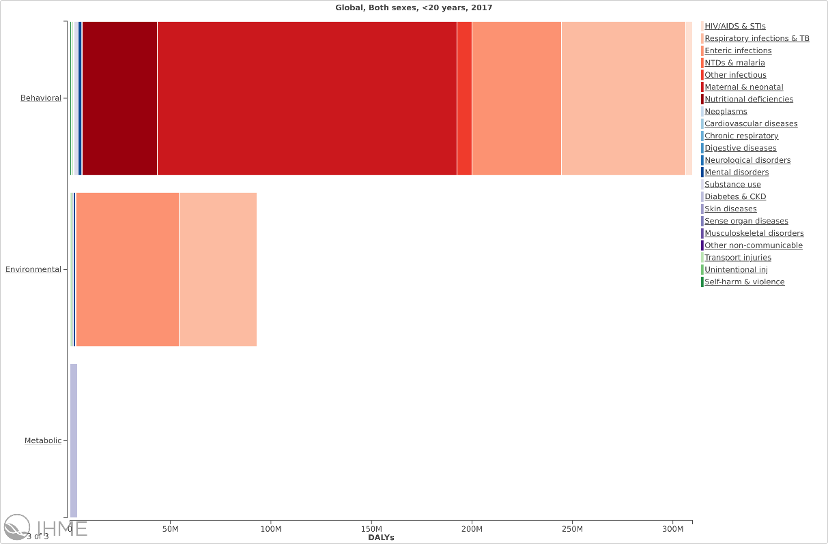
DALYs < 20 years
Notes:
309M DALYs Behavioural (malnutrition, tobacco, unsafe sex - HIV
93M Environmental
3.9M Metabolic (BMI, Glucose, BP)

Slide 4
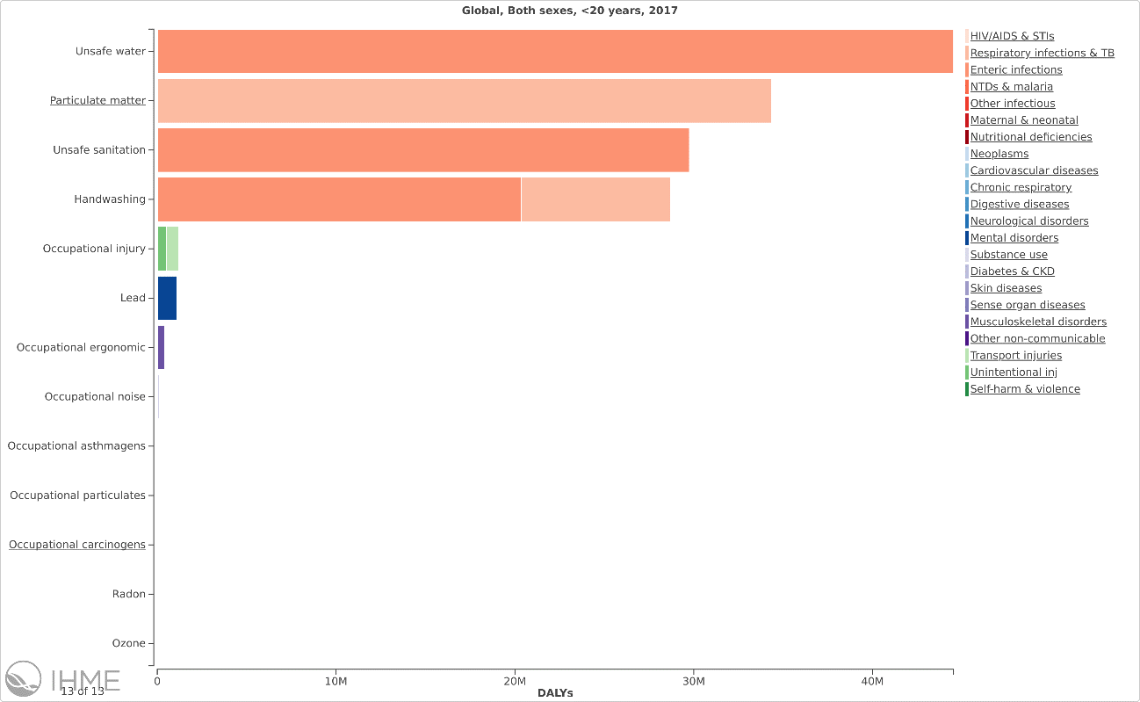
Environmental Risk Factors
Notes:
Within Environmental:
WaSH: 59 M DALYs (LRI and diarheal diseases); CHECK Handwashing and LRI) pneumonia transmission?
Air: 34 M DALYs (all LRI)
Occ: 1.8M
Other (lead): 1.1M

Slide 5
Estimating (global) disease burden from environmental risks
Exposure level
Risks
Age | Sex | Year | Location
Population Attributable Fraction
Effect Size
Risk-outcome
Age | Sex
Optimal Level
Risk Exposure
Global
Attributable
Disease Burden
Disease-specific Burden

Slide 6
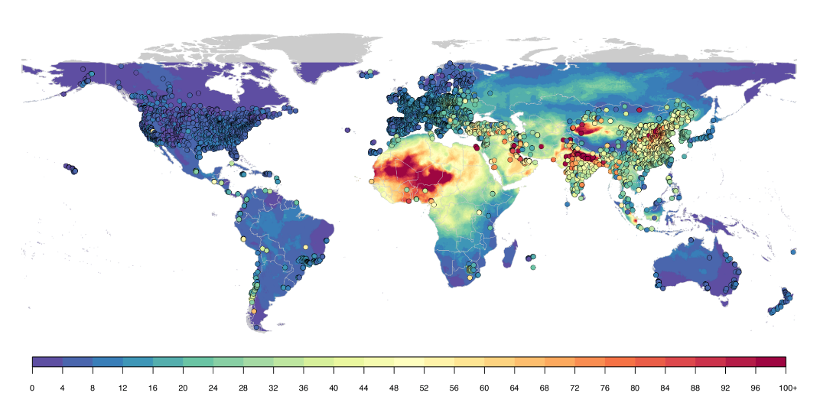
Combining satellite and ground monitoring to estimate exposure
$$\log\left({PM}_{2.5}st\right)= β_{0st}+ β_{1st}\log\left({SAT}_{s}\right)+ β_{3..P}Xst+ ε_{st}$$
Bayesian Hierarchical Model (DIMAQ)
  Spatially varying determinants of AOD – PM_{2.5} relationship (from chemical transport model, other) + hierarchical random effects
  Ground measurements
  N = 9,645 unique locations, from 116 countries
μg/m³
~11 x 11 km resolution, annual average
Median R² = 0.9
Median Pop-weighted RMSE = 10.1 µg/m3
Shaddick et al. 2018. Data integration model for air quality: a hierarchical approach to the global estimation of exposures to ambient air pollution. J. R. Stat. Soc. C, 67: 231–253; Shaddick et al. 2018. Data Integration for the Assessment of Population Exposure to Ambient Air Pollution for Global Burden of Disease Assessment. Environ Sci Technol. 2018 Aug 21;52(16):9069-9078.

Slide 7
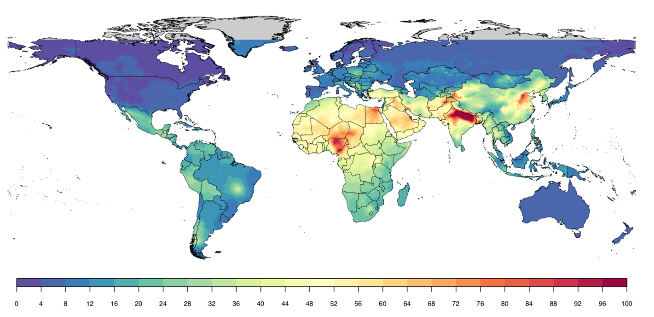
Model
μg/m³

Slide 8
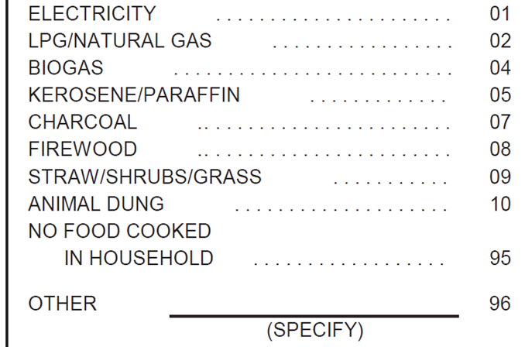
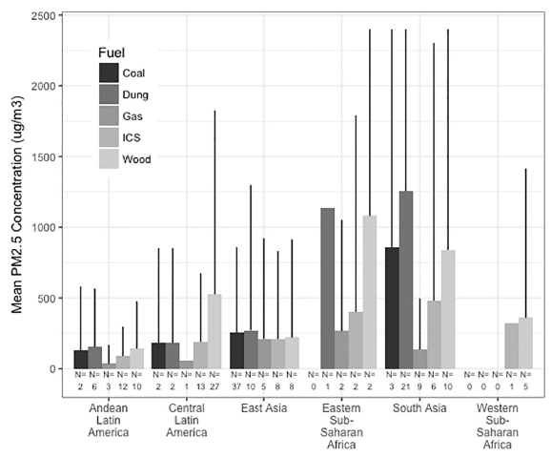
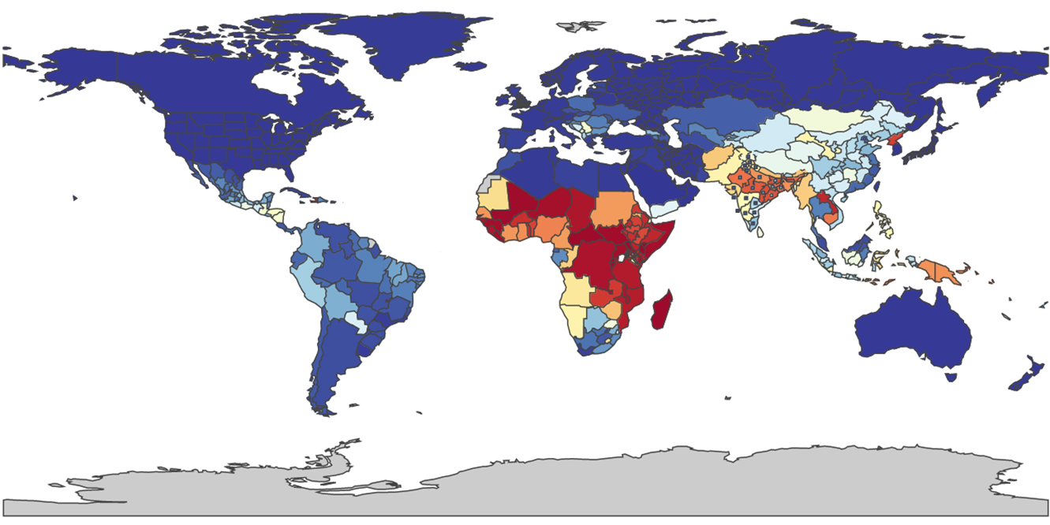
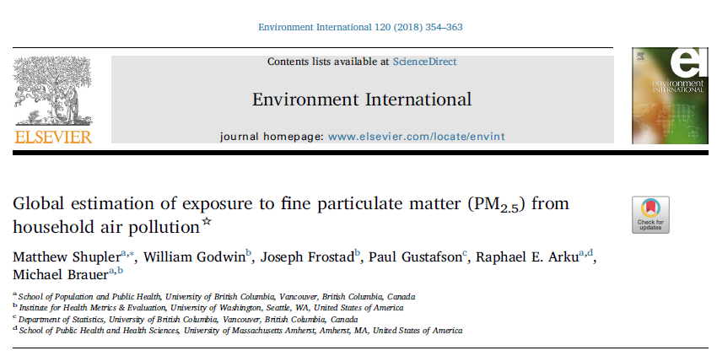
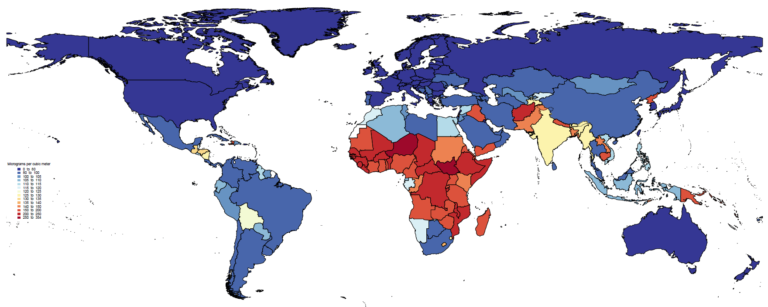
Household Air Pollution Exposure
Proportion of households
Exposure (man, woman, child)

Slide 9
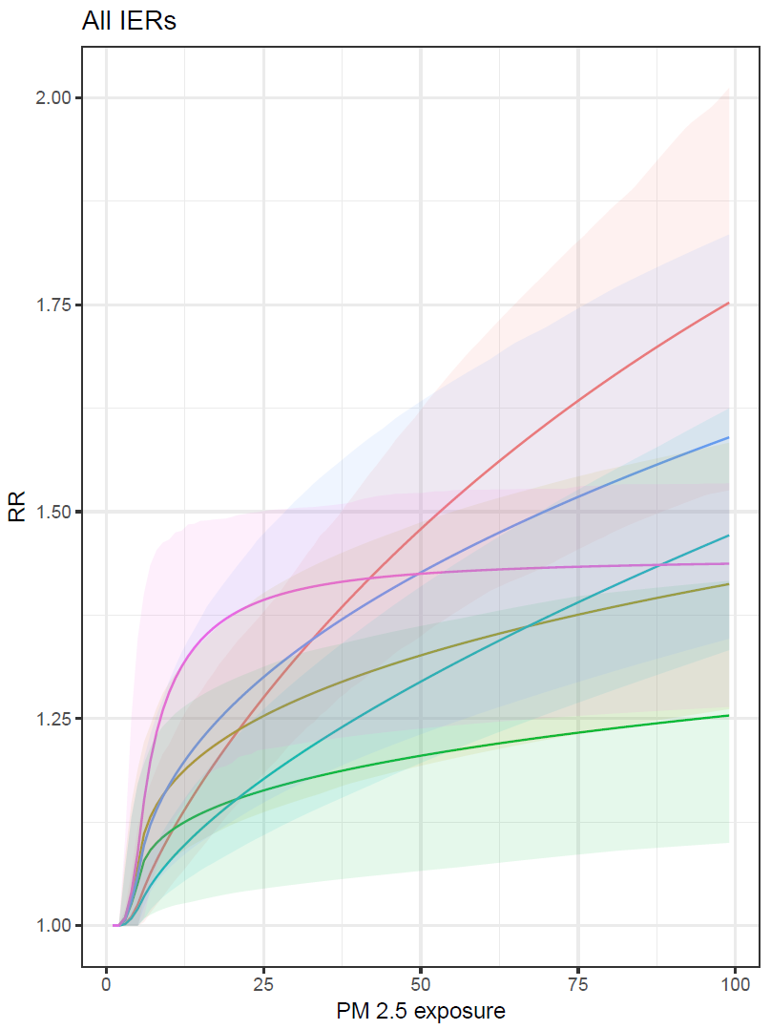
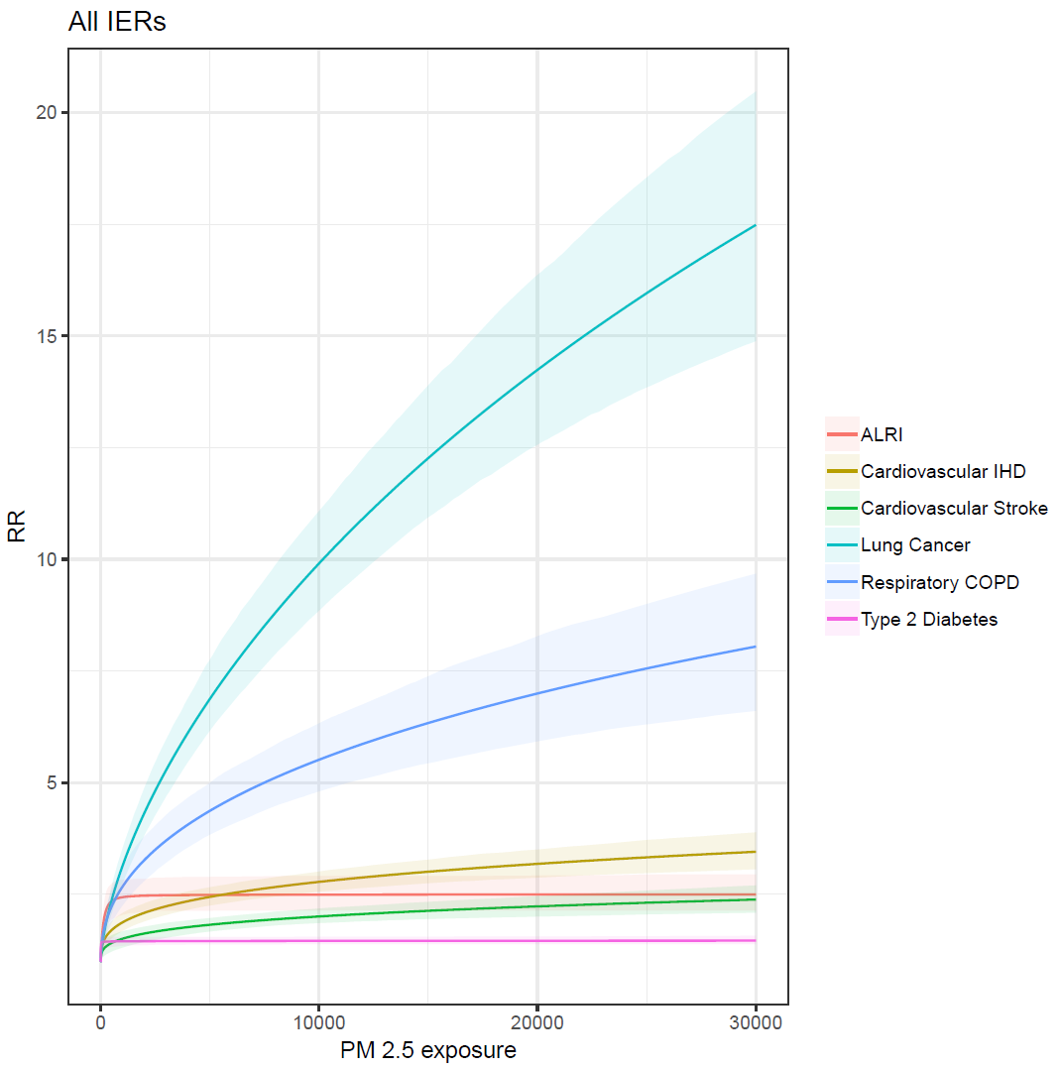
Integrated Exposure Response Function

Slide 10
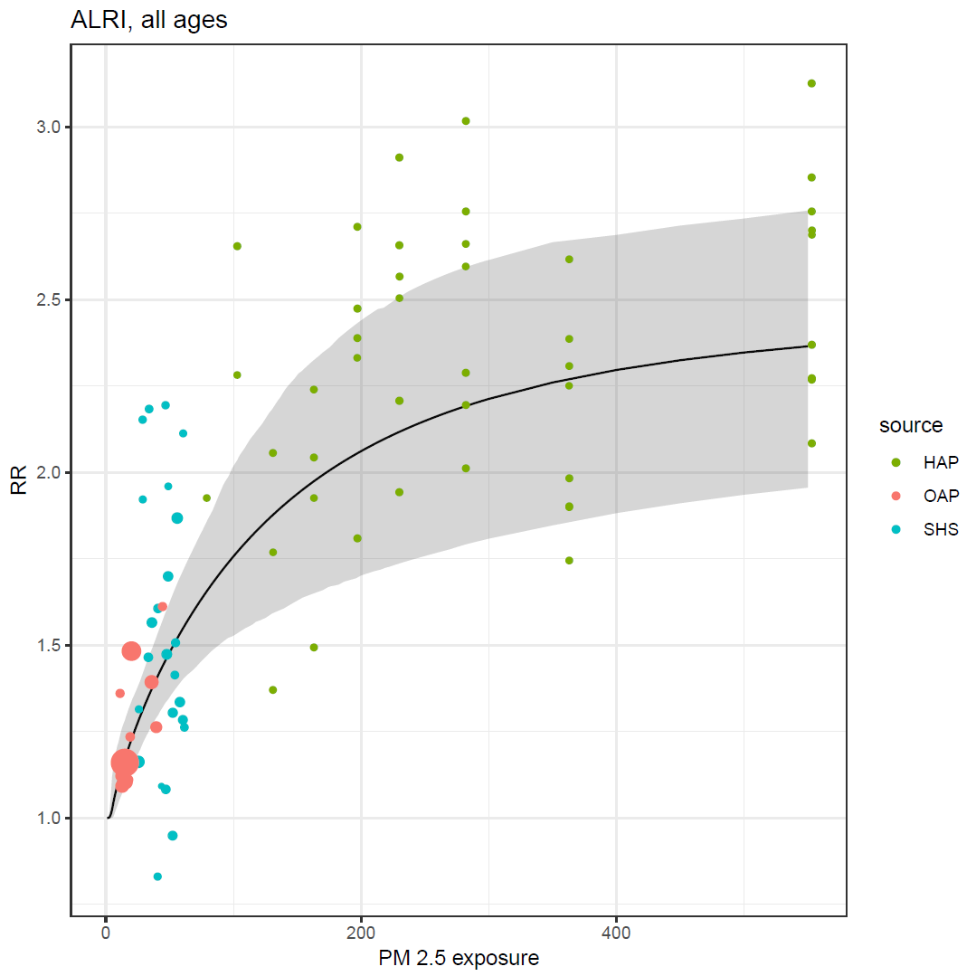
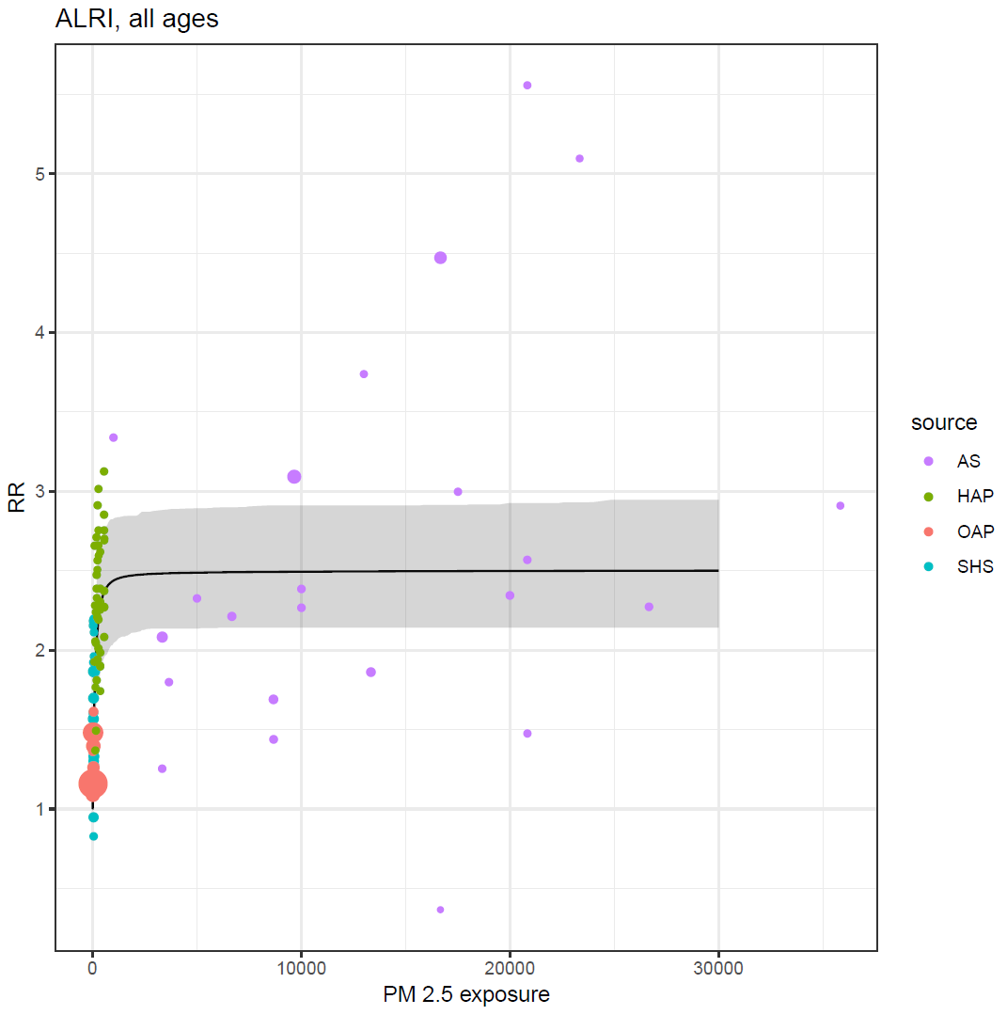
IER Fit, LRI

Slide 11
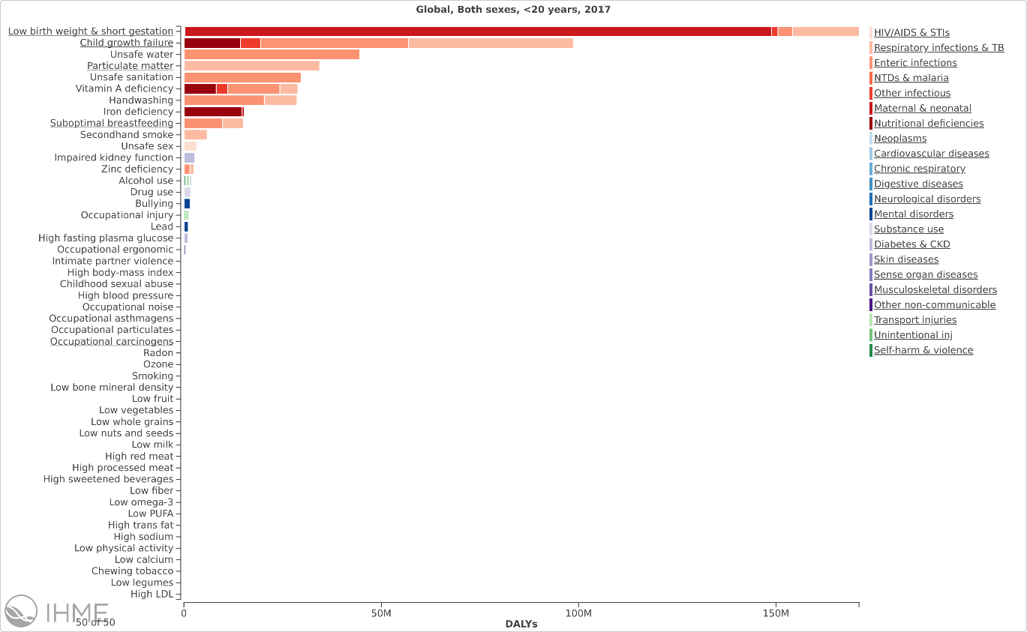
What’s missing?
Low birthweight and short gestation
Asthma
Temperature
??
Notes:
CHECK NOTES FROM RF PAPER / GBD – PHI; LANCET COMMISSION; ADD SLIDE ON ASTHMA PAPER; ADD SLIDE FROM TRASANDE PAPER

Slide 12
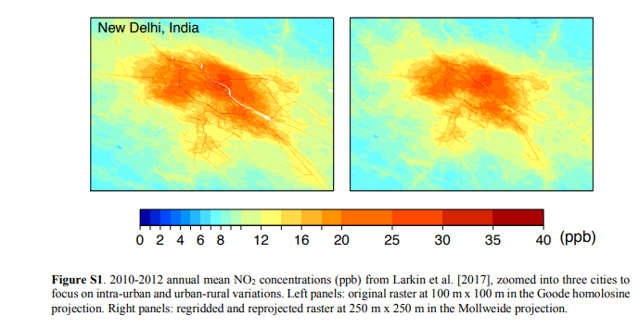
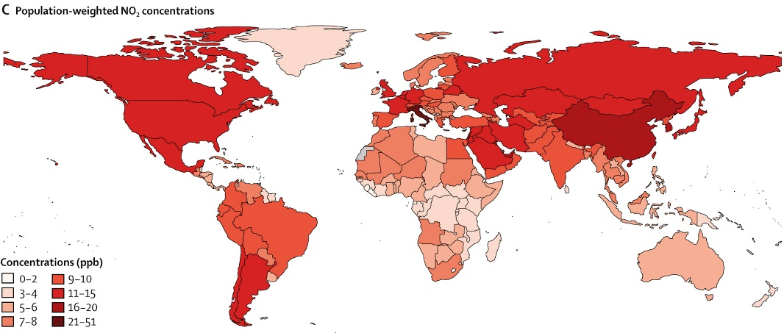
Ambient NO₂ and Pediatric Asthma: Exposure
100 m x 100 m → 250 m x 250 m
  Sufficient to capture intra-urban and near-roadway exposure gradients
2010-2012 annual average NO₂ from land-use regression
  ground-based measurements
  satellite-derived pollutant estimates
  geospatial variables (ex: distance from road)
2015 Global Human Settlement population grid (250 m x 250 m)
Achakulwisut et al. Global, national, and urban burdens of paediatric asthma incidence attributable to ambient NO2 pollution: estimates from global datasets. Lancet Planetary Health DOI: (10.1016/S2542-5196(19)30046-4)
Notes:
No trends

Slide 13
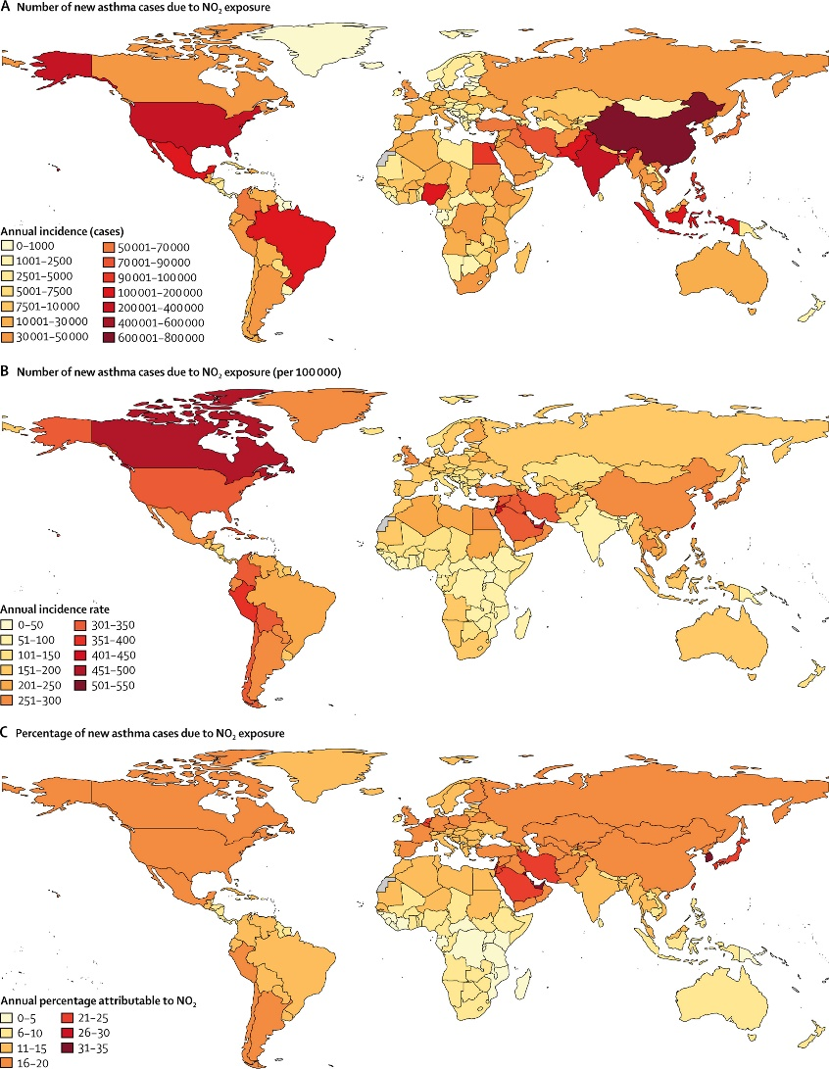
Ambient NO₂ and Pediatric Asthma: Burden
4.0 (95% UI, 1.8-5.2) million new pediatric asthma cases annually
13% (5.8-16%) of global incidence
730,000 DALYs per year
Achakulwisut et al. Global, national, and urban burdens of paediatric asthma incidence attributable to ambient NO2 pollution: estimates from global datasets. Lancet Planetary Health DOI: (10.1016/S2542-5196(19)30046-4)

Slide 14
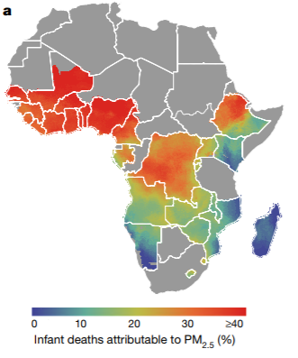
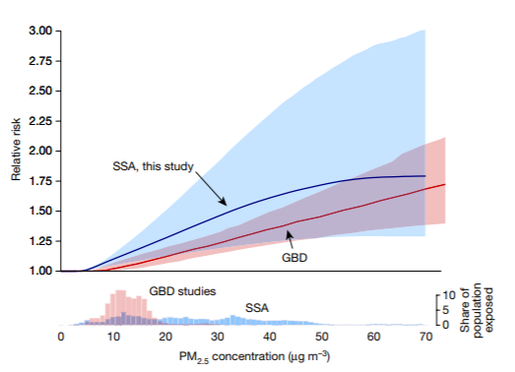
PM_{2.5} and < 5yr mortality in Africa
neonatal deaths
birth weight
stunting
diarrhea
22%
13% (LRI)
Heft-Neal S et al. Robust relationship between air quality and infant mortality in Africa. Nature. 2018. doi:10.1038/s41586-018-0263-3

Slide 15
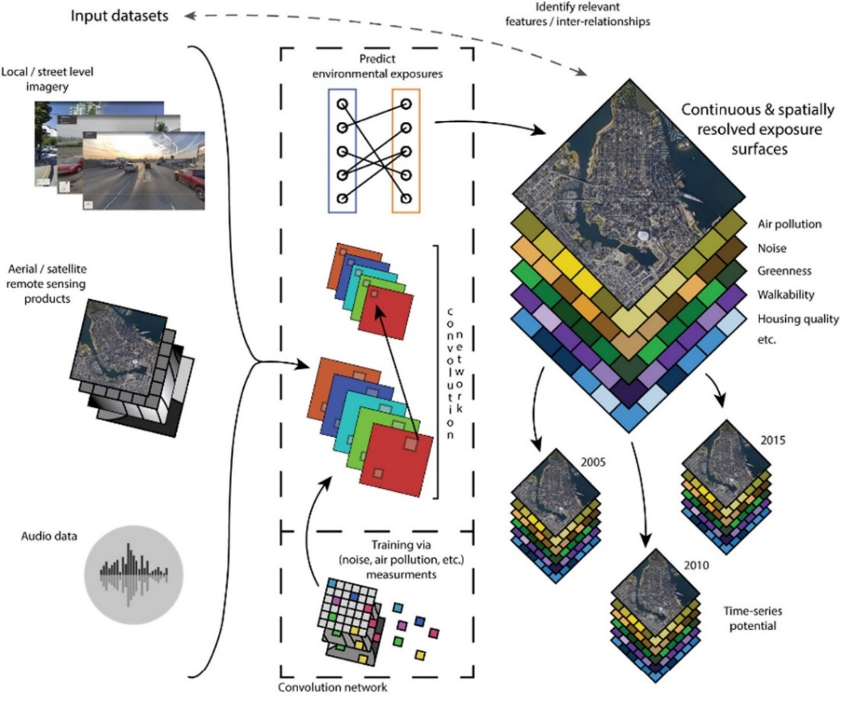
Characterizing complex exposures
City-level image classification
transferability
downscaling
fore/backcasting
Weichenthal S, Hatzopoulou M, Brauer M. A picture tells a thousand…exposures: Opportunities and challenges of deep learning image analyses in exposure science and environmental epidemiology. Environment International, 2018. doi: 10.1016/j.envint.2018.11.042

Slide 16
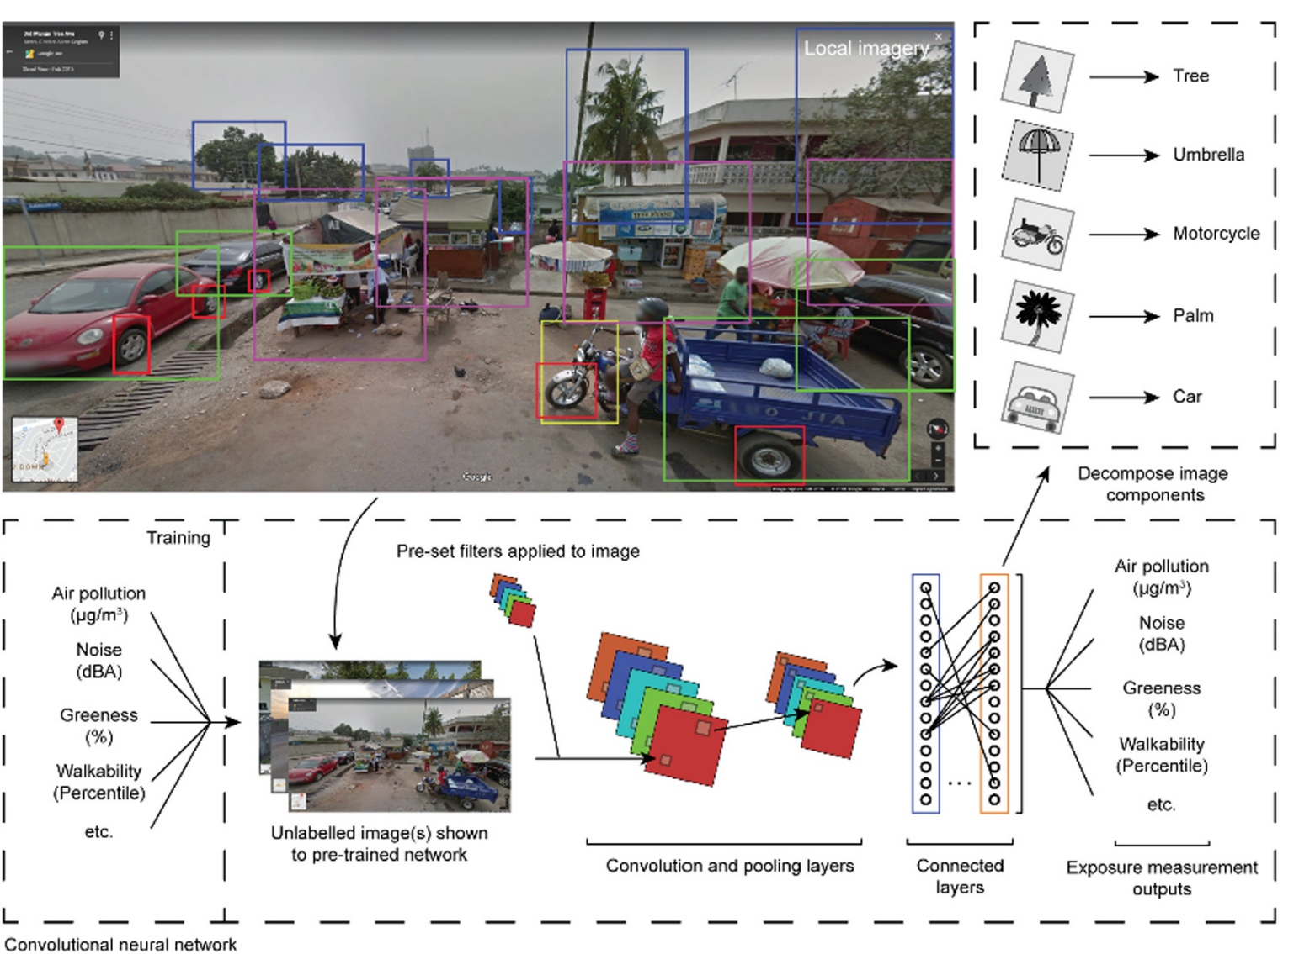

Slide 17
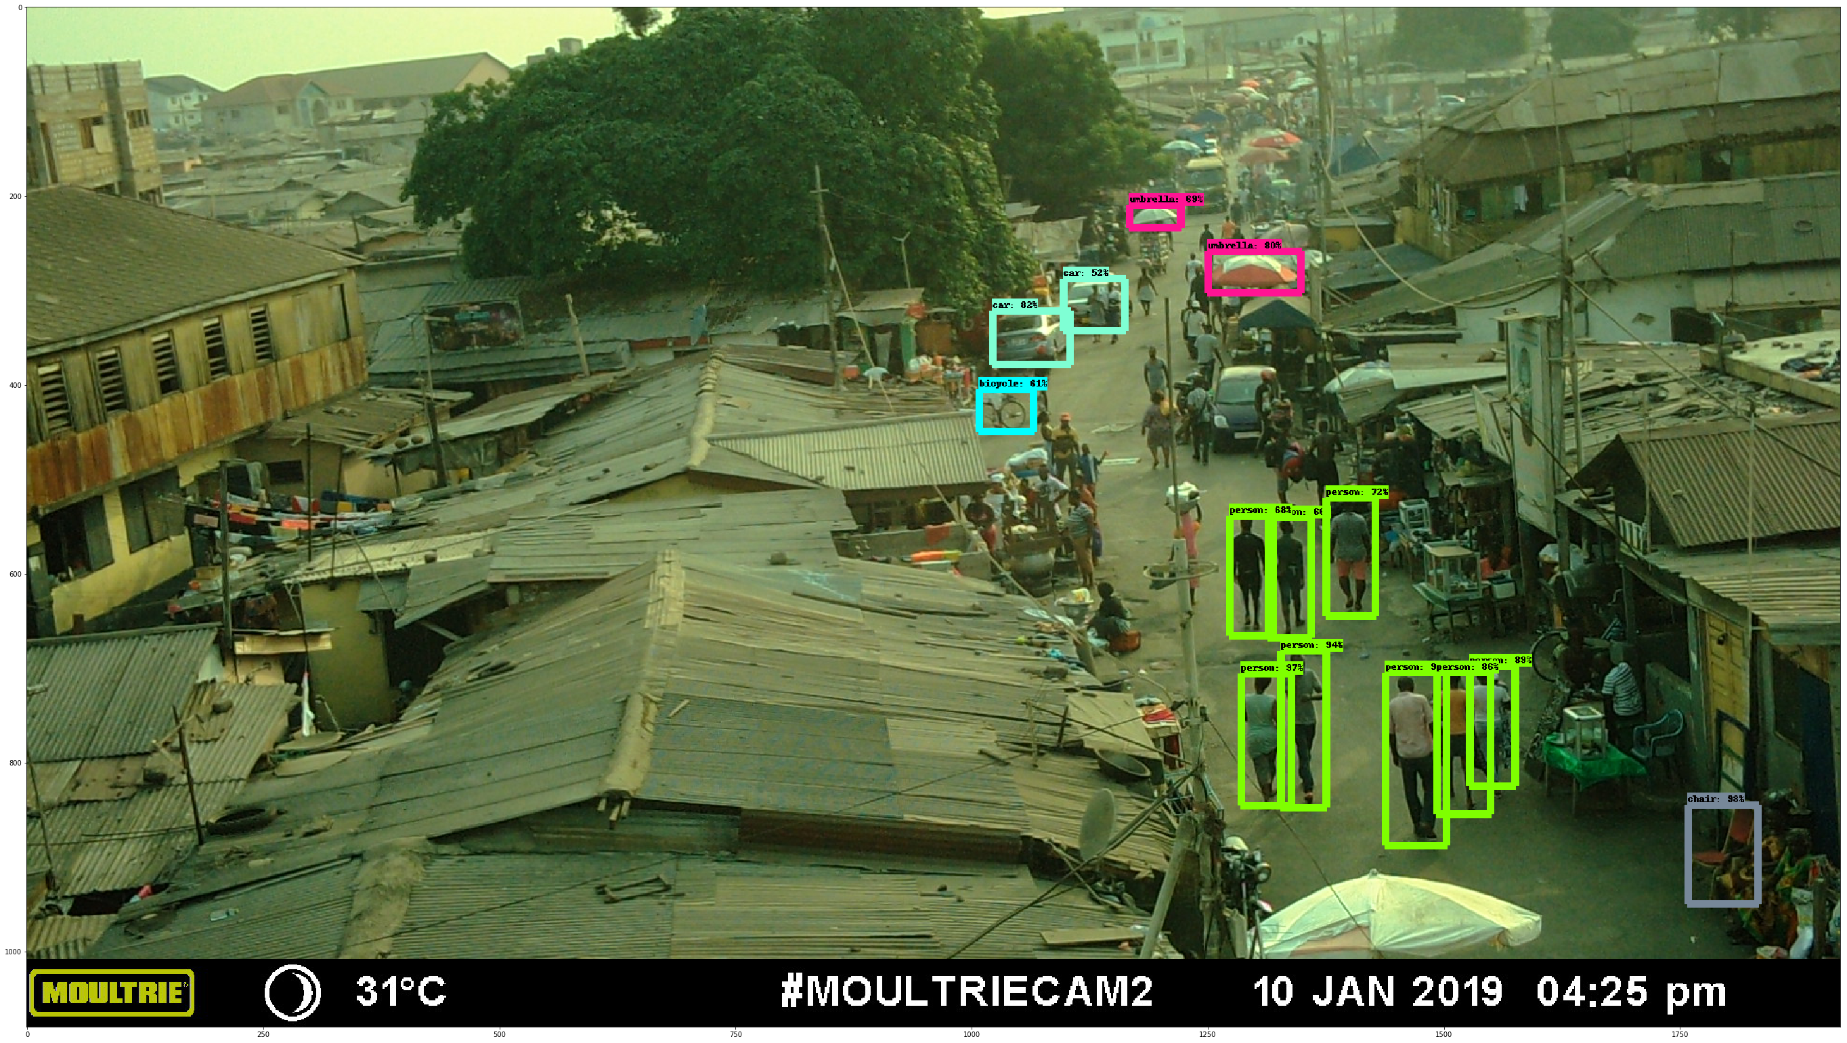
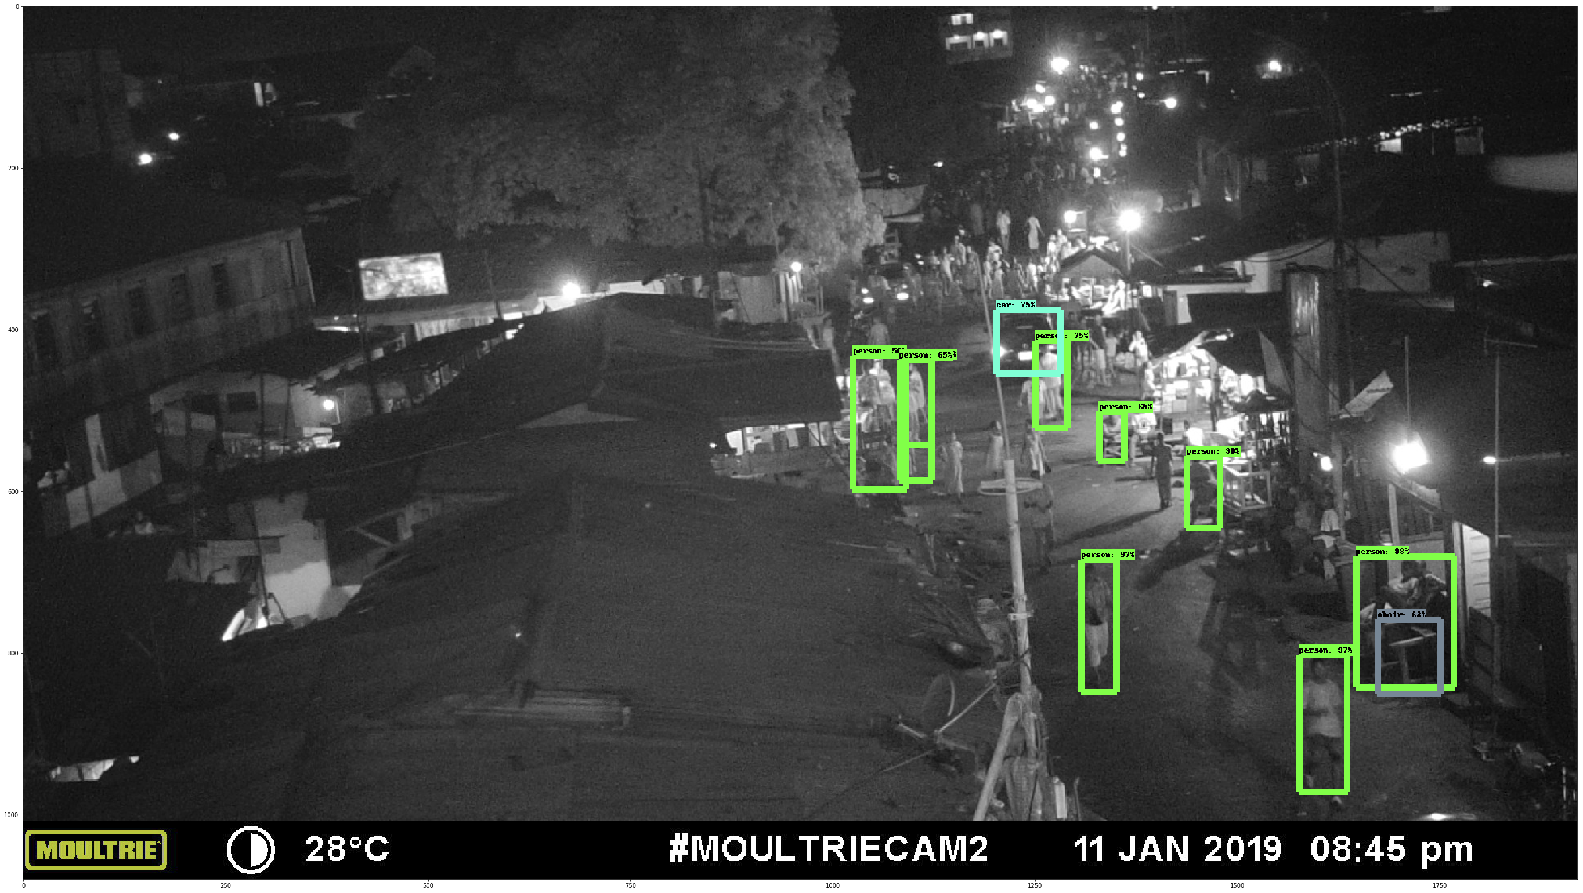
Feature detection from time lapse images
Accra (Jan 2019): day/night
TensorFLow / Pre-trained Network
People, bikes, umbrellas, cars, chairs
Preliminary analysis: Ricky Nathavni, Emily Muller

Slide 18
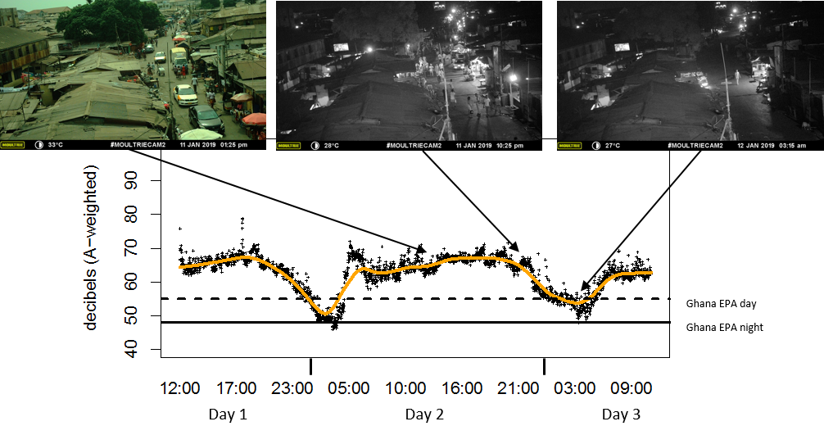
Noise levels and sources in Jamestown, Accra
Pre-Pilot Measurements (January 2019): Sierra Clark
Notes:
Slide has animations

Slide 19
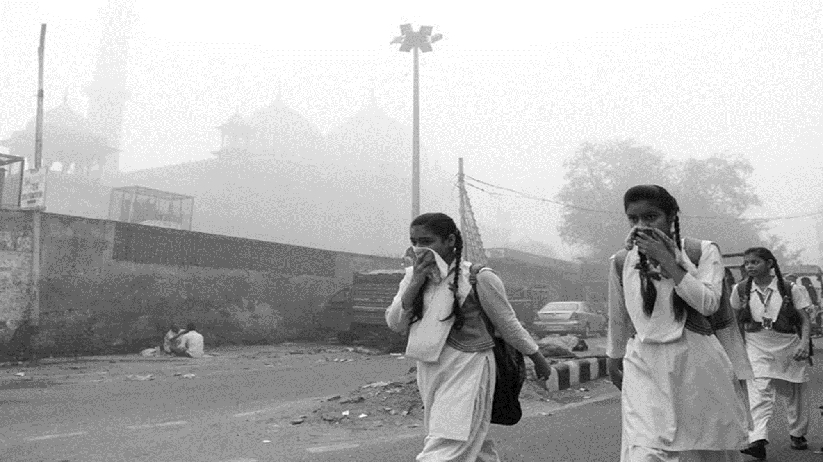
Thank you! Questions?
michael.brauer@ubc.ca
Photo: Sajjad Hussain/Agence France-Presse — Getty Images

Slide 21
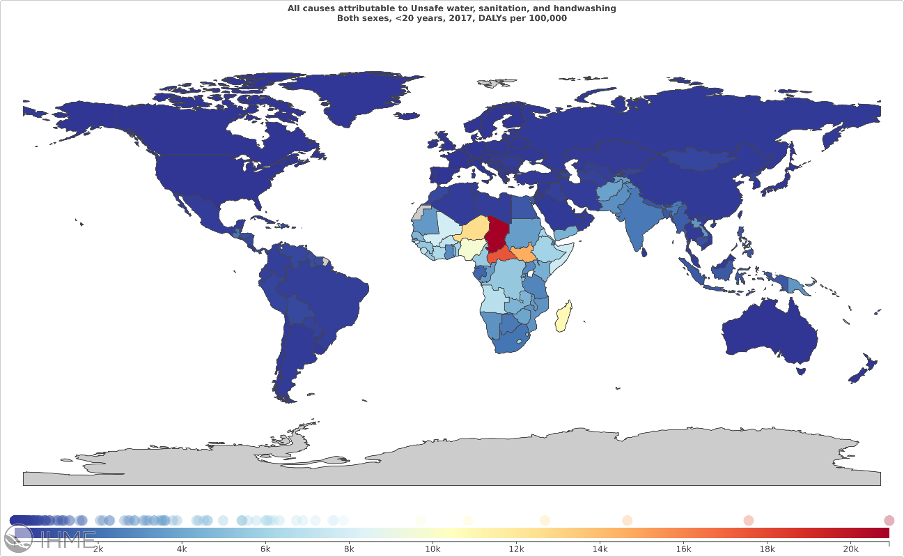

Slide 22
Large modeled exposure differences by fuel type
Fuel Type | Global Average 24-Hr Kitchen HAP-PM_{2.5} Concentration [95% CI] | Global Average 24-Hr Female HAP-PM_{2.5} Exposure [95% CI]
Gas/Electric | 104 [39-273] | 42 [16-114]
Traditional wood | 395 [148-1039] | 161 [61-431]
Improved biomass cookstove | 251 [94-686] | 102 [37-292]
Animal dung | 958 [359-2520] | 391 [148-1047]
Coal | 319 [119-838] | 130 [49-348]
Mean 24-hour HAP-PM_{2.5} concentrations
Rural areas
Season-weighted (50/50 wet/dry season)
Bayesian R² = 0.57
Shupler, M., Godwin, W., Frostad, J., Gustafson, P., Arku, R. E., & Brauer, M. (2018). Global estimation of exposure to fine particulate matter (PM2.5) from household air pollution. Environment International, 120, 354–363. https://doi.org/10.1016/j.envint.2018.08.026

Slide 23
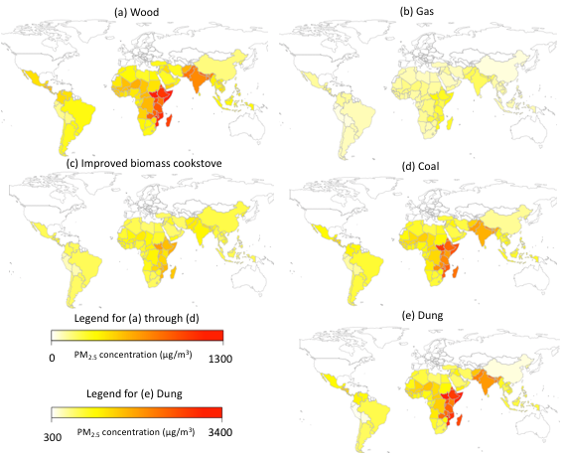
Country-level HAP-PM_{2.5} variation within same fuel type

Slide 24
WaSH
WaSH – take from Apprendix
Exposure, TMEREL,Effect Size (indicate new approach – slides from Chris)

Slide 25
Household Air Pollution Exposure modeling
Proportion Model: Proportion of population exposed to solid fuel for cooking
  Survey and report data
  Predict over space and time using ST-GPR
Mapping Function: PM2.5 exposure level by country and year
  Database of PM2.5 measurement studies in various countries and years
  Used for risk estimation—we quantify risk based on PM2.5

Slide 26
Theoretical minimum risk exposure level (TMREL)
Risk | TMREL
Ambient Air Pollution | Uniform distribution between 2.5 and 5.9 μg/m³ Based on average of minimum and 5th percentiles of exposure distributions of outdoor air pollution cohort studies in North America
Household Air Pollution | No use of solid cooking fuel in the home Also depends on Ambient TMREL

Slide 27
Relative Risks: Integrated Exposure Response Function – IER
Integrated exposure response (IER) function introduced in GBD2010 to address past limitation
Challenge: Studies of ambient PM_{2.5} in setting primarily with lower levels of PM_{2.5} - what does the shape of risk curve look beyond these levels?
Solution: Use studies of relative risk of PM_{2.5} exposure from other studies (second hand smoke, household air pollution, active smoking) to inform the shape of the risk function beyond the levels studied in ambient PM_{2.5}
PM_{2.5} as a (reasonable) common exposure metric for combustion-related risks

Slide 28
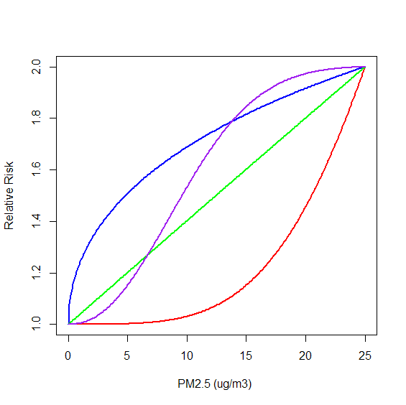
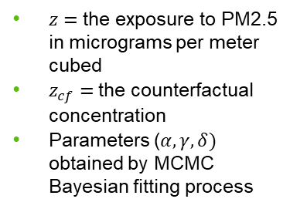
Integrated Exposure Response Function – IER
$z=$the exposure to PM2.5 in micrograms per meter cubed
$z_{cf}=$the counterfactual concentration
Parameters ($α, γ, δ)$ obtained by MCMC Bayesian fitting process

