Slide 1
EMOD Basics
Daniel Bridenbecker, Software Engineer
4/18/2016

Slide 2
Using EMOD – Virtual Machine Login
Hyatt Hotel WiFi
  Password: IDM2016
IDM USB
  Double-click on RDP file on USB
Login
  User: idmguest
  Password: idm2016!

Slide 3
Objective
Introduction
  What is EMOD
  Capabilities
  Next Steps
Is this the right model for you?

Slide 4
Agenda
8:30 | 8:40 |  | Intro to Infectious Disease Modeling
8:40 | 8:50 |  | Why Should I Use EMOD?
8:50 | 9:15 |  | EMOD Architectural Overview
9:15 | 9:30 |  | Using EMOD – Virtual Machine Login
9:30 | 9:40 |  | Break
9:40 | 10:10 |  | Using EMOD - Simulation Configuration - SIR to SEIR
10:10 | 10:50 |  | Using EMOD - Campaigns - Outbreaks, Interventions, Events
10:50 | 11:00 |  | Break
11:00 | 11:45 |  | Using EMOD - Demographics - Population Distributions, Spatial
11:45 | 12:00 |  | Next Steps

Slide 5
Intro to Infectious Disease Modeling
Polls
  Has anyone used another model?
  Has anyone created their own model?
  Is anyone new to modeling?
“all models are wrong, but some are useful” - George E. P. Box
What and Why Modeling
  Example – Moving & Furniture
  Model Complexity – Risk Vs Cost

Slide 6
Disease Modeling - Basic Epidemiology Models
SIR
SIS
SIRS
SEIR
Susceptible
Infectious
Recovered
Susceptible
Infectious
Susceptible
No Immunities
Susceptible
Infectious
Recovered
Susceptible
Exposed
Infectious
Recovered

Slide 7
Categories of Models
Deterministic vs Probabilistic
An Introduction to Infectious Disease Modelling
  Emilia Vynnycky & Richard White
Compartmental | Model infectious subgroups of population and flow between
Individual-based | Model infection process in each entity
Dynamic Transmission | Models the contact/transmission between individuals
Static | A model that does not describe change over time
Network | Explicitly models network of contacts between individuals

Slide 8
Other Infectious Disease Models
Create Your Own
EPP
Synthesis
OpenMalaria
STDSIM
Pre-PopART
MAEMOD
STI-HIV
Imperial
Eaton
GLEAM
SimulAIDS
Spectrum
Bacaer
Goals
ASSA
Comparisons
Eaton, J. W., Bacaër, N., Bershteyn, A., Cambiano, V., Cori, A., Dorrington, R. E., ... & Hallett, T. B. (2015). Assessment of epidemic projections using recent HIV survey data in South Africa: a validation analysis of ten mathematical models of HIV epidemiology in the antiretroviral therapy era. The Lancet Global Health, 3(10), e598-e608.
Okell, L., Pemberton-Ross, P., Wenger, E., Maude, R. Brady, O. et al (2015). Consensus modelling evidence to support the design of mass drug administration programmes. Malaria Policy Advisory Committee Meeting, Geneva, Switzerland.

Slide 9
Agenda
8:30 | 8:40 |  | Intro to Infectious Disease Modeling
8:40 | 8:50 |  | Why Should I Use EMOD?
8:50 | 9:15 |  | EMOD Architectural Overview
9:15 | 9:30 |  | Using EMOD – Virtual Machine Login
9:30 | 9:40 |  | Break
9:40 | 10:10 |  | Using EMOD - Simulation Configuration - SIR to SEIR
10:10 | 10:50 |  | Using EMOD - Campaigns - Outbreaks, Interventions, Events
10:50 | 11:00 |  | Break
11:00 | 11:45 |  | Using EMOD - Demographics - Population Distributions, Spatial
11:45 | 12:00 |  | Next Steps

Slide 10
What is EMOD?
Stochastic
Individual, agent based simulation
Framework that lets you use the full power of information
Can combine information with different levels of detail
Models
  Individual-level details
  Demographics
  Spatial Dynamics
  Temporal Dynamics
  Disease Dynamics
  Interventions

Slide 11
Pros / Cons
Pros
  Stochastic
  Individual-based
    Can take into account a person’s previous exposure history
    Individuals make discrete choices by sampling from distributions
    Can explore impact of interventions
    Model can include high levels of detail/realism
  Allows looking at the distribution of outcomes
  Supports multiple specific diseases
    Detailed intra-host models
    Framework for creating new models
  Can scale – households to nations
  Well tested and documented
  Source code available
Cons
  Stochastic
  Lots of parameters that are not necessarily orthogonal
  Can require lots of computing resources
  Run time scales with samples
  Requires learning someone else's model
  No UI that does everything you need

Slide 12
Agenda
8:30 | 8:40 |  | Intro to Infectious Disease Modeling
8:40 | 8:50 |  | Why Should I Use EMOD?
8:50 | 9:15 |  | EMOD Architectural Overview
9:15 | 9:30 |  | Using EMOD – Virtual Machine Login
9:30 | 9:40 |  | Break
9:40 | 10:10 |  | Using EMOD - Simulation Configuration - SIR to SEIR
10:10 | 10:50 |  | Using EMOD - Campaigns - Outbreaks, Interventions, Events
10:50 | 11:00 |  | Break
11:00 | 11:45 |  | Using EMOD - Demographics - Population Distributions, Spatial
11:45 | 12:00 |  | Next Steps

Slide 13
Simulation, Nodes & Individuals
Simulation
Conductor
Node = Physical Area
Country
Province
House
Individual = Person
Age
Gender
Properties
Migration = Travel
Rates
Destinations
Simulation
Node n
Node 2
Node 1
Individual n
Individual 2
Individual 1
Migration

Slide 14
Infection & Susceptibility
Simulation
Node n
Node 2
Infection = Intra-host
Detailed Disease Specific
Individual has their own
Individual can have multiple
  Different Strains
Node 1
Individual n
Individual 2
Individual 1
Susceptibility = Immunity
Acquire
Transmit
Mortality
Infection
Infection
Infection
Susceptibility
Migration

Slide 15
Transmission Models
Disease is spread between individuals
Simulation
Node n
Node 2
Disease specific mechanism.
Airborne
Environmental
Vector
Sexual
Node 1
Individual n
Individual 2
Individual 1
Infection
Infection
Infection
R
Disease models of:
Climate (C)
Vectors (V)
Relationships (R)
Transmission
Susceptibility
V
C
Migration

Slide 16
Disease Specific Transmission Models
Generic
SEIRS
Airborne
Vector
Environmental
Sexual
TB
Malaria
Polio
HIV
Dengue
Typhoid

Slide 17


Vector Transmission
Vectors get disease by biting infected human
Vectors spread the disease

Slide 18
Sexual Transmission / Network
Relationships change over time
Must have a relationship to transmit disease
Marital
Marital
Informal
Marital
Transitory
Transitory
Transitory
Transitory
Informal
Informal

Slide 19



Heterogeneous Intra-Node Transmission (HINT)
Spray On
Properties
Individual Properties
= Rural
= Suburban
= Urban

Slide 20
Campaigns, Interventions, & Events
Campaigns
Distribute outbreaks and interventions
Target Nodes, specific groups of individuals
Interventions
Methods for impacting the spread of the disease
  Drugs
  Vaccines
  Bednets
  Circumcisions
Simulation
Individual Events
A change in a person’s state
A message can be sent when these changes occur
Built-in Events include:
  Birth
  Pregnant
  DiseaseDeath
User Defined Events
  Interventions can broadcast events due to state change
Node n
Node 2
Node 1
Individual n
Campaign
Event
Campaign
Event
Campaign
Event
Individual 2
Individual 1
Infection
IV
Infection
IV
Infection
IV
R
Transmission
Susceptibility
V
C
Migration

Slide 21
Infect 50% of Males on Day 5
OutbreakIndividual
Outbreak to 50%
of Males
0
Days
5
10
15
20
25
30

Slide 22
NewInfection Event Is Broadcasted
OutbreakIndividual
GenericDrug
NodeLevelHealthTriggeredIV
NewInfection
0
Days
5
10
15
20
25
30

Slide 23
GenericDrug Is Distributed on NewInfection Event
OutbreakIndividual
GenericDrug
NodeLevelHealthTriggeredIV
NewInfection
GenericDrug
0
Days
5
10
15
20
25
30

Slide 24
Disease Transmitted on Day 10 and Drug Cured Person
OutbreakIndividual
GenericDrug
NodeLevelHealthTriggeredIV
NewInfection
GenericDrug
Drug cured individual
Transmits
Disease
0
Days
5
10
15
20
25
30

Slide 25
NewInfection Causes Generic Drug To Be Distributed
OutbreakIndividual
GenericDrug
NodeLevelHealthTriggeredIV
NewInfection
GenericDrug
NewInfection
GenericDrug
Transmits
Disease
0
Days
5
10
15
20
25
30

Slide 26
DelayedIntervention Distributed on NewInfection
BroadcastEvent
OutbreakIndividual
DelayedIntervention
SimpleDiagnostic
GenericDrug
NodeLevelHealthTriggeredIV
NewInfection
FeelsSick
TestedPositive
DelayedIntervention
SimpleDiagnostic
GenericDrug
Delay waiting to feel sick
0
Days
5
10
15
20
25
30

Slide 27
Inputs
Simulation
Control parameters
config.json
Simulation Configuration
Simulation
Node n
Intervention
When, who and what interventions to distribute
campaign.json
Node 2
Intervention Configuration
Node 1
Individual n
Campaign
Event
Campaign
Event
Campaign
Event
Demographics
Initial information about regions and the people in those regions
demographics.json
Demographics Data
Individual 2
Individual 1
Infection
IV
Infection
IV
Infection
IV
R
Climate Data
Climate Data
Transmission model dependent
Temperature, rainfall, etc.
Transmission
Susceptibility
V
C
Migration Data
Migration
Migration Data
Where and rate of travel

Slide 28
Outputs & Miscellaneous
Reports
Built-in vs Custom
Controlled by Simulation Configuration
Formats: JSON, CSV, Binary
Simulation Configuration
Simulation
Node n
Node 2
Intervention Configuration
Node 1
Report Data
Logs
Information in stdout
Controlled by Simulation Configuration
Individual n
Campaign
Event
Reporters
Campaign
Event
Campaign
Event
Demographics Data
Individual 2
Individual 1
Logs
Error
Handler
Random Number Generator
Needed for model to be stochastic
A change in random number stream will cause differences in output
Configurable
Infection
IV
Infection
IV
Infection
IV
R
Climate Data
Transmission
Susceptibility
V
Random
Number
Generator
C
Migration Data
Migration

Slide 29
Agenda
8:30 | 8:40 |  | Intro to Infectious Disease Modeling
8:40 | 8:50 |  | Why Should I Use EMOD?
8:50 | 9:15 |  | EMOD Architectural Overview
9:15 | 9:30 |  | Using EMOD – Virtual Machine Login
9:30 | 9:40 |  | Break
9:40 | 10:10 |  | Using EMOD - Simulation Configuration - SIR to SEIR
10:10 | 10:50 |  | Using EMOD - Campaigns - Outbreaks, Interventions, Events
10:50 | 11:00 |  | Break
11:00 | 11:45 |  | Using EMOD - Demographics - Population Distributions, Spatial
11:45 | 12:00 |  | Next Steps

Slide 30
Using EMOD – Virtual Machine Login
Hyatt Hotel WiFi
  Password: IDM2016
IDM USB
  Double-click on RDP file on USB
Login
  User: idmguest
  Password: idm2016!

Slide 31
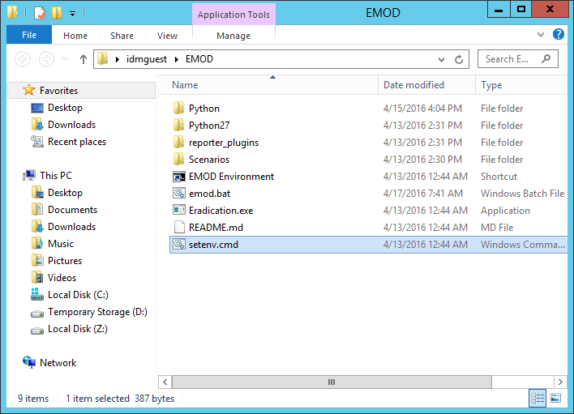
Z Drive
Desktop
  Double-click
    EMOD
EMOD Folder
  Double-click
    setenv.cmd
See & Select
  Local Disk (Z:)

Slide 32
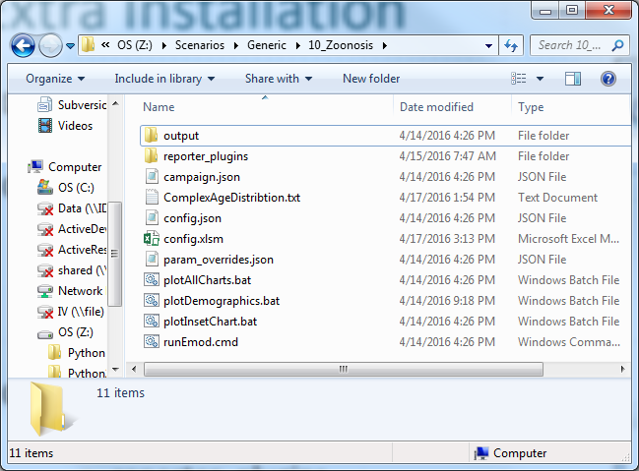
Extra Installation
Start button + Internet Explorer
  http://idmod.org
Select “Symposium” + scroll to bottom
Download & Open emod_basics.zip
Copy
  emod_basics.zip\EMOD_Basics\emod.bat
  To
  Z:\
  Overwrite existing file
Copy
  emod_basics.zip\EMOD_Basics
    reporter_plugins
    ComplexAgeDistribution.txt
    plotDemographics.bat
  To
  Z:\Scenarios\Generic\10_Zoonosis

Slide 33
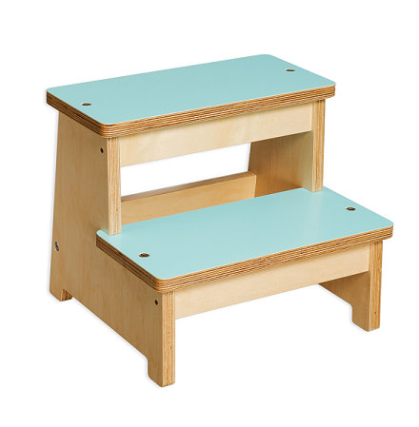
Using EMOD - Introduction
No official UI to EMOD
Excel Front End is tool for getting to know EMOD
  Not main path for running EMOD
  Beta Version
Usually run EMOD from the command line
  Not being covered in this class
Will combine using the Excel Front End with editing JSON files

Slide 34

QuickStart Excel Tips
Windows Key + E = Open Windows Explorer
Always open Excel files from the Z drive
Always save before pressing the button
Close or “Save As” the output data (CSV)
EMOD_Macros.xslm – Ignore

Slide 35
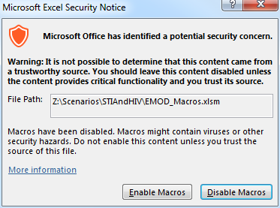
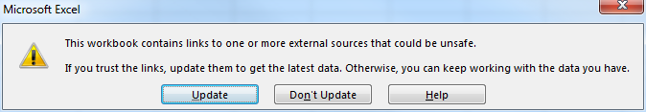
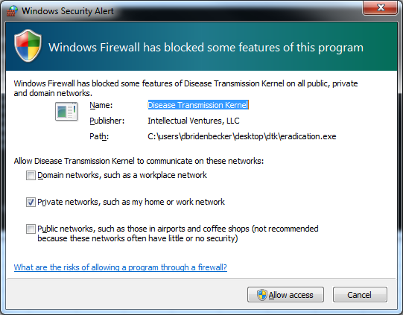

Warnings
Please
  Update, Enable, Allow

Slide 36
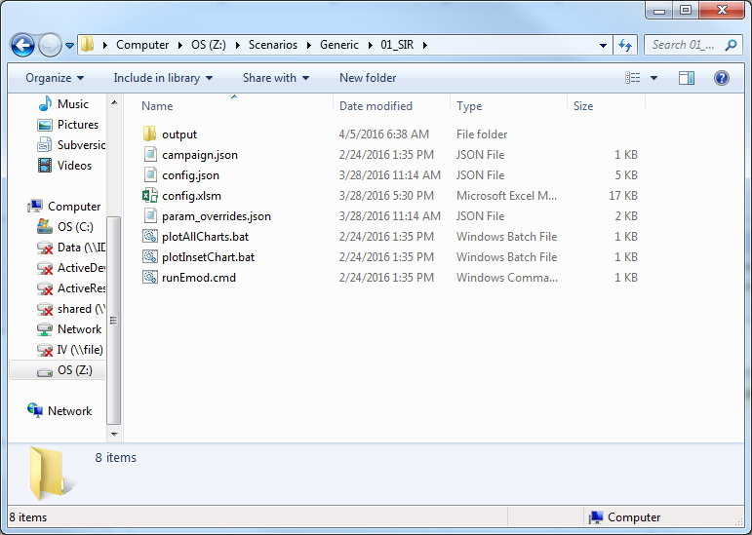
Generic\01_SIR
Open Windows Explorer
  <Windows Key>+E
Navigate to
  Z:\Scenarios\Generic\01_SIR
Open / Double click on
  config.xlsm

Slide 37
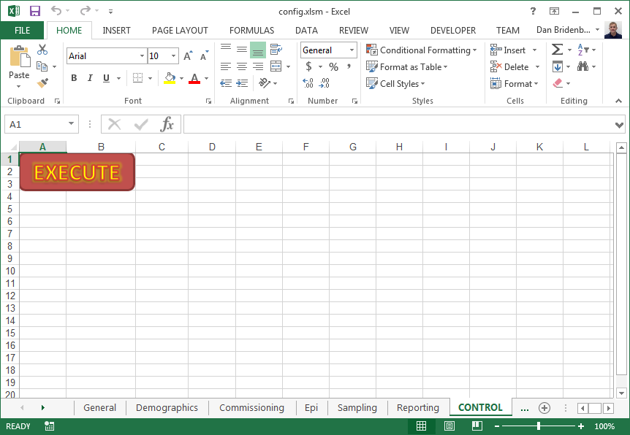
Run Simulation Generic\01_SIR
Select CONTROL tab
Press EXECUTE button

Slide 38
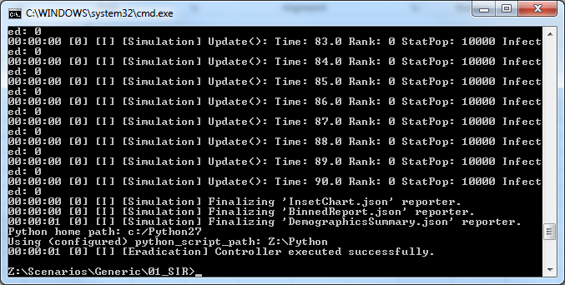
Output Window
Pressing the EXECUTE button will open Command Window for simulation output/logging
Verify you see
  Controller executed successfully
  Raise hand if you don’t

Slide 39
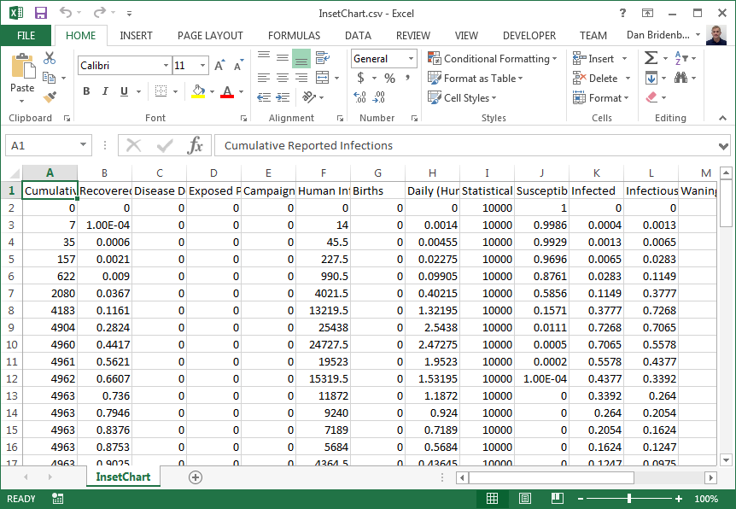
Results Data
Closing Output Window will cause Results data spreadsheet to open
  testing\InsetChart.csv
Installation works!!
  Close InsetChart.csv

Slide 40
Agenda
8:30 | 8:40 |  | Intro to Infectious Disease Modeling
8:40 | 8:50 |  | Why Should I Use EMOD?
8:50 | 9:15 |  | EMOD Architectural Overview
9:15 | 9:30 |  | Using EMOD – Virtual Machine Login
9:30 | 9:40 |  | Break
9:40 | 10:10 |  | Using EMOD - Simulation Configuration - SIR to SEIR
10:10 | 10:50 |  | Using EMOD - Campaigns - Outbreaks, Interventions, Events
10:50 | 11:00 |  | Break
11:00 | 11:45 |  | Using EMOD - Demographics - Population Distributions, Spatial
11:45 | 12:00 |  | Next Steps

Slide 41
Agenda
8:30 | 8:40 |  | Intro to Infectious Disease Modeling
8:40 | 8:50 |  | Why Should I Use EMOD?
8:50 | 9:15 |  | EMOD Architectural Overview
9:15 | 9:30 |  | Using EMOD – Virtual Machine Login
9:30 | 9:40 |  | Break
9:40 | 10:10 |  | Using EMOD - Simulation Configuration - SIR to SEIR
10:10 | 10:50 |  | Using EMOD - Campaigns - Outbreaks, Interventions, Events
10:50 | 11:00 |  | Break
11:00 | 11:45 |  | Using EMOD - Demographics - Population Distributions, Spatial
11:45 | 12:00 |  | Next Steps

Slide 42
Simulation Configuration
Simulation Configuration
Simulation
Node n
Node 2
Intervention Configuration
Report Data
Node 1
Individual n
Campaign
Event
Reporters
Campaign
Event
Campaign
Event
Demographics Data
Individual 2
Individual 1
Error
Handler
Infection
IV
Infection
IV
Logs
Infection
IV
R
Climate Data
Transmission
Susceptibility
V
Random
Number
Generator
C
Migration Data
Migration

Slide 43
Simulation Configuration
Parameters for controlling the entire simulation
  Versus Demographics which control region specific parameters
Categories of parameters include:
  General – Simulation duration, time step size
  Demographics – Scaling, enable/disable - aging, births, deaths
  Commissioning – Excel Front End parameters
  Epi – Incubation, immunity, infectivity
  Sampling – how and rates of sampling
  Reporting – enable / disable and other output controls/reports
config.json

Slide 44
Generic\01_SIR
Open Windows Explorer
  <Windows Key>+E
Navigate to
  Z:\Scenarios\Generic\01_SIR
Open / Double click on
  config.xlsm

Slide 45
Run Simulation Generic\01_SIR
Select CONTROL tab
Press EXECUTE button

Slide 46
Output Window
Pressing the EXECUTE button will open Command Window for simulation output/logging
Verify you see
  Controller executed successfully

Slide 47
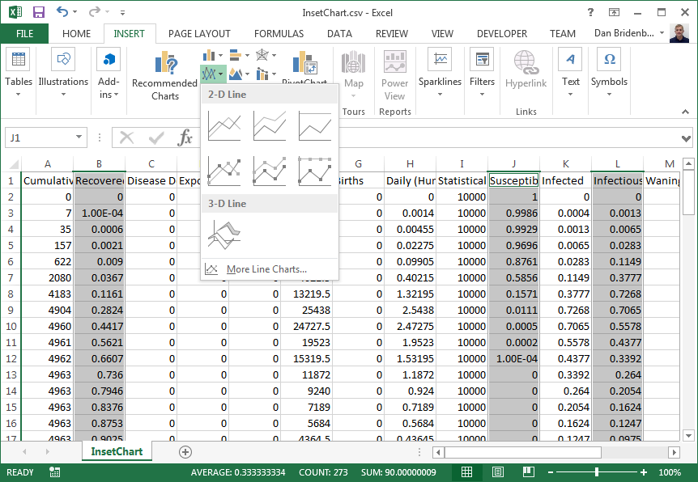
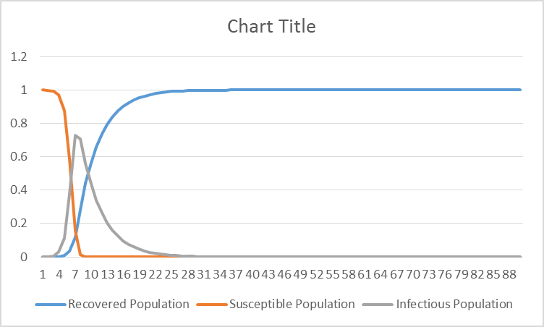
Plotting Results Data
#4
Select columns B, J, L with Ctrl pressed
On Insert tab, select 2-D Line chart
SIR Chart
Explore data
Close Results Data
  InsetChart.csv

Slide 48
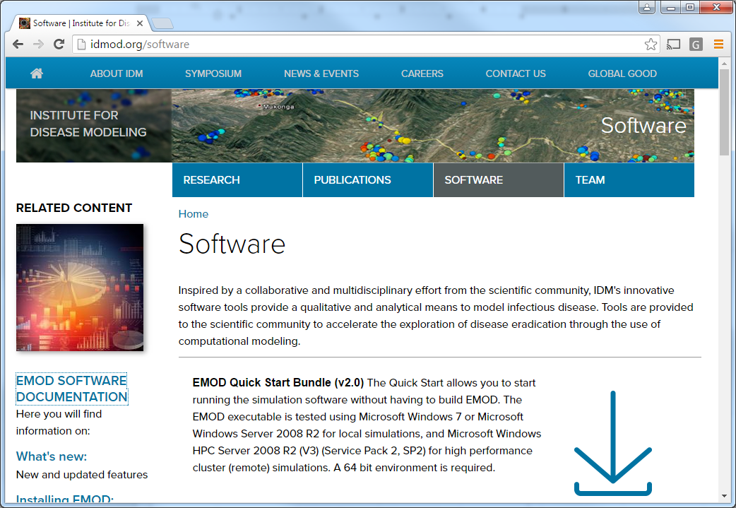
Online Documentation
Open browser and go to
  Idmod.org/software
On right, select
  EMOD Software Documentation

Slide 49
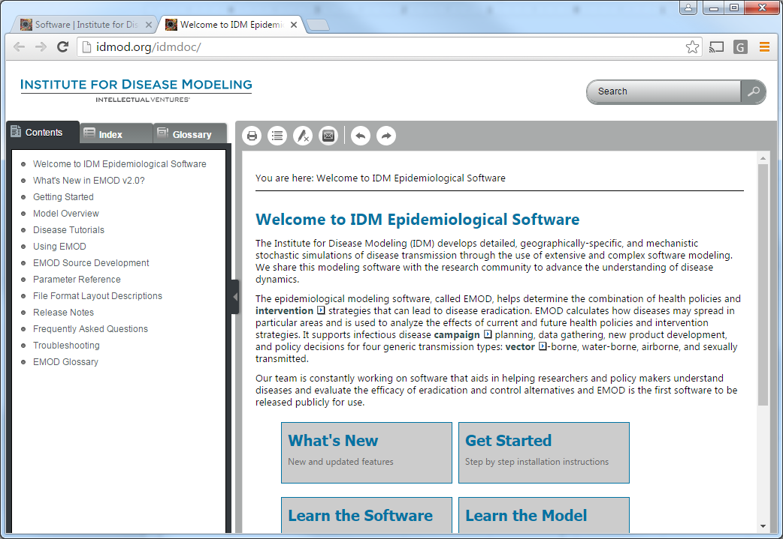
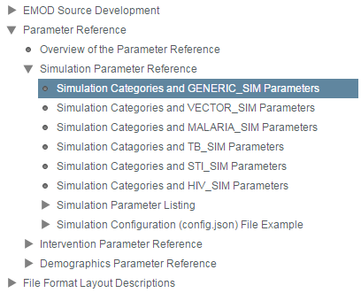
Parameter Reference
Find the Parameter Reference option on the left and select/expand
Expand Simulation Parameter Reference
Select Simulation Categories and GENERIC_SIM Parameters
Select General Disease in Main Window

Slide 50
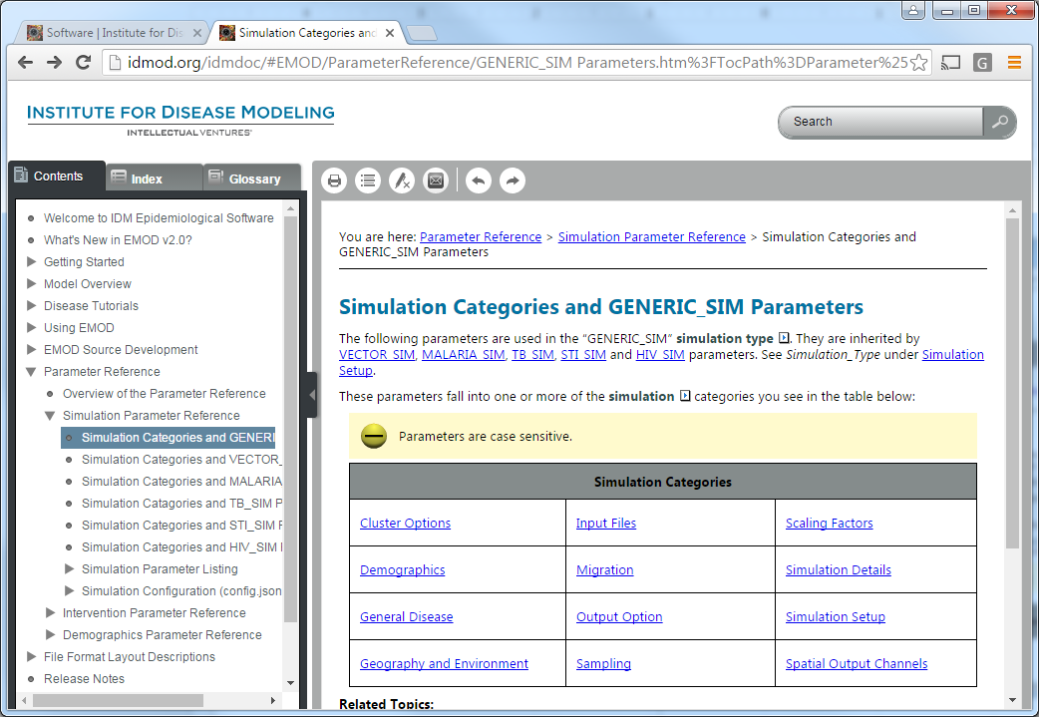
GENERIC_SIM Simulation Parameters
Should be able to find all of the parameters in the spreadsheet
Take a moment to explore

Slide 51
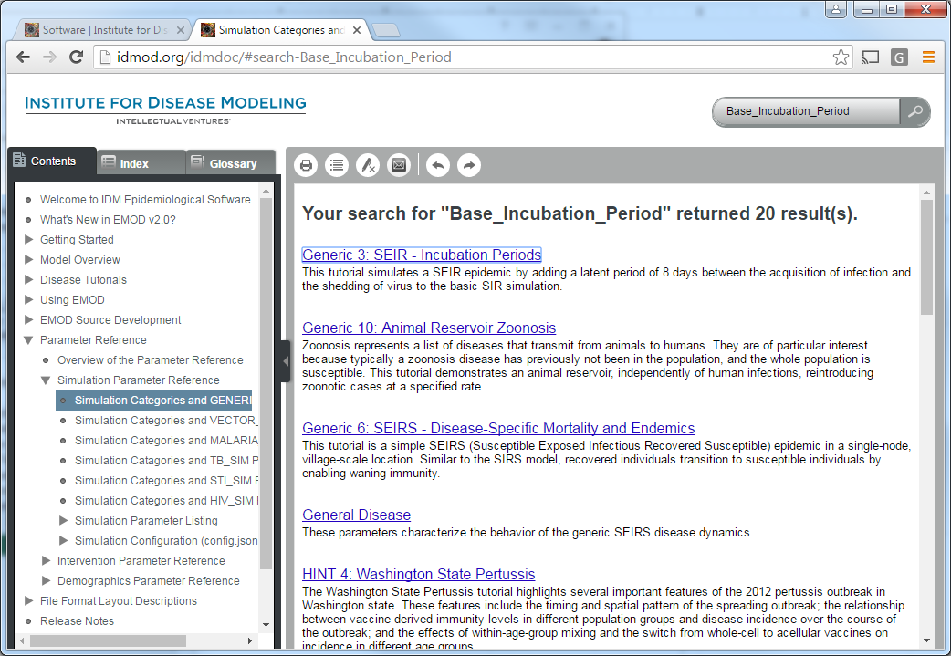
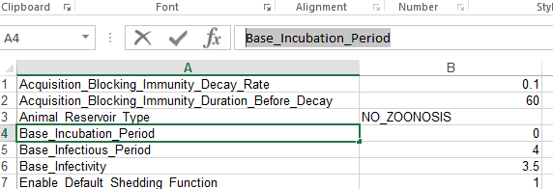
Searching For Parameters
Alternatively, you can search for parameters and find different places where it is discussed
Easy as copying cell in to search bar

Slide 52
Generic\01_SIR
Open Windows Explorer
  <Windows Key>+E
Navigate to
  Z:\Scenarios\Generic\01_SIR
Open / Double click on
  config.xlsm

Slide 53
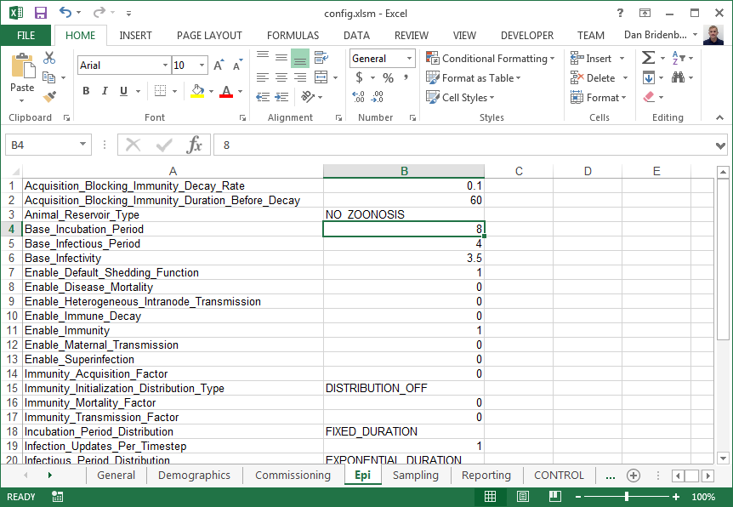
SIR to SEIR
Change
  Base_Incubation_Period
  from 0 to 8
Save the spreadsheet
  Ctrl-S
Go to CONTROL tab

Slide 54
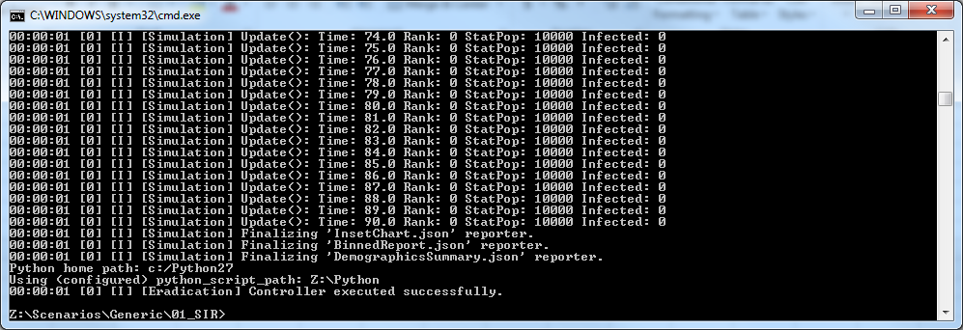
Output Window
See
  Controller executed successfully
Close

Slide 55
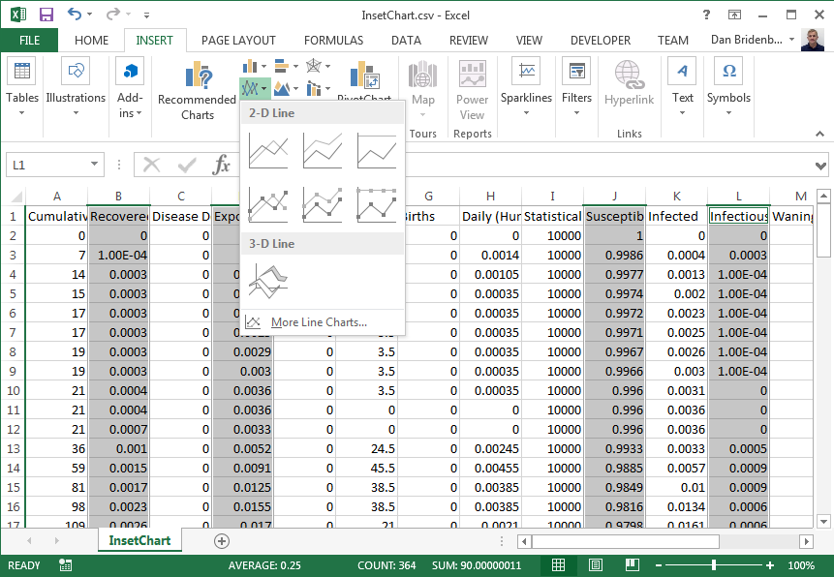
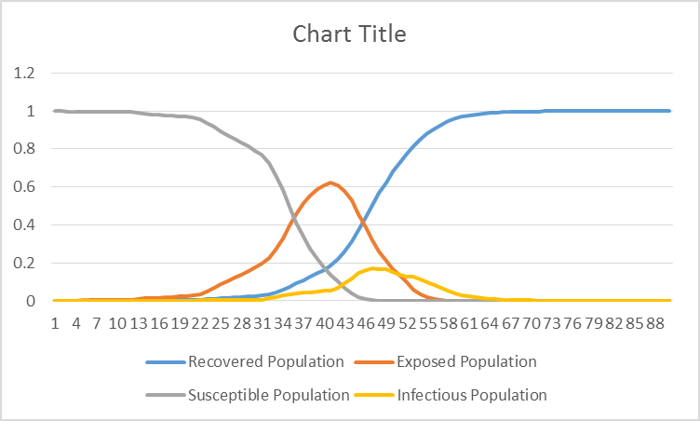
Plot Results Data - SEIR
Select columns B, D, J, L with Ctrl pressed
On Insert tab, select 2-D Line chart
SEIR Chart
Close Results Data
  InsetChart.csv

Slide 56
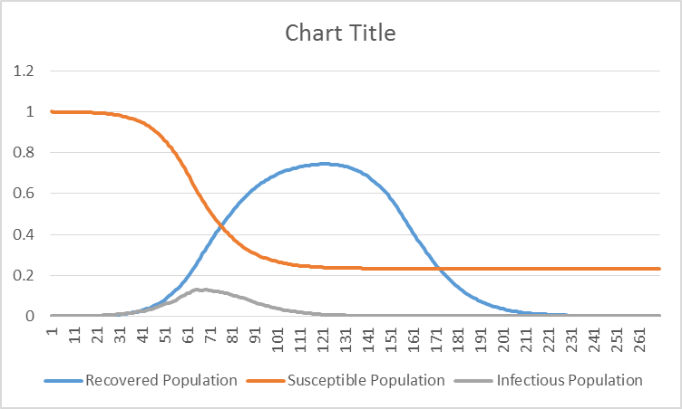
SEIRS to SIRS
Change the following parameters
CONTROL tab
Close output window
Plot columns B, D, J, L
Explore on your own
Don’t forget to Save

Slide 57
Agenda
8:30 | 8:40 |  | Intro to Infectious Disease Modeling
8:40 | 8:50 |  | Why Should I Use EMOD?
8:50 | 9:15 |  | EMOD Architectural Overview
9:15 | 9:30 |  | Using EMOD – Virtual Machine Login
9:30 | 9:40 |  | Break
9:40 | 10:10 |  | Using EMOD - Simulation Configuration - SIR to SEIR
10:10 | 10:50 |  | Using EMOD - Campaigns - Outbreaks, Interventions, Events
10:50 | 11:00 |  | Break
11:00 | 11:45 |  | Using EMOD - Demographics - Population Distributions, Spatial
11:45 | 12:00 |  | Next Steps

Slide 58
Intervention Configuration
Simulation Configuration
Simulation
Node n
Node 2
Intervention Configuration
Report Data
Node 1
Individual n
Campaign
Event
Reporters
Campaign
Event
Campaign
Event
Demographics Data
Individual 2
Individual 1
Error
Handler
Infection
IV
Infection
IV
Logs
Infection
IV
R
Climate Data
Transmission
Susceptibility
V
Random
Number
Generator
C
Migration Data
Migration

Slide 59
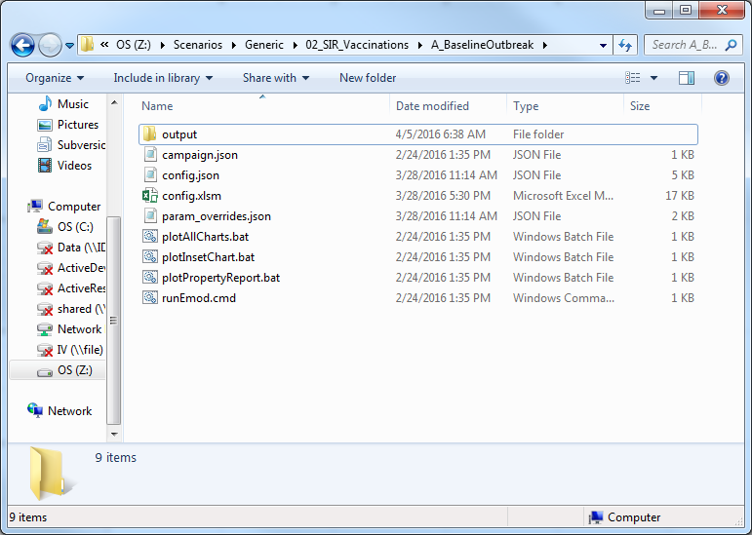
Generic\02_SIR_Vaccinations\A_BaselineOutbreak
Open Windows Explorer
  <Windows Key>+E
Navigate to
  Z:\Scenarios\Generic\02_SIR_Vaccinations\A_BaselineOutbreak
Open / Double click on
  config.xlsm

Slide 60
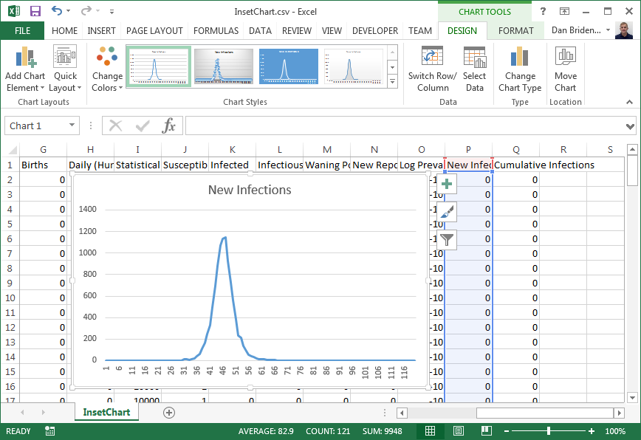
Run and Plot New Infections
Go to CONTROL tab
Close Output Window
Plot column P
“Save As” so we can compare to later

Slide 61
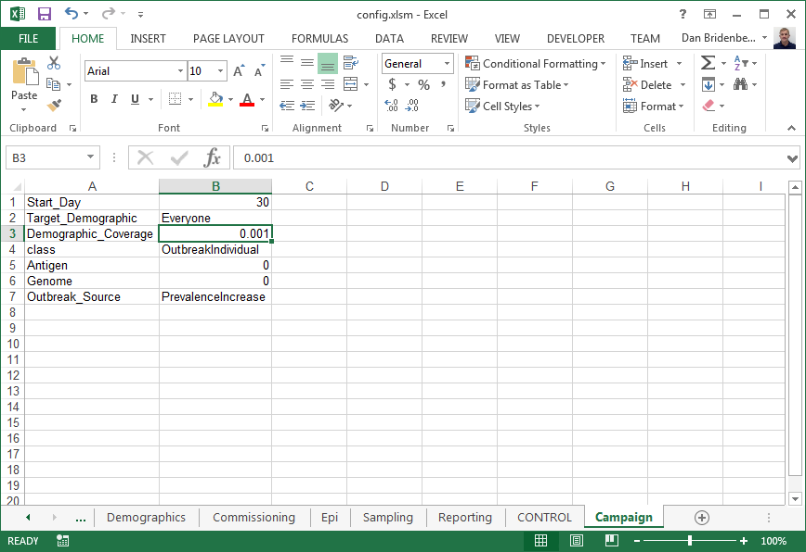
Outbreaks
An outbreak is really an intervention that is used to initiate the disease in the scenario
Notice
  When: day 30
  Who: 0.001 of Everyone
  What: OutbreakIndivudal
Change
  Demographic_Coverage
  From: 0.001
  To: 0.01

Slide 62
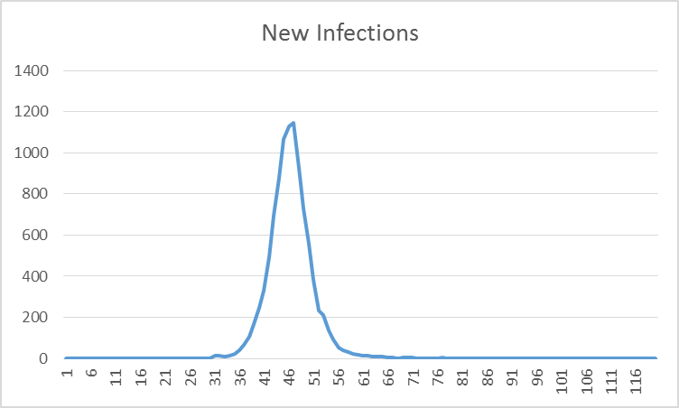
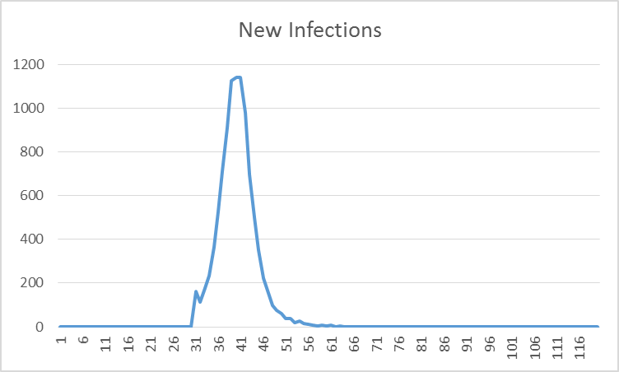
Run and Compare to Saved Plot
Go to CONTROL tab
Close Output Window
Plot column P
Compare to saved plot
Both start on day 30 but infecting 10x more people causes faster rise in number infected.

Slide 63
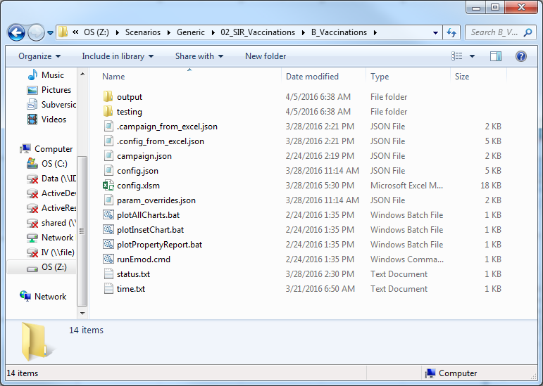
Generic\02_SIR_Vaccinations\B_Vaccinations
Open Windows Explorer
Navigate to
  Z:\Scenarios\Generic\02_SIR_Vaccinations\B_Vaccinations
Open / Double click on
  config.xlsm

Slide 64
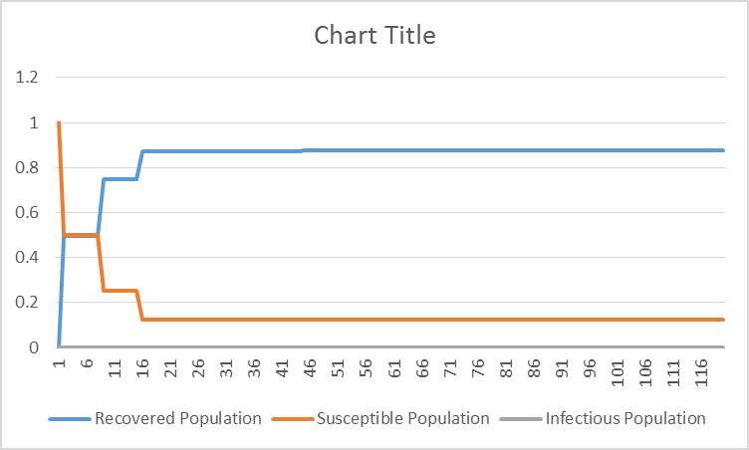
Run and Plot SIR Data
Go to CONTROL tab
Close Output Window
Plot B, J, L
Close InsertChart.csv

Slide 65
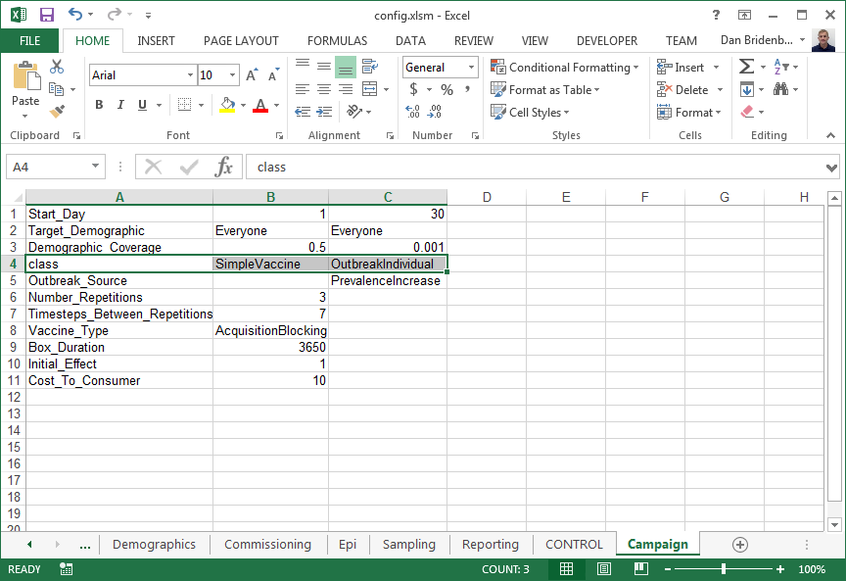
SimpleVaccine
Scenario B adds distributing a vaccine to 50% of population on day 1
Distributing
  SimpleVaccine - Day 1
  OutbreakIndividual - Day 30

Slide 66
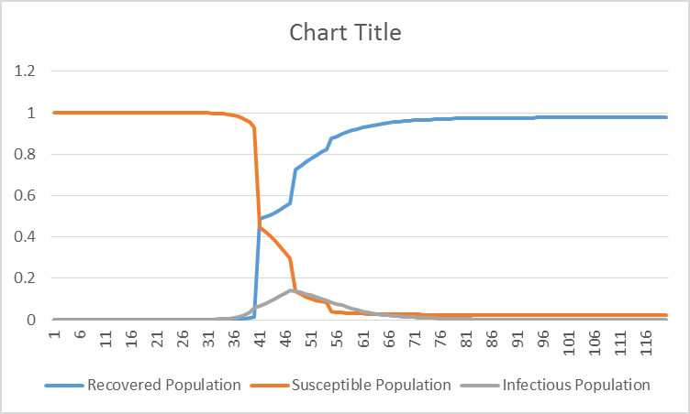
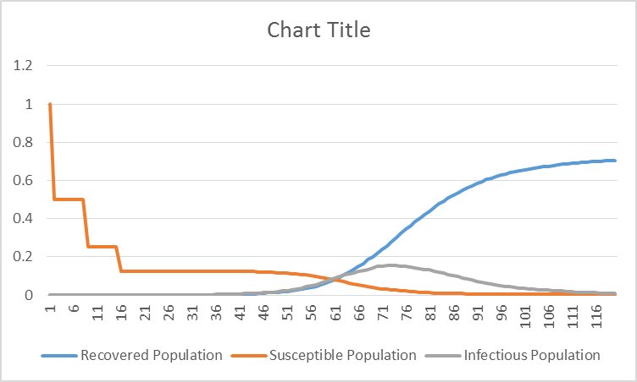
SimpleVaccine Experiments
Experiment with a couple of parameters of SimpleVaccine
Plot columns B, J, & L seeing how things change
Start_Day = 40
Initial_Effect= 0.5

Slide 67
Campaign File
{ When, Where
{ Who
{ Why
{ What
}
}
}
}
JSON Format
Defines
  When an intervention is distributed
  Where it is distributed
  Who it is distributed to
  Why it is being distributed
  What intervention to distribute
Simulation Configuration
  Enable_Interventions
  Campaign_Filename
  Listed_Events

Slide 68
JSON Format
Comma since next element
Value
Key
No spaces in Key
Colon
Separator
Key-Value Pairs
  No duplicate keys in same object (EMOD)
Every { needs a }
Commas
  Means “another key coming”
  After all values but last
Keys are case sensitive
  “NodeID” vs “NodeId”
Decimals require a zero
Our booleans are 0 or 1 (EMOD)
Every [ needs a ]
If you open it, close it
Useful links
  http://www.w3schools.com/json/
  http://jsonlint.com/
Values can have spaces
Open
{
"Start_Day" : 5,
"Event_Name" : "Give Vaccine",
"Demographic_Coverage": 0.8,
"Is_Moving" : 1,
"Ages" : [ 5, 15, 25, 35 ],
"Intervention_Config" :
{
"class" : "SimpleVaccine",
"Trigger_Condition_List" :
[
"InitialPopulation",
"Birth",
"Waiting"
]
}
}
Close
}
Need leading zero
No comma after last element
Close

Slide 69
Generic\01_SIR - Campaign File
Many elements removed for illustration purposes
{
"Events": [
],
"Use_Defaults": 1
}
{
}
Array of CampaignEvents
"Event_Coordinator_Config": {
},
"Event_Name": "Outbreak",
"Nodeset_Config": {
"class": "NodeSetAll"
},
"Start_Day": 1,
"class": "CampaignEvent"
}
Who
"Demographic_Coverage": 0.0005,
"Intervention_Config": {
},
"Target_Demographic": "Everyone",
"class": "StandardInterventionDistributionEventCoordinator"
"Antigen": 0,
"Genome": 0,
"Outbreak_Source": "PrevalenceIncrease",
"class": "OutbreakIndividual"
What
Who in the node it goes to
Where
What nodes this goes to
When
0 = User must define every parameter
1 = Default values will be used for all parameters undefined

Slide 70
Generic\02_SIR_Vaccinations\B_Vaccinations
Many elements removed for illustration purposes
{ "Event_Coordinator_Config": {
},
"Nodeset_Config": { "class": "NodeSetAll" },
"Start_Day": 1,
"class": "CampaignEvent"
},
{ "Event_Coordinator_Config": {
},
"Nodeset_Config": { "class": "NodeSetAll" },
"Start_Day": 30,
"class": "CampaignEvent"
}
"Demographic_Coverage": 0.5,
"Intervention_Config": {
},
"Number_Repetitions": 3,
"Target_Demographic": "Everyone",
"Timesteps_Between_Repetitions": 7,
"class": "StandardInterventionDistributionEventCoordinator"
"Demographic_Coverage": 0.001,
"Intervention_Config": { },
"Target_Demographic": "Everyone",
"class": "StandardInterventionDistributionEventCoordinator"
"Vaccine_Type": "AcquisitionBlocking",
"class": "SimpleVaccine"
"class": "OutbreakIndividual"
Things to notice:
  Two elements in Events array
  First CampaignEvent starts on Day 1 and distributes SimpleVaccine
  Second starts on Day 30 and distributes OutbreakIndividual
What
Who
Where
When
What
Who
Where
When

Slide 71
The What - Interventions
Node Targeted Interventions
Node Targeted
  Interventions that target all of the entities of the region
  Others live at the node level listening for changes to individuals and will distribute Individual Targeted interventions
Individual Targeted
  Interventions that target the specific people of a node

Slide 72
Individual Targeted Interventions

Slide 73
Agenda
8:30 | 8:40 |  | Intro to Infectious Disease Modeling
8:40 | 8:50 |  | Why Should I Use EMOD?
8:50 | 9:15 |  | EMOD Architectural Overview
9:15 | 9:30 |  | Using EMOD – Virtual Machine Login
9:30 | 9:40 |  | Break
9:40 | 10:10 |  | Using EMOD - Simulation Configuration - SIR to SEIR
10:10 | 10:50 |  | Using EMOD - Campaigns - Outbreaks, Interventions, Events
10:50 | 11:00 |  | Break
11:00 | 11:45 |  | Using EMOD - Demographics - Population Distributions, Spatial
11:45 | 12:00 |  | Next Steps

Slide 74
Agenda
8:30 | 8:40 |  | Intro to Infectious Disease Modeling
8:40 | 8:50 |  | Why Should I Use EMOD?
8:50 | 9:15 |  | EMOD Architectural Overview
9:15 | 9:30 |  | Using EMOD – Virtual Machine Login
9:30 | 9:40 |  | Break
9:40 | 10:10 |  | Using EMOD - Simulation Configuration - SIR to SEIR
10:10 | 10:50 |  | Using EMOD - Campaigns - Outbreaks, Interventions, Events
10:50 | 11:00 |  | Break
11:00 | 11:45 |  | Using EMOD - Demographics - Population Distributions, Spatial
11:45 | 12:00 |  | Next Steps

Slide 75
Demographics Data
Simulation Configuration
Simulation
Node n
Node 2
Intervention Configuration
Report Data
Node 1
Individual n
Campaign
Event
Reporters
Campaign
Event
Campaign
Event
Demographics Data
Individual 2
Individual 1
Error
Handler
Infection
IV
Infection
IV
Logs
Infection
IV
R
Climate Data
Transmission
Susceptibility
V
Random
Number
Generator
C
Migration Data
Migration

Slide 76
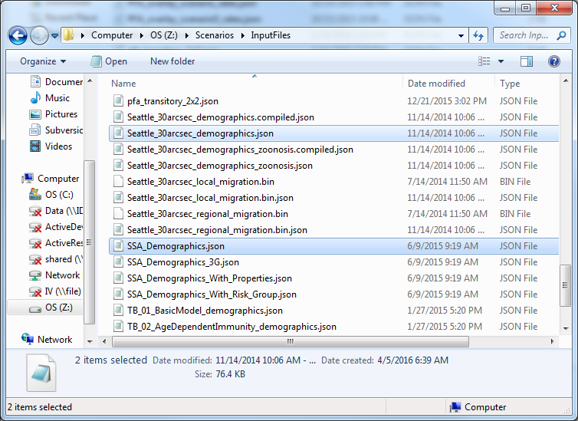
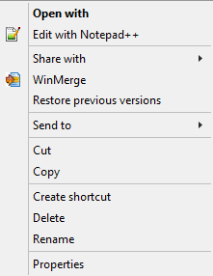
Examples
Z:\Scenarios\InputFiles
  generic_scenarios_demographics.json
  SSA_Demographics.json
  Seattle_30arcsec_demographics.json
Right-Click and select
  Edit with Notepad++

Slide 77
generic_scenarios_demographics.json
Many elements removed for illustration purposes
{
"Metadata": {
"DateCreated": "Sun Sep 25 23:19:55 2011",
"NodeCount": 1
},
"Defaults": {},
"Nodes": [
{
"NodeID": 1,
"NodeAttributes": {
"Latitude": 0,
"Longitude": 0,
"InitialPopulation": 10000
},
"IndividualAttributes": {
"AgeDistributionFlag": 3,
"AgeDistribution1": 0.000118,
"AgeDistribution2": 0,
"MortalityDistribution": {
"NumDistributionAxes": 2
}
}
}
]
}
Metadata
  Provenance Information
Defaults
  Default values for nodes
  In this example, everything for Node 1 could be in Defaults except NodeID
Nodes
  Node specific information
  Minimum is one entry for each node with the NodeID element
  NodeAttributes
    Node-level attributes such as location and initial population
  IndividualAttributes
    Information about the individuals of the node

Slide 78
Seattle_30arcsec_demographics.json
{
"Metadata": { },
"Defaults": {
"NodeAttributes": { },
"IndividualAttributes": {
"AgeDistributionFlag": 1,
"AgeDistribution1": 0,
"AgeDistribution2": 21900
}
},
"Nodes": [
{ "NodeID": 1,
"NodeAttributes": {
"Latitude": 47.72628134,
"Longitude": -122.2887375,
"InitialPopulation": 5530
}
},
{ "NodeID": 2,
"NodeAttributes": {
"Latitude": 47.72663842,
"Longitude": -122.3099881,
"InitialPopulation": 7345
}
}
]
}
Many elements removed for illustration purposes
Defaults
  Simple distributions
Nodes
  124 elements / nodes in the array
  Each node has a specific location and initial population
  Anything defined in the defaults could be defined differently for specific nodes

Slide 79
SSA_Demographics.json
Many elements removed for illustration purposes
{
"Metadata":
{
"RegionName": "Sub-Saharan Africa: Single Node",
"DataSource": "UN Population Division, ..."
},
"Defaults":
{
"NodeAttributes": { },
"IndividualAttributes":
{
"FertilityDistribution" : { },
"MortalityDistributionMale" : { },
"MortalityDistributionFemale" : { },
"AgeDistribution" : { }
}
},
"Nodes": [
{
"NodeID": 1,
"NodeAttributes":
{
"InitialPopulation": 17396000,
}
}
]
}
Metadata
  Good example of recording provenance information
Defaults
  Contains bulk of information even though only one node
  Detailed distributions are provided since data is available

Slide 80
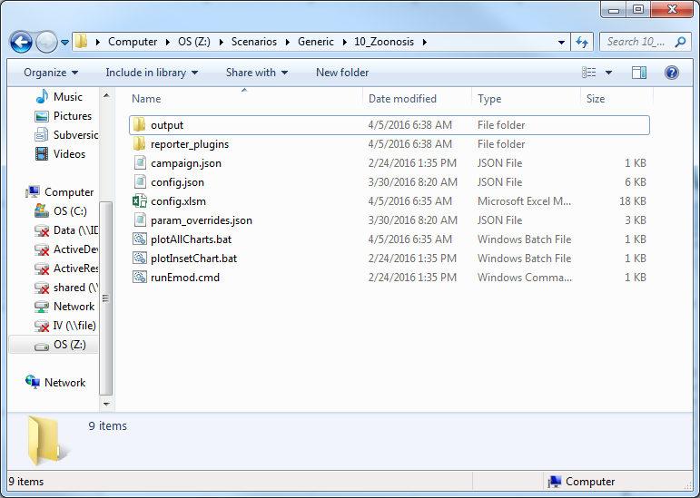
Generic\10_Zoonosis
Open Windows Explorer
Navigate to
  Z:\Scenarios\Generic\10_Zoonosis
Open / Double click on
  config.xlsm

Slide 81
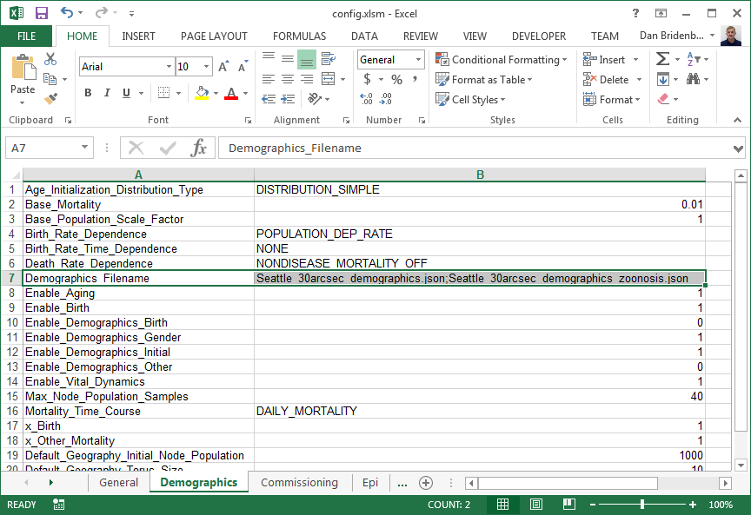
Demographics File
Simulation Configuration Parameter
  Demographics_Filename
File can be located in
  Current Working Directory
  Input Directory
    Specified on command line

Slide 82
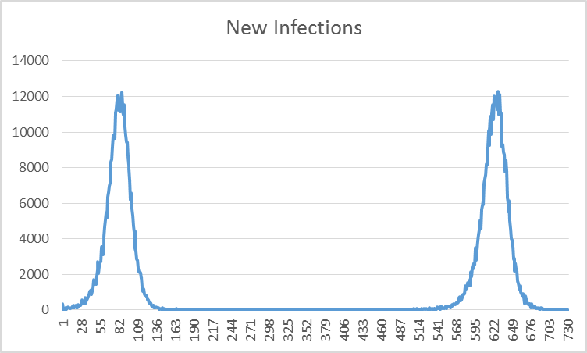
Run and Plot New Infections
Go to CONTROL tab
Close Output Window
Plot column P
Close InsetChart.csv

Slide 83
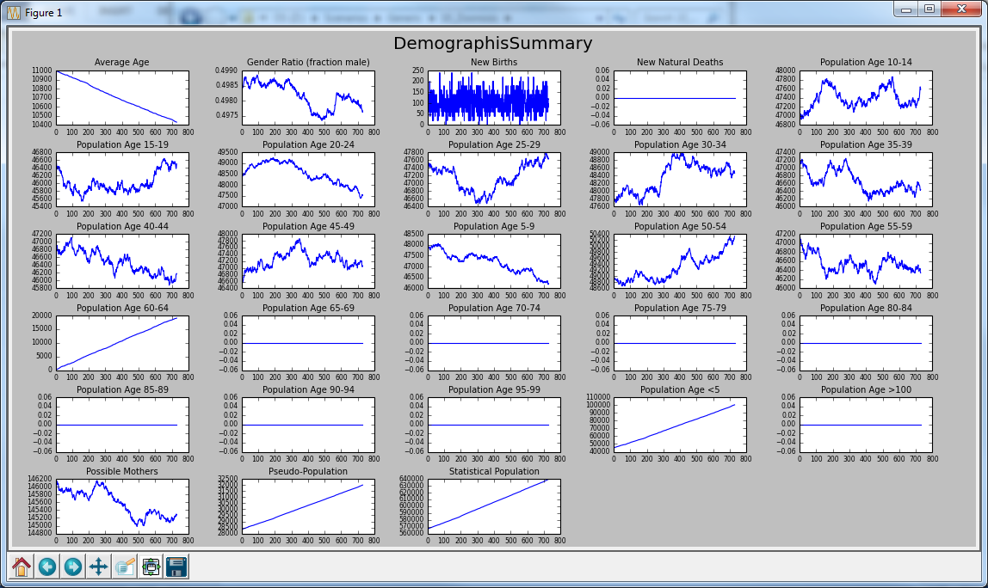
DemographicsSummary.json
Double-click on
  plotDemographics.bat
Batch file should open a window showing the population in different age ranges
Notice population exists between 0 and 64, but how 60-64 starts at 0 and climbs

Slide 84
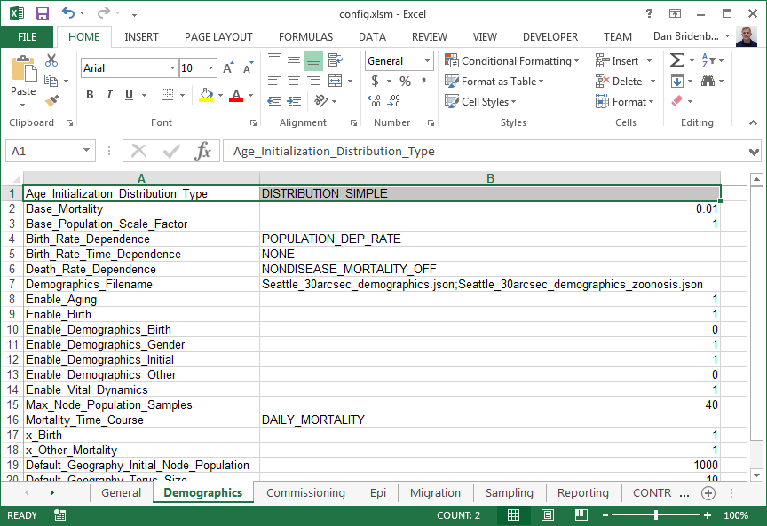
Age_Initialization_Distribution_Type & AgeDistributionFlag
DISTRIBUTION_SIMPLE indicates that the AgeDistributionFlag parameters are to be used.
Notice that these flags say to initialize the population with ages uniformly distributed between 0 and 60 years (=21900 days)
Seattle_30arcsec_demographics.json
"Defaults": {
"IndividualAttributes": {
"AgeDistributionFlag“ : 1,
"AgeDistribution1“ : 0,
"AgeDistribution2“ : 21900
}
}

Slide 85
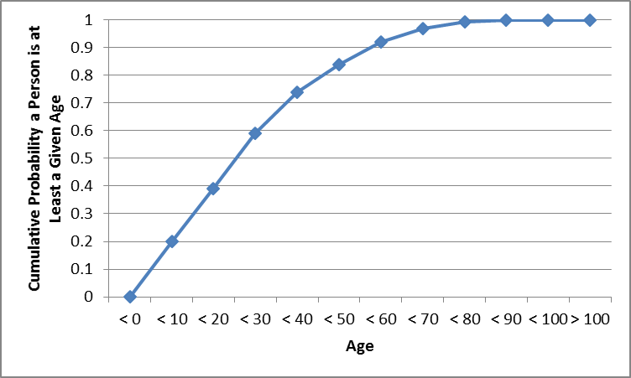
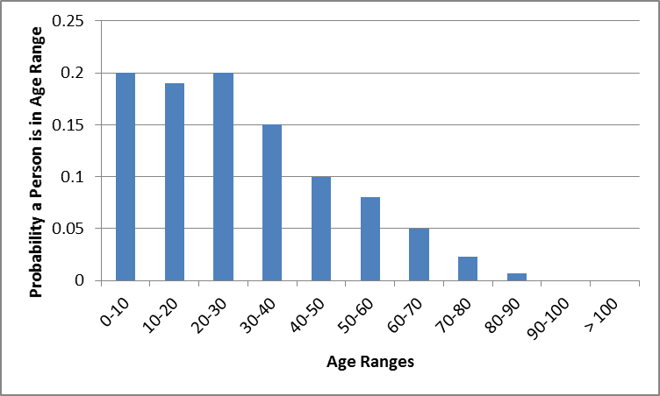
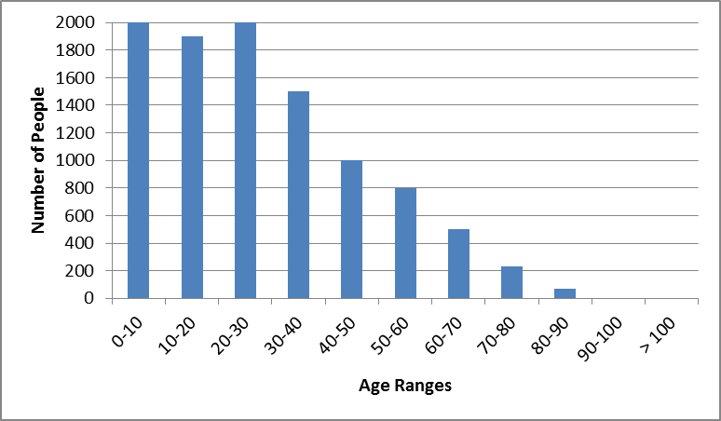
“Real Data” Example
Convert real data to a Cumulative Distribution Function (CDF)
10,000 Total

Slide 86
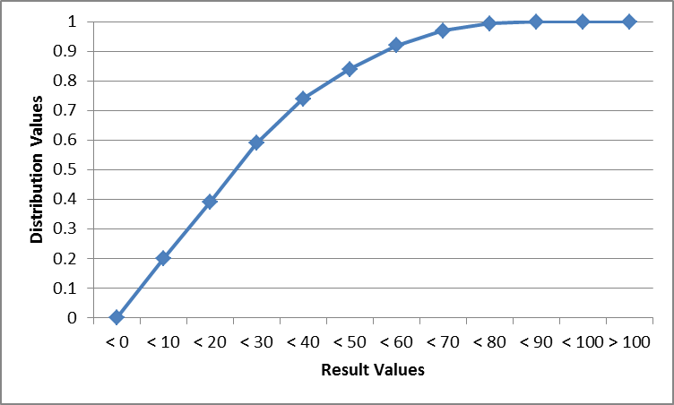
“Real Data” Example (cont.)
DistributionValues represent a cumulative distribution function (CDF)
Linear interpolation is performed between the points
"AgeDistribution": {
"ResultScaleFactor": 365,
"ResultValues": [ 0, 10, 20, 30, 40, 50, 60, 70, 80, 90, 100 ],
"DistributionValues": [ 0, 0.2, 0.39, 0.59, 0.74, 0.84, 0.92, 0.97, 0.993, 1.0, 1.0 ]
},
Used to convert ResultValues to units of days
Ages
CDF

Slide 87
“Real Data” Example (cont.)
Open
  Z:\Scenarios\Generic\10_Zoonosis\ComplexAgeDemographics.txt
Open
  Z:\Scenarios\InputFiles\Seattle_30arcsec_demographics.json
ComplexAgeDemographics.txt
Seattle_30arcsec_demographics.json
"AgeDistribution": {
"ResultScaleFactor": 365,
"ResultValues": [ 0, 10, ..., 100 ],
"DistributionValues": [ 0, 0.2, ..., 1.0 ]
},
"Defaults": {
"IndividualAttributes": {
"AgeDistributionFlag“ : 1,
"AgeDistribution1“ : 0,
"AgeDistribution2“ : 21900
}
}
Copy & Paste/
Insert

Slide 88
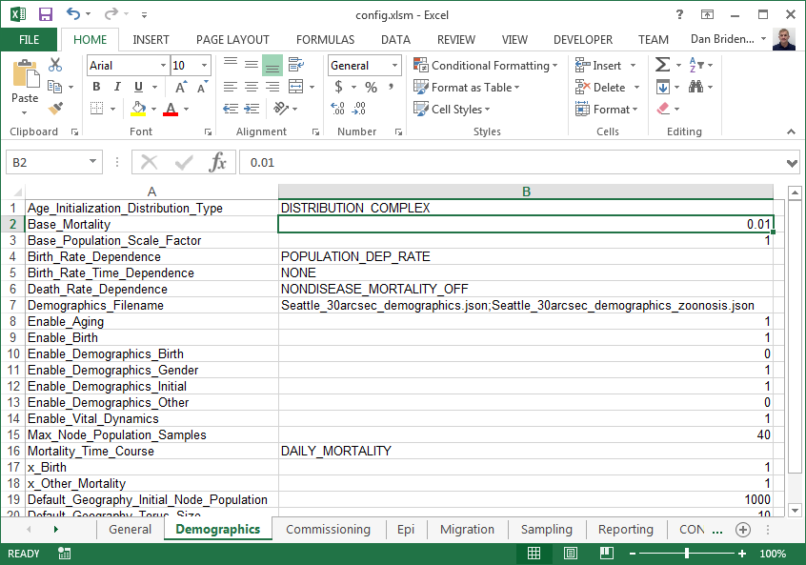
“Real Data” Example (cont.)
Change
  Age_Initialization_Distribution_Type
  From: DISTRIBUTION_SIMPLE
  To: DISTRIBUTION_COMPLEX
CONTROL tab
Close Output Window
Close InsetCharts.csv
Double-click plotDemographics.bat

Slide 89
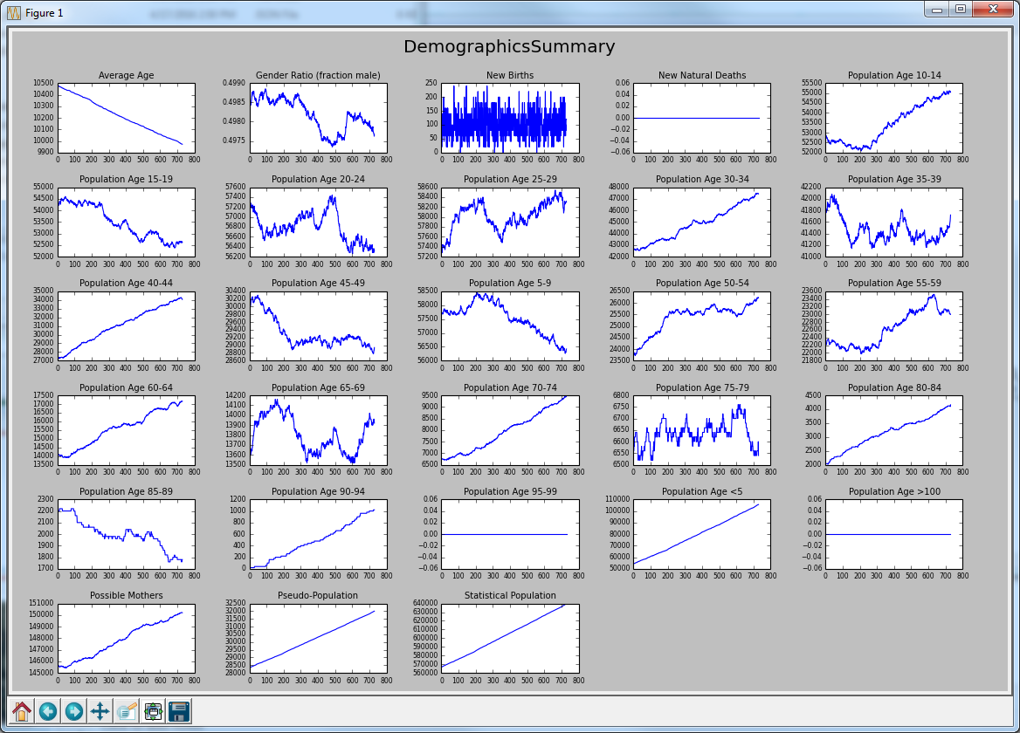
“Real Data” Example (cont.)
Notice how the distribution of ages has changed.
Explore

Slide 90
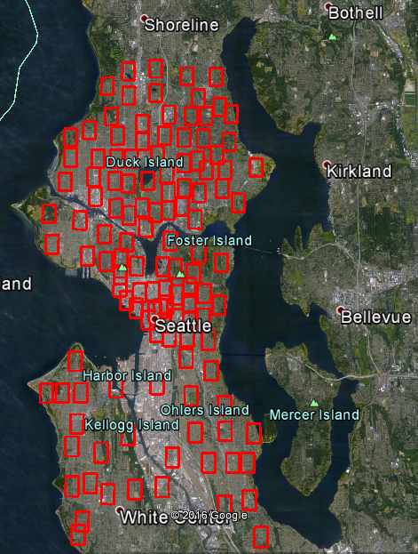
Spatial Scenarios
Why?
  Disease is affected by location based effects
    Climate
    Population.
  Calibrating against data for multiple regions.
Typically you’ll need
  Multiple Nodes with different populations
  Migration rates between nodes

Slide 91
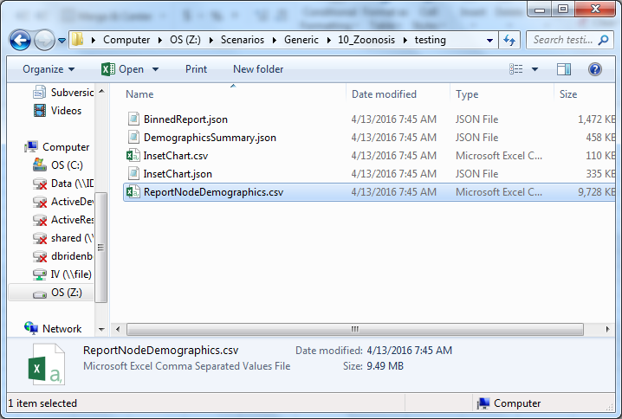
Generic\10_Zoonosis
Sampling tab
  Base_Individual_Sample_Rate
    0.05 to 1
Demographics tab
  Base_Population_Scale_Factor
    1 to 0.1
CONTROL tab
Navigate to
  Z:\Scenarios\Generic\10_Zoonosis\testing
Open ReportNodeDemographics.csv

Slide 92
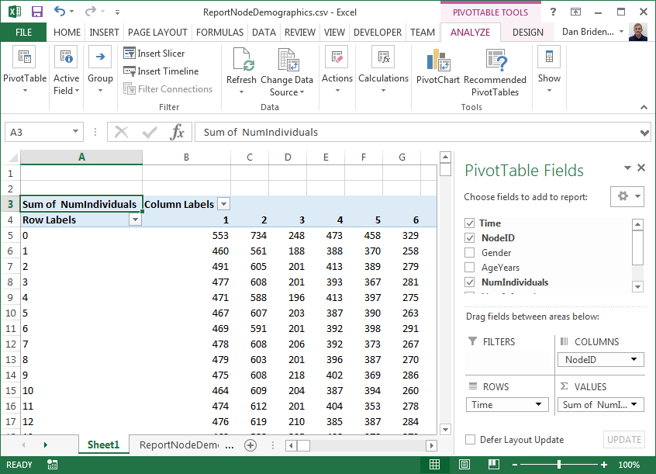
ReportNodeDemographics
Seattle_30arcsec_demographics.json
{ "NodeID": 1,
"NodeAttributes": { "InitialPopulation": 5530 }
},
{ "NodeID": 2,
"NodeAttributes": { "InitialPopulation": 7345 }
},
{ "NodeID": 3,
"NodeAttributes": { "InitialPopulation": 2485 }
},
Select columns A-F
On Insert tab select Pivot Table
Press Ok on Create Pivot Table dialog
Drag
  Time to ROWS
  NodeID to COLUMNS
  NumIndividuals to VALUES
Sum of NumIndividuals
  Click Count of NumIndividuals
  Select Value Field Settings
  Select Sum
Notice 10% of initial population due to Base_Population_Scale_Factor

Slide 93
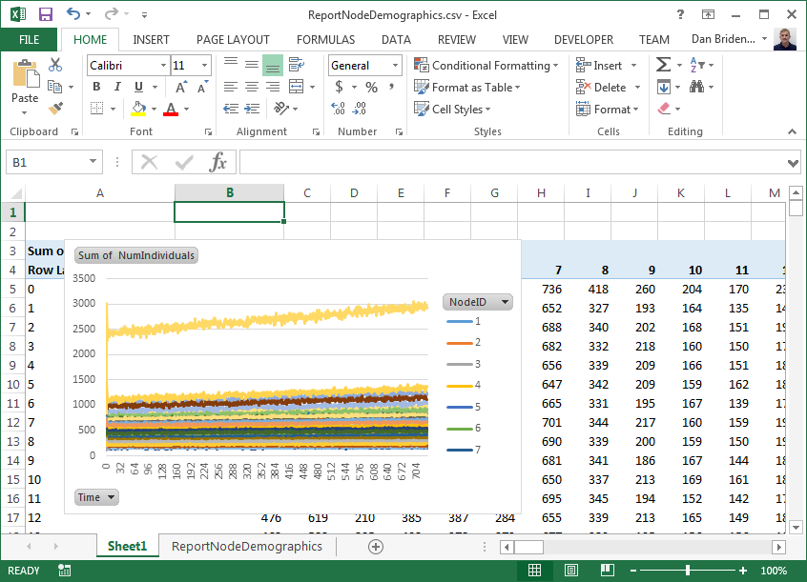
Migration
Look at data in columns or Plot Pivot Chart selecting Line Plot
Notice how the population is changing in each node

Slide 94

Migration (cont.)
On Migration tab
  Enable_Local_Migration
    1 to 0
  Enable_Regional_Migration
    1 to 0
On CONTROL tab

Slide 95

Migration (cont.)
Open ReportNodeDemographics.csv
Select columns A-F
On Insert tab select Pivot Table
Drag
  Time to ROWS
  NodeID to COLUMNS
  NumIndividuals to VALUES
Sum of NumIndividuals
  Click Count of NumIndividuals
  Select Value Field Settings
  Select Sum
Notice populations are near constant.

Slide 96

Migration (cont.)
In InsetChart.csv
  Select column P
  Plot Line chart
Notice how the infection has not spread since people are not migrating
Explore
With Migration
Without Migration

Slide 97
Agenda
8:30 | 8:40 |  | Intro to Infectious Disease Modeling
8:40 | 8:50 |  | Why Should I Use EMOD?
8:50 | 9:15 |  | EMOD Architectural Overview
9:15 | 9:30 |  | Using EMOD – Virtual Machine Login
9:30 | 9:40 |  | Break
9:40 | 10:10 |  | Using EMOD - Simulation Configuration - SIR to SEIR
10:10 | 10:50 |  | Using EMOD - Campaigns - Outbreaks, Interventions, Events
10:50 | 11:00 |  | Break
11:00 | 11:45 |  | Using EMOD - Demographics - Population Distributions, Spatial
11:45 | 12:00 |  | Next Steps

Slide 98



Roadmap to Research with EMOD
IDM
Pit Crew
Quick Start
Tutorials
Source
Code
EMOD Basics
Class
Calibration
HPC /
COMPS
Analysis
Tools
Experiment
Building
Visualization
Tools
Research

Slide 99

QuickStart Disease Tutorials
The Disease Tutorials are meant to inform the reader about the disease specific details of the model.
Tutorials include
  Generic
  HINT
  Vector & Malaria
  Tuberculosis (TB)
  STI & HIV

Slide 100

Source Code on GitHub
Source code is now available on GitHub
Source code is useful for:
  Information
  Creating custom reports
  Creating custom interventions
  Creating new disease models
C++ & Python
Attend session on building EMOD

Slide 101
Computational Modeling Platform Service (COMPS)
Web
Databases
Web
Databases
Workers
HPC Clusters
Workers
User Interface
( Dashboard, Search, Output Data Visualization, Geospatial Visualization, Input Data Visualization )
User Interface
Input File Creation Workers
Job, Asset, Suites, Experiments, Simulations, Work Items
Input File Creation
Simulation Data Storage
Demographics
Simulation Building
Ask us.
We might have the input data you need
Clients
RESTful API
Merge Nodes
On Premise
Search Service
SQL Server
( Fail Over )
Nan Check
Asset Service
HPC Job Scheduling
RESTful API
Builder Worker
Authentication
Input File Creation
Iterative Algorithms
HPC Job Scheduling Worker
Usage Metrics
Climate Data Storage
Climate Data Storage
Clean up Worker
Clean up
Work Items
Worker Hosting Service
Azure
Postgres SQL
High Performance Storage Area Network

Slide 102
Further Steps
IDM
Pit Crew
Work with your IDM Pit Crew on
  Experiment Building
  Calibration
  Analysis Tools
  Visualization Tools
IDM Pit Crew
  Support – IDMSupport@intven.com
  IDM Research Collaborator
Let us help you get started

Slide 103
Review
Simulation Configuration
Simulation
Node n
Node 2
Intervention Configuration
Report Data
Node 1
Individual n
Campaign
Event
Reporters
Campaign
Event
Campaign
Event
Demographics Data
Individual 2
Individual 1
Error
Handler
Infection
IV
Infection
IV
Logs
Infection
IV
R
Climate Data
Transmission
Susceptibility
V
Random
Number
Generator
C
Migration Data
Migration

