Slide 1
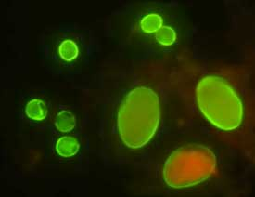
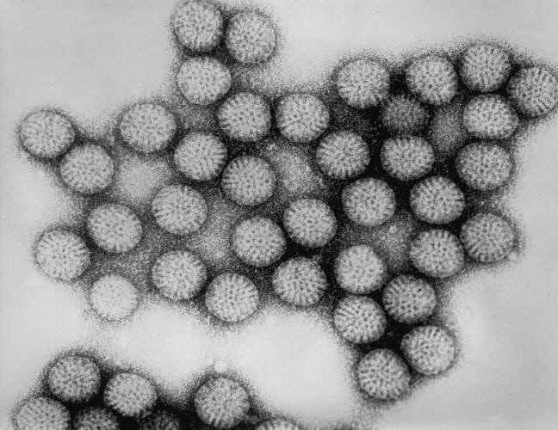
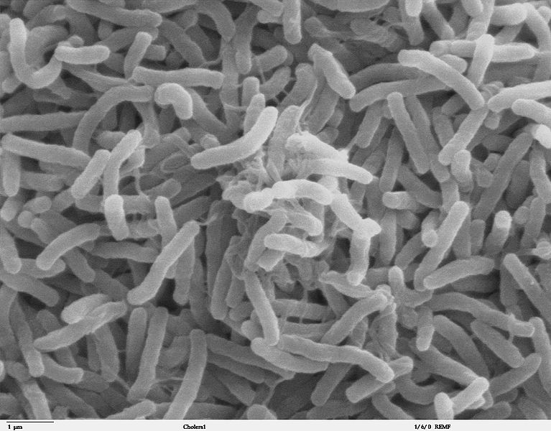
The Role of
Environmental Processes in
Infectious Disease Dynamics
Andrew Brouwer
University of Michigan

Slide 2
Acknowledgements
Funding: Models of Infectious Disease Agent Study (MIDAS)
Collaborators:
  Joseph Eisenberg, University of Michigan
  Marisa Eisenberg, University of Michigan
  Rafael Meza, University of Michigan
  Justin Remais, UC Berkeley

Slide 3
Outline
Role of the environment in infectious disease systems
Updating a SIR-with-environment model
  Pathogen persistence: mechanisms of decay
  Pathogen infectivity: dose-response

Slide 4
The role of the environment
Historically, classical SIR dynamics, which do not explicitly model the environment, have been very successful at modeling outbreaks.
However, the environment mediates transmission for many pathogens, which can impact dynamics. This occurs in a variety of media: water, air, food, fomites, etc.

Slide 5
The role of the environment
Mitigation is often uses environmental interventions: water treatment, hand-washing, surface decontamination etc.
Explicitly modeling the environment allows consideration of environmental interventions, pathogen persistence and transport, and the variability of pathogen dose.

Slide 6
EITS model
Environmental Infection Transmission System (EITS) model (Li, 2009), one model that explicitly considers the role of the environment.
S
susceptible
I
infected
R
recovered
pick-up
shedding
E
pathogens in environment

Slide 7
Goal
Advance modeling framework in two areas:
  Pathogen fate
  Pathogen infectivity

Slide 8
Fate and Transport
Analysis of the EITS model demonstrated that the relationship between the pathogen pick-up rate and the pathogen die-off rate mediates between frequency- and density-dependent dynamics.
Explicitly modeling pathogens in the environment allows consideration of spatial pathogen transport and the impact of deviations from expected pathogen decay.

Slide 9
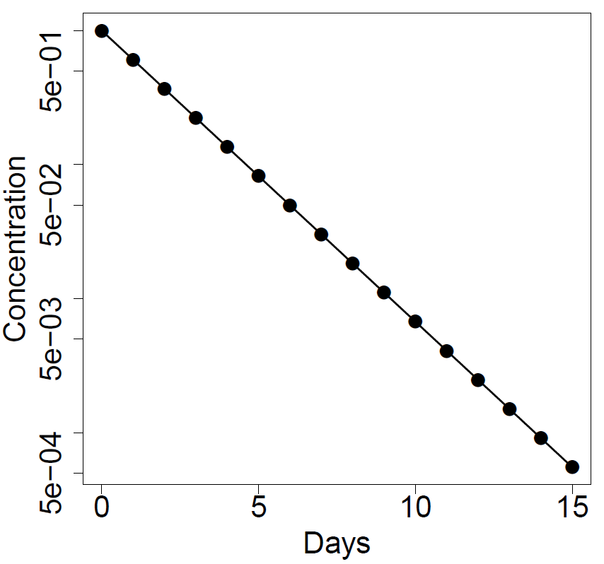
Pathogen decay
Pathogen decay is usually assumed to be exponential, that is, linear on the log-scale.

Slide 10
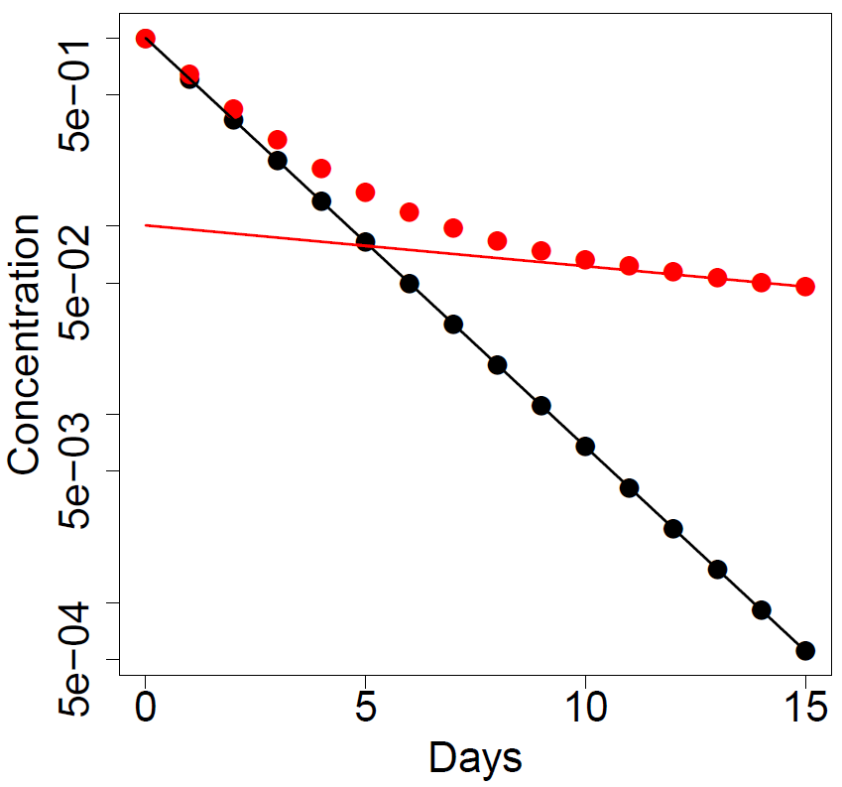
Pathogen decay
Pathogen decay is usually assumed to be exponential, that is, linear on the log-scale.
But certain pathogens have long-tailed deviations, which we call biphasic.

Slide 11
Pathogen decay
Neglecting long tail deviation can lead to an appreciable underestimation of disease risk.
This is has implications in a wide array of risk assessments, including drinking and recreational water use.

Slide 12
Mechanisms of pathogen decay
Many mechanisms have been proposed to explain biphasic decay
Population heterogeneity
Hardening-off
Viable-but-not-cultivable

Slide 13
Mechanisms of pathogen decay
However, identical biphasic dynamics can be produced by a general family of mechanisms.
General model
Brouwer et al. In preparation.

Slide 14
Mechanisms of pathogen decay
However, identical biphasic dynamics can be produced by a general family of mechanisms.
Hence, the data available in sampling studies is not informative for mechanism.
The information available in this data can be expressed in terms of parameter combinations (identifiability analysis).
General model
Brouwer et al. In preparation.

Slide 15
Pathogen decay: take-aways
Pathogen decay is usually modeled by monophasic exponential decay, but long-tailed deviations are common.
A wide-variety of mechanisms can produce identical dynamics.
More work is needed to inform mechanism (DNA or gene analysis) and to explore how environmental factors (e.g. temperature, pH) influence when biphasic behavior occurs
Neglecting biphasic decay leads to risk misestimation

Slide 16
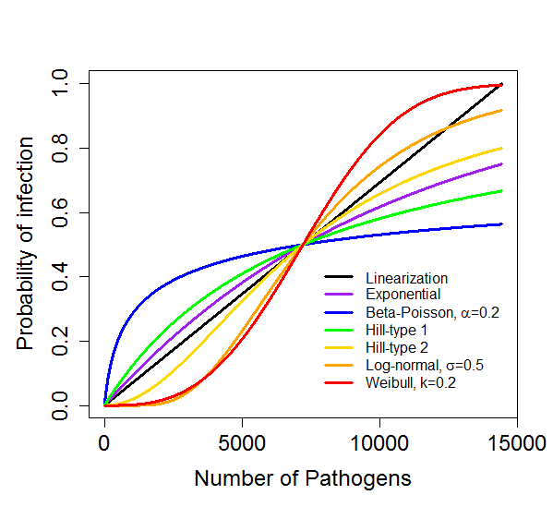
Dose-response relationship
The probability of becoming infected may not be linear with pathogen dose. The relationship is a dose-response function.
Categories of DR functions
  Biologically derived: exponential, exact beta-Poisson
  Mathematically convenient: Hill functions, linear, approximate Beta-Poisson
  Empirically derived: log-normal, Weibull
Figure: Example DR functions, with same ID₅₀.

Slide 17
Modeling concerns
DR relationships are often derived from limited medium- and high-dose data.
Choice of DR function can drastically change model dynamics.
For near-continuous exposures, it is not clear how to define contact and pick-up rates in relation to the DR function.
R₀, a standard measure of epidemic potential, does not give a useful measure when using certain DR functions.

Slide 18
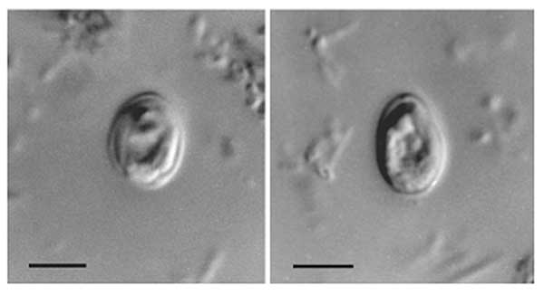
Example: Cryptosporidium
Cryptosporidium is a genus of parasitic protozoa that cause gastrointestinal illness (cryptosporidosis).
The spore form (oocyst) is environmentally hardy and resists chlorine disinfection.

Slide 19
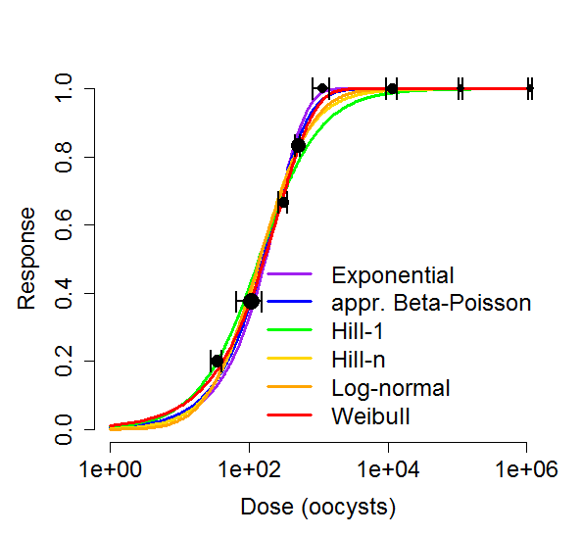
Example: Cryptosporidium
Dose-response data is available for the Iowa strain of C. parvum in Dupont et al. 1995 (NEJM).
We fit six dose-response functions to this data.
We use the functions in an EITS model (with exposed compartment) parameterized to loosely represent crypto.

Slide 20
Example: Cryptosporidium
$$\dot{S}=−S×\left(contact rate\right)×f(pick up rate×dose)$$

Slide 21
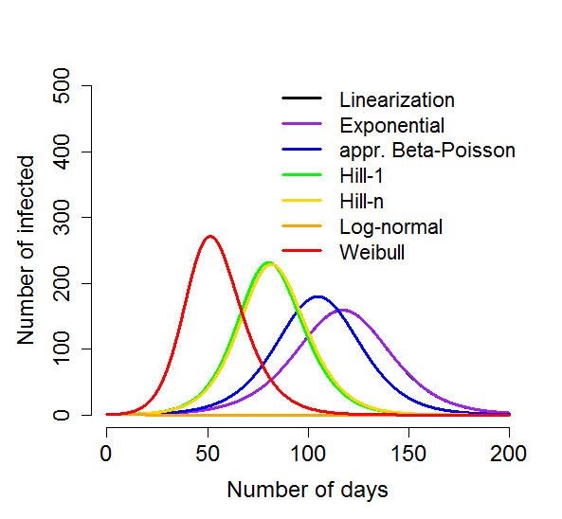
Example: Cryptosporidium
$$\dot{S}=−S×\left(contact rate\right)×f(pick up rate×dose)$$

Slide 22
Example: Cryptosporidium
$$\dot{S}=−S×\left(contact rate\right)×f(pick up rate×dose)$$
What appears to be good agreement in dose-response functions creates dramatically different dynamics!

Slide 23
Example: Cryptosporidium
Why are medium and high dose data so uninformative for disease dynamics?

Slide 24
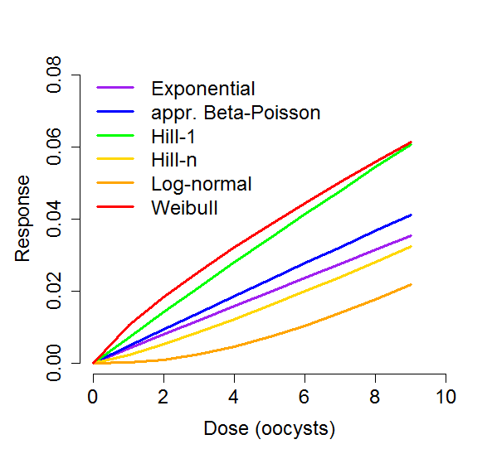
Example: Cryptosporidium
Why are medium and high dose data so uninformative for disease dynamics?
Consider the low-dose regime and R₀.

Slide 25
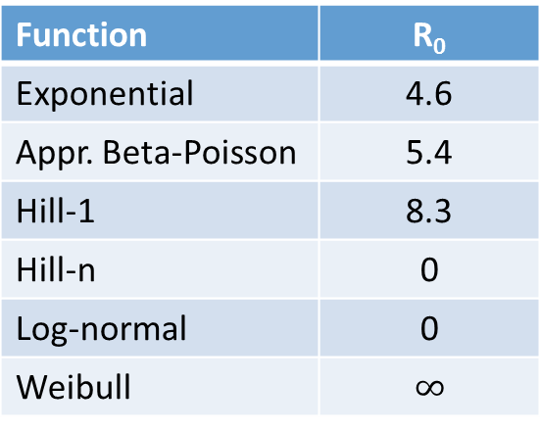
Example: Cryptosporidium
Why are medium and high dose data so uninformative for disease dynamics?
Consider the low-dose regime and R₀.
Function | R₀
Exponential | 4.6
Appr. Beta-Poisson | 5.4
Hill-1 | 8.3
Hill-n | 0
Log-normal | 0
Weibull | $$∞$$
Not low-dose linear

Slide 26
Dose-response: take-aways
Most dose-response data is in the middle and high dose regime, but it is the low dose regime that governs dynamics.
Constraining functions at higher does not satisfactorily constrain behavior at low-doses.
Statistical “best-fit” is only one of many criteria that should be taken into account. Biological mechanism and realism of the low-dose regime should be primary.

Slide 27
Final thoughts
Incorporating the environment into models:
  better understanding of the role and importance of underlying environmental processes.
Can assess potential interventions:
  more effective intervention design and allocation of resources.
Significant challenges remain.
Identify data gaps:
  Mechanism of biphasic decay
  Low-dose regime of dose-response functions

Slide 28
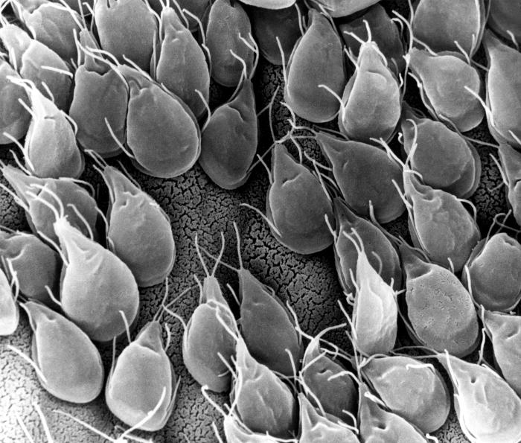
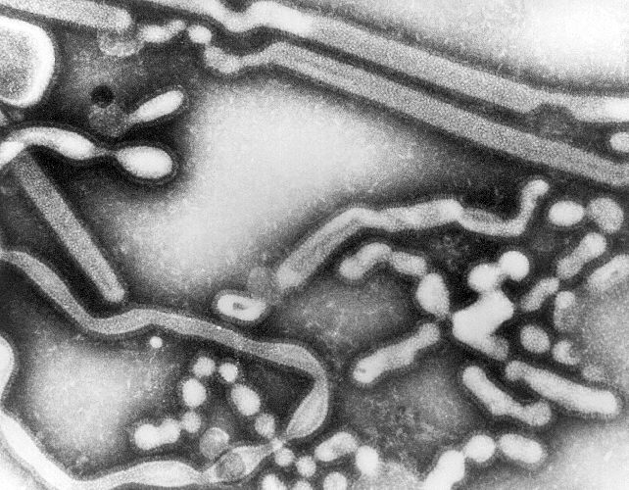
Thank you!
Rotavirus
Giardia
Cholera
Cryptosporidium
Influenza

