Slide 1
Introduction to the PPA Wizard
An online tool supporting the Patient Pathway Analysis

Slide 2
Introduction to the PPA Wizard
Jessie Brown, Linksbridge SPC
Refresher on the Patient Pathway Analysis (PPA)
Rationale for the PPA Wizard
Demonstration
Next steps
Your questions and input
Notes:
Jessie Brown, w Linksbridge
Consulting and advisory firm based in Seattle
Our team has worked on the PPA in collaboration w/ Christy Hanson and BMGF for 3-4 years
Last year we started working developing an online tool to support PPA implementers—”PPA Wizard”
Agenda
Quick refresher on PPA
Why we decided to build the PPA Wizard
Quick demo of the wizard
Share next steps in the works for Linksbridge; suggest some next steps for you
Appreciate your questions and input

Slide 3
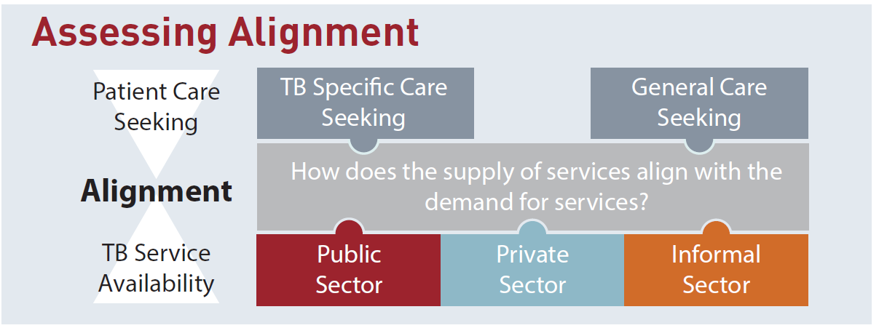
Refresher on the Patient Pathway Analysis
Evaluating alignment between care seeking and service availability
Care seeking data sources:
TB prevalence survey
Health expenditure and utilization survey
Demographic and health survey
Living standards measurement survey
National health accounts
TB services data sources:
Health Facility Master List
Service availability and readiness assessment
Service provisions assessment
National health accounts
National TB lab database
Notes:
At last year’s IDM Symposium Mike presented the PPA methodology
Won’t go into the methods in detail today
After the symposium this presentation will be available to you
Including extra slides and references to additional PPA resources
Quick Refresher
Primary goal:
Evaluate how well TB services align with where people with presumptive TB seek care for illness
Sheds light on missing cases
Analytical method using existing data
Care seeking data comes from population-based surveys
Service availability data may come from a survey or a census of health facilities

Slide 4
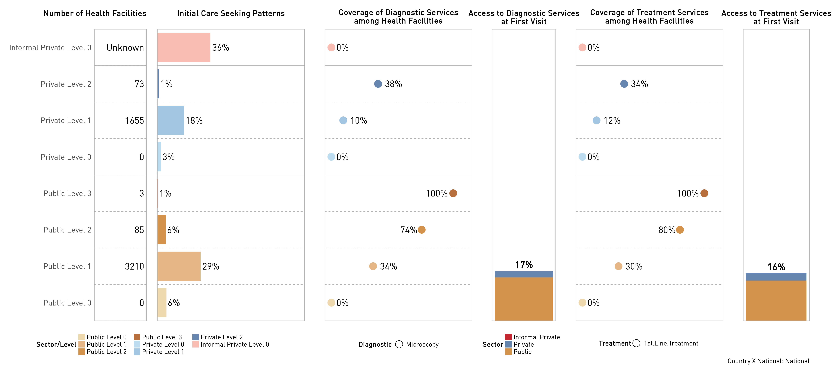
National PPA for Country X
Notes:
This is an example of the standard PPA visual
Other PPA visuals are variations on this theme
Shows fictional data for an imaginary “Country X”
Visual overview
CS col show where people initiate care for illness, specifically sectors + levels of the health system
Col next to it shows coverage of TB diagnostic services at those same sectors + levels
Vertical bar middle: “of all people seeking care for illness, what proportion accessed a facility with TB diagnostic capacity?”
Vertical bar right: “of all people seeking care for illness, what proportion accessed a facility with TB Treatment capacity?”
Considerable misalignment between care seeking and service availability
While public sector hospitals (L2 and L3) have high coverage
People initiate care in other places—informal, private, and lower level public (health ctrs etc.)
This leads to low access to TB services; People will need to loop back through the system
Understanding these key gaps in the health system can inform planning for National TB programs
Shape private sector engagement strategy
Provide input as to where to place new diagnostics
Provide input as to how to optimize a referral system

Slide 5
Rationale for the PPA Wizard
Enable wider use of the PPA in planning and policy
Situation:
The PPA is a valuable methodology
Problem:
Countries face barriers to routine usage
Solution:
Create a tool that reduces the barriers to countries
Notes:
For the reasons just described, PPA can be a valuable tool to help countries find “missing” cases
However, countries often face barriers to using the PPA
Needed a solution that would address some of the barriers countries face
Goal: help enable wider use of the PPA in TB policy and planning
Target users:
NTP Staff
TA providers
Researchers + data analysts throughout TB community

Slide 6
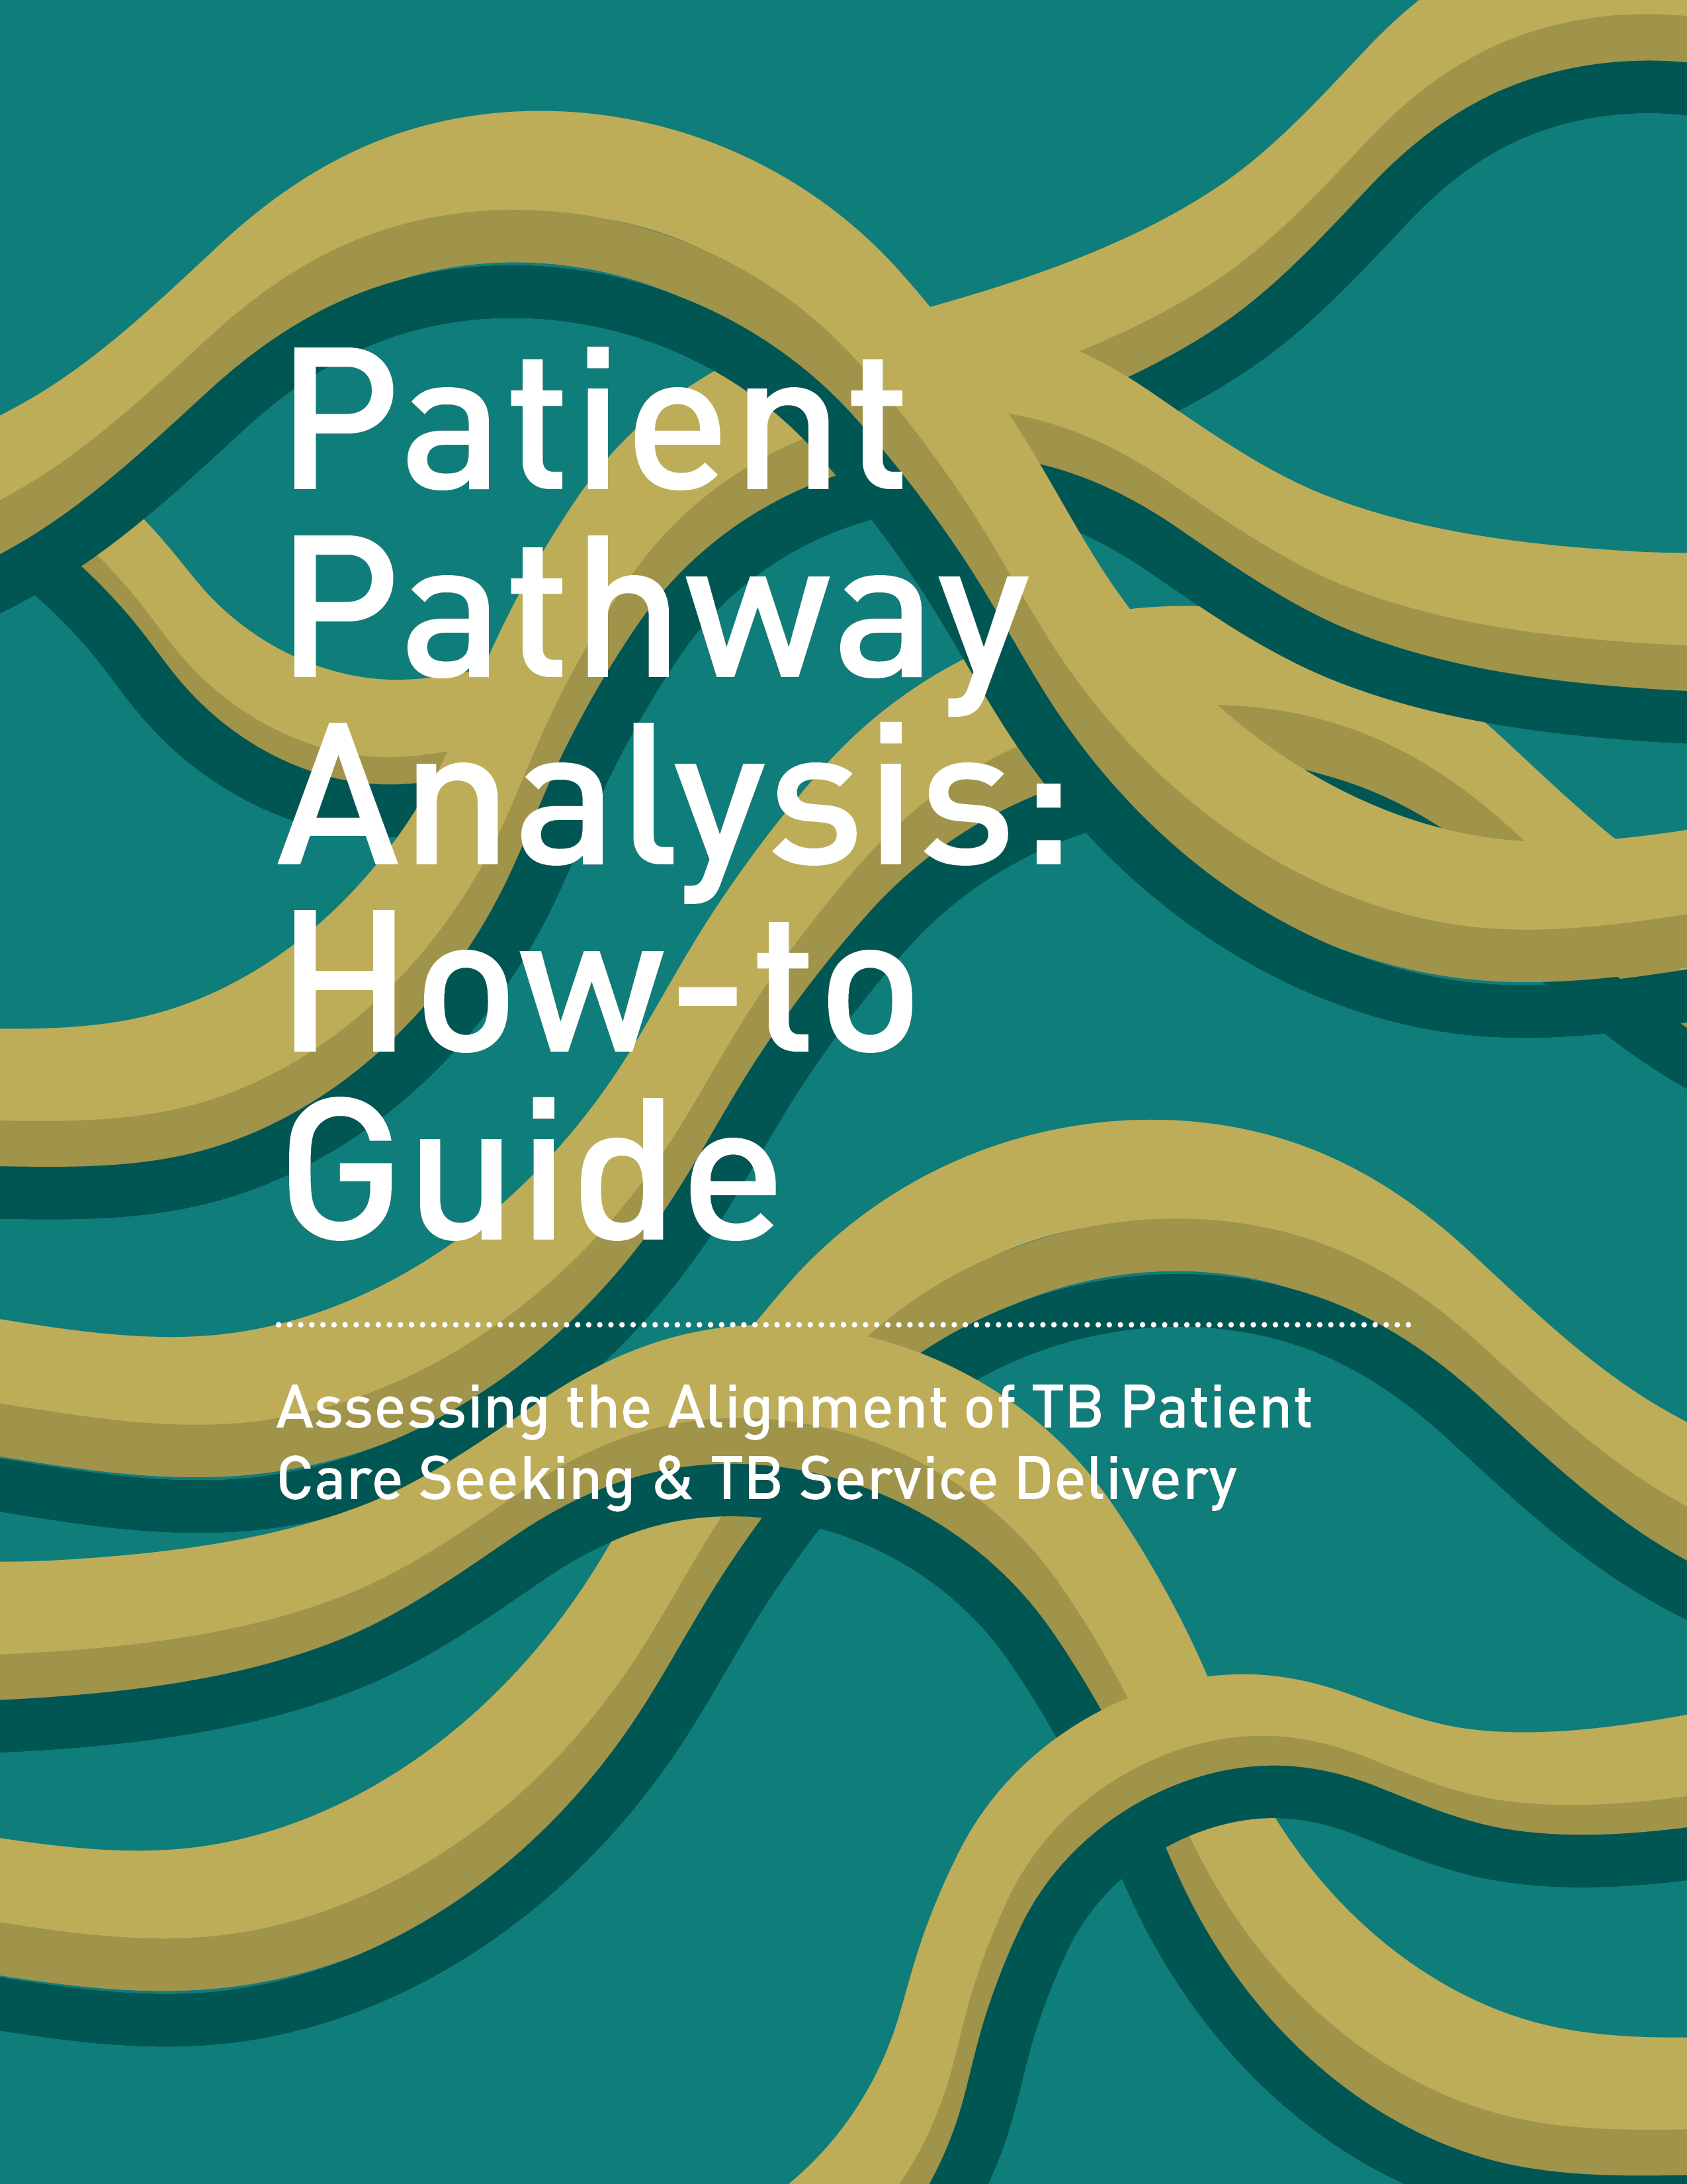
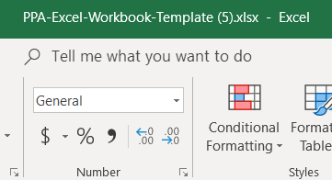
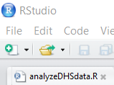
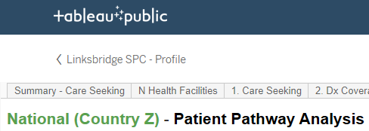
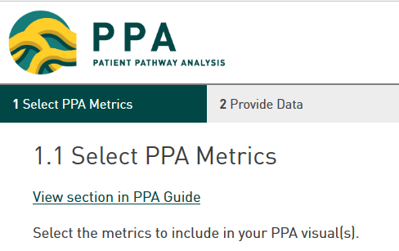
Changes in the PPA Development Process
The wizard automates two time-intensive phases of the PPA
Manual Process
1. Prepare to Complete PPA
2. Collect Data Sources
3. Analyze
Data
4. Visualize
Data
5. Interpret
Results
Existing Resources
Manual Process
PPA Wizard
1. Prepare to Complete PPA
2. Collect Data Sources
3. Analyze
Data
4. Visualize
Data
5. Interpret
Results
Automated Process
Notes:
The process for developing a PPA generally includes 5 phases of work:
Preparation – learning, assembling team
Accessing and collecting the data required
Analyzing the data
Conducting data visualization
Interpreting results
Overall phases of work remain unchanged
Tools available for phase 3 + 4 have changed considerably w/ introduction of the wizard
Previous process for data analysis + viz could be time consuming (especially for new people) +
Requires specific software access, knowledge, and usage
Important role of the PPA Wizard is to make the data analysis and visualization phases of a PPA faster and easier

Slide 7
PPA Wizard Addresses Implementation Barriers
Barrier to routine country implementation | Header Text | Solution adopted in the wizard
Time needed for analytics | g | Automated analytics and visualization
Software requirements (R, Excel, Tableau) | g | Friendly user interface
Analytical processes are complex to share | g | Team Space makes sharing easy and transparent
Ad hoc documentation of PPA inputs | g | Record inputs automatically generated with PPA
Ad hoc process for updating PPAs | g | Version control system
Notes:
How specifically does the wizard make the PPA process faster and easier and how does it address barriers to countries?
To address the time dedication and software requirements, wizard has:
Automated the data analysis and visualization
Introduced a UI
Additionally, wizard addresses reasons it has been challenging to transfer PPA analytical capacity from TA providers to countries
1) No organized way for analysts to communicate their analytical process w/ their country team
Now the “Team Space” makes sharing easy and transparent
2) Prior to the wizard, documentation of inputs was ad hoc (email, slide deck, notes in excel file)
Now the process of creating a PPA in the wizard generates a record of the inputs
3) Prior process for updating a PPA was artisanal (R, tableau, etc.)
Now whole analytical process in one place, w/ version control system makes updating a PPA easier
Important b/c countries want to update PPAs with new data, compare alternative data sources, or answer a new question of interest to programming

Slide 8
Demonstration
Lightning tour of the wizard via the Demo Team
ppa.linksbridge.com

Slide 9
Next Steps for Linksbridge
Rolling out the PPA Wizard to countries
As more countries plan to incorporate PPAs into their National Strategic Plans (NSPs) in 2019 and 2020, Linksbridge plans for the wizard include:
Complete a package of supporting resources
Introduce it to countries
Gather and incorporate user feedback
Notes:
Next steps for Linksbridge = getting the wizard to countries
A wave of ~10 countries are planning to bring a PPA into their NSP this year or next year
LB aims to:
Finish putting together a package of resources
In progress; near completion
“How-to” guide (written and video format) integrated within wizard
Introduce package of wizard + accompanying resources to countries and partners
Incorporate user feedback to ensure this is meets country needs
Will this help enable countries to complete PPAs w/ minimal TA?

Slide 10
Next Steps for You
Learn more, try it yourself, and give us feedback!
Go to ppa.linksbridge.com | Create a user profile with your email and password Automatically become a read-only member of the Demo Team Create your own PPAs
Email ppa@linksbridge.com | Receive occasional updates via the PPA newsletter Provide any feedback about the wizard
Attend Union webinar April 18 14:00 Paris Time | Live session for Union members Session recorded and posted online Christy Hanson (BMGF) on PPA methodology Jessie Brown (Linksbridge SPC) on the wizard “How-To”

Slide 11
Your Questions and Input
The Linksbridge Team would love to hear from you!
What considerations come to mind when delivering an online tool like this to countries?
Where have you seen similar tools succeed or fail?
Are there other collaboration opportunities we should explore?

Slide 13
Home

Slide 14
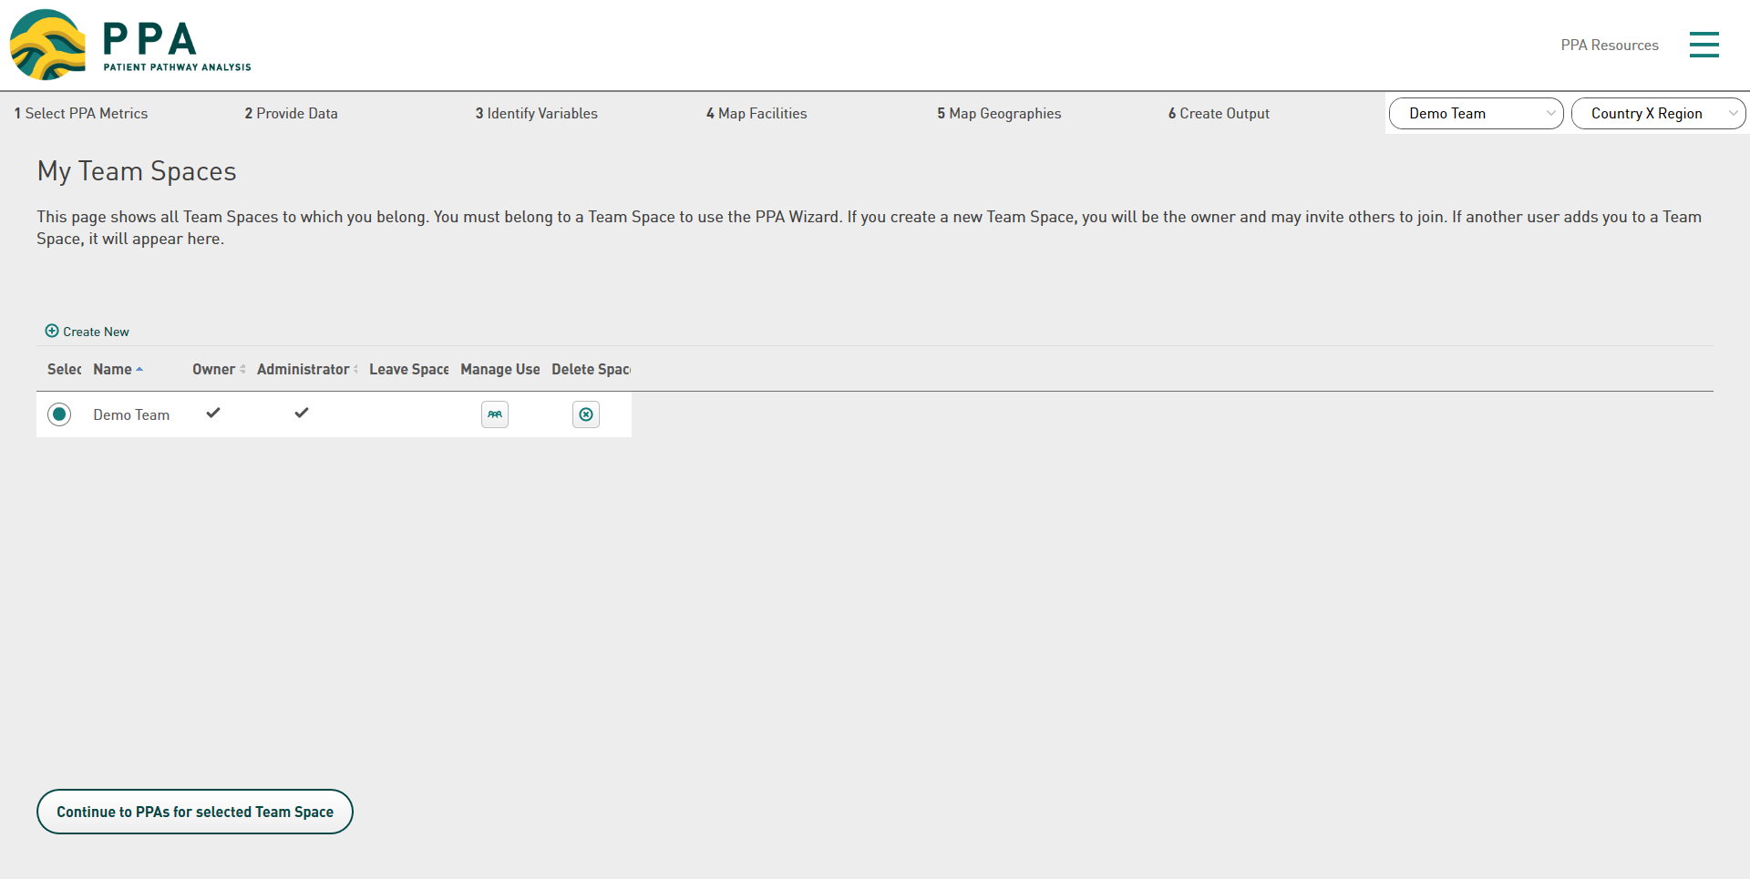
My Team Spaces

Slide 15
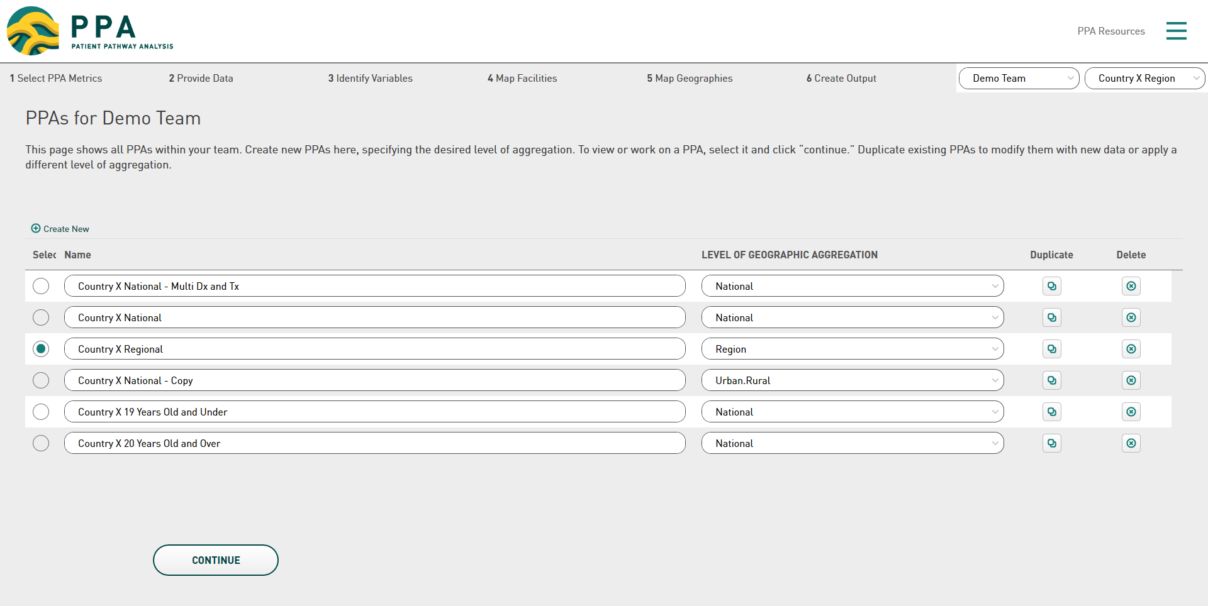
Team PPAs

Slide 16
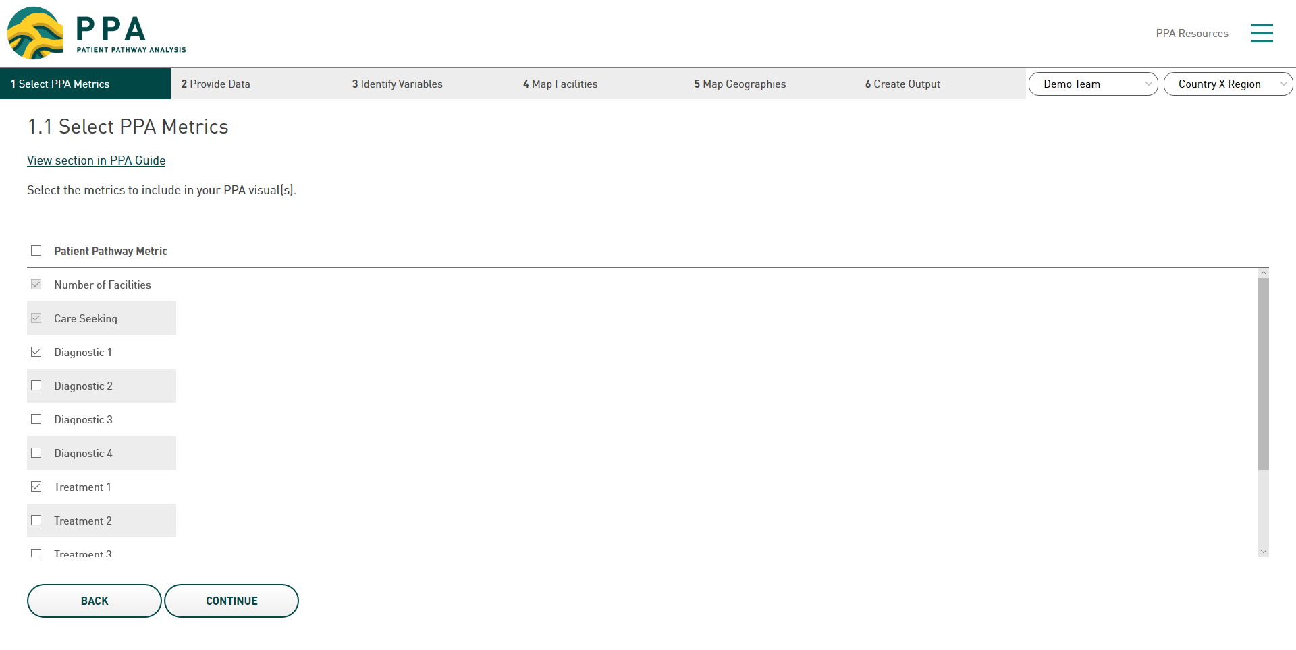
1.1 Select PPA Metrics

Slide 17
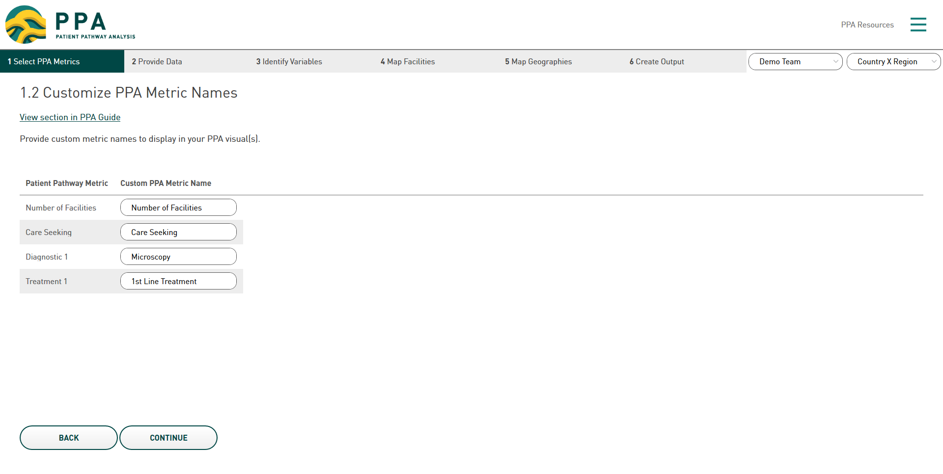
1.2 Customize PPA Metric Names

Slide 18
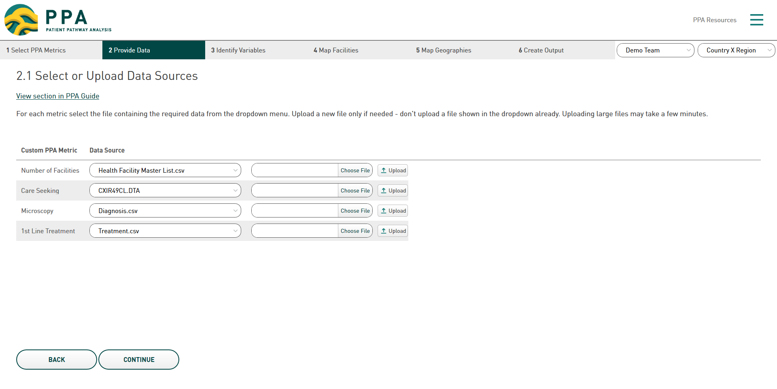
2.1 Select or Upload Data Sources

Slide 19
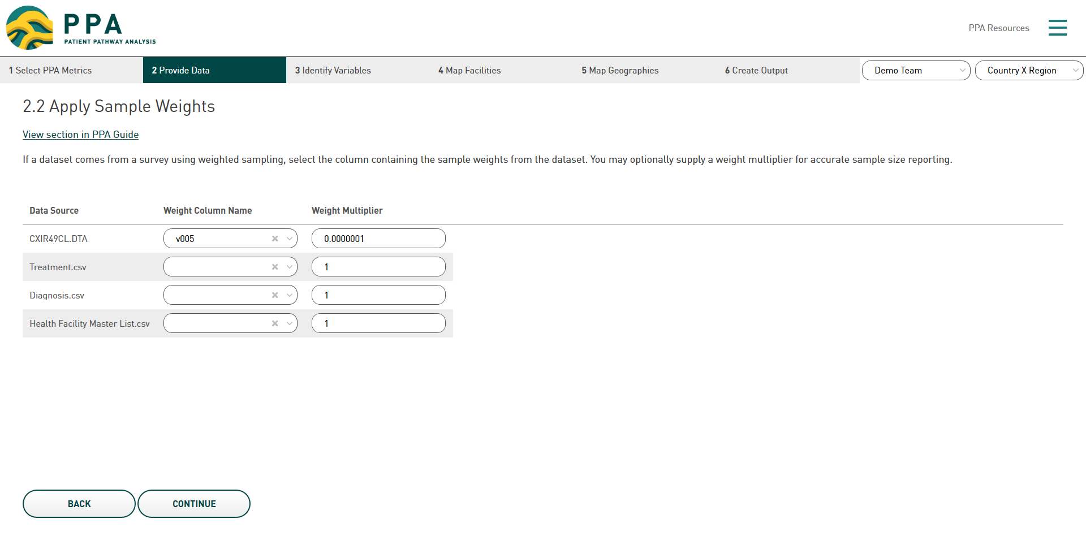
2.2 Apply Sample Weights

Slide 20
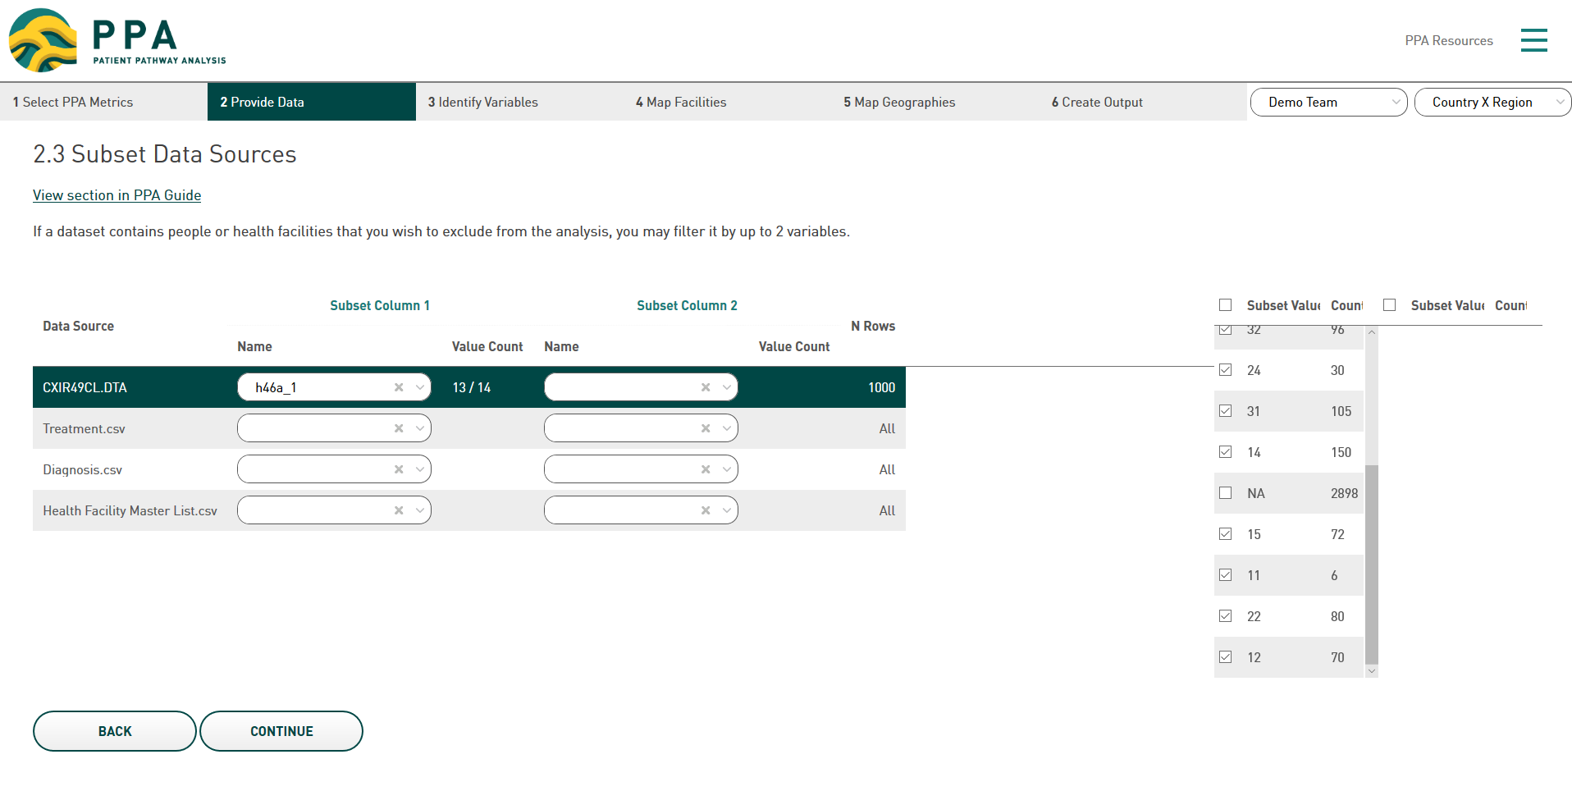
2.3 Subset Data Sources

Slide 21
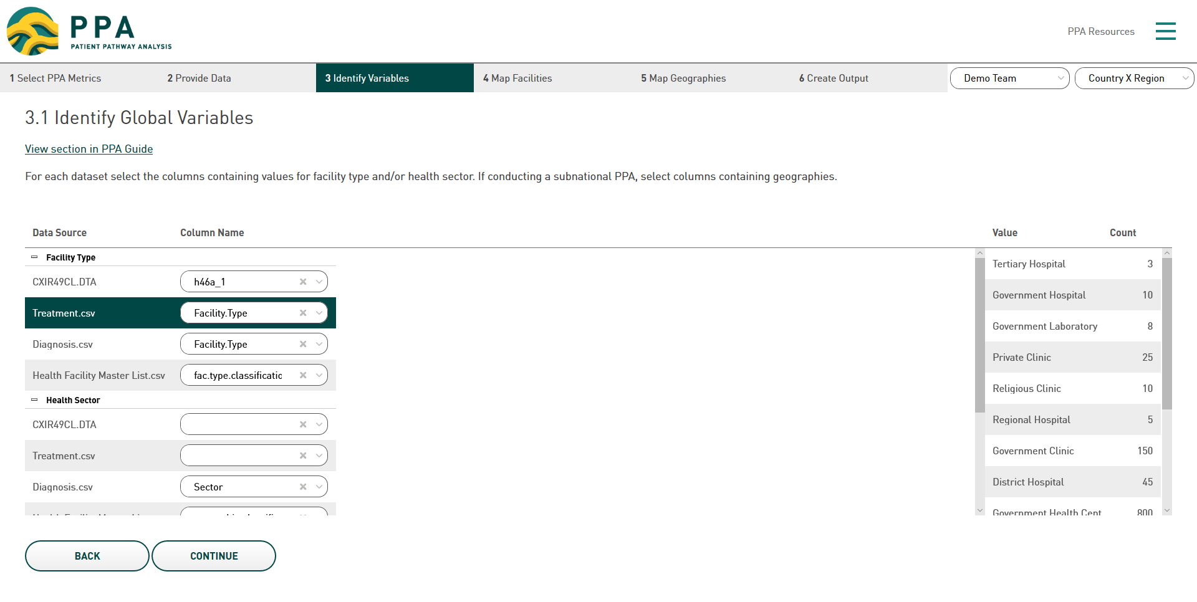
3.1 Identify Global Variables

Slide 22
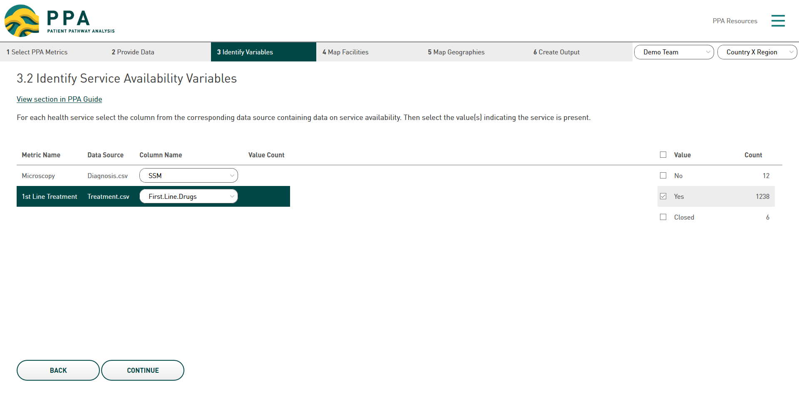
3.2 Identify Service Availability Variables

Slide 23
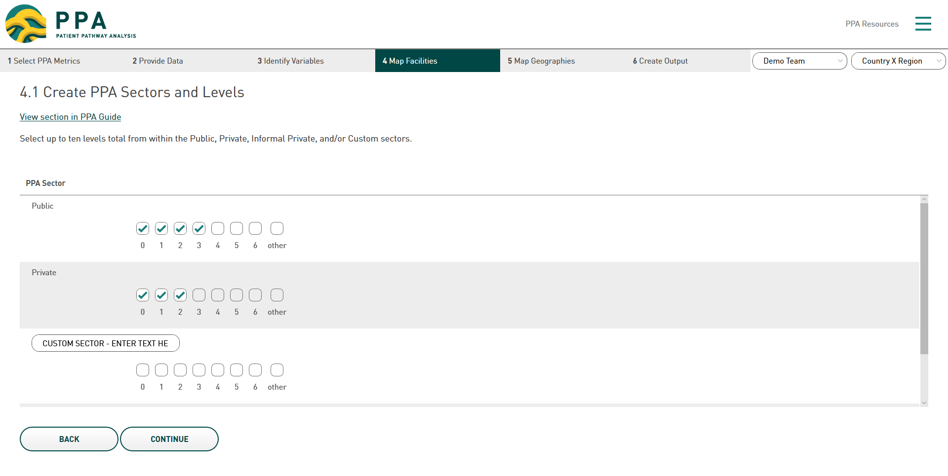
4.1 Create PPA Sectors and Levels

Slide 24
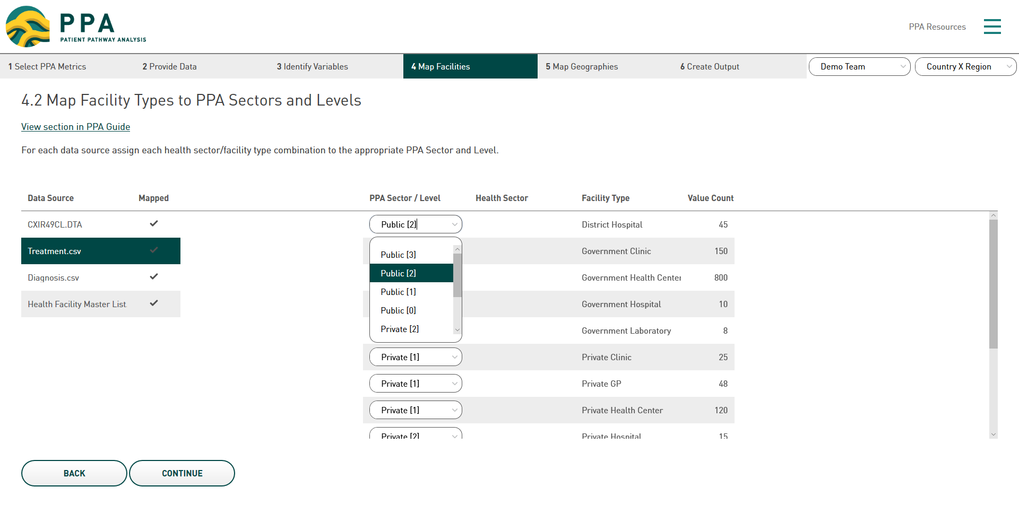
4.2 Map Facility Types to PPA Sectors and Levels

Slide 25
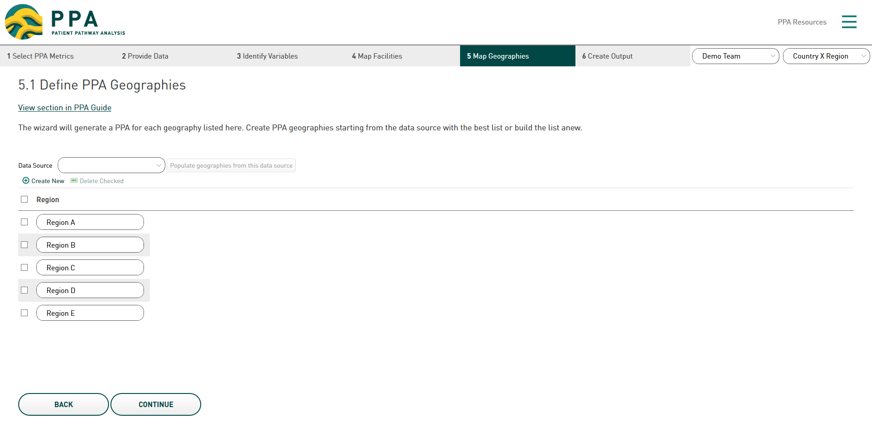
5.1 Define PPA Geographies

Slide 26
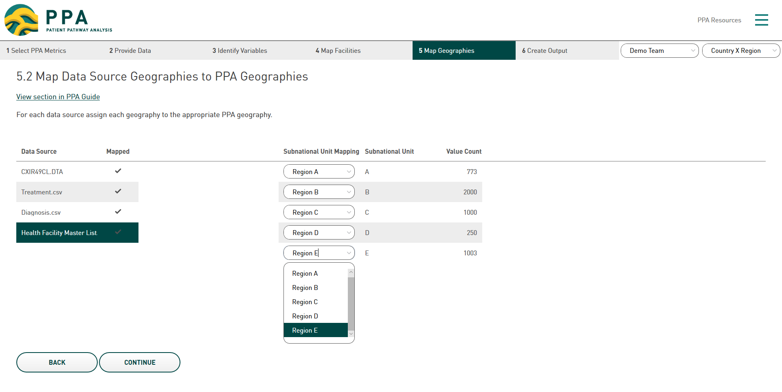
5.2 Map Data Source Geographies to PPA

Slide 27
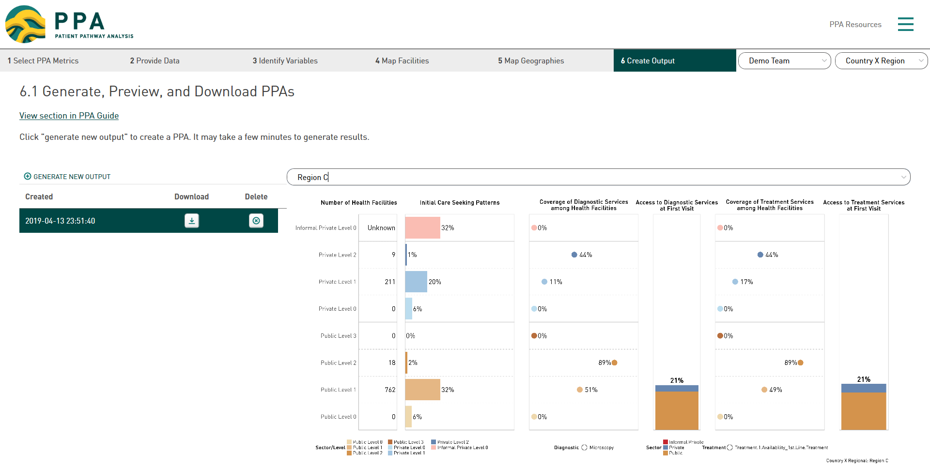
6.1 Generate, Preview, and Download PPAs

