Slide 1
Risk Mapper tool workshop
Guillaume Chabot-Couture, April 18th 2017
Project collaboration teams
Software Research
Benoît Raybaud Steve Kroiss
Qinghua Long Laina Mercer
Dennis Harding Kevin McCarthy
Chris Lorton Hil Lyons
Gene Oates Guillaume Chabot-Couture

Slide 2
Why the “RiskMapper” tool?
Goal: help/support disease control, drive towards disease eradication
A few reasons why disease control is difficult
  Disease incidence, is not homogeneous
  Disease dynamics are non-linear and stochastic
  Programmatic data is imperfect and/or incomplete
  Coverage of control efforts is not homogeneous
Predicting disease incidence with risk models can help
  Select most predictive risk indicators from multiple data sets
  Combine them to maximize predictive power
  Take into account geography, trends, ancillary data
  Try multiple models, select the best one
  Automate the process

Slide 3
Vision
Make it easy and fast to create a customized risk model with good predictive results
What we want to achieve:
  Easy to use
    Guide user through data input, data visualization, model construction, model validation
  On-demand and fast
  Customized risk models: any country, any disease
  Provides data security and data privacy
  Software-as-as-service:
    Automatic updates/upgrades
    Computation on the server, keeps user’s machine free, can run longer jobs, and multiple jobs
    User customization, retains data and model results, so easy to update
  Library of models, run multiple and select best

Slide 4
Roadmap
More features / more work / more complexity
DATA INPUT | Disease incidence only Location by name only | Upload multiple data formats Data pre-loaded in the tool More (all) countries | Data cleaning and preparation in the platform Upload your own shapefile
VISUALIZATION | Mapping Epi curve / AUC curve | Different admin levels, point data, interpolation More model quality metrics | Computation status Data mining/feature selection
MODELING | 3 models disease incidence as predictor | More models, longer running Multiple predictors, variable selection | Feature engineering Predict more general outcomes User models
WEBSITE | No sign-in required Intermediate data security All outputs can be exported | Sign-on and user accounts Data privacy and security Support longer running models | RESTful API to support programmatic access Easy to share model outputs

Slide 5
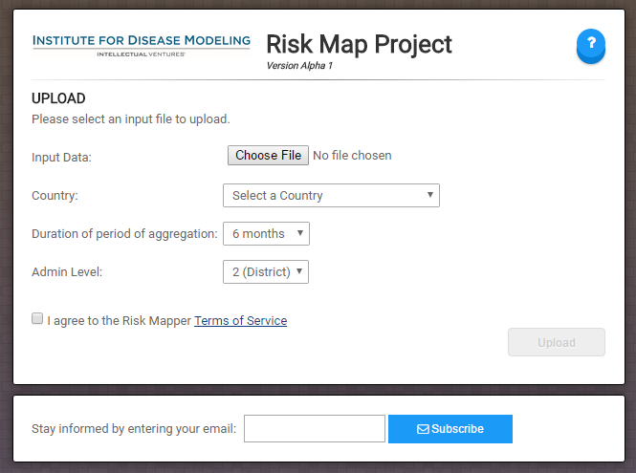
Live demo
Go to riskmap.idmod.org
You should see this launch page:

Slide 6
Next steps
User survey (http://bit.ly/2oj2nik)
Your experience with the tool?
Found any bugs?
What feature would you want/need next?
Sign-up for our user email list
(bottom of launch page at riskmap.idmod.org)
Receive updates about the RiskMapper tool
Contact us at riskmap@idmod.org

