Slide 1
Risk mapping
Embedded tool for disease outbreak prevention
Guillaume Chabot-Couture
April 17th 2018

Slide 2
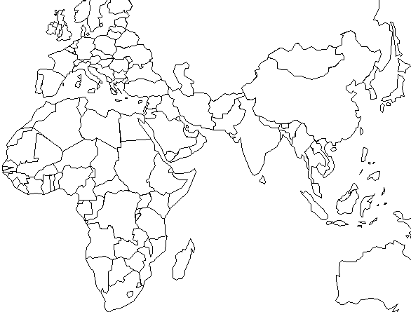
What do the following outbreaks have in common?
Polio
2013-2014
38 cases
Yellow fever
2015-2017
1000+ cases
Measles
2009-2010
150,000 cases
Notes:
What do these outbreaks have in common?
Within the affected countries, a minority of provinces and districts were responsible for the majority of cases
The outbreaks were explosive and unexpected: they expanded to multiple countries
There had been an accumulation of susceptible people, ripe for a “spark”
Risk modeling existed prior to these outbreaks – why were these outbreaks not anticipated??
A vaccination campaign conducted prior to these outbreaks could have prevented them, or significantly limited their sizes

Slide 3
How much suffering? How big is the effort?
Global burden, per year
Measles
(global) ~7,000,000 cases, ~100,000 deaths
Yellow fever
(Africa) ~130,000 cases, ~70,000 deaths
Meningitis
(Africa) ~30,000 cases, ~3000 deaths
Polio
(global) ~50 cases, ~5 deaths
GAVI ($1.3B/yr total spend)
  approx. $160M/yr on measles and rubella ($1.2B so far)
  approx. $13M/yr on yellow fever ($300M since 2001)
Measles and Rubella initiative
(funding laboratory and tech assistance)
Polio Eradication Initiative spends $1B/yr ($14B since 1988)
Notes:
[Number of deaths: ]
[Amount of money spent]
Hundreds of millions of dollars are spent each year on vaccination campaigns to prevent disease outbreaks. These investments could be made more effective by a better understanding of outbreak risk.
We don’t live in fear of these diseases anymore because we were able to control them.
Around the world, it is possible to entirely prevent disease outbreaks (and maybe even eradicate) such that these diseases cease to kill or cripple children and adults.
As modelers, scientists:
It is important to continuously improve the accuracy, relevance, and ease of use of risk modeling products. Risk models need to be embedded into the decision making process, and disease surveillance data will need to be maintained through the end of the polio program, and further expanded to fully support all the infectious diseases we are working to control.

Slide 4
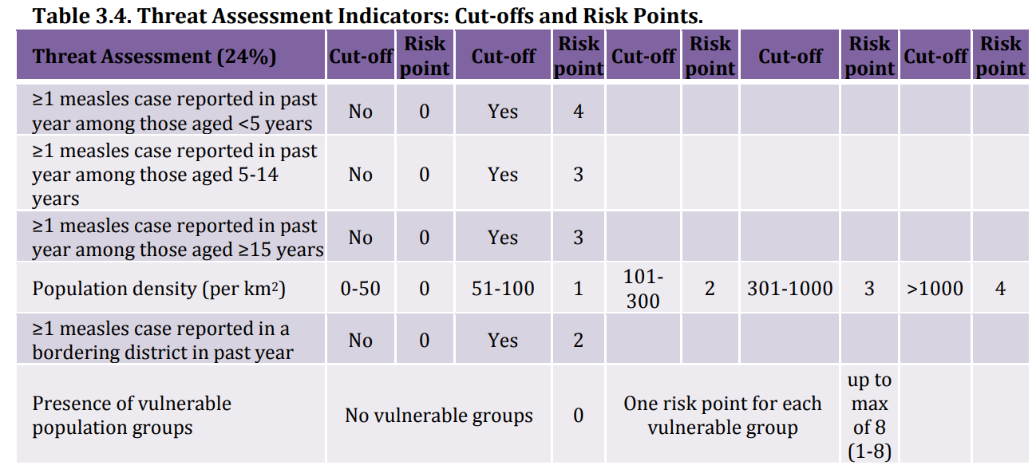
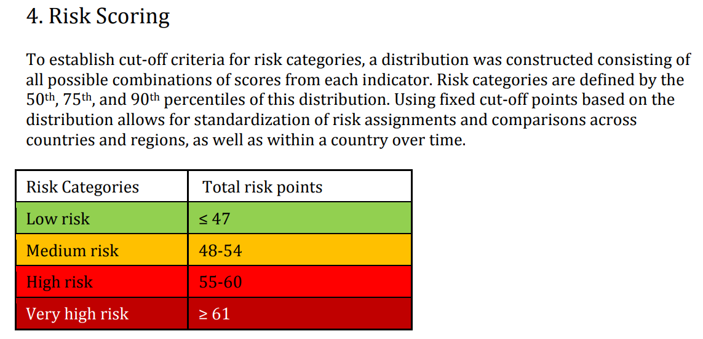
Structured risk assessments
Advantages: incorporates expert knowledge, interpretable/actionable, doesn’t need incidence data
Limitations: not calibrated or validated, unknown predictive power
(Example) Measles programmatic risk assessment tool (WHO/CDC)
http://www.who.int/immunization/monitoring_surveillance/routine/measles_assessment/en/

Slide 5
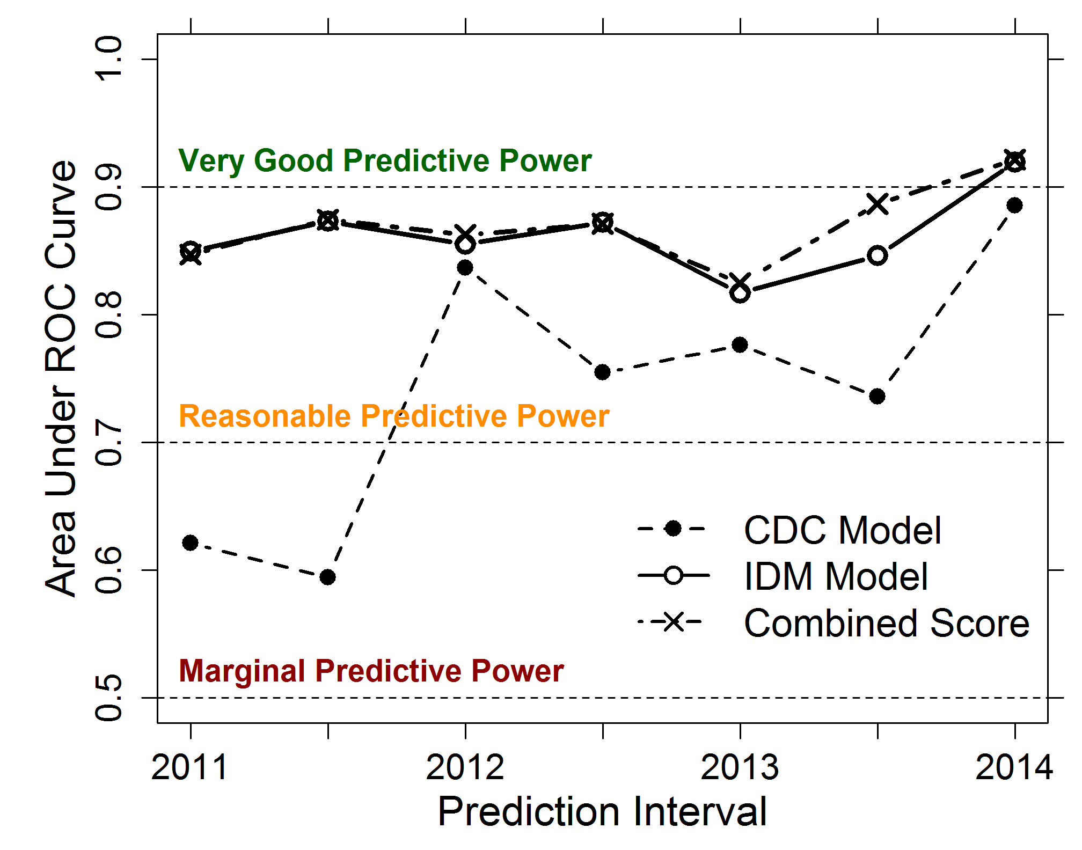
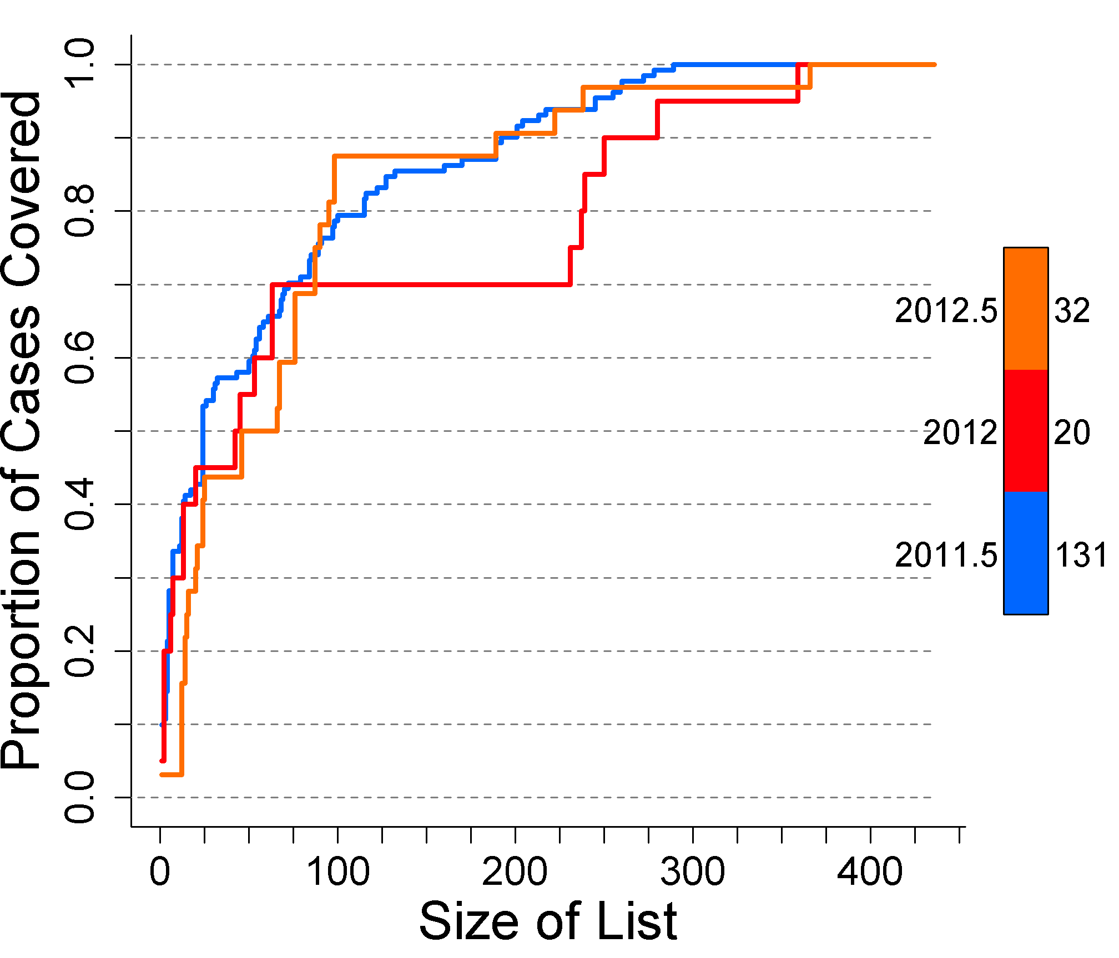
Optimizing predictive power
Building risk model
Case data is reliable target
Unmeasured risk (random effects)
Predictors: select best, remove bad
Include local experts, get consensus
Tiering for prioritization
CDC-IDM-NIE risk modeling (2014)
Pakistan high-risk list (2013)

Slide 6
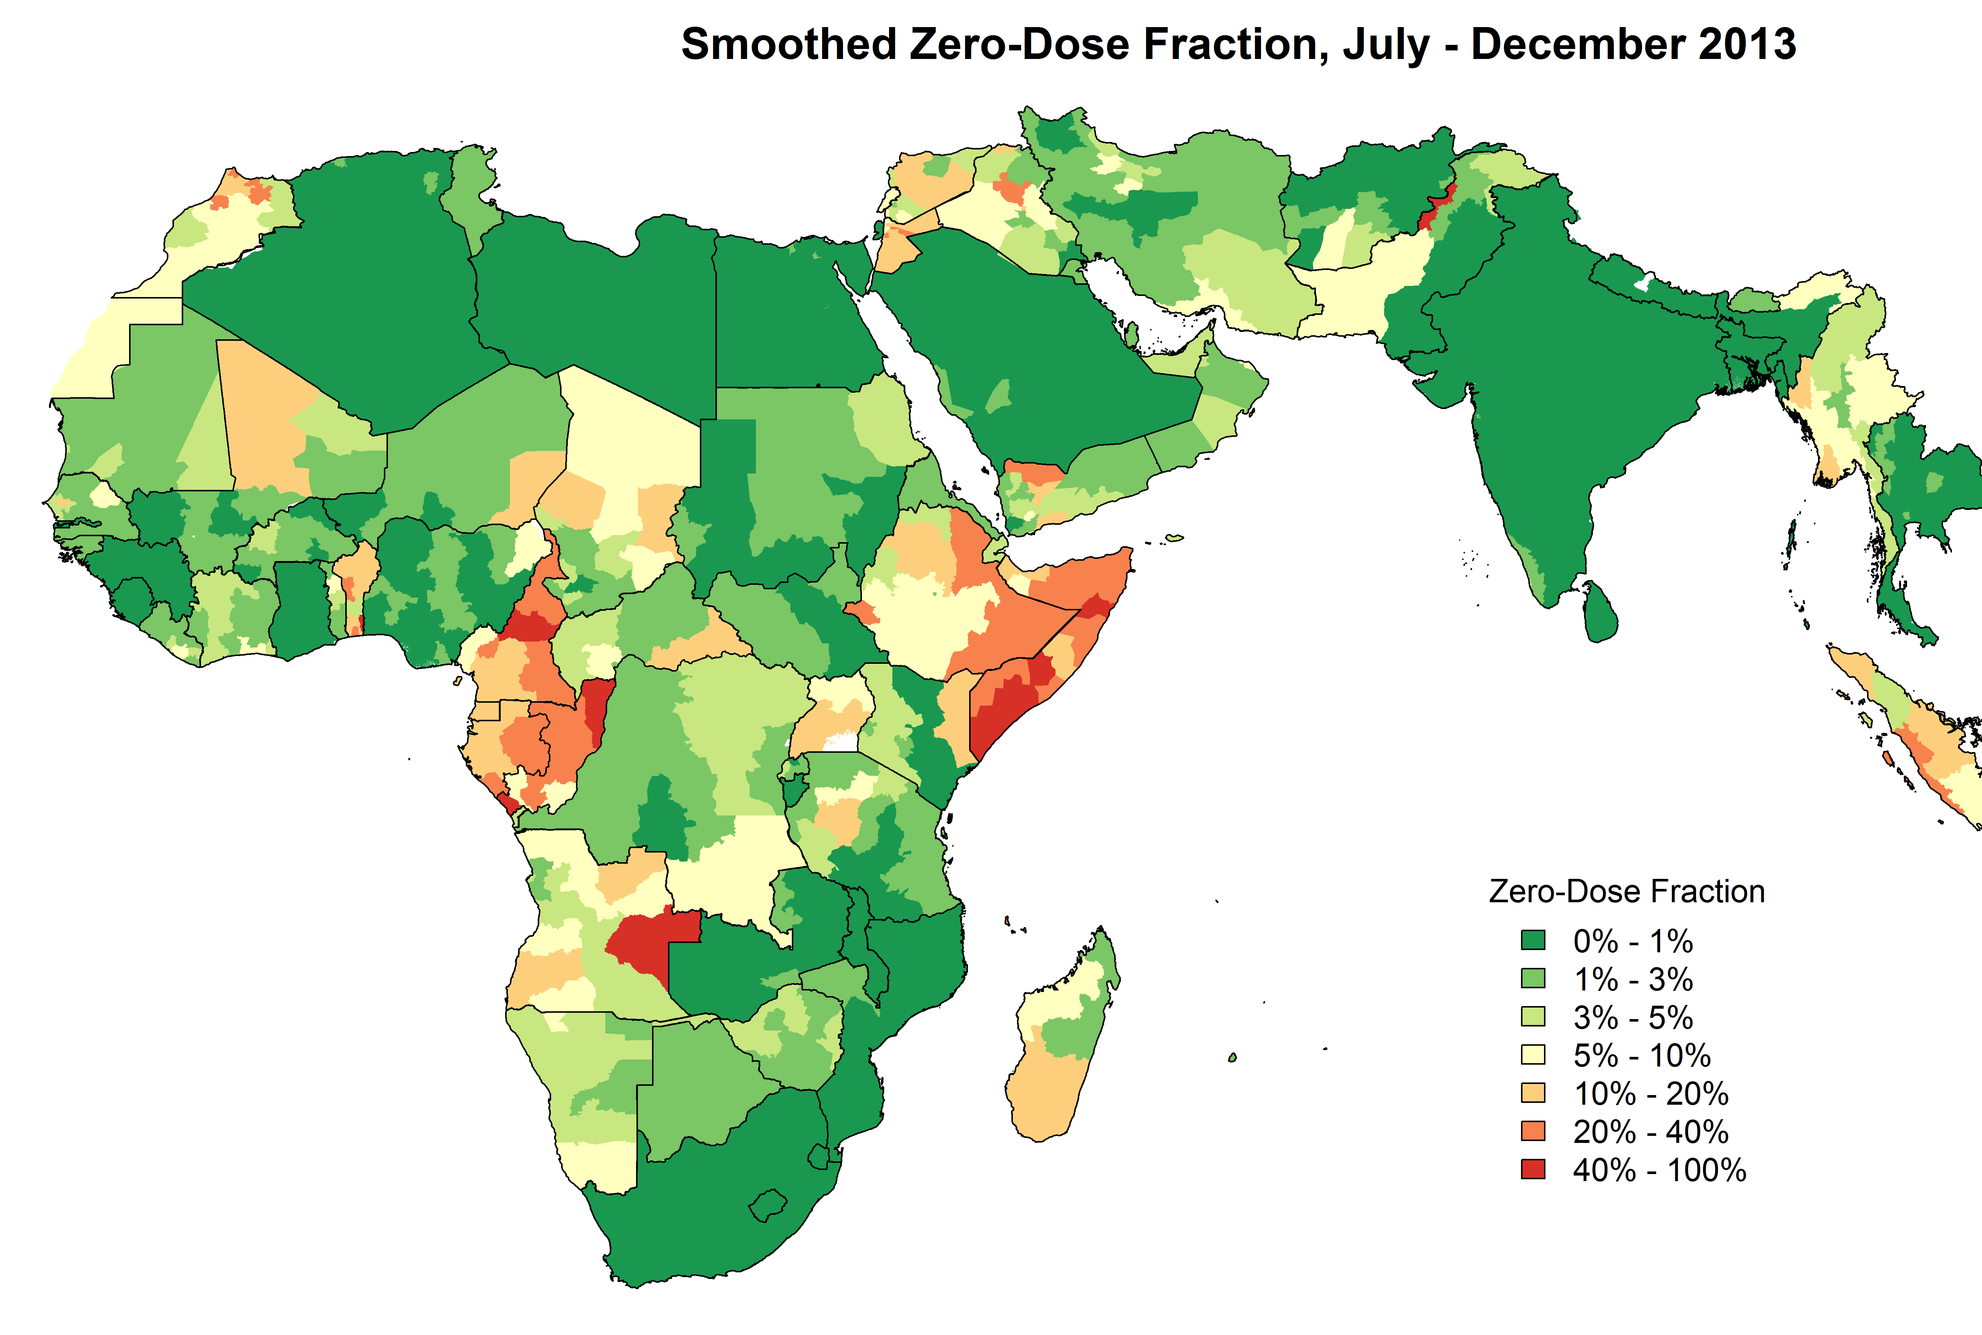
Global model of polio risk to prevent outbreaks
Delays in 2000-2010:
  multiple outbreaks
  draining resources
  focus away from endemic countries
More prevention reduces global burden
Nigeria*, India stop polio transmission
Improve data, prevent blind spots
Stories:
  cVDPV, homegrown risk in Yemen
  Outbreaks in Chad/Cameroon, Somalia
Global model used to determine which countries receive preventive vaccination campaigns, every 6 months
Map of fraction of children who are unimmunized, used in GPEI risk assessments and SIA planning
Notes:
2000-2010: polio program facing multiple outbreaks, draining resources, shifting focus away from endemic countries, delaying progress
Increasing vaccination efforts, more prevention reduces global burden
Nigeria*, India stop polio transmission
Actively working to improve data quality, detect gaps, to prevent blind spots

Slide 7
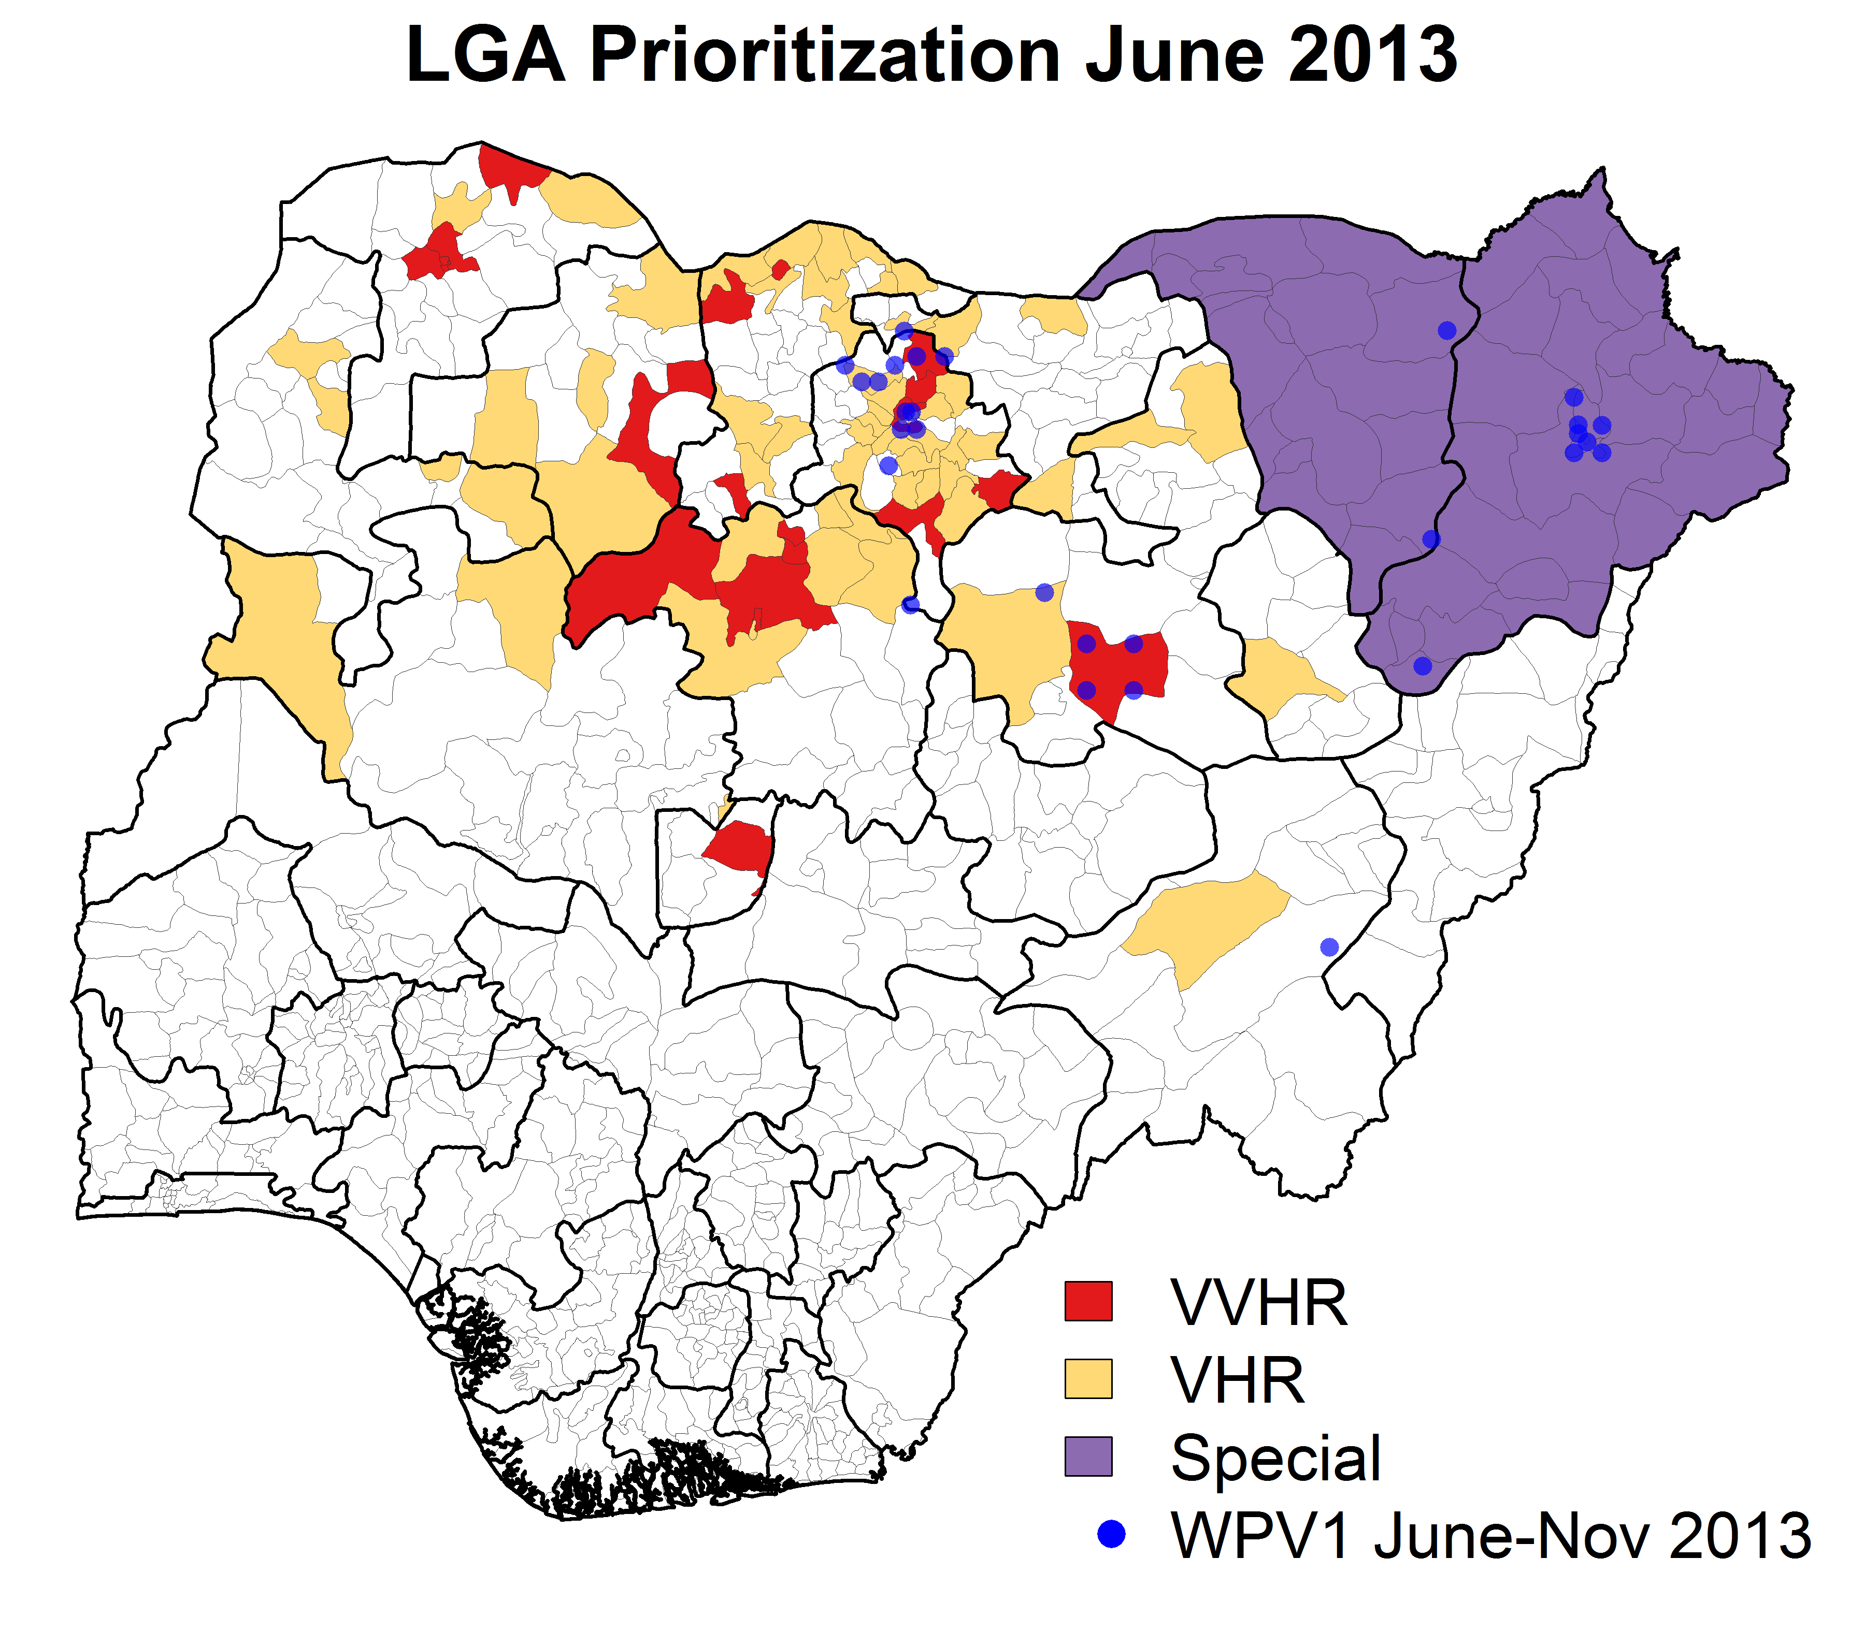
Chase down the virus, everywhere
After 2008, few cases limit program prioritization
Risk modeling
Immunity modeling
Local unmeasured risk
Stories:
  HR, VHR, VVHR
  Borno/Yobe are “special”
Country-level models used to determine which subnational areas to target for technical support, every 6-12 months
Nigeria
Map of LGA (district) prioritization. VVHR: Very very high risk. Special: areas with security and access limitations
Notes:
Goal
Estimating risk consistently across many different countries, estimating the number of SIAs needed to mitigate this risk
Approach:
Tracking susceptibility using AFP surveillance, smoothing the indicators
Calculation of risk (low/mid/high/very high)
Consensus by combining multiple risk scoring
Calculation of number of SIAs
Determining vaccine balance and scope
Results
More consensus between partners
More tools and people to help with this work
Story of Borno/Yobe separation:
Should there have been a closer review of Borno/Yobe data to more quickly detect there was a problem?
Borno/Yobe separation, the 2013 cases in Borno were the last ones detected there until 2016 (but circulation had continued undetected and may still be ongoing)

Slide 8
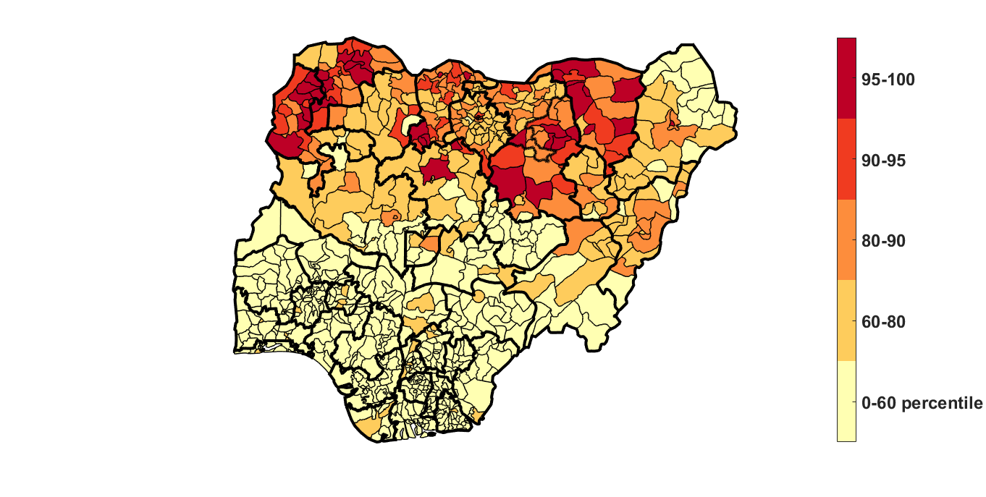
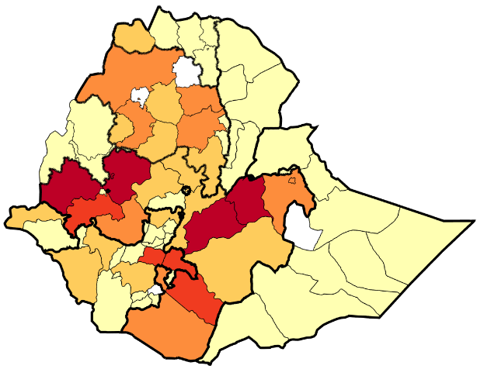
New challenges
Measles risk, RandomForest model
Measles:
  Variable disease surveillance quality
  Indicators are misleading, or absent
  Importance of natural immunity
  Multi-year outbreak cycles
Examples:
  Borno (NIE) low risk?
  Somali region (ETH) low risk?
K. McCarthy et al. (in prep)
Notes:
(cases are no longer a gold standard for calibration/validation)

Slide 9
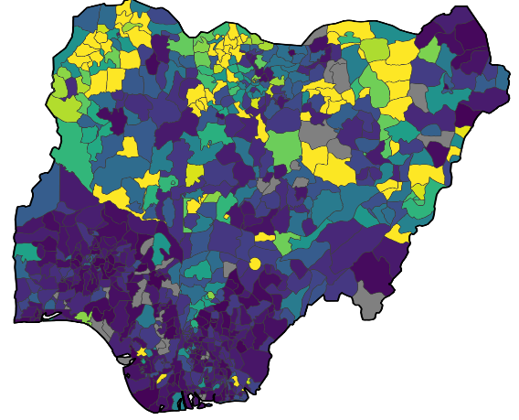
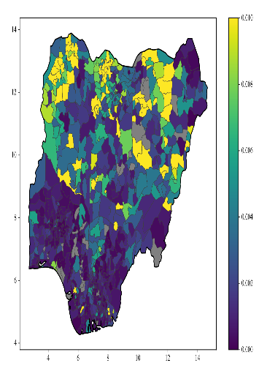
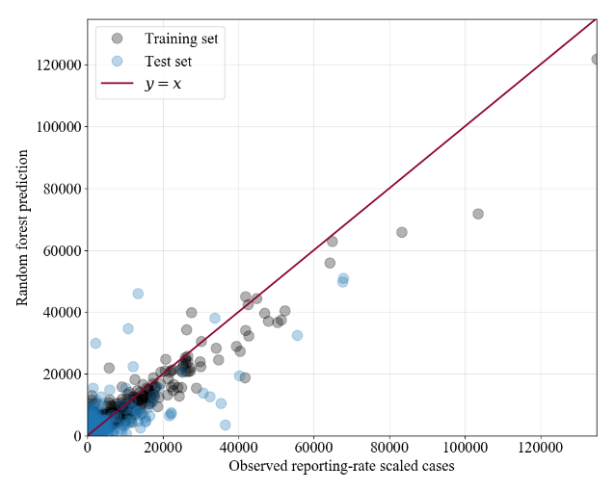
New approaches
Estimated reporting rate
1%
Case reporting rate correction
Embedded non-linear dynamics
Triangulation
Weak predictor discovery
Feature engineering
Examples:
  Estimate of reporting rate
  RandomForest trained on that rate
0.5%
0%
N. Thakkar et al. (in prep)

Slide 10
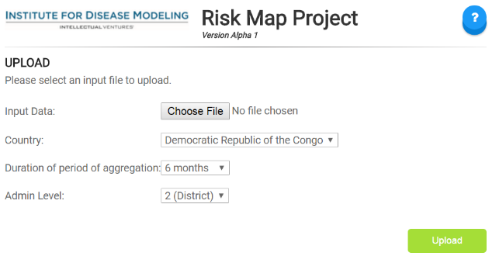
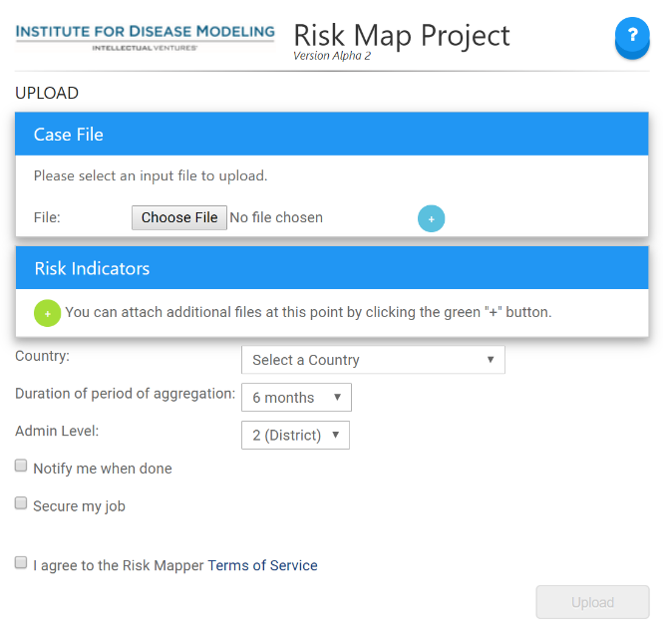
Can we scale?
riskmap.idmod.org
Goal
Can risk maps be built for “any disease, any country, in one day”?
Approach
Self-service for semi-custom risk models: try out many model structures, automate variable selection, optimize for predictive power
Demo tools
Riskmap:
  Cases only, 3 models, fast demos
Riskplus:
  Cases and/or indicators, 3 models,
  improved predictive power
riskplus.idmod.org

Slide 11
Thanks
IDM research
  Hil Lyons
  Alex Upfill-Brown
  Kevin McCarthy
  Niket Thakkar
  Laina Mercer
  Steve Kroiss
IDM software
  Benoit Raybaud
  Qinghua Long
  Dennis Harding
Collaborators
  Nigeria EOC
  Pakistan EOC
  RATT @ GPEI
  GID team @ CDC
  BMGF polio team
  Measles team @ WHO HQ
  Measles team in Nigeria
  Measles team in Pakistan
  BMGF measles team

