Slide 1



Forecasting the ongoing Ebola epidemic in DRC
2019 IDM Sympoisum
17 April 2019
Gerardo Chowell, PhD

Slide 2
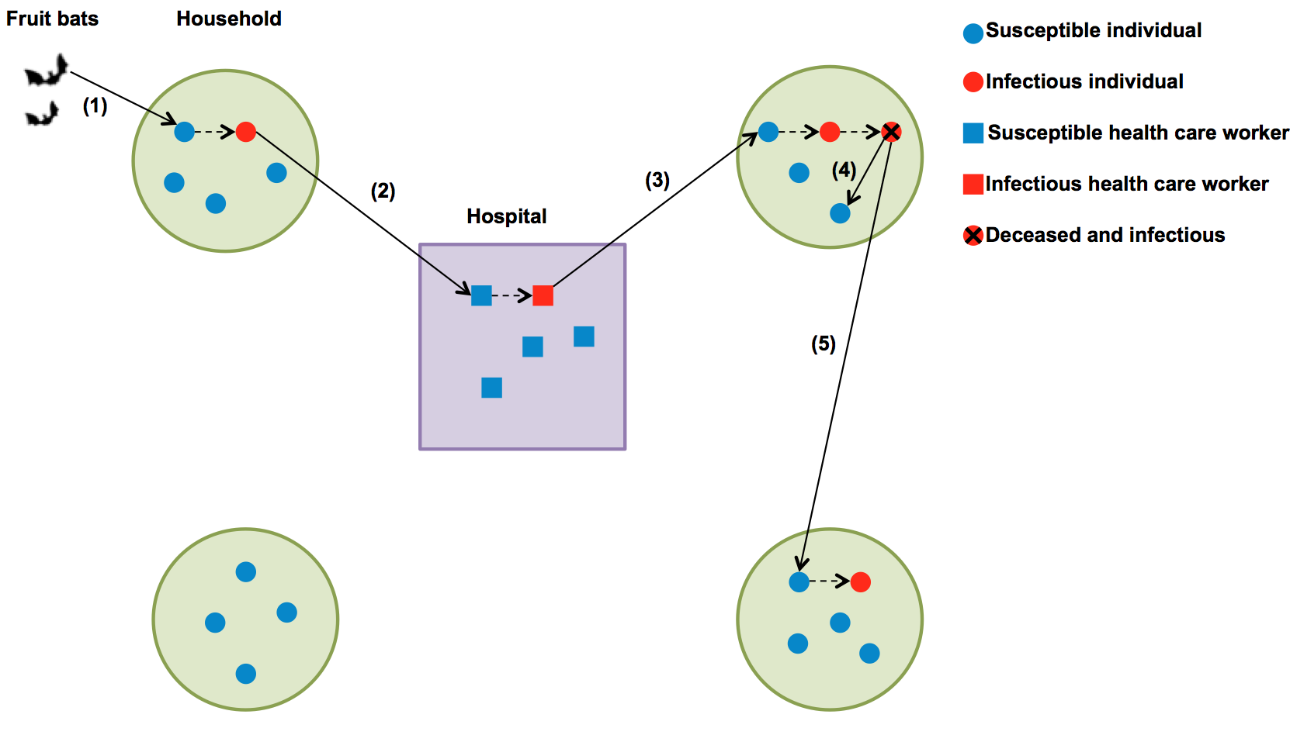
Ebola transmission pathways, Western Africa epidemic, 2014-2015
1) Spillover transmission to humans by direct contact with a reservoir (e.g., fruit bats), 2) within hospital transmission from EVD patients to health care workers, 3) within household transmission from infected health care workers to their family members, 4) within household transmission during unsafe burials, and 5) inter-household transmission arising from unsafe burials.
Notes:
Schematic representation of the transmission dynamics of Ebola virus disease (EVD) where the main transmission pathways are: 1) Spillover transmission to humans by direct contact with a reservoir (e.g., fruit bats), 2) within hospital transmission from EVD patients to health care workers, 3) within household transmission from infected health care workers to their family members, 4) within household transmission during unsafe burials, and 5) inter-household transmission arising from unsafe burials. Solid arrows indicate a transmission link while dashed arrows denote disease progression (e.g., from susceptible to infectious or from infectious to dead and infectious).
Ebola: spreads by close contact when individuals are most ill.
Spreads among caretakers.

Slide 3
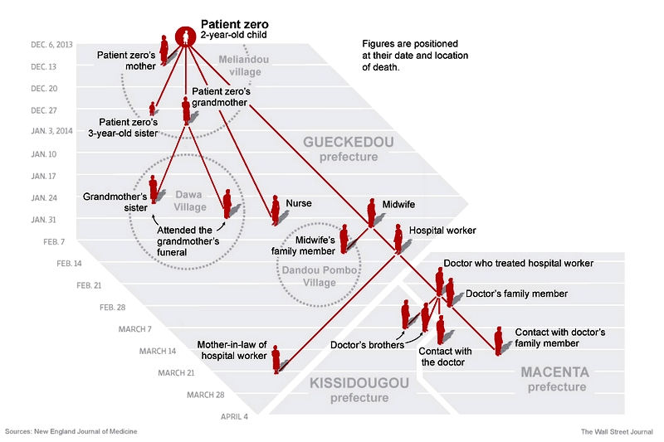
Ebola transmission pathways

Slide 4
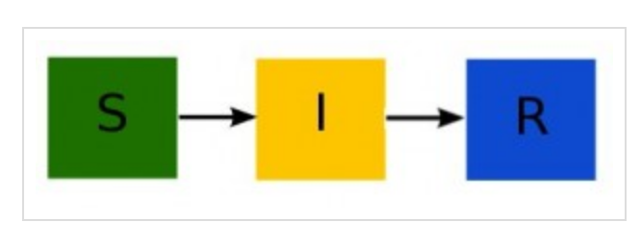
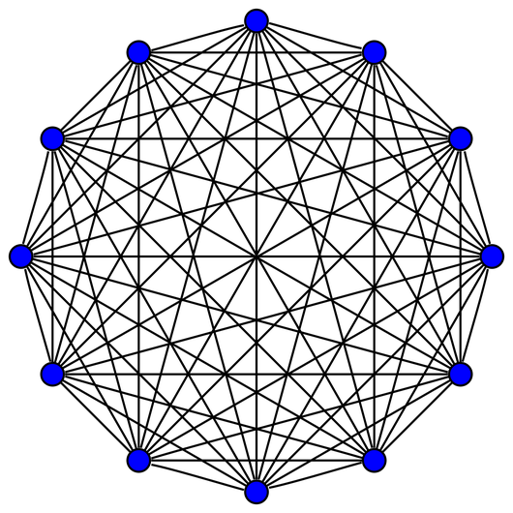
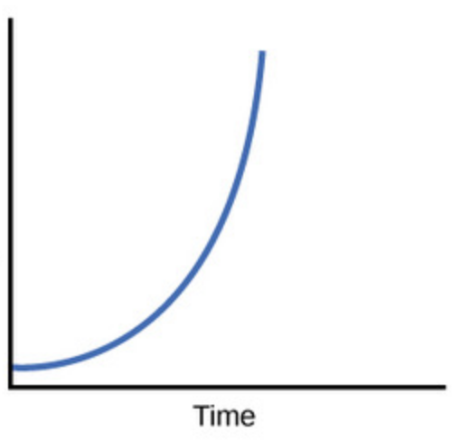
Basic Susceptible-Infectious-Recovered (SIR) compartmental model
Complete network
Prob. transmission per contact
Transmission rate
Exponential growth
Case incidence
Contact rate
Recovery rate
Ross 1910; Kermack & McKendrick 1927

Slide 5
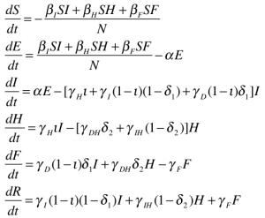
Compartmental Ebola Epidemic Model
Legrand et al. 2006 model for
Understanding the dynamics of Ebola epidemics
Notes:
How many generations into epidemic?
Throughout the epidemic course, the term ‘exponential epidemic growth’ was widespread among scientists and journalists covering the story.
Epidemic curves in semi-logarithmic scale illustrate the exponential growth and sub-exponential growth patterns. In semi-logarithmic scale, exponential growth is evident if a straight line fits well several consecutive disease generations of the epidemic curve whereas a strong curvature in the epidemic curve would be indicative of sub-exponential growth.
Implications --
Say something about the huge implications for estimation of final epidemic size from models.
What about timing? How many weeks into the epidemic can one know it is sub-exponential? Etc etc

Slide 6
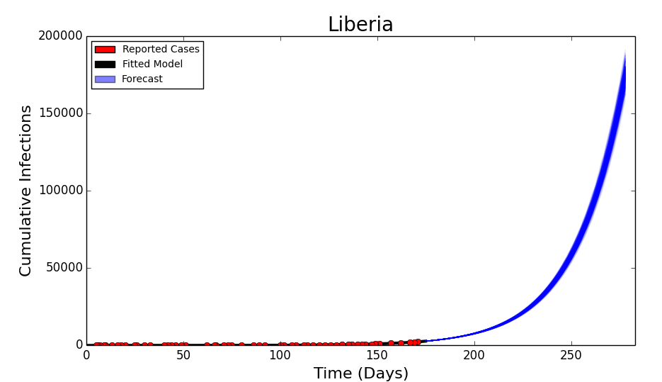
SIR based “Worst-case” Scenarios
No changes in behavior or increased medical interventions.
Calibration
Forecast

Slide 7
BUT….
Outbreak data displays variable epidemic growth scaling

Slide 8
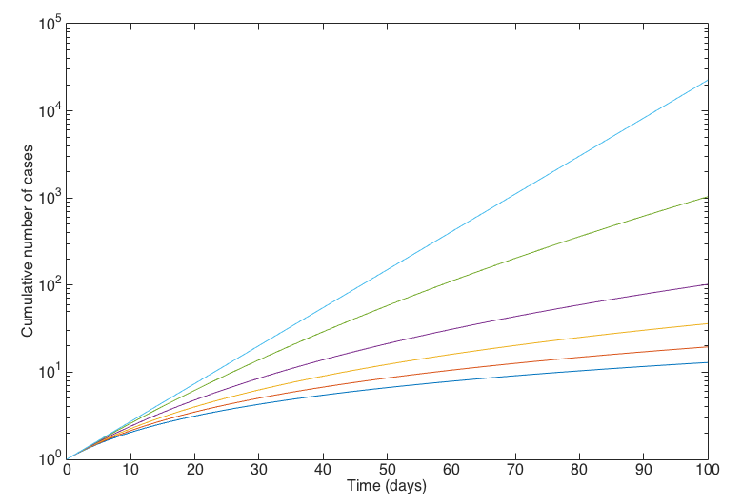
Differentiating Exponential vs. Sub-exponential growth
Common assumption made in epidemic models (homogenous mixing)
Exponential growth
Sub-exponential growth
Chowell et al. PLOS Currents Outbreaks. 2015 Jan 21.
Notes:
Social behavior
Spatial effects (clustering)
Individual-level (unobserved) heterogeneities in susceptibility and infectivity
Here the growth rate “r” is related to R₀ as derived from classic SIR-type compartmental transmission models, e.g., for the simple SIR (susceptible-infected-removed) model, R₀ = 1 + r/γ where 1/γ is the mean infectious period.
R0 is important, but also important to know whether a disease spreads exponentially or linearly fast.. This information is not given in a value of R0.
SEIR-type compartmental models assume exponential growth dynamics in the absence of control interventions
How many generations into epidemic?
Throughout the epidemic course, the term ‘exponential epidemic growth’ was widespread among scientists and journalists covering the story.
Epidemic curves in semi-logarithmic scale illustrate the exponential growth and sub-exponential growth patterns. In semi-logarithmic scale, exponential growth is evident if a straight line fits well several consecutive disease generations of the epidemic curve whereas a strong curvature in the epidemic curve would be indicative of sub-exponential growth.
Implications --
Say something about the huge implications for estimation of final epidemic size from models.
What about timing? How many weeks into the epidemic can one know it is sub-exponential? Etc etc

Slide 9
What mechanisms can give rise to
sub-exponential growth?
Spatially constrained contact network (e.g. high clustering)
Control interventions/behavior changes
Heterogeneity in risk of infection (e.g., substantial number of asymptomatic cases?, prior immunity)
Combinations of the above
Chowell et al. Phys. Life Rev. 2016

Slide 10
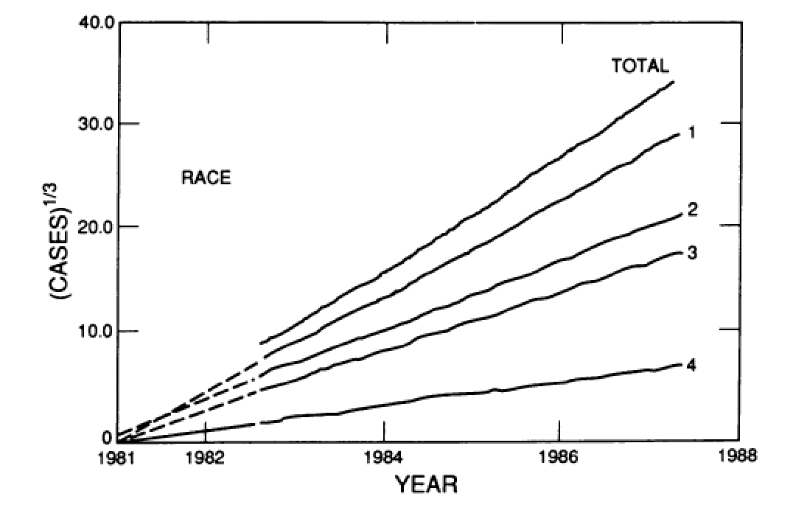
The US HIV/AIDS epidemic exhibits cubic polynomial growth
Colgate et al. PNAS 1989
1=white; 2= black; 3=hispanic; 4=unknown
Notes:
Polynomial growth in the early HIV/AIDS epidemic was due to a strong biased mixing in the population where like-prefers-like.

Slide 11
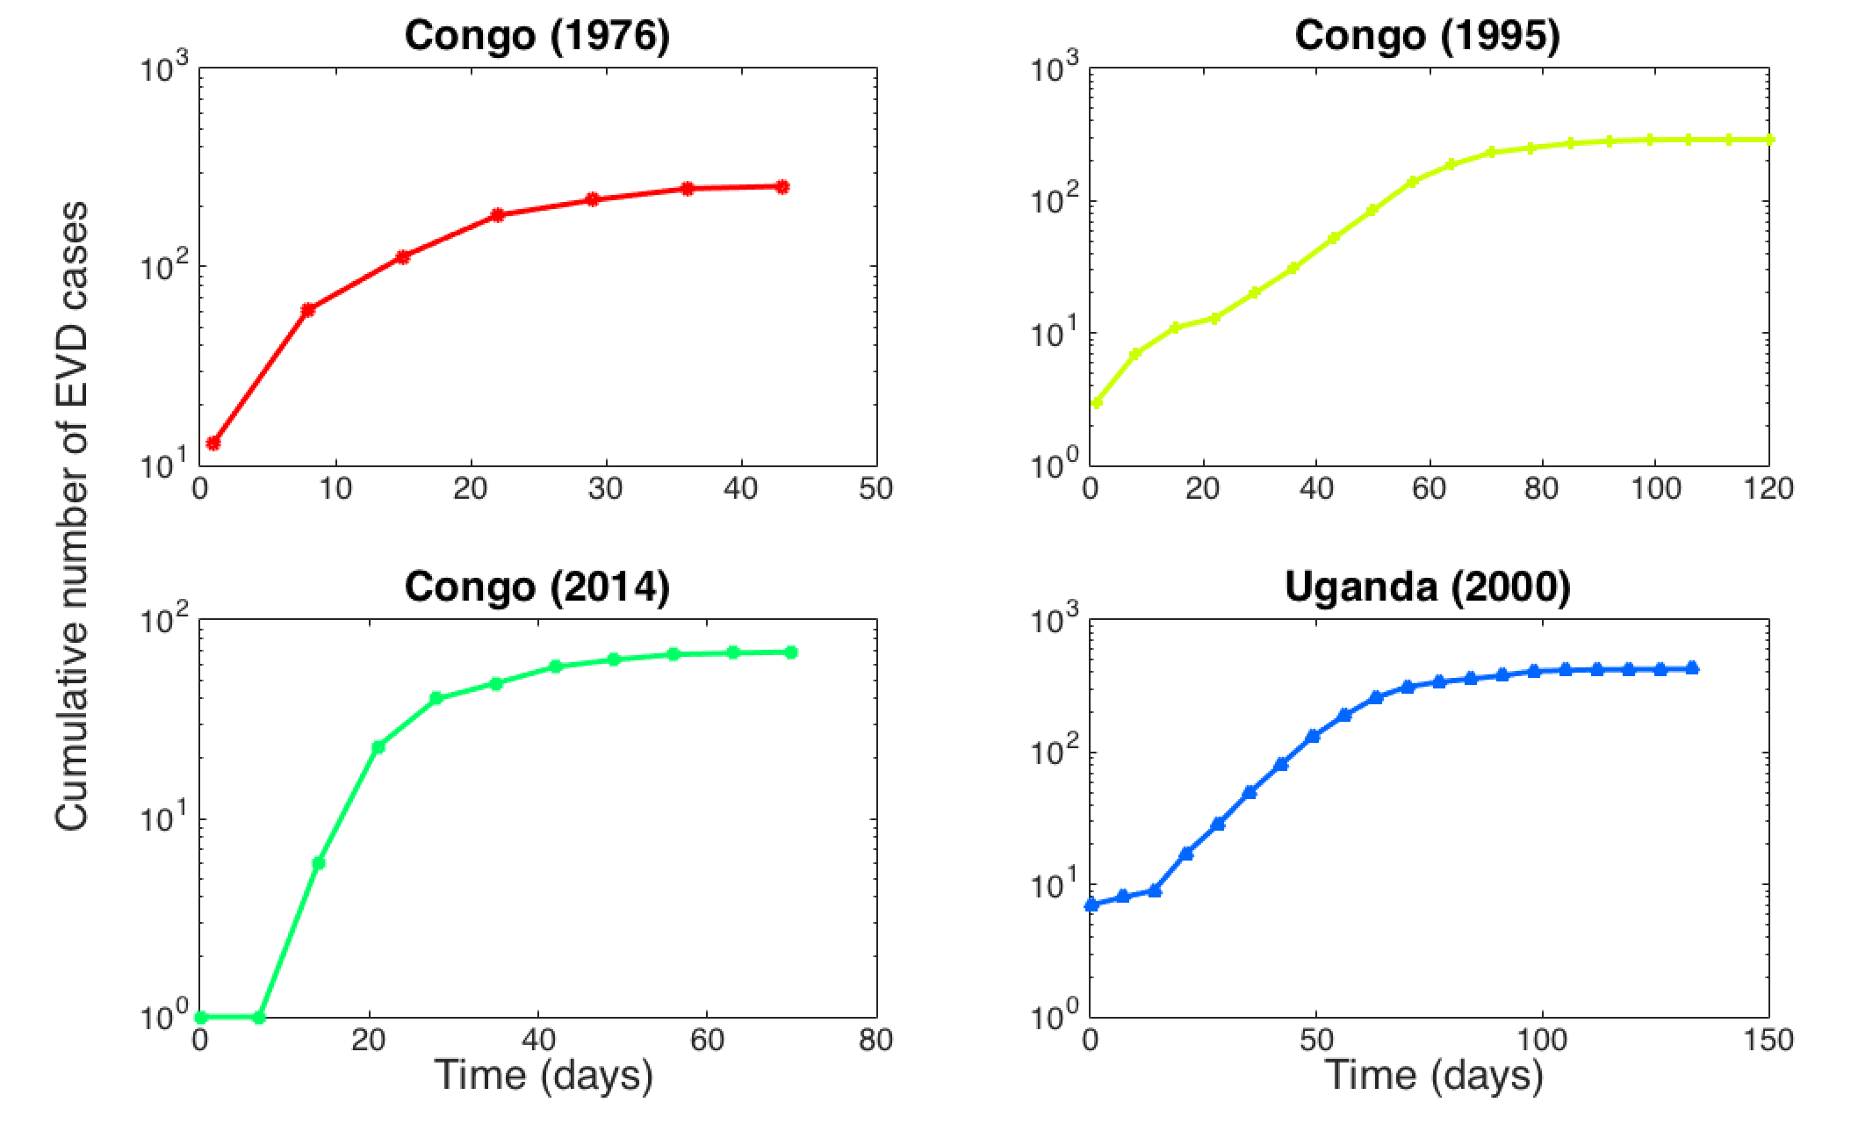
Prior outbreaks limited in geographic scope, size and duration
255 cases
290 cases
69 cases
426 cases
Effective reproduction number rapidly declines after 2-3 generations of infections
Breman J et al. (1978) ; Khan et al. (1999); Maganga et al. (2014); WHO (2001); Chowell et al (2004); Baize et al. (2014)

Slide 12
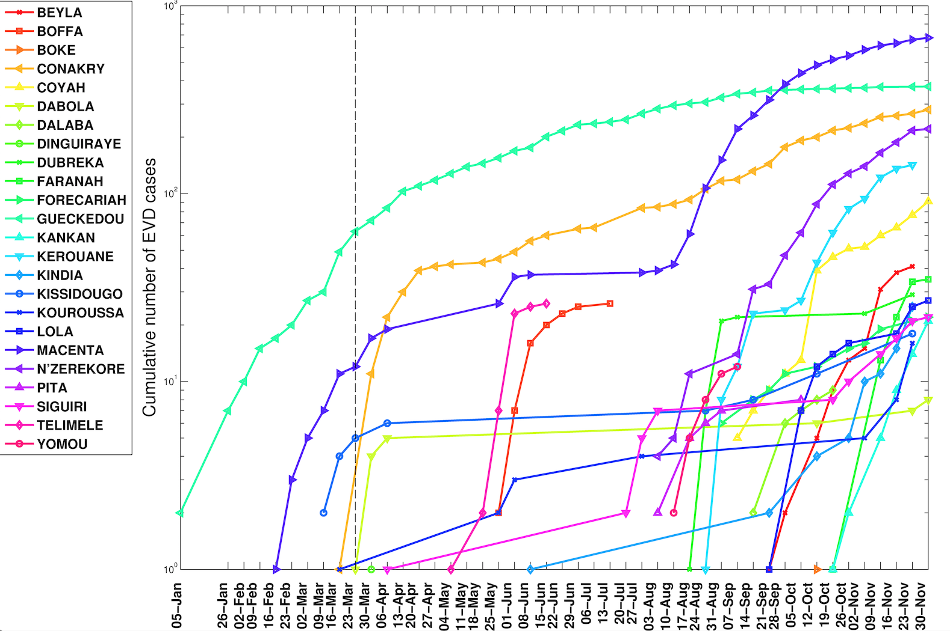
Polynomial growth rates from subnational data: 2014 Ebola epidemic in Guinea
WHO is notified of outbreak
Gueckedou
Asynchronous overlapping sub-exponential sub-epidemics
Chowell et al. PLOS Currents Outbreaks. 2015 Jan 21.
Notes:
If there are changes in behavior and the availability of heath-care, and the epidemic does not have exponential solutions, then must our mathematical model needs to account for these changes and admit nonexponential solutions.
- Reminiscent of the HIV/AIDS epidemic in the United States

Slide 13
How do we quantify epidemic growth scaling regardless of the mechanisms driving it?
Generalized-Growth Model (GGM)

Slide 14
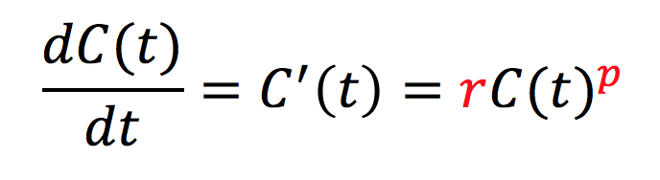
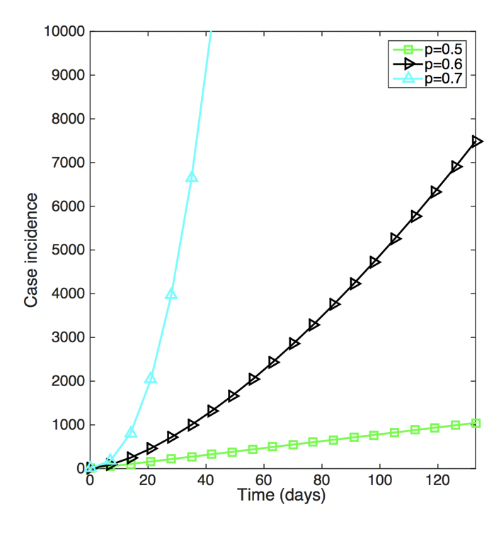
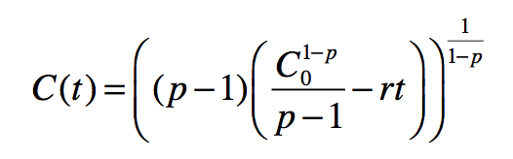
Generalized-Growth Model (GGM)
Epidemic growth scaling with quantified uncertainty
growth rate
Parameter
Growth scaling parameter
Where:
C’(t) describes the incidence curve over time t
r is a positive parameter denoting the growth rate
p∈ [0,1] is an scaling of growth parameter
Viboud, Simonsen, Chowell. Epidemics (2016)
Chowell & Viboud. Infectious Disease Modeling (2016)

Slide 15
What happens to R₀ in the context of sub-exponential growth?

Slide 16
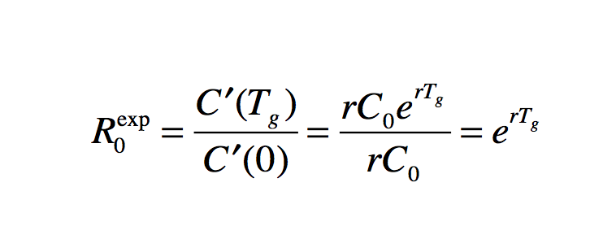
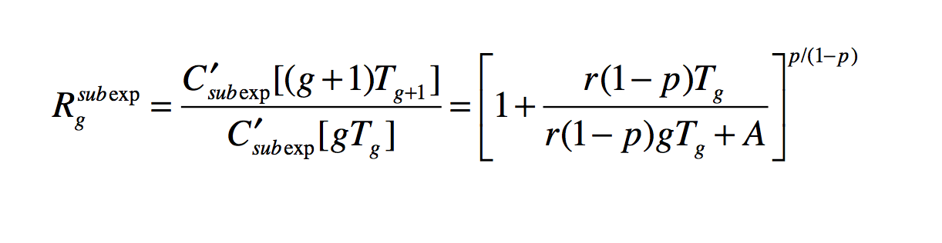

Reproduction Number
If p=1 (exponential growth)
Wallinga & Lipsitch (2007); Roberts & Heesterbeek (2007)
If p<1 (sub-exponential growth)
Chowell, Viboud, Simonsen, Moghadas. J. R. Soc. Interface (2016)
Notes:
Rg_subexp declines over disease generations asymptotically towards 1.0.

Slide 17
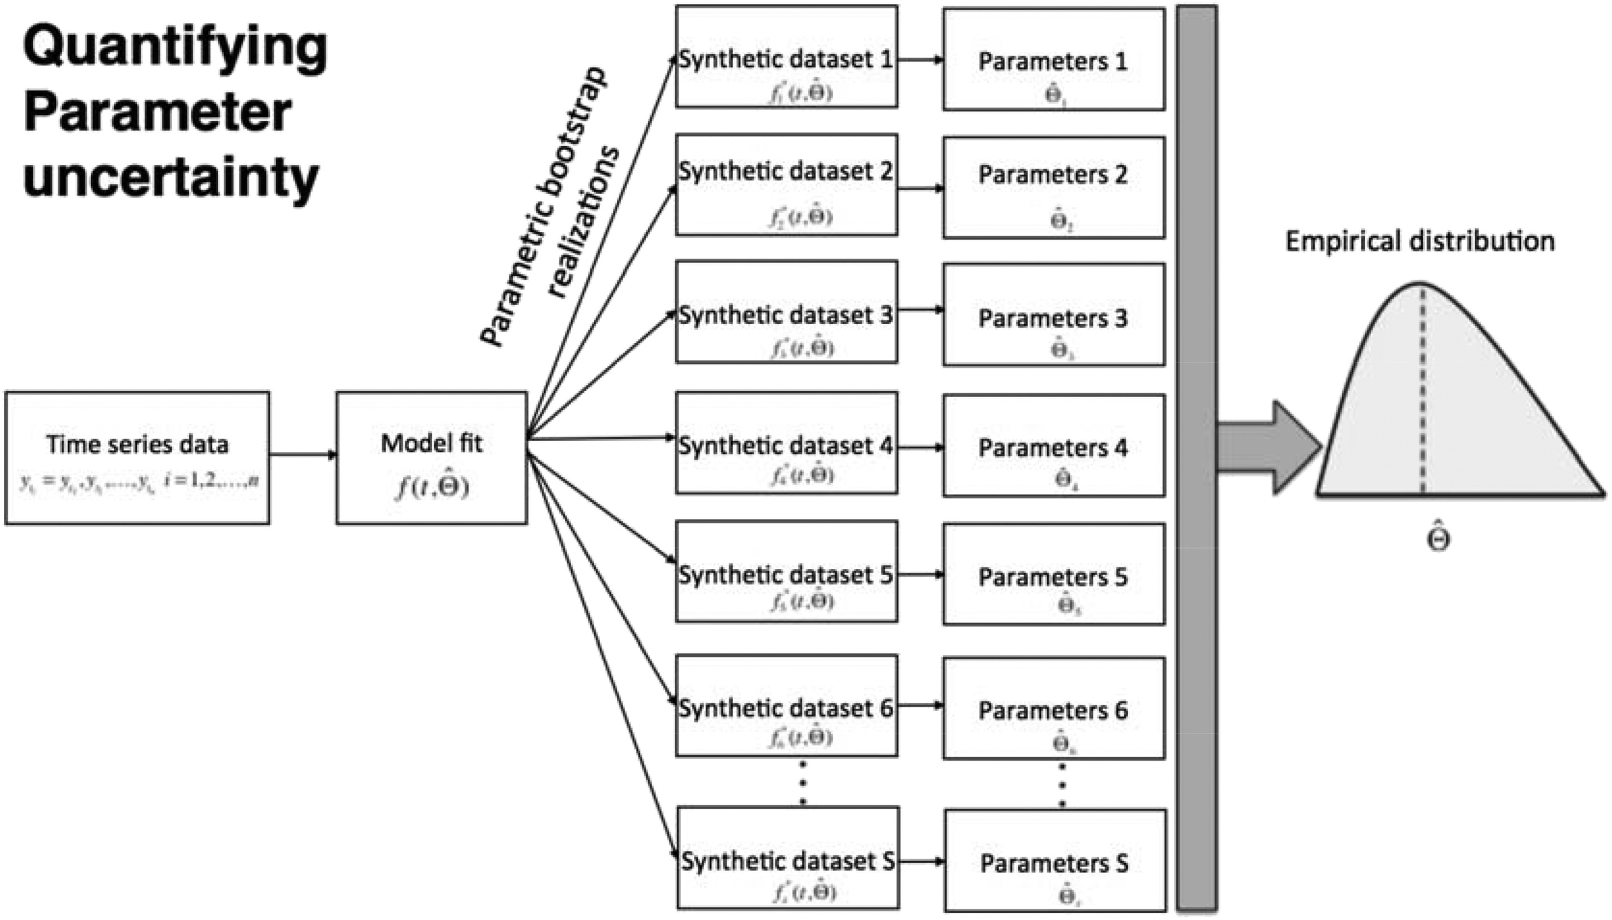
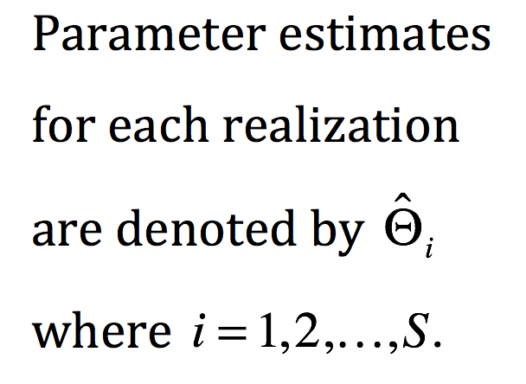
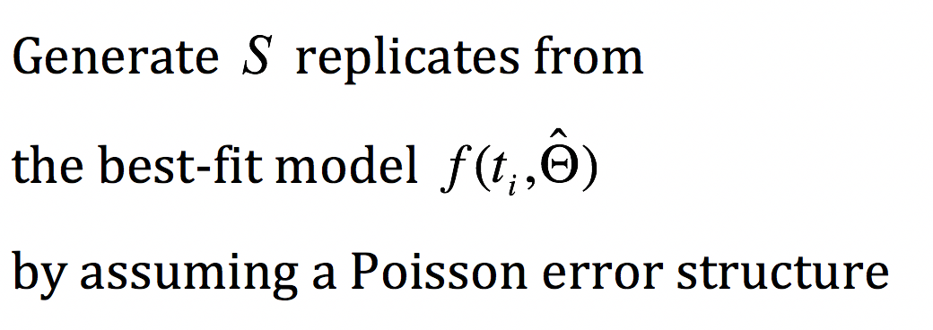
Parameter estimation framework
G. Chowell. Infectious Disease Modeling 2017

Slide 18
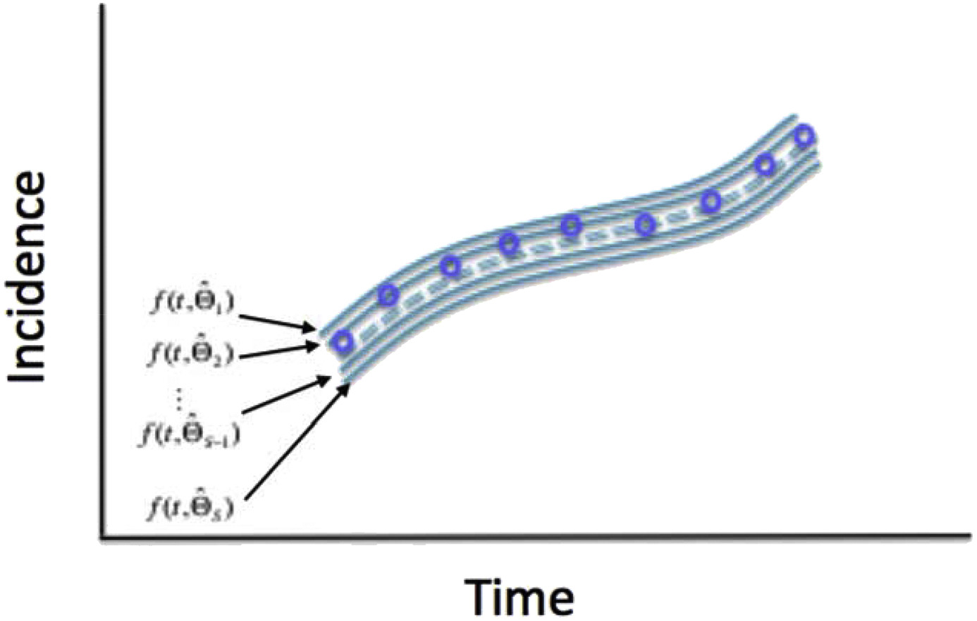
Uncertainty of the model best fit
Confidence and prediction intervals

Slide 19
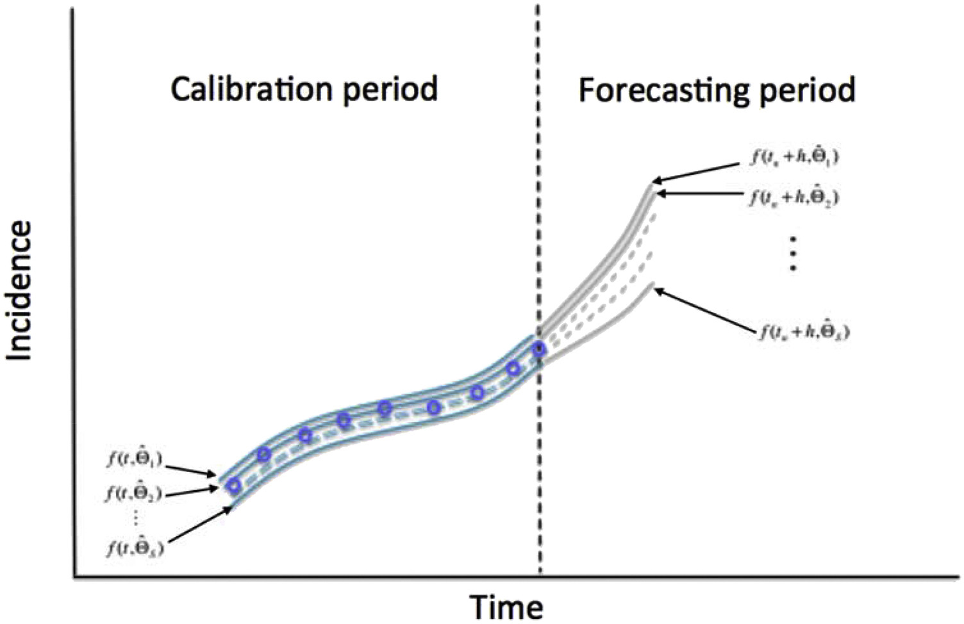
Model-based forecast with quantified uncertainty
G. Chowell. Infectious Disease Modeling 2017

Slide 20
The 1918 influenza pandemic, San Francisco

Slide 21
The 2014-16 Ebola in Western Area Urban, Sierra Leone

Slide 22
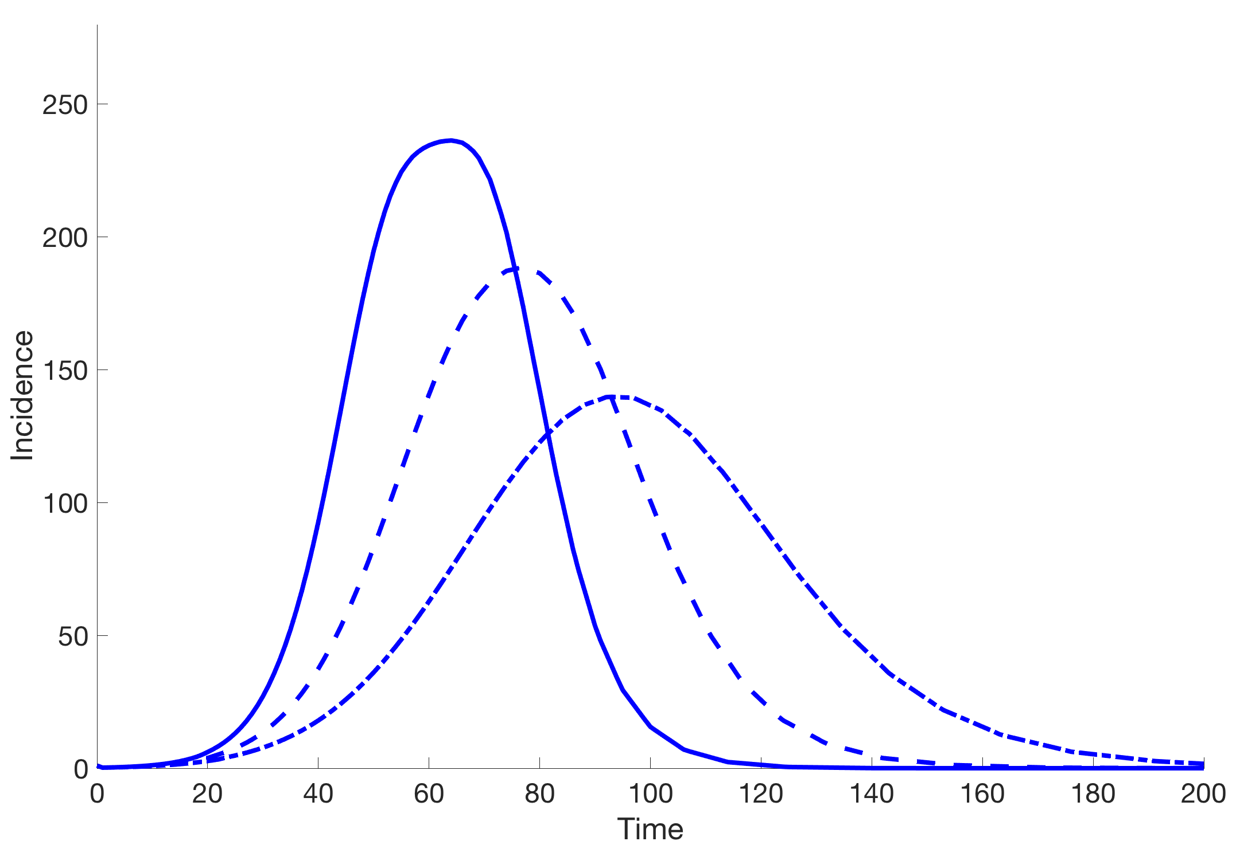
Epidemics with flexible epidemic growth scaling
Social behavior
Spatial effects (clustering)
Individual-level (unobserved) heterogeneities in susceptibility and infectivity
Increasing Saturation effects
Notes:
Same epidemic size, but different epidemic growth scaling

Slide 23
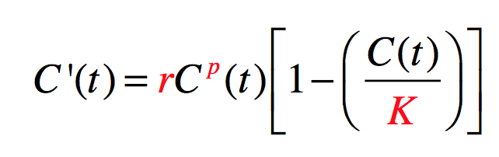
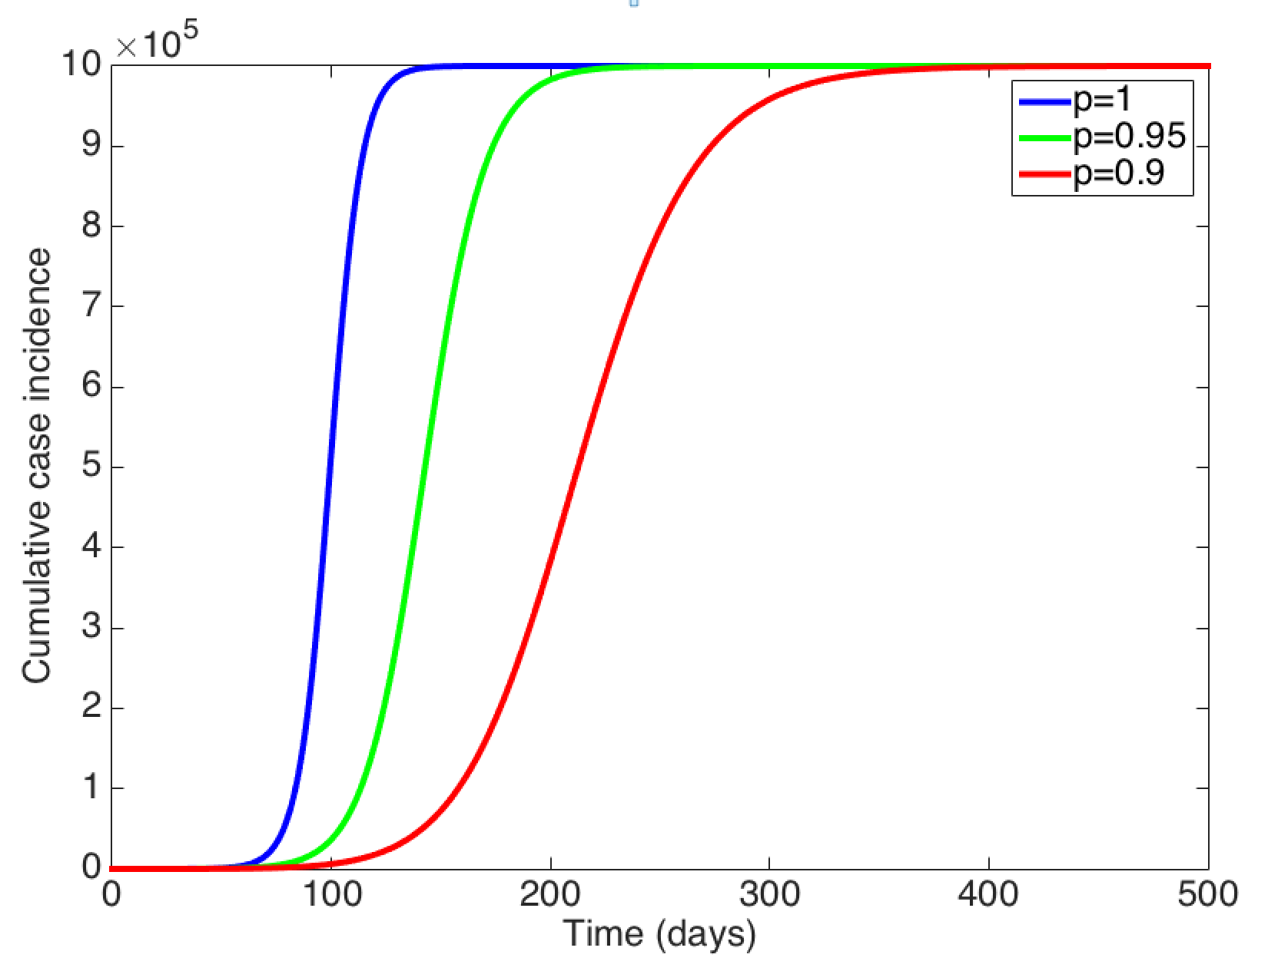
The generalized-logistic growth model (GLM)
Scaling of
growth parameter
Growth rate
Epidemic size
Where:
C’(t) describes the incidence curve over time t
r is a positive parameter denoting the growth rate
p∈ [0,1] is an “deceleration” growth parameter
K indicates the final epidemic size
Chowell et al. Plos Currents Outbreaks 2016.

Slide 24
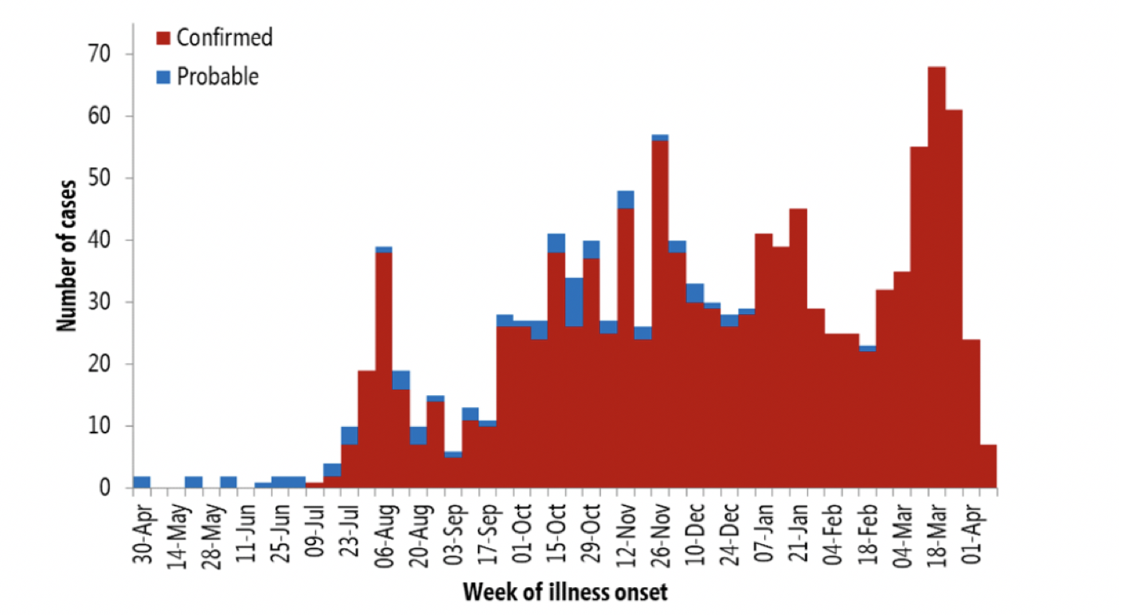
Ongoing Ebola Epidemic in DRC is shaped by overlapping sub-epidemics
WHO Ebola Report, April 11th, 2019
Notes:
There are a total of 1186
EVD cases
751 deaths (63% case fatality ratio)
87 EVD affected health care workers
13 health zones have reported new cases
in the past one week
Katwa, Vuhovi, Mandima and Butembo
are the current epicenters of the disease
69000 registered contacts as of April 7
8678 contacts are under surveillance
83-87% have been followed in past 7 days
96133 contacts, and contacts of
contact have been vaccinated as of April 6

Slide 25
Reporting delays
The most recent estimate of the average reporting delay is 1.7 weeks (95% CI: 1.6, 1.78) for the March, 2019.
Tariq, Roosa et al. Epidemics 2019

Slide 26
Vaccination and Attacks to Public Health Infrastructure
Yuhas, A. ‘Crippling’ Attacks Force Doctors Without Borders to Close Ebola Centers in Congo. The New York Times.

Slide 27
Representative epidemic waves composed of overlapping sub-epidemics
Endemic state
Temporary endemic state
Declining sub-epidemics
Sustained oscillations
Damped oscillations

Slide 28
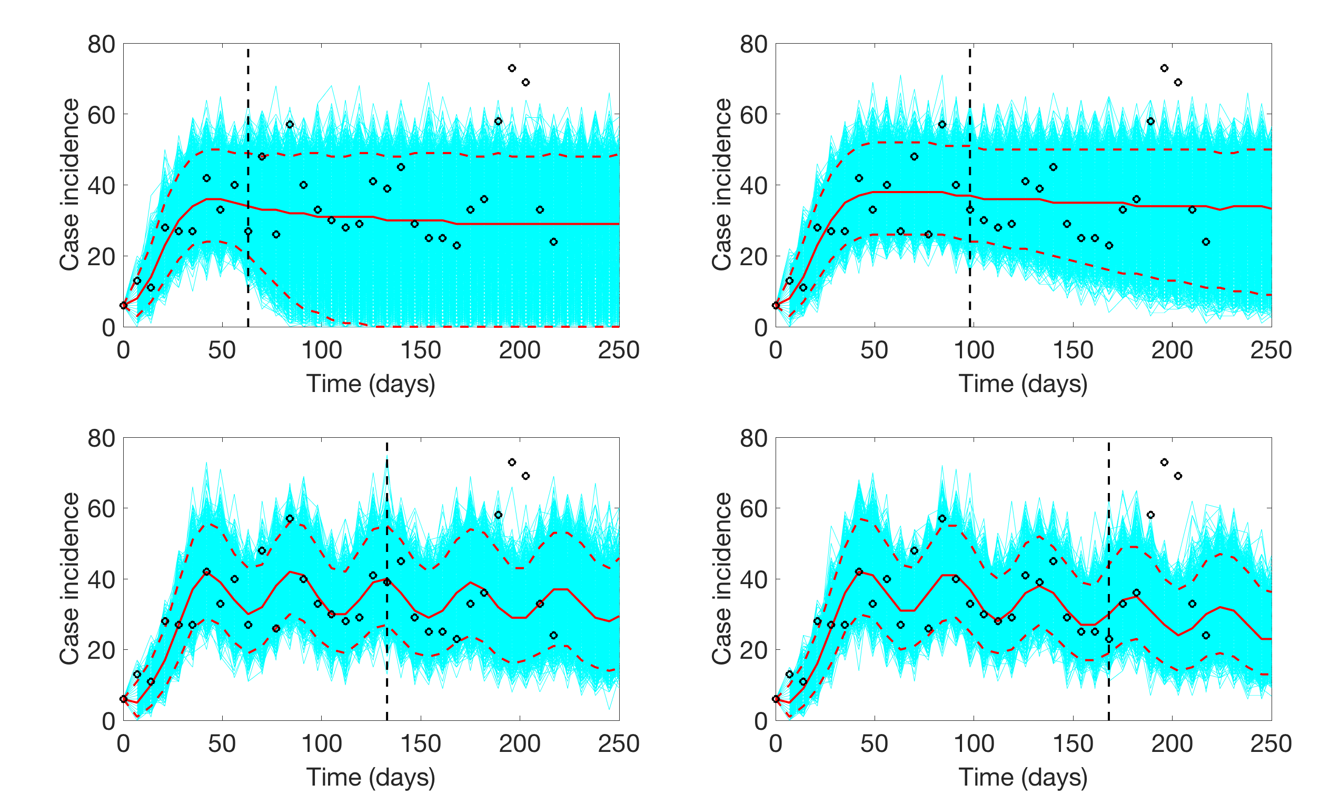
Forecasts of the DRC Ebola outbreak
Calibration
Forecast
Calibration
Forecast
Chowell, Tariq, Hyman. Submitted.

Slide 29
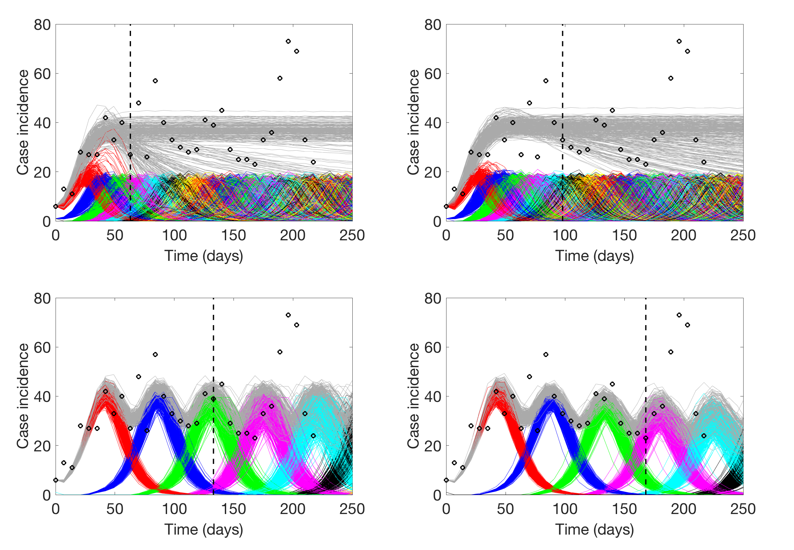
Disaggregating the epidemic wave into sub-epidemics

Slide 30
Summary
Our ability to generate reliable epidemic forecasts is challenged by the sparse data on the individual and group-level heterogeneity that affect the dynamics of infectious disease transmission
Our epidemic wave model is based on the premise that the observed coarse-scale incidence can be decomposed into overlapping sub-epidemics at finer scales.
Our findings support the view that the persistent epidemic wave pattern of the ongoing Ebola epidemic in DRC can be decomposed into overlapping sub-epidemics of relatively small size to provide more robust short-term forecasts.
Our results have significant implications for interpreting apparent noise in incidence data since the oscillations could be dismissed as the result of overdispersion or give the false impression of a positive effect of public health interventions.

Slide 31
Acknowledgements
Amna Tariq (PhD student – Georgia State)
Kimberlyn Roosa (PhD student – Georgia State)
Kenji Mizumoto (Postdoc – Georgia State)
Cecile Viboud Fogarty International Center, NIH)
Lone Simonsen (FIC & Rosklide University, Denmark)
Mac Hyman (Tulane University)

Slide 32
References
A novel sub-epidemic modeling framework to forecast the DRC Ebola outbreak. Chowell, Tariq, Hyman. Under Review.
Assessing reporting delays and the effective reproduction number: The Ebola epidemic in DRC, May 2018-January 2019. Tariq A, Roosa K, Mizumoto K, Chowell G. Epidemics. 2019 Mar;26:128-133. doi: 10.1016/j.epidem.2019.01.003.
Fitting dynamic models to epidemic outbreaks with quantified uncertainty: A Primer for parameter uncertainty, identifiability, and forecasts. Chowell G. Infect Dis Model. 2017 Aug;2(3):379-398. doi: 10.1016/j.idm.2017.08.001.
The Western Africa ebola virus disease epidemic exhibits both global exponential and local polynomial growth rates. Chowell G, Viboud C, Hyman JM, Simonsen L. PLoS Curr. 2015 Jan 21;7.
A generalized-growth model to characterize the early ascending phase of infectious disease outbreaks. Viboud C, Simonsen L, Chowell G. Epidemics. 2016 Jun;15:27-37.
Characterizing the reproduction number of epidemics with early subexponential growth dynamics. Chowell G, Viboud C, Simonsen L, Moghadas SM. J R Soc Interface. 2016 Oct;13(123). pii: 20160659.

