Slide 1
Applied Simulation Modeling for Interrupting Malaria Transmission on Bioko Island
Daniel T. Citron
April 15, 2019
Notes:
Worked in close collaboration with the elimination program in equatorial guinea,
using their data to build a simulation model to help them plan for what to do next to interrupt malaria transmission on Bioko Island

Slide 2
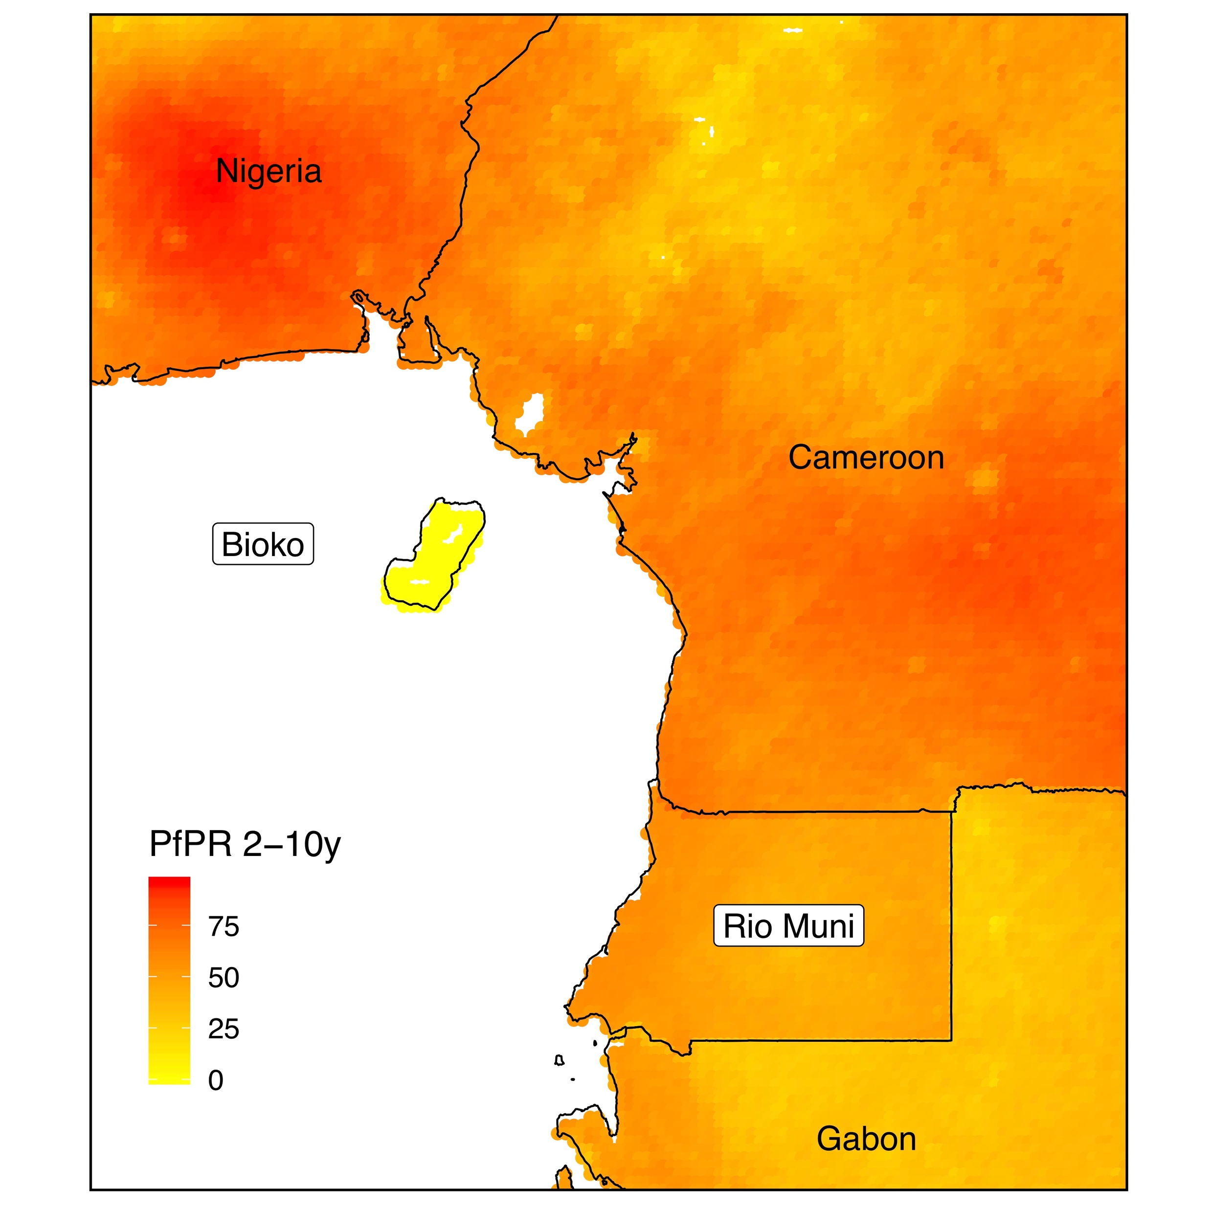
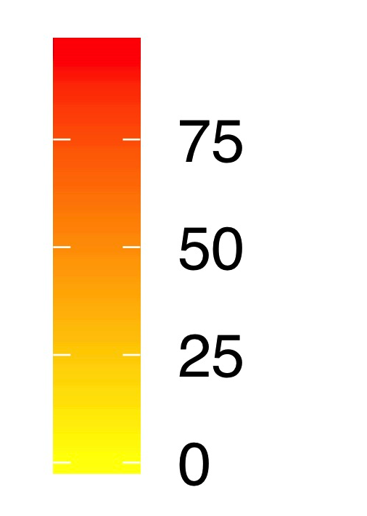
Bioko Island
Island Population: ~250,000
Malabo Population: ~190,000
Nigeria
Cameroon
Bioko
PR 2-10y
100
Río Muni
Bioko Island
Census Map
Gabon

Slide 3
Malaria on Bioko Island
PR = Parasite Rate, a measure of prevalence
High risk region
2004 – Bioko PR ~ 40%
15-year control program, including:
  Extensive surveillance
  Extensive vector control
  Freely available treatment
  Capacity building
Since 2015 – Bioko PR ~ 10%
Nigeria
Cameroon
Bioko
PR 2-10y
100
Río Muni
Gabon

Slide 4

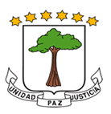











Bioko Island Malaria Elimination Program
Program managed by MCDI
Collect data in Malaria Indicator Survey:
  Annual survey of ~15,000 residents
  Parasite Rate
  Travel history
Close collaboration was crucial for understanding transmission environment
Ministerio de Minas
Industria y Energia

Slide 5
Key Questions
The conundrum:
  No reduction in PR since 2015
  Why has progress stalled?
What to do next?
  Will adding vaccination to the current intervention package halt transmission on Bioko Island?
What is the role of off-island transmission?
  High risk among travelers from mainland EG
  Few vectors in Malabo, yet malaria persists
Prevalence (PR)
2004-2018

Slide 6
Modeling Methodology
Begin with aggregated MIS data, 2015-2017
Create geostatistical maps:
  PR estimates
  Travel behavior
Use mechanistic models, calibrated to MIS and geostatistical maps
  Geospatially explicit model of transmission
  Include human travel between Bioko Island and Mainland EG
Analysis:
  Assess influence of cases acquired off-island with simple dynamical model
  Simulate vaccination deployment scenarios

Slide 7
Mapping Malaria Prevalence
Geostatistical prevalence mapping
  Census
  Survey data
  Environmental covariates
Estimate prevalence in each map-area
  Captures km²-scale variability in PR
  Highest PR along northwest coast
  ~10-14% in Malabo

Slide 8
Prevalence Conditioned on Travel History
Map PR, this time conditioning on recent travel
Higher risk of malaria among those who traveled off-island
Total PR
PR | travel
PR | no travel

Slide 9
Influence of Off-Island Transmission
Mainland EG has very high transmission risk
Frequent off-island travel from Malabo
How much of the prevalence seen on the island is attributable to travel?
Use simple dynamical model
  Ross-Macdonald
  Include off-island infections
  Calibrate based on PR + travel survey
Nigeria
Cameroon
Bioko
PR 2-10y
100
100
Río Muni
Gabon

Slide 10
Influence of Off-Island Transmission
Travel Fraction: % cases attributable to off-island transmission
Malabo
  High travel fraction (white)
  Infections not occurring locally
  Explains high prevalence and few viable vectors in urban area
Malaria cases acquired off-island maintain PR in parts of Bioko
Travel Fraction

Slide 11
Effect of Additional Interventions
Agent-based simulation model of malaria transmission
  Allow individuals to travel, calibrated to travel survey data
  Individuals come in contact with mosquitoes, transmit parasites
At Home
Travel (Off Island)
Humans
Infected
Susceptible
Infected
Susceptible
Mosquitoes
New Adults
Infectious
Adults
Infectious
Adults

Slide 12
Simulation Modeling Results
Baseline: what would happen with no additional interventions
Red: tracking mean prevalence over time
Baseline

Slide 13
Simulation Modeling Results
Adding vaccine + treatment, as a best-case scenario
Malaria returns after a few years – unlikely to eliminate
Baseline
Vaccination

Slide 14
Simulation Modeling Results
Simulated reducing risk of acquiring infections off-island
Results robust to varying vaccine coverage and efficacy
Addressing risk of returning with malaria may be more effective
Vaccination
Reduced Off-Island Risk

Slide 15
Conclusion
Bioko Island malaria transmission reduced in many areas
Continued elevated PR maintained by infections acquired off-island
Vaccination + Mass Treatment campaign ineffective in long run
Reducing off-island infections may be more effective
Augmenting travel model with highly detailed 2018 MIS data
Improving transmission model
Extending sensitivity analysis to show robustness of results to data inputs
Next Steps

Slide 16
Acknowledgments
Forthcoming: CA Guerra et al. Nature Communications
Support from BMGF
MCDI: Carlos A. Guerra, Guillermo Garcia, Julie Niemczura, Dianna Hergott,
Jordan Smith, Megan Perry, Wonder Philip Phiri,
Jose Osá Osá Nfumu, Jeremias Nzamio
MAP: Su Yun Kang, Katherine E. Battle, Harry S. Gibson
IHME: Sean Wu, David Smith

