Slide 1
Increasing access to malaria case management IDM Disease Modeling Symposium 15 April 2019 Justin M. Cohen, PhD, MPH

Slide 2
Business as usual systems lead to only a small fraction of incident malaria infections being cured
Gaps: Disease Access Management Adherence
0%
80%
80%
50%
80%
Drug cures infection
Infection results in acute febrile episode
Treatment sought at appropriate access point
Appropriate case management
26% cured
No cure
Poor case management
Treatment not sought at appropriate access point
Asymptomatic cases
100%

Slide 3
Improved access to effective case management leads to more infections cured
Gaps: Disease Access Management Adherence
Prevalence
0%
80%
No change in case management
80%
90%
80%
Infection results in acute febrile episode
Treatment sought at appropriate access point
Appropriate case management
Drug cures infection
46% cured
Increase cure rate from 26% to 46%
Improved access
No cure
Years
Poor case management
Credit: Emilie Pothin, CHAI/Swiss TPH
Impact:
Reduced illness & mortality
Augmented surveillance
Decreased transmission
No access
Asymptomatic cases
100%

Slide 4
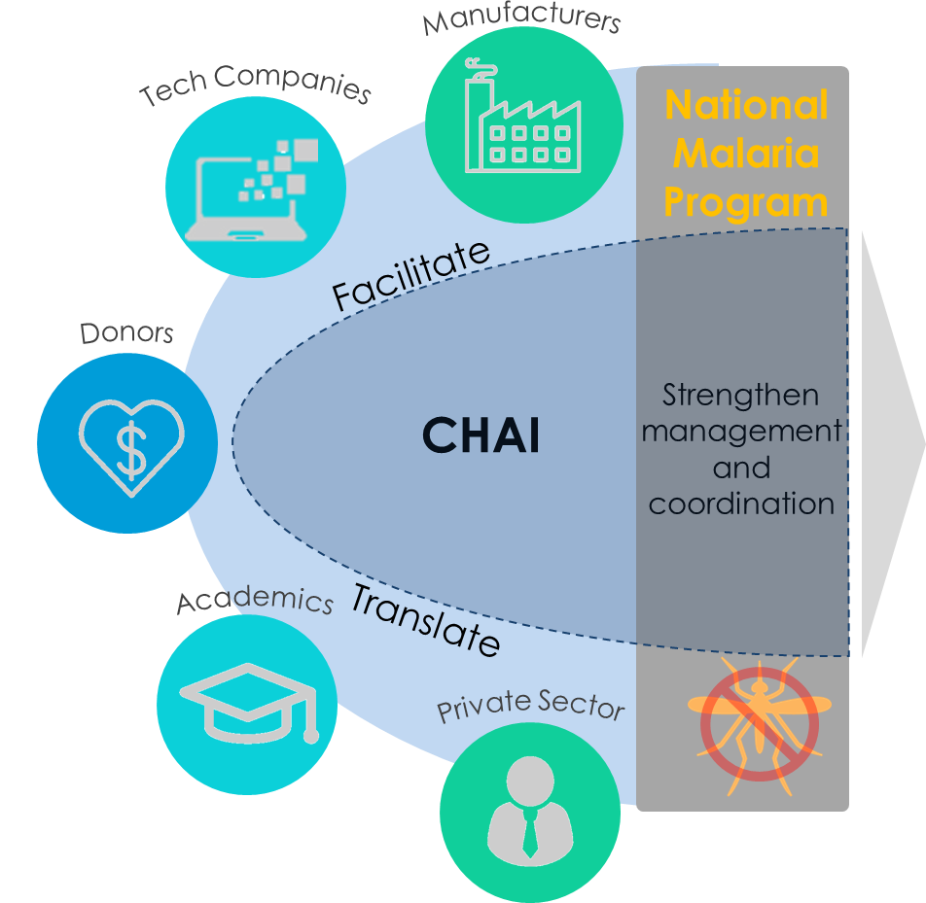
CHAI builds stronger government-owned systems to enhance impact and sustainability
1
Embed
problem-solving staff within governmental malaria programs to work as a day-to-day operational partner
2
Strengthen
government-owned systems through improved management and data-driven decision-making
Enhanced
impact and sustainability of government-owned and led systems
3
Facilitate & Translate
interactions between the malaria program and global actors who can provide useful tools and support

Slide 5
CHAI program countries
CHAI Programs
CHAI Malaria Programs

Slide 6
Panama: malaria declines have plateaued, with remaining malaria cases concentrated in indigenous communities
62%
Notes:
Malaria case distribution:
Malaria cases in Panama are increasingly becoming concentrated in autonomous, indigenous comarca territories.
As of end of June 2018, 85% of malaria cases have been reported in Panama’s comarca communities.
Some of the factors that maintain malaria endemicity among indigenous communities are: (i) lack of culturally appropriate policies and strategies that empower communities and encourage their participation in malaria case management, (ii) lack of knowledge about malaria drivers in the Guna territories by the national malaria program, and (iii) poor organization and participation of community members in activities related to prevention and surveillance of malaria.
The increasingly focalized distribution of malaria cases in Panama indicates a need for improved access to timely diagnosis and community-based case management services
As a result, a key focus for support from CHAI to the Panama malaria program centered around improving access to malaria case management services through community based care in the country’s indigenous, comarca communities

Slide 7
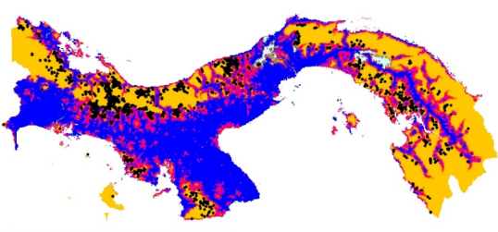
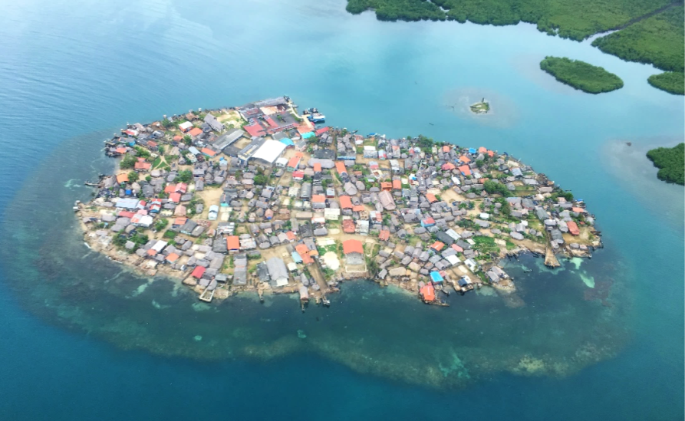
Weak access to care and dependency on microscopy resulted in significant delays in malaria diagnosis and treatment prior to 2016
Time in minutes to nearest health facility:
Guna Yala
80% of reported malaria cases diagnosed via active case detection through biweekly community visits by malaria technicians
Reliance on microscopy for diagnosis resulted in significant delays from 4 days up to 1 month for slide reading and return of results to patient
Understaffed program meant a single microscopist in Guna Yala was responsible for reading 4450 slides in 2016
Guna de Madungandi
Comarca Ngäbe-Buglé
Guna de Wargandi
Comarca Emberá Wounaam
Credit: K. Battle, MAP, Oxford University
Ailigandi, 1 of the 365 islands of the archipelago, in Guna Yala
Notes:
Previous delivery of diagnosis:
In endemic areas for malaria, case detection previously relied largely on vertically organized Vector Control Department technicians conducting biweekly community visits to provide active case detection.
These methods of detection were delivered in areas as shown on map that were ‘difficult to access’ with poorest access to health services.
Time to health facility was calculated using a cost-distance algorithm which computes the cost in time to travel from the closest health facility to any one location in Panama. Cost calculations were computed using remotely sensed environmental data including land cover, elevation, water bodies, and roads.
Successful delivery of ACD implementation was frequently impacted by factors such as weather, transportation challenges, and cultural practices that may close the community to outsiders.
Lack of confidence between indigenous leadership and the Ministry of Health previously created challenges for service delivery and collaboration, complicating efforts towards malaria elimination.
Prior to 2016: malaria diagnosis relied exclusively on microscopy and transport of slides to the lab was be logistically challenging, causing lengthy delays of several days to a few weeks in case confirmation and reporting to the central level.
As a result, historical use of presumptive treatment for suspected malaria cases, challenges for equitable access to malaria diagnosis and major delays in case detection reporting were common in endemic areas in Panama
COMMENT IN PRE PRESENTATION: MENTION THAT ITS NOT JUST DISTANCE, BUT ALSO LOW TX SEEKING TO HF’S, LACK OF ACTUAL TRANSPORT OPPORTUNITIES

Slide 8
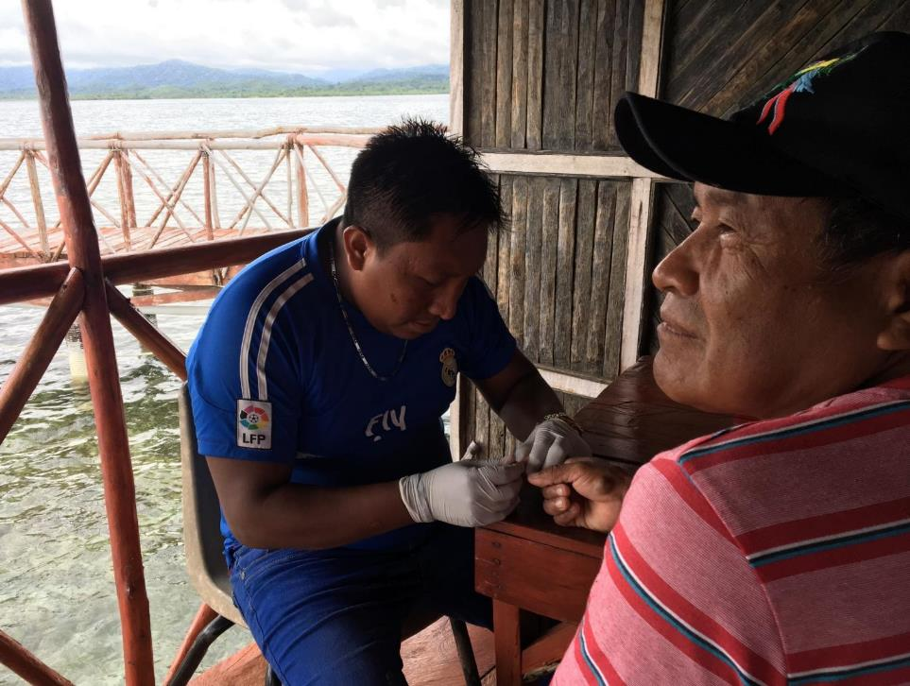
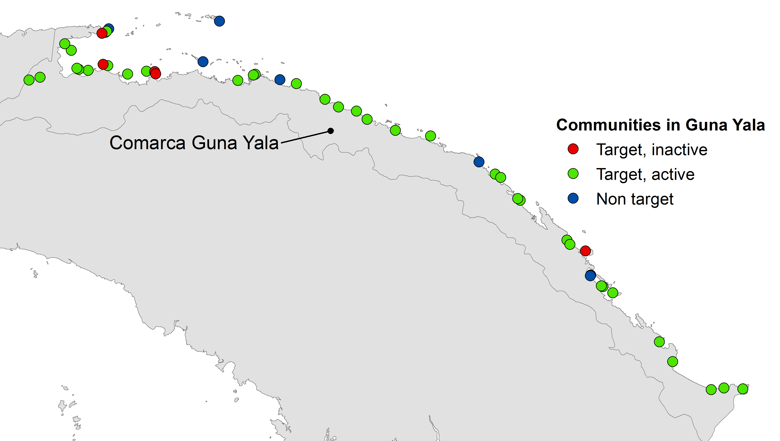
Community health workers launched in 2016 to extend diagnosis, treatment, and surveillance to communities in Guna Yala.
Collaboration between CHAI, Guna authorities, and MOH
One CHW per target community (42 total)
CHW would:
Perform an RDT
Prepare a slide for microscopy
Administer treatment
Report on those tested using a updated paper notification form
CHWs were first trained in October 2016, provided with refresher trainings and paid $50/month
Target and active CHW communities, Guna Yala,
Non-Targeted
12%
Targeted,
Inactive
8%
Targeted, Active
79%

Slide 9
CHWs increased access to nearly 100% of the population at risk and shifted case management away from active detection
At risk population is defined using a cut off of >1 predicted case per 1000.

Slide 10
Slide positivity rates among those tested by CHWs appears to be declining over time
Notes:
all:
lm(formula = SPR ~ Time + Tests, data = trend)
Residuals:
Min 1Q Median 3Q Max
-16.465 -5.911 -1.440 4.175 19.263
Coefficients:
Estimate Std. Error t value Pr(>|t|)
(Intercept) 37.77006 5.32734 7.090 3.19e-07 ***
Time -0.71222 0.24257 -2.936 0.00742 **
Tests -0.06583 0.06462 -1.019 0.31896

Slide 11
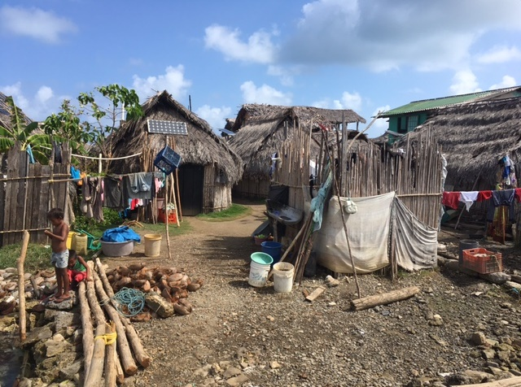
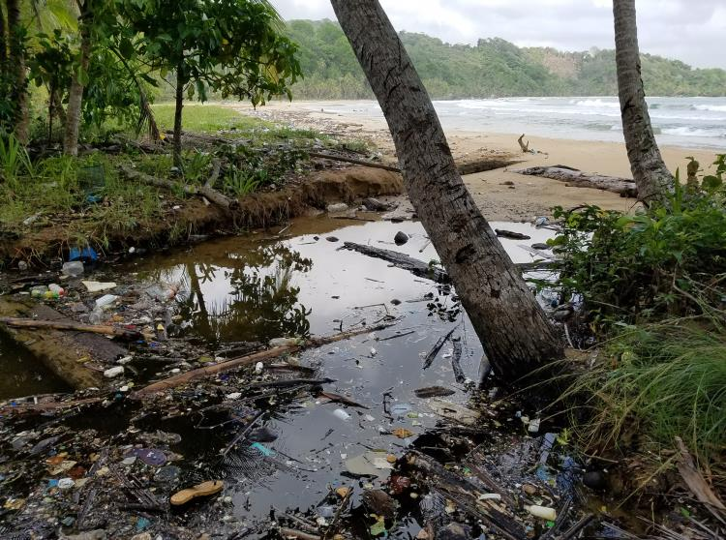
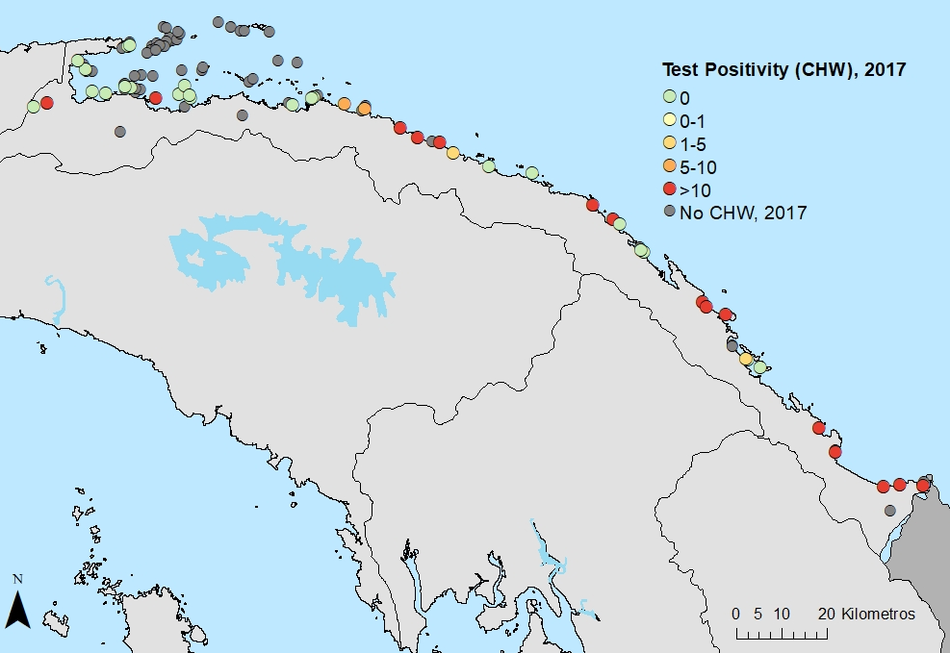
More specific data on village-level malaria permits more tailored understanding of transmission drivers
Notes:
The Panamanian government has long known malaria is focalized to poor indigenous communities along the Caribbean coast. However, we worked to expand community health workers into those communities, giving a much finer picture of where transmission is happening. Once we know which communities have the most transmission, we can go out to those communities and investigate the specific causes of malaria in those locations, including the type of housing people live in, their behaviors, and the characteristics of the mosquito vector in that place.

Slide 12
CHAI program countries
CHAI Programs
CHAI Malaria Programs

Slide 13
Cambodia’s Village Malaria Worker program covered 2,539 villages & reported 41% of national cases until it stalled in 2015/2016
% of country’s total cases recorded by VMWs
11%
29%
29%
39%
46%
44%
39%
46%
41%
24%
13%
Cases Reported
Number of VMWs

Slide 14
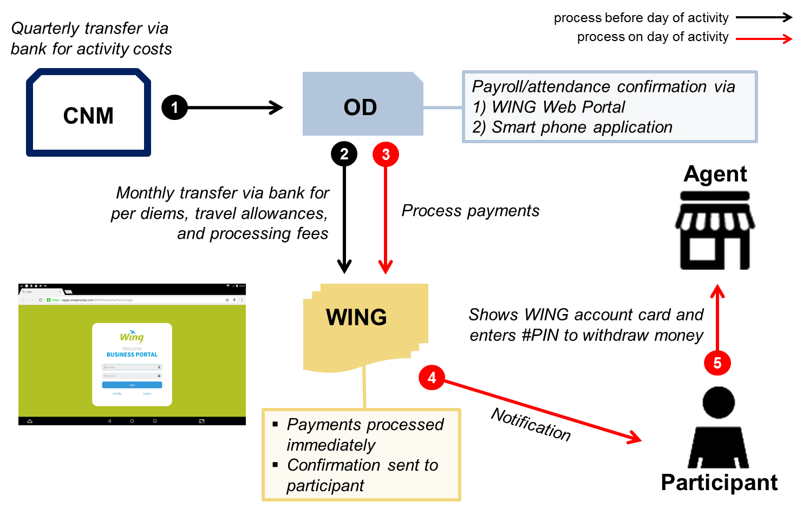
Over 2018, 3,247 VMWs were registered into a new electronic payment scheme to restart the program

Slide 15
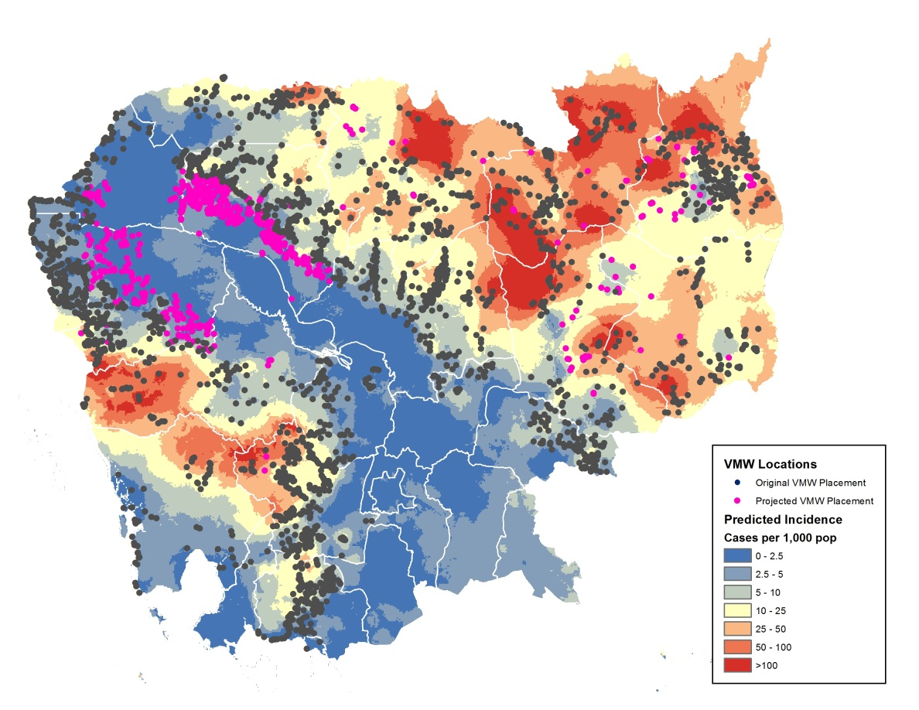
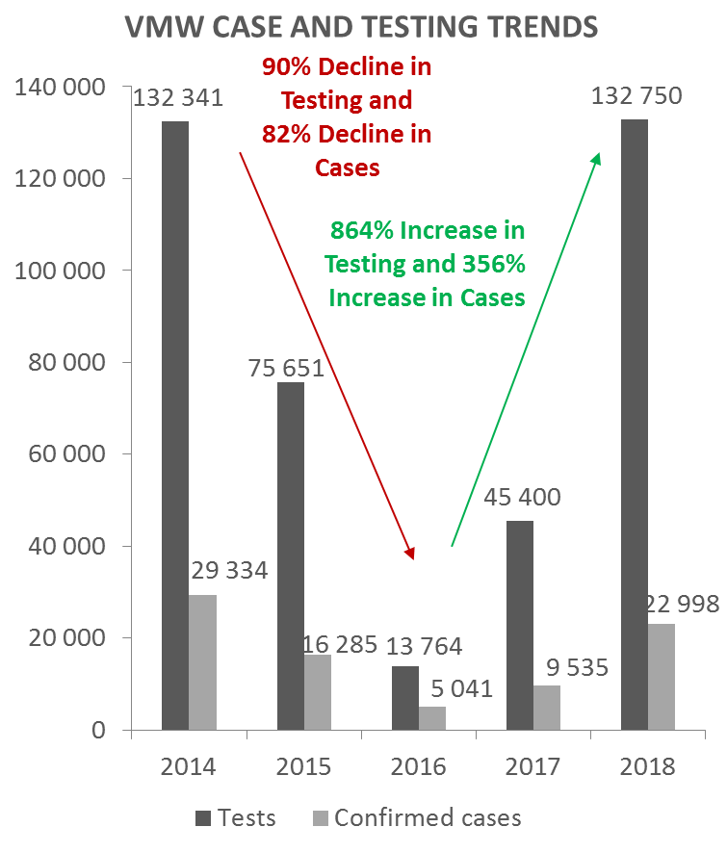
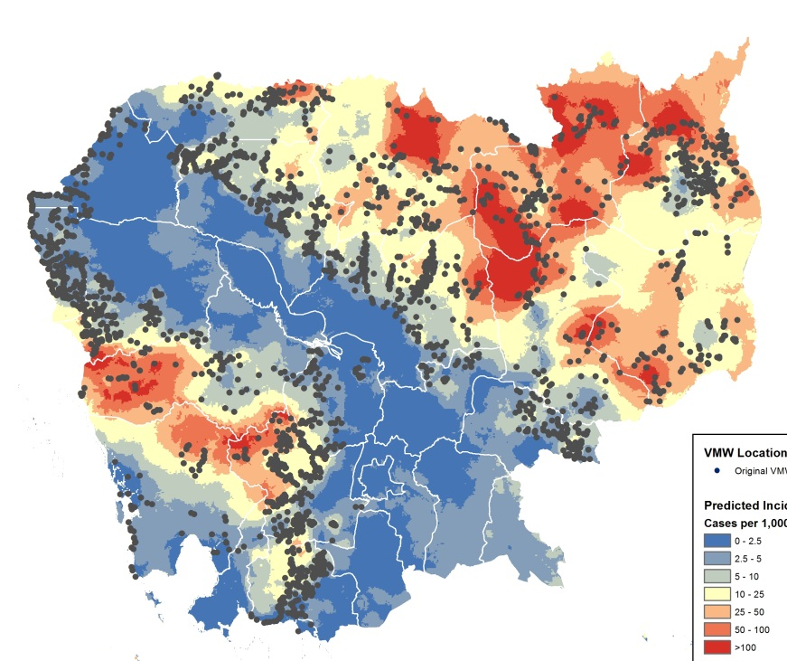
Risk stratification of ~15,000 villages to inform the allocation of VMWs to new villages
Additional 837 villages covered with VHWs
VMW allocation in 2013/2014

Slide 16
CHAI program countries
CHAI Programs
CHAI Malaria Programs

Slide 17
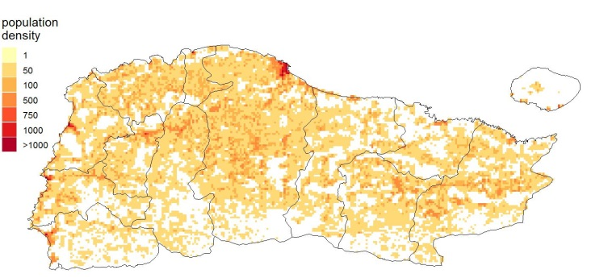
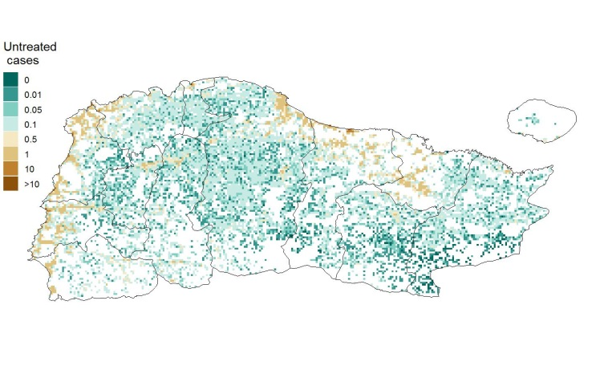
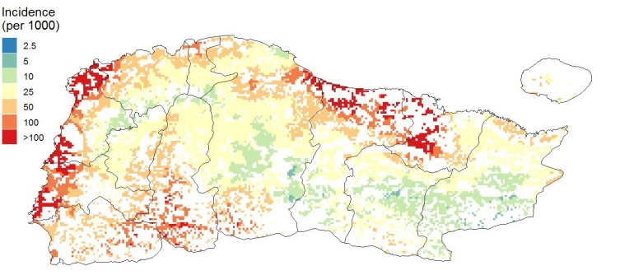
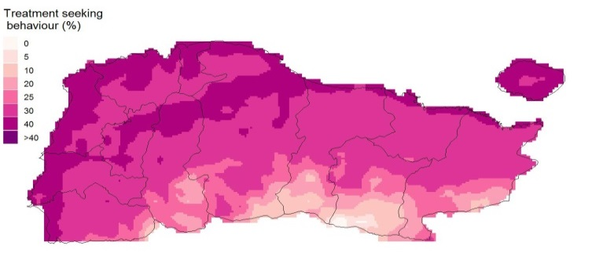
Evaluating where to place a new cadre of CHWs
Population
Untreated cases
Incidence
Treatment-seeking

Slide 18
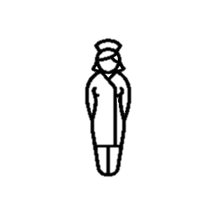
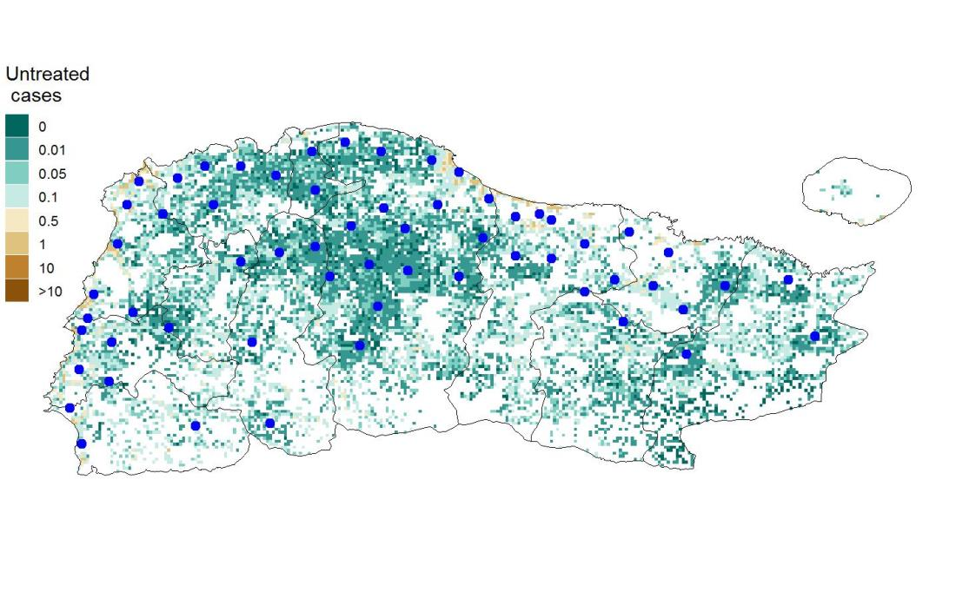
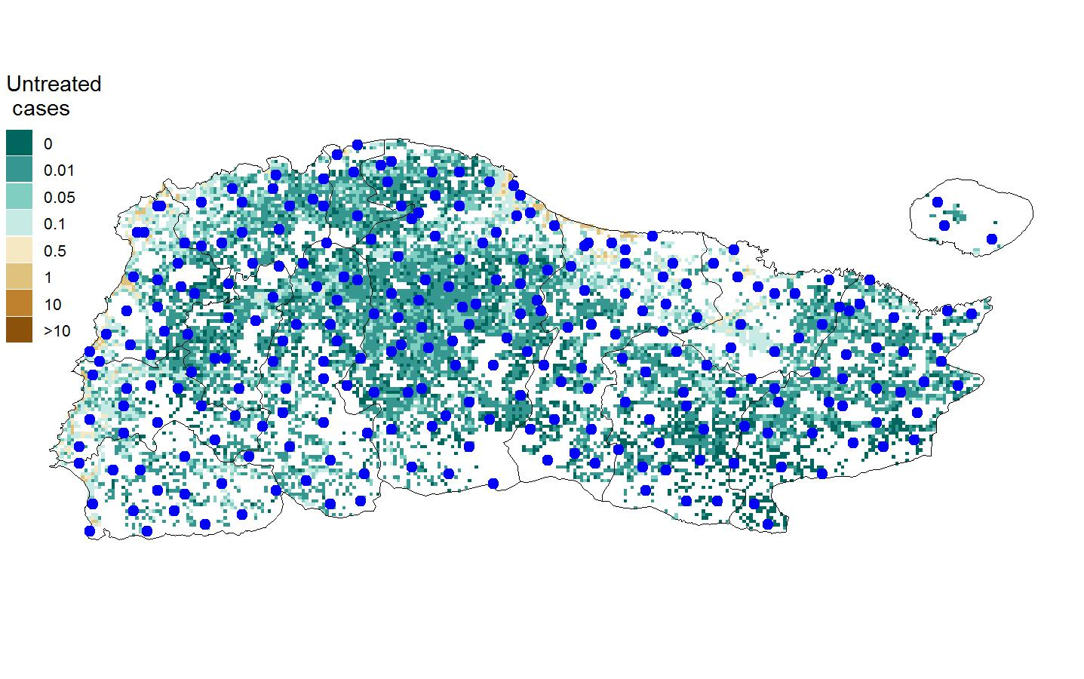
Optimal allocation of a pre-determined number of CHWs
Algorithm: Iterative pixel selection based on where a CHW would treat the most fevers
Assumptions:
CHW catchment can extend up to 2 km
Each CHW can test up to 800 fevers/yr
Recommended location for placing CHW

Slide 19
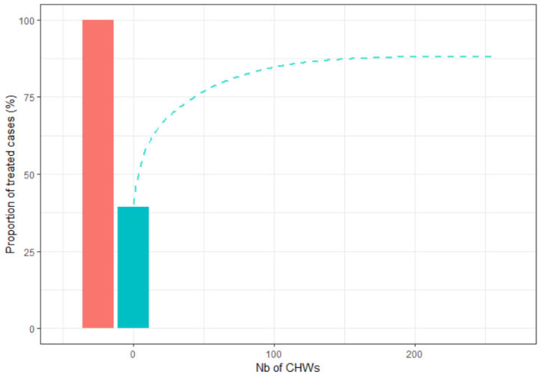
Number of CHWs required to maximize malaria treatment
Incidence of Grand’Anse: 13 cases per 1000
Approximately 100 well-placed ASCPs should be sufficient to maximize treatment in Grand'Anse
39% of fevers are accessing treatment
Recommended location for placing CHW

Slide 20
Improved access to effective case management leads to more infections cured
Gaps: Disease Access Management Adherence
0%
80%
80%
90%
80%
Infection results in acute febrile episode
Treatment sought at appropriate access point
Appropriate case management
Drug cures infection
46% cured
Improved access
No cure
Poor case management
No access
Asymptomatic cases
100%

Slide 21
Acknowledgements
Malaria Atlas Project
Emilie Pothin and Swiss TPH
Arnaud Le Menach, Darlene Bhavnani, Chris Lourenco, Alyssa Young, Inessa Ba, Sebastian Salvador and many others from CHAI
Malaria Zero Consortium (Haiti)
Panama Ministry of Health
Guna Authorities & Communities
Cambodian National Center for Parasitology, Entomology and Malaria Control
Haiti Program National de la Contrôle de la Malaria
Bill & Melinda Gates Foundation

