Slide 1

PCV impact on Pneumonia – the Vaccine Probe Approach:
The Case of Alveolar Pneumonia
Ron Dagan
The Pediatric Infectious Disease Unit
Soroka University Medical Center
Ben-Gurion University
Beer-Sheva, Israel

Slide 2
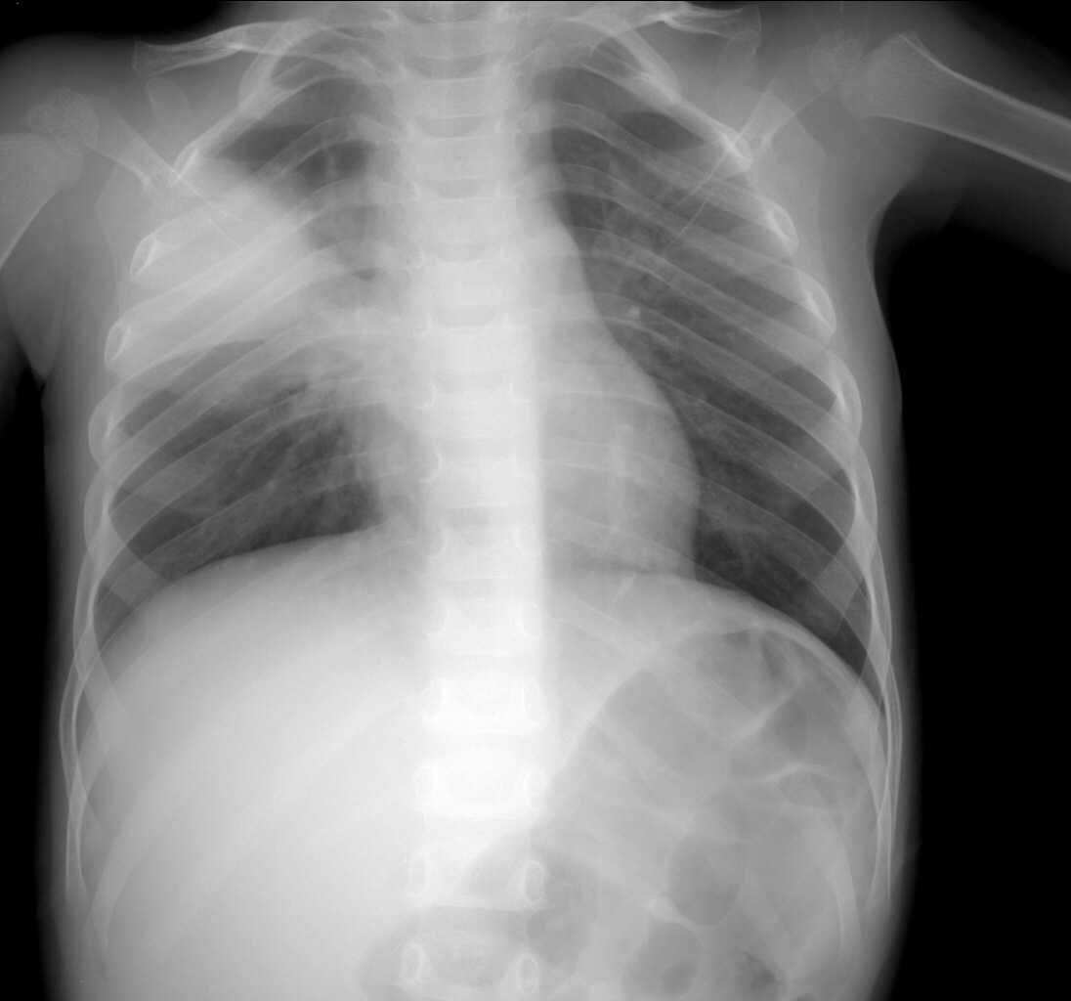
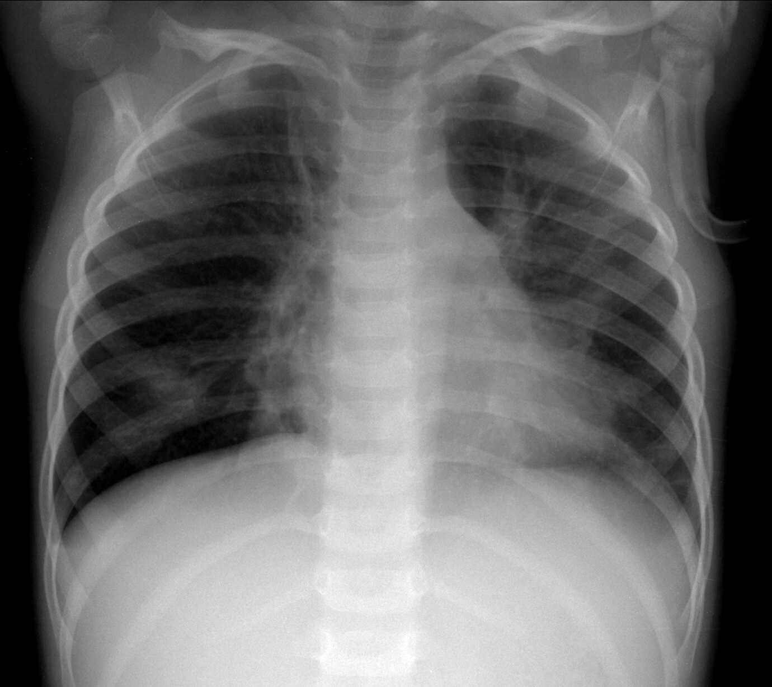
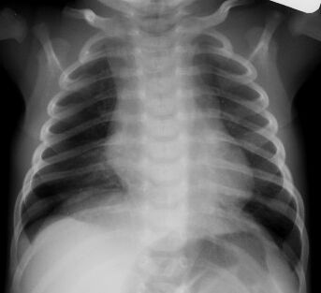
Alveolar Pneumonia
Dense opacity that may be a fluffy consolidation of a portion, whole of a lobe or of the entire lung, often containing air bronchogram and sometimes associated with pleural effusion
Atelectasis of an entire lobe that produces a dense opacity and positive silhouette sign with the mediastinal border was considered also as an end –point p consolidation
The presence of significan alveolar consolidation is considered by most authorities to be the most specific radiographic predictor of bacterial pneumonia
13/20 readers had a Kappa of >0.6 compared to reference readers
Cherian et al. Standardized Interpretation of Pediatric Chest Radiographs for the Diagnosis of Pneumonia in Epidemiological Studies, Bull World Health Organ; 83:353–9, 2005

Slide 3
Defining Pneumococcal Pneumonia
Clinical diagnosis
(WHO fast breathing? Febrile? Other clinical signs?)
Any severe pneumonia
Any Chest X-ray
abnormality
Lobar consolidation/pleural
effusion or CRP >40 mg/L
Specificity for being bacterial
Lobar consolidation/
pleural effusion
?
Culture-positive
Pneumococcal pneumonia
Modified from a slide prepared by Dr Thomas Cherian, WHO

Slide 4
Monthly Hospital X-Rays in Children < 5 years
IRR 2014-16 vs 2002-08
All X-rays: 0.643 (0.629, 0.658)
CAAP: 0.519 (0.488, 0.552)
Non CAAP: 0.667 (0.651, 0.683)
86.4 ± 3.6
13.8 ± 0.9
55.6 ± 1.1
Incidence CAAP per 1,000
Yearly Total X-Rays Incidence per 1,000
7.2 ± 0.8
PCV7
PCV13
01-02
02-03
03-04
04-05
05-06
06-07
07-08
08-09
09-10
10-11
11-12
12-13
13-14
14-15
15-16
Month, Year
Each study year is July through June
Greenberg et al, Vaccine, 33:4623–4629, 2015 (updated)

Slide 5
Monthly Hospital Visits for Alveolar Pneumonia, Children <5Years,
Southern Israel, Since July 2002
A prospective population-based study to document hospital use for alveolar pneumonia in young children
PCV7
Private market
PCV7
NIP
PCV7
→
PCV13
14.6
14.8
14.3
13.4
13.7
13.4
13.8
12.2
12.0
IRR Vs. 2002-2008
0.501 (0.470; 0.533)
8.0
7.4
Monthly incidences per 1,000 population
7.0
Annual incidence per 1,000 population
6.6
6.4
n=537
n=540
n=873
n=645
n=964
n=994
n=1044
n=984
n=1028
n=910
n=1007
n=629
n=557
n=1045
02-03
03-04
04-05
05-06
06-07
07-08
08-09
09-10
10-11
11-12
12-13
13-14
14-15
15-16
16-17
Year
Each study year is July through June
Greenberg et al, Vaccine, 33:4623–4629, 2015 (updated)

Slide 6
What Does Potentially Determines Impact of PCVs
on Pneumonia in Young Children?
Proportion of Vaccine-type serotypes before vaccination
Overall reduction
?
PCV7 serotypes
PCV713
serotypes
Efficacy against
Vaccine-type SP
Extent of Vaccine-type carriage rate reduction
Which PCV?
PCV7, PCV10, PCV13
Reduced opportunity to
encounter Vaccine-type SP
Extent of replacement
disease
Vaccination coverage
(high? Low?)
Time since start of the program
(did it reach stable steady-state?)
Compensatory increase in Non-vaccine type SP or other bacteria disease

Slide 7
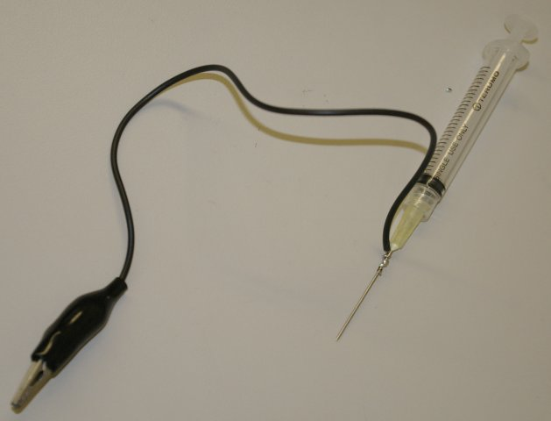
The Vaccine Probe Concept
Vaccine probe studies
Trying to understand pathogenesis, epidemiology, and disease burden through unexpected or unpredictable responses to vaccine

Slide 8
Impact of PCV7/PCV13 on IPD in Children
<5 Yrs Old in Israel
PCV7 in private market and HMOs
PCV7 in NIP
+ Catch up
PCV13 gradually replaces PCV7
Incidence (per 100,000 children <5 yrs)
IRR 2014-16 vs 2004-08
0.277
(0.233; 0.331)
0.033
(0.020; 0.054)
Ben-Shimol et al, Vaccine, 32:3452–3459, 2014 (updated)

Slide 9
Incidence Rate Ratios (IRRs) of Bacteremic Pneumonia, Non-pneumonia IPD and
All Hospital Visits with CAAP in Children <5 Years
PCV7 Subsidized
PCV7 implemented
PCV13 Gradually replaced PCV7
Incidence rate ratio vs. Pre-PCV era (95% CI)
PCV7 subsidized
PCV13 in NIP
PCV7 in NIP
0.36 (0.25 – 0.52)
0.31 (0.25 – 0.39)
Ben-Shimol et al, Pediatr infect Dis J, 34:409-16, 2015, updated

Slide 10
Incidence Rate Ratios (IRRs) of Bacteremic Pneumonia, Non-pneumonia IPD and
All Hospital Visits with CAAP in Children <5 Years
PCV7 Subsidized
PCV7 implemented
PCV13 Gradually replaced PCV7
Incidence rate ratio vs. Pre-PCV era (95% CI)
0.60 (0.55 – 0.66)
PCV7 subsidized
PCV13 in NIP
PCV7 in NIP
0.36 (0.25 – 0.52)
0.31 (0.25 – 0.39)

Slide 11
Incidence Rate Ratios (IRRs) of Bacteremic Pneumonia, Non-pneumonia IPD,
Hospitalization with CAAP and Ambulatory Visits with CAAP
in Children <5 Years
PCV7 Subsidized
PCV7 implemented
PCV13 Gradually replaced PCV7
Incidence rate ratio vs. Pre-PCV era (95% CI)
PCV7 subsidized
PCV13 in NIP
PCV7 in NIP
0.36 (0.25 – 0.52)
0.31 (0.25 – 0.39)

Slide 12
Incidence Rate Ratios (IRRs) of Bacteremic Pneumonia, Non-pneumonia IPD,
Hospitalization with CAAP and Ambulatory Visits with CAAP
in Children <5 Years
PCV7 Subsidized
PCV7 implemented
PCV13 Gradually replaced PCV7
Incidence rate ratio vs. Pre-PCV era (95% CI)
PCV7 subsidized
PCV13 in NIP
0.43 (0.35 – 0.52)
PCV7 in NIP
0.36 (0.25 – 0.52)
0.31 (0.25 – 0.39)

Slide 13
Incidence Rate Ratios (IRRs) of Bacteremic Pneumonia, Non-pneumonia IPD,
Hospitalization with CAAP and Ambulatory Visits with CAAP
in Children <5 Years
PCV7 Subsidized
PCV7 implemented
PCV13 Gradually replaced PCV7
Incidence rate ratio vs. Pre-PCV era (95% CI)
0.70 (0.62 – 0.78)
PCV7 subsidized
PCV13 in NIP
0.43 (0.35 – 0.52)
PCV7 in NIP
0.36 (0.25 – 0.52
0.31 (0.25 – 0.39)

Slide 14
Incidence Rate Ratios (IRRs) of Hospitalization with CAAP and
Ambulatory Visits with CAAP in Children <5 Years:
Comparison between Jewish and Bedouin Children
Jewish children
Bedouin children
Total
PCV7
Subsidized
PCV7
Subsidized
PCV7
implemented
PCV7
implemented
PCV13
Gradually replaced PCV7
PCV13
Gradually replaced PCV7
Incidence rate ratio vs. Pre-PCV era (95% CI)
Each study year from July - June
Givon-Lavi et al, 10th ISPPD, Glasgow, June 2016

Slide 15
Incidence Rate Ratios (IRRs) of Hospitalization with CAAP and
Ambulatory Visits with CAAP in Children <5 Years:
Overall Episodes vs. Episodes with >20,000 WBC/mm³
Blood counts were tested in 92.6% of all episodes
CAAP with ≥20,000
white blood cells per mm³
PCV7 Subsidized
PCV7 Subsidized
PCV7 implemented
PCV7 implemented
PCV13 Gradually replaced PCV7
PCV13 Gradually replaced PCV7
Incidence rate ratio vs. Pre-PCV era (95% CI)
0.70 (0.62 – 0.78)
0.68 (0.59-0.78)
PCV7 subsidized
PCV13 in NIP
PCV7 subsidized
PCV7 in NIP
0.43 (0.35 – 0.52)
PCV13 in NIP
PCV7 in NIP
0.32 (0.27-0.38)

Slide 16
Incidence Rate Ratios (IRRs) of Hospitalization with CAAP and
Ambulatory Visits with CAAP in Children <5 Years by Admission WBC Count
PCV7 Subsidized
PCV7 Subsidized
PCV7 implemented
PCV7 implemented
PCV13 Gradually replaced PCV7
PCV13 Gradually replaced PCV7
Incidence per 1,000 population at risk
Ambulatory
Hospitalized
Year

Slide 17
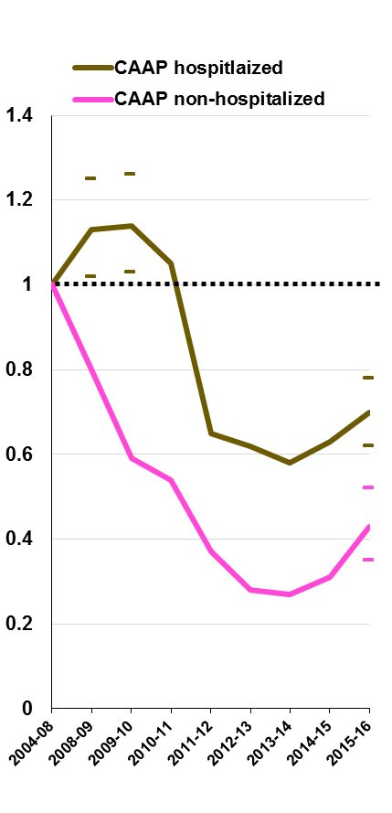
Potential speculations/explanations
Differences in VT-serotype distribution
Higher proportion of viral infections in hospitalized children
Higher proportion on non-pneumococcal bacterial pathogens
PCV7 Subsidized
PCV7 implemented
PCV13 Gradually replaced PCV7

Slide 18
Radiologically-diagnosed Community-acquired Alveolar Pneumonia in Children <5 Years:
Comparison of Hospitalized Vs. Ambulatory Emergency Department Patients
in the Pre-PCV Period
“Viral”
“Bacterial”
PRR: 1.05
P=0.027
PRR: 0.57
P=0.027
PRR: 5.82
P<0.001
PRR: 0.60
P<0.001
PRR: 0.74
P<0.001
PRR: 0.32
P<0.001
PRR: 2.31
P<0.001
PRR: 28.5
P<0.001
% of all the patients from whom data were available
Age
<12m
O₂ Sat.
<92%
Rhinorrhea
Resp.
Virus (+)
>39.5C
WBC
>20K/µL
ANC
>10K/µL
CRP
>100 mg/L
PRR = Prevalence rate ratio
Greenberg et al, 34th ESPID meeting, Brighton, UK May 2016, abstr #OPS07

Slide 19
Odds Ratios of Clinical and Laboratory Variable in Hospitalized Children <5 years with Radiologically diagnosed Community-acquired Alveolar Pneumonia:
PCV13 vs. Pre-PCV Periods
“Viral”
“Bacterial”
Odds ratios (95% Cis)
Age
<12m
O₂ Sat.
<92%
Rhinorrhea
Resp.
Virus (+)
>39.5C
WBC
>20K/µL
ANC
>10K/µL
CRP
>100 mg/L
Pleural
fluid
All variables were controlled for age, ethnicity and season, except the age variable which was controlled for ethnicity and season only
Greenberg et al, 34th ESPID meeting, Brighton, UK May 2016, abstr #OPS07

Slide 20
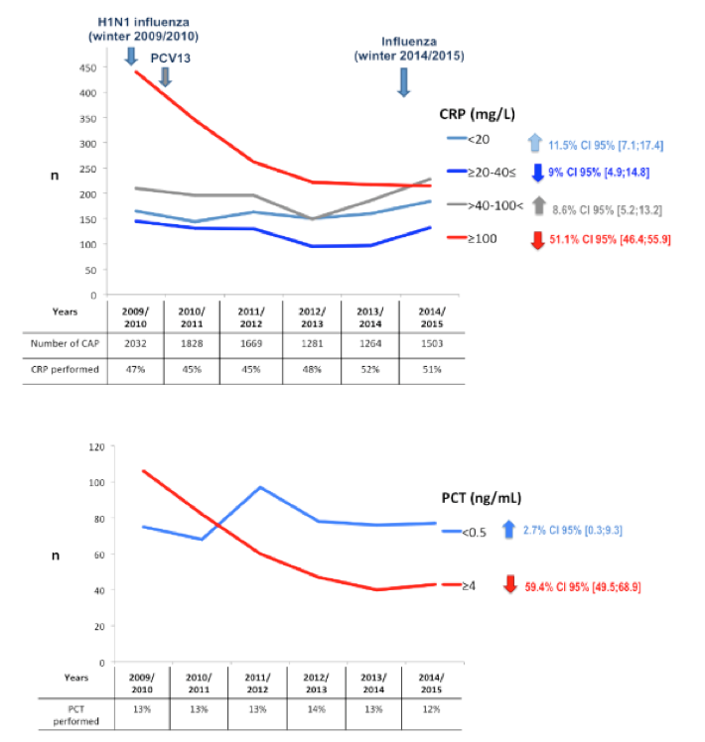
Impact Of PCV13 On Community Acquired Pneumonia
By C-reactive Protein (CRP) and Procalcitonin In Children,
France
Levy et al, ESPID 2016, 2016

Slide 21
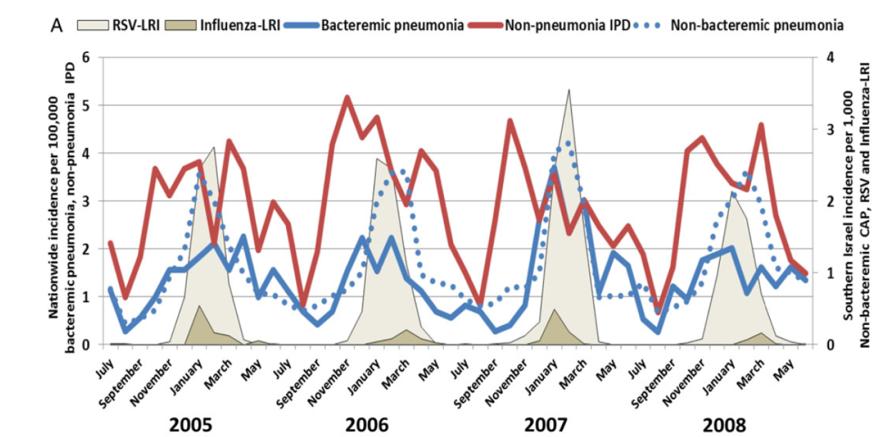

Seasonality of Bacteremic Pneumococcal Pneumonia, Non-pneumonia IPD, RSV, Influenza, and Community-acquired Alveolar Pneumonia (CAP)
in Israeli Children <5 Years, Before PCV Introduction
Ben-Shimol et al, Clin Infect Dis, 60:1384–7, 2015

Slide 22
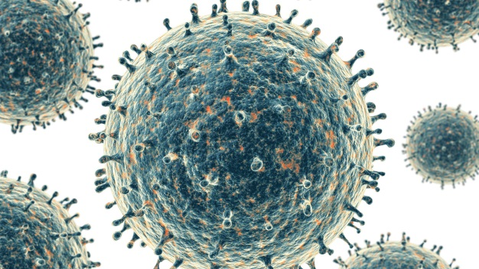
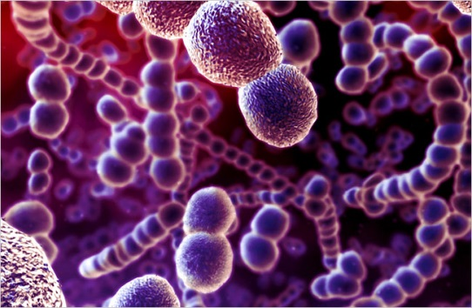
How do RSV and S. pneumoniae interact
to cause respiratory disease?
3
⇑ Virulence of S. pneumoniae
RSV (and maybe other viruses) Increase susceptiblity to pneumococci with lower invasive potential
RSV
S. pneumoniae
2
predisposes tissue to bacterial infections
1
Tissue damage

Slide 23
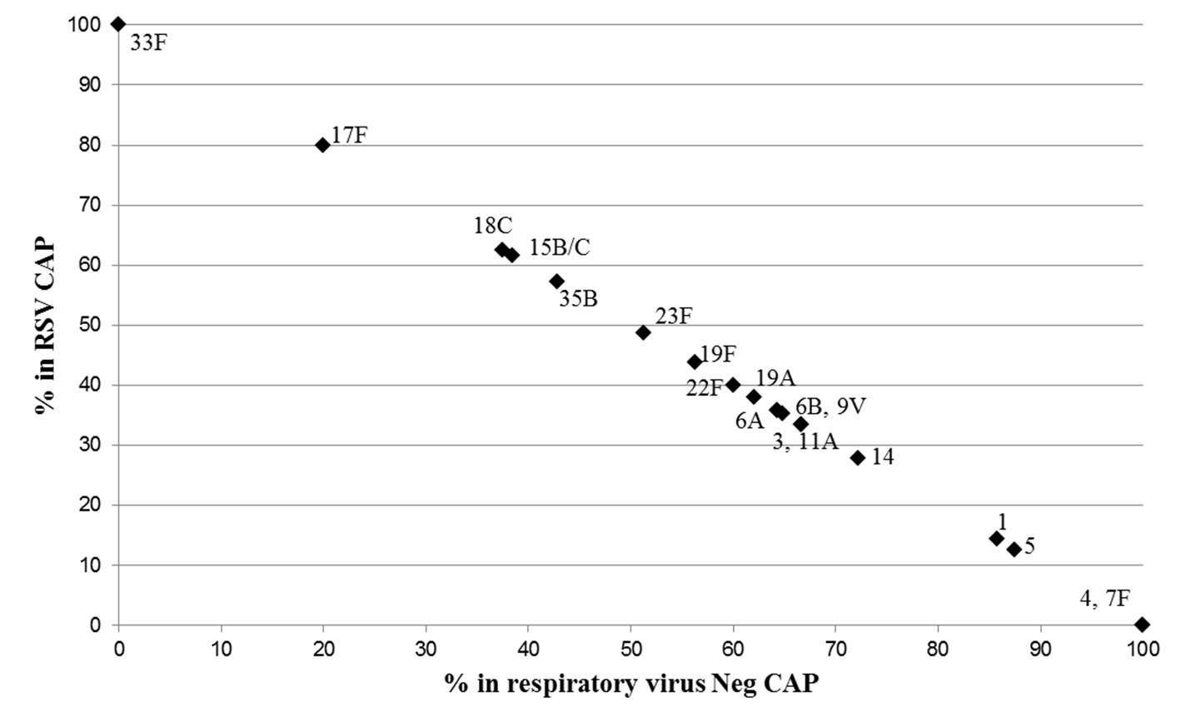
Relative Distribution of Carried Serotypes During RSV(+) CAAP
and No-virus CAAP in Children <5 Yrs
n=250
n=376
Greenberg et al, J Infect Dis, 2017 (in press)

Slide 24
Most Commonly Carried “Invasive” Serotypes (1, 4, 5, 7F)
vs. “Non-invasive” Serotypes (15B/C, 17F, 33F, 35B)
Serotype | n (%) in RSV(+) CAAP | n (% ) in non-virus CAAP | P value | OR | 95% CI
1, 4, 5, 7F | 3 (1.2) | 31 (8.2) | .005 | 0.179 | 0.053-0.603
15B/C, 17F, 33F, 35B | 17 (6.8) | 9 (2.4) | .054 | 2.387 | 0.984-5.792
Serotype | n (%) in RSV(+) CAAP | n (%) in other- virus(+) CAAP | P value | OR | 95% CI
1, 4, 5, 7F n (%) | 3 (1.2) | 5 (3.9) | .202 | 0.374 | 0.082-1.697
15B/C, 17F, 33F, 35B n (%) | 17 (6.8) | 4 (3.1) | .343 | 1.729 | 0.557-5.369
Serotype | n (%) in other- virus(+) CAAP | n (%) in non-virus CAAP | P value | OR | 95% CI
1, 4, 5, 7F n (%) | 5 (3.9) | 31 (8.2) | .145 | 0.484 | 0.183-1.283
15B/C, 17F, 33F, 35B n (%) | 4 (3.1) | 9 (2.4) | .661 | 1.313 | 0.390-4.418
*P and ORs adjusted for age, ethnicity and hospitalization
Greenberg et al, J Infect Dis, 2017 (in press)

Slide 25
Alveolar Pneumonia incidence
per 1,000 Children < 5 years of Age
PCV7
PCV13
IRR 2014-2016
Vs. 2002-2008
Incidence per 1,000 children
0.53 (0.50 - 0.58)
0.38 (0.33 - 0.44)
Year

Slide 26

We need to create the right models!
Please – do not move yet!!!

Slide 27
Speculations
We need to create the right models!
Childhood alveolar CAP is mostly pneumococcal
This is true for both hospitalized and ambulatory patients
Among childhood CAP, PCV13 serotypes (mainly 1, 5, 19A) are more prevalent than in non-pneumonia IPD
PCV13 serotypes are more important in hospitalized than in ambulatory childhood CAP episodes
Hospitalized CAP children represent frequently co-infections with viruses, increasing their susceptibility to non-PCV13 serotypes; this results in lower impact of PCV13 on hospitalization vs ambulatory visits with CAP

Slide 28
Influenza A Virus Infection Predisposes Hosts to Secondary Infection
with Different Streptococcus pneumoniae Serotypes with Similar
Outcome but Serotype-Specific Manifestation
Influenza A virus (IAV) and S. pneumoniae are major causes of respiratory tract infections, particularly during coinfection
The synergism between these two pathogens is characterized by a complex network of dysregulated immune responses, some of which last until recovery following IAV infection
Despite the high serotype diversity of S. pneumoniae and the serotype replacement observed since the introduction of conjugate vaccines, little is known about pneumococcal strain dependency in the enhanced susceptibility to severe secondary S. pneumoniae infection following IAV infection
Thus, we studied how pre-infection with IAV alters host susceptibility to different S. pneumoniae strains with various degrees of invasiveness using a highly invasive serotype 4 strain, an invasive serotype 7F strain, and a carrier serotype 19F strain
A murine model of pneumococcal coinfection during the acute phase of IAV infection showed a significantly increased degree of pneumonia and mortality for all tested pneumococcal strains at otherwise sub-lethal doses
The incidence and kinetics of systemic dissemination, however, remained bacterial strain dependent
Furthermore, we observed strain-specific alterations in the pulmonary levels of alveolar macrophages, neutrophils, and inflammatory mediators ultimately affecting immunopathology
During the recovery phase following IAV infection, bacterial growth in the lungs and systemic dissemination were enhanced in a strain-dependent manner
Altogether, this study shows that acute IAV infection predisposes the host to lethal S. pneumoniae infection irrespective of the pneumococcal serotype, while the long-lasting synergism between IAV and S. pneumoniae is bacterial strain dependent
These results hold implications for developing tailored therapeutic treatment regimens for dual infections during future IAV outbreaks
Sharma-Chawla et al, Infect Immunity, 84:3445–3457., 2016

Slide 29
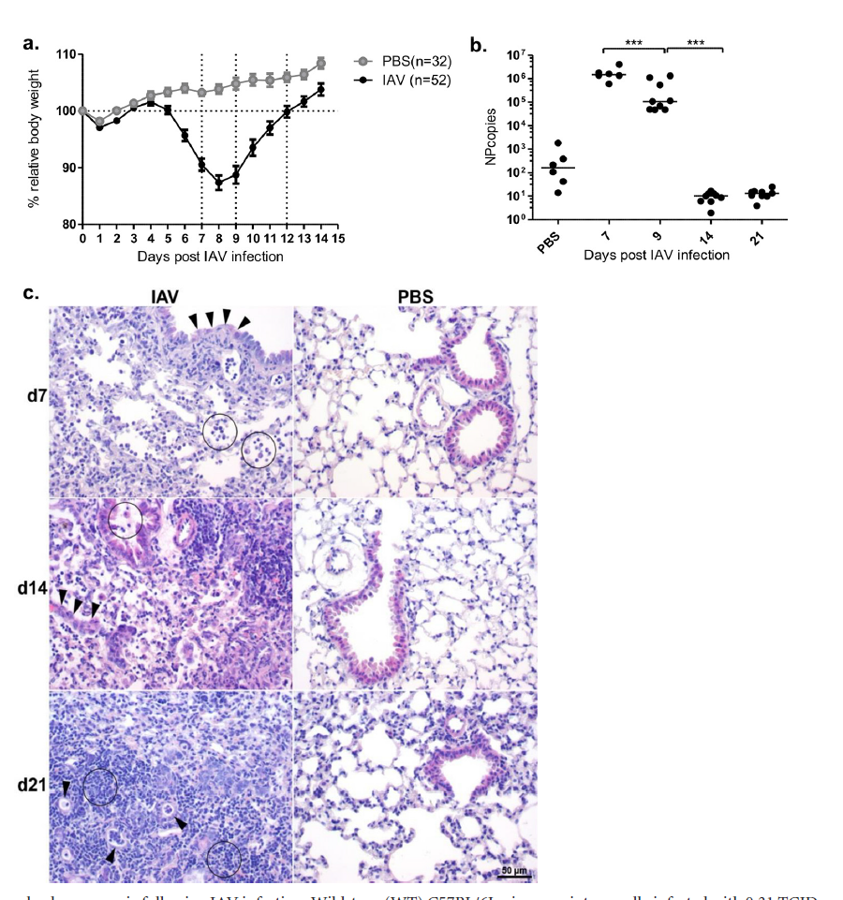
Persisting Unresolved Pneumonia following IAV Infection
Wild-type (WT) C57BL/6J mice were intranasally infected with 0.31 TCID₅₀ of the A/PR8/34
H1N1 strain of IAV or treated with PBS as control on day 0.
(a) Changes in body weight are represented as percentages relative to the starting weight. Data are
shown as means standard errors of the means (SEM)
(b) Absolute quantification of viral nucleoprotein (NP) copy numbers in the lungs of PBS-treated and IAV-infected mice at the indicated number of days following IAV infection. Lines indicate the medians *, P 0.05; **, P 0.01; ***, P 0.001. Data are compiled from at least two independent experiments with 3 to 5 mice in each group
(c) Representative example (1 of 3) of histopathological changes in the lungs of IAV-infected or PBS-treated mice at 7, 14, and 21 days post-infection analyzed following H&E staining. Lungs of PBS-treated mice were unchanged.
  For day 7 after IAV infection, the arrowheads indicate an attenuation of the bronchial epithelium, and the neutrophils and macrophages within the alveoli are circled;
  for day 14 after IAV infection, the arrowheads indicate type II hyperplasia and the neutrophils and macrophages in the bronchi (indicating bronchitis) are circled;
  for day 21 after IAV infection, the arrowheads indicate type II pneumocyte hyperplasia with increased numbers of lymphocytes in the surrounding interstitium (circled)
Sharma-Chawla et al, Infect Immunity, 84:3445–3457., 2016

Slide 30
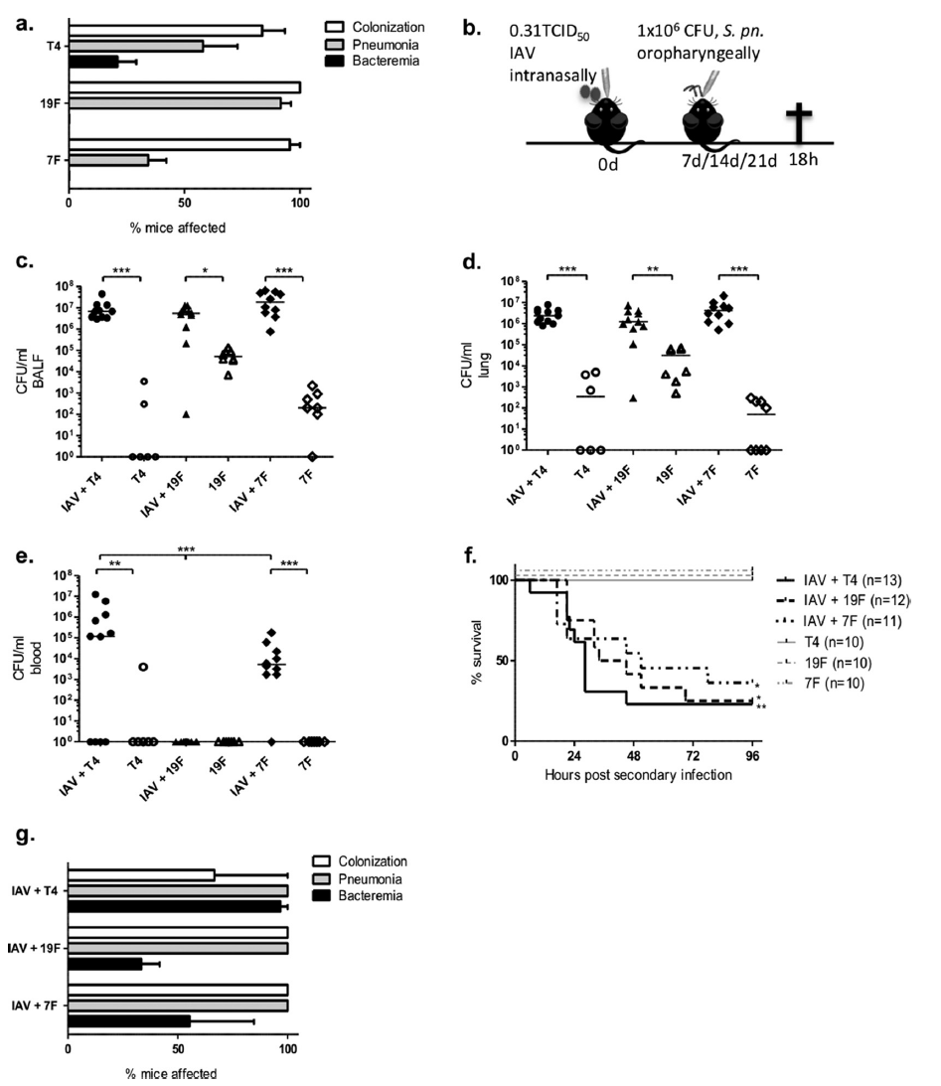
Enhanced Susceptibility to 2^{ary} S. pneumoniae Infection
During the Acute Phase of IAV Infection
Groups of 5 or 6 WT C57BL/6J mice were oro-pharyngeally infected with 1x10⁶ CFU of S. pneumoniae strain T4, 19F, or 7F
Incidence of colonization, pneumonia, and bacteremia at 18 hpi with S. pneumoniae strain T4, 19F, or 7F according to the bacterial burden detected in the nasopharynx, post-lavage lung, and blood for all bacterial mono-infections performed in the study Data are shown as means±SEM
Schematic diagram for coinfections with S. pneumoniae strain T4, 19F, or 7F following IAV infection. Mice were infected with 1x106 CFU of S. pneumoniae strain T4, 19F, or 7F on day 7 post-infection with 0.31 TCID50 of IAV or PBS treatment
(c to e) Bacterial burden in the BALF (c), postlavage lung (d), and blood (e) at 18 h after secondary infection with T4, 19F, or 7F. Lines indicate the medians. Statistical analysis was performed using one-way ANOVA with Bonferroni’s multiple-comparison test with asterisks indicating significant differences: *, P0.05; **, P 0.01; ***, P 0.001.
(f) Survival rates of mice infected with S. pneumoniae T4, 19F, or 7F on day 7 following IAV infection or PBS treatment. Asterisks indicate significant differences assessed by the log rank test on the Kaplan-Meier survival data for the co-infected groups compared to the S. pneumoniae-only groups: *, P0.05; **, P0.01. (g) Incidence of colonization, pneumonia, and bacteremia in the co-infected and single-S. pneumoniae-infected mice with lethal infection according to the bacterial burden detected in the nasopharynx, whole lung, and blood, respectively
Sharma-Chawla et al, Infect Immunity, 84:3445–3457., 2016

Slide 31
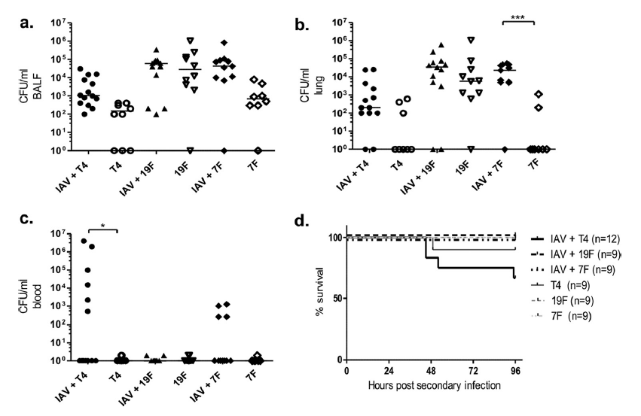
Strain-specific Alterations in the Course of 2^{ary} Pneumococcal Disease
during Recovery from IAV Infection
Mice were infected with 1 x10⁶ CFU of S. pneumoniae strain T4, 19F, or 7F on day 14 post-infection with 0.31 TCID50 of IAV or PBS treatment. (a to c) Bacterial burden in the BALF (a), post-lavage lung (b), and blood (c) at 18 h following secondary infection with T4, 19F, or 7F. Lines indicate the medians. Statistical analysis was performed using one-way ANOVA with Bonferroni’s multiple-comparison test, with asterisks indicative of significant differences between the co-infected and S. pneumoniae-only groups: *, P 0.05; **, P 0.01; ***, P 0.001
(d) Survival rates of mice co-infected on day 14 following IAV infection or infected with S. pneumoniae only
Sharma-Chawla et al, Infect Immunity, 84:3445–3457., 2016

Slide 32
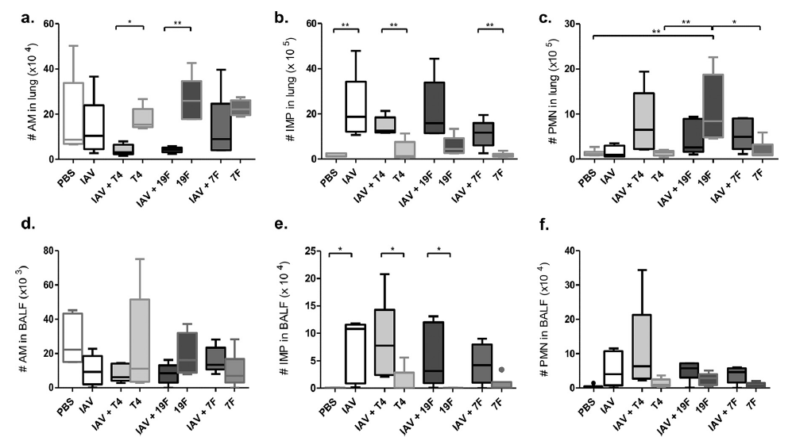
Strain-dependent Changes in the Innate Immune cell Composition of the Lungs of Mice Co-infected during the Acute Phase of IAV Infection
Mice were infected with 1x10⁶ CFU of S. pneumoniae strain T4, 19F, or 7F or treated with PBS on day 7 post-infection with 0.31 TCID₅₀ of IAV or only PBS treatment
Absolute numbers of alveolar macrophages (# AM) (a), infiltrating mononuclear phagocytes (# IMP) (b), and polymorphonuclear cells (#
PMN) (c) in postl-avage lungs at 18 h after coinfection
Absolute numbers of alveolar macrophages (# AM) (d), infiltrating mononuclear phagocytes (# MP) (e), and polymorphonuclear cells (# PMN) (f) in BALF 18 h after coinfection
Data are shown as Tukey box plots with lines indicating the medians
Data are compiled from >5 samples from at least two independent experiments with 2 or 3 WT C57BL/6J mice per group
Statistical analysis was performed using one-way ANOVA with Bonferroni’s multiple-comparison test, with asterisks indicating significant differences: *, P 0.05; **, P 0.01
Sharma-Chawla et al, Infect Immunity, 84:3445–3457., 2016

Slide 33
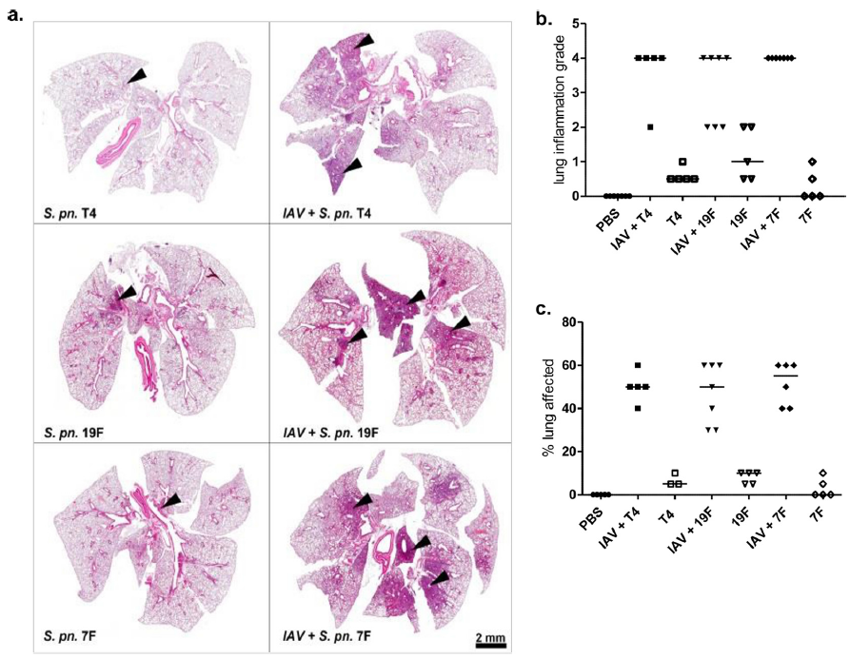
Histopathological Changes in the Lung Tissue of S. pneumoniae-mono-infected Mice and Mice co-infected during the Acute Phase of IAV Infection
Mice were infected with 1x10⁶ CFU of S. pneumoniae strain T4, 19F, or 7F on day 7 post-infection with 0.31 TCID₅₀ of IAV or PBS treatment.
Representative example (1 of 3 to 7 results) of the histopathological changes examined by H&E staining of the lungs of co-infected and S. pneumoniae-mono-infected mice at 18 h post-infection with T4, 19F, or 7F. Arrowheads indicate selected regions of bronchopneumonia.
Histopathological scores for inflammation observed in the lungs of co-infected and S. pneumoniae-mono-infected mice. Acute inflammation was characterized as perivascular and interstitial immune cell infiltration.
Percentage of the lung affected by bronchopneumonia in the co-infected and S. pneumoniae-mono-infected mice. Histological analysis was performed twice with 2 to 4 mice per group. Lines indicate the medians
Sharma-Chawla et al, Infect Immunity, 84:3445–3457., 2016

Slide 34
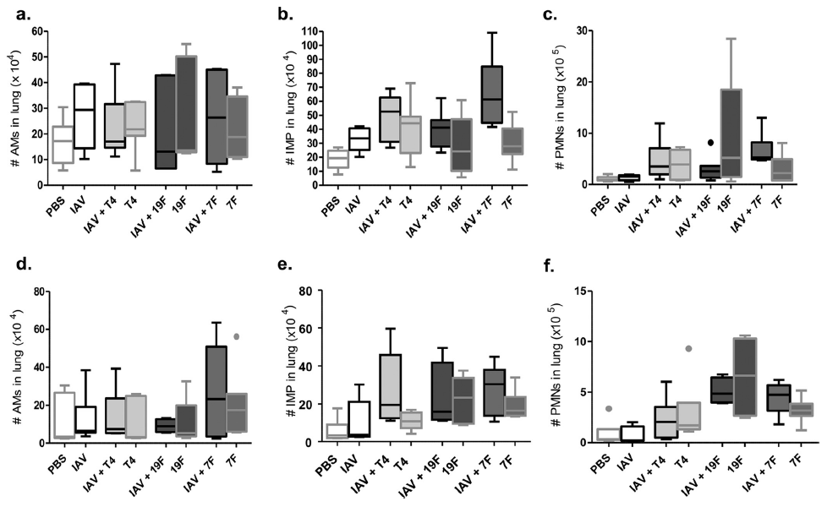
Inflammatory Cell Profiles in the Lungs of Mice Mono-infected with S. pneumoniae
or Co-infected during the Recovery Phase of IAV Infection
(a to c) Mice were infected with 1x10⁶ CFU of S. pneumoniae strain T4, 19F, or 7F or treated with PBS on day 14 post-infection with 0.31 TCID₅₀ of IAV or PBS treatment. Absolute numbers of alveolar macrophages (# AMs) (a), infiltrating mononuclear phagocytes (# IMP) (b), and polymorphonuclear cells (# PMNs) (c) in post-l-avage lungs 18 h after the bacterial infection or PBS treatment
(d to f) Mice were infected with 1x10⁶ CFU of S. pneumoniae strain T4, 19F, or 7F or treated with PBS on day 21 post-infection with 0.31 TCID50 of IAV or PBS treatment. Absolute numbers of alveolar macrophages (# AMs) (d), infiltrating cells (# IMP) (e), and polymorphonuclear cells (# PMNs) (f) in pos-tlavage lungs 18 h after the bacterial infection or PBS treatment. All data are shown as Tukey box plots with lines indicating the medians
Data are compiled from at least two independent experiments with 3 to 4 WT mice per group
Sharma-Chawla et al, Infect Immunity, 84:3445–3457., 2016

Slide 35
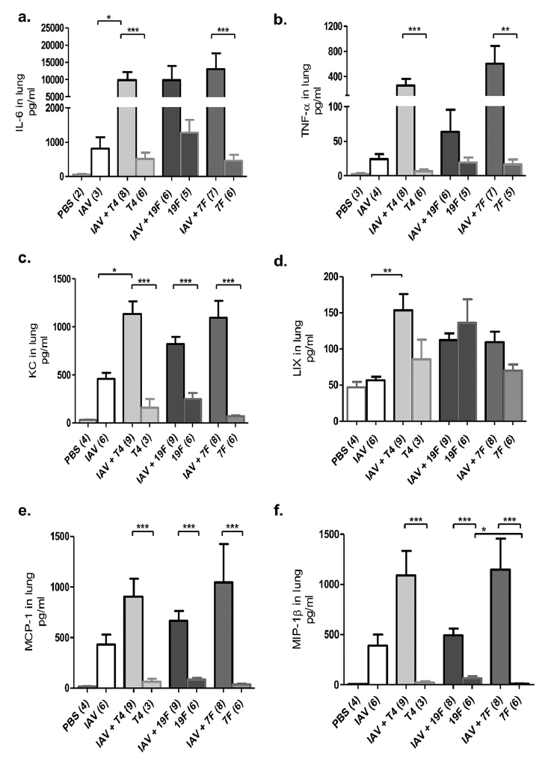
Proinflammatory Cytokine and Chemokine Profiles in the Lungs of S. pneumoniae-mono-infected
or Co-infected Mice during the Acute Phase of IAV Infection
Mice were infected with 1x10⁶ CFU of S. pneumoniae strain T4, 19F, or 7F or treated with PBS on day 7 post-infection with 0.31 TCID₅₀ of IAV or PBS treatment.
Protein concentrations of IL-6 (a) and TNF- (b) in the homogenates of post-lavage lungs at 18 h after the secondary bacterial infection or PBS treatment. Data are shown as means ± SEM of the number of mice/group indicated in parentheses and are compiled from two independent infection experiments with 1 to 4 mice per group.
Protein concentrations of KC (c), LIX (d), MCP-1 (e), and MIP-1 (f) in the homogenates of post-lavage lungs at 18 h after the secondary bacterial infection or PBS treatment. Data are shown as means ± SEM of the number of mice/group indicated in parentheses and are compiled from two independent infections with 2 to 5 mice per group.
Statistical analysis was performed using one-way ANOVA with Bonferroni’s multiple comparison posttest. Asterisks indicate significant differences: *, P 0.05; **, P 0.01; ***, P 0.001
Sharma-Chawla et al, Infect Immunity, 84:3445–3457., 2016

