Slide 1

GenEpiO: The Genomic Epidemiology Ontology
http://genepio.org
info@genepio.org
Developing a comprehensive controlled vocabulary for infectious disease surveillance and outbreak investigations
Damion Dooley, Scientific Programmer
Hsiao Lab, BCCDC Public Health Laboratory and
Department of Pathology and Laboratory Medicine
University of British Columbia
Dr. Emma Griffiths
Postdoctoral Researcher
Fiona Brinkman Lab
Simon Fraser University
Notes:
Philip Welkhoff, Bill & Melinda Gates, Institute for disease modelling
Contextual data associated with FoodBorn pathog

Slide 2

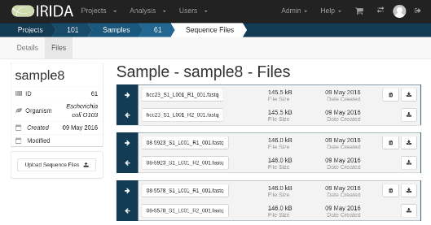
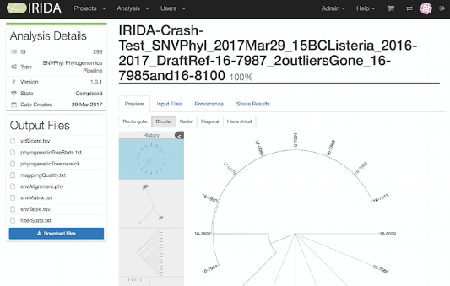
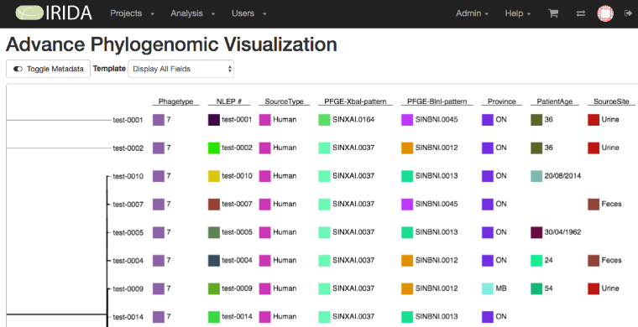
Client: Researchers, Public Health Agencies
Need: pathogen identification and phylogenic analysis
Tool: next-gen sequencing bioinformatics pipeline
www.irida.ca
WGS sequencing and analysis of food-borne pathogens

Slide 3
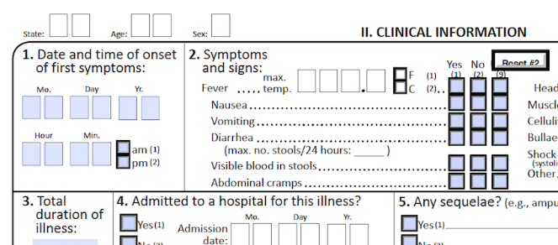
Contextual data?
CDC Atlanta
Various vocabularies about diseases, symptoms, taxonomy identifiers, anatomy terms, …
Peer-to-peer data exchange is laborious and brittle.
How to share datasets and software?
How to reuse fields and forms?

Slide 4
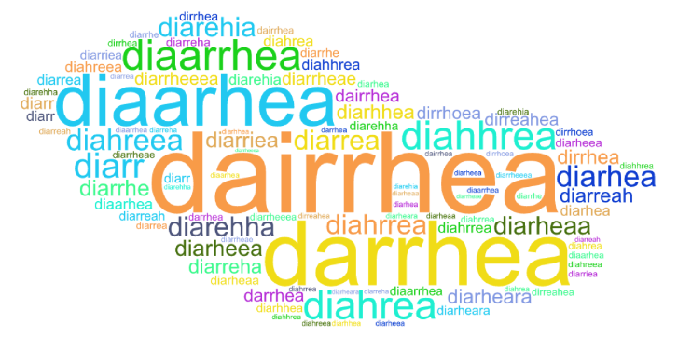
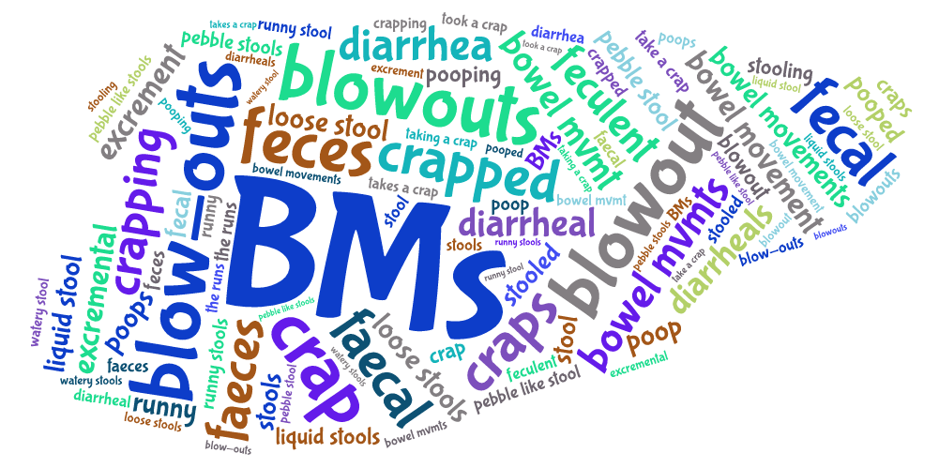
Typo’s, spelling, synonyms, semantics
Diarrhea: “Abnormally increased frequency of loose or watery bowel movements.”
Fecal: “Portion of semisolid bodily waste discharged through the anus.”
Misspellings and synonyms supplied by http://project-emerse.org/

Slide 5
Mapping a patient’s medical condition
The dimension or quality of healthiness
discharged
good
comfortable
American Hospital Association
(AHA)
progressing well
satisfactory
UK National Health Service
(NHS)
fair
stable
serious
critical but stable
critical
critical
deceased
dead

Slide 6

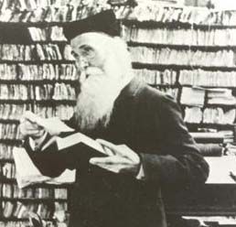

Ontology
The philosophical
study of the nature of being, becoming, existence or reality as well as the basic categories of being and their relations.
> data dictionary
> concept hierarchy
> annotation
> logical reasoning
Leaving me with all the hard work!
Wise wikibhudda
Cylon
James Murray,
editor OED, 1879

Slide 7
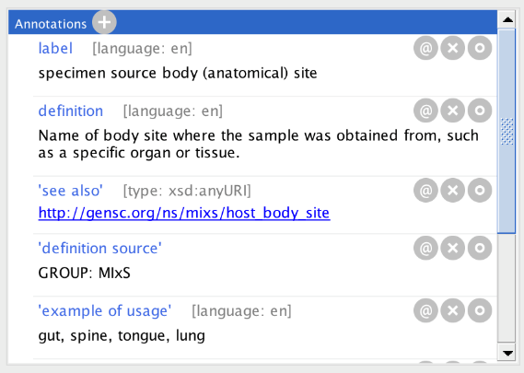
Ontology Pyramid
Data Dictionary: term label, definition, data type

Slide 8
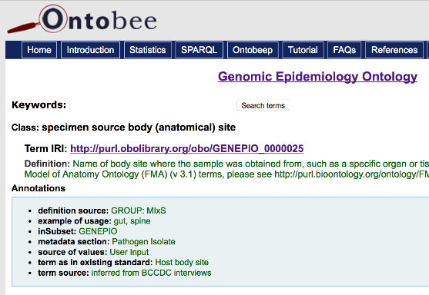
Ontology Pyramid
Specimen source body (anatomical) site =
http://purl.obolibrary.org/obo/GENEPIO_0000025
Global Identifier: global standard
Data Dictionary: term label, definition, data type

Slide 9
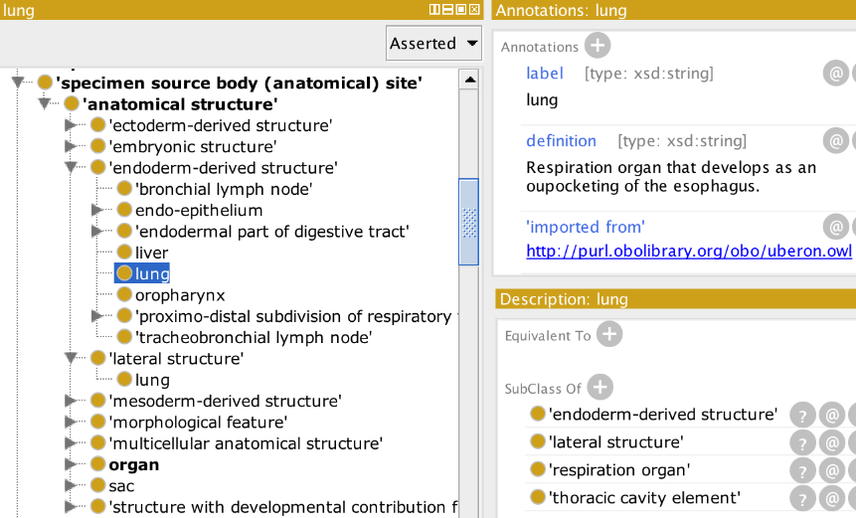
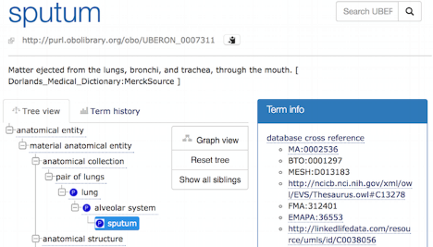
Ontology Pyramid
Hierarchy: facets of description
Global Identifier: global standard
Data Dictionary: term label, definition, data type

Slide 10

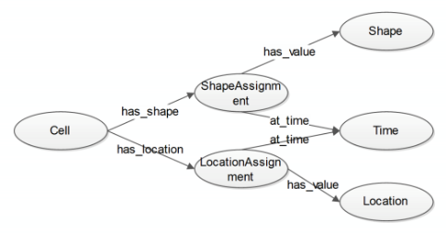
Ontology Pyramid
Querying
& Reasoning
Qualitative and
Quantitative Relations
Hierarchy: facets of description
Global Identifier: global standard
Data Dictionary: term label, definition, data type

Slide 11
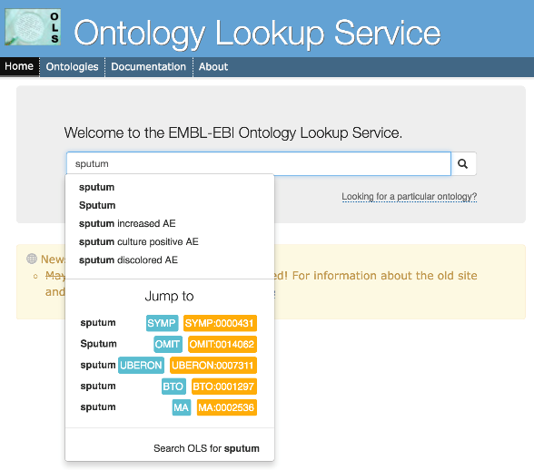
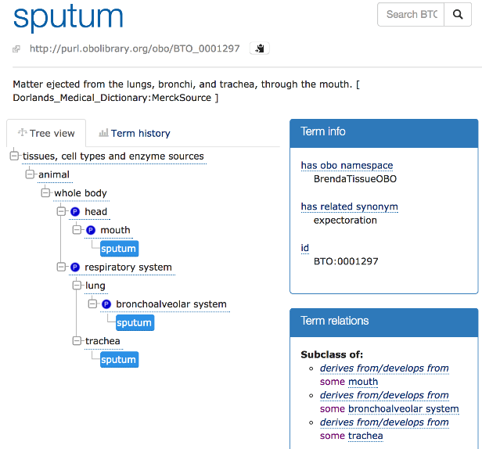
Relations
Notes:
What I do to lookup TB terms

Slide 12
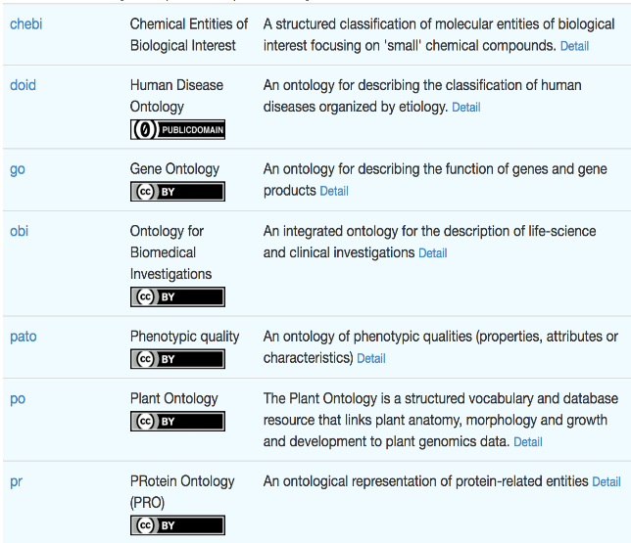
OBOFoundry.org
A family of ontologies that share a general framework for describing semantics of things, events, processes and mereology.
Notes:
One ontology per term, one identifier per term

Slide 13
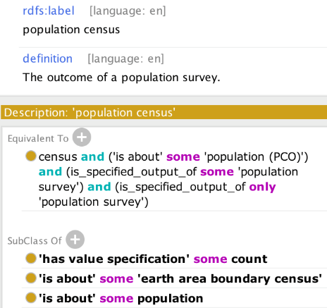
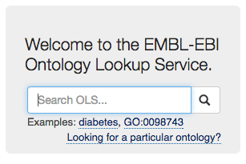
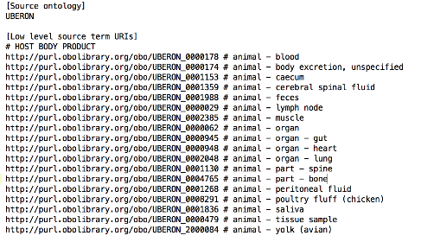
Ontology life-cycle
www.ontobee.org
www.ebi.ac.uk/ols
aber-owl.net
bioportal.bioontology.org
Find terms
Specify imports
OntoFox ontofox.hegroup.org
Curate
Open Source Stanford Protégé Editor protege.stanford.edu
Publish
OBOFoundry obofoundry.org

Slide 14



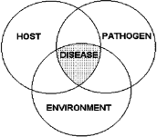


GenEpiO: Combining Different Epi, Lab, Genomics and
Clinical Data Fields
Clinical Data
Patient demographics, Medical History, Comorbidities, Symptoms, Health Status
Lab Analytics
Genomics, PFGE
Serotyping, Phage typing
MLST, AMR
Sample Metadata
Isolation Source (Food,
Host Body Product, Environmental), BioSample
Reporting Standards
Human/Computer
Test Results for physicians,
Cluster info for epidemiologists
Epidemiology Investigation
Travel, Location, Interview, Contact Networks
Notes:
----- Meeting Notes (17-04-14 09:59) -----
EPI: TRAVEL, Location,
Contact networks
Lab: sample as proxy for case.
Epi: interviews
Reporting Standards:
Human and Machine compatible

Slide 15
Pathogen investigation
context
food
swab
virulence / AMR
case
isolate
sequencing & testing
sample
variants
stool
sputum
phylogeny
taxonomy
symptoms
host
pathogen
disease
Proudly serving humans and animals since 2016
demographics
infectious
anatomical
transmission context
Notes:
SHOW YOU GenEpiO in MORE DETAIL. SEE A FEW Design Challenges, and LOOK AT where we are headed.
What do we need to make a controlled vocabulary for?

Slide 16
Pathogen investigation
FoodOn
context
ENVO
ARO / CHEBI
food
swab
virulence / AMR
case
isolate
sequencing & testing
sample
variants
Human
Phenotype
stool
sputum
phylogeny
taxonomy
UBERON
symptoms
NCBITaxon
DOID
EFO
host
pathogen
disease
+ over 700 GenEpiO terms
demographics
infectious
NDF-RT
anatomical
transmission context
Notes:
Pre-defined (i.e. frequently used) choices and their ontology codes. Note that they may originate from different ontologies

Slide 17
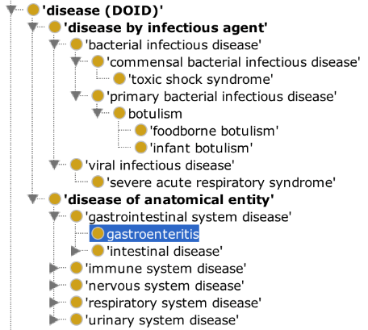
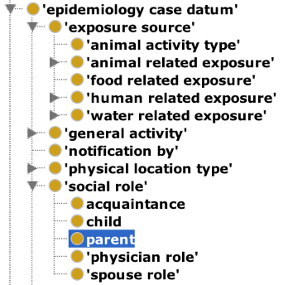
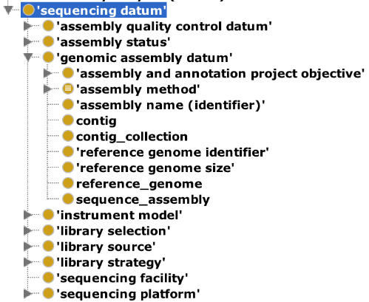
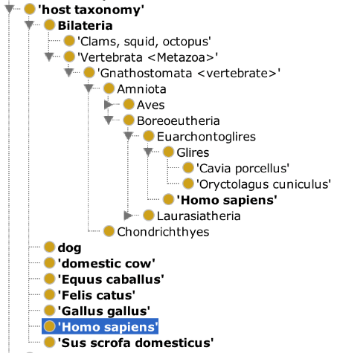
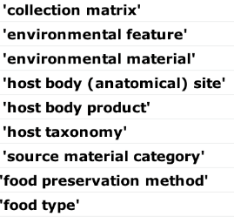
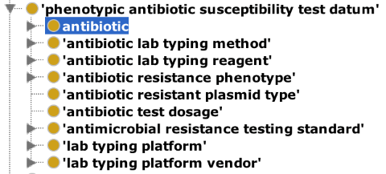
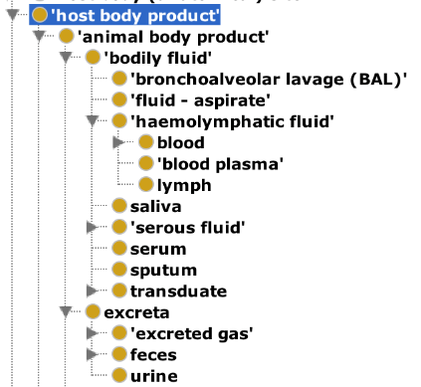
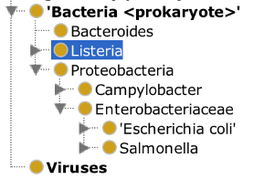
Pathogen investigation
context
food
swab
virulence / AMR
case
isolate
sequencing & testing
sample
variants
stool
sputum
phylogeny
taxonomy
symptoms
host
pathogen
disease
demographics
infectious
anatomical
transmission context

Slide 18
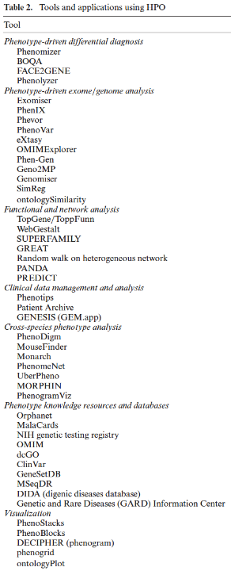
Standards
Human Phenotype Ontology (10,454 concepts)
“A standardized vocabulary of phenotypic abnormalities encountered in human disease”
e.g. diarrhea: http://purl.obofoundry.org/HP_0002014
Exact term match to Unified Medical Language System¹: 54%
Exact term match to SNOMED CT: 30%
2016 breaking news: “… the UMLS has now integrated the
entire HPO starting with the 2015AB release.”²
De-facto standard by popularity and institutional support
HPO
Abnormality
of the mouth
[HP:0000153]
UMLS Mouth Abnormalities
[C0026633]
SNOMED CT Congenital anomaly of mouth (disorder)
[SCTID:128334002]
¹https://mor.nlm.nih.gov/pubs/pdf/2016-jbms-fd.pdf
²https://www.ncbi.nlm.nih.gov/pmc/articles/PMC5210535/

Slide 19
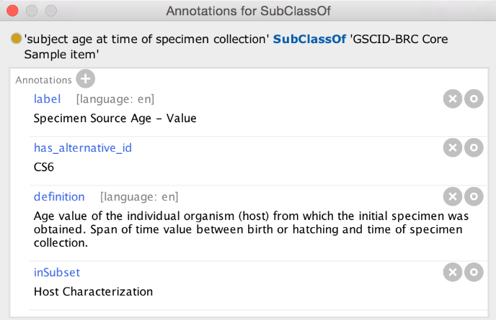
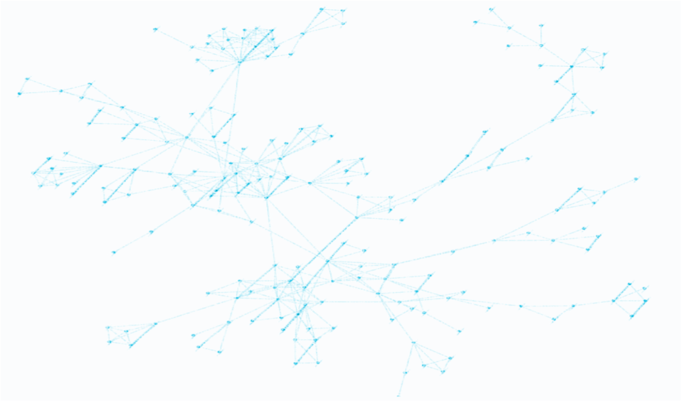
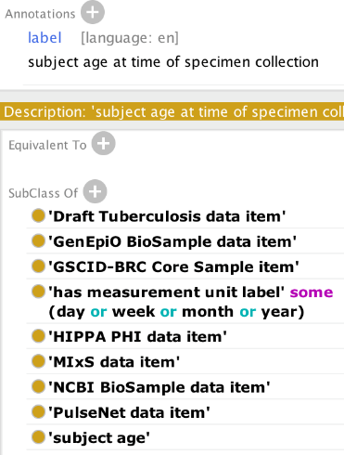
GenEpiO standards compliance
GenEpiO
NCBI BioProject
GSCID-BRC Core Sample
MIxS¹
PulseNet
IRIDA
NCBI BioSample
¹ Genomic Standards Consortium MIxS: Minimum Information about any Sequence

Slide 20
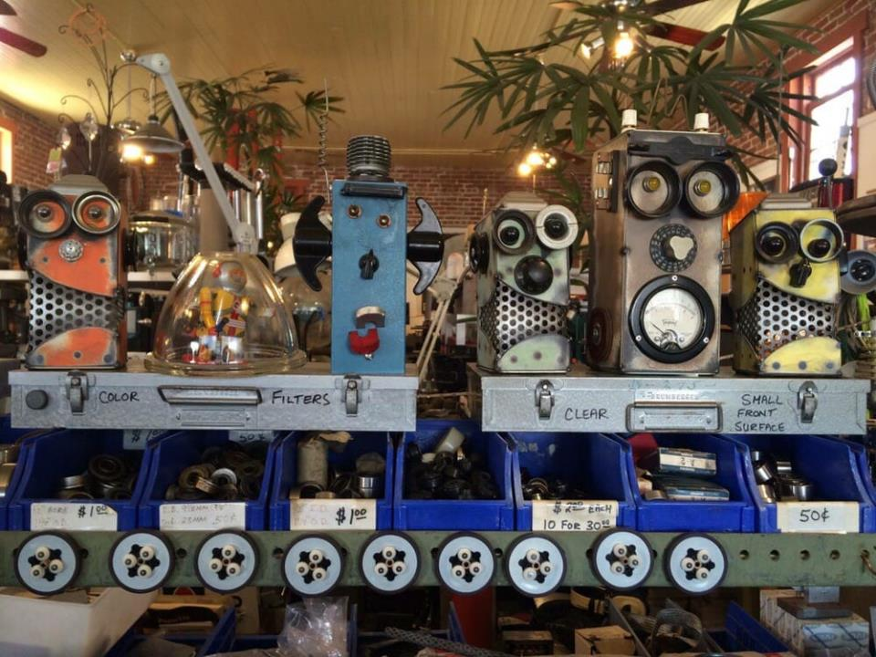
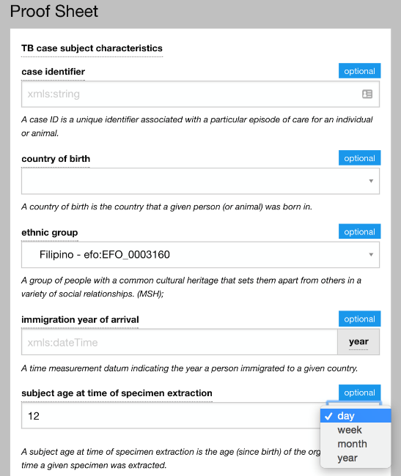
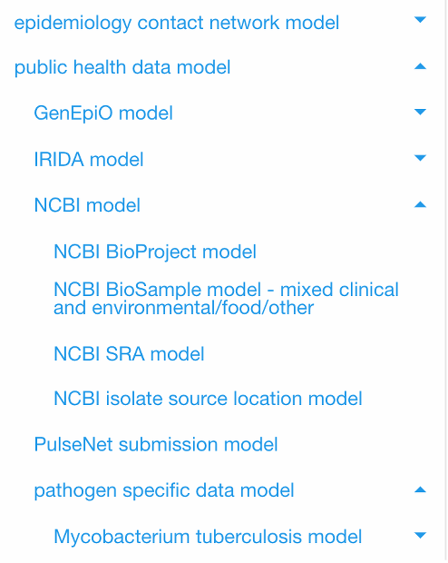
Ontology Reuse
GE²M: Entity shopping mart
Problem: Ontology reuse is rare outside academia
“It takes a masters in logic to understand ontology inference?”
“Do I have to write the software to ontologize my data?”
Browse GenEpiO entities
Search for particular data fields or field groups
Image credit:
http://www.candhsurplus.com/
http://tinyurl.com/uiproofsheet

Slide 21
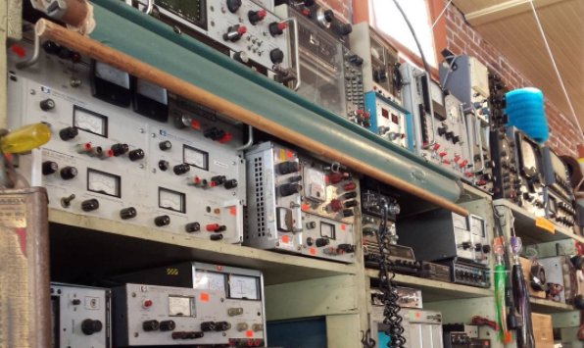
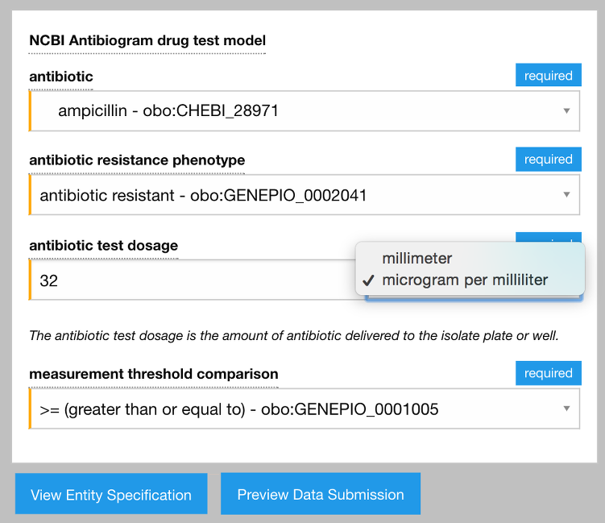
GE²M Data conversion nitty-gritty
User-oriented term label, definition and synonym display
Input validation, format control and numeric precision
An input’s optional or required details
Curation status
Link to a term’s curation forum
Allowed and preferred units
Data conversion from given unit
Checkboxes for including items in shopping cart
Cross-references to 3rd party data source fields
Download field specs for use in software
“Add to shopping cart” button
View example submission data
Notes:
Oxford English …

Slide 22
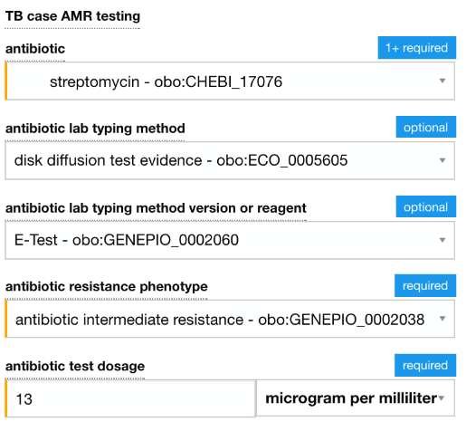
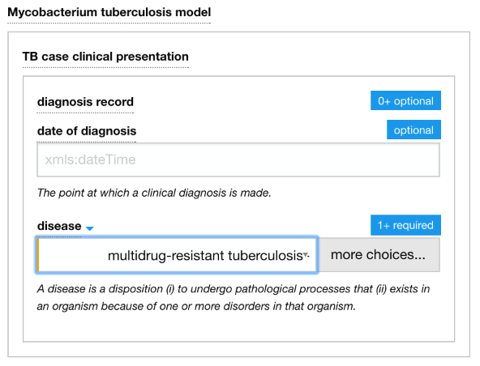
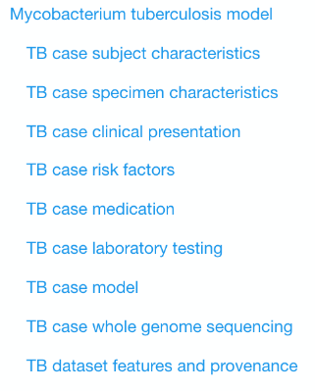
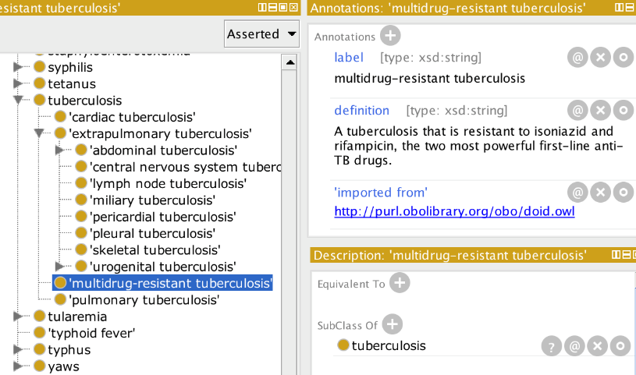
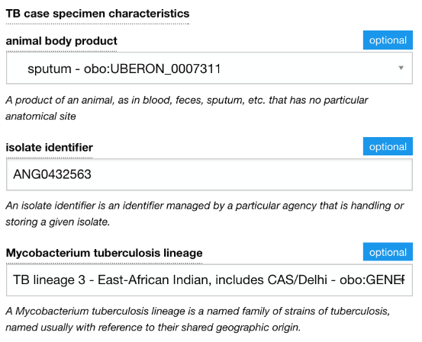
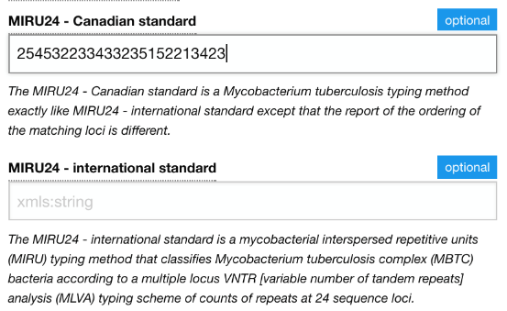
Example TB data fields

Slide 23
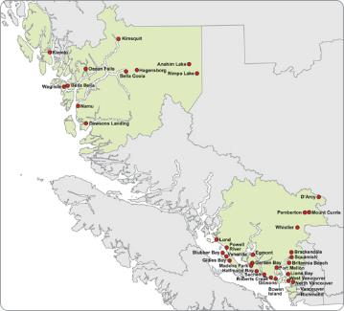
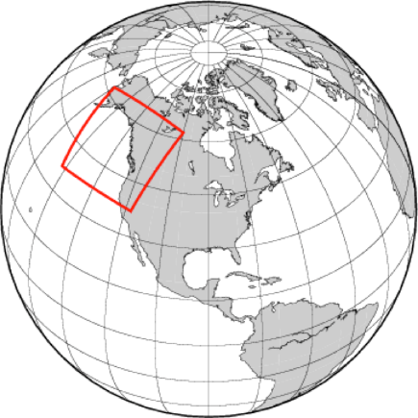
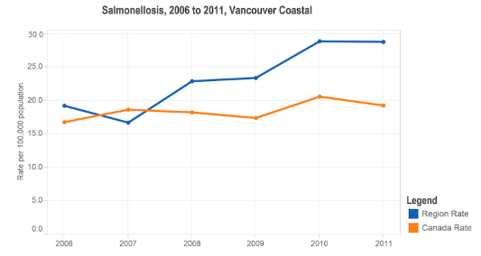
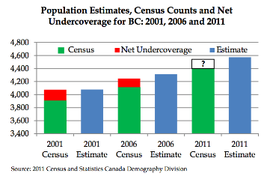

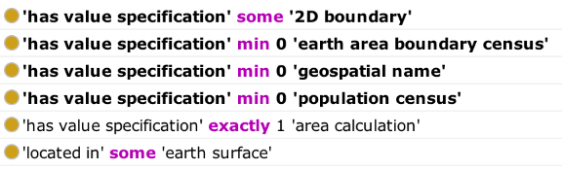
A plug and play data future
BC Vancouver Health Authority
Notes:
Ontology components will evolve into plug-and-play software entities which one can combine from the bottom-up to create software. Kind of like Lego!

Slide 24
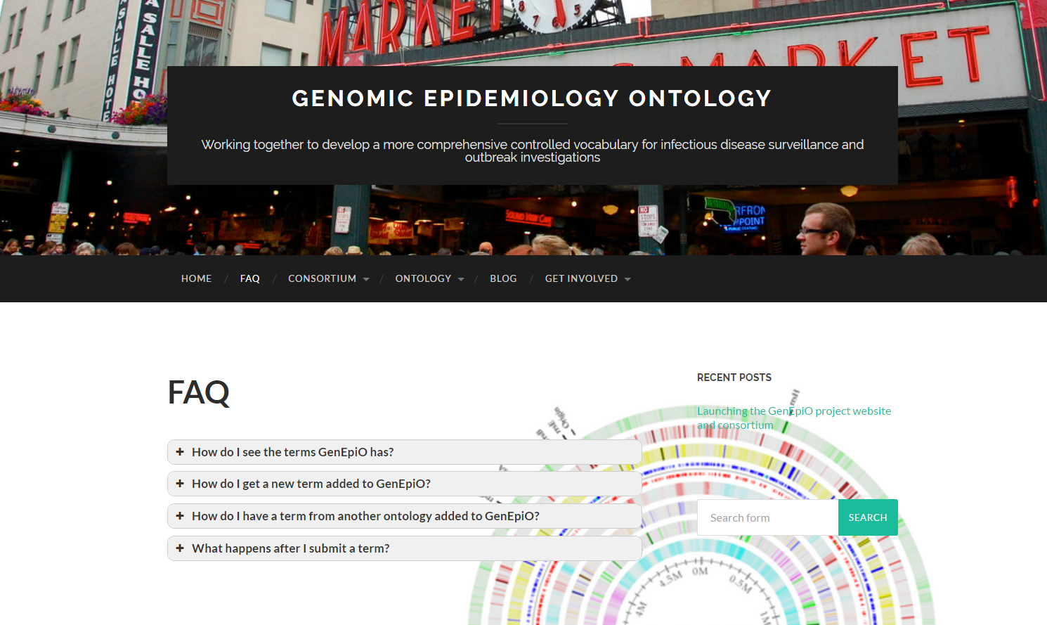
Developing an international consortium
>70 members from 15 countries
www.genepio.org

Slide 25
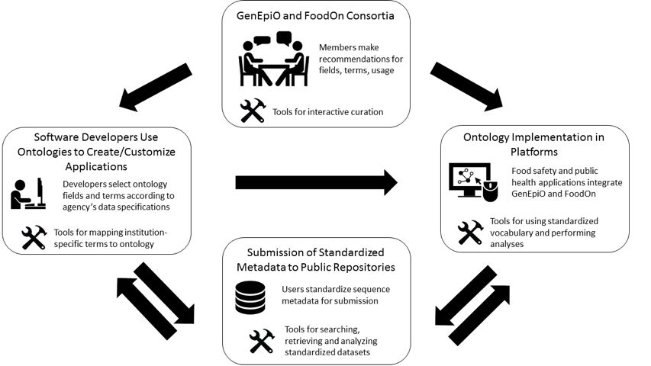
GenEpiO Use

Slide 26



Acknowledgements
GenEpiO Project Leaders
Will Hsiao – BCCDC
Fiona Brinkman – SFU
Andrew McArthur - McMaster
Simon Fraser University (SFU)
Emma Griffiths
University of British Columbia
Damion Dooley
McMaster University
Amos Raphenya
Brian Alcock
BC Centre for Disease Control
Jennifer Gardy
Jennifer Guthrie
IRIDA Project Leaders
Fiona Brinkman – SFU
Will Hsiao – PHMRL
Gary Van Domselaar – NML
Rob Beiko – Dalhousie
Andrew McArthur - McMaster
Leonid Chindelevitch – SFU
Cedric Chauve - SFU
Simon Fraser University (SFU)
Emma Griffiths
Geoff Winsor
Julie Shay
Matthew Laird
Bhav Dhillon
National Microbiology Laboratory (NML, Winnipeg, Manitoba)
Aaron Petkau
Thomas Matthews
Josh Adam
Adam Olsen
Tara Lynch
Shaun Tyler
Philip Mabon
Celine Nadon
Morag Graham
Eduardo Toboada
Peter Kruczkiewicz
Chad Laing
University of Lisbon
Joᾶo Carriҫo
… and friends at Public Health England, CRyPTIC, and C-PATH
Funding

