Slide 1


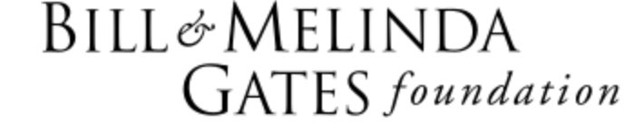




Cluster-randomized comparative effectiveness trial of iCCM vs ProCCM + PBO nets for control of resurgence post-IRS in Uganda:
Can either combination maintain reduction?
Dorothy Echodu, PhD
IDM Symposium 2019
April 15

Slide 2
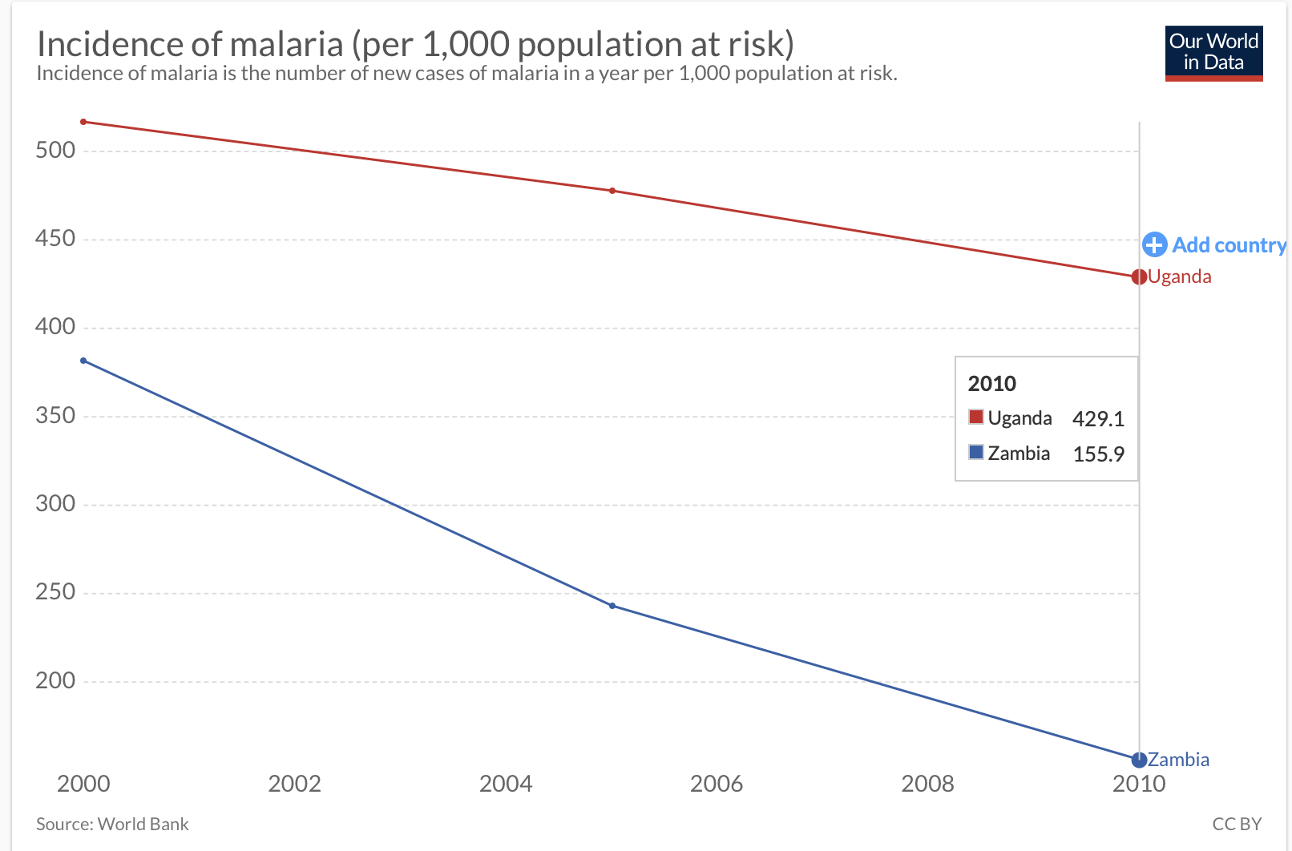
Uganda is a high burden country…
“Our World in Data”
https://ourworldindata.org

Slide 3
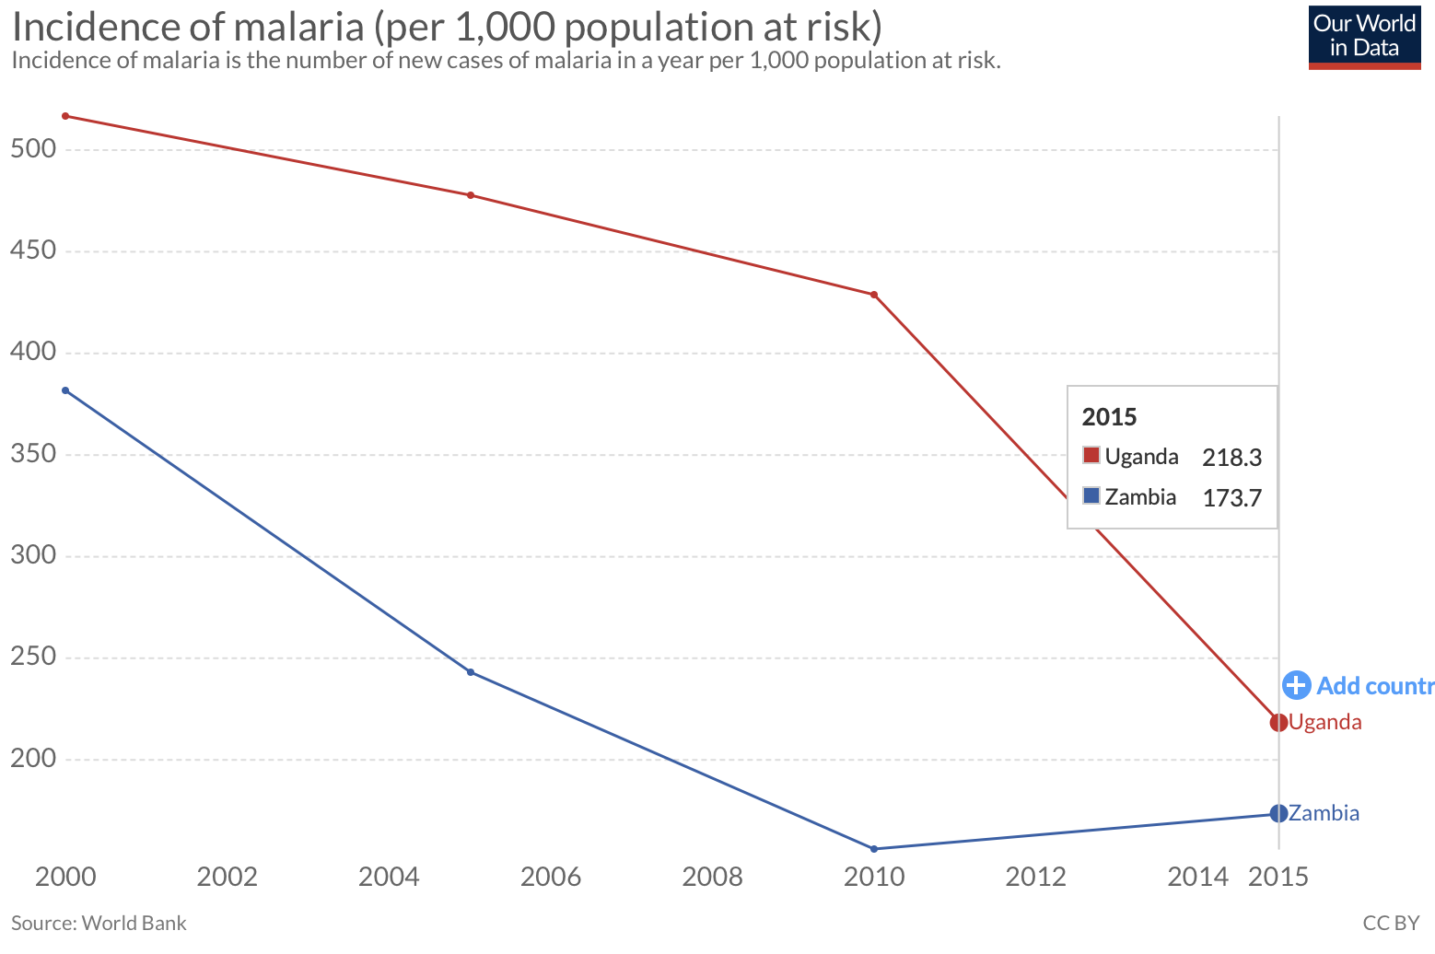
…though the meaning of “high burden” has changed
“Our World in Data”
https://ourworldindata.org

Slide 4
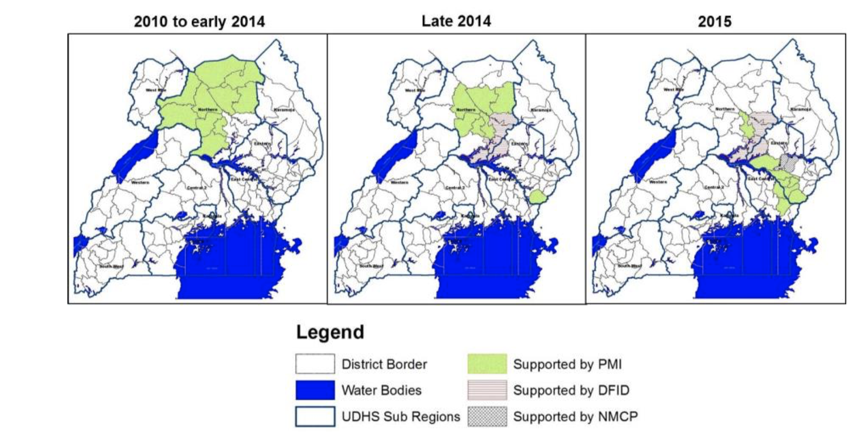
IRS in Uganda 2010-2022
scheduled for exit 2022
PMI Malaria Operational Plan FY 2015

Slide 5

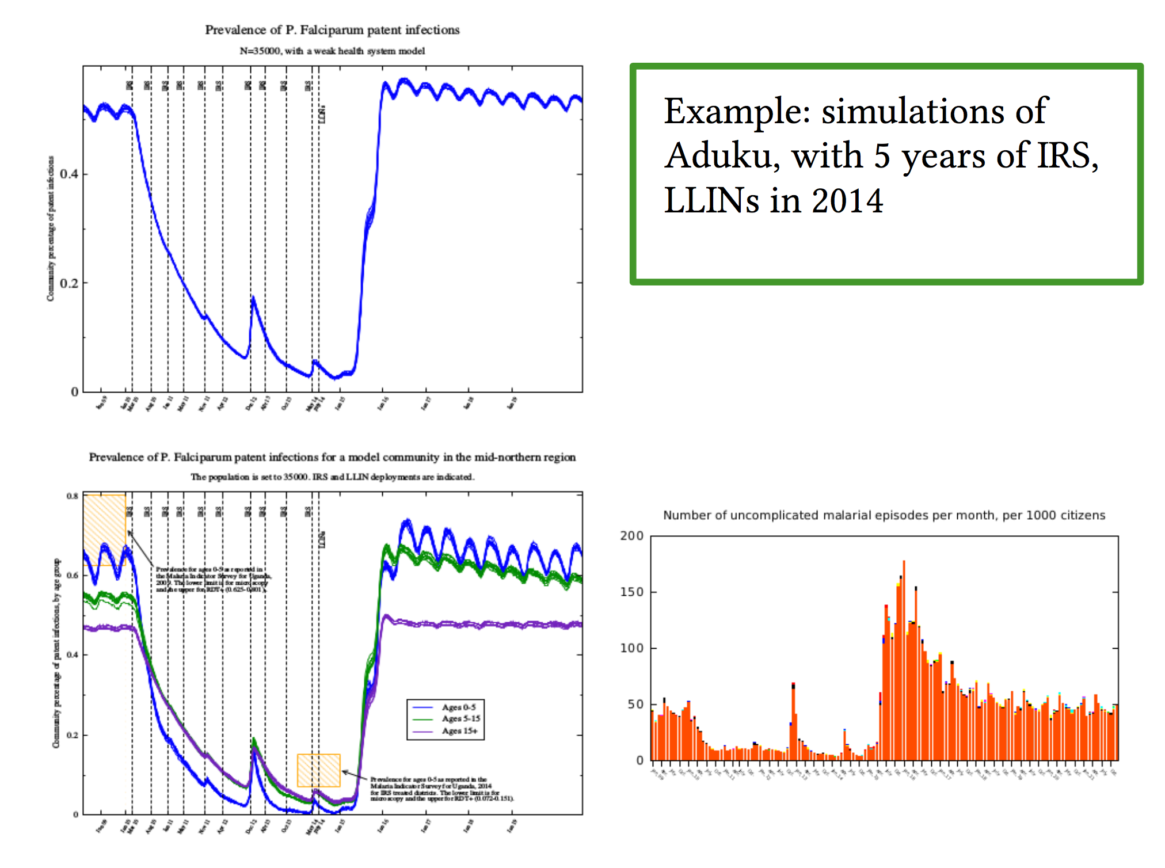
Modelling of IRS in No. Uganda: clear need for IRS exit plan
incidence– prevalence correspondence at IRS withdrawal (historical)
Both predictions correct,
unfortunately
R. Elliott

Slide 6
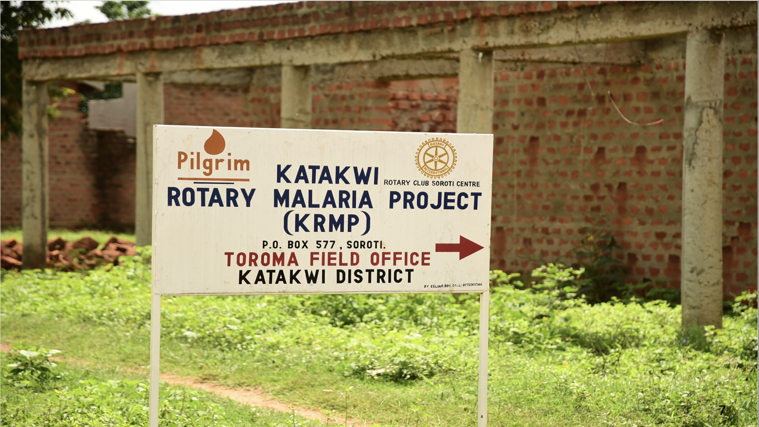

Slide 7
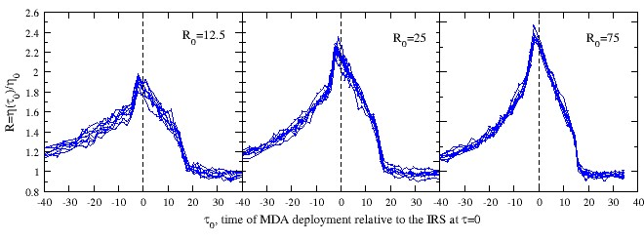
Openmalaria ‘synergy’ prediction for MDA + IRS:
Co-timing impact grows with transmission intensity
Elliott R, Smith D, Echodu D. Malaria Journal. in press.

Slide 8

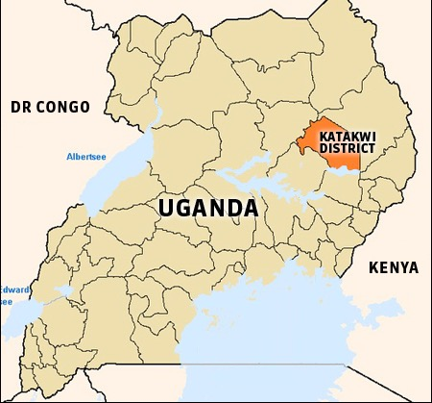
KRMP PROJECT SUMMARY: PHASE I
PAGE TITLE GOES HERE
Description and study site | Katakwi District Phase I sequences of malaria control interventions: Arm A Phase I: (IRS + MDA) Arm B Phase I: (IRS) Arm C Phase I (std of care)

Slide 9
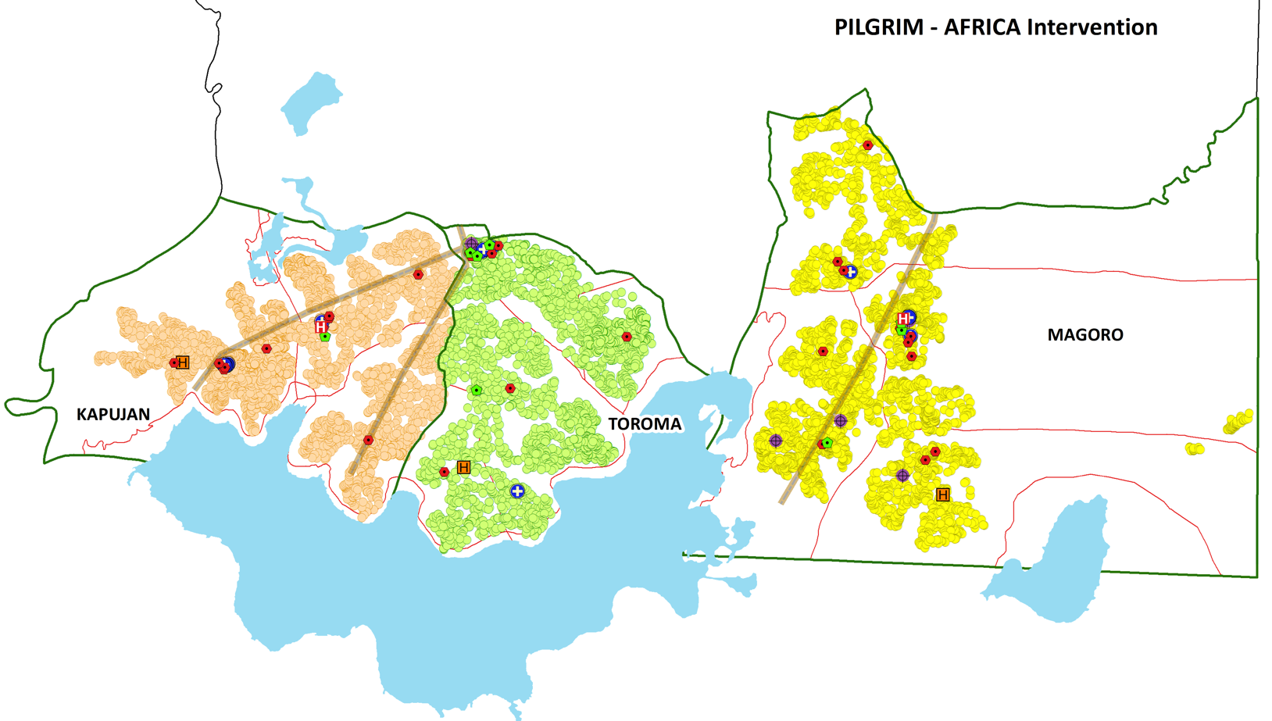
Phase I: 3 arms, controlled before and after
IRS + MDA + LLINs
IRS + LLINs
LLINs
50,178 people,
~8,000 families*
*November 2018 enumeration
S. Kigozi
Notes:
Controlled before and after.
Talk about using cross-sectional community surveys to assess these three arms

Slide 10
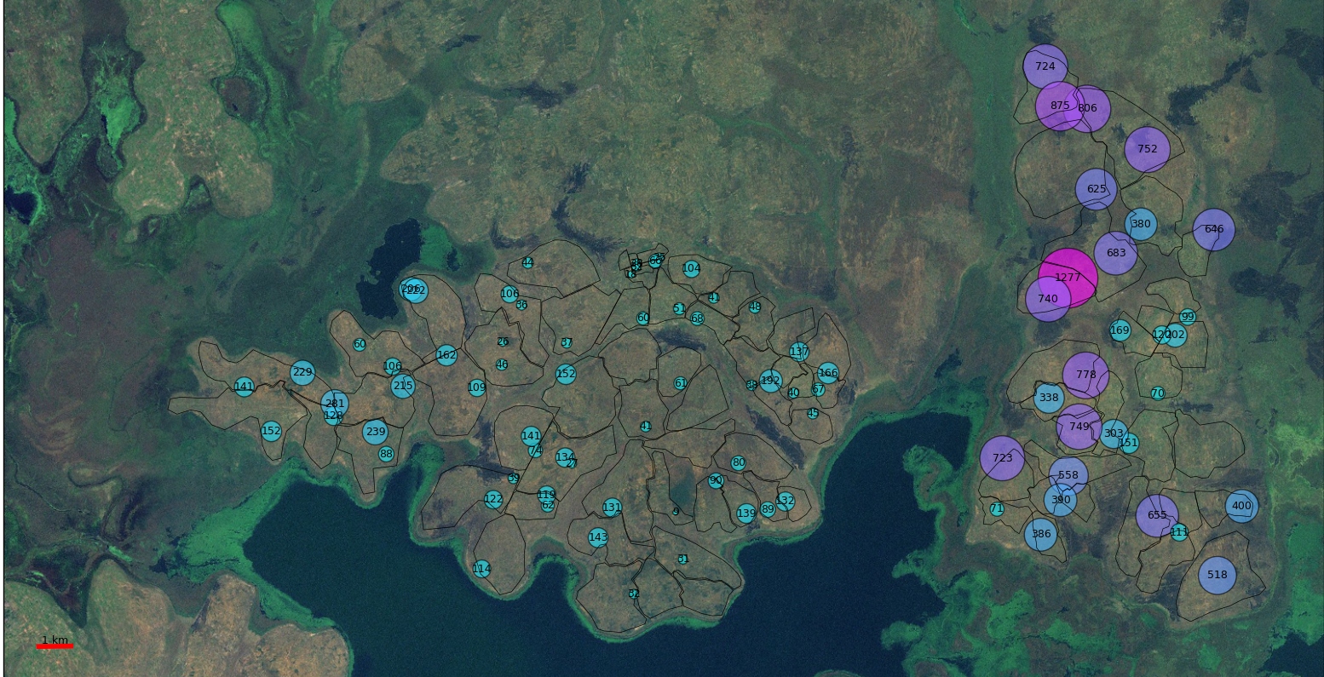
Impact of IRS on anophelines in surveillance huts
PAGE TITLE GOES HERE
R. Elliott
Notes:
We are getting at the question of whether we will be able to see the annual difference in incidence…to even model this, we need to make assumptions about demand– how many people will say yes to a test. I’m hoping to learn from all of you here about what’s usual in your geographies. The more people say yes, the more people you’ve screened for potential parasitemia. They are more likely than a random person to be positive, of course, because they are feeling sick, but we don’t know how much more likely. Is it twice as likely? If so, then green here means that about 1/200 people asks for a test each week, and blue means that 1 in every 25 people asks for a test each week. That might be really high! So we don’t know what the difference will be.

Slide 11
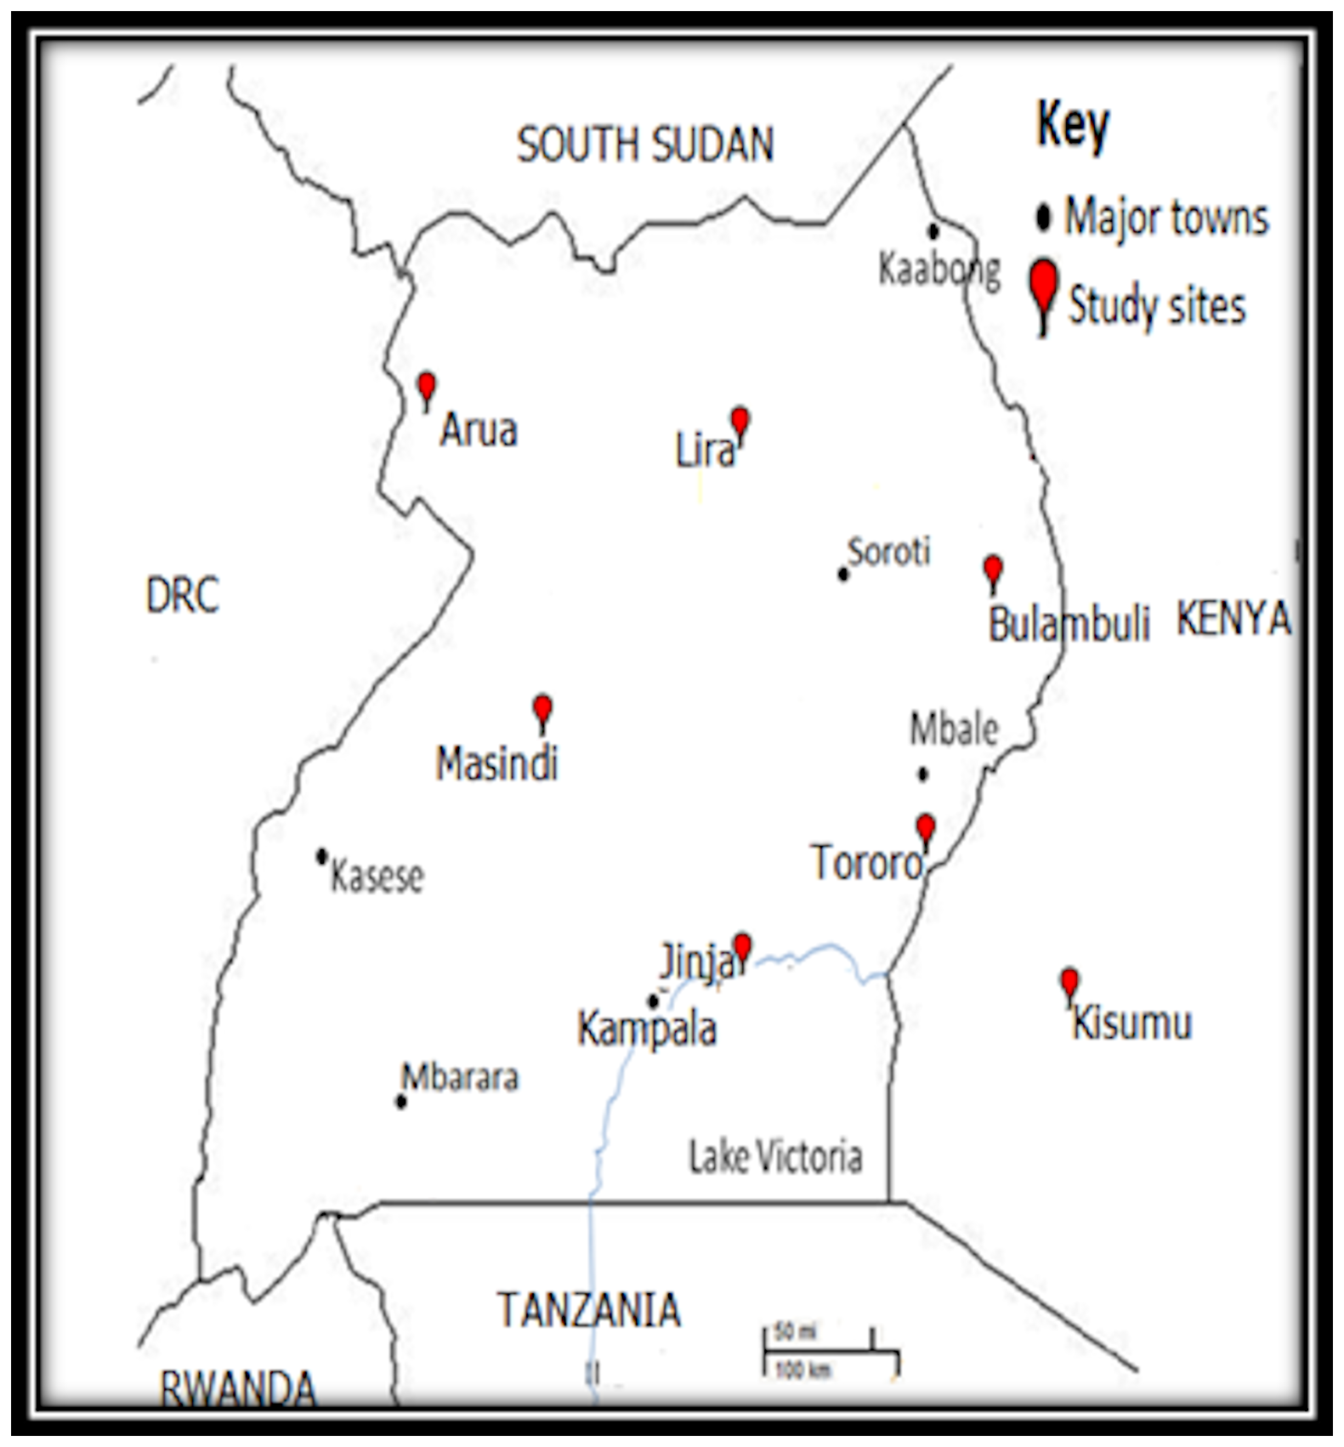
Widespread metabolic resistance to pyrethroids
Katakwi Project Site
Mulamba, C et al.
PLoS One. 2014;9(10):e110058.

Slide 12
Phase II: comparing two case management methods
  integrated community case mg’t (iCCM):
  Std of care in Uganda, targeted to children <5
  Care must be sought by child’s caregiver
  proactive community case mg’t (ProCCM)
  Active household sweeps
  Diagnosis and treatment for pneumonia and diarrhea and referral for malnutrition for < 5s
  All ages malaria case detection and treatment

Slide 13
Interventions | Phase II 2019-2021 (two years): Arm 1: ProCCM in 28 villages + PBO LLINs in former Arms A & B Arm 2: iCCM in 27 villages + PBO LLINs in former Arms A & B NB: artemether lumefantrine (AL) used for malaria treatment
Evaluation Methods | Community Surveillance CHW-reported care seeking/incidence in <5’s weekly (test positivity rate, total confirmed cases, tests requested) Cross sectional community surveys: 300 randomly selected hh (~1200 people) per arm base/mid/end (RDTs, microscopy, qPCR, serology + surveys) Primary metric: all ages Pf prevalence by RDT, microscopy and qPCR Entomological surveillance: CDC light traps-- 60 hh in each arm monitored monthly Pyrethrum spray catches every 2-3 months in 20 hh per arm (vector species and number, parity, gravidity, and sporozoite ELISAs). Health facility surveillance Primary metric: incidence trends over time in <5’s at public facilities
PAGE TITLE GOES HERE

Slide 14
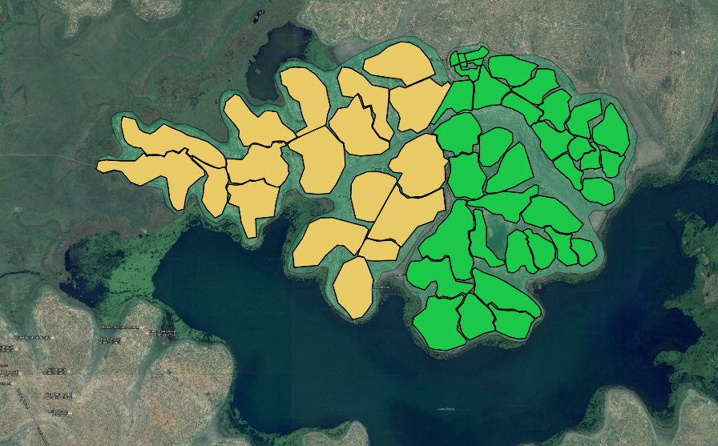
Phase II study design:
Spatial Covariate Constrained Randomization
Traditional CCR does not take into account the potential for intervention contamination due to spatial constraints, such as human or mosquito movement
Desirable to optimize community assignment to clusters that are contiguous, yet still achieve random assignment of clusters to intervention arms
To avoid spatial contamination of 55 villages, we assign villages first to clusters that could be randomized
C. Bever, K. Colborn

Slide 15
Phase II study design: Spatial CCR continued
We used k-means clustering to assign villages to clusters
To determine the number of clusters, we evaluated the within-cluster sum of squares of Euclidean distances between village centroids
This metric was also used to generate the clusters
K. Colborn

Slide 16
Phase II study design: Spatial CCR continued
Balance variables:
  Baseline microscopy prevalence
  Survey 5 microscopy prevalence
  Lake-bordering (yes/no)
  Previous arm Phase I (2 per each per arm)
  Population density
  Household density
Using the balancing scores (B-scores) described by Moulton (2004, Clinical Trials), we restricted our possible randomization schemes to those with the 12 lowest B-scores for the scenario with 4 clusters per subcounty
Chose one unique randomization and assigned ProCCM or iCCM
K. Colborn

Slide 17
IRS withdrawal area:
28 villages ProCCM+ II 27 villages iCCM
K. Colborn
Notes:
The problem is that these villages are all very close together. They aren’t much more than a kilometer wide, and we know that Anopheles gambiae has an ordinary range of around .6 km. So if we just did ordinary randomization we might actually be confounding everything, as the iCCM mosquoes would bite the ProCCM people, and vice versa.

Slide 18
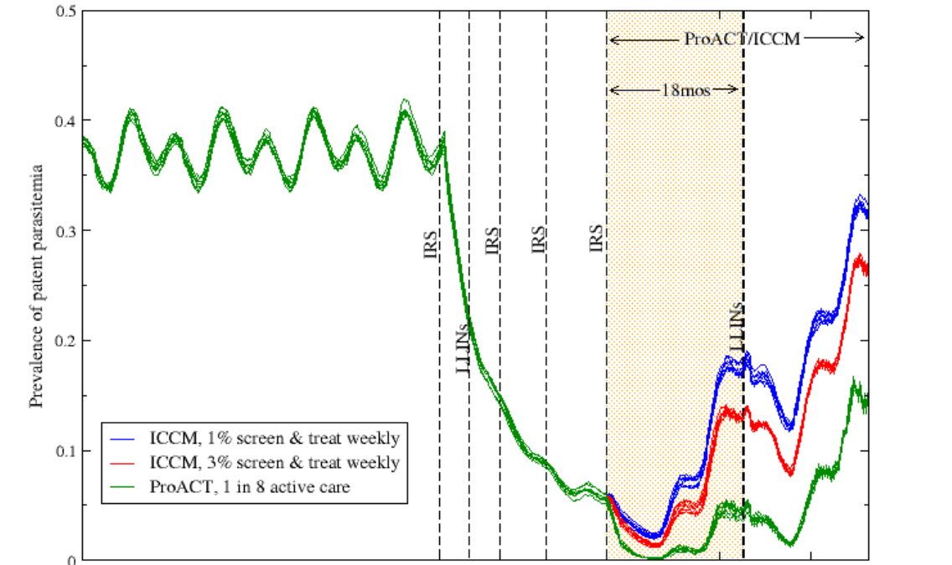

MODELLING IMPACT OF ProCCM vs iCCM, post-IRS
PAGE TITLE GOES HERE
Prevalence before, during, and after IRS
“iCCM” (lower care seeking)
“iCCM” (higher care seeking)
“ProCCM”
R. Elliott
Notes:
We are getting at the question of whether we will be able to see the annual difference in incidence…to even model this, we need to make assumptions about demand– how many people will say yes to a test. I’m hoping to learn from all of you here about what’s usual in your geographies. The more people say yes, the more people you’ve screened for potential parasitemia. They are more likely than a random person to be positive, of course, because they are feeling sick, but we don’t know how much more likely. Is it twice as likely? If so, then green here means that about 1/200 people asks for a test each week, and blue means that 1 in every 25 people asks for a test each week. That might be really high! So we don’t know what the difference will be.

Slide 19


THANK YOU!!!

Slide 20
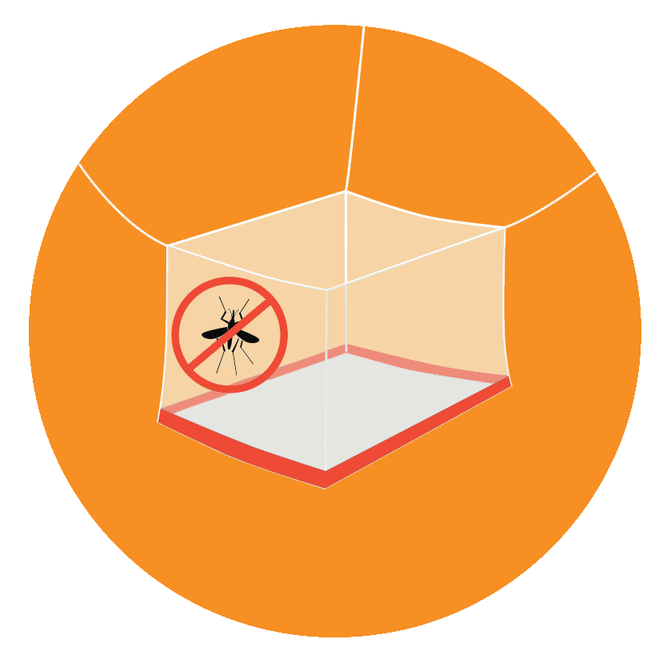

Intervention/Survey Scheduling
April
iCCM
ProCCM
PBO
2019
2020
2021
KEY
Survey (larger icon represents expanded survey)
LLIN Distribution

Slide 21
Phase II study design: Spatial CCR continued
Variable | Pink: ProCCM | Green: iCCM
Clusters per arm | 4 | 4
Baseline microscopy prevalence | 0.25 (0.02) | 0.24 (0.01)
Survey 5 RDT prevalence | 0.14 (0.06) | 0.13 (0.04)
Population density | 285.37 (56.85) | 315.81 (96.86)
Household density | 48.94 (12.30) | 55.52 (19.44)
Number of clusters along lake | 2 (50.0) | 2 (50.0)
Number of clusters per subcounty | 2 (50.0) | 2 (50.0)
Notes:
Using the balancing scores (B-scores) described by Moulton (2004, Clinical Trials), we restricted our possible randomization schemes to those with the 12 lowest B-scores for the scenario with 4 clusters per subcounty
Chose one unique randomization from the 12 and assigned them to ProCCM or iCCM

Slide 22
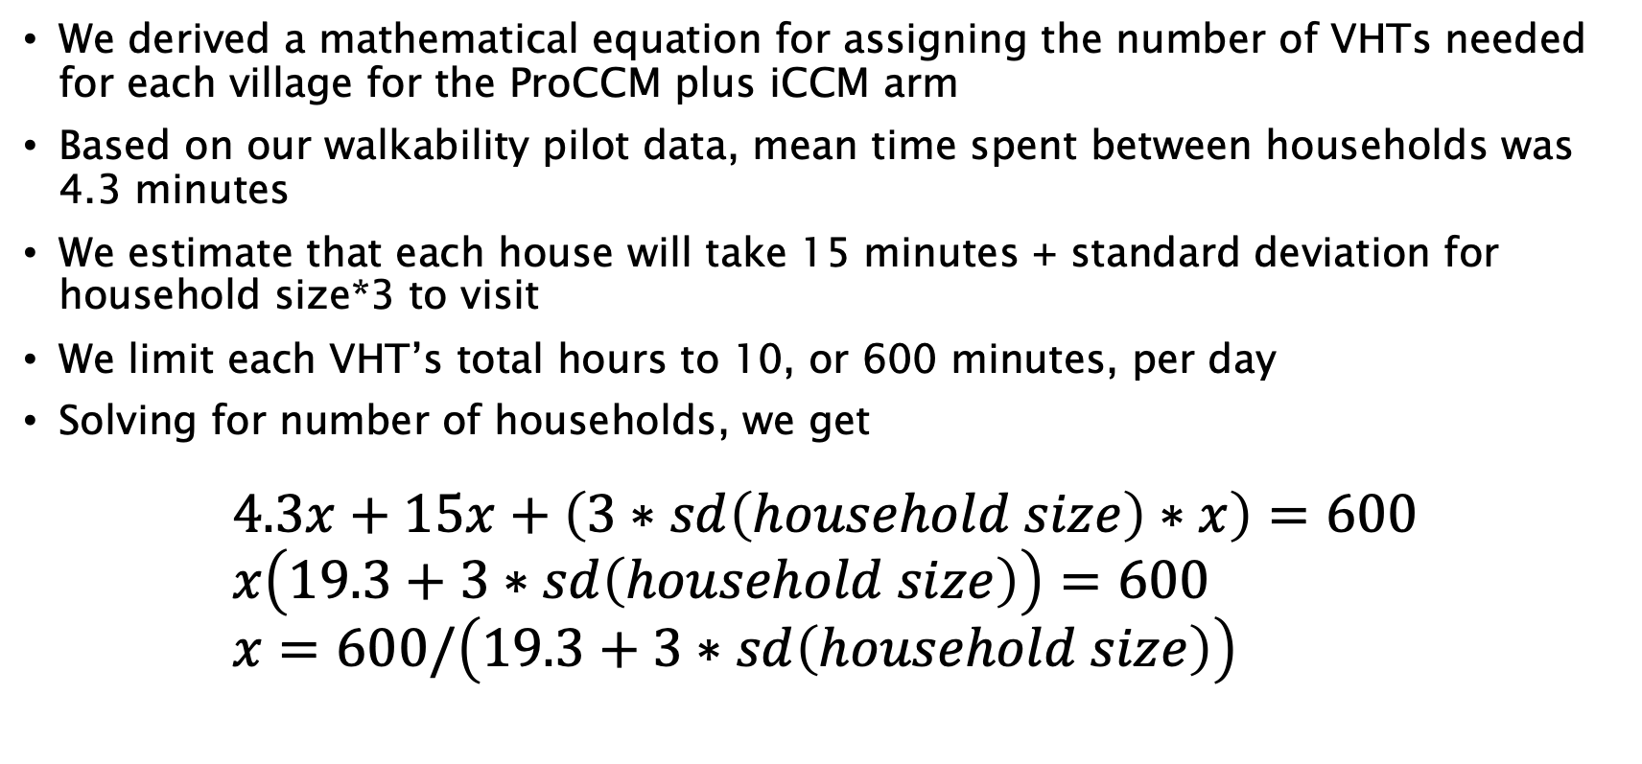
Assigning VHTs to villages continued
We derived a mathematical equation for assigning the number of VHTs needed for each village for the ProCCM plus iCCM arm
Based on our walkability pilot data, mean time spent between households was 4.3 minutes
We estimate that each house will take 15 minutes + standard deviation for household size*3 to visit
We limit each VHT’s total hours to 10, or 600 minutes, per day
Solving for number of households, we get
$$4.3x+15x+\left(3∗sd\left(household size\right)∗x\right)=600 \\ x\left(19.3+3∗sd\left(household size\right)\right)=600 \\ x=600/\left(19.3+3∗sd\left(household size\right)\right)$$

Slide 23
Assigning VHTs to villages continued
Since we also have household density, we can apply a simple equation to adjust this based on household density, such as
$$y=x−3∗sd(household density)$$
Applied to our village data, the mean and range of y (i.e., the number of households each VHT can cover in each village in a 10 hour period, taking household density into consideration), is 32 (range 24 to 45)
Total VHTs needed per village is then just y/total households per village (mean=3; range= 1 to 8). For those that had an estimate of 1 VHT per village from this model, we actually assigned them 2.

Slide 24
Assigning VHTs to villages

Slide 25
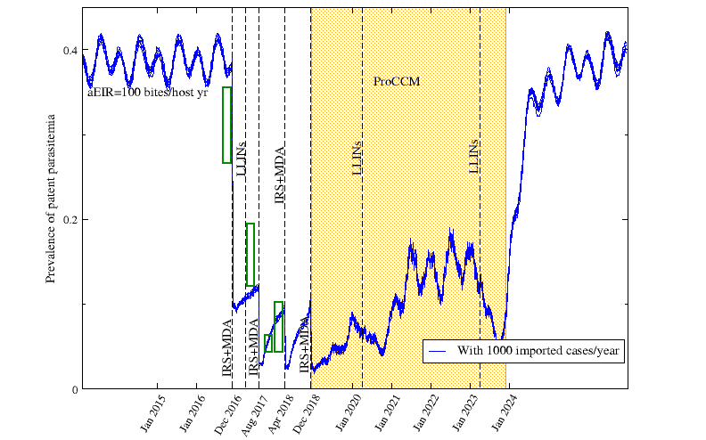
MODELLING IMPACT OF ProCCM post-IRS
PAGE TITLE GOES HERE
Prevalence before, during, and after IRS
ProCCM
R. Elliott
Notes:
We are getting at the question of whether we will be able to see the annual difference in incidence…to even model this, we need to make assumptions about demand– how many people will say yes to a test. I’m hoping to learn from all of you here about what’s usual in your geographies. The more people say yes, the more people you’ve screened for potential parasitemia. They are more likely than a random person to be positive, of course, because they are feeling sick, but we don’t know how much more likely. Is it twice as likely? If so, then green here means that about 1/200 people asks for a test each week, and blue means that 1 in every 25 people asks for a test each week. That might be really high! So we don’t know what the difference will be.

