Slide 1
Characterizing Environmental Modes of Transmission
Joseph Eisenberg
University of Michigan
April 19, 2017

Slide 2
Environmental Infection Transmission Systems (EITS): Framework
EITS provide means to
  Explicitly link environmental exposure to transmission
  Incorporate health/environmental data to assess risk
    Informs environmental sampling strategies
  Examine environmentally based interventions
    Evaluate interventions as a function of environmental variables
ρπΕ
γ
S
I
R
Pickup
α
Deposit
E
Reproduction number
μ
Infectivity
Environmental Attenuation
Die-off
Contamination Ratio
(Li et al. AJE, 2009)

Slide 3
Environmental Infection Transmission Systems
Data needs to characterize the environment
Shedding
Ingestion
Persistence
  Often assumed linear on log-scale, but biphasic die-off is common.
Transport
  Hydrologic processes
Dose-response function
  Focus of microbial risk assessments
    Human and animal data available
  Low dose linearity, concave functions required for Ro to govern stability

Slide 4
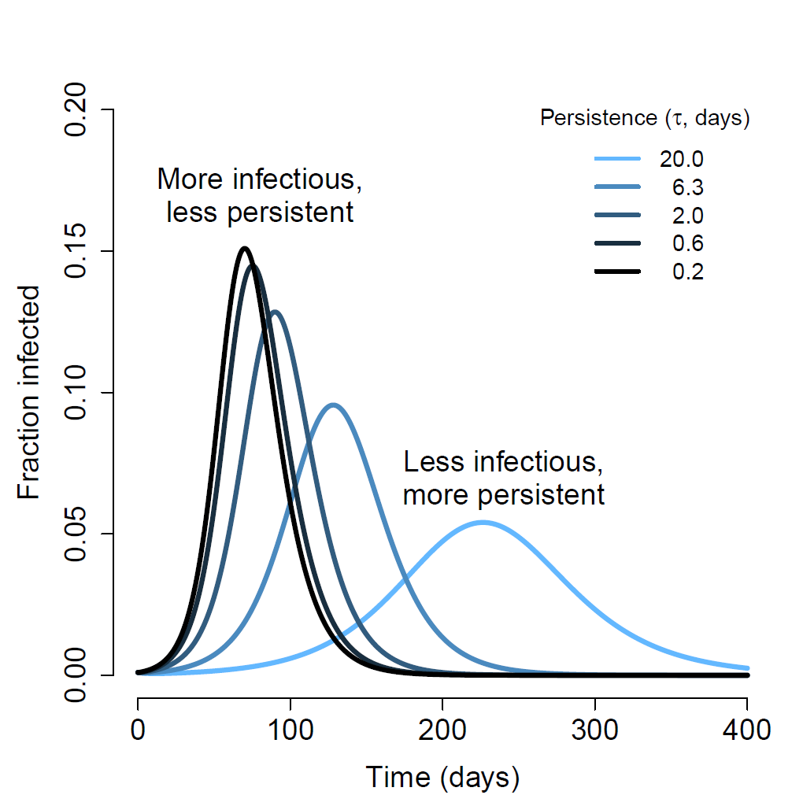
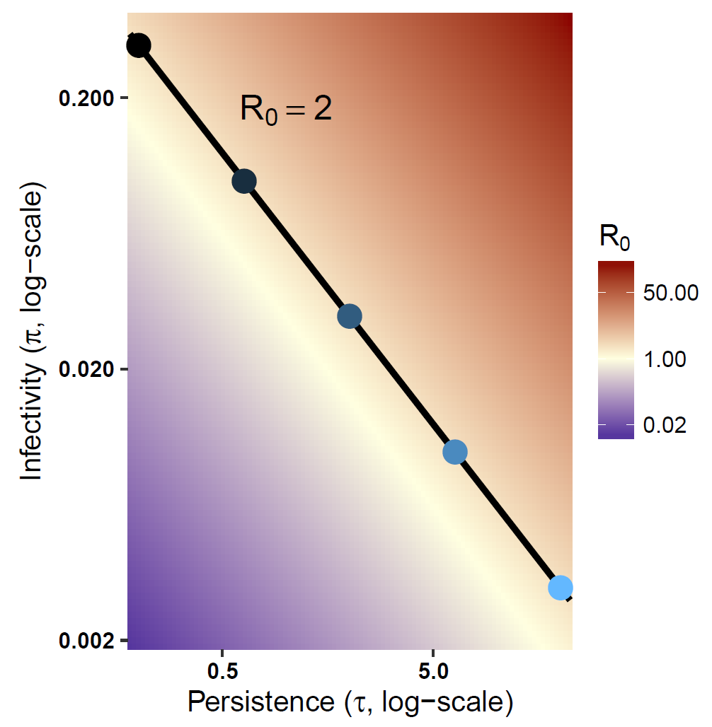
Environmental Infection Transmission Systems
Informs mechanism e.g., persistence–infectivity trade-offs
Different pathogens can have same R₀ but different persistence and infectivity
Results in different outbreak dynamics
(Brouwer et al, In Prep)

Slide 5
Environmental Infection Transmission Systems
Context matters: Multiple interdependent pathways
  Most WASH studies in past few decades have focused on independent pathways
  Evidence for interdependencies
    Water effectiveness modulated by sanitation level
      Cohort study (Vanderslice and Briscoe, 1995)
      Cross sectional studies (Esrey 1996; Fuller et al 2015)
      Meta analysis of RCTs (Gundry and Wright 2009)

Slide 6
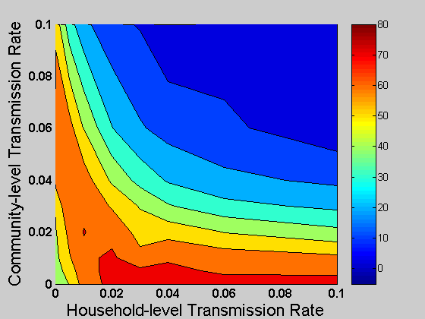
Environmental Infection Transmission Systems
Context matters: Multiple interdependent pathways
The efficacy of water interventions depend on other transmission pathways
Preventable Fraction scale
(dark blue = 0%, Red = 80%)
(Eisenberg et al, 2007)

Slide 7
Cryptosporidium Drinking Water Outbreak (Milwaukee WI, 1993)
Modes of transmission
Two competing hypotheses
    Environment-person plus person-person transmission
      Late spring snow melt and high winds along lake
    Person-environment-person transmission
      Human genotype was cause of outbreak
      Wastewater outlet close to drinking water inlet
  Retrospective Cohort Sample (N=1,663)

Slide 8
Cryptosporidium Outbreak
Person to Person vs. Environment to person
The role of person-person transmission
  Estimate fraction of outbreak cases associated with person-person transmission
I_{A}(t)
Infectious
(asymptomatic)
S(t)
Susceptible
ρ
π
π
...
π
π
E₁
E₂
E_{k}
δ
R(t)
Removed
β + β_{S}
1−ρ
Latently Infected
I_{S}(t)
Infectious
(symptomatic)
W(t)
Environmental
Transmission
W: Concentration of Pathogens in the Environment
Solid: Individual Flows from State to State
Dashed: Pathogen Flows
(Eisenberg et al, 2005)

Slide 9
Cryptosporidium Outbreak
Person to Person vs. Environment to person
Generate posterior distribution (MCMC)
  Cumulative incidence, I₁, produced by random draw of posterior
  Cumulative incidence, I₀, produced by random draw of posterior (β_{s}=0 ).
  Attributable risk = I₁- I₀
10% of cases attributable to person-person transmission (95% CI [6, 21])
Notes:
Monte Carlo Markov Chain (MCMC) was used to generate a posterior distribution.
Two step procedure was used to address colinearities of the parameter estimates
MCMC at profiled points
Second MCMC on draws from first MCMC

Slide 10
Cryptosporidium Outbreak
Role of Person-Environment-Person
Preventable fraction due to an increase in distance between wastewater outlet and drinking water inlet
  Transport time, d is surrogate for the potential intervention of moving drinking water inlet father from wastewater outlet
I_{A}(t)
Infectious
(asymptomatic)
S(t)
Susceptible
ρ
π
π
...
π
π
E₁
E₂
E_{k}
δ
R(t)
Removed
β + β_{S}
1−ρ
Latently Infected
I_{S}(t)
Infectious
(symptomatic)
W(t)
Environmental
Transmission
W: Pathogens in Environment (4 compartment distributed delay model; transport time, d)
Solid: Individual Flows from State to State
Dashed: Pathogen Flows
(Eisenberg et al, 2005)

Slide 11
Cryptosporidium Outbreak
Incorporating environmental and human case data
Turbidity data used to impute environmental data and approximate exposure
Can estimate infectivity
(becomes identifiable)
(Brouwer et al, In Press)

Slide 12
Cryptosporidium Outbreak
Role of Person-Environment-Person
Estimate of transport time for contamination in sewage to reach drinking water tap
MLE = 11days (95% CI [8.3, 19])
Predicted preventable fraction as a function of increasing transport time
Moving drinking water inlet father off-shore
Notes:
Estimate the likelihood for different values of d, ranging from 1 - 40 days.
Estimate the attack rate (AR) for the MLE parameters
Estimate the AR for different values of d, keeping all other parameters constant at their MLE values.
Plot PF_{d} = 1 - AR_{MLE} / AR_{d}

Slide 13
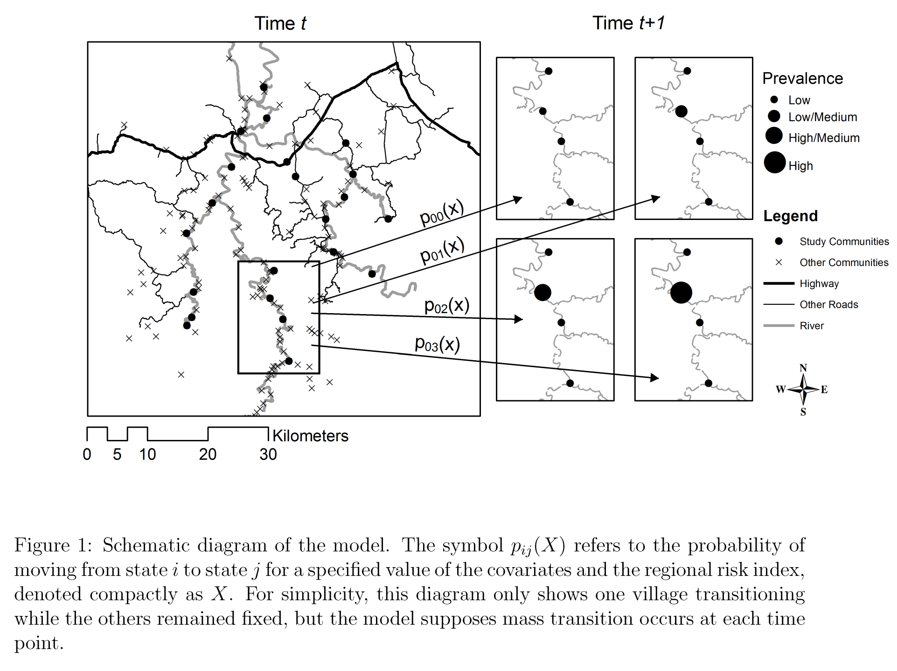
Region Spread of Enteric Pathogens
Person-Person vs. water
  Markov chain model: state of village k (high, medium, low diarrheal rates) at t depends on state of 21 villages at t-1.
    Fit to 4 years of surveillance data
    Villages weighted using a gravity model (distance and size)
Goldstick et al 2014

Slide 14
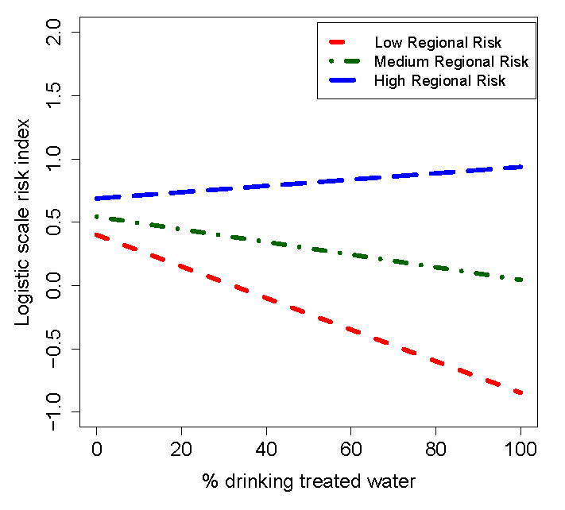
Region Spread of Enteric Pathogens
Person-Person vs. Water
Local transmission mediated via water
Regional spread mediated by human movement

Slide 15
Conclusions
Environmental data can increase specificity and power of transmission model
  Persistence, occurrence, dose response, ….
More work needed to improve understanding of
  How to integrate environmental and human data
  Identifiability issues
EITS provides framework to inform
  Environmental interventions
  Climate change

Slide 16
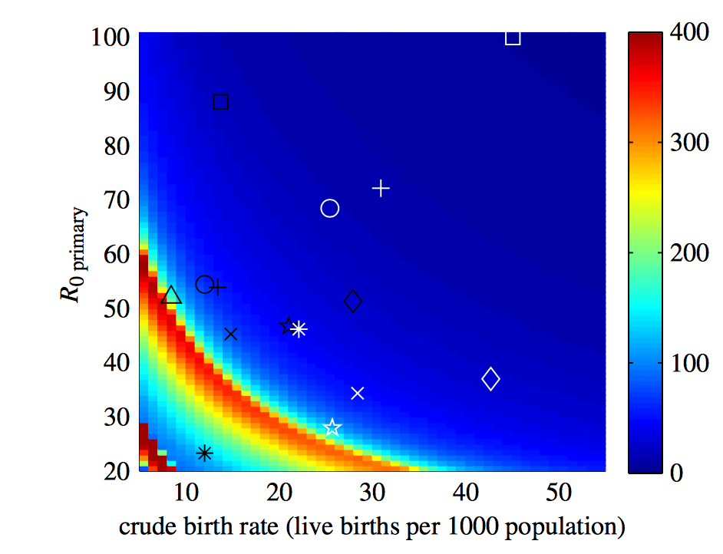
Rotavirus Seasonality
Birth Rates vs. Environmental Factors
Rotavirus typically less seasonal in tropics, where birth rates are high¹
U.S. transmission is seasonal and can be explained by birth rates,² leading researchers to overlook environmental transmission
However, no one unifying explanation for seasonality observed in the developing world³
Degree of Seasonality
¹Pitzer et al., 2011; ²Pitzer et al., 2009; ³Patel et al., 2013
Notes:
Even though some people ignore the role of environmental transmission, the evidence is mixed and it is likely that the role of environmental transmission on disease risk varies by context. In our analysis, we define the contexts in which environmental transmission is likely to be important, which is a major strength of our paper. We are explaining the previously observed geographic heterogeneity. This slide presents what different researchers have said about the topic previously. It is not meant to be a linear progression but rather to show the variety of associations that have been found.
The first and third bullets are not meant to be the same. Patel conducted a multivariate analysis of diarrhea disease worldwide. He found that no single factor adequately appeared to explain the data and postulated that the role of the environment in disease transmission is context specific. He has a figure that shows this result graphically and a table that shows it analytically. Let me know if you would like to add one/both to your presentation. See below for the relevant section of his abstract:
"Among a total of 99 studies representing all 6 geographic regions of the world, patterns of year-round disease were more evident in low- and low-middle income countries compared with upper-middle and high-income countries where disease was more likely to be seasonal. The level of country development was a stronger predictor of strength of seasonality (P = 0.001) than geographic location or climate. However, the observation of distinctly different seasonal patterns of rotavirus disease in some countries with similar geographic location, climate and level of development indicate that a single unifying explanation for variation in seasonality of rotavirus disease is unlikely."
I would also argue that the association that Patel found with development index could be largely mediated or explained by the level of WASH infrastructure (mediated if there is still a direct effect, explained if there is not and development index acts as an instrumental variable...the former is more likely). In our analysis, we see that extremely high levels of intervention will be needed to interrupt transmission in communities with standing water sources. By definition almost all studies on seasonality of rotavirus have been conducted in large cities with built infrastructure which is exactly where we would expect WASH coverage to matter. Less developed countries probably generally have poorer sanitation and water treatment systems in these large cities, so a low development index may just be a proxy for this poor WASH infrastructure.

Slide 17



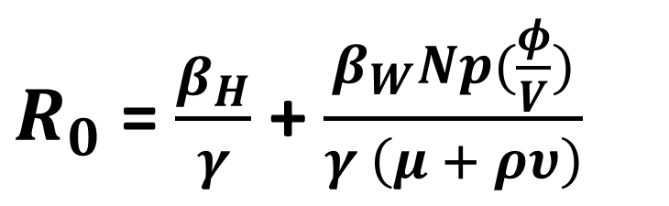














Rotavirus Modes of Transmission
Upstream Community
Downstream Community
$$βh$$
$$βh$$
S1
I1
$$γ$$
R1
S2
I2
$$γ$$
R2
$$βw$$
$$βw$$
$$∅/V$$
$$∅/V$$
W1
$$vp$$
Wi 1
$$vp$$
Wi 2
$$vp$$
Wi, 9
$$vp$$
W2
$$vp$$
…
$$μ$$
$$μ$$
$$μ$$
$$μ$$
$$μ$$
Person-Person
vs.
Person-environ-Person
Transmission
$R_{0}$ = $\frac{β_{H}}{γ}$ + $\frac{β_{W}Np(\frac{φ}{V})}{γ \left(μ + ρυ\right)}$
Kraay et al In Preparation
Notes:
If we believe the time series studies that temperature is important then environment must play a role in transmission
If water is a disseminator then may miss the role of water in traditional Epid studies and QMRA

Slide 18
Rotavirus Modes of Transmission
Water can disseminate and amplify infection
Water can amplify disease in standing water (cities)
Effect is temperature dependent
Water can disseminate infection between communities when:
Overall R₀ > 1 (from both water and human transmission)
Rate of flow is faster than decay (all temperatures)
 | Direct Transmission
Water Transmission | Low R_{0,H}<1 | High R_{0,H}>1
High Concentration R_{0,W}>1 | Yes | Yes
Low Concentration R_{0,W}<1 | No | Yes
Decay Rate (/day)
Environmental attenuation

Slide 19
Temperature and Rotavirus Risk
Increased temperature result in decreased risk of infection
Greater temperature effects occur for low person-person transmission
0.1-2.7% per °C
Consistent with prior meta-analyses:
1-10% decrease in risk per °C

