Slide 1
Beyond reversion: evolutionary epidemiology of vaccine-derived poliovirus transmission
Mike Famulare
Senior Research Scientist, IDM
IDM Symposium 2018

Slide 2
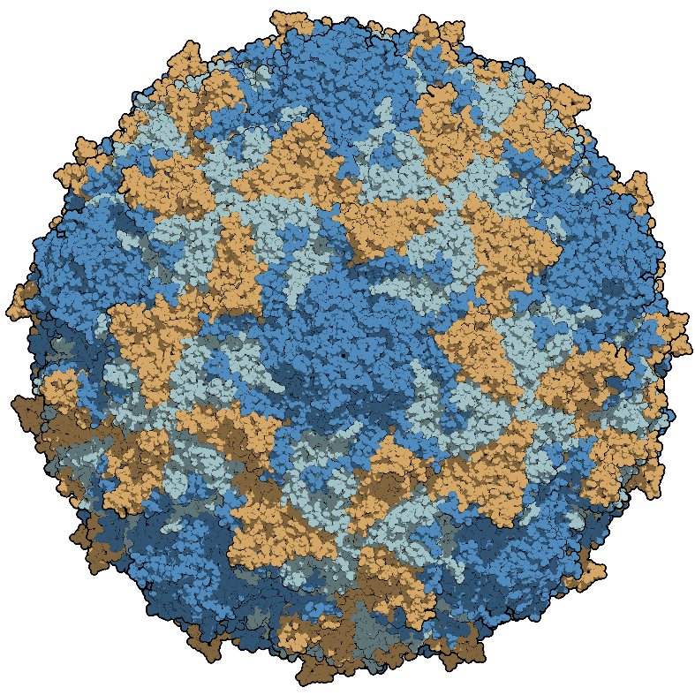
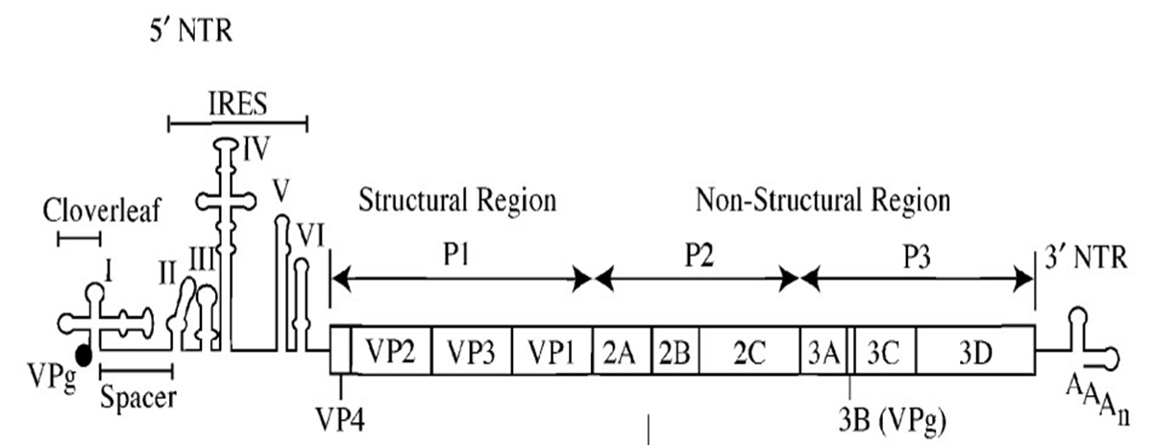
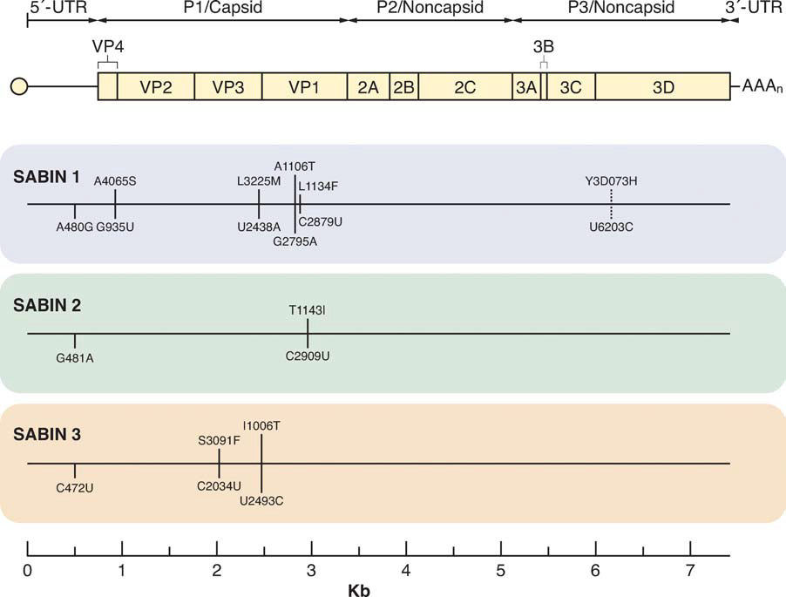
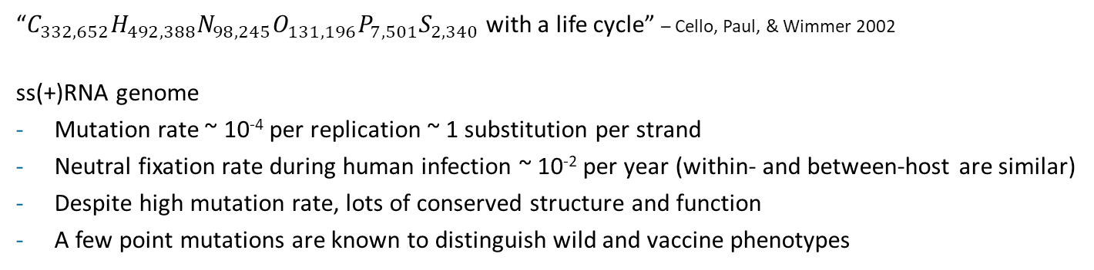
A quick poliovirus primer
from De Jesus 2007
Kew et al 2005
upload.wikimedia.org/wikipedia/
commons/b/bc/Polio-3-chains.png
“$C_{332,652}H_{492,388}N_{98,245}O_{131,196}P_{7,501}S_{2,340}$ with a life cycle” – Cello, Paul, & Wimmer 2002
ss(+)RNA genome
Mutation rate ~ 10⁻⁴ per replication ~ 1 substitution per strand
Neutral fixation rate during human infection ~ 10⁻² per year (within- and between-host are similar)
Despite high mutation rate, lots of conserved structure and function
A few point mutations are known to distinguish wild and vaccine phenotypes

Slide 3
Poliovirus phenotypes in people
WPV
iVDPV
cVDPV
Transmission
aVDPV
Within-host fitness
WPV
Sabin-like
iVDPV
aVDPV
cVDPV
Sabin
Sabin-like
Sabin
Virulence
Virulence
Genetic classification | WPV | Sabin | Sabin-like | cVDPV | iVDPV | aVDPV
Epidemiology | Circulating wild type | Vaccine | Shed after vaccination | Circulating vaccine-derived | Chronic shedding of vaccine from immunocompromised people | Ambiguous vaccine-derived (could be cVDPV, iVDPV, or Sabin-like)

Slide 4
cVDPV is a weird zoonosis
The Sabin vaccine strains are cold monkey kidney polioviruses.
Person-to-person transmission plays no role in the survival of Sabin polioviruses.
Millions of people are exposed to OPV every year.
Sabin polioviruses transmit less effectively than WPV and rarely cause disease.
But roughly every one in 100 million exposures over the last 20 years has lead to cVDPV emergence, which are often phenotypically WPV reborn.

Slide 5
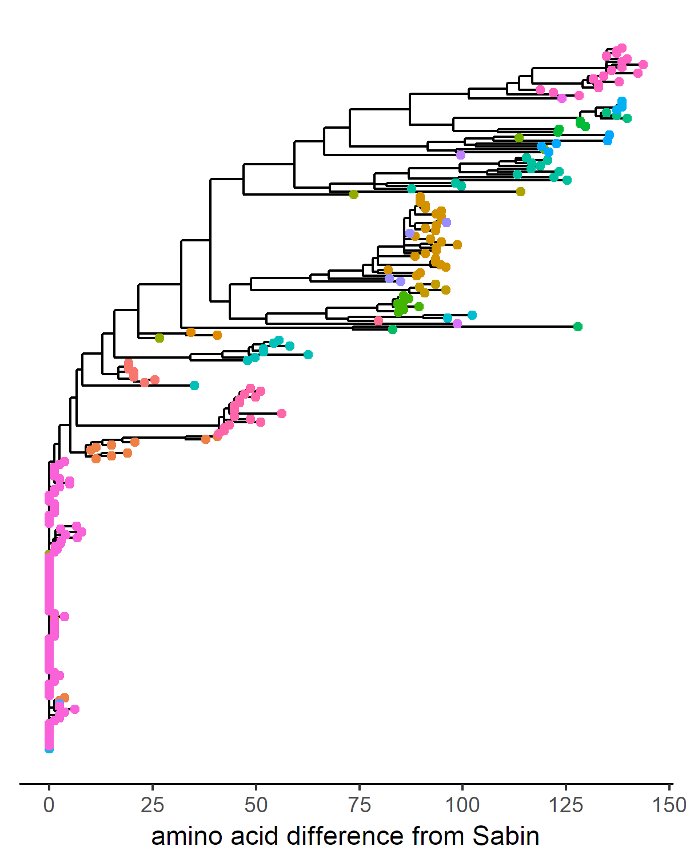
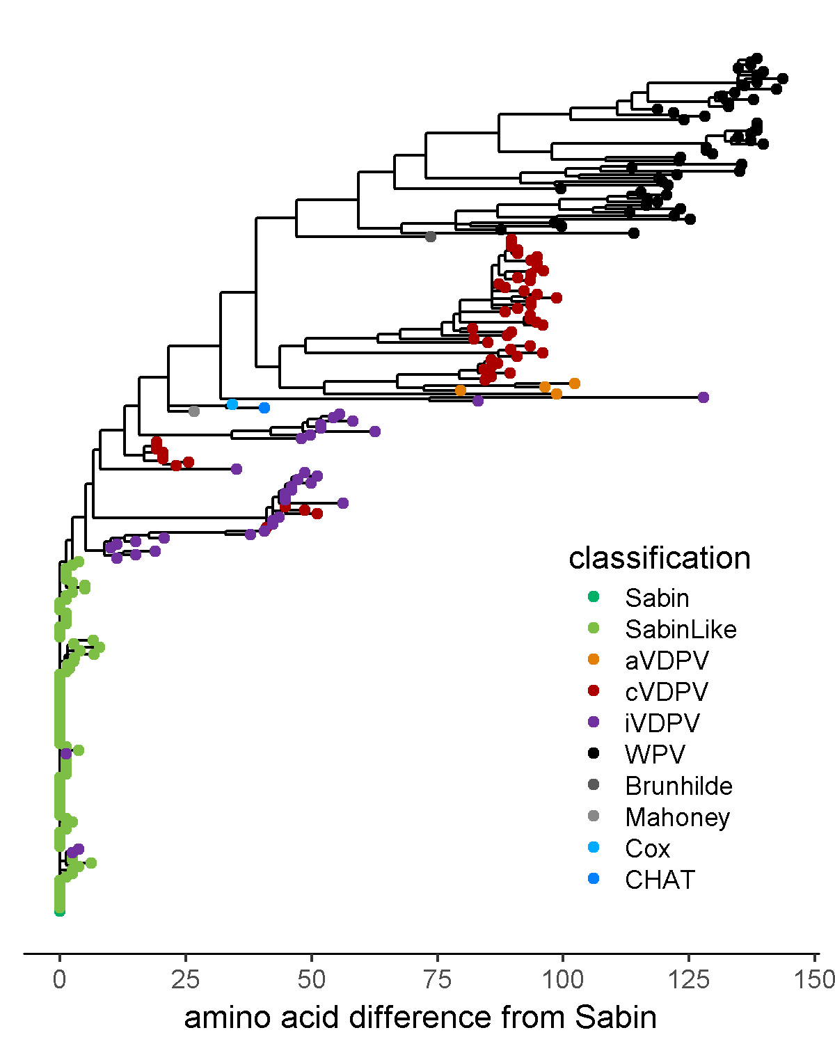
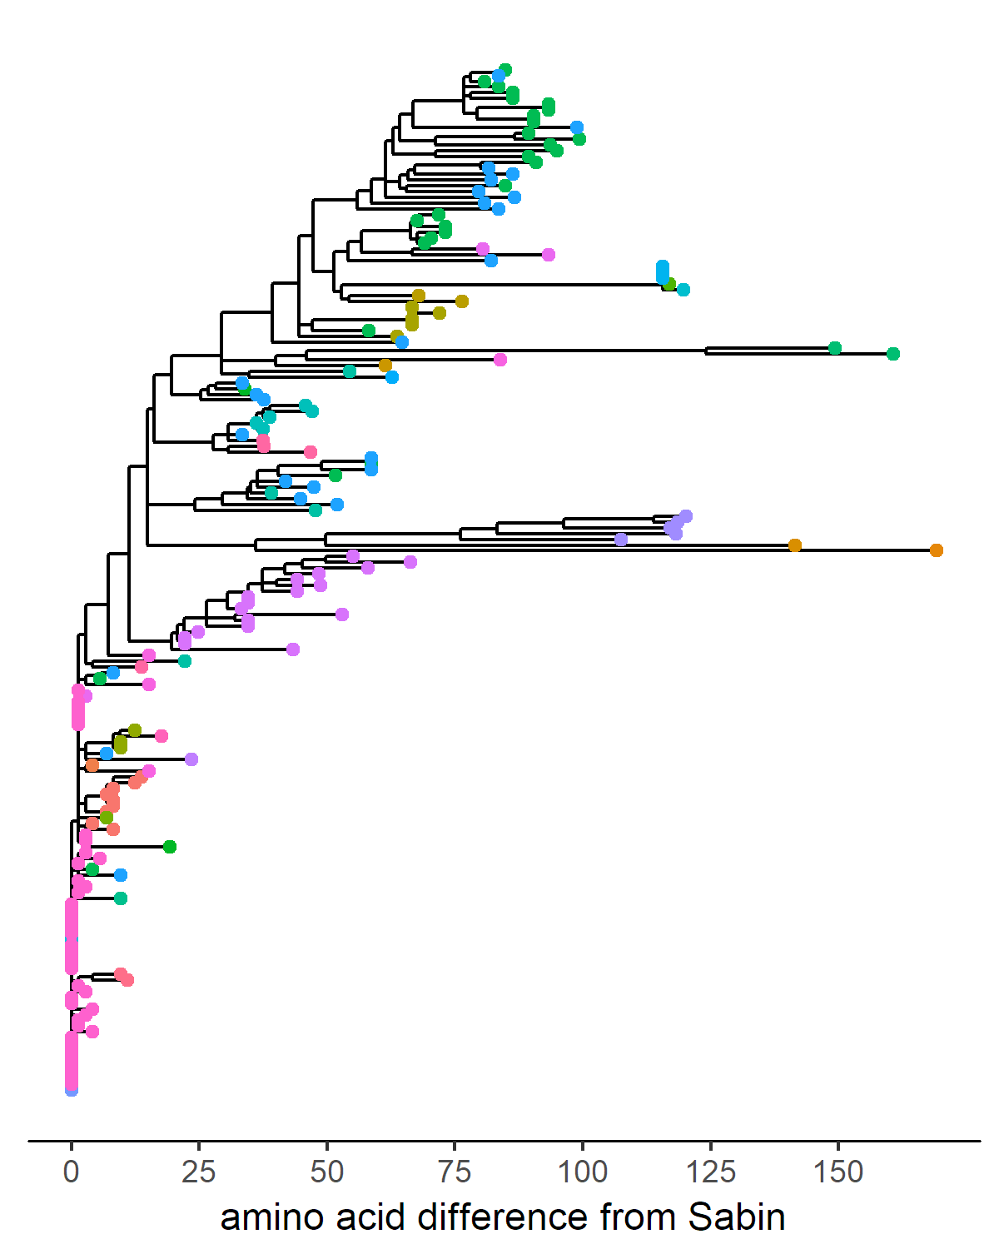
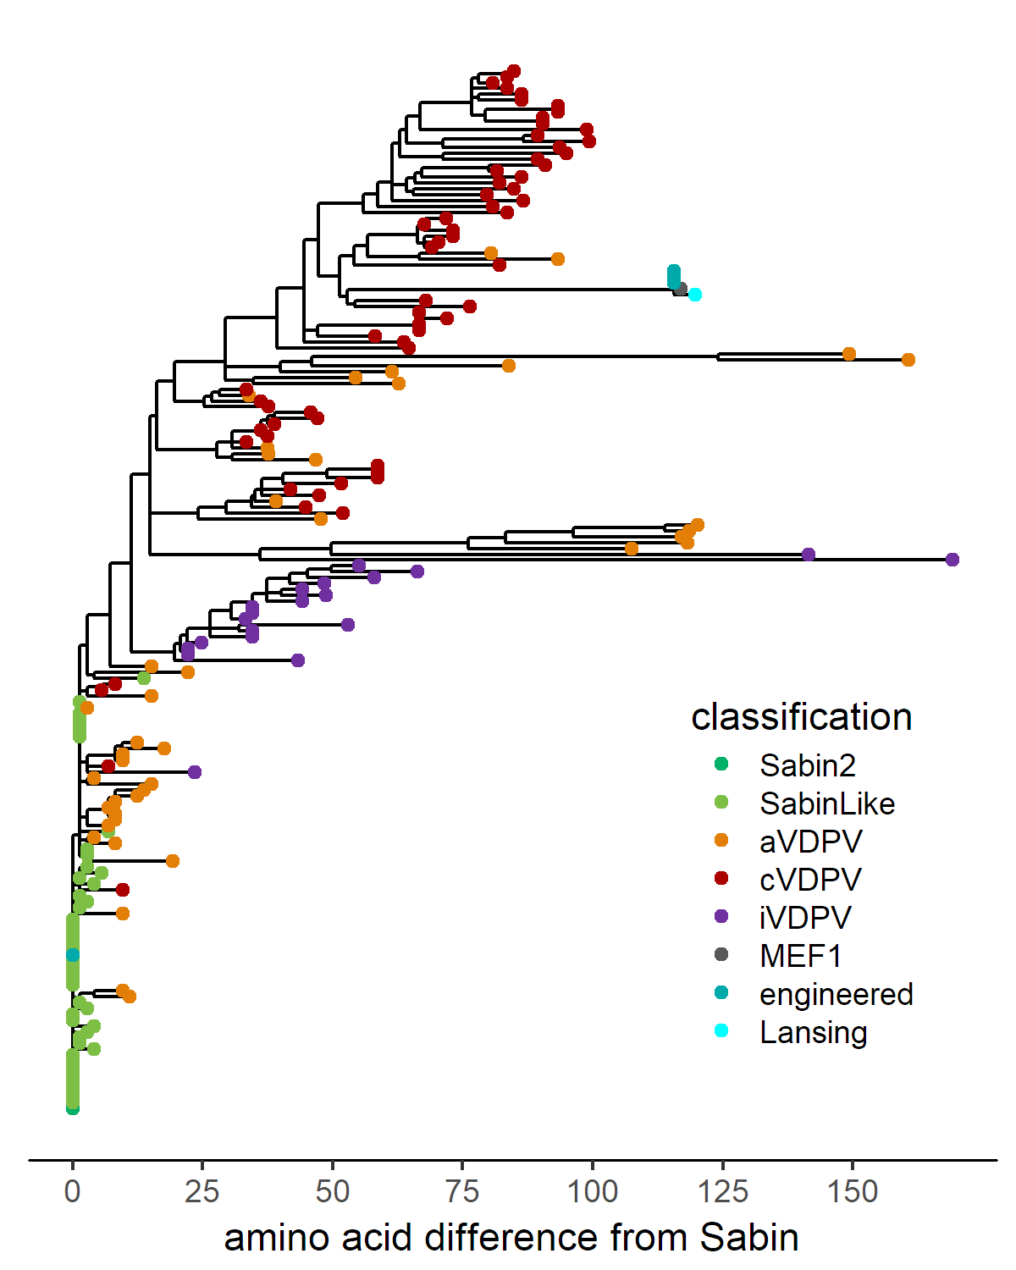
Many tests of poliovirus evolution in Genbank
Type 1
amino acid sequences
whole coding region
Type 2
amino acid sequences
whole coding region
WPV

Slide 6
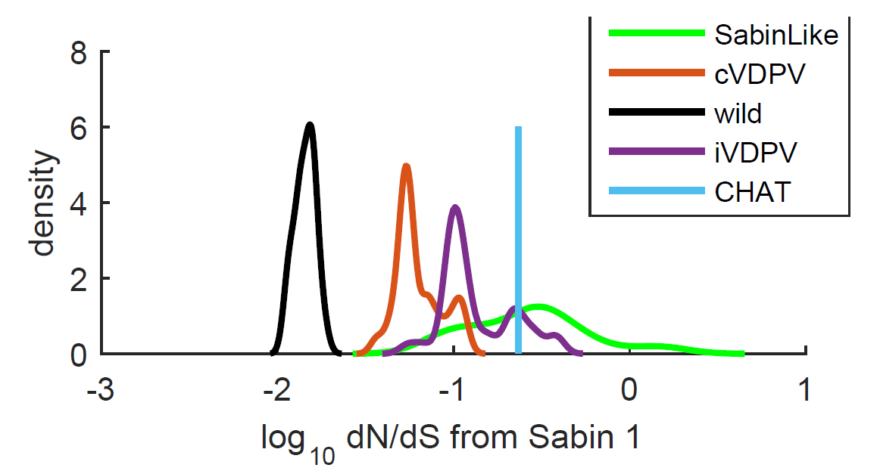
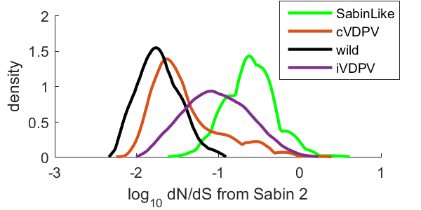
Higher dN/dS is less often associated with transmission!
Type 1
Capsid polyprotein (P1)
Type 2
Capsid polyprotein (P1)
WPV has very few non-synonymous changes from Sabin!
Sabin-likes explore a lot of sequence space.
Sequences plus epidemiology suggests that non-reverting, non-synonymous mutations may reduce transmissibility while increasing within-host fitness.

Slide 7
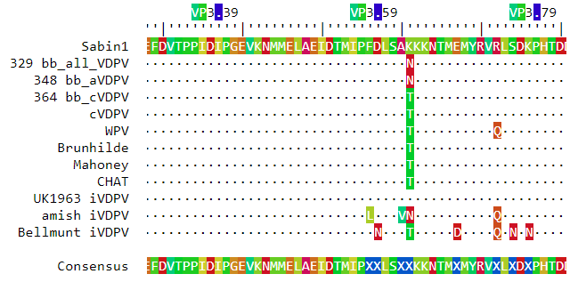
Antigenic variation is less often associated with transmission!
VP3-40 VP3-60 VP3-80
Type 1
amino acid sequences
whole coding region
Despite widespread population immunity, WPV and cVDPV have stable antigenicity within a narrow region in sequence space.
And yet, much broader antigenic variation is typical in immuno-compromised carriers.
`

Slide 8
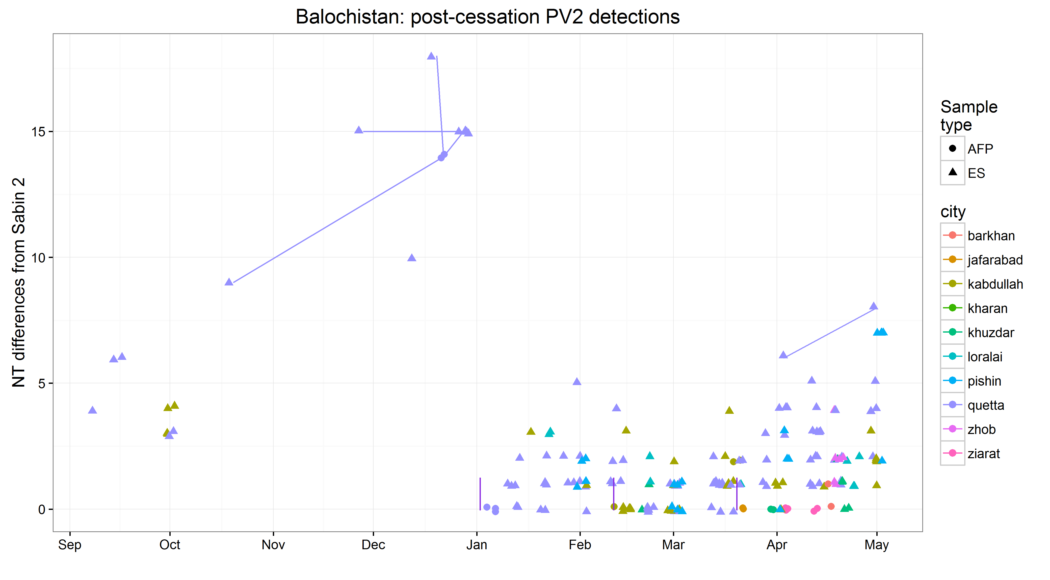
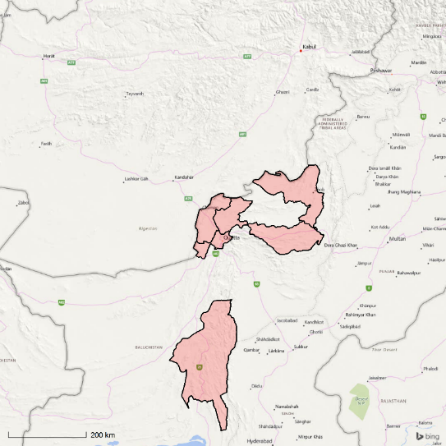
Changes in surveillance and vaccination policy are letting us watch poliovirus population genetics in the field for the first time.
*
Courtesy of Department of Virology,
National Institute of Health, Pakistan.
* VP1 only

Slide 9
What do I think we know now?
Multiple evolutionary pathways reveal within-host and between-host fitness trade-offs.
Virulence and transmissibility are different phenotypes.
VDPV evolution violates textbook expectations about phylogenetic correlates of increased transmissibility.
For poliovirus, antigenic variation and high dN/dS are anti-correlated with transmission.
We should not be glib when interpreting phylogenies of emerging pathogens for which little is known.
The transition from Sabin to cVDPV is not simply a matter of reverting neurovirulence attenuation.
There is a complex population genetics process embedded in complex transmission dynamics.
Polio program is exploring the utility of incorporating dN/dS in risk assessment.

Slide 10
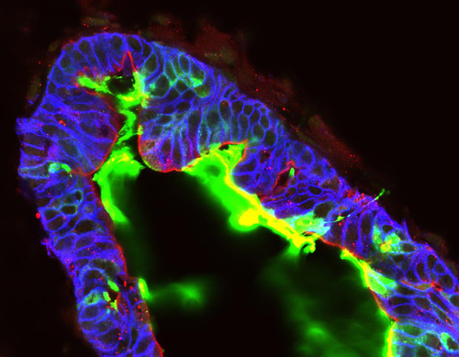
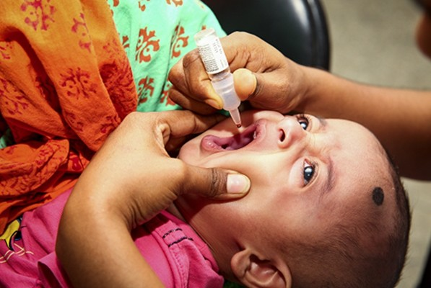
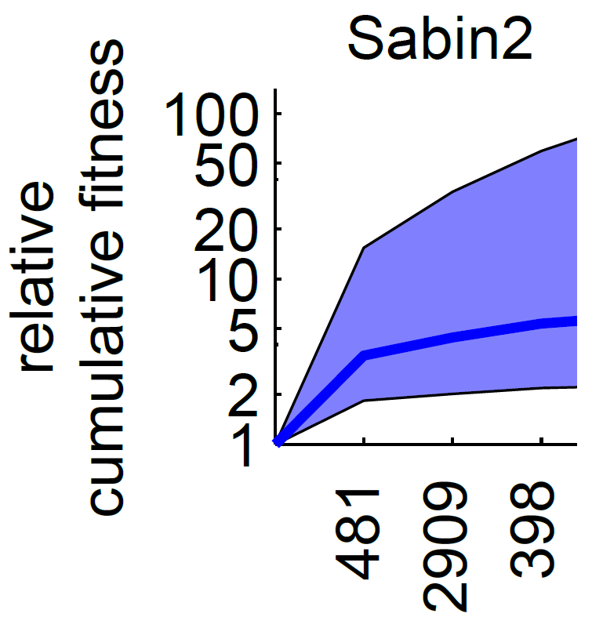
What’s next?
Test causal hypotheses and build models!
Construct evolutionary intermediates and measure infectivity and replication in human intestinal organoids and mice (collaboration with Adam Lauring)
Sequence recent Sabin 2 transmission study (collaboration with Mami Taniuchi (UVA), K Zaman (icddr,b), and A Lauring (UMich))
Model post-campaign surveillance data (want to collaborate?)
Model within-host population genetics (want to collaborate?)
Polio policy questions:
What does this mean for iVDPV containment policy?
Why have cVDPV emergences have only have only occurred at rates of one per 100 million doses and will that change after eradication?
How would a new OPV with altered evolutionary dynamics behave in large populations?
www.jasonspencelab.com/
Courtesy of Mami Taniuchi (UVA)

Slide 11
Thanks!
IDM
Guillaume Chabot-Couture
Hao Hu
Hil Lyons
Kevin McCarthy
Steve Kroiss
Laina Mercer
Bradley Wagner
Joel Miller
Edward Wenger
(former IDM)
Philip Welkhoff (BMGF)
Matthew Behrend
Alex Upfill-Brown (UCLA)
Christian Selinger (MIVEGEC)
University of Virginia
Mami Taniuchi
William Petri
icddr,b
Rashidul Haque
K Zaman
Mohammad Yunus
University of Michigan
Adam Lauring
Jim Koopman
Global Polio Eradication Initiative
NIH, Pakistan
Cessation Risk Task Team
Global Polio Laboratory Network
China National Polio Laboratory
US CDC
BMGF
John Modlin
Ananda Bandyopadhyay
Arie Voorman
Jay Wenger

