Slide 1
Investigating 3 epidemics of invasive Salmonella disease in Blantyre, Malawi
Notes:
Talk about the piecemeal approach we have previously taken to modelling and how we are trying to join the methodologies up

Slide 2
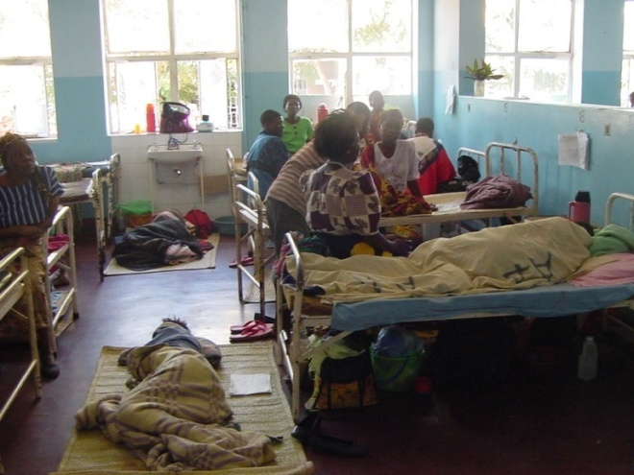
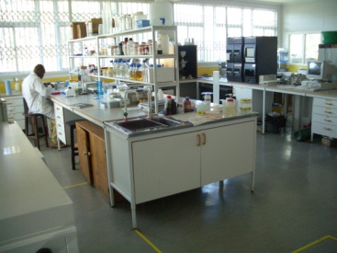
Malawi Liverpool Wellcome Trust Clinical Research Programme (MLW) at Queen’s Hospital, Blantyre, Malawi Longitudinal bacteraemia surveillance since 1998
Notes:
Brief descrtipion of MLW, Blantyre and Malawi

Slide 3
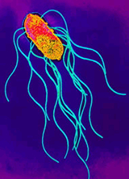
Salmonella serovars and syndromes – a simple (clinician’s) perspective
Enterobacteriaceae
Shigella
Shigella
Salmonella
E. coli
S. bongori
S. enterica
Typhimurium
Enteritidis
Paratyphi A
Typhi
Non-typhoidal, NTS
Broad host range
Gut / local disease
5-8% cases invasive
0.1% mortality
Typhoid or enteric fever
Human restricted
Systemic disease
(always invasive)
20% mortality

Slide 4
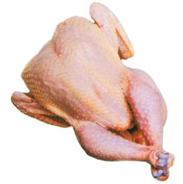
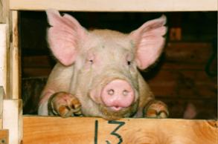
NTS in high income countries
Transmission ~85% food borne
Most clinical infections cause self limiting diarrhoea
94 million cases/year (Majowicz CID 2010)
155,000 deaths
Supportive treatment (no antibiotics) normally adequate
“Sepsis” uncommon ~ 5% cases

Slide 5
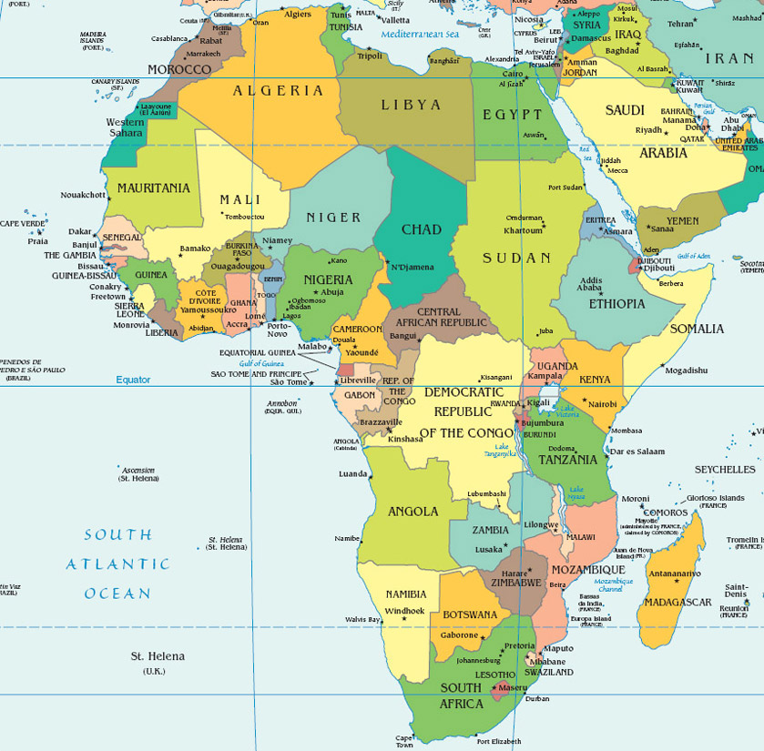
Paediatric iNTS disease in Africa: pre/early HIV era
Gambia 1980s
Mabey, JID
Kenya 1980s
Wamola, E Afr Med J
Nigeria, 1970s
Alausa, Scand J Infect Dis
Rwanda, 1980s
Le Page, Lancet
DRC 1980s
Green, Ann Trop Paeds

Slide 6
HIV & iNTS disease
Recurrent “Salmonellosis” (BSI) was one of the first AIDS defining illness
HIV infected patients ~200x more likely to get iNTS disease (NY USA)
Any NTS BSI = WHO Stage IV condition
Declined in industrialised countries following roll-out of ART
Clumeck et al,
Lancet, March 19, 1983: 321; 642

Slide 7
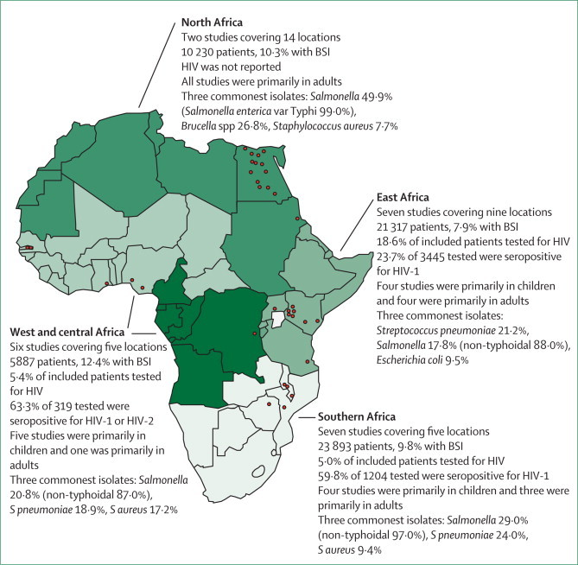
Bloodstream infection in Africa
Reddy et al, Lancet Infect Dis 2010:10;417-32
Notes:
Only about 60,000 patients in total
As a consequence, bloodstream invasive disease is neglected and with it AMR
NB – Typhoid not common in sub-Saharan Africa in this study

Slide 8
3 epidemics of multidrug resistant* Salmonella in Malawi
*MDR = resistant to 3 or more agents
Feasey CID 2015
Notes:
3 epidemics of MDR iSalmonella
E.Coli and Klebsiella data: invasive Salmonella should not be though of in isolation

Slide 9
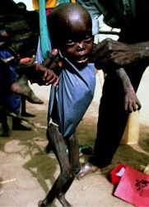
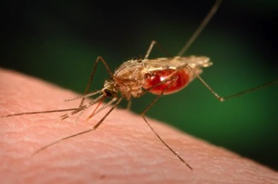
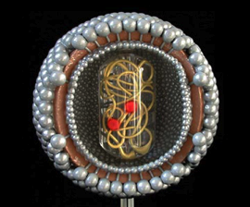
iNTS in Sub-Saharan Africa
BSI or iNTS disease common
Vast majority Typhimurium or Enteritidis
Adults with severe HIV
Children with
HIV
Malaria
Malnutrition

Slide 10
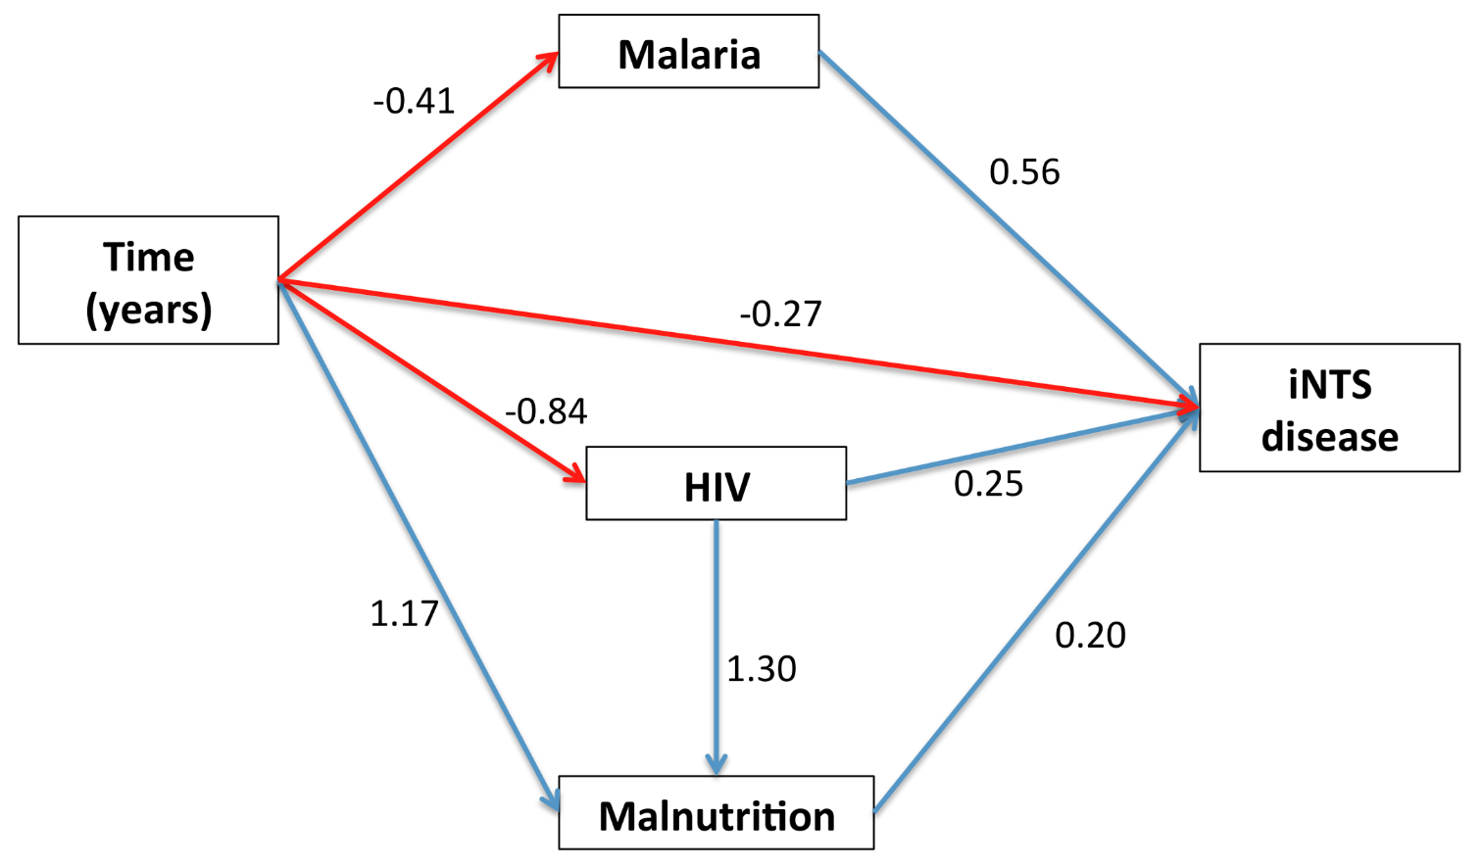
Structural equation model of risk factors for iNTS disease, Blantyre – Seasonality smoothed
Feasey PLoS NTDs 2015

Slide 11
Mortality high, recurrence common: iNTS disease in Malawi pre-ART roll-out
1.00
Inpatient mortality | 47%
1 year mortality | 77%
HIV positive | 98%
Recurrence | 43%
Multiple recurrences | 26%
0.75
47% inpatient mortality
0.50
0.25
0.00
0
200
400
600
1.00
0.75
43% survivor recurrence
0.50
0.25
0.00
0
200
400
600
Gordon AIDS 2002

Slide 12
Global burden of invasive nontyphoidal Salmonella disease, 2010
Age group-specific, population-based invasive nontyphoidal Salmonella (iNTS) incidence data obtained
Data were categorized by HIV and malaria prevalence and then extrapolated by using 2010 population data
Case fatality determined by expert opinion
Estimated 3.4 million cases/year
58% in Africa
CFR of 20% yielded 681,316 deaths (range 415,164-1,301,520)
Ao et al EID 2015

Slide 13
Spectrum of NTS disease
“Textbook” NTS
Self-limiting diarrhoea predominates
Sepsis uncommon and frequently follows diarrhoeal episode
Animals are the reservoir
Transmission follows consumption of contaminated food
Sub Saharan African iNTS
Bacteraemia without enterocolitis common
High mortality & frequent relapse
Impossible to diagnose from clinical syndrome
Reservoirs and transmission unknown
Feasey Lancet 2012 ; Feasey EID 2010; Gordon AIDS 2002

Slide 14
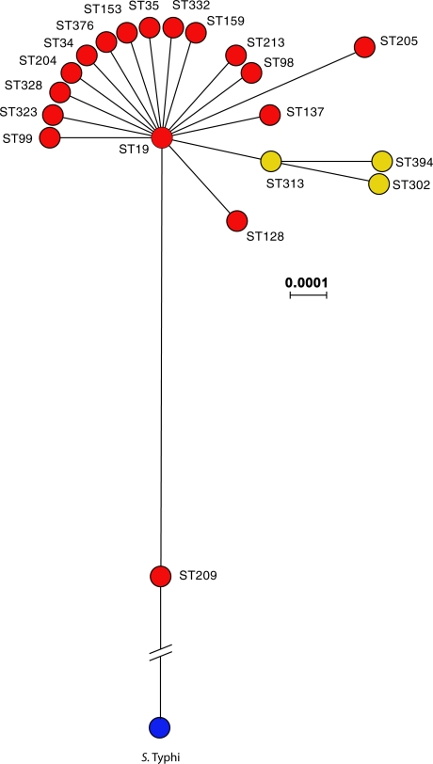
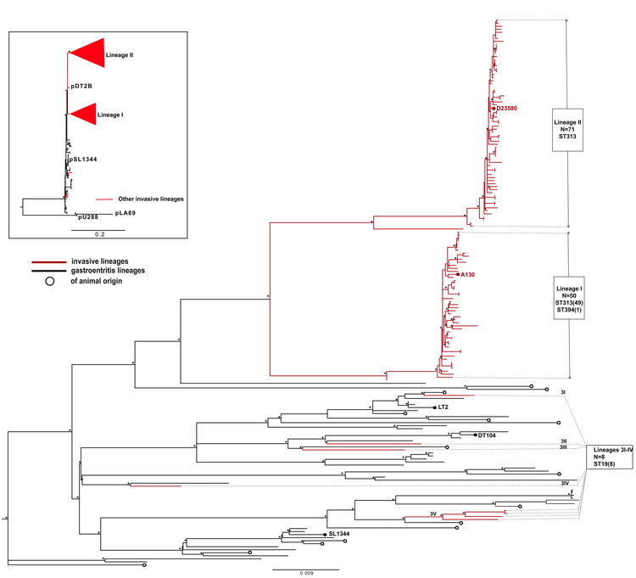
Susceptible host or novel pathogen?
Msefula et al Gen Res 2009
Okoro et al Nat Gen 2012

Slide 15
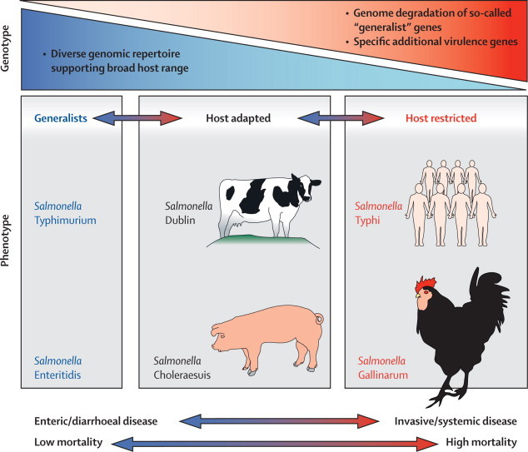
Are ST313 more invasive or just Salmonellae prevalent in Africa?
Feasey Lancet 2012

Slide 16
Outstanding questions
What are the environmental reservoirs of African clades of Salmonella?
What are the relative ratios of the different serovars?
What contributions do the different serovars make to mortality?
Niche vs ‘invasiveness’
Can African clades cause gastroenteritis?

Slide 17
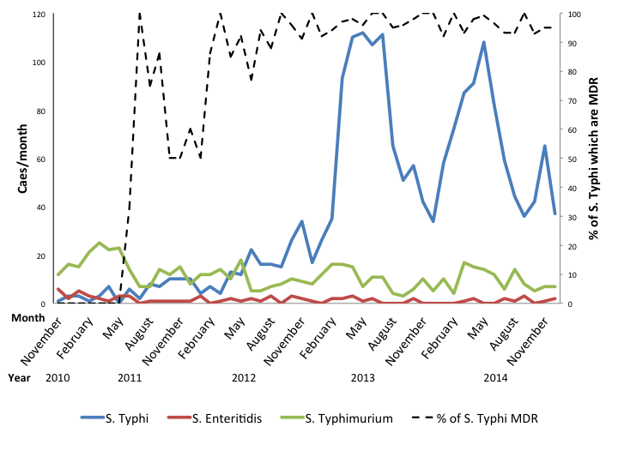
Current work – investigation of Typhoid epidemic
Feasey CID 2015
Notes:
3 epidemics of MDR iSalmonella
E.Coli and Klebsiella data: invasive Salmonella should not be though of in isolation

Slide 18
Modelling the transmission of S. Typhi in Blantyre
Cohort study
Define clinical outcomes
Identify hotspots within Blantyre using GPS
Case control study – identify risk factors, plus health care utilization survey to put hospital attendance into context
Build transmission tree using BEAST* based on:
Whole genome sequence data
Spatial data
Date of isolation
*Bayesian Evolutionary Analysis Sampling Trees Drummond Molecular Biology and Evolution 2012

Slide 19
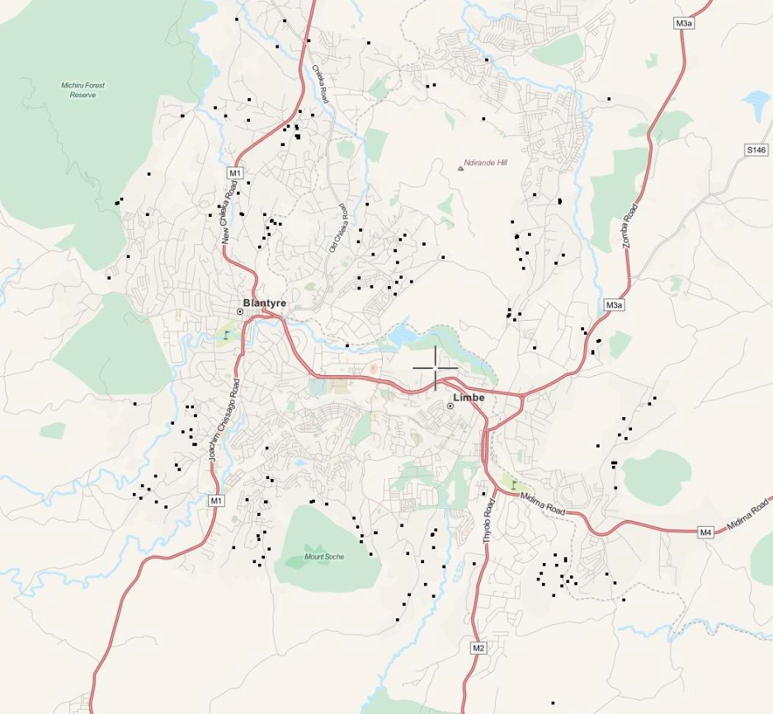
1. Create an app for determining GPS coordinates
ESA satellite HR photo of Blantyre
250 points of interest around Blantyre identified and validated
Patients can identify homes/water sources from photo
GPS coordinates generated in hospital
Notes:
More on current study
Number of patients
Surgical pts

Slide 20
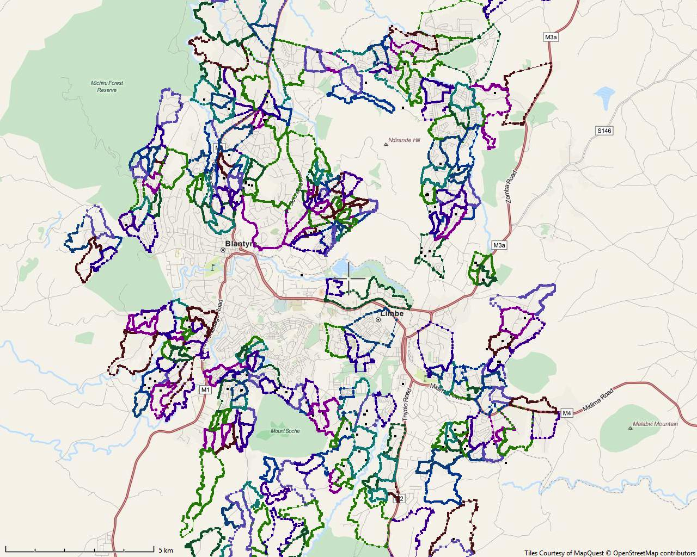
2. Improved demography in Blantyre
Blantyre divided into 250 health surveillance areas
Boundaries demarcated using GPS machines
Household count and composition conducted

Slide 21
3. Patients recruited on the basis of positive blood culture following admission to Queen’s
157 cases mapped
Hot spots and ‘cold’ spots emerging
Water sources collated, but signal less clear
Early suggestion low lying housing more heavily affected
Notes:
More on current study
Number of patients
Surgical pts

Slide 22
4. Whole genome sequencing of isolates and BEAST analysis
“Here’s one I made earlier” - Global dissemination of S. Typhi H58
Emerged ~30 years ago
Fiji
Recent epidemics reported:
Uganda
Malawi
Zimbabwe
Zambia
Wong et al Nat Gen 2015
Notes:
H58 appeared to have emerged approx 30 years ago
Major routes for global dissemination depicted on world map

Slide 23
Future work
Environmental sampling for S. Typhi in Blantyre
Need to optimize current approaches to culture
Spatial modelling to identify urban features associated with reservoirs of S. Typhi
WASH interventions to augment (proposed) vaccination strategies

Slide 24
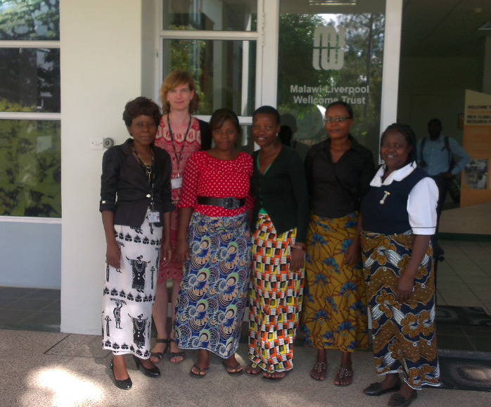
Thank you!
Franziska Olgemöller Pilirani Kachulu
Witness Mtambo Roselyn Mussa
Pamela Kamanga Rose Nkhata

