Slide 1

Characterizing the within-host spatial structure of Simian-HIV drug resistance evolution
Institute for Disease Modeling Annual Symposium
April 17, 2018
Alison Feder
Stanford University

Slide 2


Slide 6
Does the HIV population within a body look like a well-mixed population?
Mostly yes
Sometimes
Mostly no
Imamichi, et al., 2011
Lerner, et al., 2011
Vanderford et al., 2011
Evering, et al., 2012
Kearney, et al., 2015
Poss et al., 1995
Poss, et al., 1998
Kemal, et al., 2003
Tirado, et al., 2004A
Tirado, et al., 2004B
Philpott, et al., 2005
Overbaugh, et al, 1996
Si-Mohamed, et al., 2000
Bull, et al., 2009
Kelley, et al., 2010
Chaudhary et al., 2011
Bull, et al., 2013
van Marle, et al., 2007
Lerner, et al., 2011
Potter, et al., 2003
Potter, et al., 2004
Fulcher, et al., 2004
Delobel, et al., 2005
Josefsson et al., 2013
Boritz et al., 2016
Barnett et al., 1991
Zhang, et al., 2002
Van Marle, et al., 2010
Lewis, et al., 2013
Rozera, et al, 2014
Vanderford et al., 2011
Wang, et al., 2000
Potter, et al., 2006
Rozera, et al., 2014
Josefsson et al., 2013
Kearney, et al., 2015
Boritz et al., 2016
Vanderford et al., 2011
Heeregrave et al, 2003
Haddad et al., 2000

Slide 7

$$F_{ST}= \frac{π_{between} − π_{within}}{π_{between}}$$

Slide 8
What is actually going on inside a patient?

Slide 9

Viral load (log)
Treatment
0
5
10
15
20
25
Weeks Post-Infection
Infected with RT-SHIV
Plasma
Lymph Node
Gut
PBMC
Vagina
Data from Feder et al, PLoS Pathogens (2017)
Notes:
SIVmne027

Slide 10
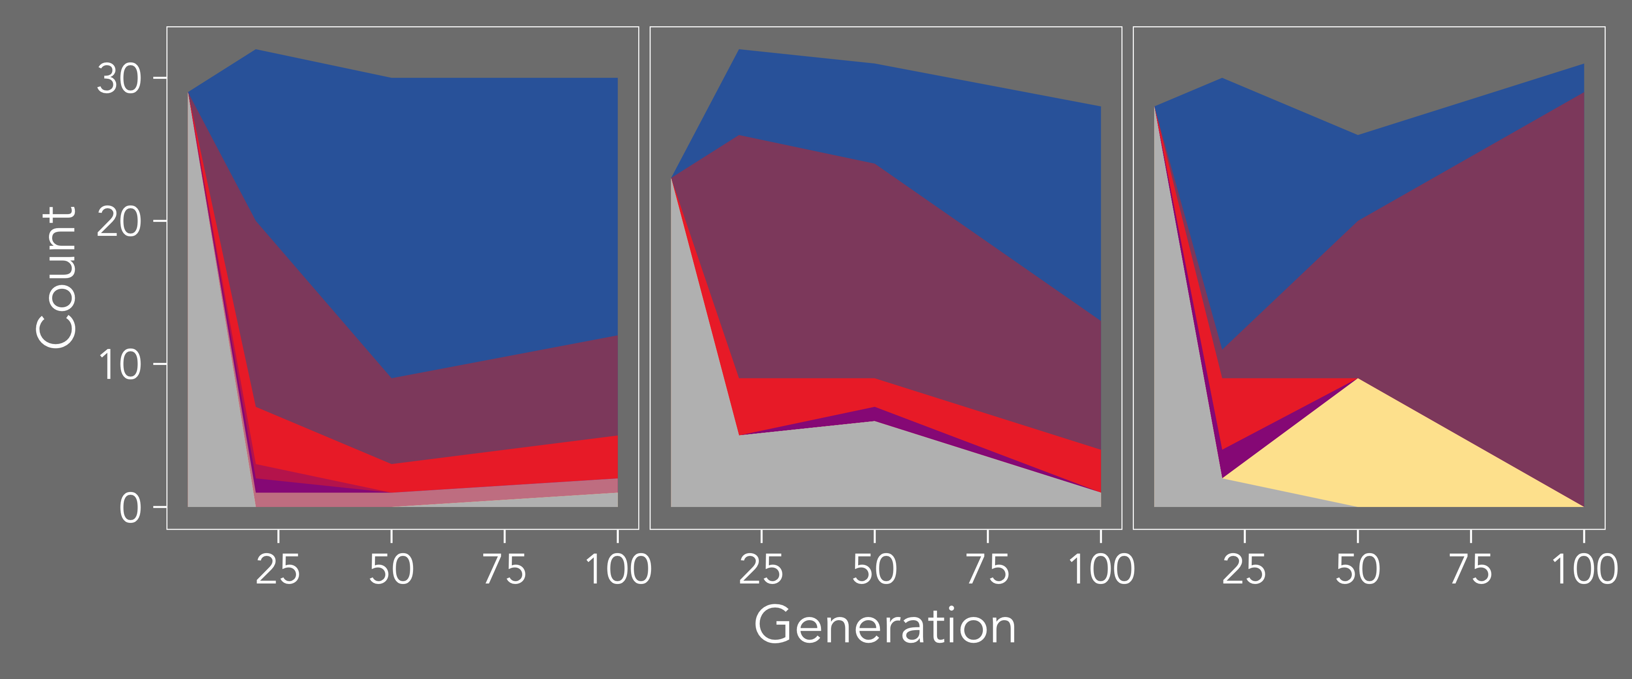
Plasma
Lymph Node
Gut
M184V
M184V+N255N
-WT
M184I
Generation
Generation
Mutation, selection and migration are apparently strong
Data from Feder et al, PLoS Pathogens (2017)

Slide 11
What regime of population genetic parameters can create these patterns?

Slide 12
Frequency of allele
in population A
f_{l}(t)
f _{nl}(t)
f’ _{nl}(t) = m (f_{l}(t)–f_{nl}(t)) + s (1 – f(t))f(t)
f(t)
f (t)
s
Force of migration
Force of selection
f_{nl}(t)
m
f _{nl}(t)
1
f_{nl}(0)
1
Frequency of allele
in population B
= + ( - ) e^{-2mt}
f(t)
2
f(0)
2
s

Slide 13
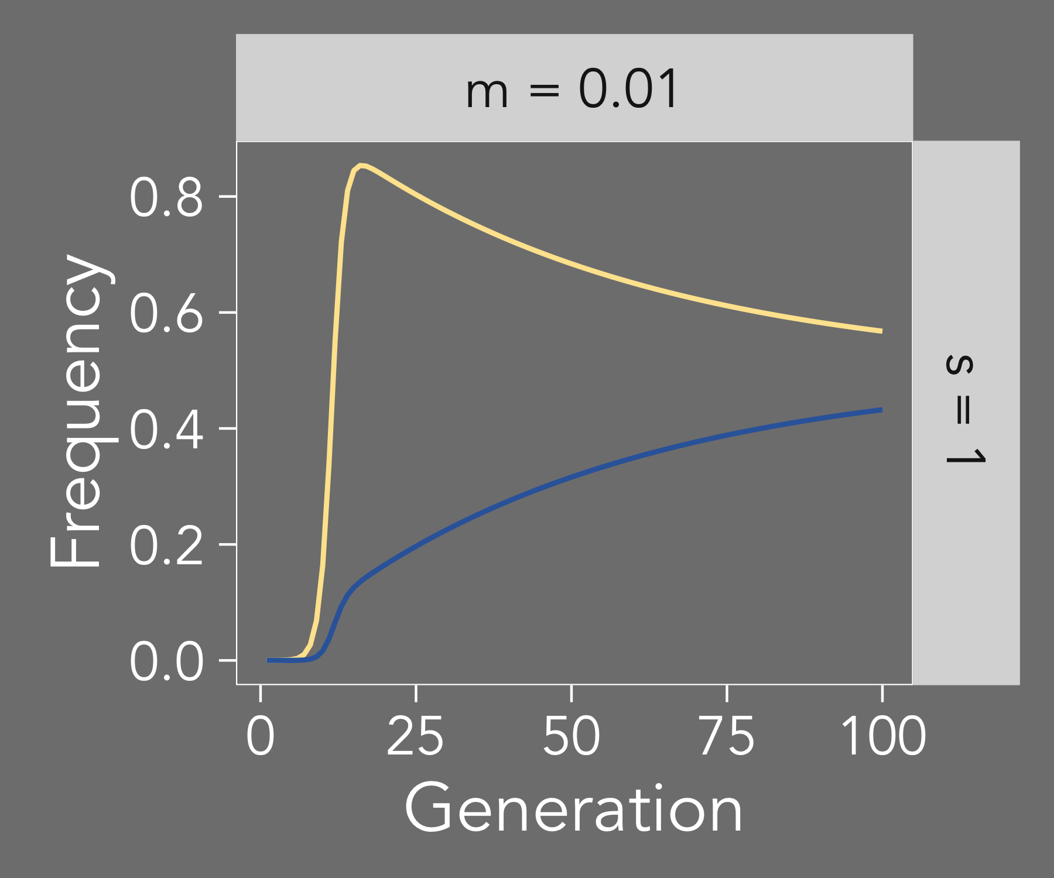
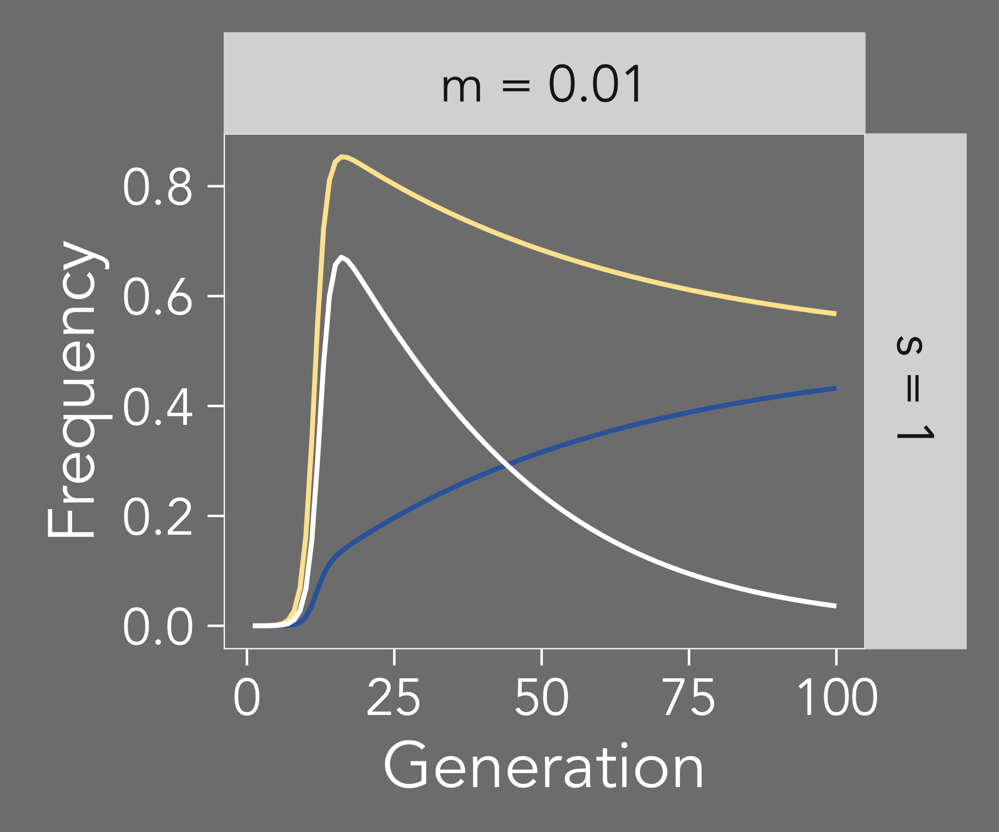
f_{l}(t)
F_{ST}
f_{nl}(t)

Slide 14
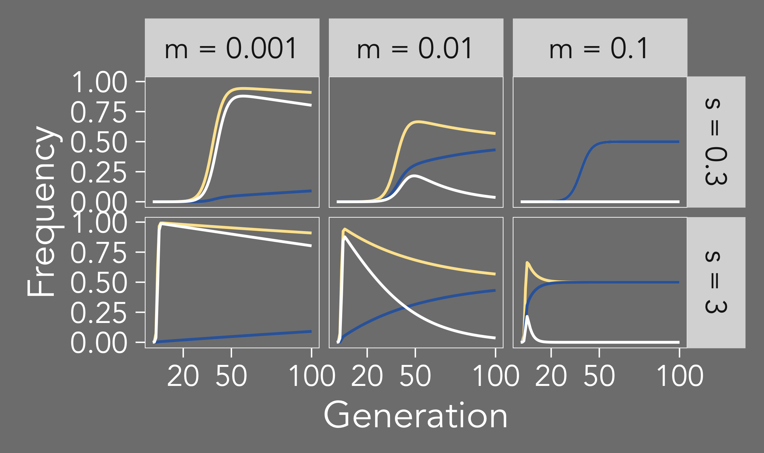
F_{ST}
f_{nl}(t)
f_{l}(t)
Patterns of population differentiation are diverse under strong selection and migration

Slide 15
Can we exploit these patterns to estimate parameters from data?

Slide 16
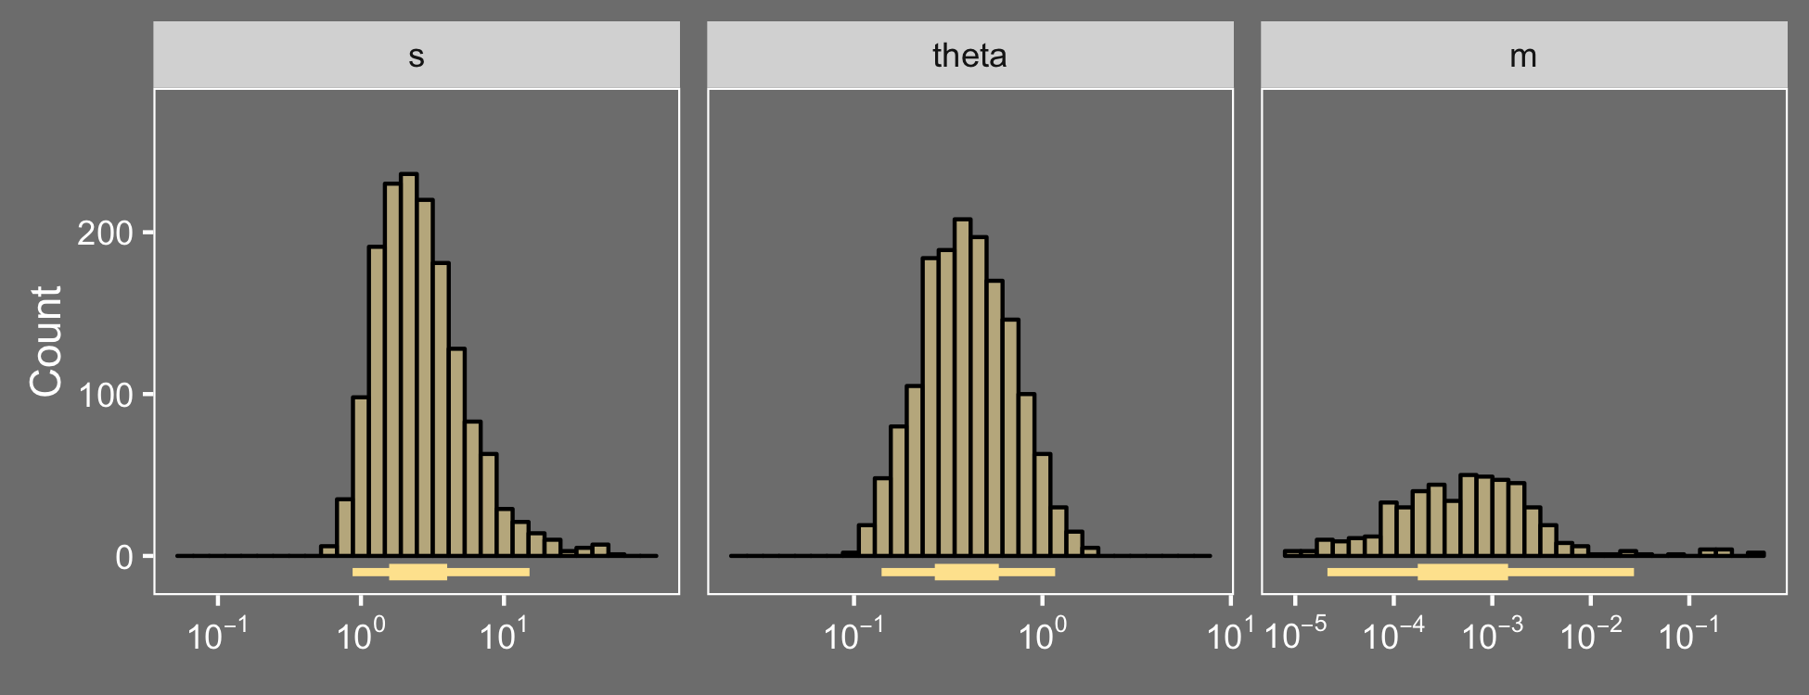
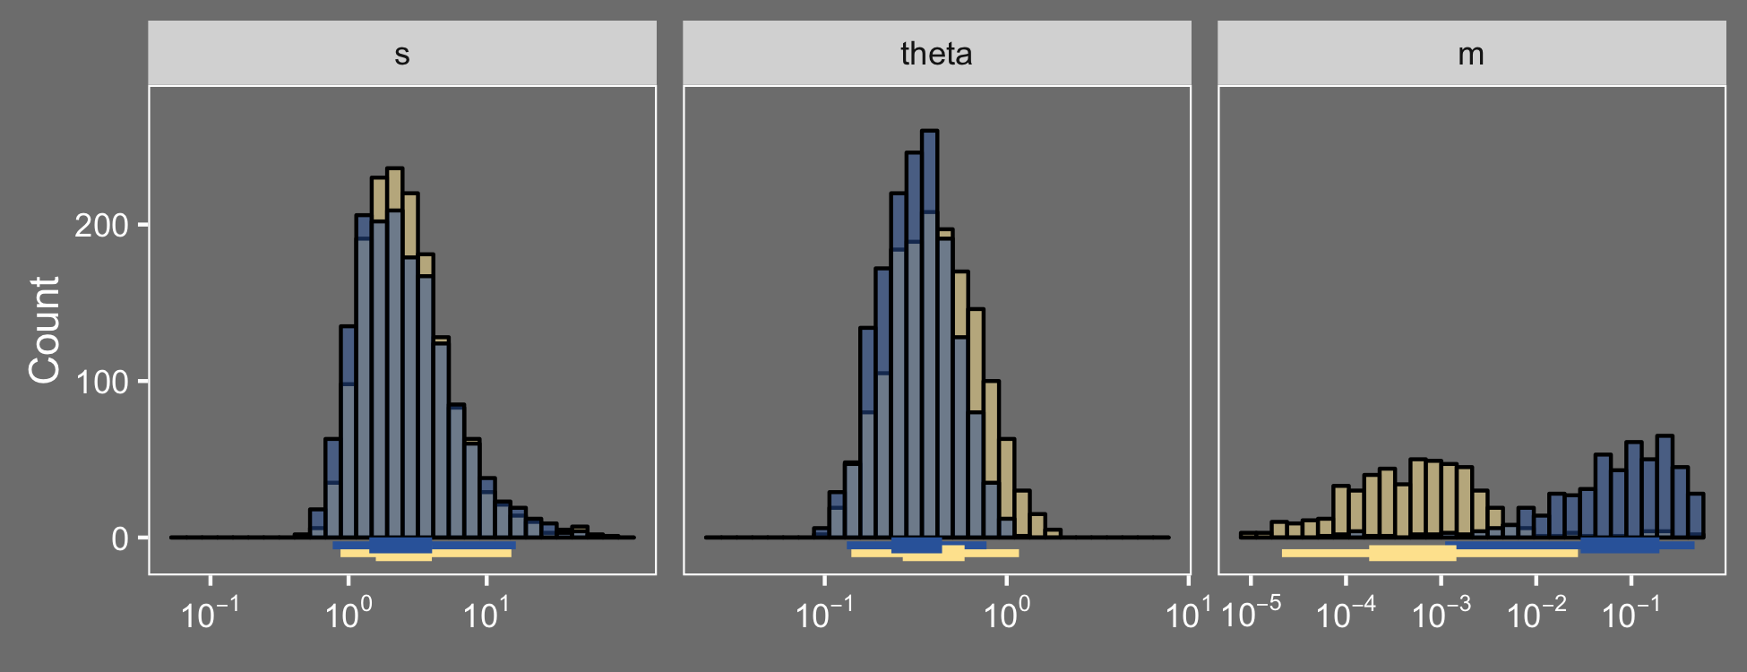
Population mutation rate
Selection strength
Migration probability
Plasma v. Gut
Plasma v. LN
Count
s
Nμ
m
Migration rates are fast and vary between tissue types

Slide 17
Does the HIV population within a body look like a well-mixed population?
Mostly yes
Sometimes
Mostly no
Blood v Female Genital Tract
Imamichi, et al., 2011
Lerner, et al., 2011
Vanderford et al., 2011
Evering, et al., 2012
Kearney, et al., 2015
Overbaugh, et al, 1996
Si-Mohamed, et al., 2000
Bull, et al., 2009
Kelley, et al., 2010
Chaudhary et al., 2011
Bull, et al., 2013
Poss et al., 1995
Poss, et al., 1998
Kemal, et al., 2003
Tirado, et al., 2004A
Tirado, et al., 2004B
Philpott, et al., 2005
Blood v Gut
Heeregrave et al, 2003
Josefsson et al., 2013
Kearney, et al., 2015
Boritz et al., 2016
Barnett et al., 1991
Zhang, et al., 2002
Van Marle, et al., 2010
Lewis, et al., 2013
Rozera, et al, 2014
Vanderford et al., 2011
van Marle, et al., 2007
Lerner, et al., 2011
Wang, et al., 2000
Potter, et al., 2006
Rozera, et al., 2014
Haddad et al., 2000
Among T cell populations
Potter, et al., 2003
Potter, et al., 2004
Fulcher, et al., 2004
Delobel, et al., 2005
Josefsson et al., 2013
Boritz et al., 2016
Blood v Lymph Node
Vanderford et al., 2011

Slide 18
Population differentiation changes dynamically during adaptation
Lymph node
Plasma
time
Gut
Dynamics are dependent on tissues being compared

Slide 19



Acknowledgements
Pleuni Pennings
Joachim Hermisson
Dmitri Petrov
Christopher Kline
Patricia Polacino
Mackenzie Cottrell
Angela D. M. Kashuba
Brandon F. Keele
Shiu-Lok Hu
Zandrea Ambrose

Slide 20
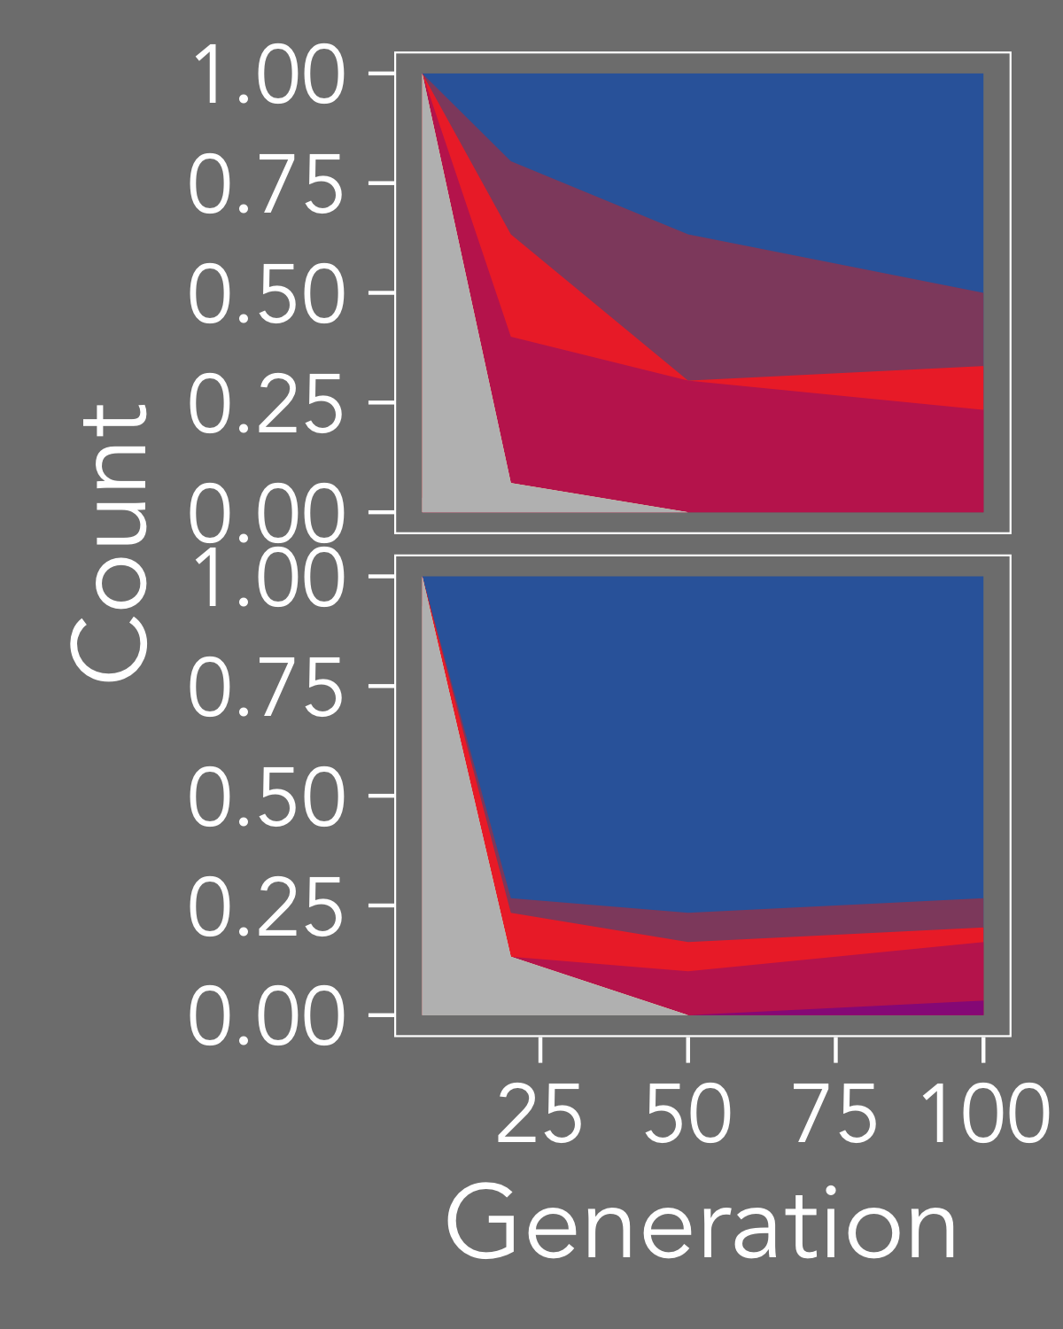
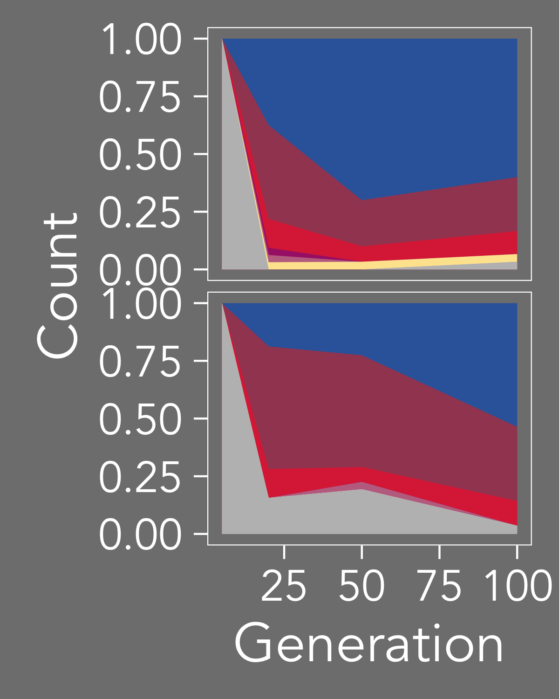
Simulate trajectories under many values for s, Nµ and m
Compute summary statistics at each time point:
Simulated
trajectories
Observed
trajectories
FST, GST’, difference in heterozygosities
Best fit s under logistic growth
Ewens’ Sampling Formula ML θ
Frequency
Frequency
Classify best matches of summary statistics to determine posteriors for s, Nµ and m

