Slide 1
Identifying underlying cause-of-death at scale: the verbal autopsy and beyond
Abraham D. Flaxman
4/17/2019

Slide 2
Outline
Why count deaths and why count them cause by cause?
What is verbal autopsy and how can it help to do this?
What can we do today, and how does SmartVA play a role?

Slide 3
Outline
Why count deaths and why count them cause by cause?
What is verbal autopsy and how can it help to do this?
What can we do today, and how does SmartVA play a role?

Slide 4
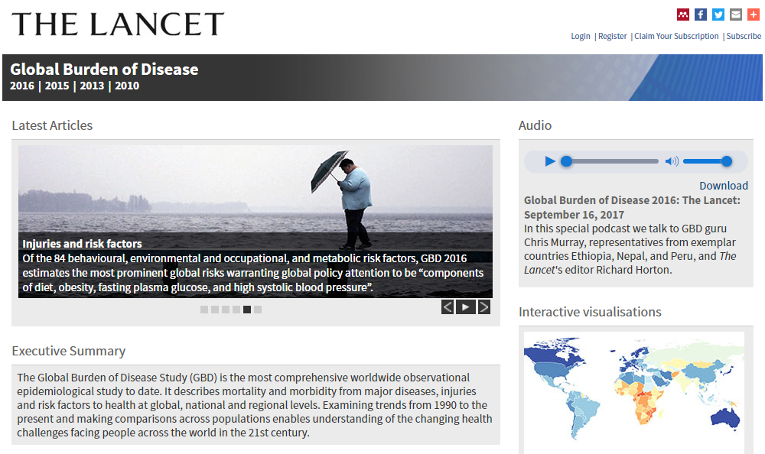
Notes:
As I mentioned, I’m an associate professor of global health, but I used to be a mathematician. I started working on global health metrics for the Global Burden of Disease 2010 Study about ten years ago, and before that I didn’t know what it was.
Live Poll on Familiarity with GBD. Raise your hands, who has:
* Worked on GBD
* Read/cited results from GBD
* Heard of GBD
* Read an article that starts with “[Disease X] causes [YYY] deaths annually”…
The GBD is a massive, collaborative effort to quantify the burden of over 200 diseases, injuries, and risk factors, and make comparable estimates of how much health each condition claims geographically and temporally.

Slide 5
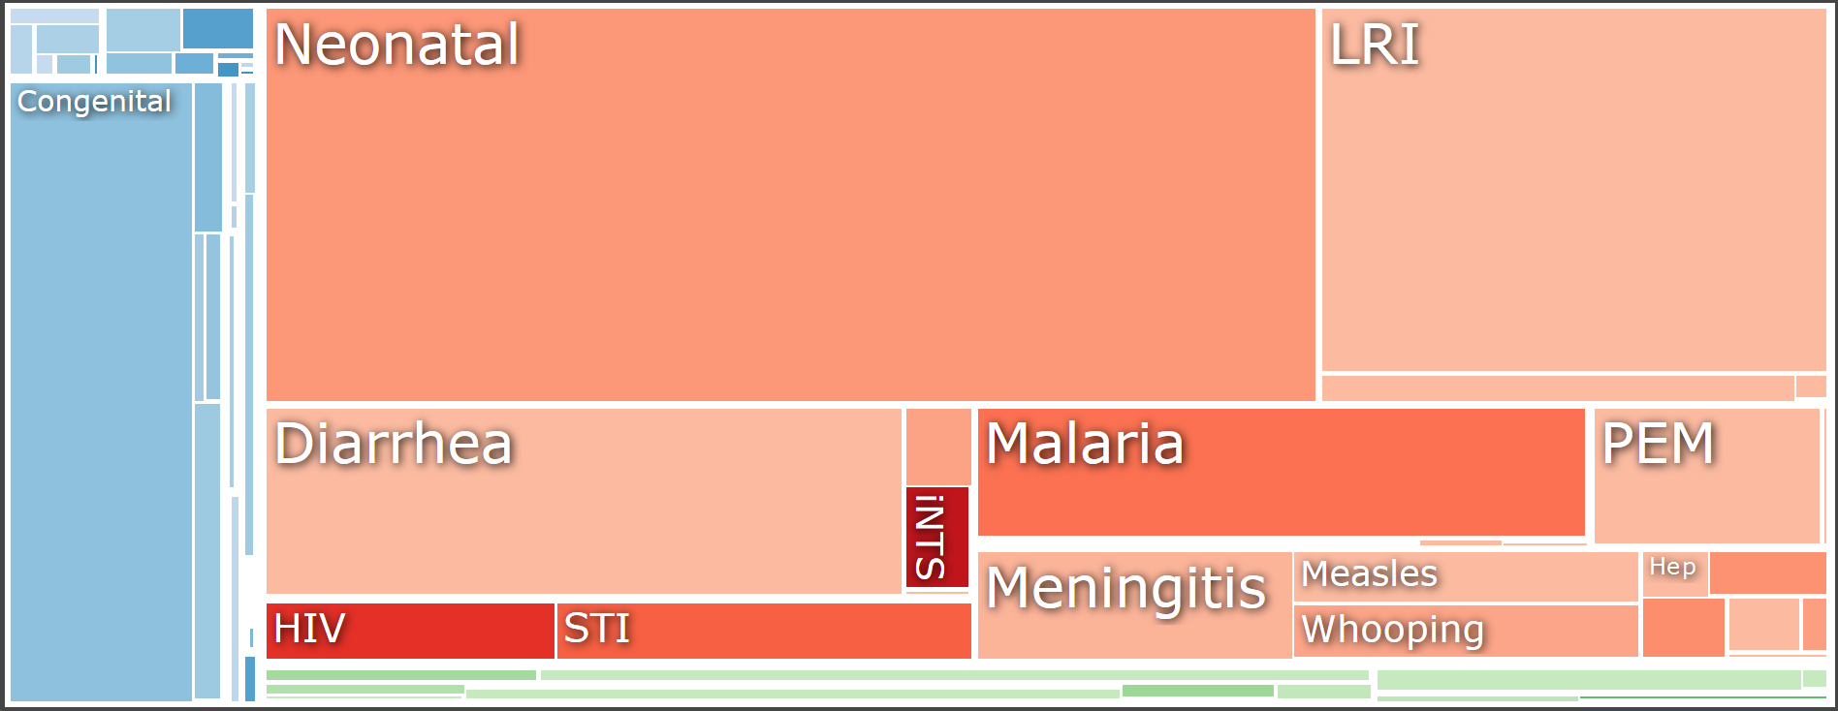
GBD Results Viewer: vizhub.healthdata.org
“It takes a while to get good at finding your way around the tools, but once you do, they are amazingly informative.”
---Bill Gates
Notes:
Quote source: https://web.archive.org/web/20181227184913/https://www.gatesnotes.com/Books/Epic-Measures
Viz source: Under 5 mortality in sub-Saharan Africa from vizhub.healthdata.org

Slide 6
Outline
Why count deaths and why count them cause by cause?
What is verbal autopsy and how can it help to do this?
What can we do today, and how does SmartVA play a role?

Slide 7
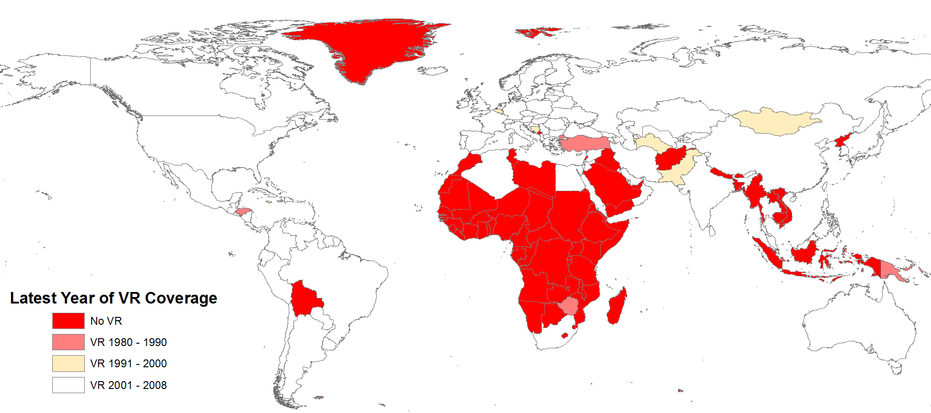
Death Registration Coverage

Slide 8
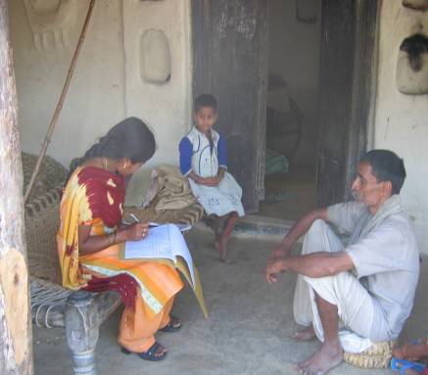
Verbal Autopsy
Notes:
Signs and symptoms associated with major causes of death can be recalled by relatives after the fact of death.
Field interviewers speak with the next of kin using a VA questionnaire

Slide 9
History
Projects in Asia and Africa in the 1950s and 1960s used systematic interviews by physicians to assess causes of death
Field workers at the Narangwal project in India labeled this technique ‘‘verbal autopsy’’ (VA)
The method subsequently spread and developed, particularly during the 1970s, when WHO suggested lay reporting of health information by people with no medical background
Today, VA remains the best available approach for assessing causes of death in communities in which most deaths occur at home

Slide 10
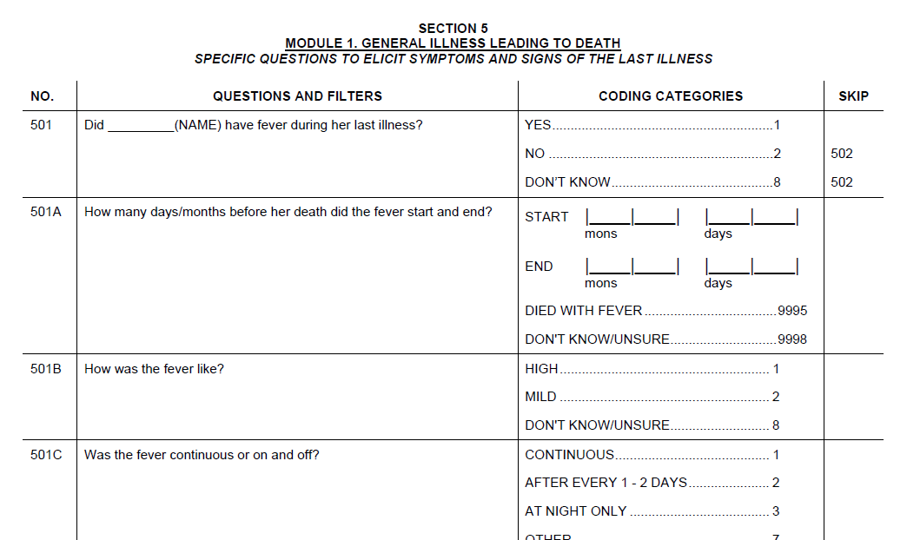
Notes:
To do this, let me introduce you to the verbal autopsy.
The verbal autopsy is a survey designed to gather the necessary information on signs and symptoms of a fatal illness through a structured interview with a relative of the deceased who is familiar with their health experience. The survey itself does not require mobile technology. It was invented before most of this mobile technology.
But… it is complicated!
Here are some parts:

Slide 11
Example VA response (this data is real)
Deceased was 53 Year Old Male, with:
  Asthma
  Heart Disease
  Hypertension
  Ankle Swelling
  Puffiness of the Face, All Over His Body
  Cough, Produced Sputum
  Difficulty Breathing - On-and-Off, Worse in Walking Position
  More than Usual Protruding Belly
  Used Tobacco
  Drank Low Amount of Alcohol
  Free Text: Asthma, Breath, Heart, Lung, Swell, Water
Underlying Cause: COPD
Notes:
COPD (A)
Level 1 Diagnosis established by one of:
Spirometry diagnosis FEVI<70% with no response to bronchodilators
Chest x-ray features hyperinflation, flat hemi-diaphragms, reduced peripheral vascular markings, presence of bullae in conjunction with clinical features of COPD
AND Terminal illness due to one of:
Pneumonia
Cor pulmonale
Respiratory failure
Level 2B Diagnosis established by the following criteria:
Productive cough and breathlessness for 3 or more months of the year for a minimum of 2 successive years
Level 3 Clinical diagnosis of COPD not meeting the above criteria

Slide 12
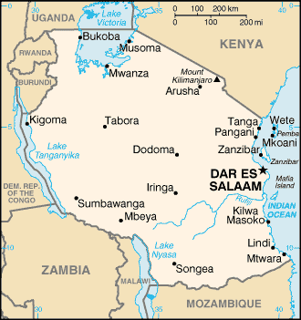
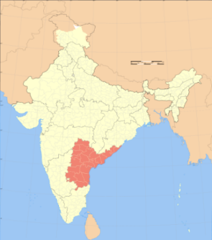
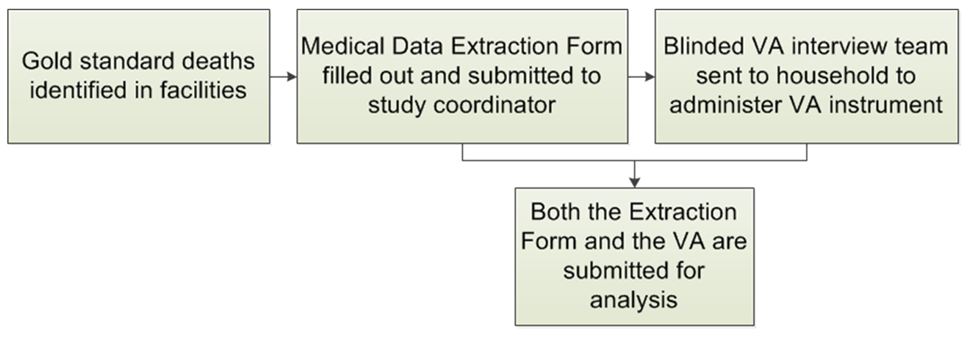
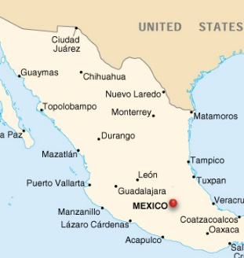
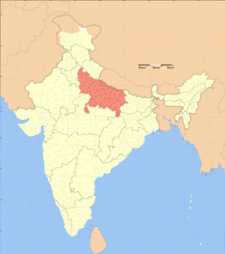
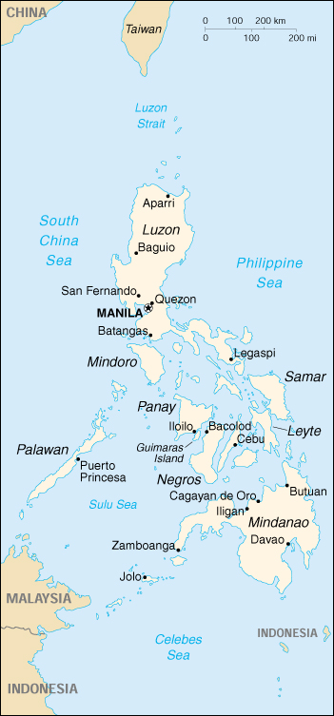
PHMRC VA Validation Dataset
Population Health Metrics Research Consortium (PHMRC) study was part of the Bill & Melinda Gates Foundation Grand Challenges in Global Health
Notes:
http://ghdx.healthmetricsandevaluation.org/record/population-health-metrics-research-consortium-gold-standard-verbal-autopsy-data-2005-2011

Slide 13
Deaths with CoD known and VA collected
Site | Adult |  | Child |  | Neonate |  | Total
 | Level 1 | Level 2 | Level 1 | Level 2 | Level 1 | Level 2
AP | 1,285 | 269 | 385 | 66 | 376 | 1 | 2,382
Bohol | 998 | 262 | 234 | 30 | 374 | 0 | 1,898
Dar | 1,556 | 162 | 366 | 106 | 1,047 | 2 | 3,239
Mexico | 1,373 | 215 | 124 | 4 | 313 | 2 | 2,031
Pemba | 266 | 31 | 156 | 105 | 261 | 3 | 822
UP | 1,277 | 142 | 412 | 87 | 251 | 1 | 2,170
Total | 6,755 | 1,081 | 1,677 | 398 | 2,622 | 9 | 12,542

Slide 14
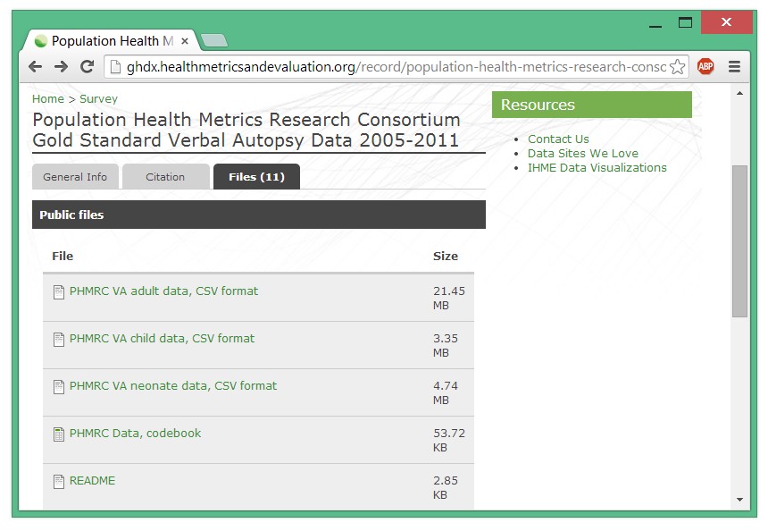
Labeled data

Slide 15
Outline
Why count deaths and why count them cause by cause?
What is verbal autopsy and how can it help to do this?
What can we do today, and how does SmartVA play a role?

Slide 16
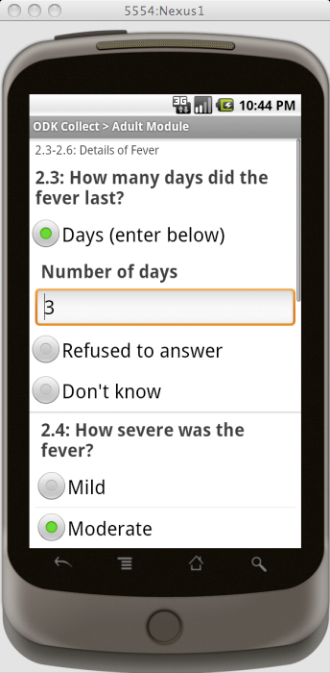
Notes:
The time it takes to do an interview is important, and electronic data collection makes it possible to monitor these times precisely. Even more important, however, is the time it takes to process the results, and having a uniform database is a simple success that is important to emphasize.
Of course, once the data is in digital format, it is also very appealing to process it automatically. If this were a different talk, I would have quite a lot to say about methods for computer-coded verbal autopsy.

Slide 17
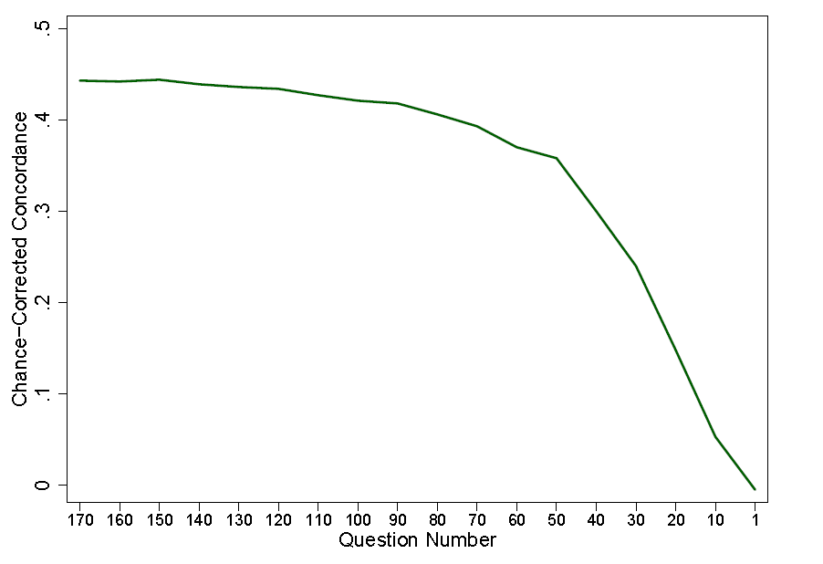
Data-driven Item Reduction

Slide 18
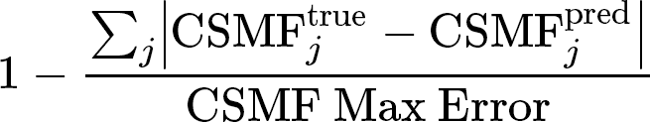
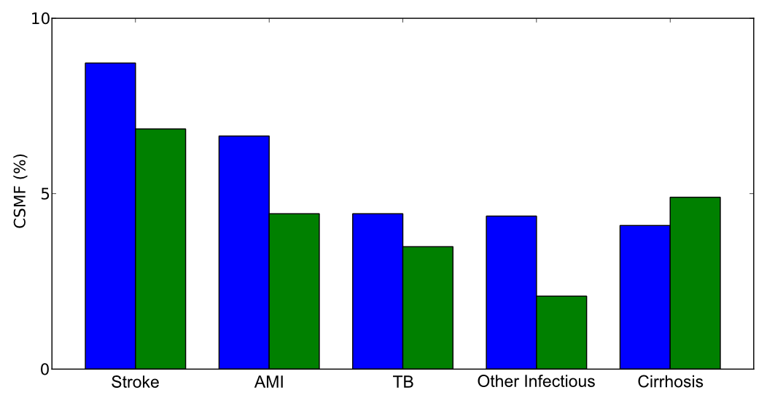
Population-level quality
CSMF Accuracy,
True CSMF
Predicted CSMF

Slide 19
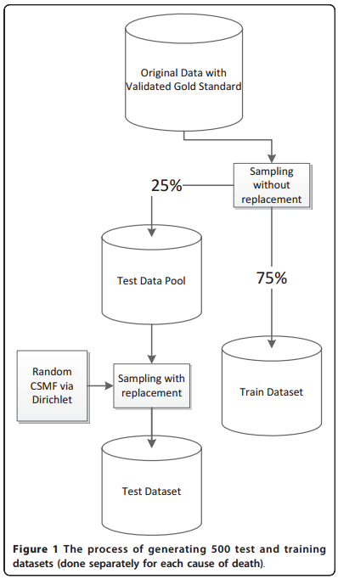
Out-of-sample validation
Really being out-of-sample is tricky for CSMF Accuracy
Unusual part here

Slide 20
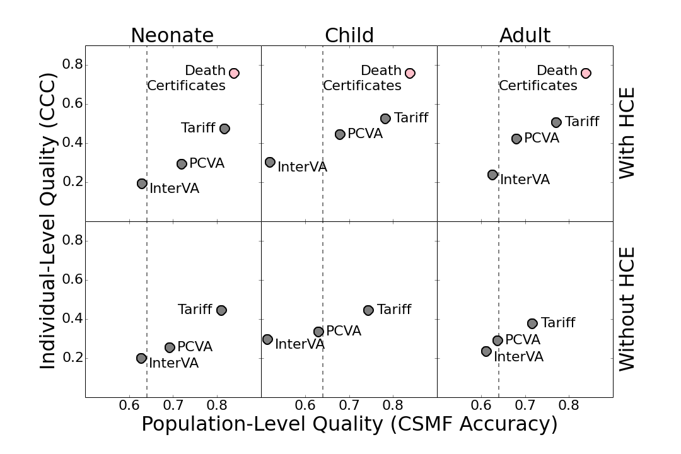

Slide 21
SmartVA works!
It has been applied in a dozen countries on more than 80,000 deaths.
We can train people (community health workers) to successfully apply the questionnaire in 20-25 minutes
We typically diagnose the cause of death in 7 out of 8 cases.
  We are progressively embedding in country VR systems where the method is dramatically increasing information about causes of death in the community.
  In some countries (e.g. Solomon Islands, Philippines), they are using SmartVA to diagnose the cause of death for DoAs.
  It’s revolutionizing CRVS systems Abie!!

Slide 22
Acknowledgements
Bill and Melinda Gates Foundation
Bloomberg Philanthropies
Many hard-working researchers, especially Drs. Alan Lopez, Chris Murray, Spencer James, Andrea Stewart, Alireza Vahdatpour, Jonathan Joseph.
All of the families who provided their interviews to the PHMRC “Gold Standard” Database.

