Slide 1
Child Health Interventions from Global Burden of Disease estimates
Abraham D. Flaxman
April 18, 2018

Slide 2
Outline
Global Burden of Disease (GBD)
From GBD to Future Burden of Disease (FBD)
From FBD to Adoptable Health Interventions (AHI)

Slide 3
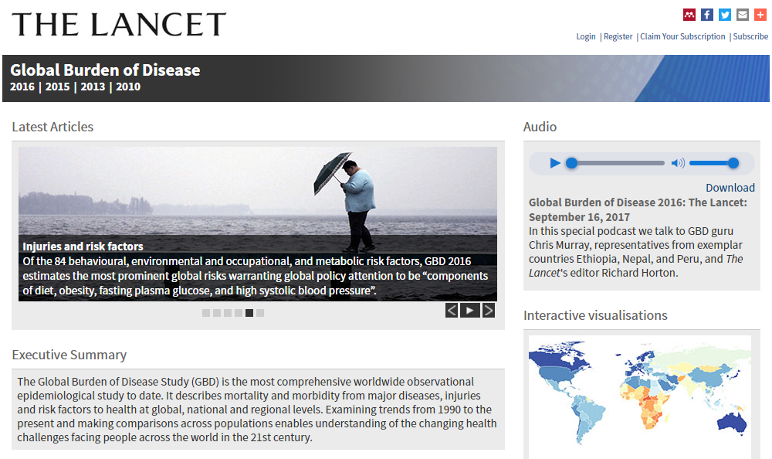
Notes:
I used to be a mathematician. I started working on global health metrics for the Global Burden of Disease 2010 Study about ten years ago.
The GBD is a massive, collaborative effort to quantify the burden of over 200 diseases, injuries, and risk factors, and make comparable estimates of how much health each condition claims geographically and temporally.
When I left math to work on disease burden estimation, my colleagues in the math department thought this change in direction was a little weird. At least unusual.
When I would tell them about what I’ve been doing, they often say “yeah, yeah, sounds great…” but when I did manage to interest them in it, the first question was often “What units?” What units did we use to quantify disease burden?”
The answer is “years”, or disability-adjusted life years, to be specific. This DALY is a summary health metric that accounts for premature mortality in Years of Life Lost, as well as non-fatal health outcomes, or Years Lived with Disability.

Slide 4
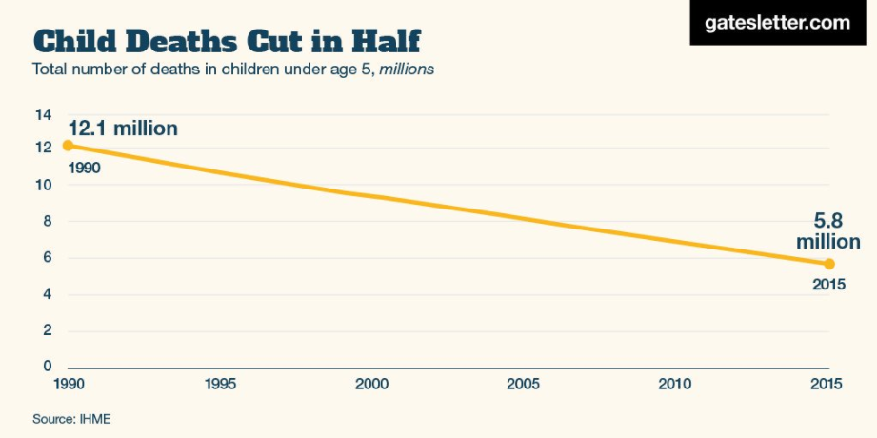
Child Mortality in GBD

Slide 5
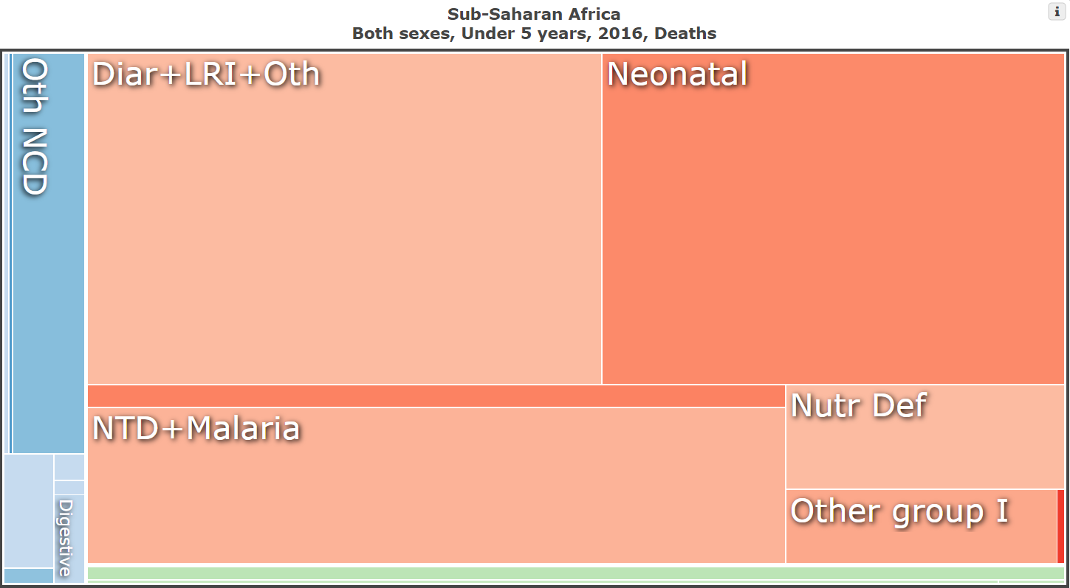
Child Mortality by Cause

Slide 6
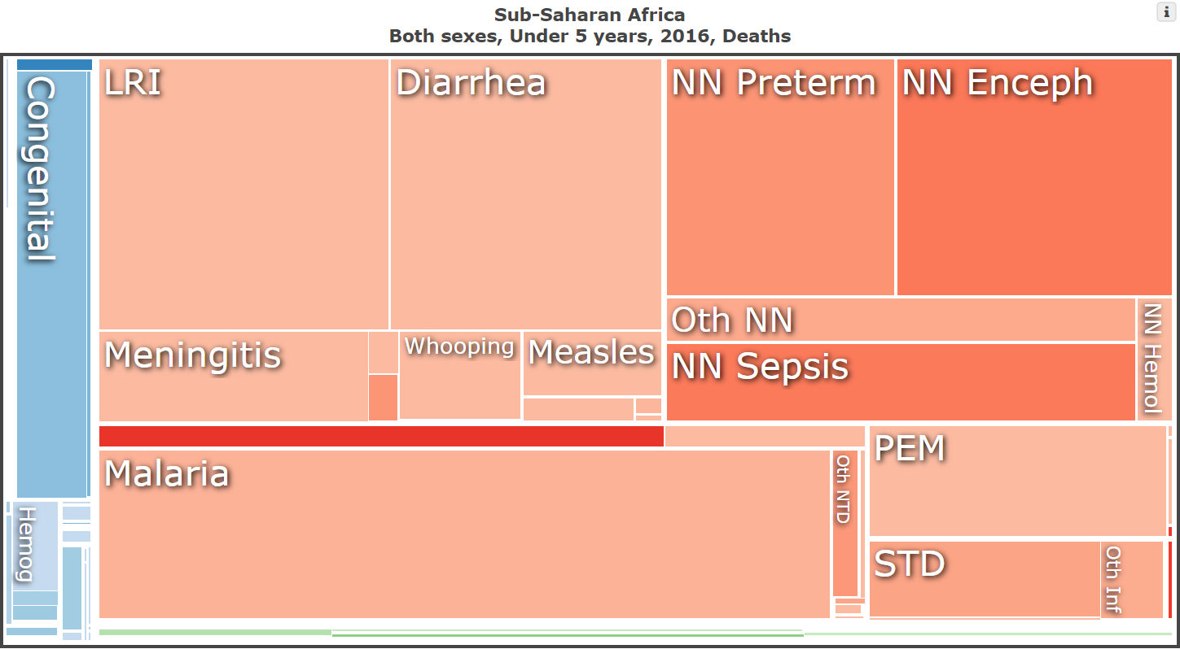
Child Mortality by Cause

Slide 7
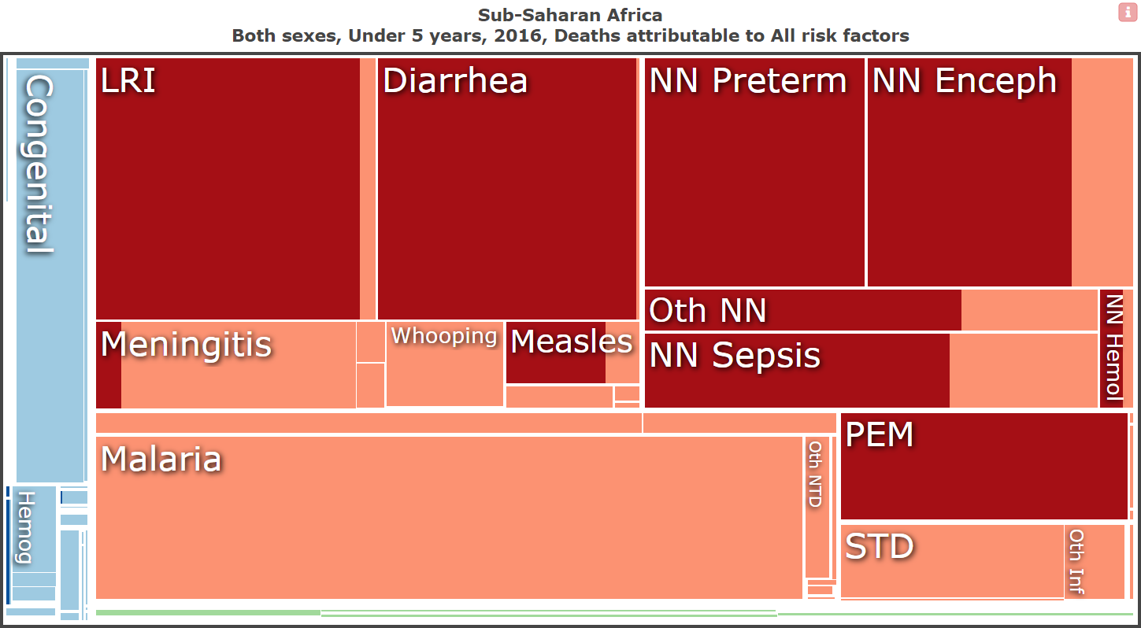
Child Mortality by Modifiable Risk

Slide 8
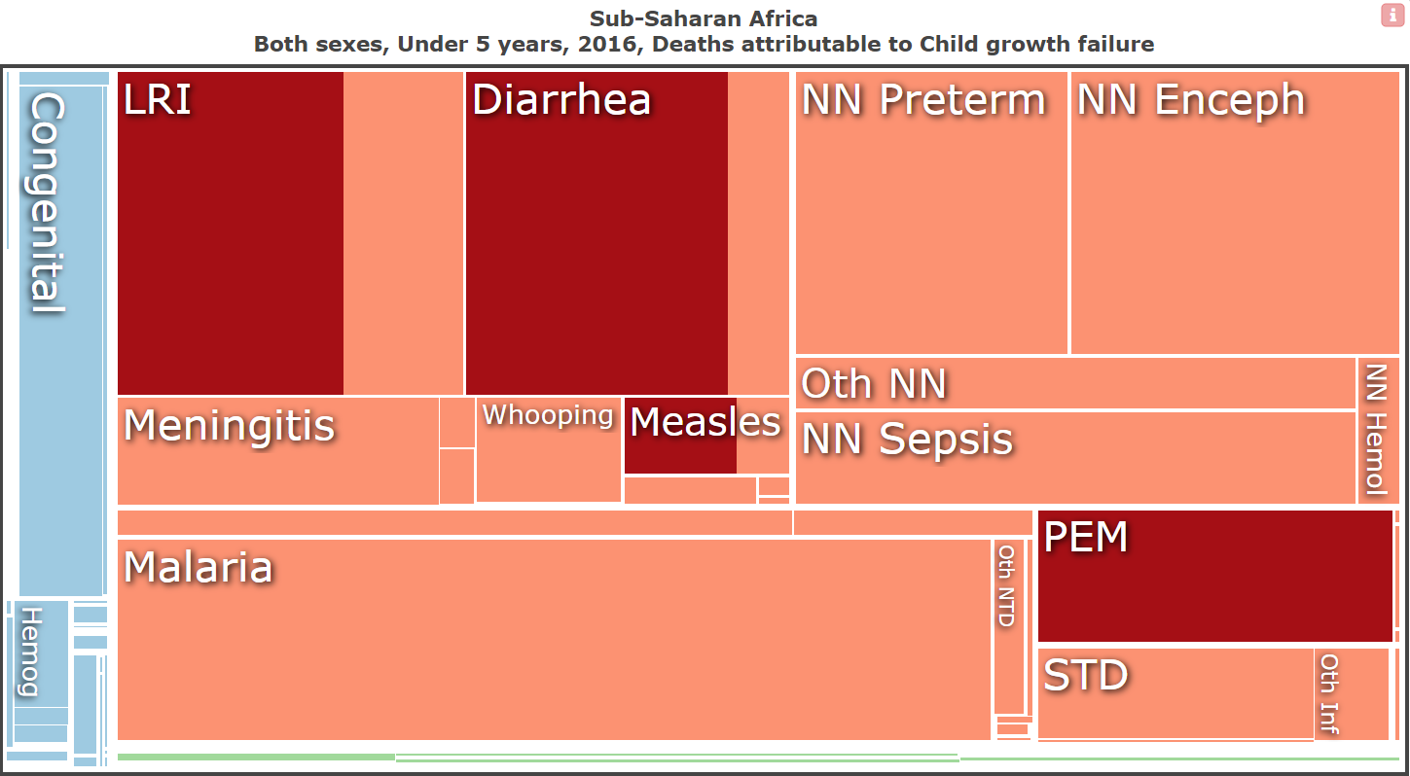
Child Mortality by Modifiable Risk

Slide 9
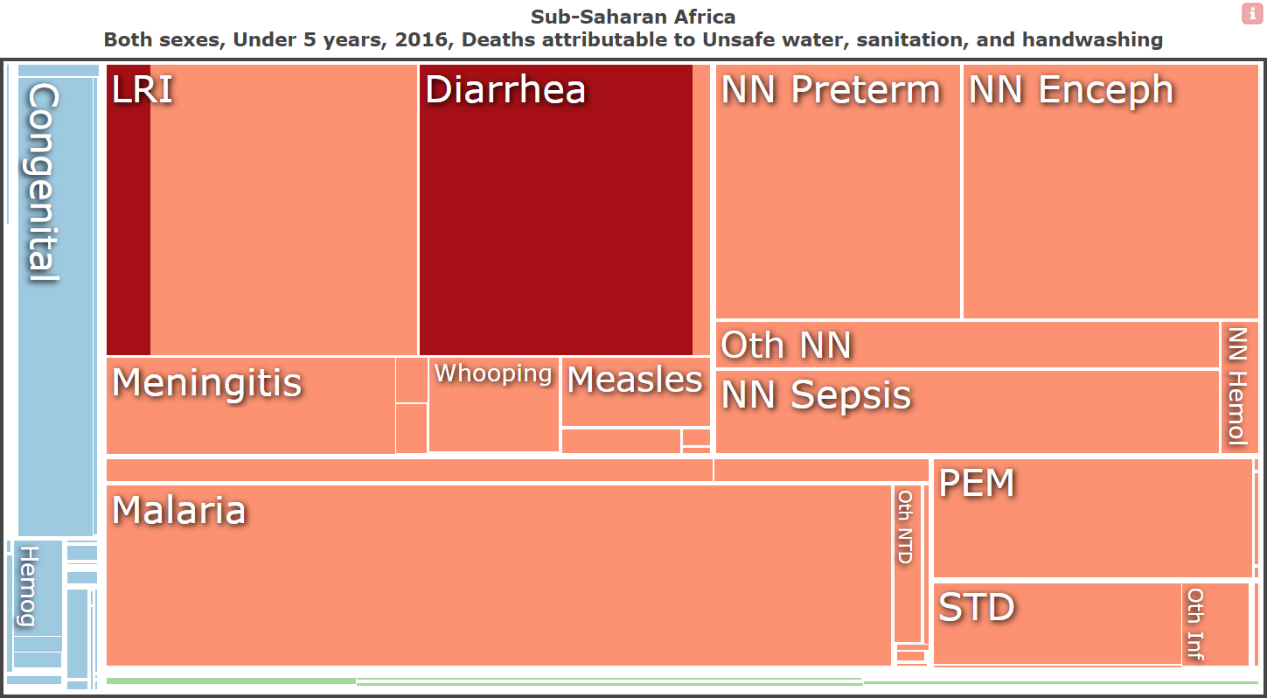
Child Mortality by Modifiable Risk

Slide 10
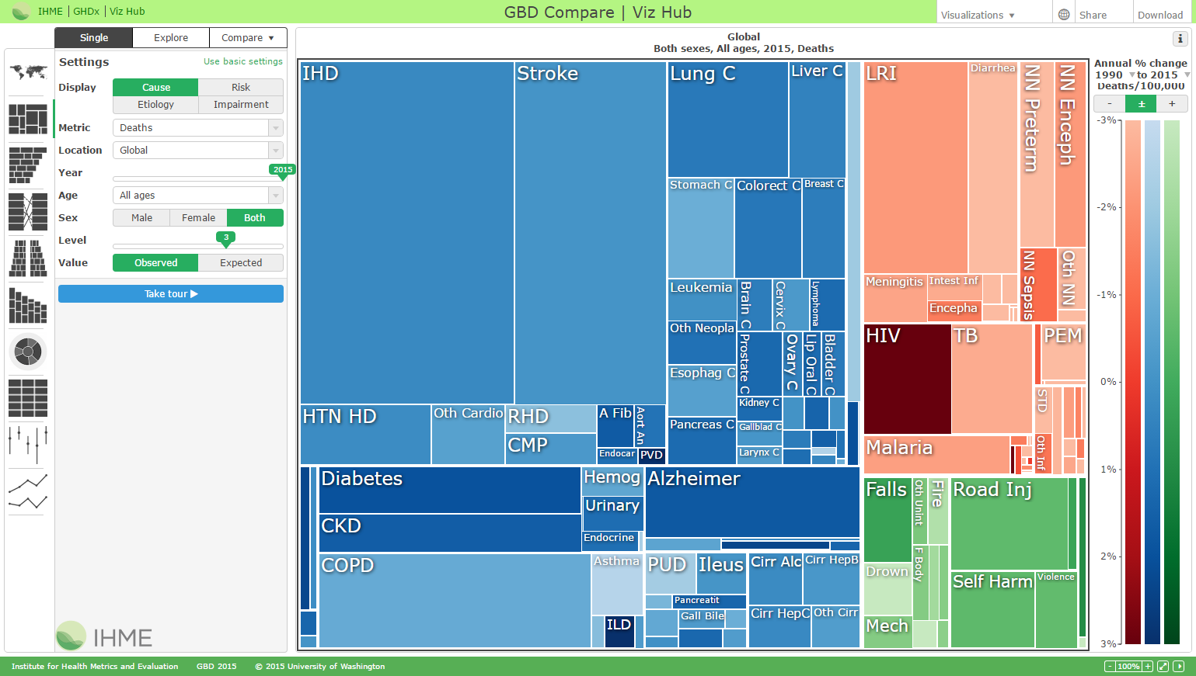
Interactive version: vizhub.healthdata.org
“It takes a while to get good at finding your way around the tools,
but once you do, they are amazingly informative.”
---Bill Gates

Slide 11
Outline
Global Burden of Disease (GBD)
From GBD to Future Burden of Disease (FBD)
From FBD to Adoptable Health Interventions (AHI)

Slide 12
Future Burden of Disease
This is work in progress! Forecasting the burden of disease results out to 2040.
I’m showing preliminary results today: based on forecasts of population, fertility, and mortality, all by age, sex, and country.
I’ve put them together to get something that I think will be very interesting if you or any health decision maker is thinking about SDG 3.2 --- reduce child mortality to 25 deaths per 1,000 live births by 2030.

Slide 13
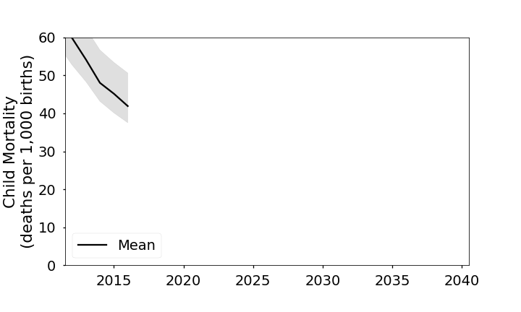
Future Burden of Disease: U5M in country X

Slide 14
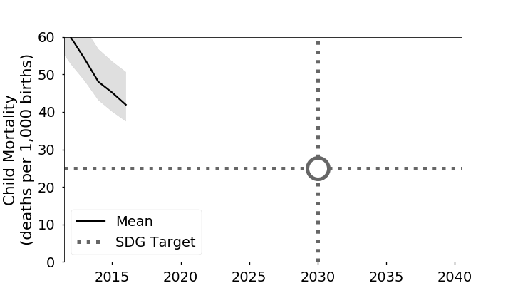
Future Burden of Disease: U5M in country X
“It is difficult to make predictions, especially about the future.”

Slide 15
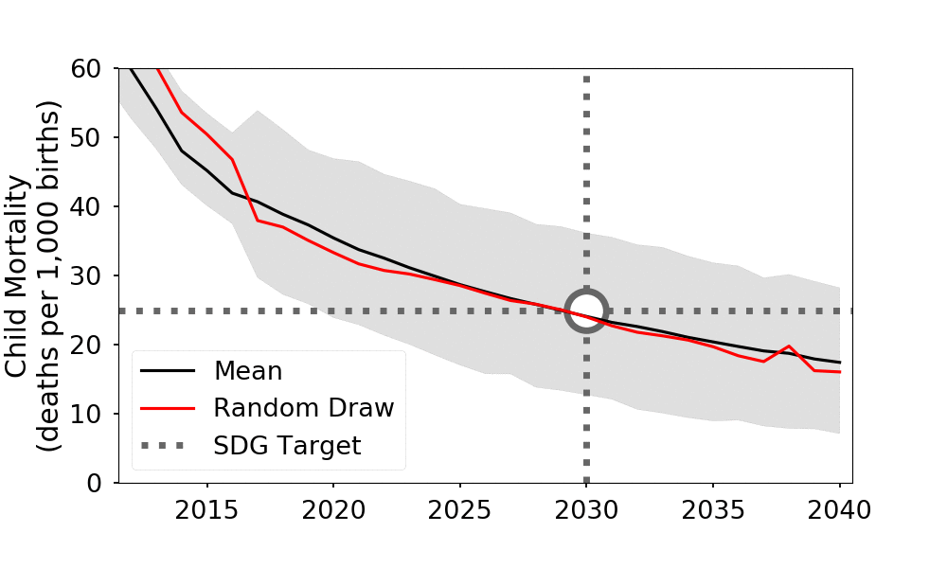
Future Burden of Disease: U5M in country X

Slide 16
Outline
Global Burden of Disease (GBD)
From GBD to Future Burden of Disease (FBD)
From FBD to Adoptable Health Interventions (AHI)

Slide 17
Bending the curve
This is work in progress (even more so than FBD!)
How do we bend this curve? Compare intervention technologies and implementations (e.g. community vs facility distribution) with simulation.
In remainder of talk time, I would like to sketch you an illustrative example.
This is a case study---in the big picture, for any health intervention, we can construct a simulation like this one.
This one is about water improvement with solar water disinfection. But others might be about any number of alternative interventions---expanded vaccination, clean cook stoves, mass drug administration of a broad spectrum antibiotic, etc.

Slide 18
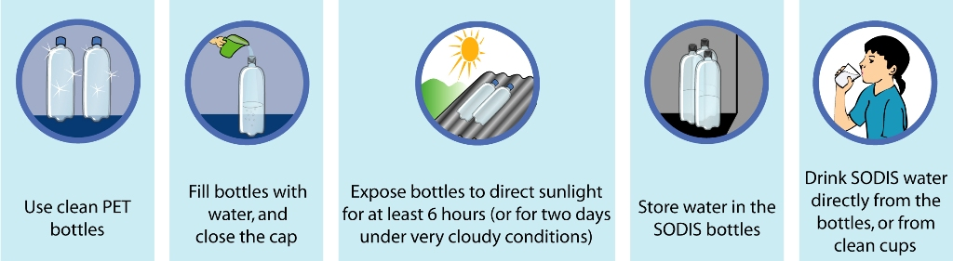
Case Study: Solar Water Disinfection (SoDis)
(figure by Samuel Luzi, Fundacion SODIS)
Notes:
Figure by Samuel Luzi (file as it is) Fundacion SODIS, http://www.fundacionsodis.org/ (some pictorials) [Public domain], from Wikimedia Commons
https://commons.wikimedia.org/wiki/File:Pictograms_SODIS.jpg

Slide 19
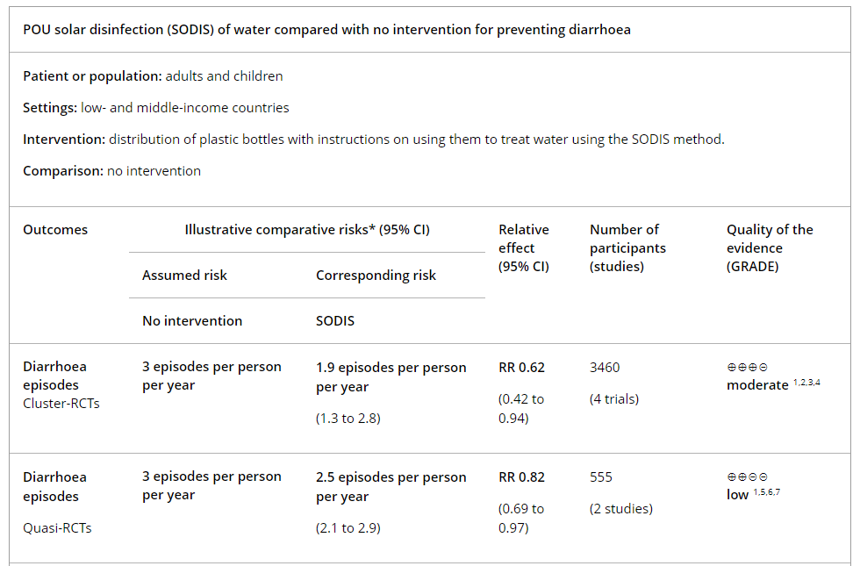
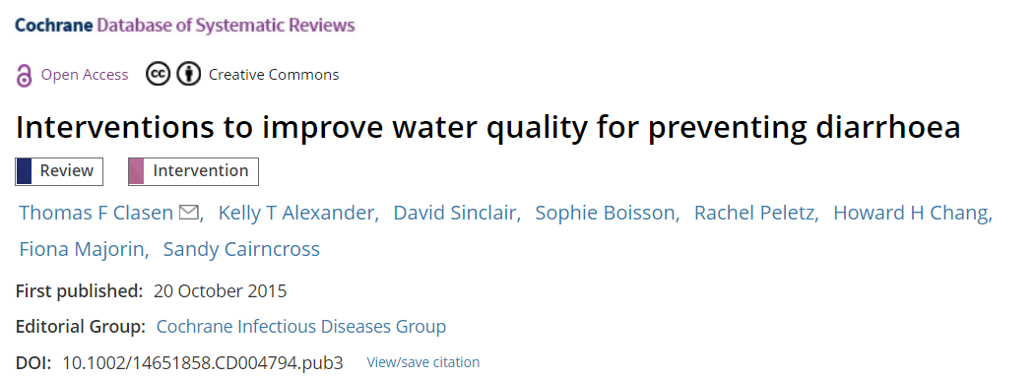
Case Study: Solar Water Disinfection

Slide 20
Simulation model
Start with a cohort of 10,000 individuals, initialized to age 0 in 2011
Every tick of a simulation clock, age individuals by one day
Expose individuals to location-/age-/sex-/time-specific diarrhea and pneumonia incidence rates from GBD
When individual is “with condition”, expose to excess mortality rates from GBD
Expose individuals to background mortality
All individual have risk factor exposures, which match GBD---WaSH, CGF, Indoor Air Pollution, and this relative risk adjusts epidemiological rates.

Slide 21
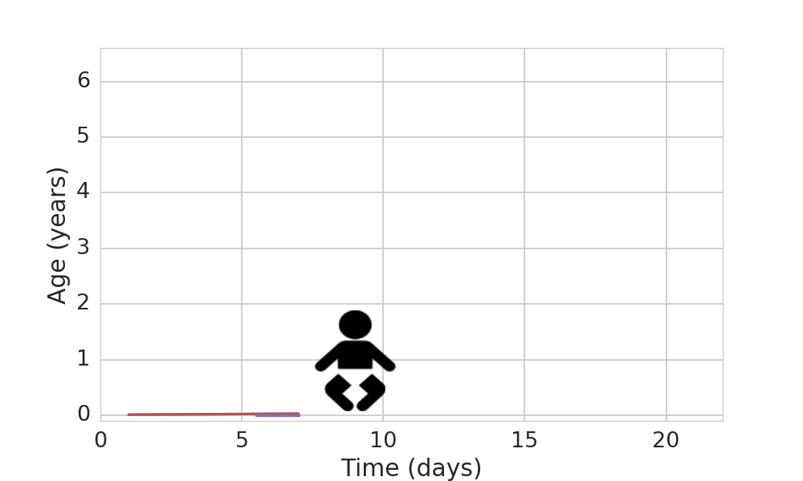
The “micro” in microsimulation

Slide 22
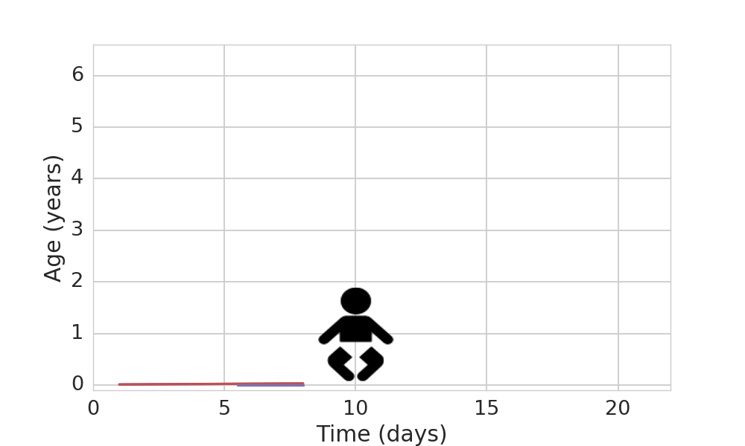
The “micro” in microsimulation

Slide 23
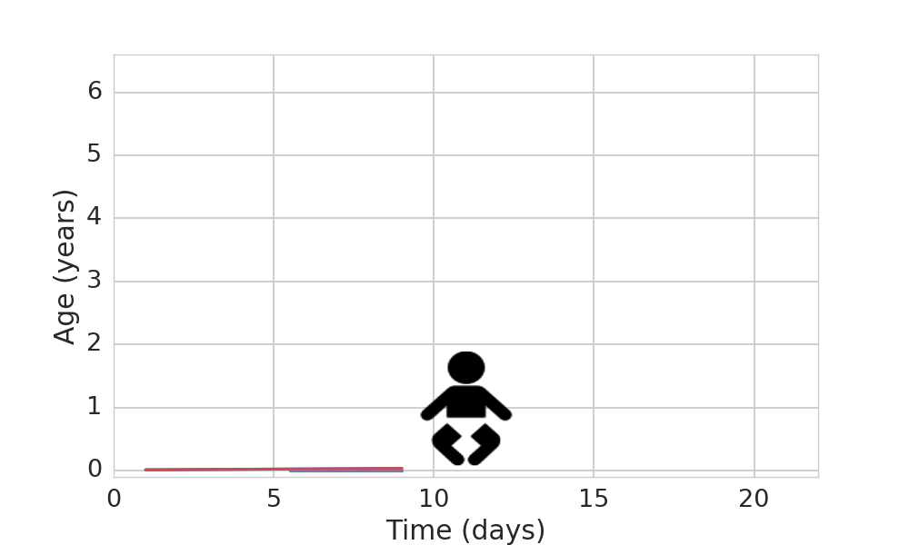
The “micro” in microsimulation

Slide 24
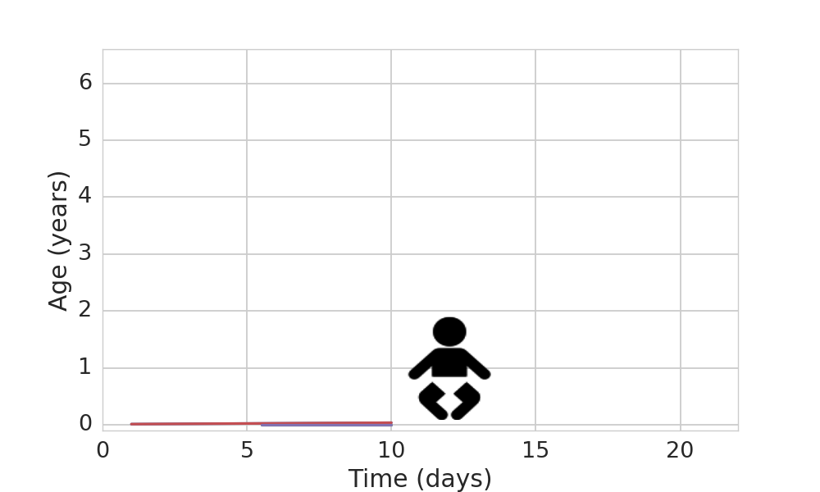
The “micro” in microsimulation

Slide 25
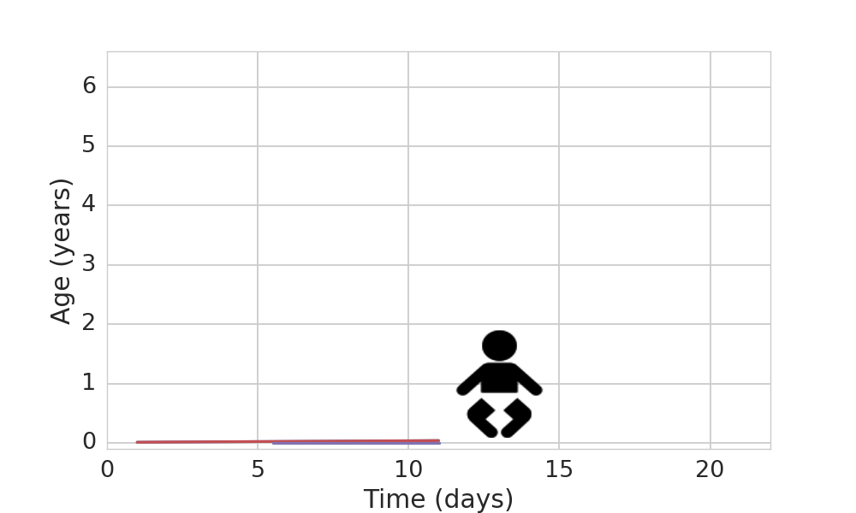
The “micro” in microsimulation

Slide 26
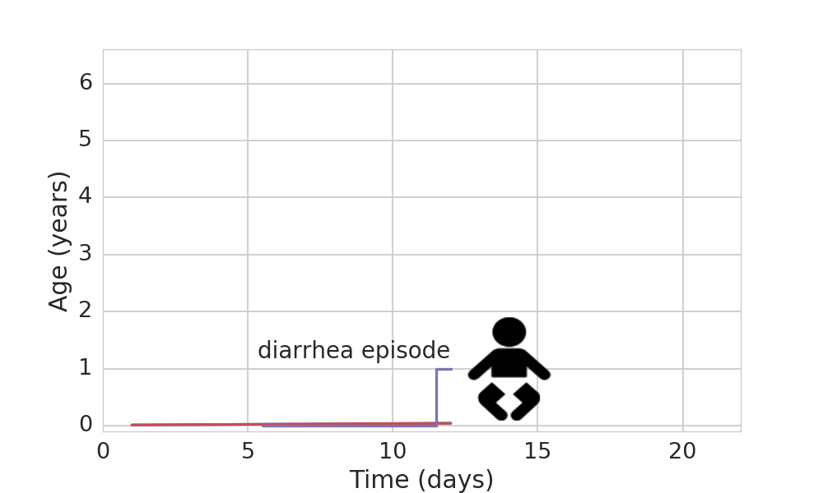
The “micro” in microsimulation

Slide 27
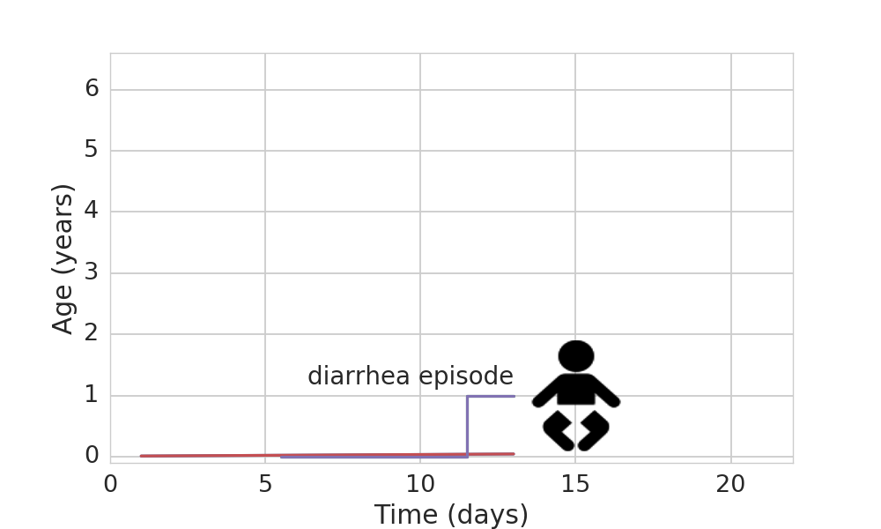
The “micro” in microsimulation

Slide 28
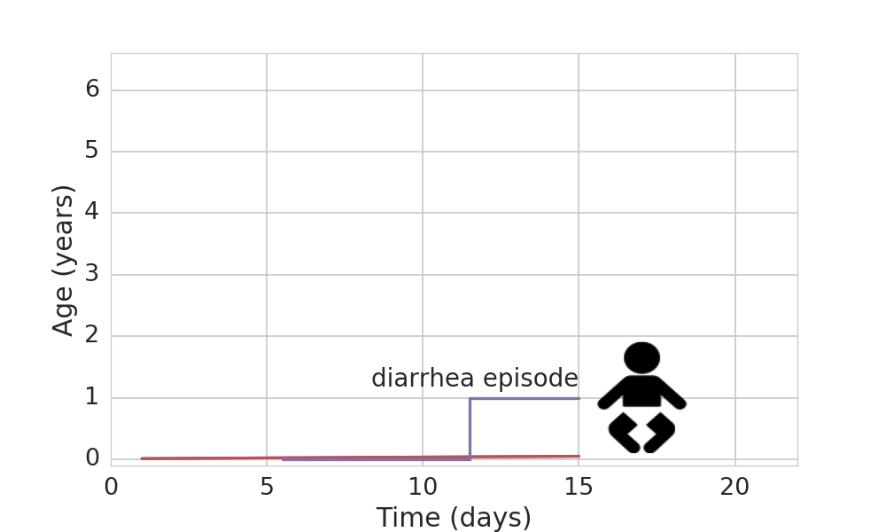
The “micro” in microsimulation

Slide 29
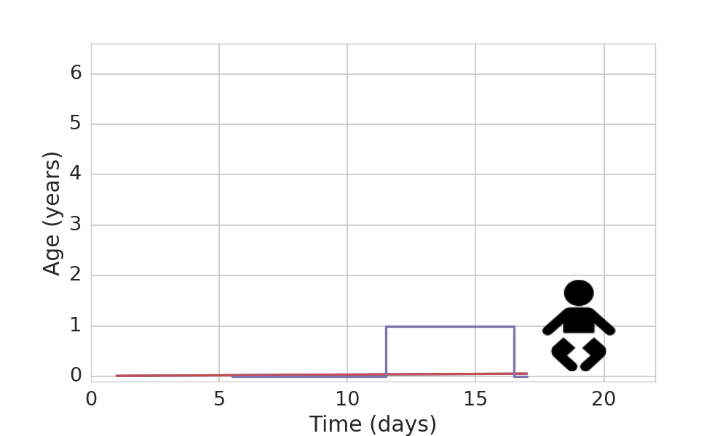
The “micro” in microsimulation

Slide 30
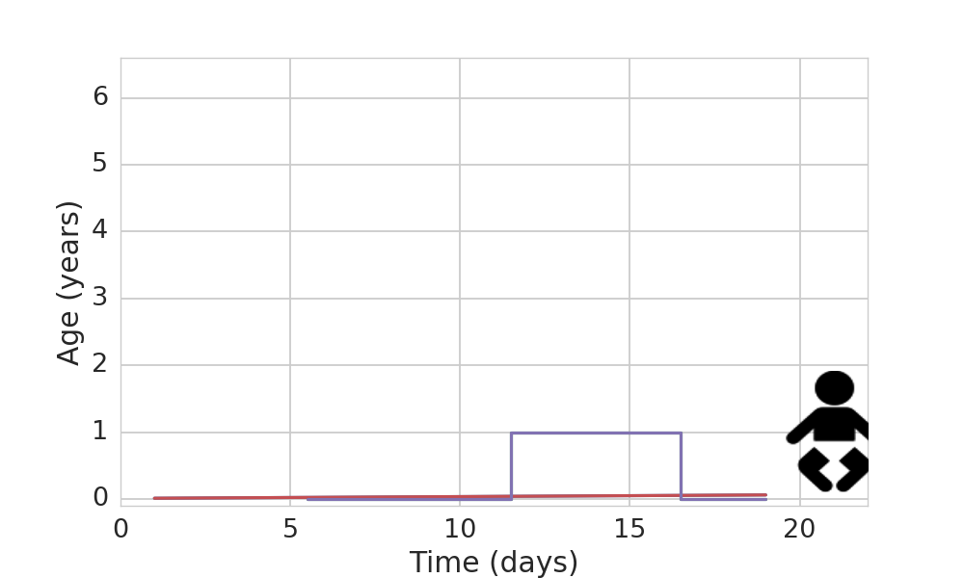
The “micro” in microsimulation

Slide 31
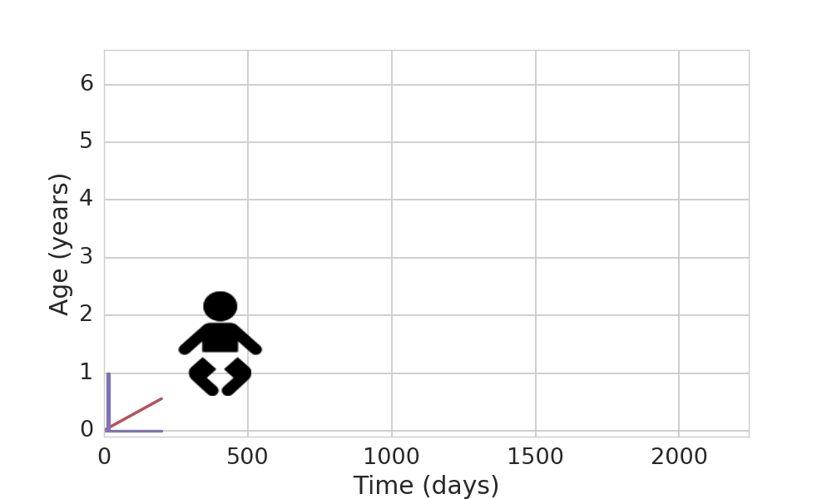
Comparing scenarios yields impacts

Slide 32
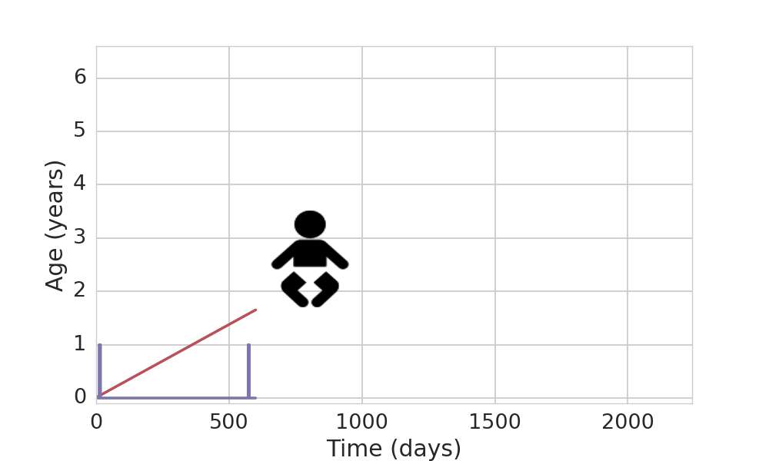
Comparing scenarios yields impacts

Slide 33
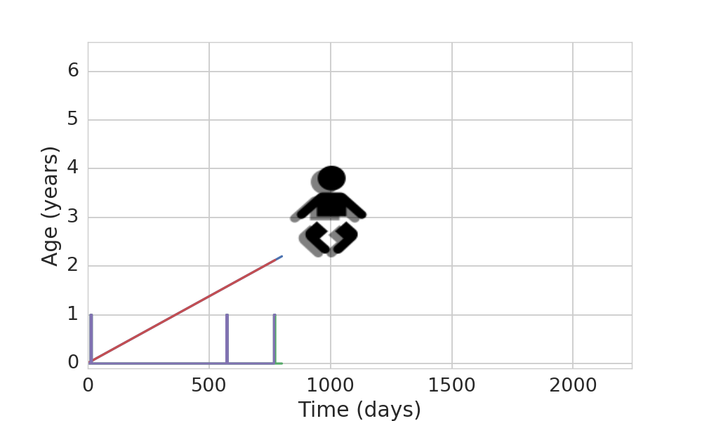
Comparing scenarios yields impacts

Slide 34
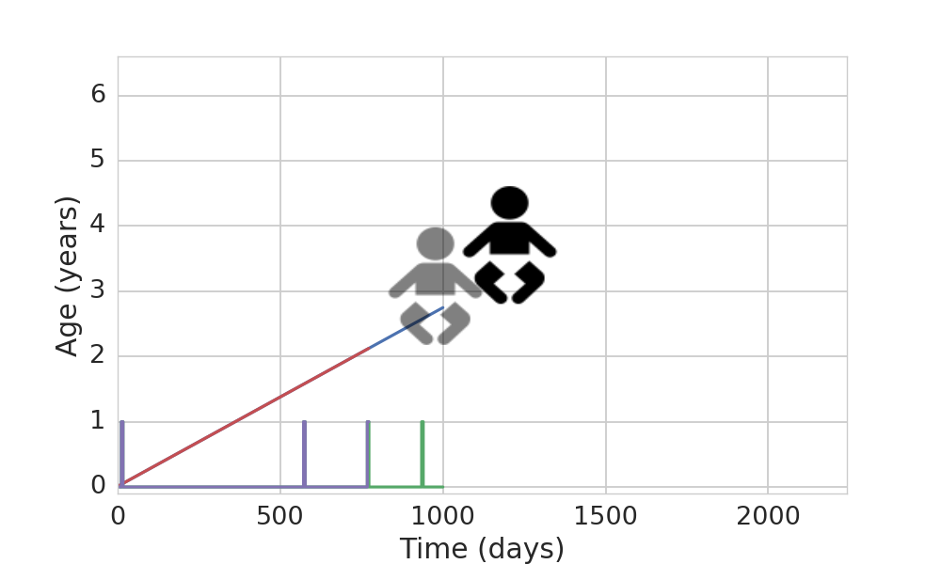
Comparing scenarios yields impacts

Slide 35
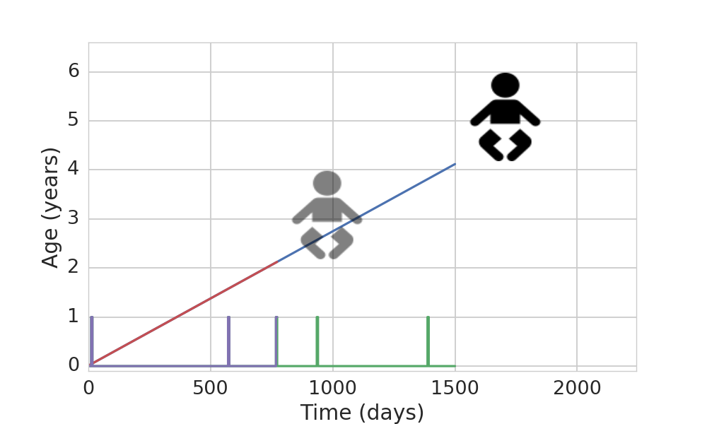
Comparing scenarios yields impacts

Slide 36
Baseline and Intervention Scenarios
Baseline: run this simulation for 5 years, slowly regenerate GBD results
Intervention scenario: add in a community-based SoDis distribution program, that goes house-by-house giving people solar water purification kits and instruction on how and why to use it.
The effect of this intervention is a change in an individual’s exposure to unsafe water risk (for one year).
Notes:
We have some really cool affordances to match up the baseline and intervention scenarios---I don’t have time to go into detail on this now---and we run multiple times to propagate the uncertainty quantified in the GBD.

Slide 37
Intervention Scenario Effect
Recall that each individual has a “risk exposure” for unsafe water, designed to match the GBD:
Relative Risk of Diarrheal Diseases:
 | Untreated | Chlorinated/Solar Disinf. | Filtered
Unimproved | 11.0 | 9.3 | 6.0
Improved | 9.0 | 7.6 | 4.9
Piped | 8.0 | 6.7 | 4.4
High quality | 1.8 | 1.5 | 1.0

Slide 38
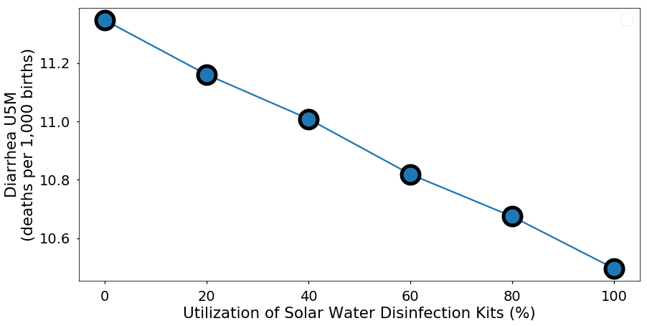
Importance of Utilization Rate

Slide 39
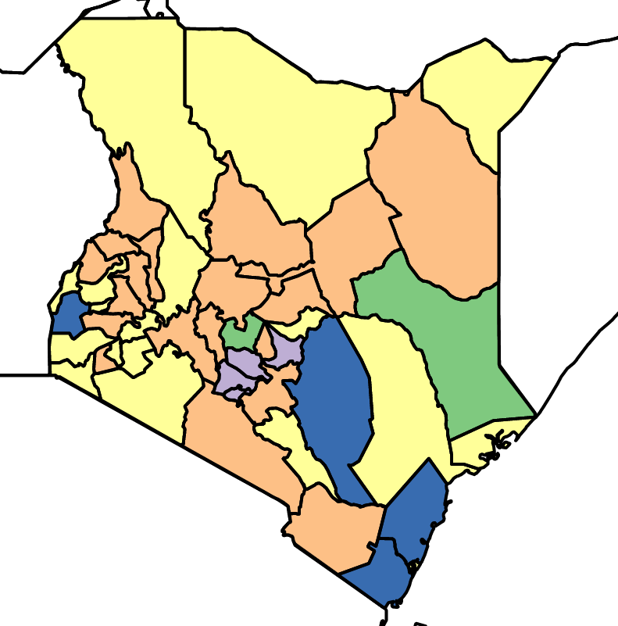
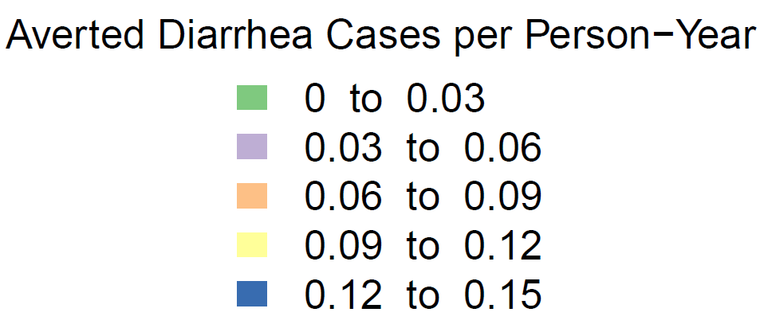
More broadly, importance of context

Slide 40
An alternative strategy for distribution
Alternative intervention scenario: facility-based distribution program, that works in the clinic giving people solar water purification kits and instruction, but does it when a sick kid is heading home.
Knowledge gap: GBD does not currently measure health care access during diarrheal diseases---but the GBD machinery makes it pretty straightforward to do so.
Notes:
Knowledge gap 2: Utilization rates for solar water purification are largely unknown. One reason I started here is I’ve got a cool way to get hard data on this.

Slide 41
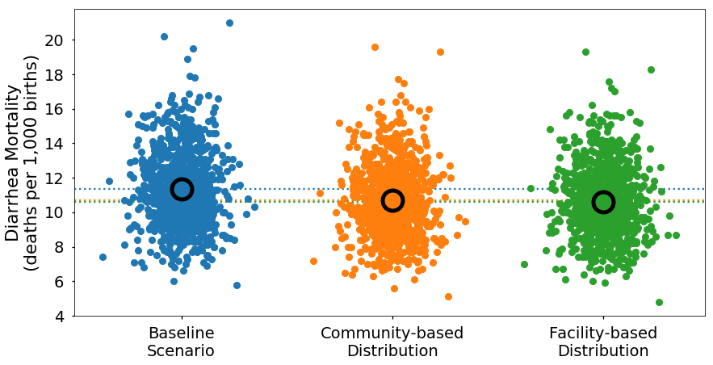
Child Deaths due to Diarrheal Diseases
Notes:
Mention approach to Uncertainty Quantification (UQ)

Slide 42
To recap
How do we bend this curve? Investigate potential answers with simulation models
This is a case study---in the big picture, for any health intervention, we can construct a simulation like this one.
This one is about water improvement with solar water disinfection. But others might be about any number of alternative interventions---expanded vaccination, clean cook stoves, mass drug administration of a broad spectrum antibiotic, etc.

Slide 43
To recap even more
Global Burden of Disease (GBD)
From GBD to Future Burden of Disease (FBD)
From FBD to Adoptable Health Interventions (AHI)

Slide 44
Thank you

Slide 45
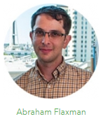

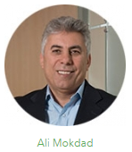


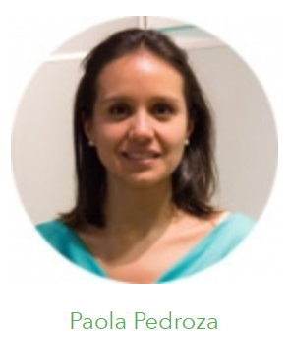
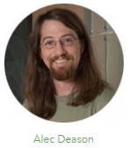
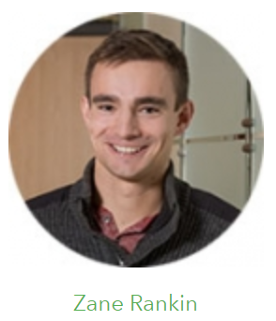
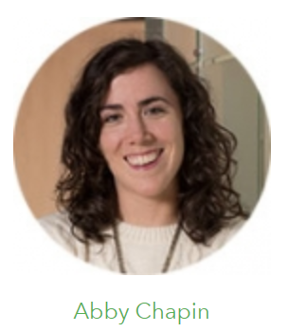

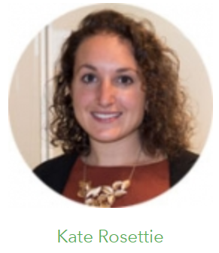

Adoptable Health Interventions Team
This work was supported by BMGF Grant OPP1170133, “CoNIC: Prospective modeling of child health interventions’ ability to meet SDG targets”.

