Slide 1
Typhoid Fever in Santiago, Chile: Modern Insights Where Historical Data Meet Mathematical Modeling
Jillian Gauld
Institute for Disease Modeling
April 20, 2017

Slide 2
Outline
Typhoid and Santiago overview
Modeling approach
Lessons learned:
  Age distribution and immunity/exposure
  Chronic carriage and short cycle transmission
  Vaccine impacts
Take-aways: site specific and new locations

Slide 3
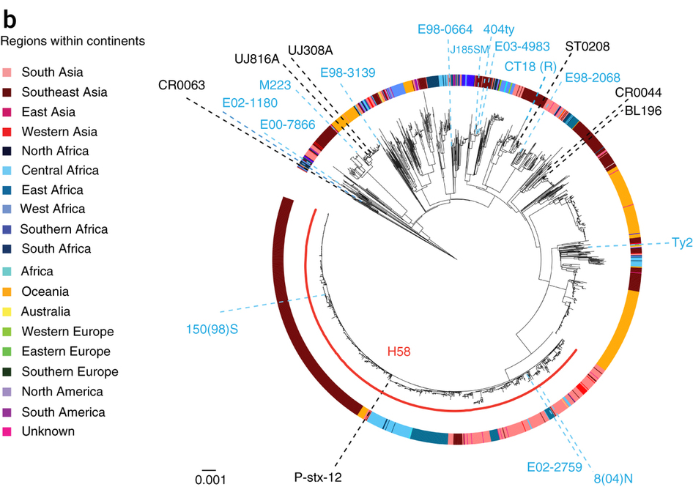
Typhoid as a deadly disease
Wong et al. Nature Genetics

Slide 4
Typhoid modeling initiative
Motivating questions:
  Is local elimination feasible with current and upcoming tools?
  What do we need to know in order to make informed decisions around control and elimination?

Slide 5
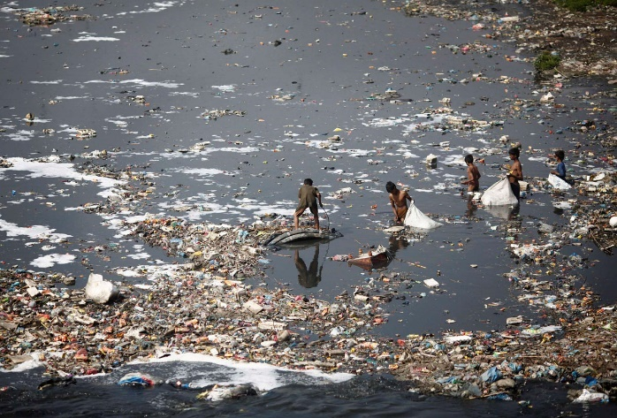
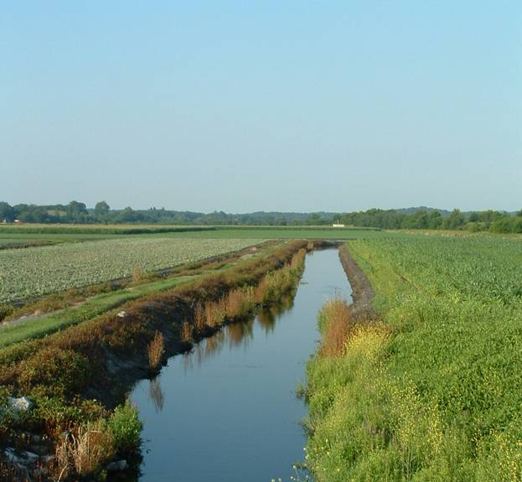
Typhoid modeling initiative
Water supply in Kathmandu, Nepal
Challenging features:
  Transmission route varied and unknown in many locations
Irrigation practices in Santiago, Chile

Slide 6
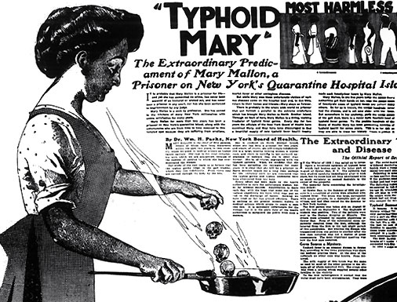
Typhoid modeling initiative
Challenging features:
  Transmission route varied and unknown in many locations
  Mechanisms of persistence unclear

Slide 7

Typhoid modeling initiative
Challenging features:
  Transmission route varied and unknown in many locations
  Mechanisms of persistence unclear

Slide 8

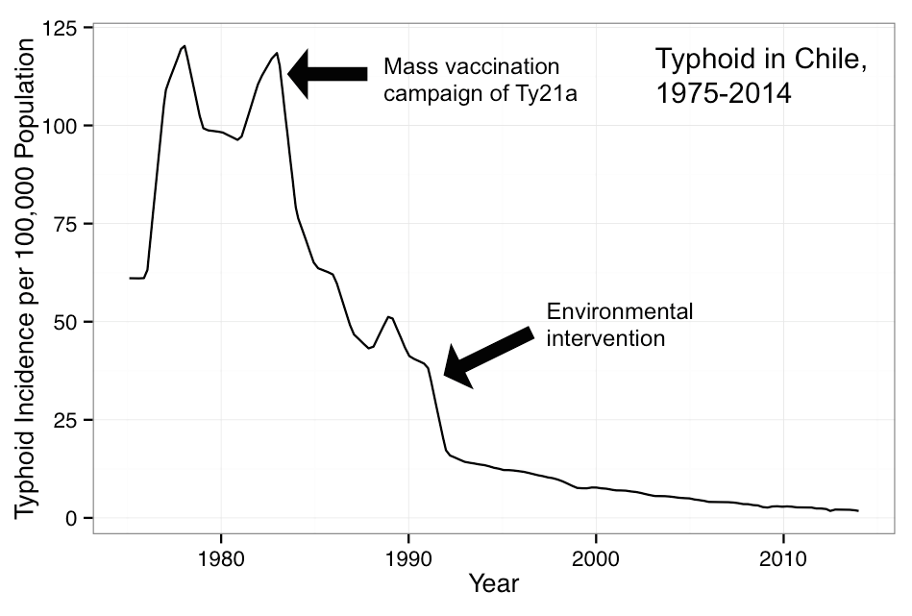
Santiago, Chile
Very low level typhoid incidence in modern day
In the 1970-1980s: high endemic transmission despite >90% sewage and drinking water coverage
Decline in 1980s coincident with Ty21a vaccine trial
1991 ban of wastewater irrigation: sharp decline in cases

Slide 9
Why model in Santiago?
Three different transmission periods in a single population/ demographic set
Data that is not commonly available:
  Age distribution, seasonality, transmission route, carrier prevalence, low endemic transmission
Allows us to explore underlying mechanisms for observed dynamics and understand areas of uncertainty

Slide 10
Modeling approach
Individual-based model:
Allows for individual level variation in parameters including immunity, shedding duration, and carrier probabilities

Slide 11
Modeling approach
Key components:
Infections can be either acute or subclinical
Permanent chronic carrier state
Protection-per-infection parameter

Slide 12
Modeling transmission routes
Distinct transmission routes in model:
Long cycle: Homogenous mixing, dose-response dynamics, decay in water/ environment
Short cycle: Non-seasonal, modeled as direct transmission
contaminated food

Slide 13
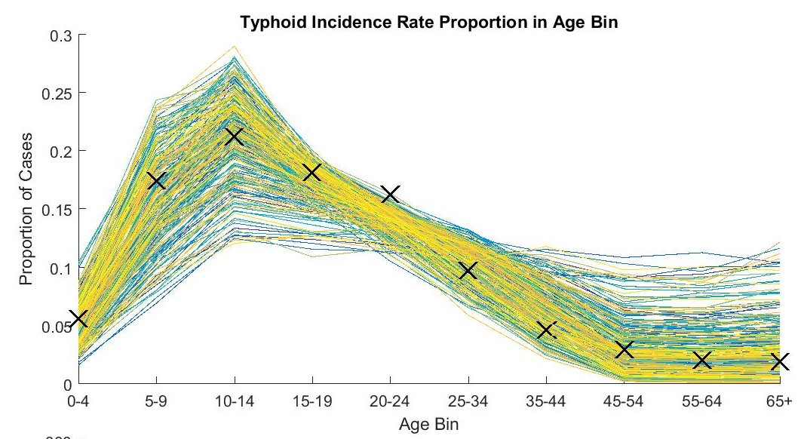
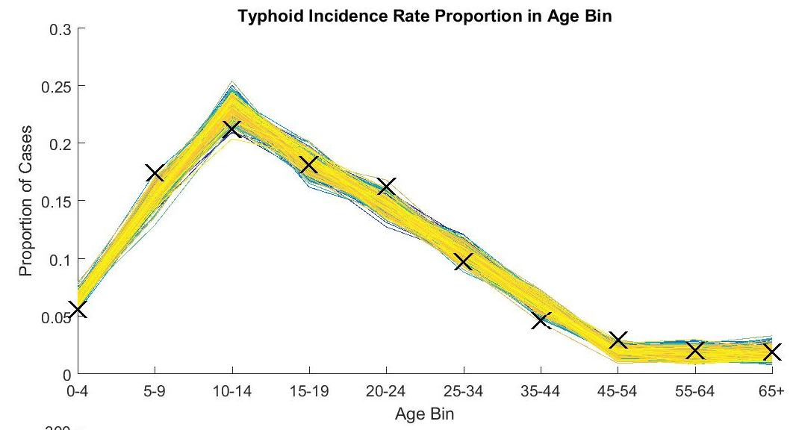
Model fitting process
Optimization to maximize likelihoods informing model fit to age distribution, incidence, carrier prevalence, seasonality
Point estimates for unknown parameters
Proportion of typhoid incidence in age bins
Proportion of typhoid incidence in age bins
-- Simulation
X Data

Slide 14
Take-aways from model fitting
Immunity and exposure trade-off to create adult age distribution of typhoid
Population immunity:
None
Low
High

Slide 15
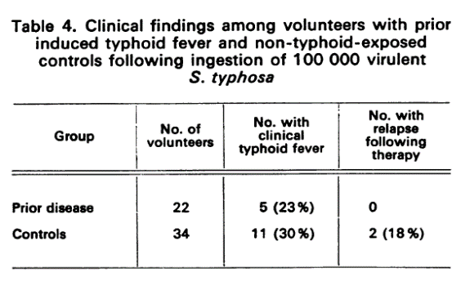
Take-aways from model fitting
Immunity and exposure trade-off to create adult age distribution of typhoid
Best fit model >95% protection after initial infection
Contrasts with challenge models
Boosting from environment in endemic regions?
Dupont, 1971: Challenge study with re-exposure within 12 months of initial infection

Slide 16
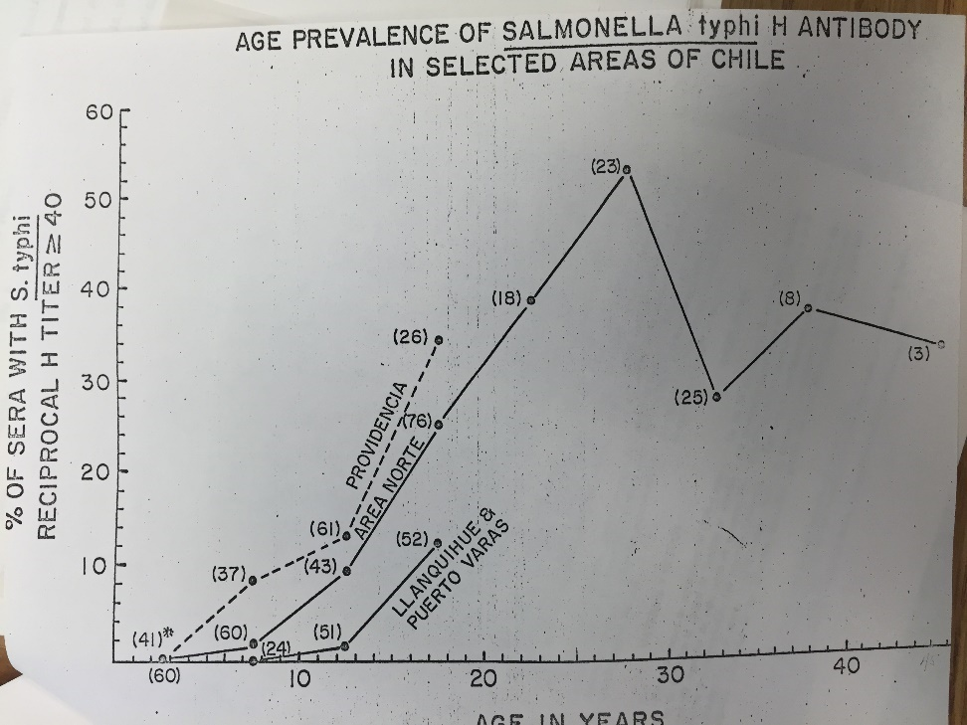
Take-aways from model fitting
Immunity and exposure trade-off to create adult age distribution of typhoid
Best fit model >95% protection after initial infection
Contrasts with challenge models
Boosting from environment in endemic regions?
We are likely catching a small fraction of total cases:
<10% total cases (clinical/subclinical) reported in model

Slide 17
Take-aways from model fitting
Exposure likely drives childhood age distribution:
Increases in incidence timed with entry ages into preschool, elementary school system → potential exposure to new foods

Slide 18
Take-aways from model fitting
Exposure likely drives childhood age distribution:
Increases in incidence timed with entry ages into preschool, elementary school system → potential exposure to new foods
Site-specific, flexible mechanisms needed to capture variation across locations

Slide 19
We can estimate the probability of becoming a chronic carrier from infection
Age/gender distribution determined by age distribution of gallstones
Point estimates of probability of becoming a chronic carrier in range of estimates from Ames, 1943
Best-fit model estimates, cases resulting in carriers(%)
Age | Male | Female
10-19 | 0 | 1.4
20-29 | 0.7 | 3.3
30-39 | 2.0 | 6.0
40-49 | 2.5 | 7.2
50-59 | 3.0 | 8.4
60-69 | 3.7 | 9.7
70-79 | 6.5 | 9.7
80-90 | 6 | 7.8
Ames, 1943
Notes:
Add age group

Slide 20
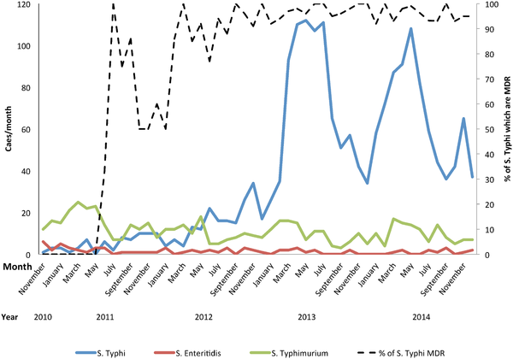
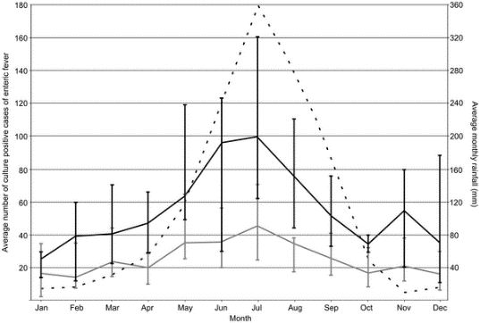
Low-season persistence and the importance of chronic carriers
Highly seasonal locations: trade-offs between long and short cycle dominated scenarios
What sustains typhoid in short cycle dominated scenarios?
Typhoid in Santiago, Chile
Typhoid in Blantyre, Malawi
Kathmandu, Nepal
Data shared from Mike Levine
Karkey et al., 2015
Feasey, 2015

Slide 21
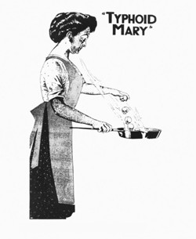
What sustains typhoid during the low season?
Three possible contributors:
  Chronic carriers

Slide 22
What sustains typhoid during the low season?
Three possible contributors:
  Chronic carriers
  Sustained long-tail shedding
Ames, 1943

Slide 23
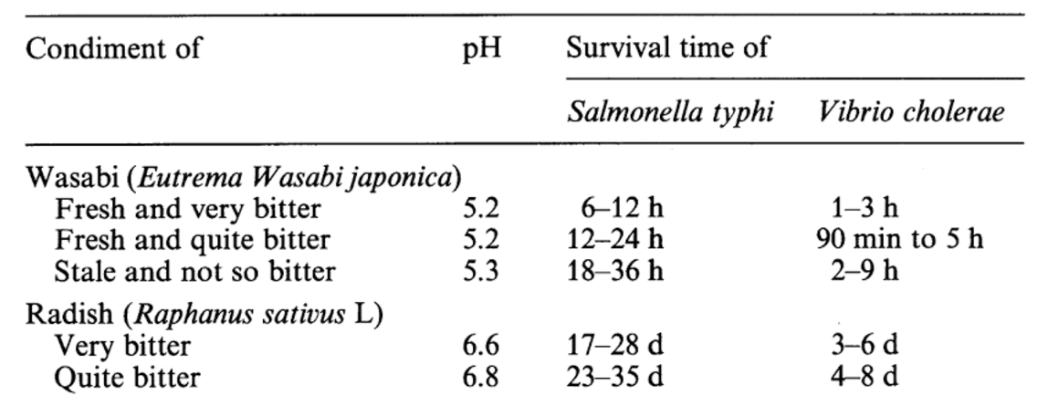
What sustains typhoid during the low season?
Survival of S. Typhi on vegetables, Tetsumoto 1934
Three possible contributors:
  Chronic carriers
  Sustained long-tail shedding
  Environmental persistence
Decline of culturable cells, total cells in unfiltered groundwater. Cho 1999

Slide 24
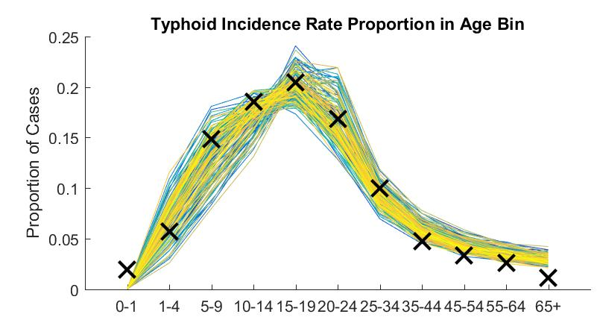
Low-season persistence and the importance of chronic carriers
Chronic carriers are not necessary to capture transmission dynamics in endemic Santiago
Model dynamics, no chronic carriers

Slide 25
Estimating the impact of chronic carriers
Complete cutoff of long cycle transmission in 1991 allows us to estimate short cycle transmission and chronic carrier infectiousness
Vaccination campaign of Ty21a
Environmental intervention

Slide 26
Estimating the impact of chronic carriers
Sustained transmission after 1991 can’t be explained by short cycle transmission without chronic carriers
Chronic carriers are ~18% as infectious as acute cases in this setting
No carrier infectiousness
Fitted carrier infectiousness

Slide 27
Estimating impact of chronic carriers
Public health implications: even with cessation of long cycle transmission, chronic carriers can sustain transmission through the short cycle in this setting
Implications for vulnerable systems: continued impact of intervention, or carrier case finding necessary for elimination scenarios

Slide 28
Estimating vaccine impact: what contributed to the decline in cases?

Slide 29
Fitting changes in incidence
Original assumption: sharp increase in cases in 1983 not necessary to capture decline, fit to mean over years prior to vaccination
Incidence of typhoid in Santiago, Chile
Baseline
• Santiago Data

Slide 30
Fitting changes in incidence
Original assumption: underestimates decline in cases seen
Incidence of typhoid in Santiago, Chile
Baseline
Vaccine
• Santiago Data

Slide 31
Fitting changes in incidence
• Santiago Data
Unemployment rate (%)
GDP change (%)
Food inspection counts
Data courtesy Catterina Ferreccio

Slide 32
We still don’t capture the decrease in incidence
Incidence of typhoid in Santiago, Chile
Vaccine duration of efficacy may be longer than evaluated
7 year maximum follow-up, 3 years or less for less efficacious formulations
Debate regarding environmental impact
No data informing any quantitative changes in exposure through the environment
Incidence per 100,000
Vaccine
Baseline
• Santiago Data
Notes:
62% efficacy, 7 year duration assumed for all vaccines for at least 3 doses, short interval = 216,691
143,451 received non-long term evaluated dosage, used minimum-evaluated years and efficacy %
PLOT LOOKING MUCH CLOSER

Slide 33
We still don’t capture the decrease in incidence
Hint: age distribution of typhoid during/ after the vaccination period
Proportion of total incidence
Notes:
62% efficacy, 7 year duration assumed for all vaccines for at least 3 doses, short interval = 216,691
143,451 received non-long term evaluated dosage, used minimum-evaluated years and efficacy %

Slide 34
Age distribution differs by intervention type
Decline due to environmental intervention
Decline due to vaccine
Model fitted to decline in incidence between 1983 and 1991: 100% attributed to environment vs. vaccine
Distinct shifts in age distribution when decline is due to vaccine
Age distribution conserved across decline for environmental change
Proportion of total incidence
Age bin

Slide 35
Age distribution and vaccine duration
Fitting vaccine duration to age distribution indicates duration may be longer than originally evaluated
Indication of herd effects from typhoid vaccine in Santiago
Application to present day
Best fit model results for age distribution over time
- Simulation
• Santiago Data

Slide 36
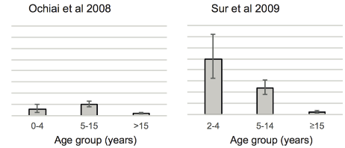
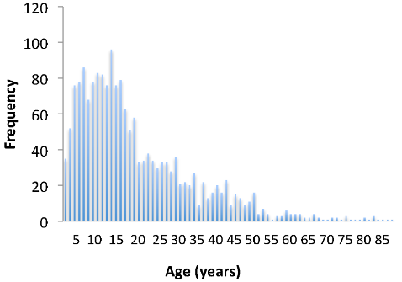
Take-aways from modeling typhoid in Santiago
Age specific exposure and immunity are important to capture the age distribution of typhoid
India
Blantyre, Malawi
Fiji
Sinha 1999
Incidence per 100,000
Age (years)
John et al. 2016
Feasey et al. 2015
Thompson et al. 2014

Slide 37
Take-aways from modeling typhoid in Santiago
Age specific exposure and immunity are important in explaining the age distribution of typhoid
Chronic carriers played a large role in Santiago persistence after long cycle cutoff

Slide 38
Take-aways from modeling typhoid in Santiago
Age specific exposure and immunity are important in explaining the age distribution of typhoid
Chronic carriers played a large role in Santiago persistence after long cycle cutoff
Utilize contextual approaches for vaccine impact estimation

Slide 39
Take-aways from modeling typhoid in Santiago
Age specific exposure and immunity are important in explaining the age distribution of typhoid
Chronic carriers played a large role in Santiago persistence after long cycle cutoff
Utilize contextual approaches for vaccine impact estimation
Parameter uncertainty: how do assumptions change across unknowns?

Slide 40
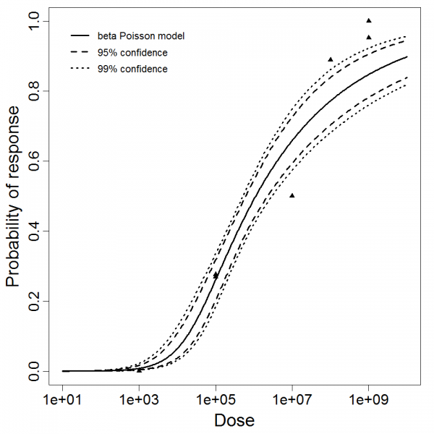
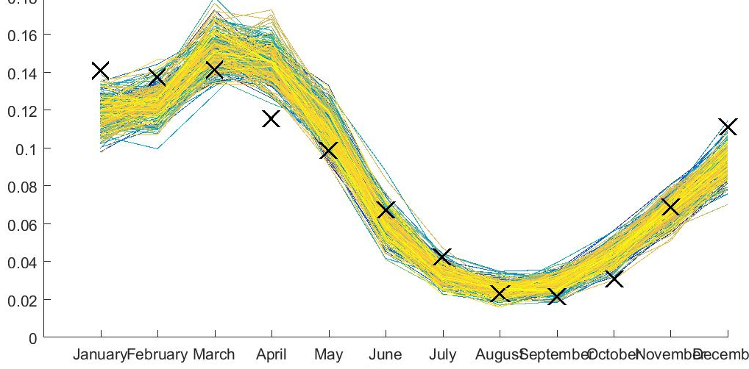
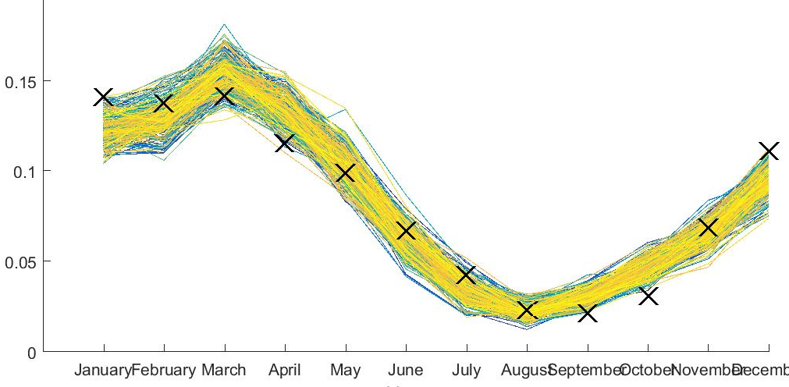
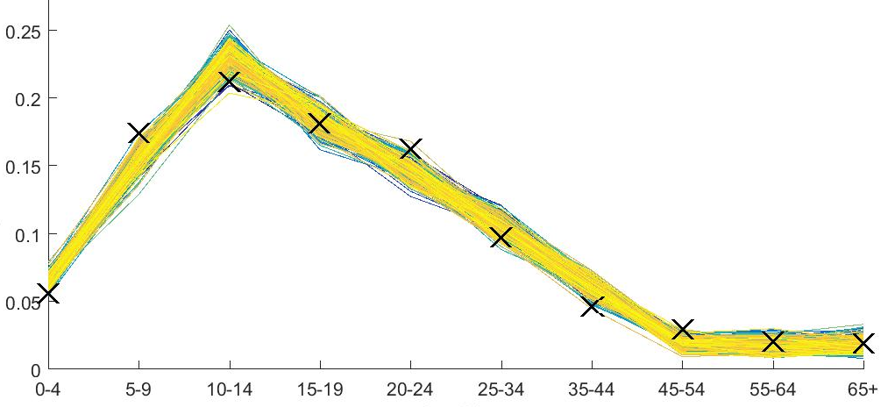
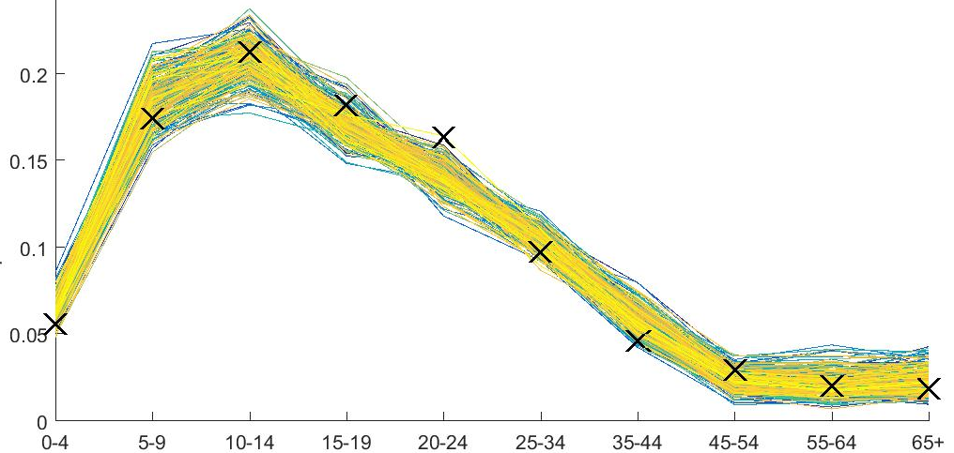
Multiple fits to Santiago data are possible within parameter uncertainty
Daily exposure rate: 0.5
Approximately 50% of population exposed daily
Daily exposure rate: 0.005
Approximately 0.5% of population exposed daily
Seasonality
Seasonality
Source: QMRA wiki
Age Distribution
Age Distribution
-- Simulation
X Data

Slide 41
Multiple fits to Santiago data are possible within parameter uncertainty
Daily exposure rate: 0.5
Approximately 50% of population exposed daily
Daily exposure rate: 0.005
Approximately 0.5% of population exposed daily
Seasonality
Seasonality
Source: QMRA wiki
Age Distribution
Age Distribution
-- Simulation
X Data
Notes:
One slide to totally hide it.
Approximately 0.5% exposed daily
Incubation period
Disease outcomes
Potentially
----- Meeting Notes (5/18/16 17:47) -----
make sure to say high exposure low dose
low exposure high dose

Slide 42
Thanks!
jgauld@intven.com
Hao Hu, Dennis Chao & Epidemiology Team
Thank you to Mike Levine, University of Maryland, for data sharing and collaboration

