Slide 1
Typhoid fever in Blantyre, Malawi: Using spatial and genomic data to identify transmission pathways
Jillian Gauld, Franziska Olgemoeller, Alex Wailan, Peter Diggle, Nick Feasey
April 16, 2018
Institute for Disease Modeling Annual Symposium

Slide 2
Transmission of S. Typhi
“Short-cycle” and “long-cycle”
Unknown in most locations
Understanding transmission pathways: targeted interventions, vaccine impact estimates
Short cycle
Long cycle
contaminated food

Slide 3
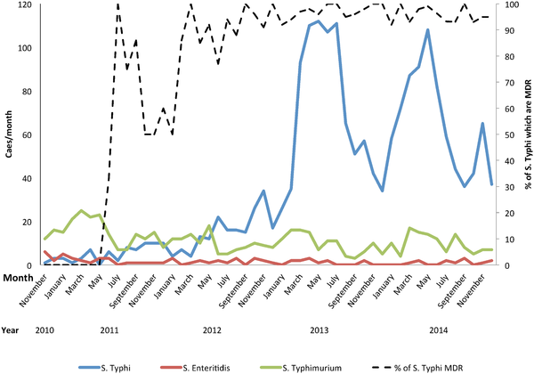
Blantyre context
Increase in cases starting ~2011, majority MDR
Dominant transmission routes unknown
Cohort study including GPS coordinates of households of typhoid fever cases and whole genome sequences starting in mid-2015
Nested case-control study conducted through MLW to assess risk factors
Feasey et al, 2015
Notes:
UPDATE THE FIGURE

Slide 4
Case-control study
Data collection by Fran Olgemoeller et al.
Nested case control study of children 8 years of age and younger
Exposure related variables spanning water usage, food storage, other risk factors
Largest odds ratios (other than healthcare-seeking): water usage patterns for cooking and cleaning
  Those using river water for cooking and cleaning had 3.7 (95% CI 1.4-9.5) odds of being a case
  Using open dug wells for cooking and cleaning also high 3.07 (95% CI 1.7-8.0)
• Cases
• Controls
Notes:
Variable selection: 1. forwards/backwards AIC selection 2. likelihood ratio test. 16 variables in final model

Slide 5
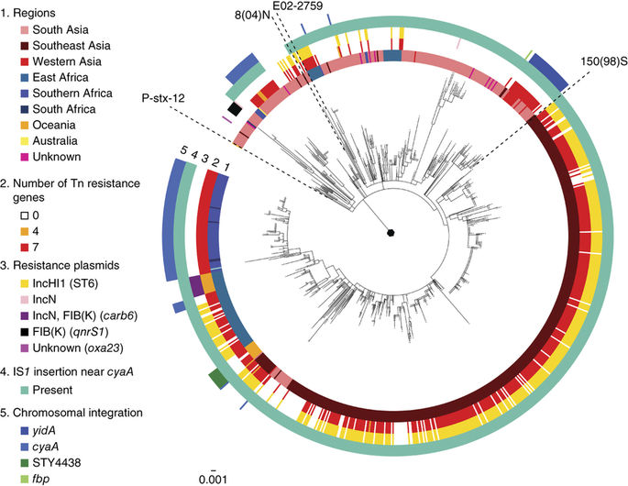
Whole genome sequencing on a small geographic scale
Historically difficult to detect patterns within small geographic regions
  Highly clonal
  Chronic carriers
Work at Sanger to identify parts of the genome that are informative to transmission
Wong et al, 2015

Slide 6
Whole genome sequencing on a small geographic scale
Historically difficult to detect patterns within small geographic regions
  Highly clonal
  Chronic carriers
Work at Sanger to identify parts of the genome that are informative to transmission
Can genomics aid in understanding typhoid transmission within Blantyre?
Tree generated by Alex Wailan, Sanger
Notes:
7 major clusters highlighted
Maximum likelihood tree– root to tip approach.

Slide 7
Exploring spatial patterns of genomics
  Motivation for spatio-genetic modeling: Significant association between genetic and spatial distances
  What are the spatial scales of genetic relatedness as a proxy for transmission scales?
  Can we predict these patterns with any environmental variables?
Multidimensional scaling to decompose pairwise distance matrix into informative variables for modeling
Axis 2
Axis 1

Slide 8
Predicting genetic relatedness
Variogram of axis 2 indicates spatial-genetic correlation is captured
Fitted model indicates significant spatial correlation of genetic relatedness
Interesting on its own, but what possible transmission mechanisms operate on this scale?
Model prediction
Axis 2

Slide 9
Exploring possible predictors
Hypothesis driven by case-control results
Explore ability of river catchment across city to predict genetic relatedness

Slide 10
Exploring possible predictors
Hypothesis driven by case-control results
Explore ability of river catchment across city to predict genetic relatedness
Shapefiles from Costly Chanza

Slide 11
Findings: Including both river catchment and spatial correlation in the model is significantly better at predicting genetic relatedness than either alone
Prediction: Spatial alone
Axis 2

Slide 12
Findings: Including both river catchment and spatial correlation in the model is significantly better at predicting genetic relatedness than either alone
Prediction: Spatial alone
Prediction: Rivers alone
Axis 2

Slide 13
Findings: Including both river catchment and spatial correlation in the model is significantly better at predicting genetic relatedness than either alone
Prediction: Spatial alone
Prediction: Rivers + spatial
Prediction: Rivers alone
Axis 2

Slide 14
Interpreting model results
Including river catchment removes large scale spatial patterns of genetic relatedness seen in spatial-only model
Fitted variogram: spatial clustering of genetics up to 200m
“nugget” of variogram is explained by within-household variance
Prediction: Rivers + spatial
Axis 2
Estimated scale of spatial correlation (m)

Slide 15
Take-aways:
Physical distance and SNP distance are significantly correlated in Blantyre, Malawi
River catchment predicts the large-scale spatial correlation seen in Blantyre, but there is still small-scale spatial clustering of genetic relatedness (short-cycle transmission?)
Large amount of non-spatial genetic variation remains to be explained, possible explanations: chronic carriage, other transmission routes

Slide 16
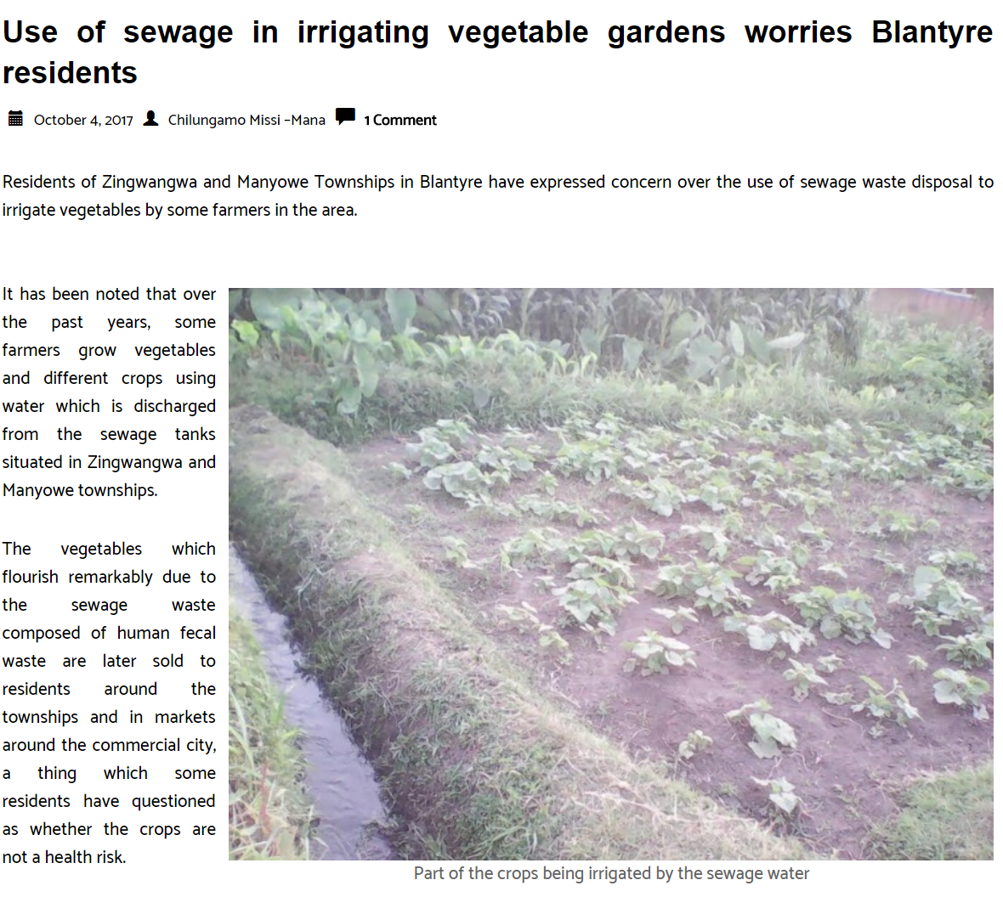

Take-aways:
Physical distance and SNP distance are highly correlated in Blantyre, Malawi
River catchment predicts the large-scale spatial correlation seen in Blantyre, but there is still small-scale spatial clustering of genetic relatedness (short-cycle transmission?)
Large amount of non-spatial genetic variation remains to be explained, possible explanations: chronic carriage, other transmission routes
Map of residual spatial variation S(x)

Slide 17
Take-aways for environmental sampling:
Cooking and cleaning water may be as important (or more important) of a focus for environmental sampling than drinking water in some locations
If methodologically possible, sequencing may help confirm or refute the findings from this study (do ES sequences cluster similarly to active cases?)
Distinguishing exposure vs. shedding in rivers

