Slide 1
A road to malaria elimination in Zambia:
Using mathematical models to inform malaria control and elimination strategies
Jaline Gerardin
April 17, 2018

Slide 2
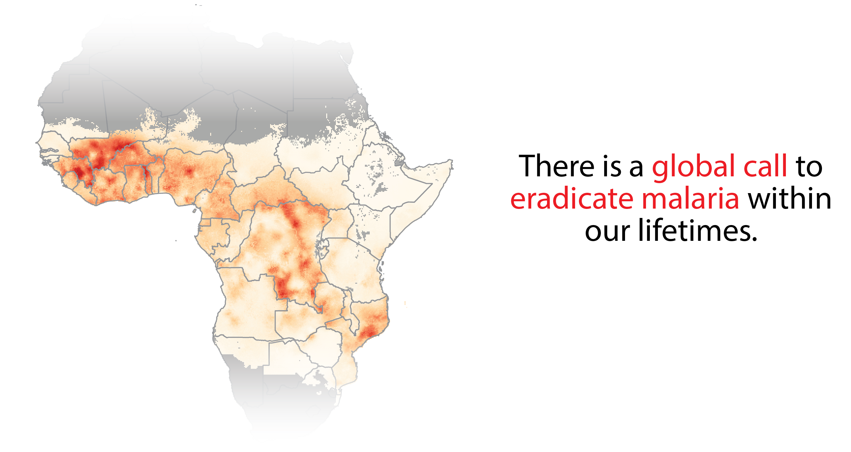


Slide 3
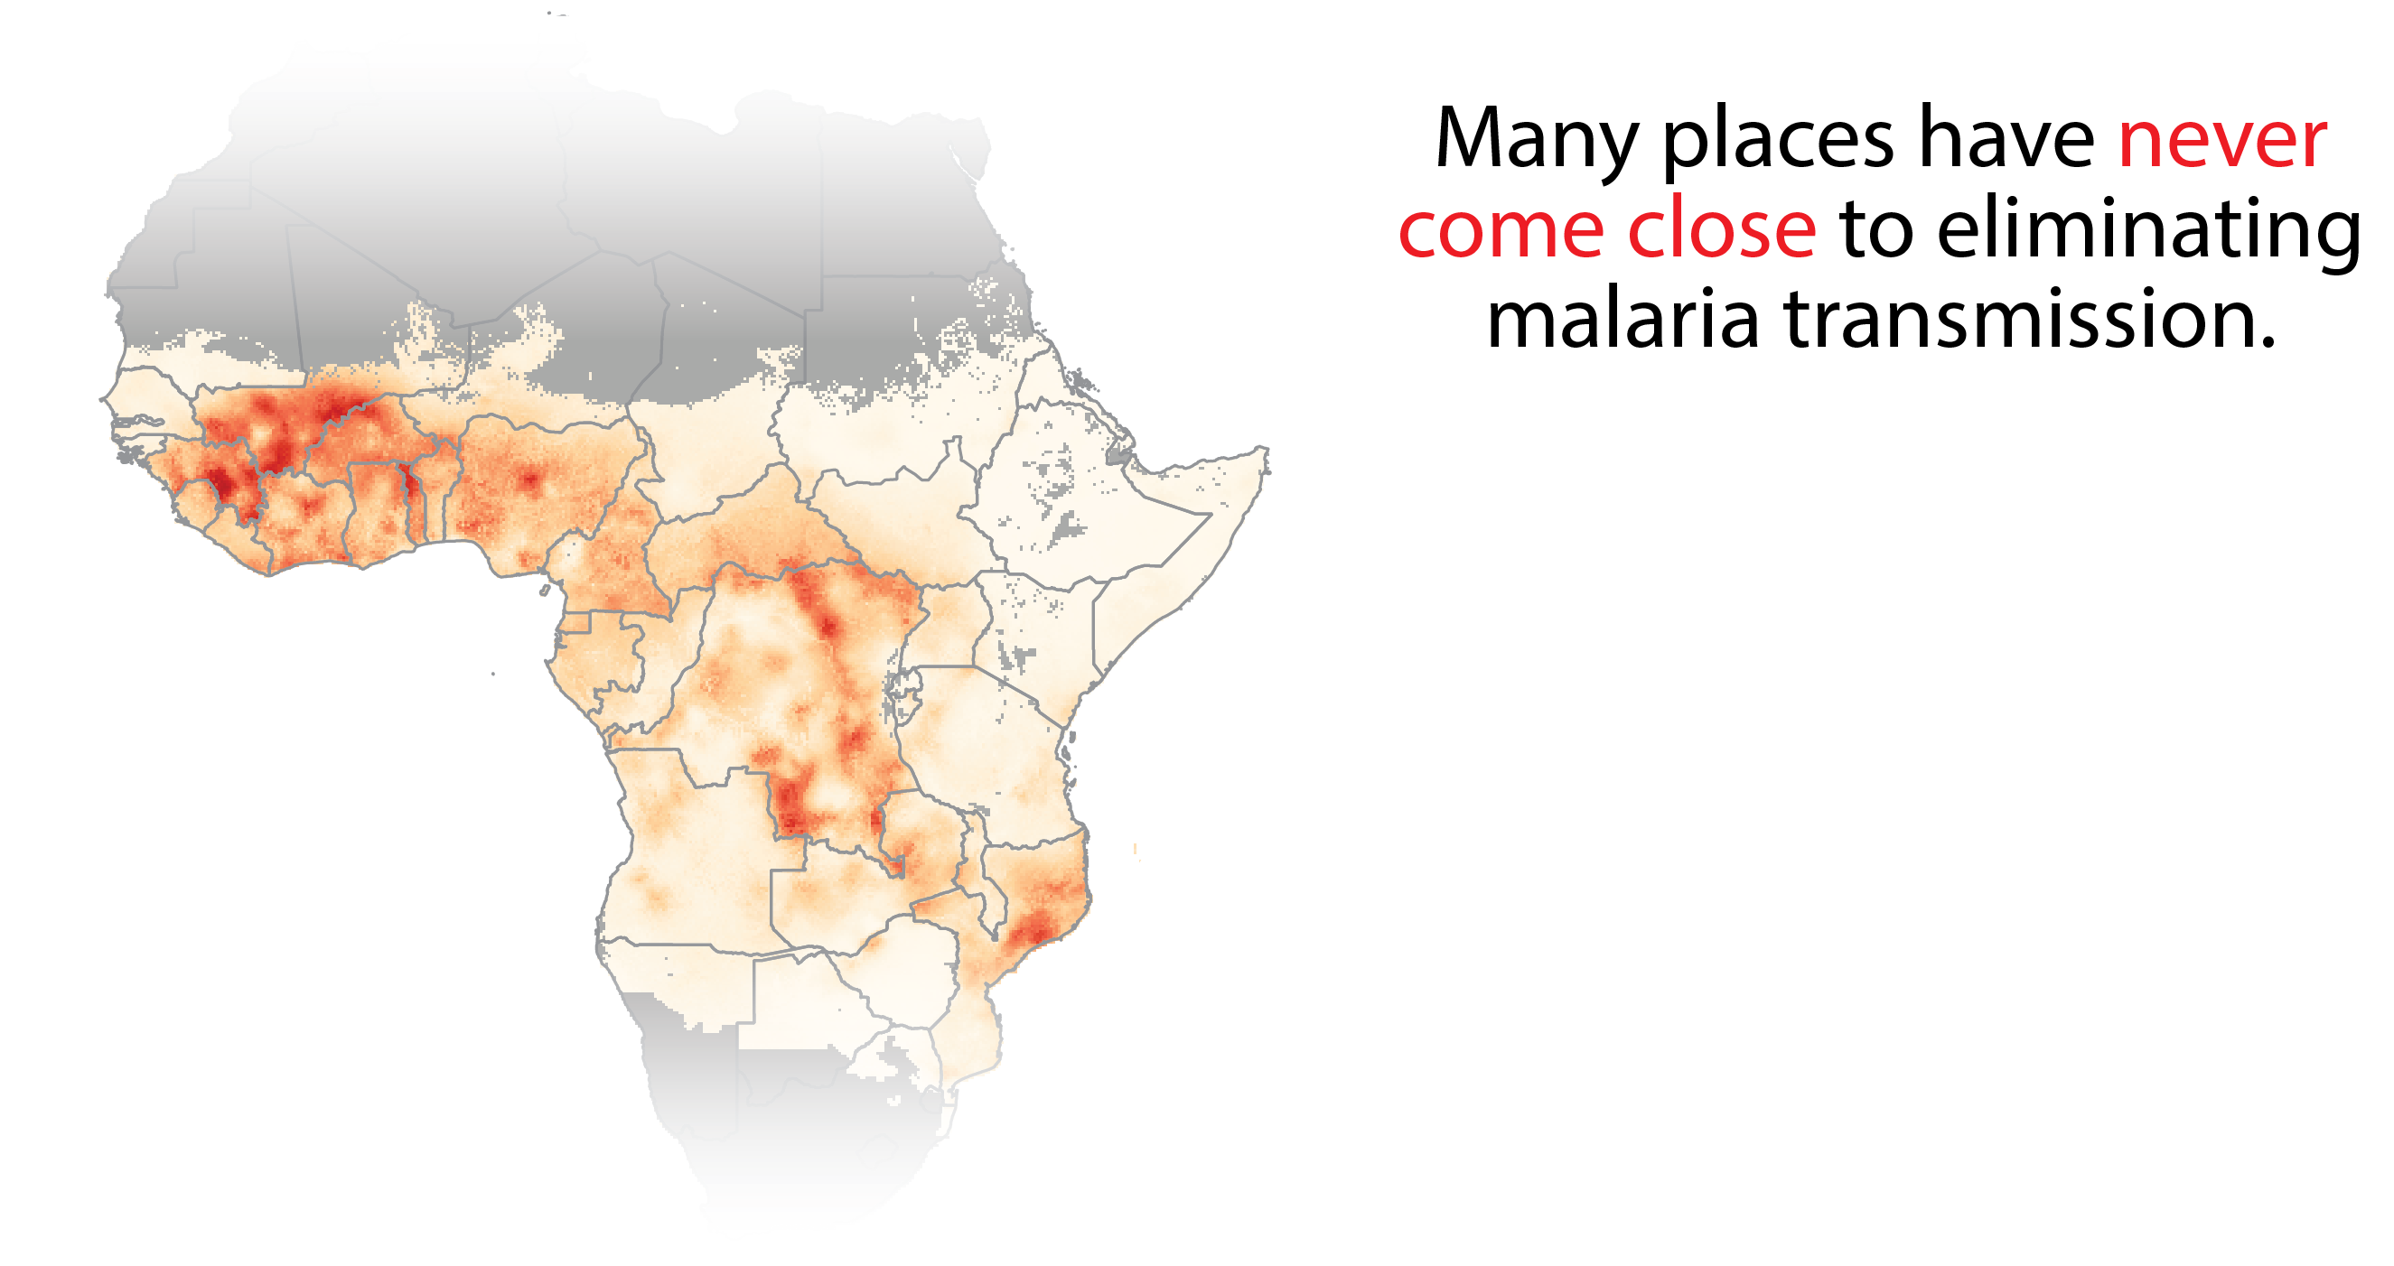
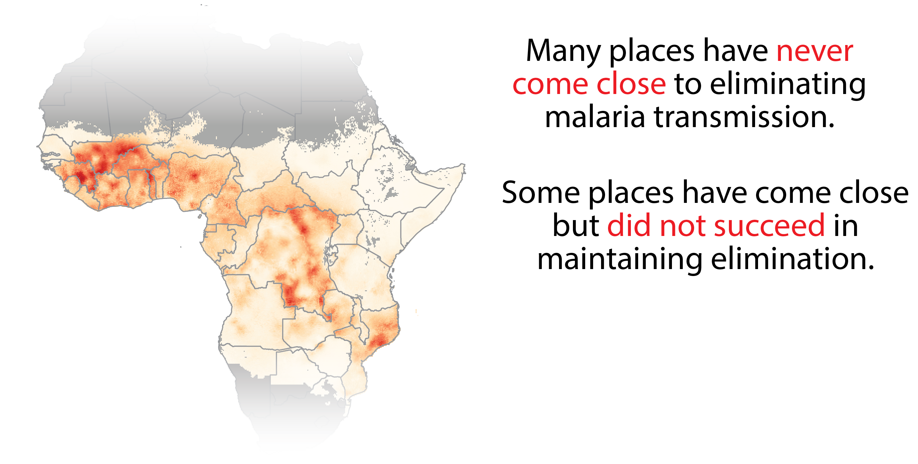
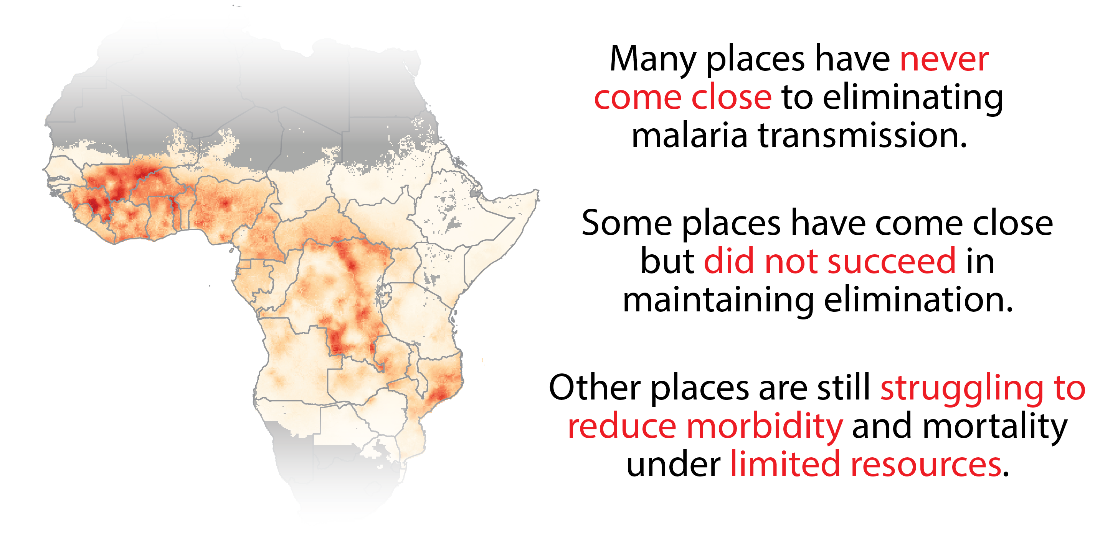

Slide 4
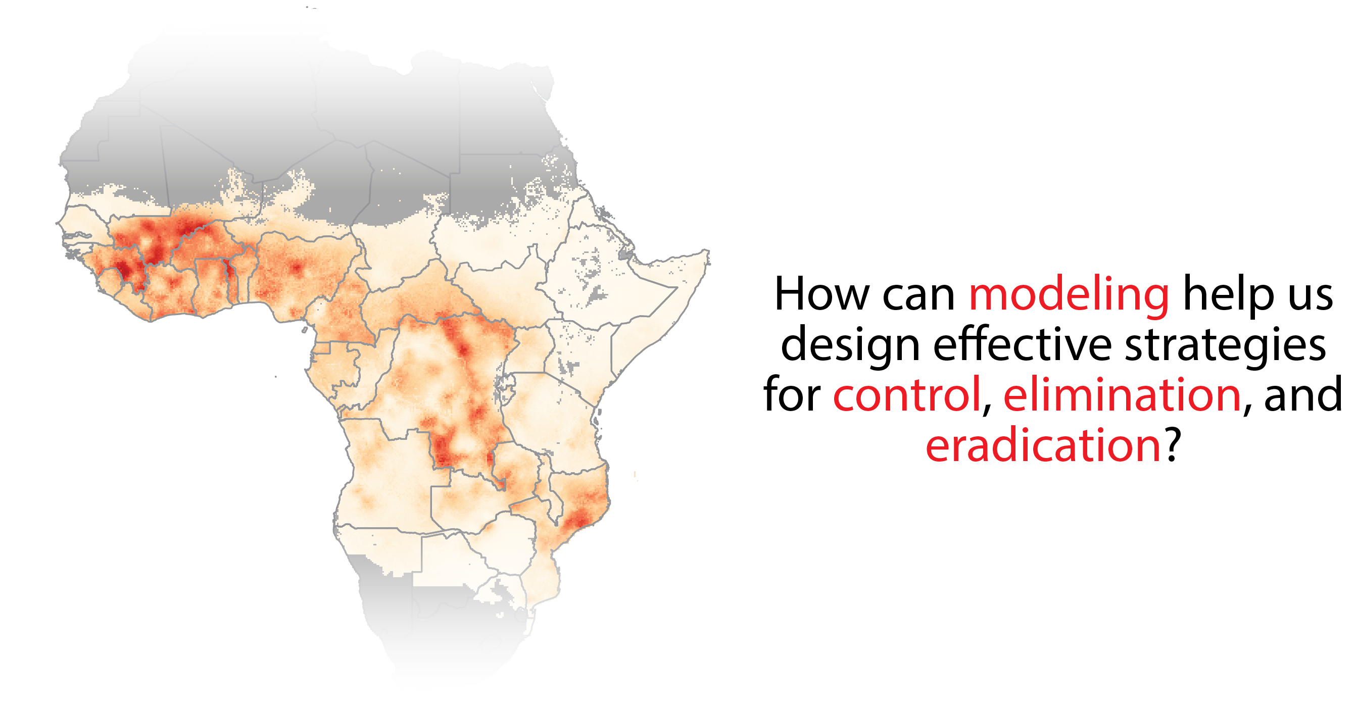

Slide 5
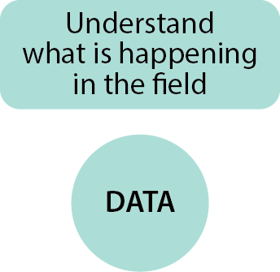
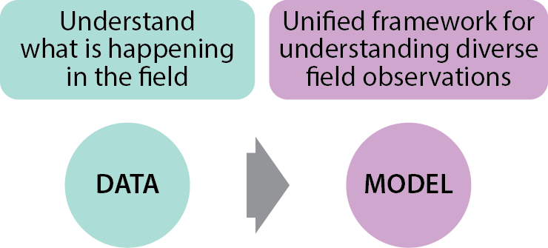
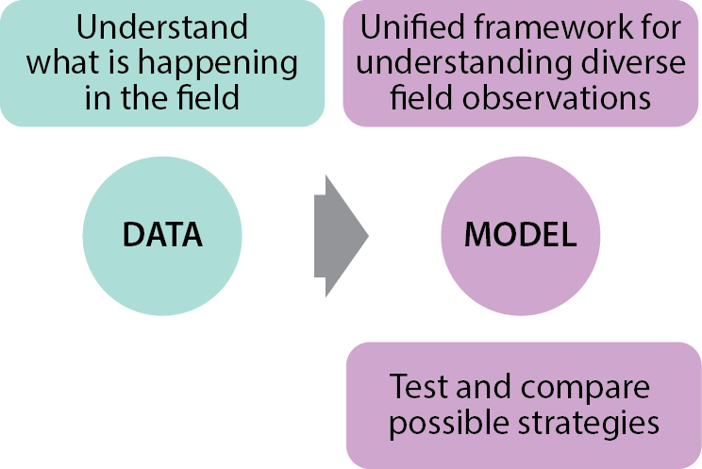
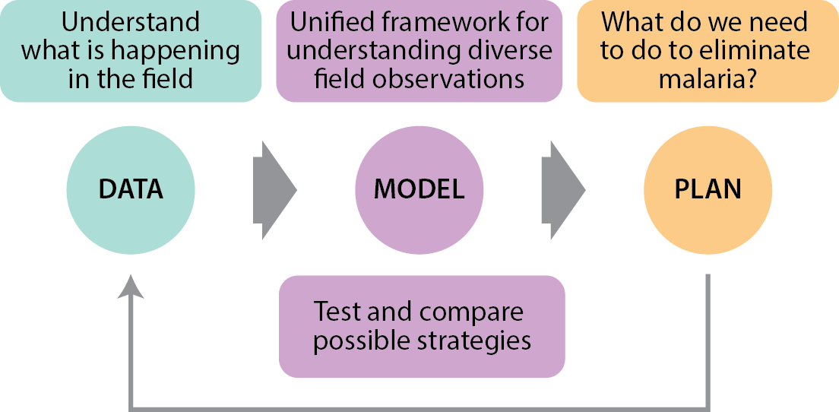

Slide 6
What is a strategy for malaria elimination in southern Africa?
Stratification as a means of efficient use of resources
Developing a model of malaria transmission
Creating a framework for stratification in Zambia

Slide 7
What is a strategy for malaria elimination in southern Africa?
Stratification as a means of efficient use of resources
Developing a model of malaria transmission
Creating a framework for stratification in Zambia

Slide 8
Stratification allows elimination goals to be achieved while limiting wasted resources
Stratification: The spatial targeting of interventions necessary to achieve control/elimination goals
Recommendations should be based on achievable implementation
Scale is based on functional operational units
Reported case rates by district 2011 (case counts by facility)
Caitlin Bever

Slide 9
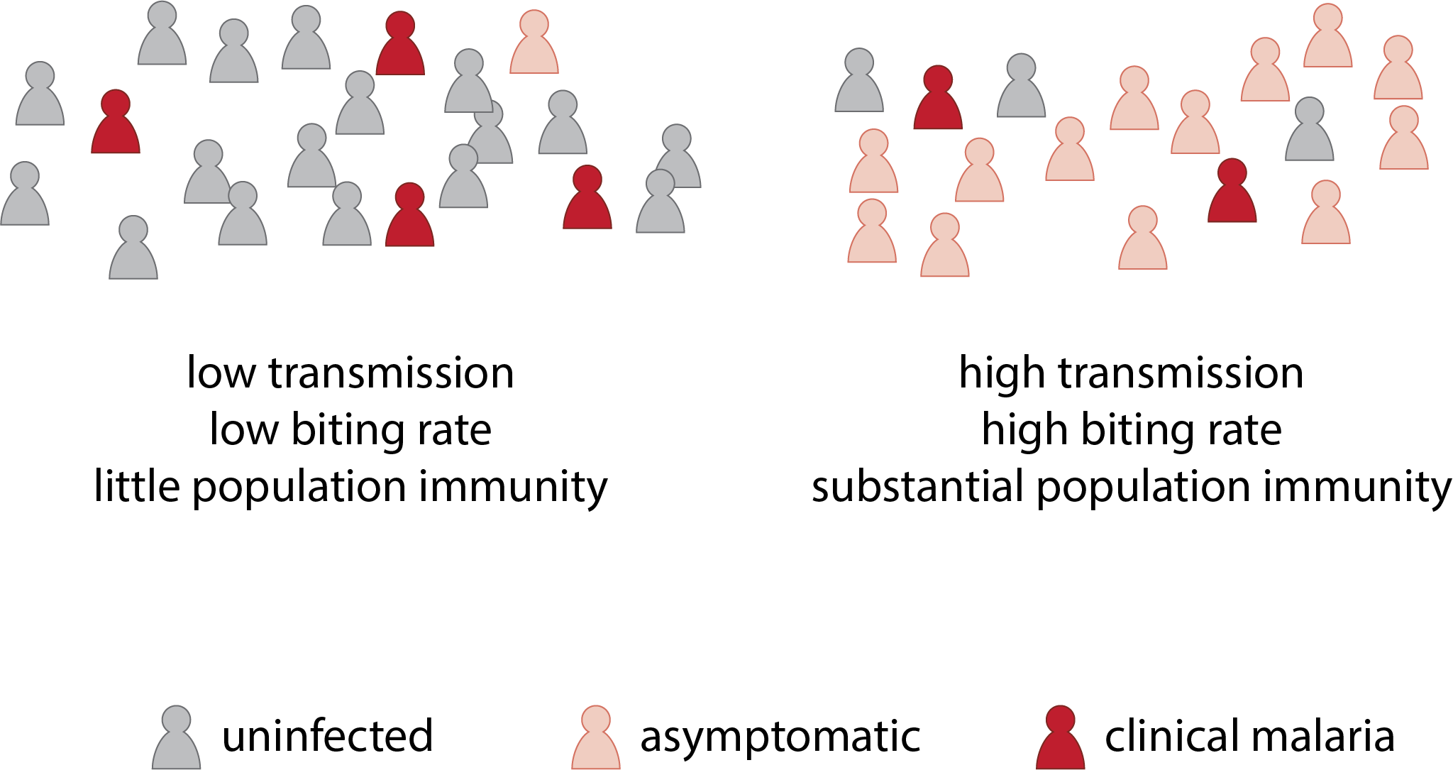
What are the relevant dimensions for classification?
Baseline transmission intensity
Population clustering
Rate of imported infections

Slide 10
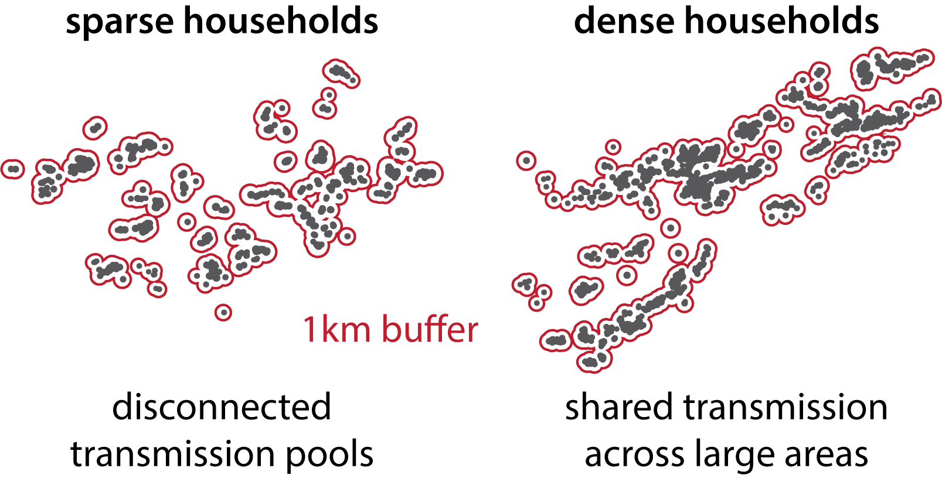
What are the relevant dimensions for classification?
Baseline transmission intensity
Population clustering
Rate of imported infections

Slide 11
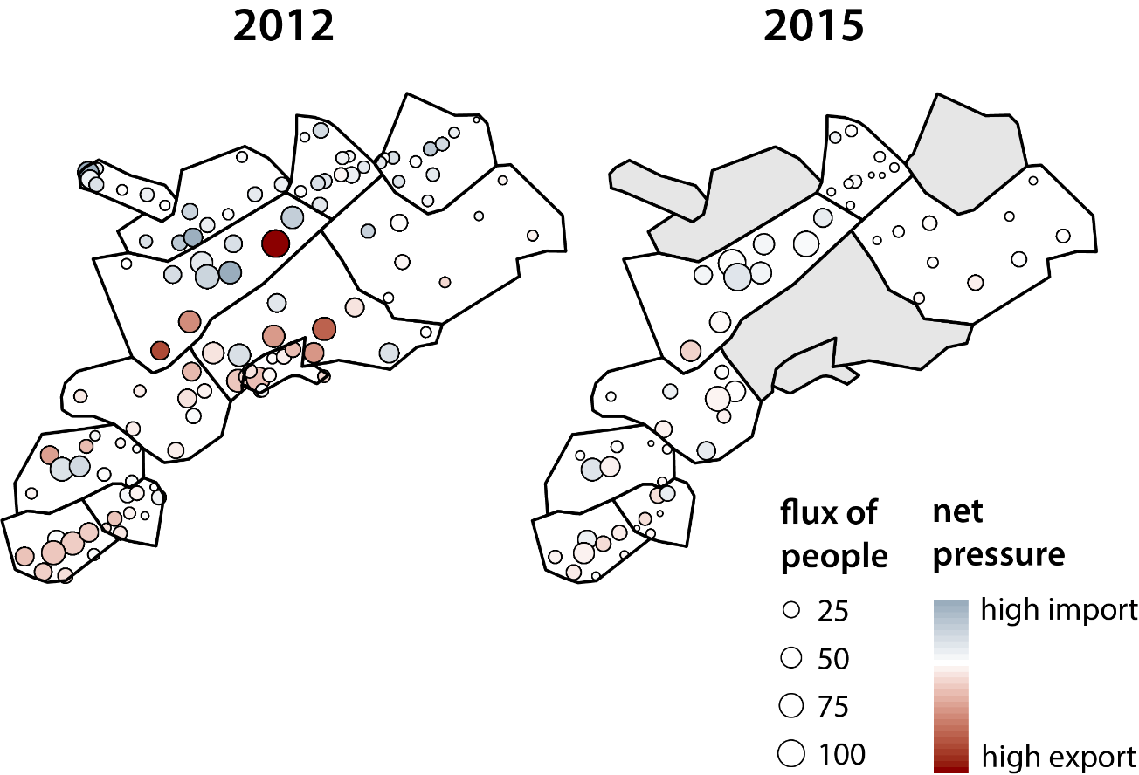
What are the relevant dimensions for classification?
Baseline transmission intensity
Population clustering
Rate of imported infections

Slide 12
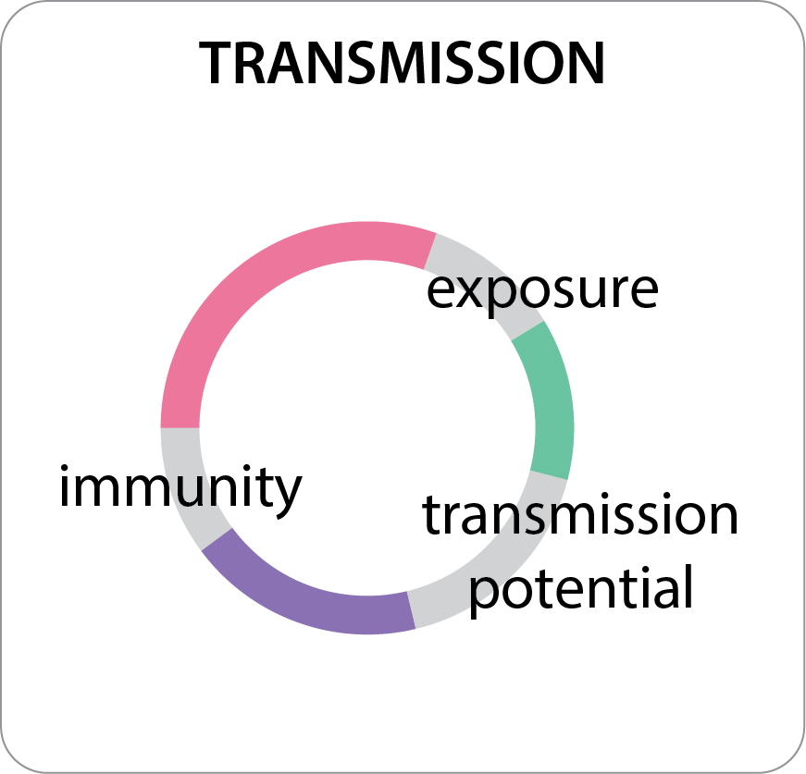
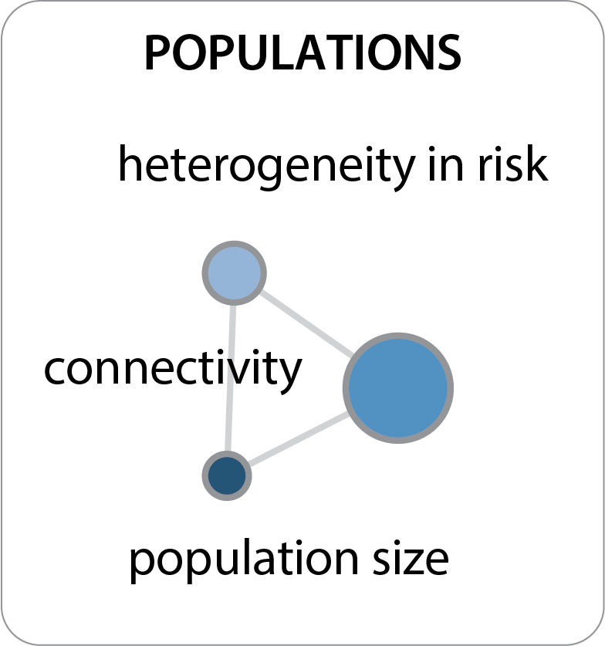
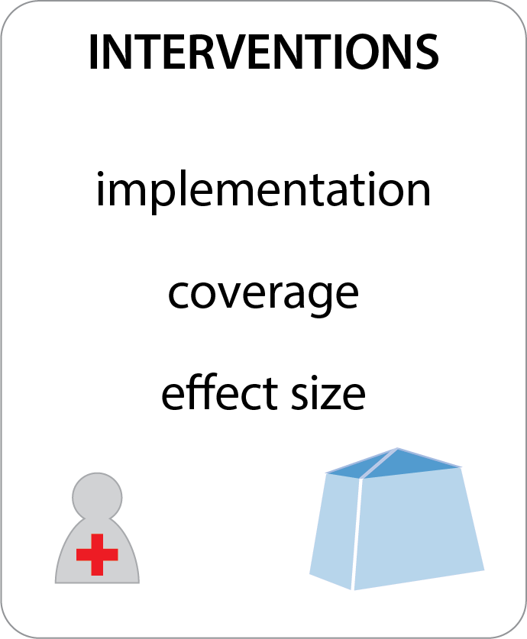
What are key elements to get right in our models?

Slide 13
What is a strategy for malaria elimination in southern Africa?
Stratification as a means of efficient use of resources
Developing a model of malaria transmission
Creating a framework for stratification in Zambia

Slide 14
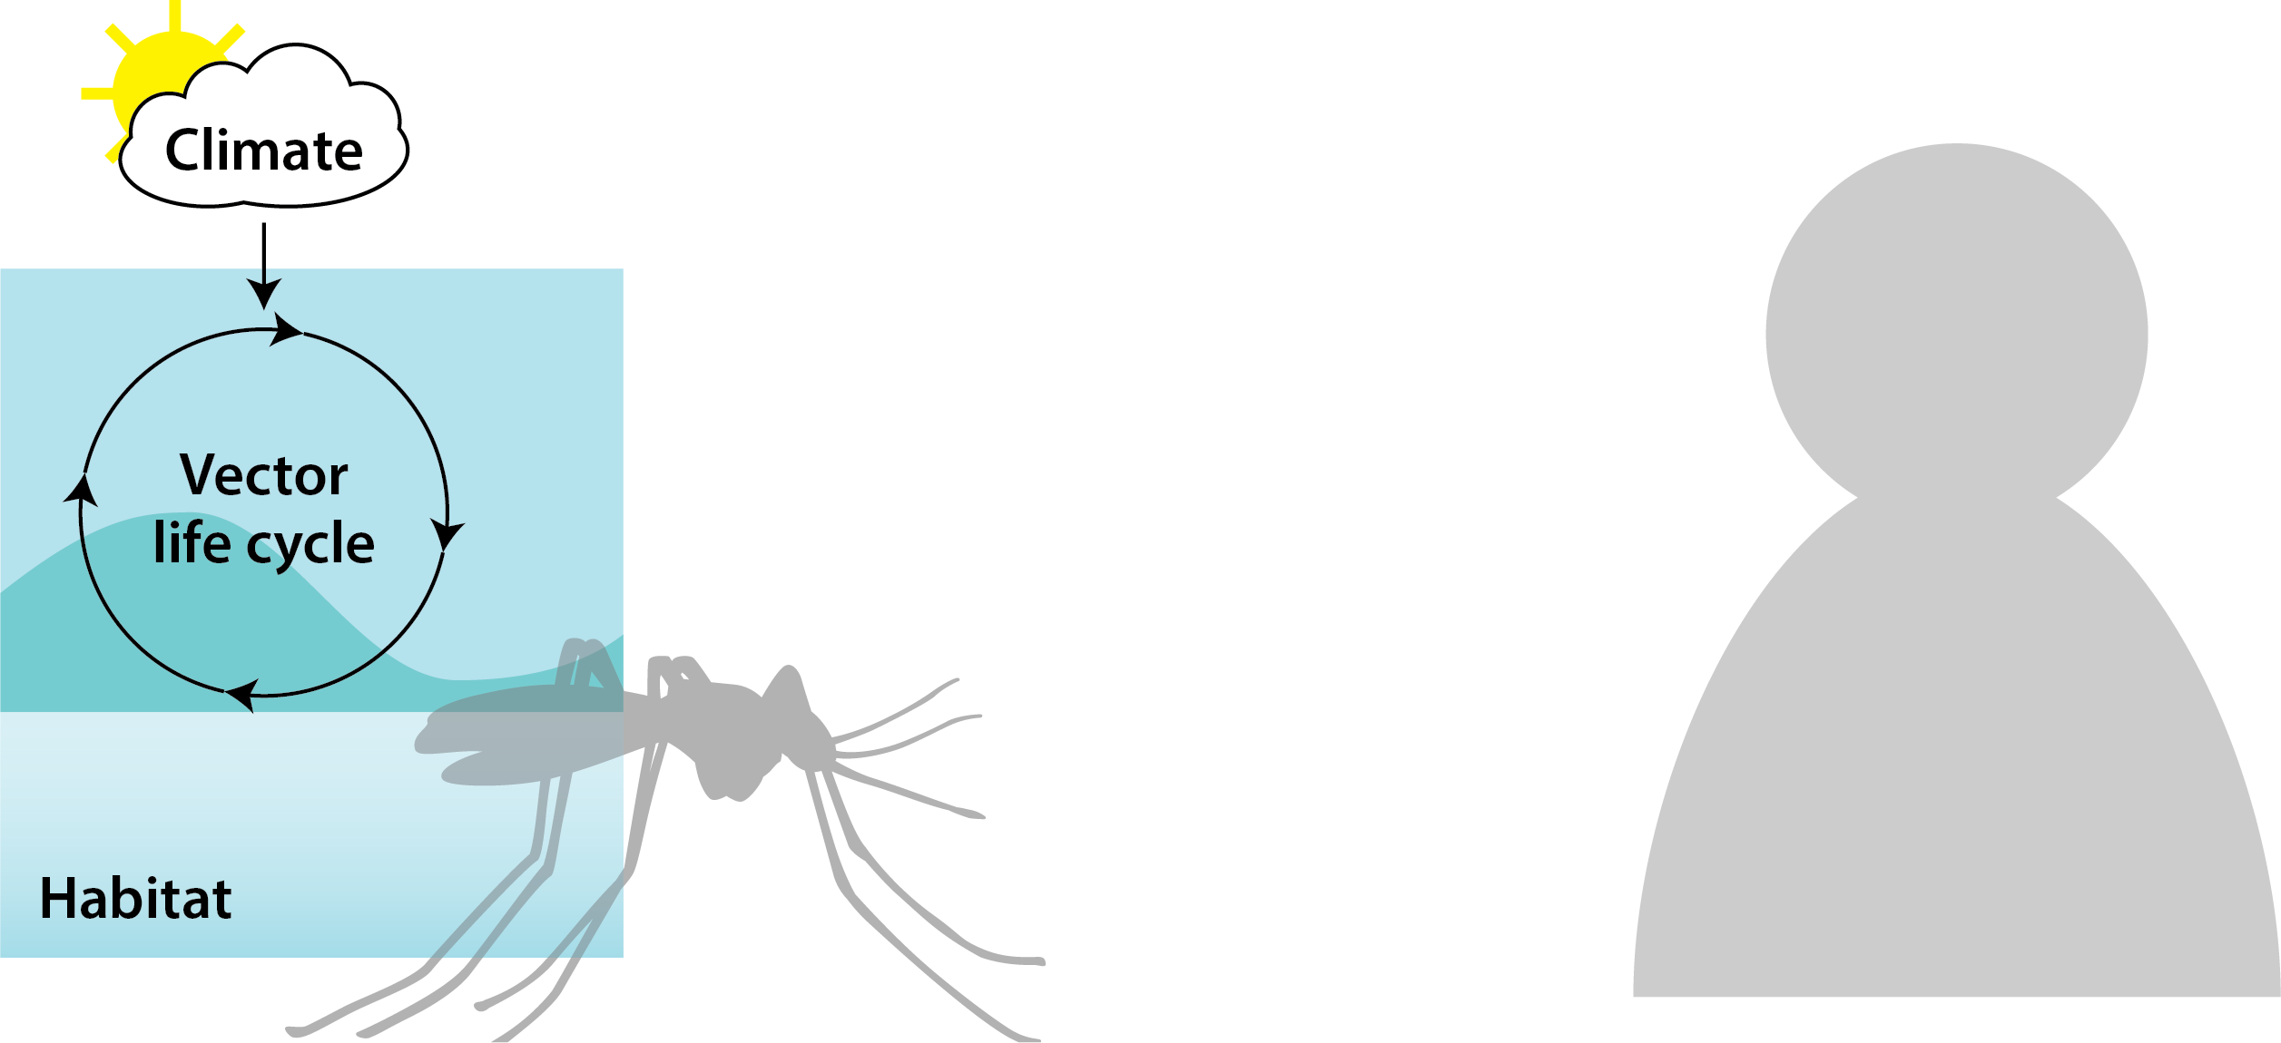
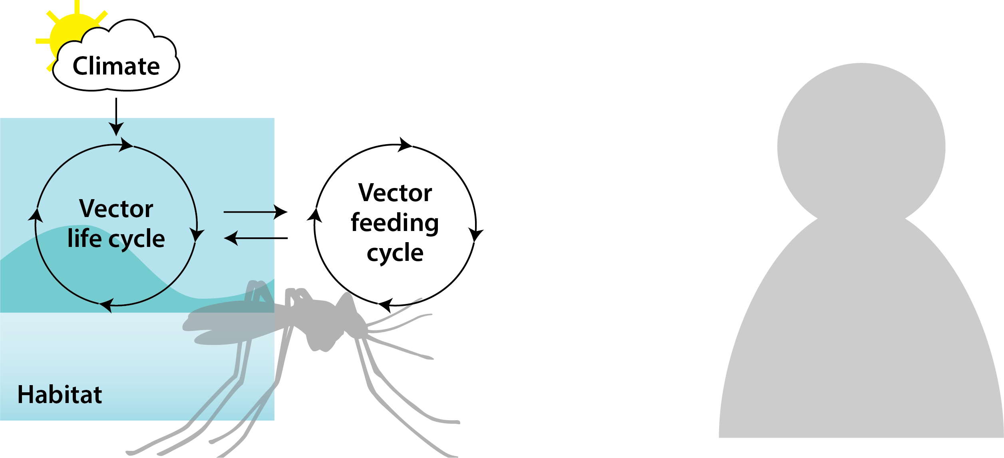
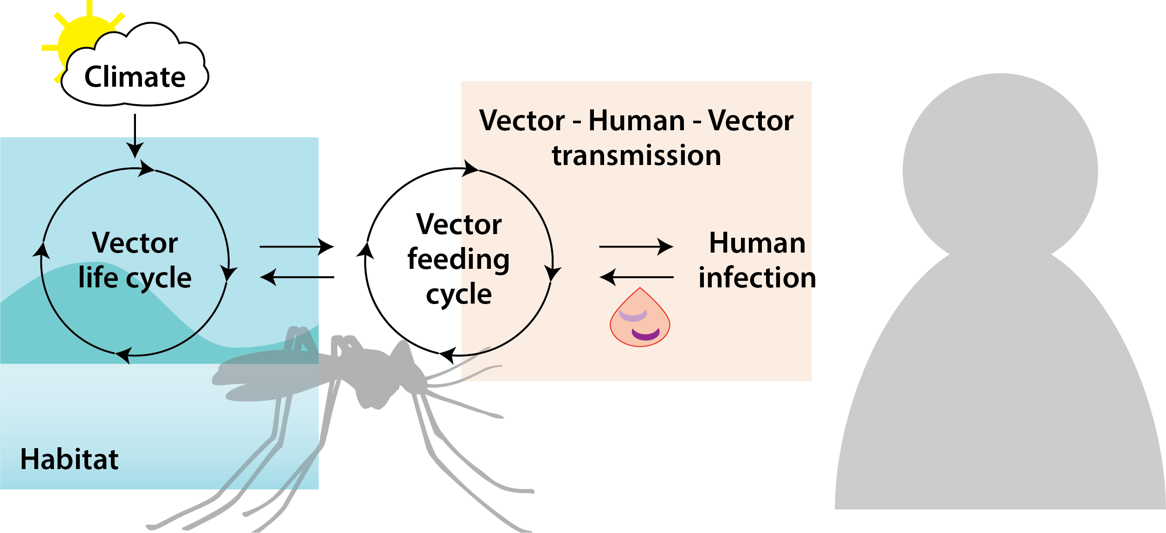
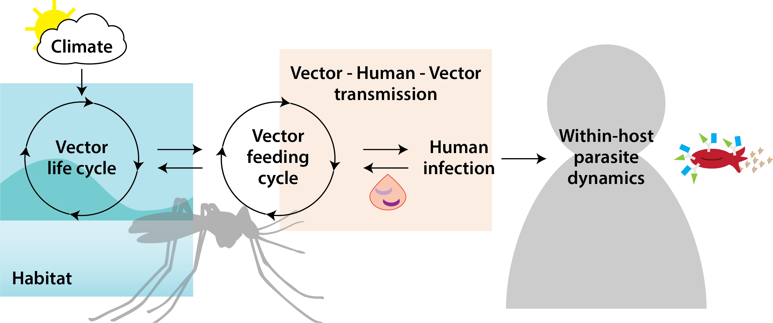
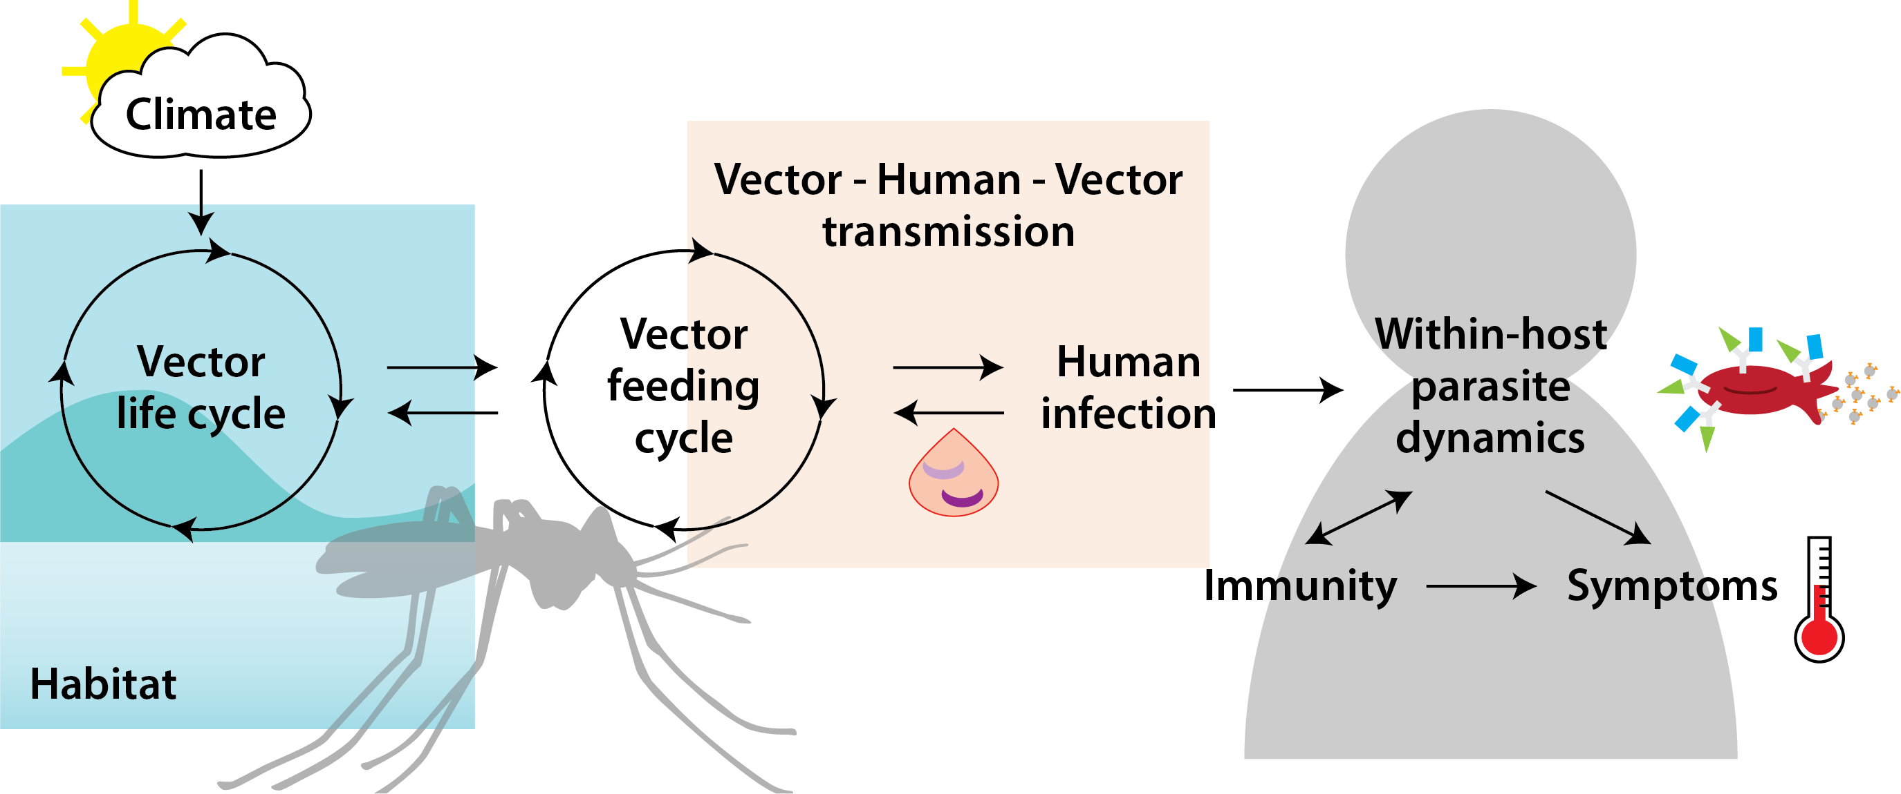

EMOD is a modular, individual-based model

Slide 15
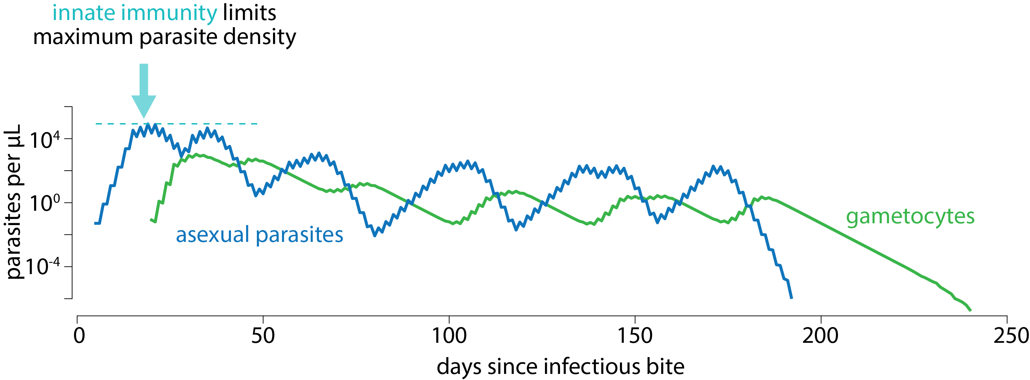
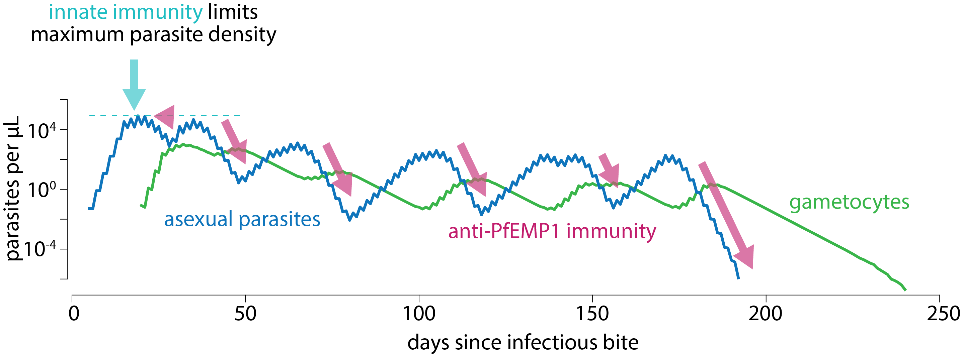
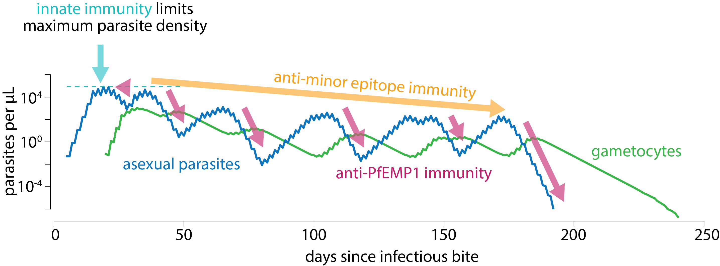
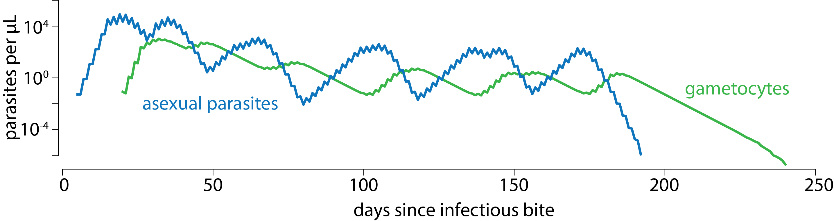
Immunity shapes the course of individual infections

Slide 16
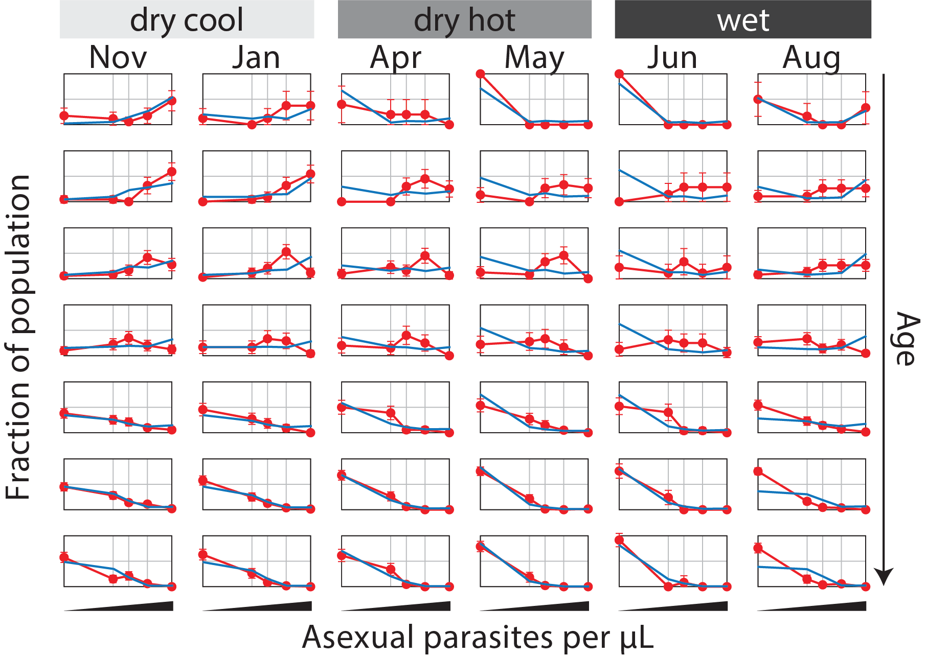
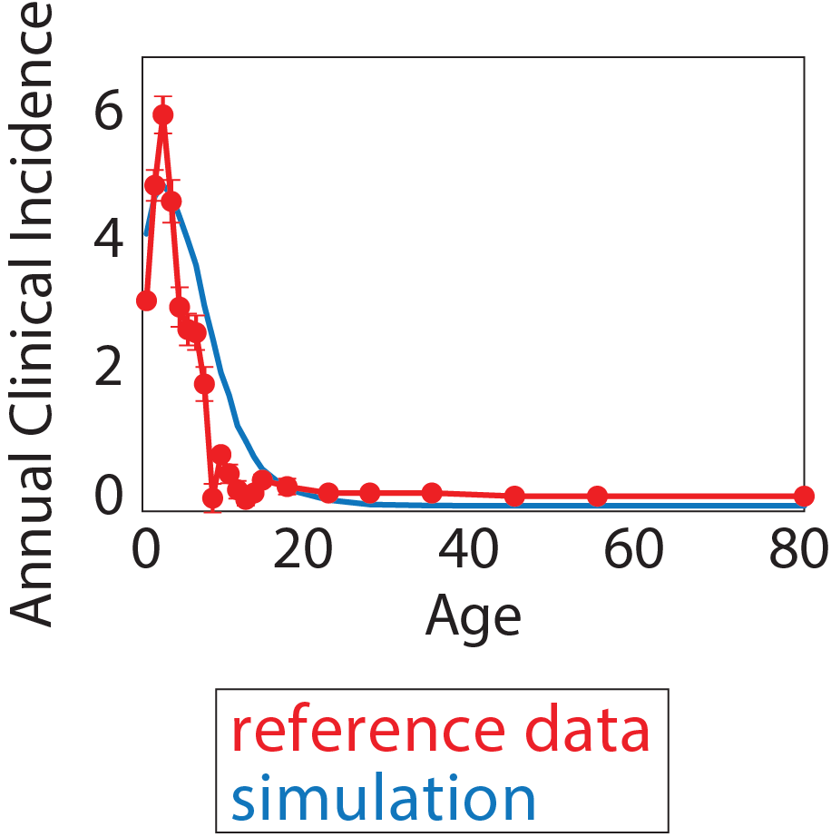
Parasite dynamics and acquisition of immunity are calibrated to field data…
P Selvaraj in review

Slide 17
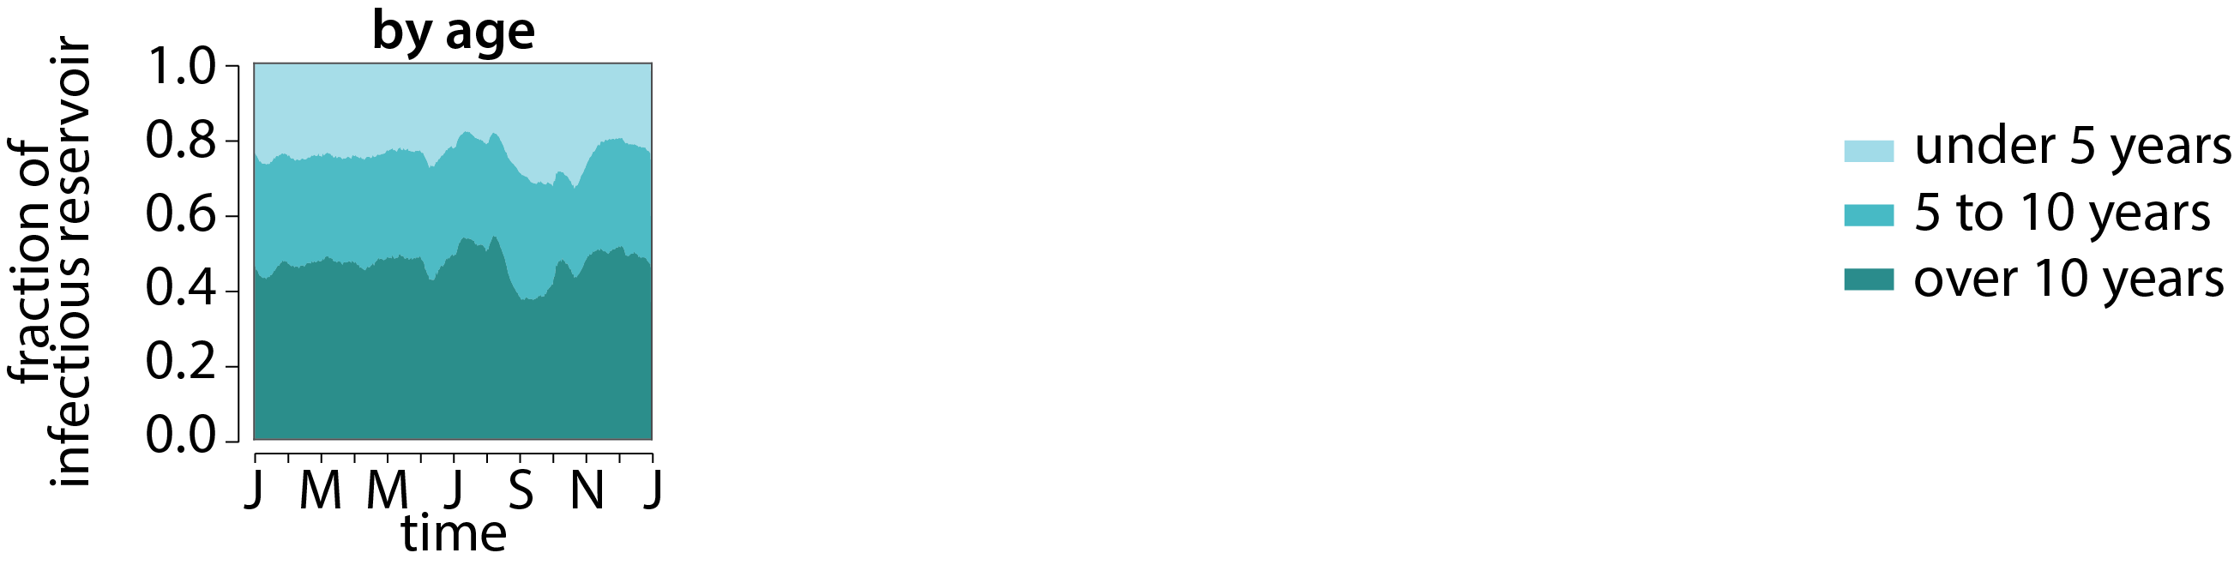
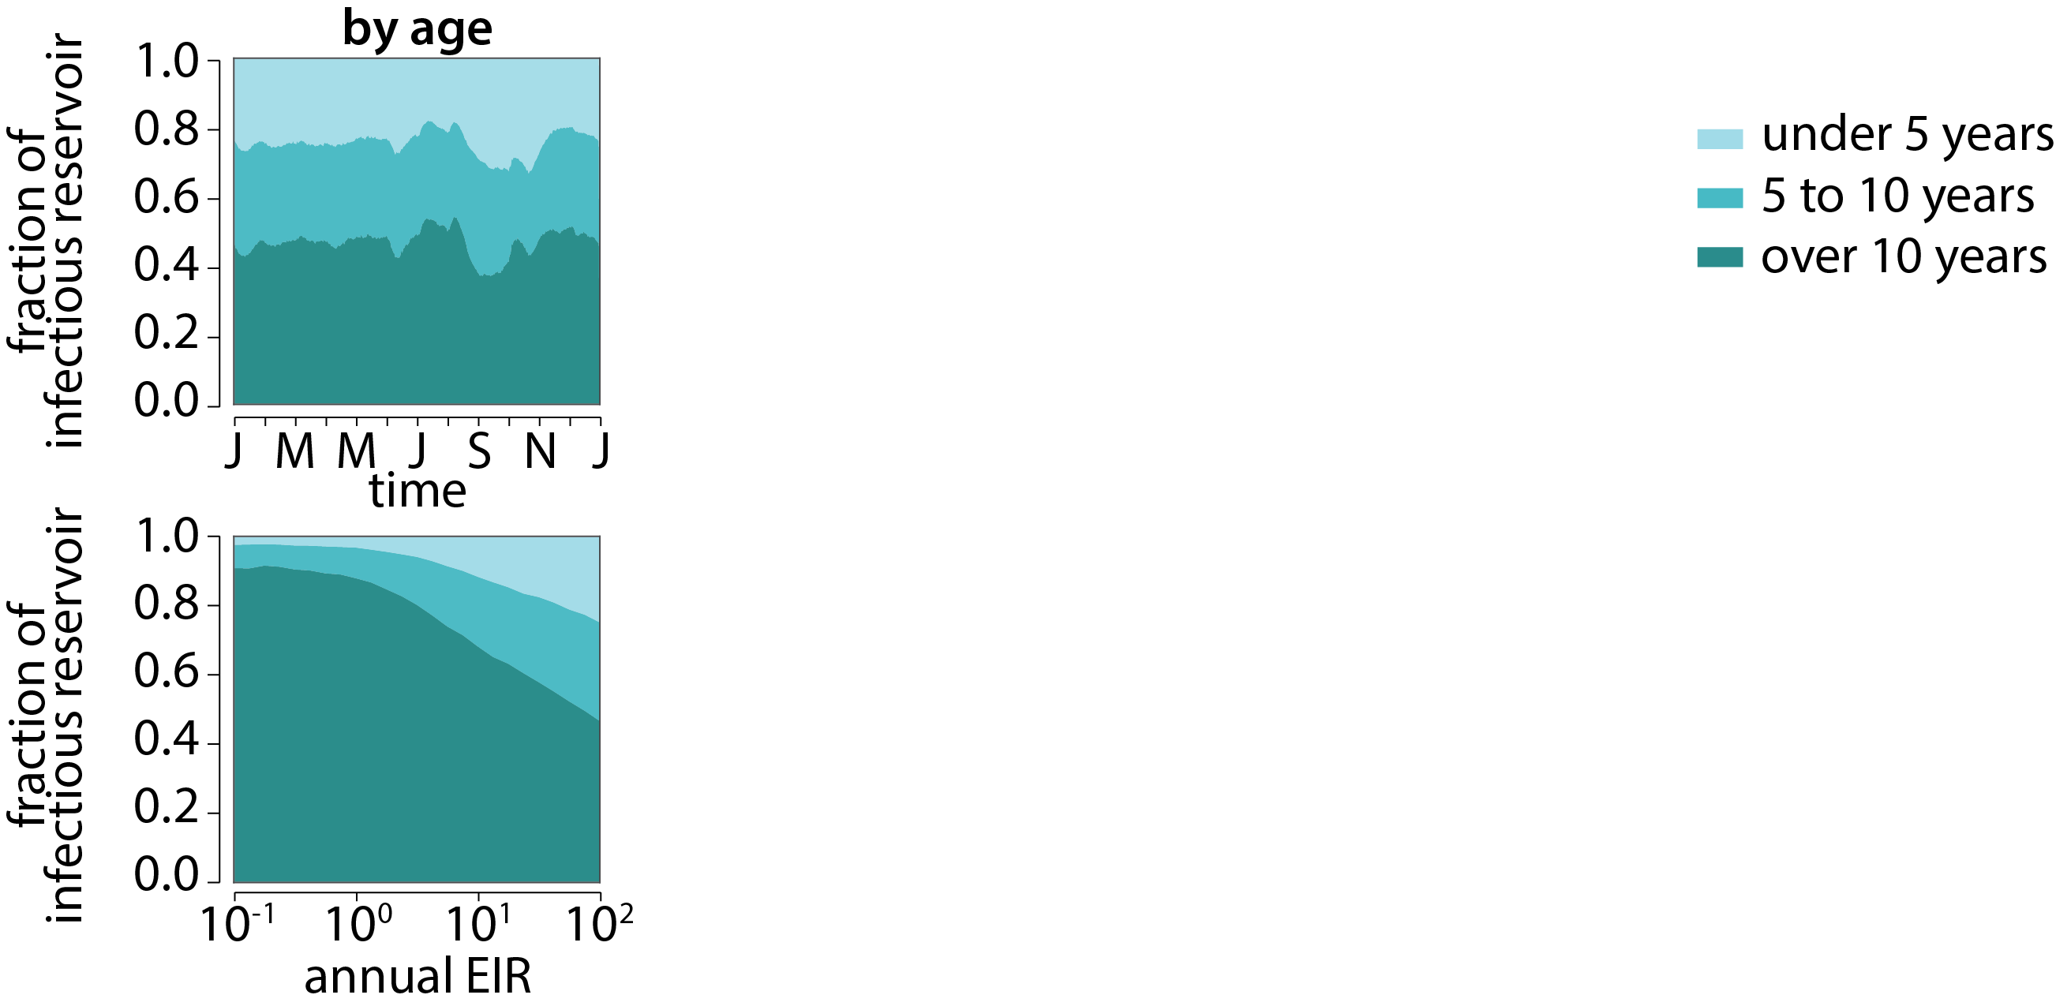
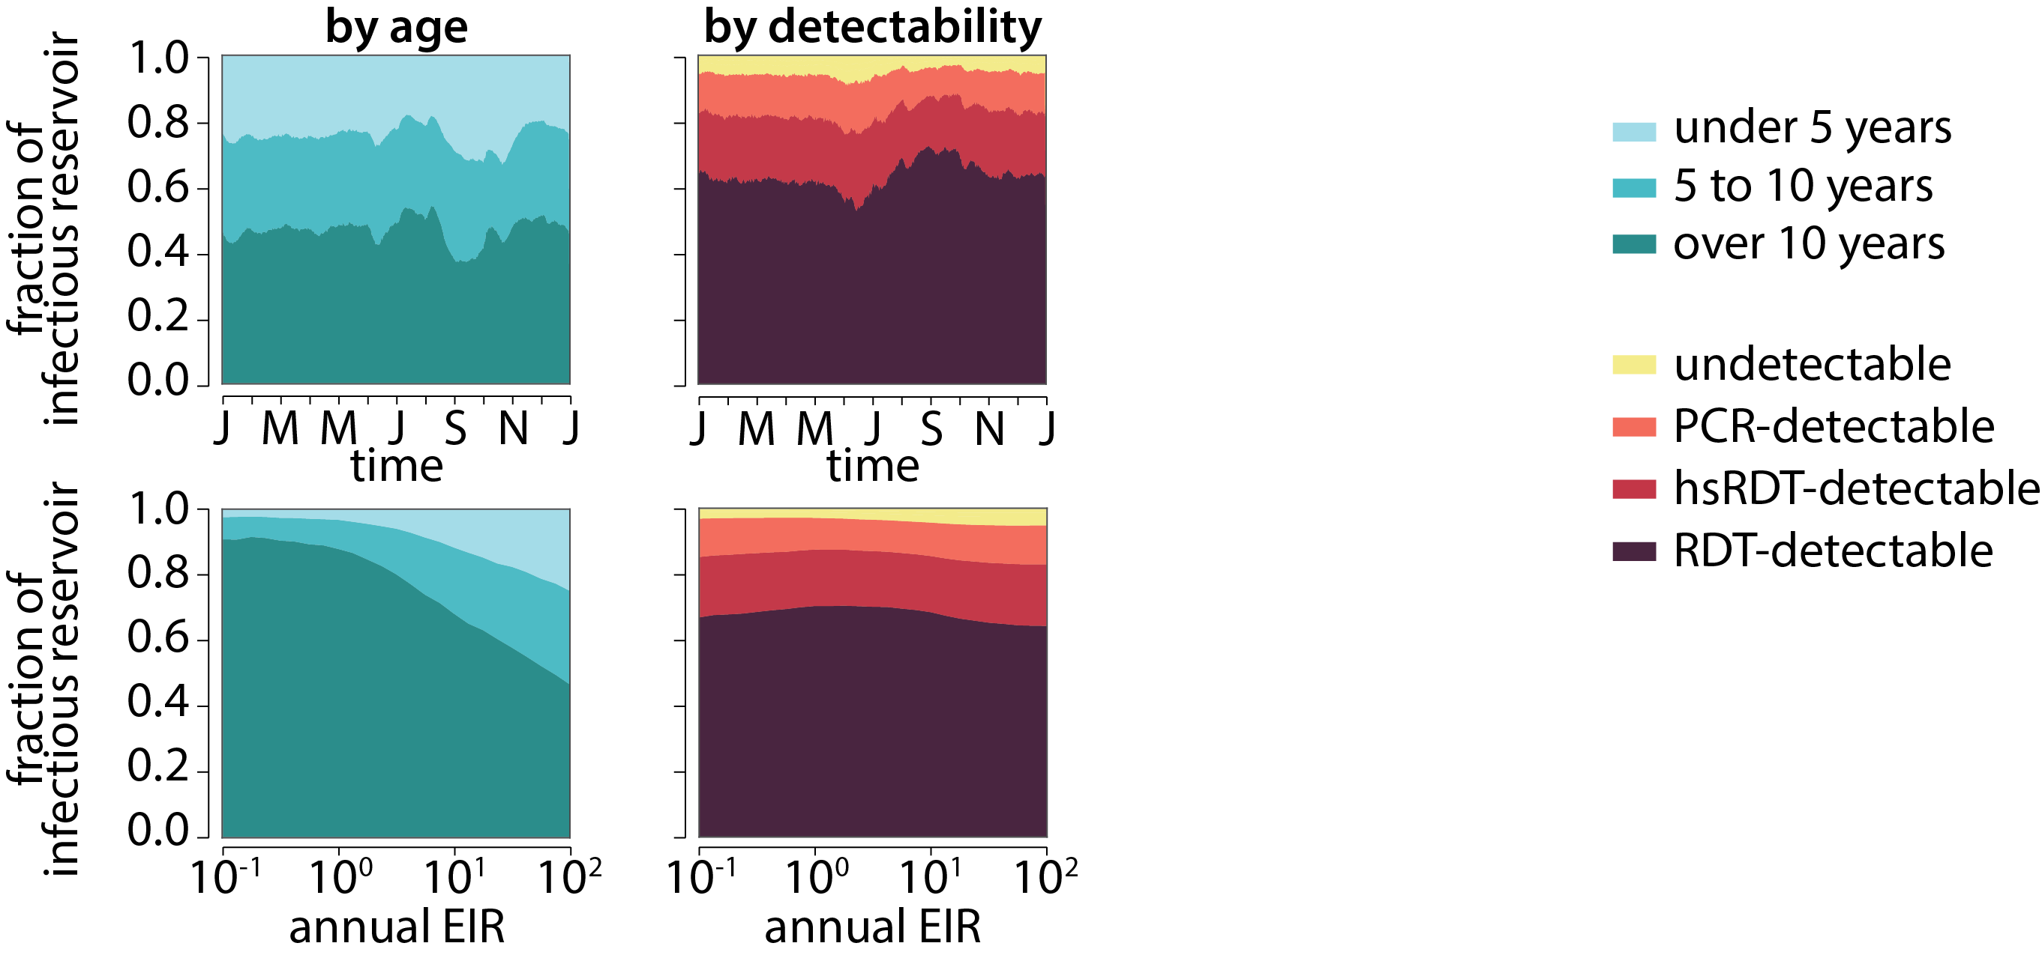
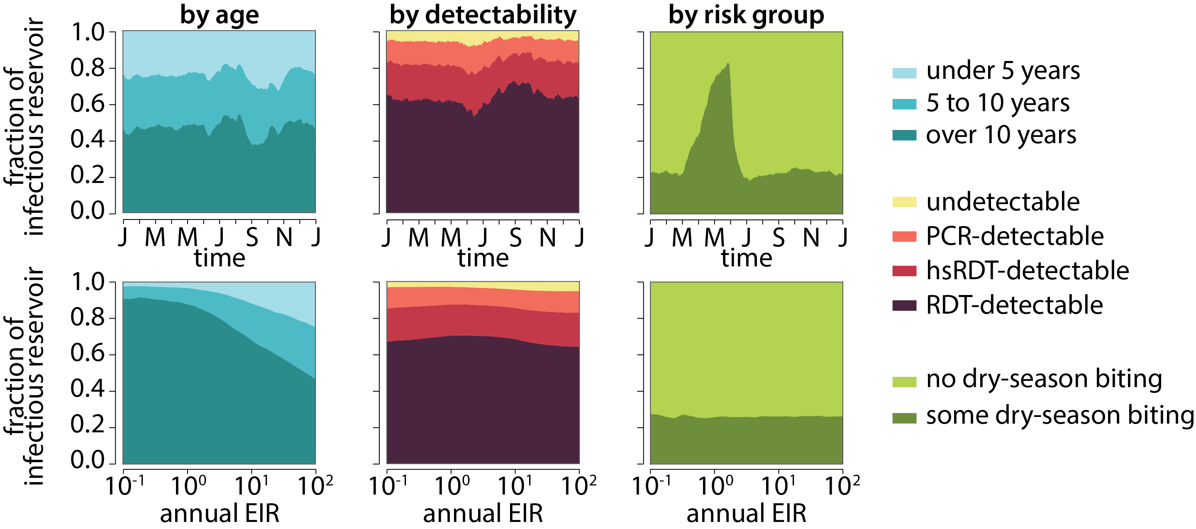
…allowing us to predict the relative contribution to transmission from various population groups
P Selvaraj in review

Slide 18
What is a strategy for malaria elimination in southern Africa?
Stratification as a means of efficient use of resources
Developing a model of malaria transmission
Creating a framework for stratification in Zambia

Slide 19
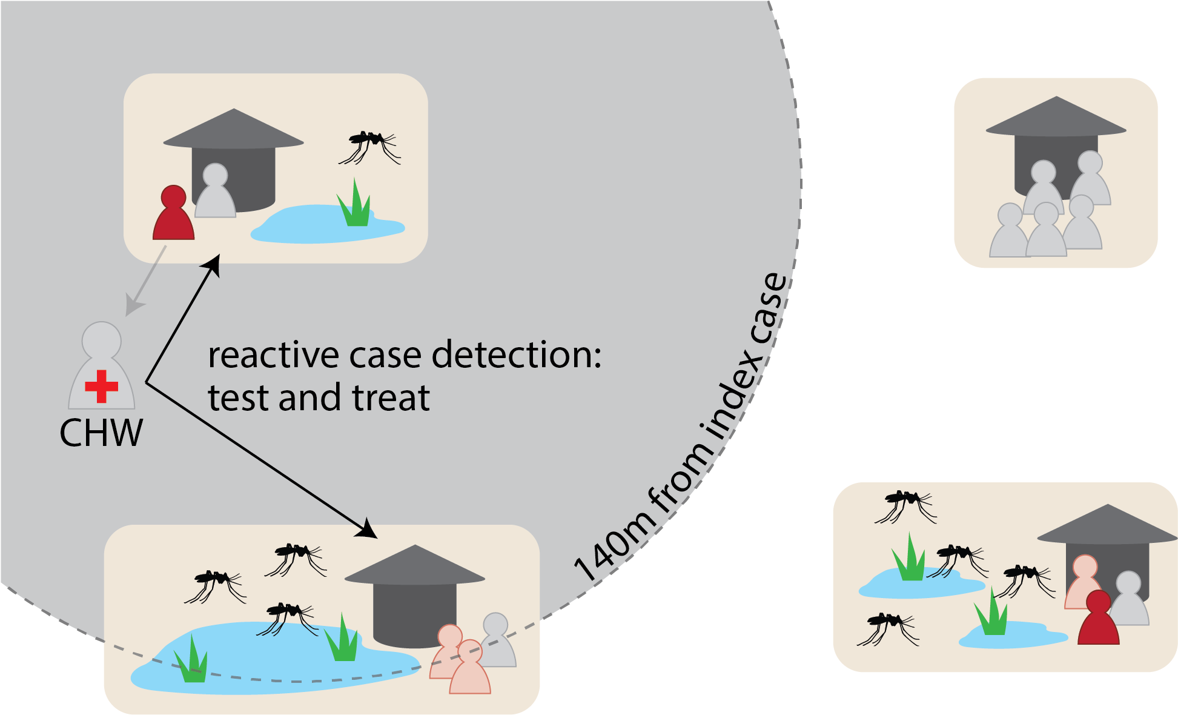
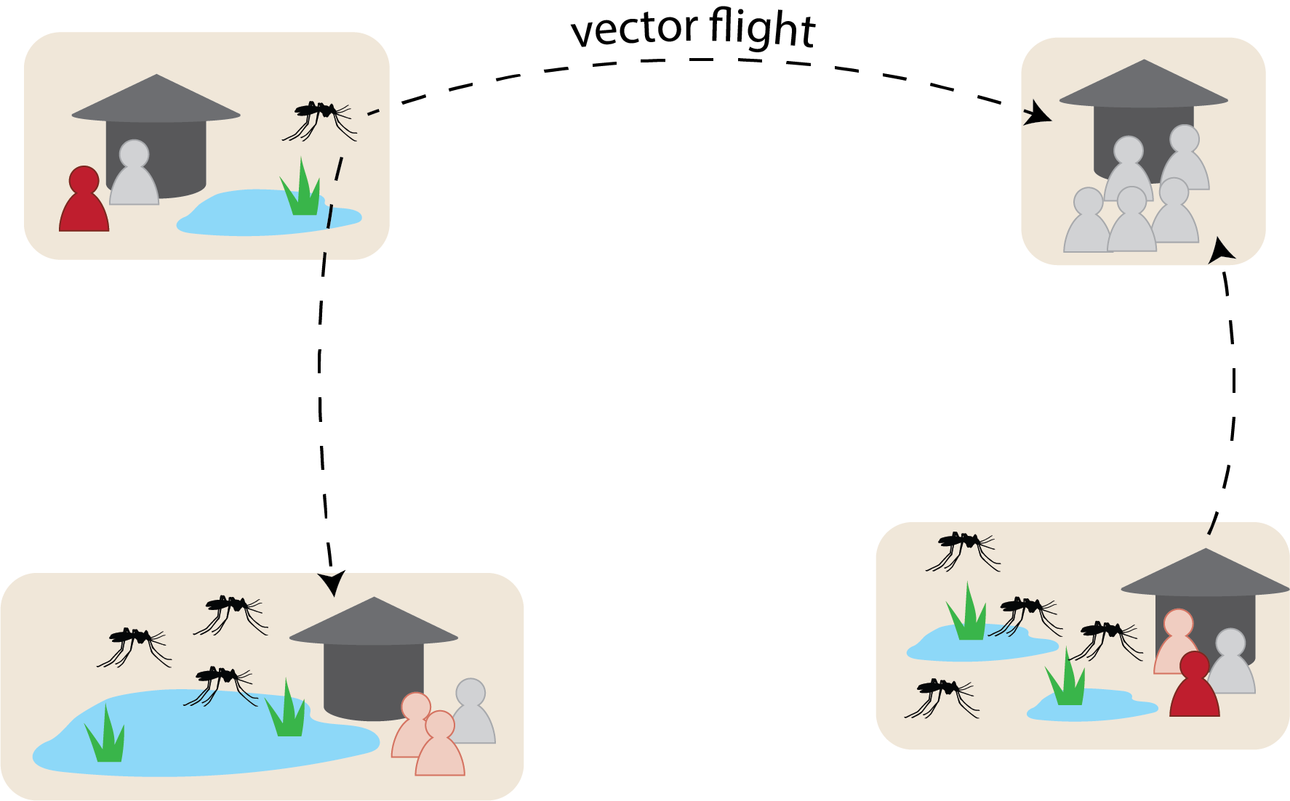
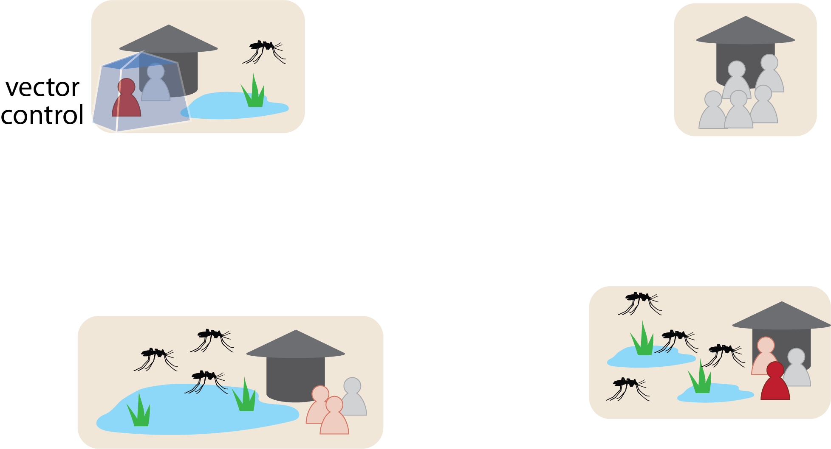
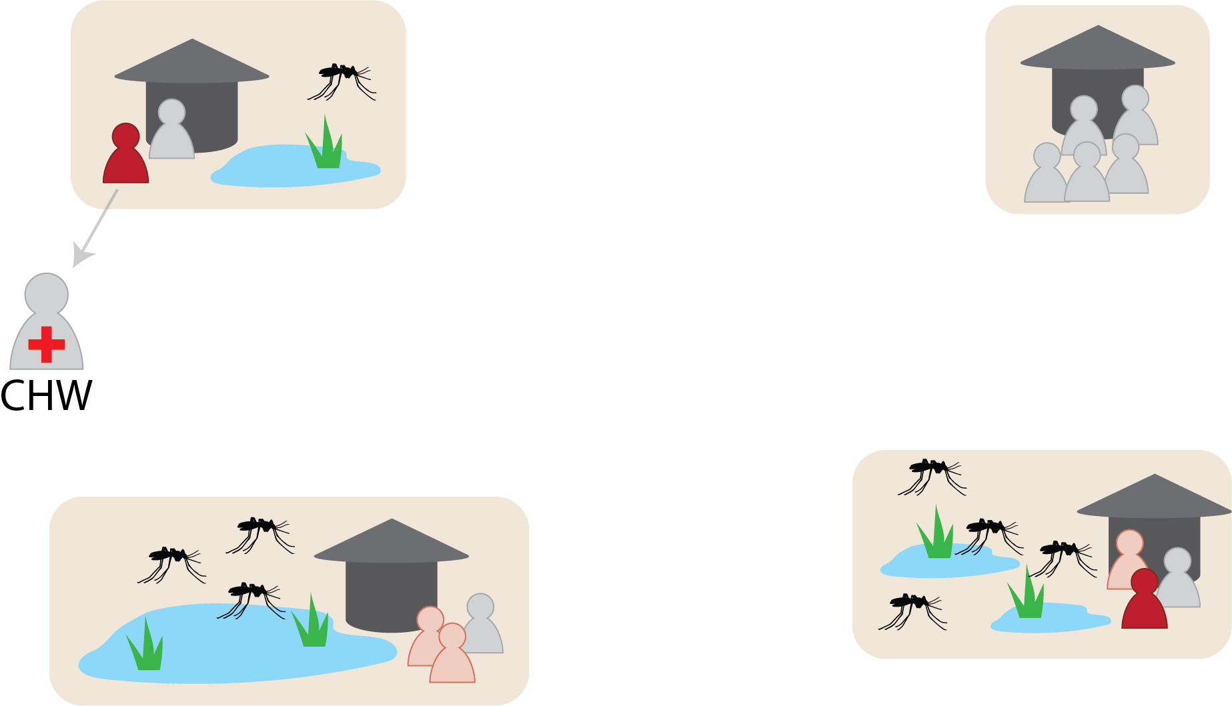
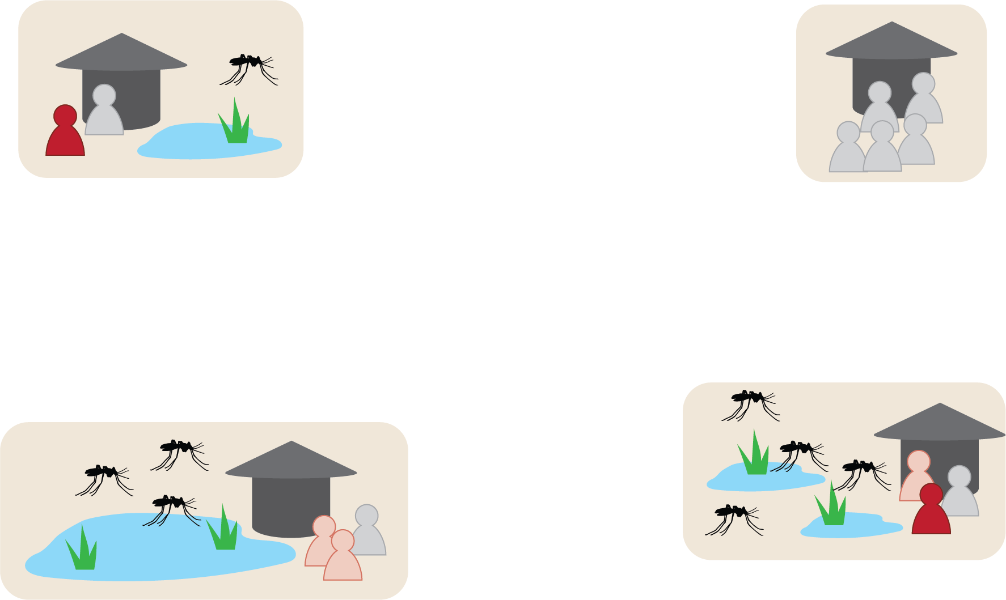
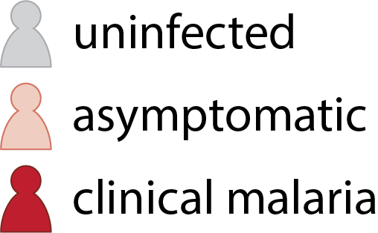
To understand how infections spread and respond to interventions, we need a spatial model of transmission

Slide 20
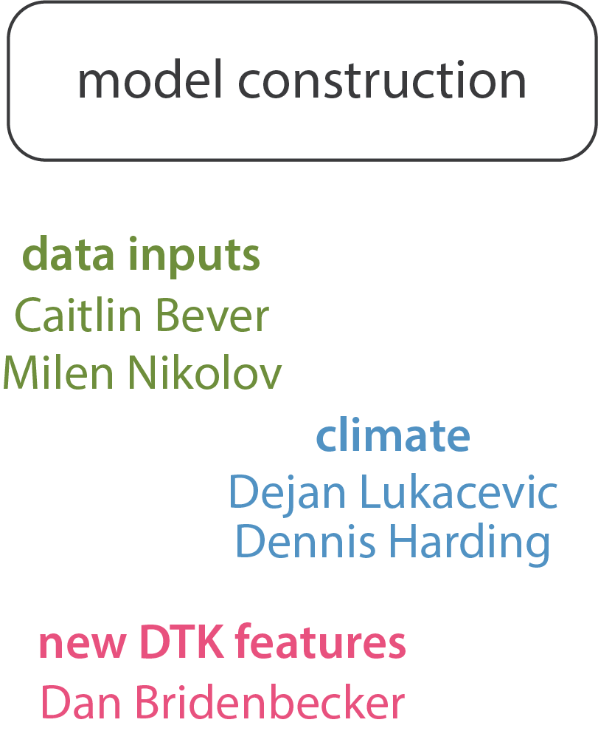
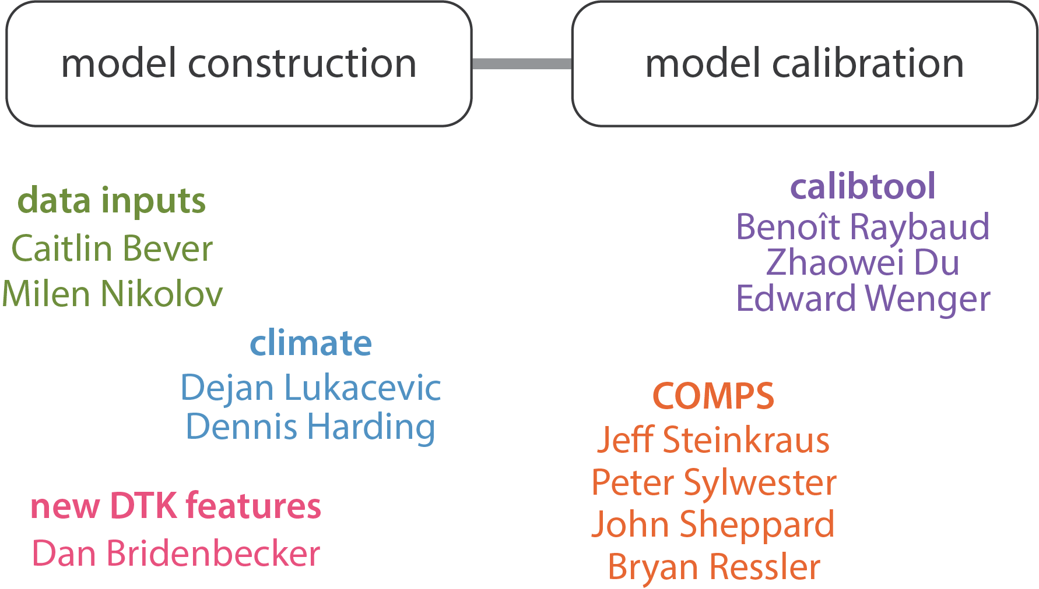
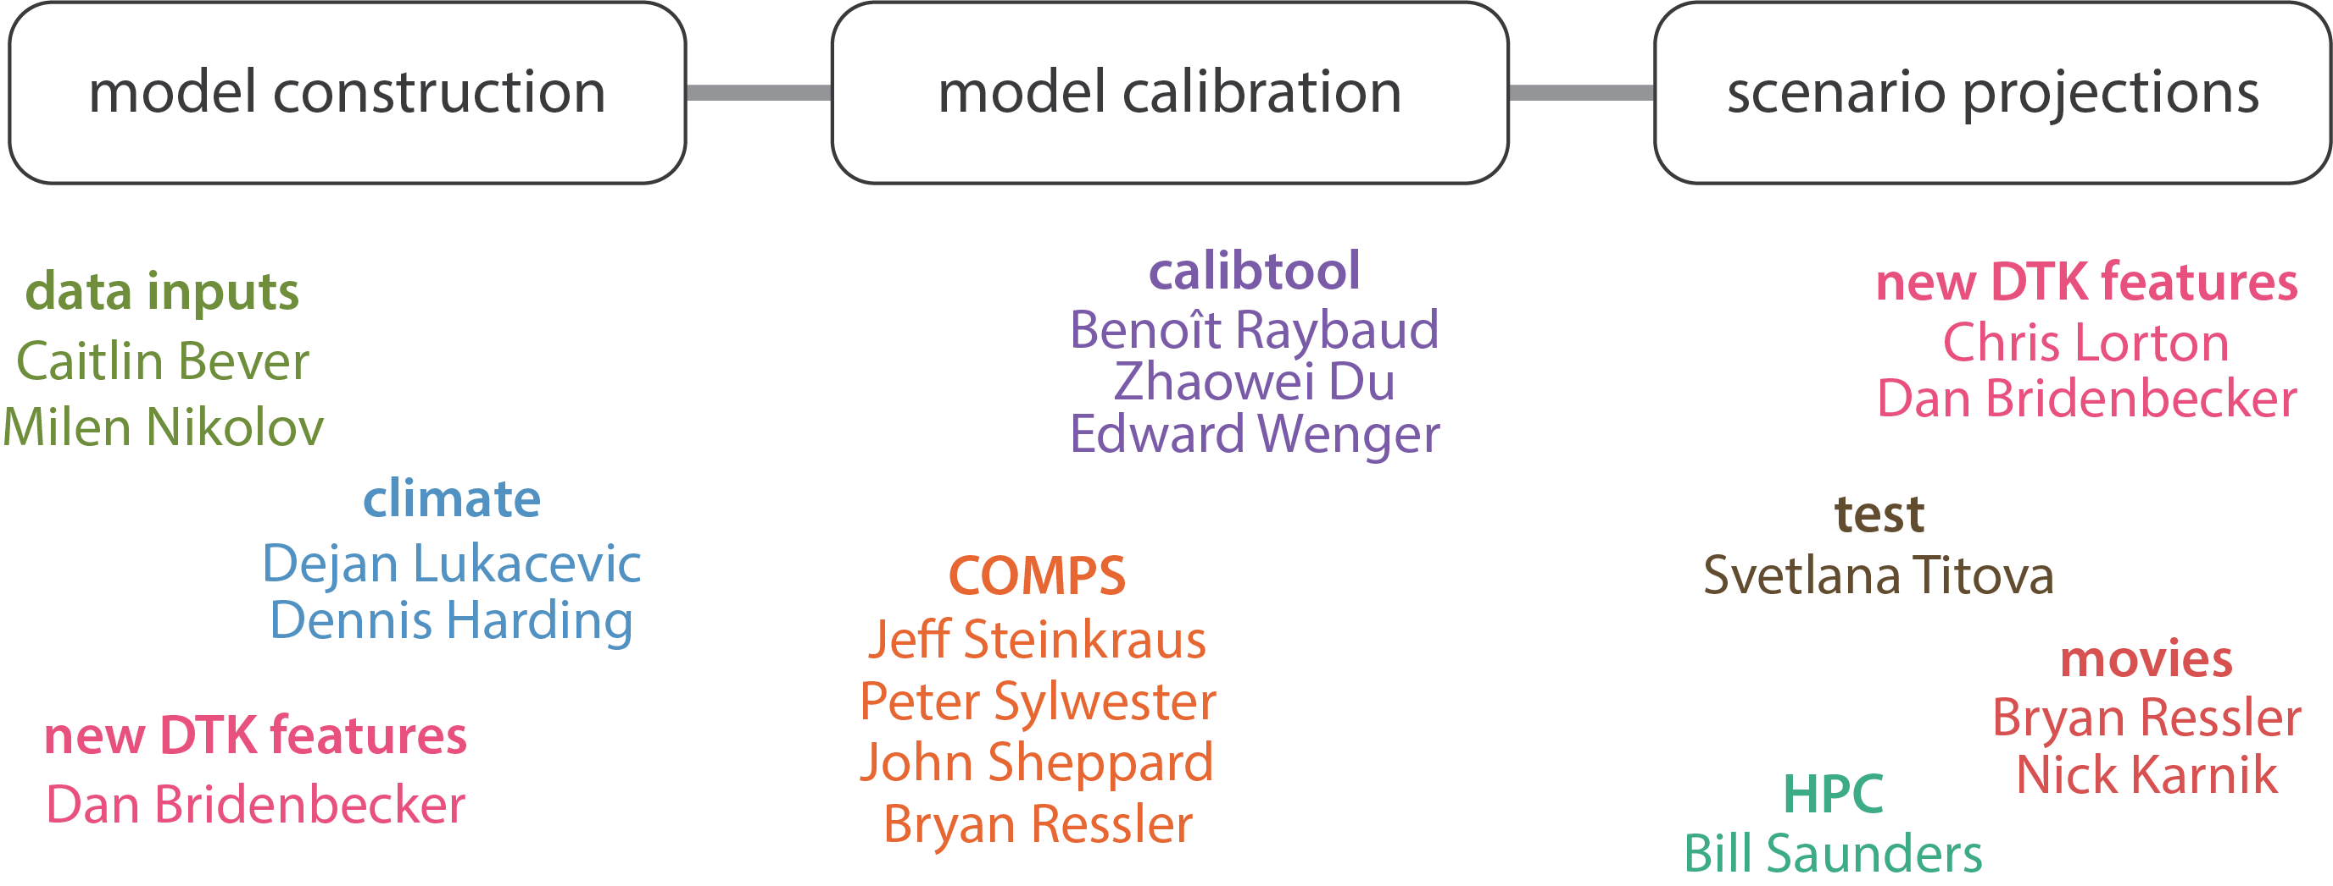
What does it take to model at the household level?

Slide 21
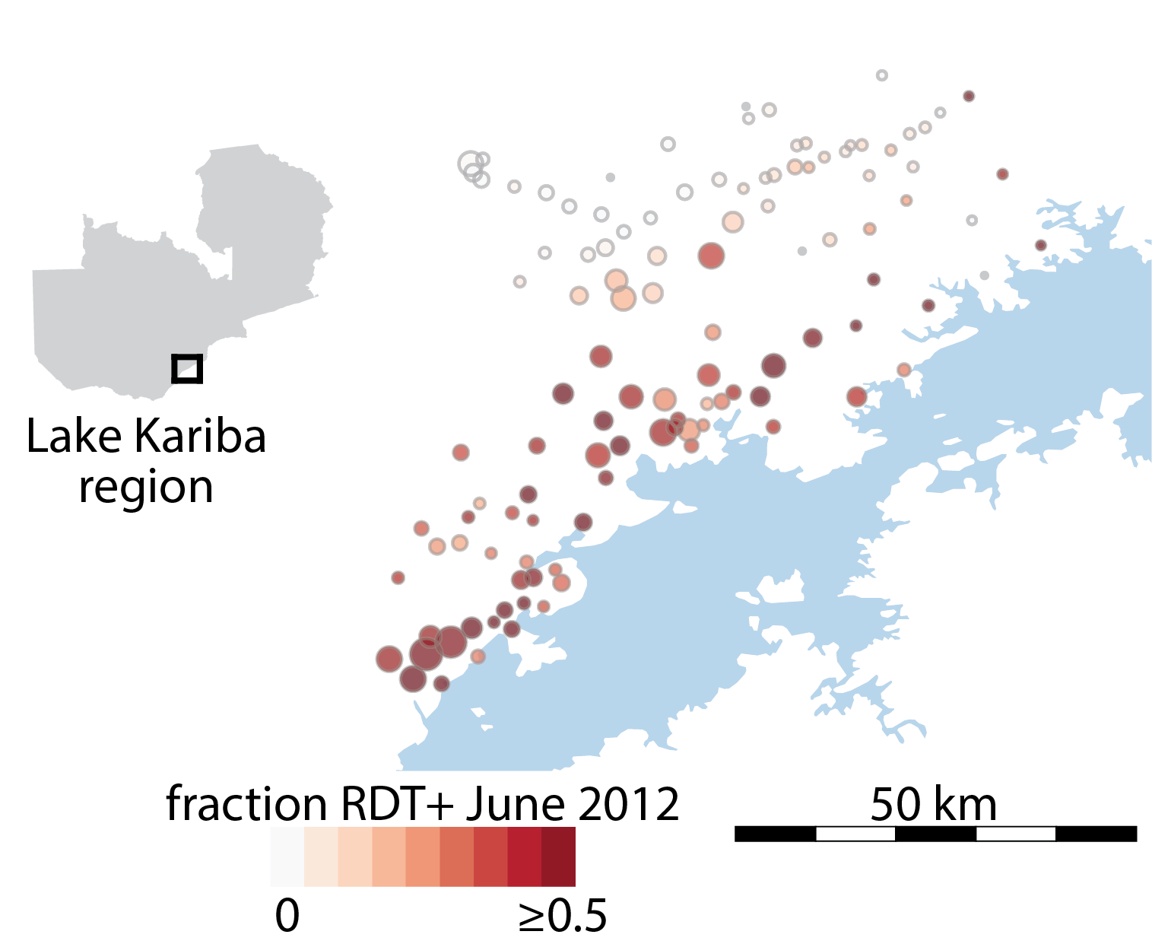
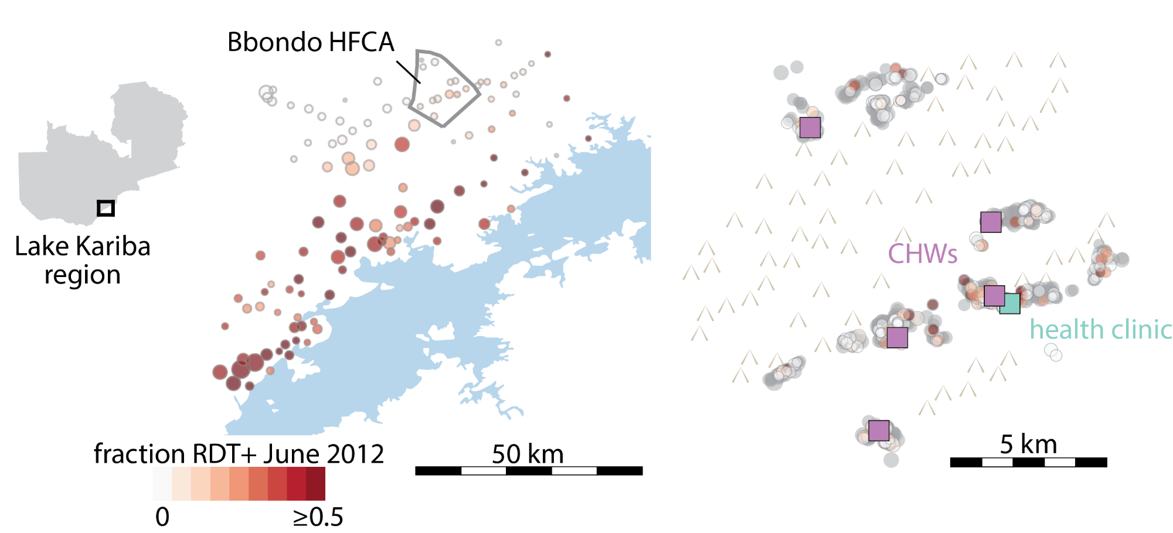
Rich data and diverse transmission settings make the Lake Kariba region an excellent study area to model

Slide 22
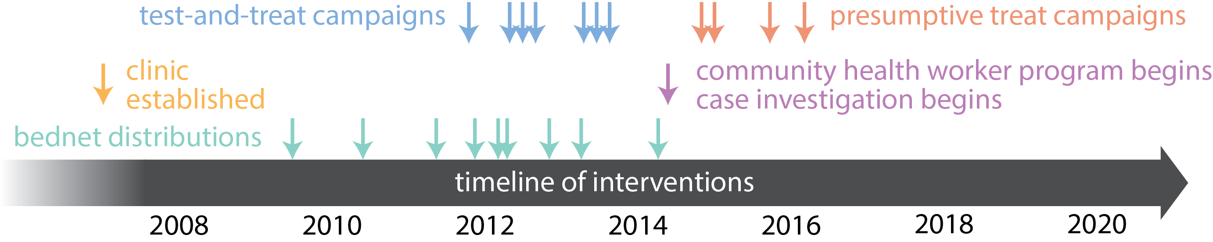
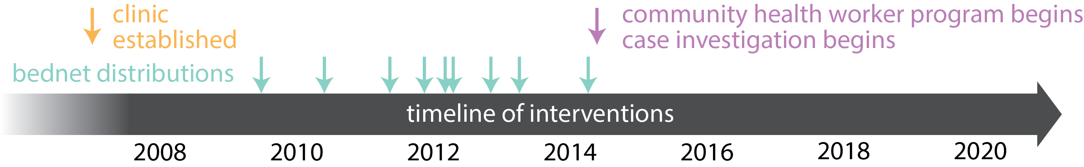

Include in the model all the interventions that have been deployed in this area

Slide 23
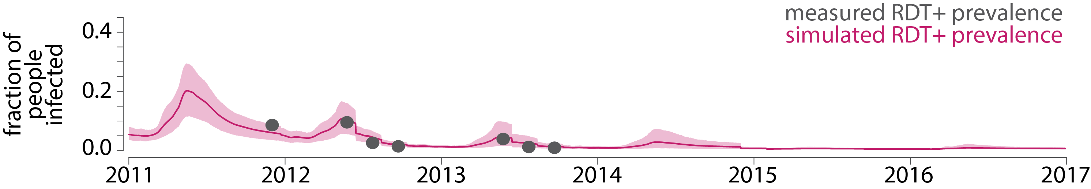
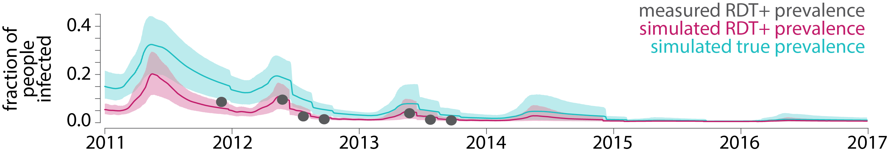
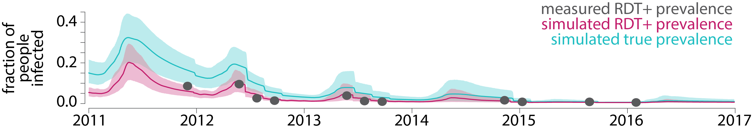
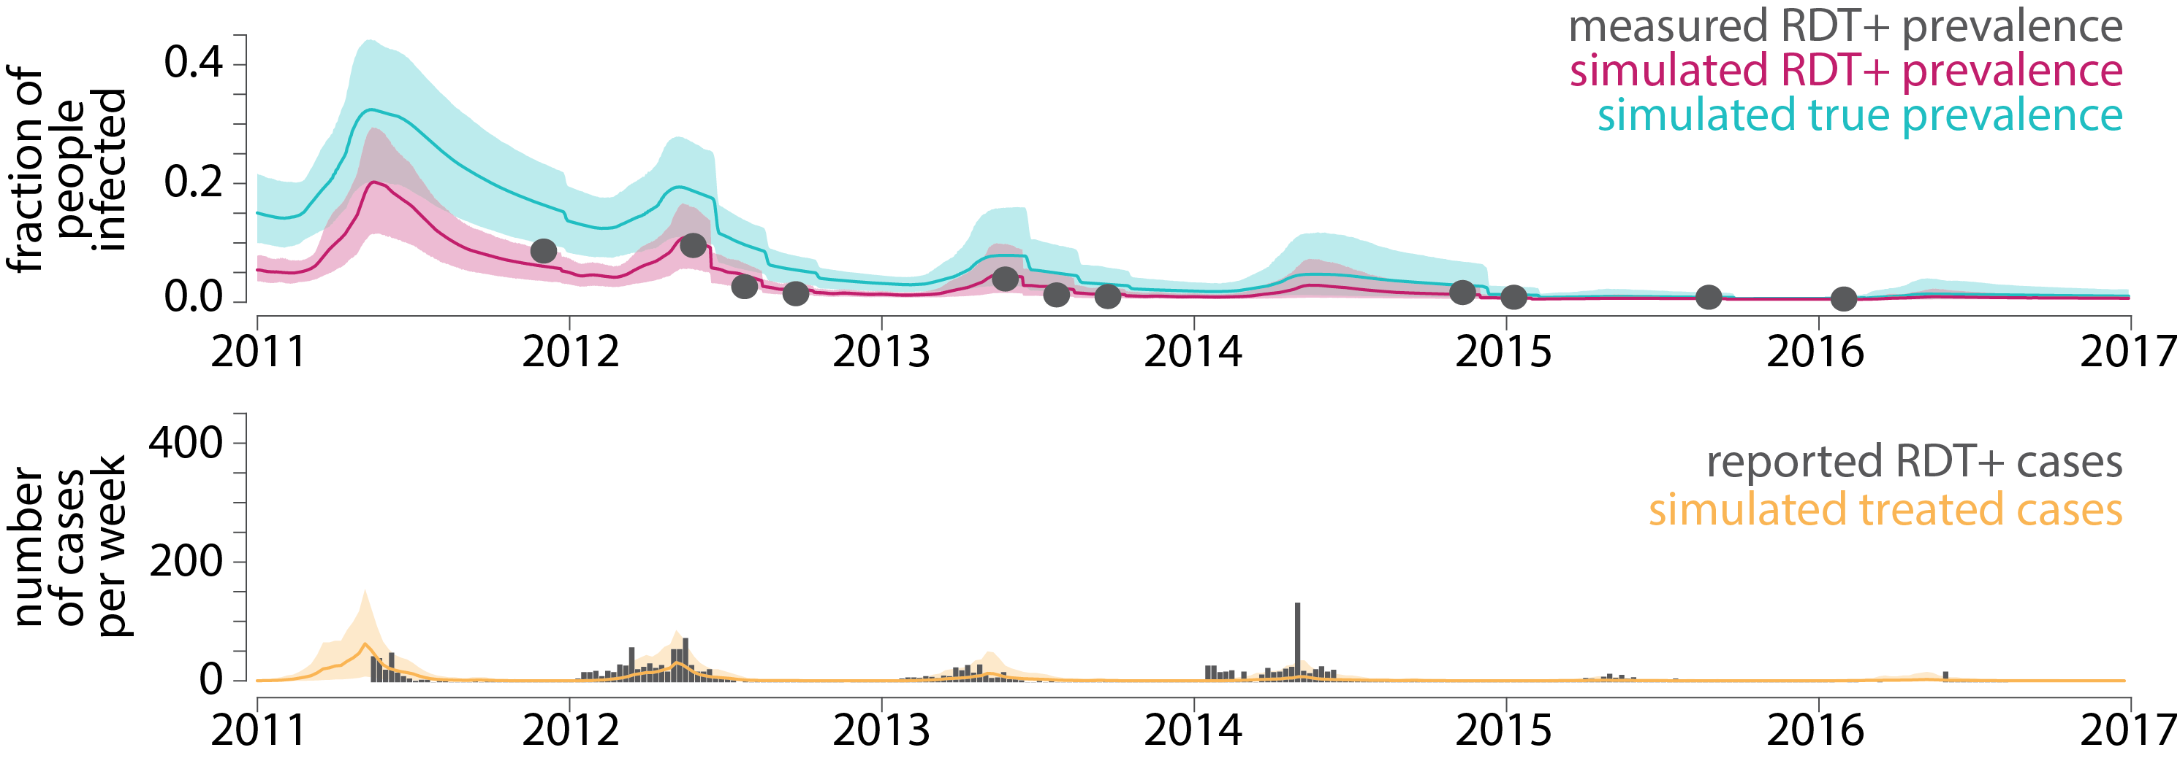
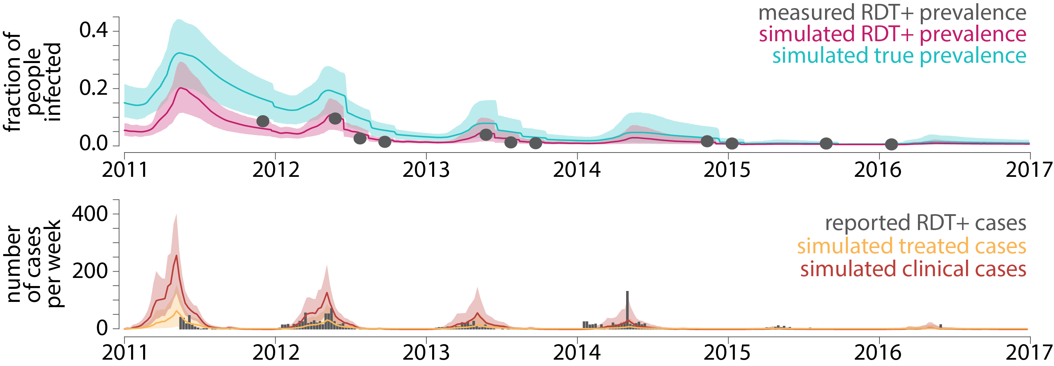
Can we be confident that our model captures local transmission dynamics?

Slide 24
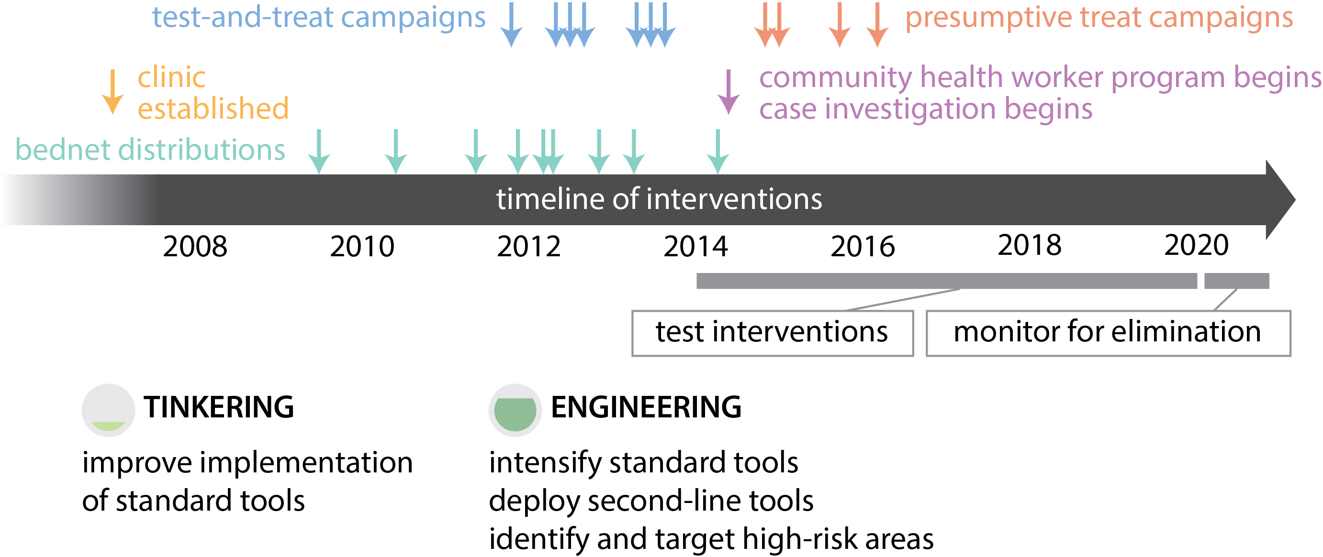
Using calibrated model, test whether various intervention scenarios would lead to elimination

Slide 25
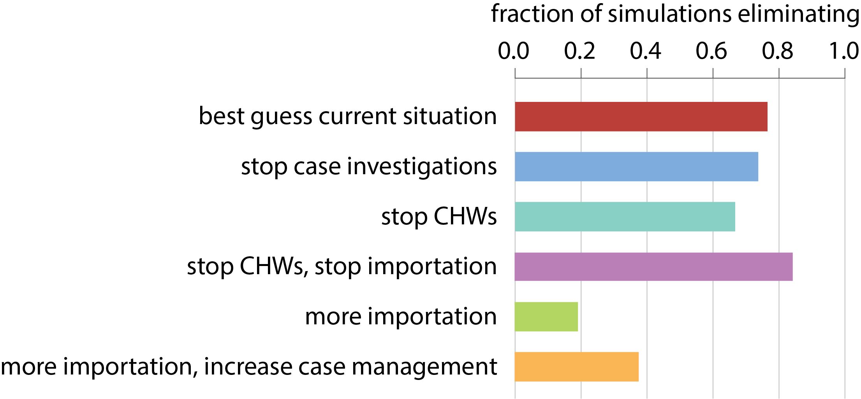





Model predicts that elimination is likely in this area as long as importation is limited

Slide 26






Elimination strategy depends on baseline transmission intensity, local household density, and importation rate

Slide 27


What does a practical roadmap for elimination look like?

Slide 28

Southern Province health facility catchment areas
Carve up the map according to:
  Baseline transmission
  Population clustering
  Importation
C Bever

Slide 29

Baseline transmission
Based on earliest available household survey data (2012 or 2014)
C Bever

Slide 30

Clustering of settlements
Based on median settlement size in catchment
(Maps from processed satellite imagery)
C Bever

Slide 31


Slide 32

Importation rates
Based on longitudinal linking of individuals in MDA campaign
C Bever

Slide 33

Southern Province stratification of intervention pkgs
C Bever

Slide 34
Ongoing projects in this space
Where are the boundaries between stratification categories?
Can we use less data to still accurately categorize operational units on this stratification scheme?
How can this scheme be tested in the field?
What should be done to prevent resurgence once elimination has been achieved?

Slide 35


Thank you!
IDM
Zambia NMEC
Caitlin Bever
Dan Bridenbecker
Chris Lorton
Benoît Raybaud
Prashanth Selvaraj
Philip Welkhoff
Edward Wenger
Duncan Earle
John Miller
Kafula Silumbe
Rick Steketee
Busiku Hamainza
Malaria Modeling Consortium
Tulane
Study participants
Thom Eisele

