Slide 1


Projected effectiveness of mass HIV vaccination with multi-dose regimens to be tested in South Africa
Peter Gilbert
Dobromir Dimitrov
Christian Selinger
Supported by B&MGF (OPP1110049)

Slide 2
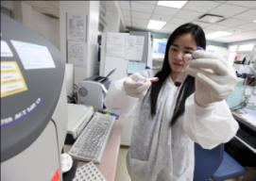
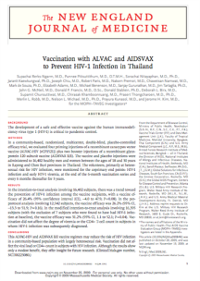
First Sign of HIV Vaccine Efficacy: RV144
The Thai HIV Vaccine Study
First HIV vaccine to show efficacy (Rerks-Ngarm et al., 2009)
  Major international collaboration with 16,403 Thai volunteers
  Vaccine: ALVAC-HIV + Bivalent Subtype B/AE gp120/alum
Efficacy of ~60% at 1 year 1; demonstrated 31.2% efficacy at end of study (3.5 years)

Slide 3
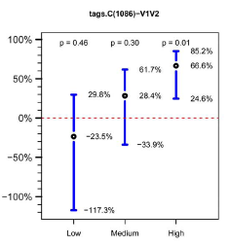
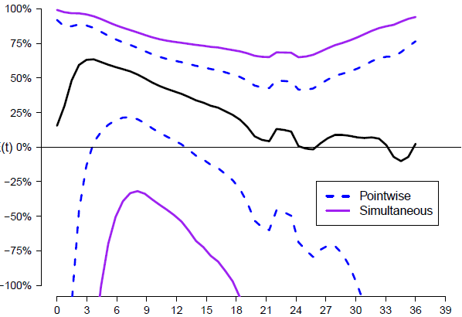
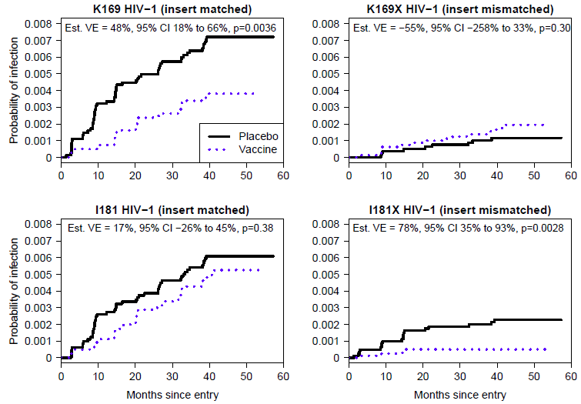
RV144: VE Waned Over Time* and Depended on Immune Responses and Genetics (Host, Virus)**
Estimated Instantaneous VE with 95% Confidence Intervals
VE
Vaccine Efficacy VE(t)
V1V2 Ab response
Months Since Entry
VE(t) = [1 – instantaneous incidence ratio (vaccine/placebo) at time t]×100%
Months Since Entry
*Robb et al. (2012, Lancet Inf Dis); **Corey et al. (2015, Science Transl Med) summarizes correlates results

Slide 4
HVTN 702 Phase 3 Trial in South Africa
HIV negative volunteers enrolled and tested for HIV infection 3-monthly for a maximum of 36 months
  Sample size selected to achieve 90% power to reject
  H0: VE ≤ 25% if VE = 50% [VE over 24 months of follow-up]
Study Arm | Number Ppts | Month 0 | Month 1 | Month 3 | Month 6 | Month 12
Vaccine | 2700 | ALVAC-HIV (vCP2438) | ALVAC-HIV (vCP2438) | ALVAC-HIV+ Bivalent Subtype C gp120/MF59® | ALVAC-HIV+ Bivalent Subtype C gp120/MF59® | ALVAC-HIV+ Bivalent Subtype C gp120/MF59®
Placebo | 2700 | Placebo | Placebo | Placebo + Placebo | Placebo + Placebo | Placebo + Placebo
Total | 5400
Notes:
Following the positive result of the Thai trial and the availability of multiple promising prime-boost HIV vaccine regimens, there is interest in designing efficient multi-vaccine arm Phase 2b efficacy trials with a shared placebo group

Slide 5
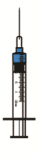
Scenario Transporting VE from RV144 to HVTN 702 to
Achieve VE = 50% Based on V1V2 Antibody Response
RV144
Observed VE = 44%
observed VE (V1V2 responders) = 69%
V1V2 Response
Observed
V1V2 = 64%
Month
0
1
3
6
6.5
12
18
24
702
To achieve observed VE ≥ 50%, assuming observed VE (V1V2 responders) = 69%
V1V2 Response
Require Observed
V1V2 ≥ 63%
Need Observed
V1V2 ≥ 72%
Month
0
1
3
6
6.5
12
12.5
18
24
[% V1V2 neg Mo 12]×VE(neg) + [% V1V2 pos Mo 12]×VE(pos)= 0.28×0 + 0.72×0.69=0.50

Slide 6
Objectives
Simulate vaccination scenarios reproducing the immune response and vaccine efficacy targets from HVTN 702.
Explore variations in the vaccination schedule and in the vaccine efficacy profile
Estimate the population level effectiveness on vaccination strategies over extended periods of time (10 and 20 year horizon).
Metrics of interest include:
  Proportion of cumulative HIV infections prevented
  Reduction in HIV incidence
  Number of vaccinations per HIV infection prevented

Slide 7







































Modeling framework*
$$λ_{0}^{H}$$
CD4>500
CD4 200-350
Acute/
Recent
CD4 350-500
VE stratified by immune response:
72% responders
28% non-responders
Time-dependent VE:
20% for 0-6 m
80% for 6-18m
20% for 18-24m
HIV+ stratified by CD4 count with distinct rate of HIV diagnosis
CD4 < 200
$$S^{H}$$
$$S^{L}$$
$$λ_{0}^{L}$$
$$I_{1}$$
$$I_{2}$$
$$I_{3}$$
$$I_{4}$$
$$I_{5}$$
$$V_{1}^{H}$$
$$λ_{1}^{H}$$
$$V_{1}^{L}$$
$$λ_{1}^{L}$$
$$I_{1}^{V}$$
$$I_{2}^{V}$$
$$I_{3}^{V}$$
$$I_{4}^{V}$$
$$I_{5}^{V}$$
$$V_{2}^{H}$$
$$λ_{2}^{H}$$
$$V_{2}^{L}$$
$$λ_{2}^{L}$$
$$I_{1}^{D}$$
$$I_{2}^{D}$$
$$I_{3}^{D}$$
$$I_{4}^{D}$$
$$I_{5}^{D}$$
$$V_{3}^{H}$$
$$λ_{3}^{H}$$
$$V_{3}^{L}$$
$$I_{2}^{T}$$
$$I_{3}^{T}$$
$$I_{4}^{T}$$
$$I_{5}^{T}$$
$$λ_{3}^{L}$$
$$I_{2}^{F}$$
$$I_{3}^{F}$$
$$I_{4}^{F}$$
$$I_{5}^{F}$$
* Analysis performed by Simon de Montigny at University of Montreal.
Presented at the 2016 HIV Vaccine Keystone Symposium

Slide 8
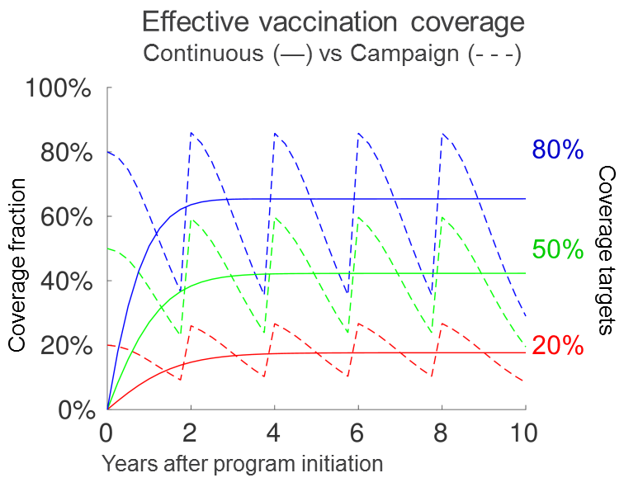
Calibration and Vaccination Schedules
Calibrated to 2012 demographic and epidemiologic data for South Africa: - Population size - HIV prevalence
- ART coverage - HIV incidence - Undiagnosed HIV+
Vaccine coverage targets:
  20% / 50% / 80%
ART eligibility criteria:
  CD4<350 / CD4<500 / Test& treat
Vaccination strategies:
  Continuous
  Campaign (every 2 years)

Slide 9
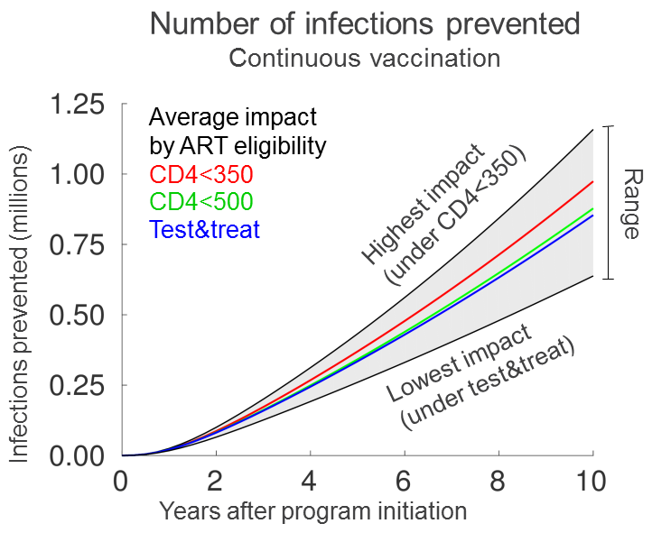
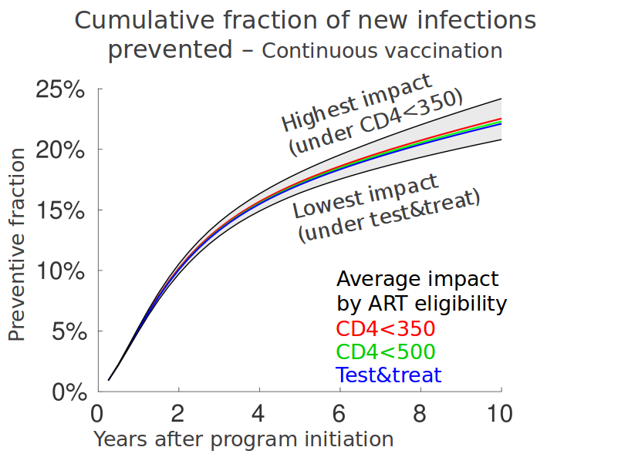
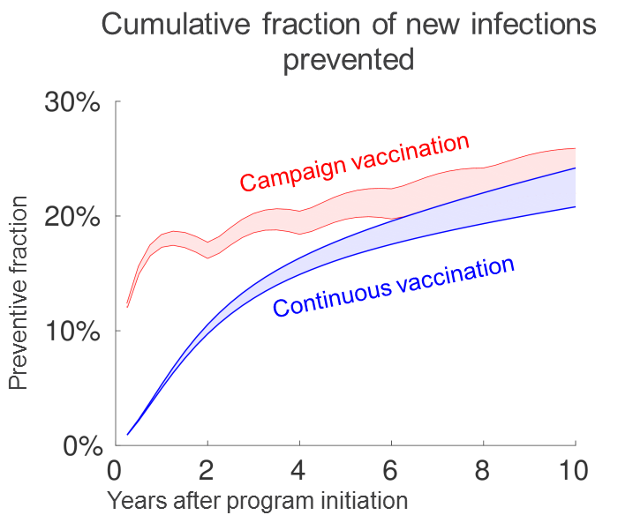
Results

Slide 10
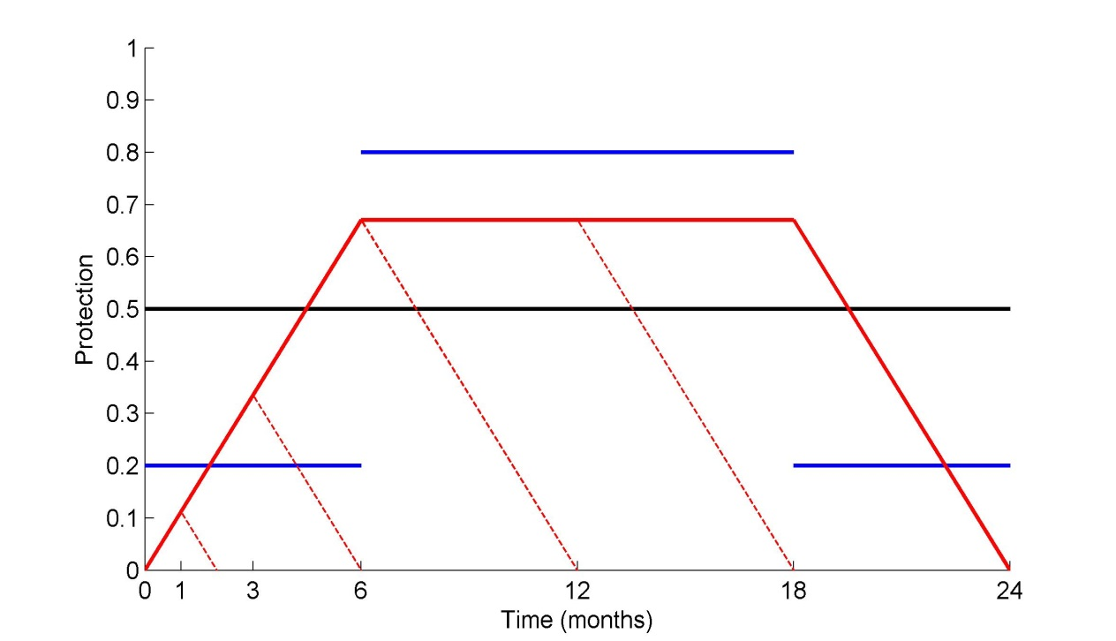
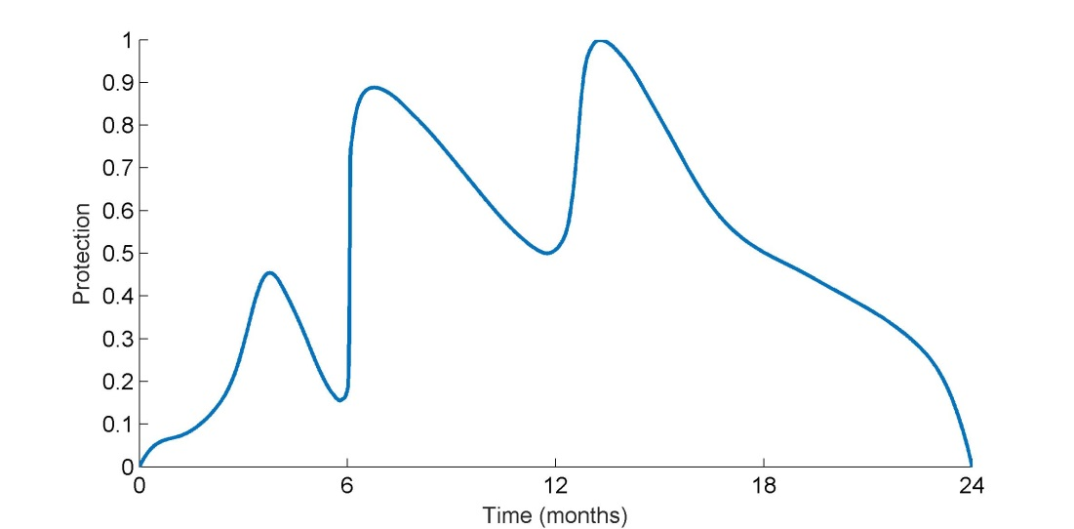
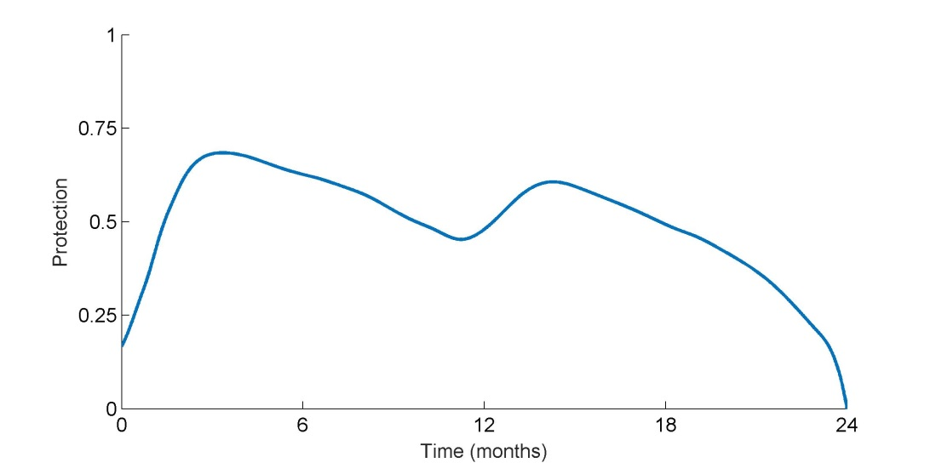
Different Vaccine Efficacy Profiles
Cumulative Fraction of infections Prevented (CFP) over 10 years:
25.6%-30.6% (fixed VE)
25.5%-30.5% (trapezoid VE)
25.1%-30.1% (stepwise VE)
Projected CFP is reduced by
12%-13% under trapezoid VE with dropout
Based on projected V1V2 response*
Based on RV144 + booster at 12 m*
* Profiles created by Daniel Wood, post-doctoral researcher at FHCRC

Slide 11
Summary
Our analysis suggests that even a partially effective vaccine would have a substantial impact on the HIV epidemic in South Africa.
Our preliminary results indicate that vaccine effectiveness is not influenced significantly by uncertainties in the temporal VE profile, provided that the average VE is the same.
High rates of regimen discontinuation may have detrimental effect on the vaccination impact

Slide 12
Population-level impact under targeted campaign roll-out
Individual-based network model EMOD v2.0, calibrated to 2012 prevalence estimates
Time-dependent efficacy profile with vaccine schedules of 5 injections without dropouts, 50% average VE efficacy over 2 years
Revaccinate every two years with 3 million VS (corresponds to 80% 15-25 years old women in 2017)

Slide 13
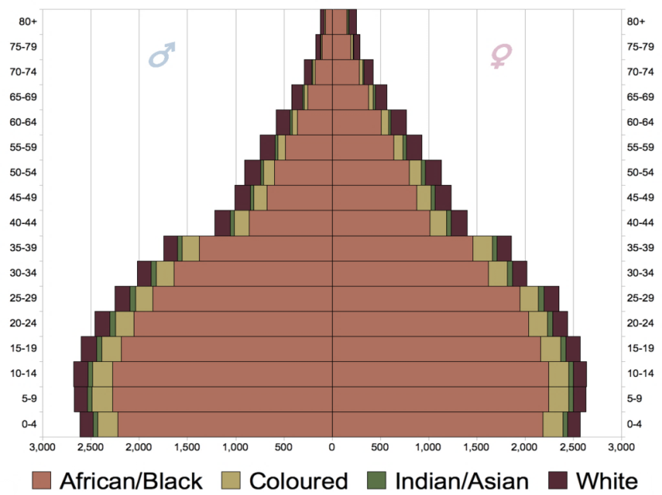
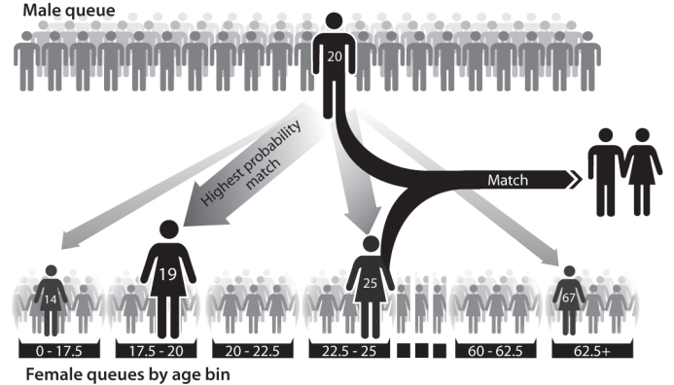
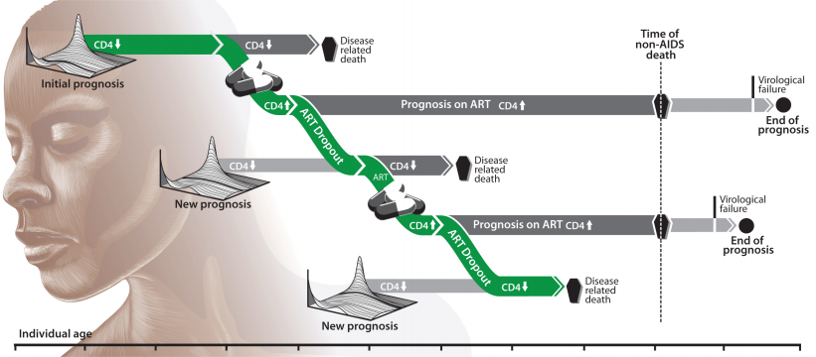
Population-level impact under targeted campaign roll-out
+
+
"South Africa Population Pyramid 2011 estimates"
by Underlying lk - Own work. Licensed under CC0 via Commons.
+
Notes:
Detailed demographics: fertility and mortality by age and gender
Explicit network of relationships that form and break. Transmission is modeled at the level of individual coital acts with factors such as condom usage, STI co-infection, VMMC, and viral suppression on ART.
Detailed within-host biology including age dependence of duration of latency, CD4 decline, CD4 reconstitution on ART
Detailed health systems modeling. You can configure a cascade of care.
Calibrated to four cluster-randomized HIV prevalence surveys done by Human Sciences Research Council (HSRC) in 2002, 2005, 2008, and 2012.
Also calibrated to mortality rates because South Africa has had fairly complete vital registration since 1991.
We don’t calibrate to antenatal prevalence because its relationship to general population prevalence may change over time.
Instead, we extract as much information as we can from the HSRC surveys by calibrating to age- and gender-stratified prevalence. This gives us some info about the past epidemic trends.

Slide 14
Population-level impact under targeted campaign roll-out
Targeting:
(a) young women only (15-25)
(b) young men and women (15-25)
(c) general population (14-49)
same number of VS per campaign
No assumptions on PreP use
evaluate population-level impacts of the vaccine starting in 2017

Slide 15
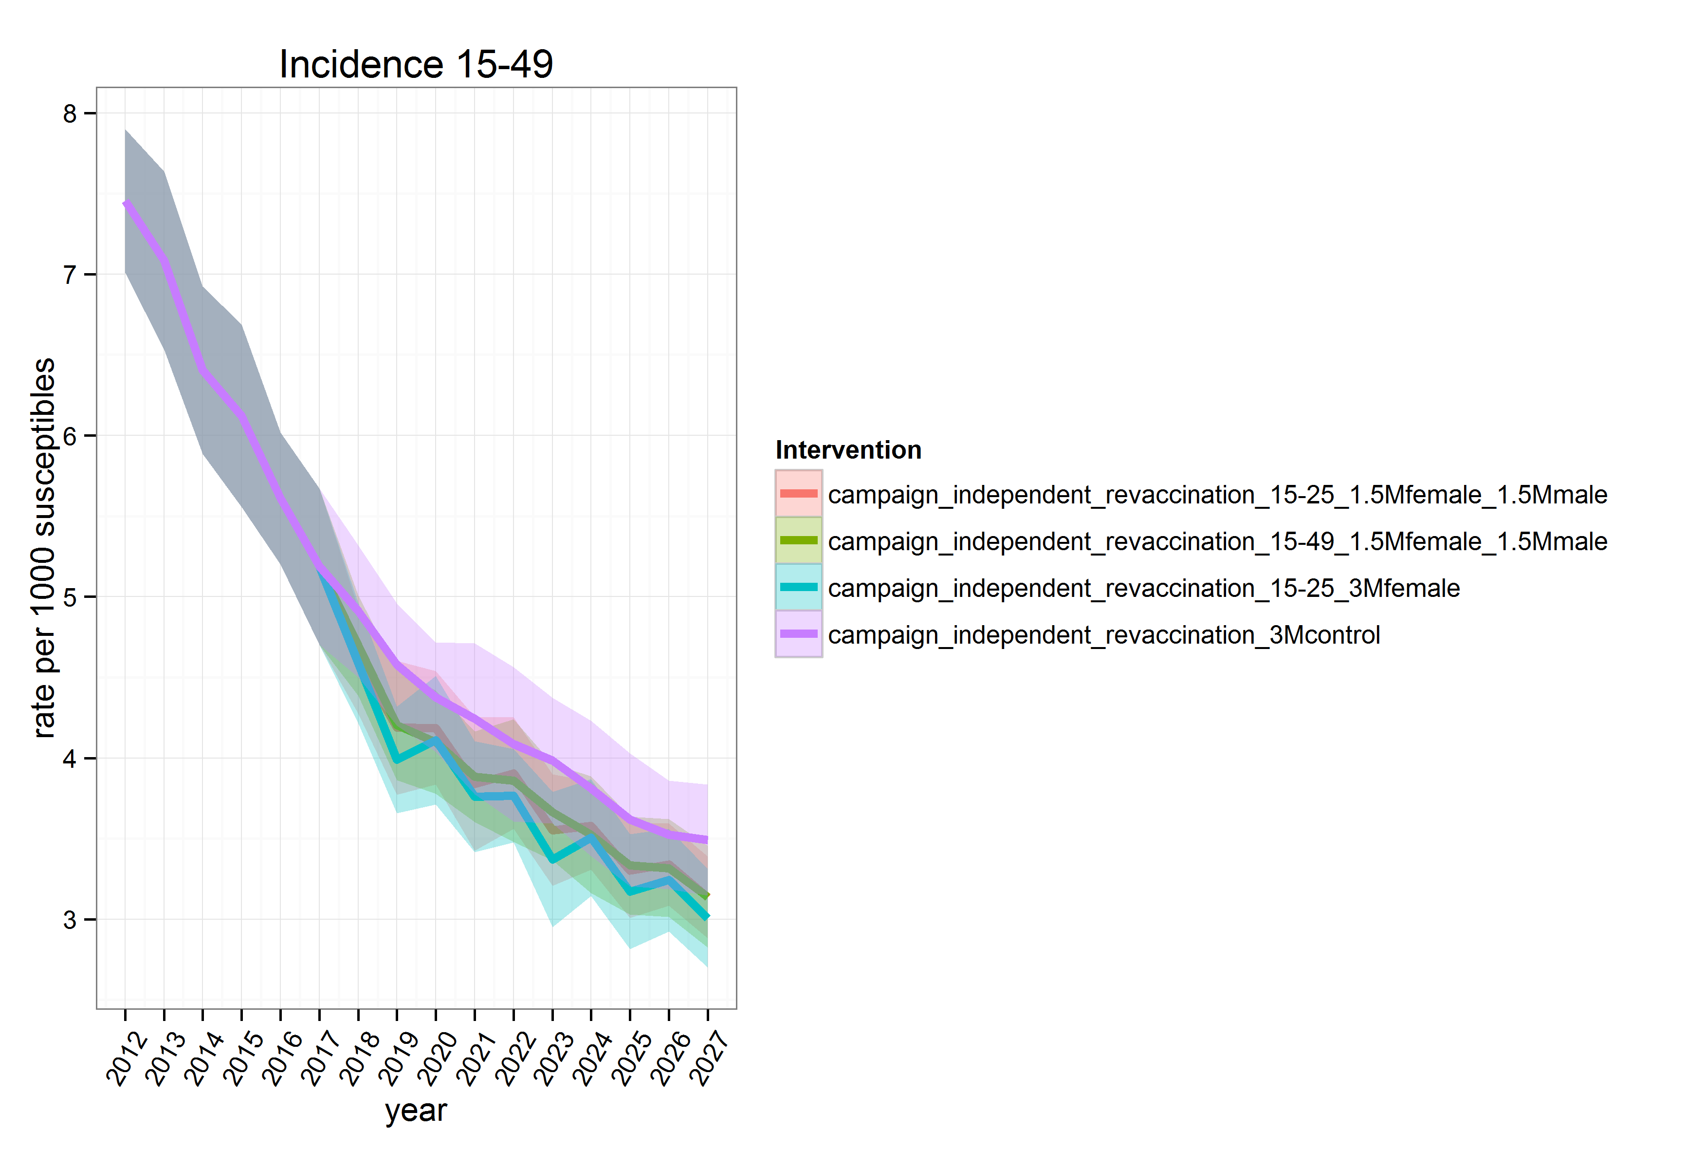
Incidence decline 2017-2027

Slide 16
Incidence decline 2017-2027
Intervention target | 2017 Incidence in % | 2027 Incidence in % | Decrease in %
Young women | 0.51 | 0.30 | 42
Young men and women | 0.51 | 0.31 | 39.5
General population | 0.51 | 0.315 | 39
No vaccination (baseline) | 0.51 | 0.35 | 31

Slide 17
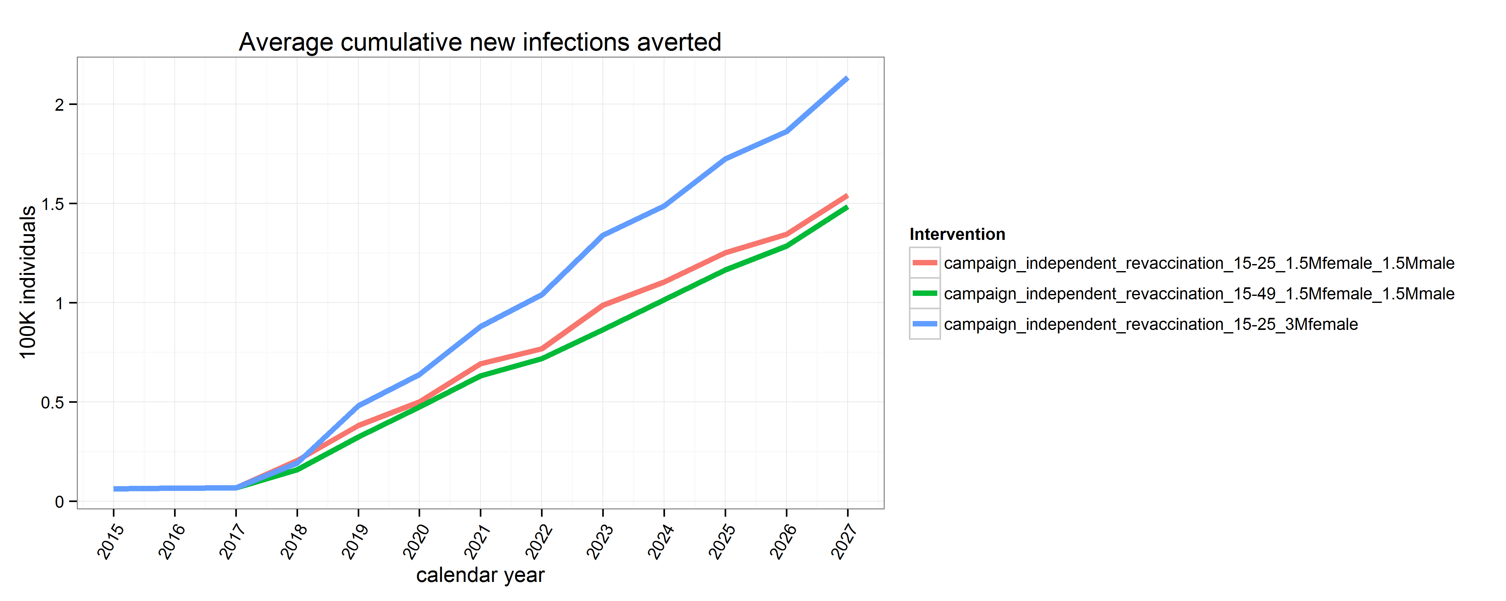
New infections averted under fixed number of doses
Targeting young women would
avert 70K more infections than
other targets
Age and gender-stratified incidence curves
indicate that there targeting does only
moderately benefit to age ranges/gender
outside the target group

Slide 18
Number of vaccine schedules needed to prevent infection
153
194
224
Number of vaccine schedules
one would need
to prevent infection by 2027

Slide 19
Summary
Our analysis suggests that even a partially effective vaccine would have a substantial impact on the HIV epidemic in South Africa.
Preliminary results indicate that targeting young women may have greater impact on the HIV epidemic under the assumption of limited vaccine supply and no PrEP use
Targeting young women requires consistently less VS per infection prevented and results in 70K more infections prevented

