Slide 1

Tracking malaria by its shadows
Bryan Greenhouse, MD, MA
University of California, San Francisco
bryan.greenhouse@ucsf.edu
Notes:
Appreciate the opportunity to be here, and tell you about a new set of tools we are developing that we hope will really augment the quality and extent of malaria surveillance data we can collect

Slide 2

The need for tracking malaria
Many available interventions, finite funds
We need to choose which ones, where, when
We need to know:
  How much
  Variation in space & time
  Effect of interventions
  Focal hotspots / high risk populations
  Interruption of transmission
Notes:
Things are looking good for malaria control.
Many interventions available- IRS, ITN, ACT, MDA, and some that don’t even have 3 letter acronyms
Money for control, while better than it once was, is still not enough to do everything everywhere.
Our responsibility to do the sleuthing and figure out which ones to use, where to use them, and when
What do we need to know depends to some degree on the level of transmission
In areas with a lot of malaria..
In areas where malaria is on the run, more specific details become important, such as…

Slide 3
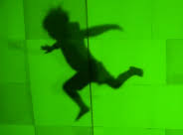
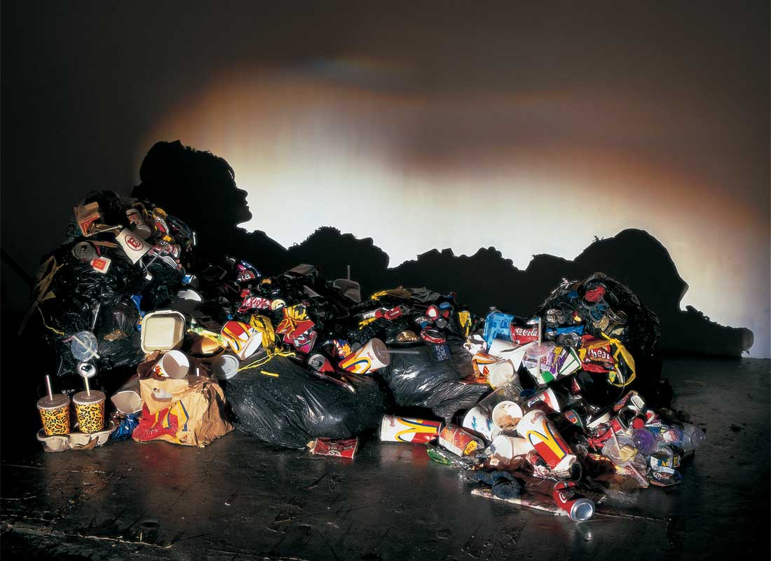
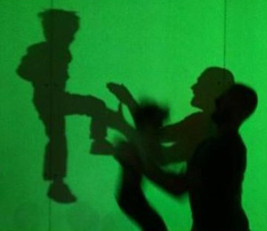
Why shadows?
Sculpture by Tim Noble and Sue Webster
Identify transient events
Reveal patterns
Notes:
What can shadows add, when we have been able to see the parasite directly with a microscope for over 100 years?
I am going to make the argument that surveillance can be improved in 2 ways
If you are trying to identify transient events, like malaria infections, shadows of those events may provide the best or only evidence that they happened.
A shadow can connect seemingly disparate events to reveal patterns not otherwise apparent.

Slide 4
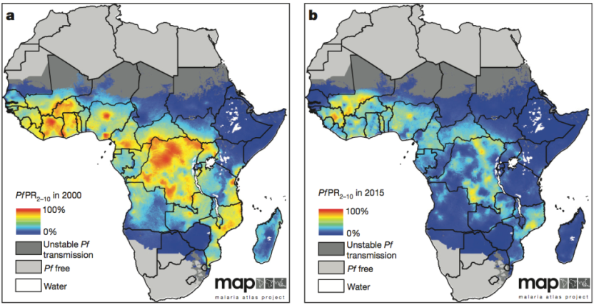
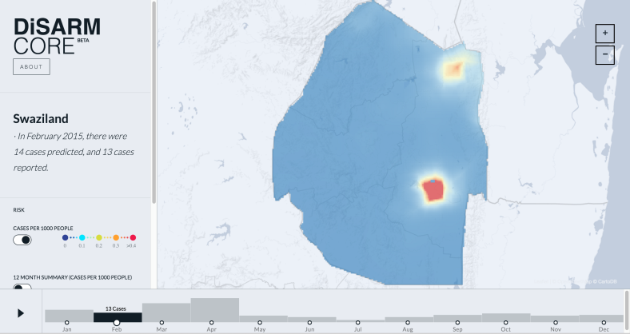
How we track malaria now
Entomological inoculation rate
  Cumbersome, insensitive, not widely used
Parasite prevalence
  Simple, standardized, widely available
  Imprecise at low and high transmission
Incidence of malaria
  Cohort studies (expensive, few)
  Health facility data
    Unknown denominator
    Consistency of diagnostic tests, reporting
    Confounded by immunity
    Most useful for very low transmission
Bhatt, Weiss, Cameron et al. 2015 Nature
Fig. courtesy Hugh Sturrock, UCSF
Notes:
Define metric, how it is measured, issues

Slide 5

How we track malaria now
Entomological inoculation rate
  Cumbersome, insensitive, not widely used
Parasite prevalence
  Simple, standardized, widely available
  Imprecise at low and high transmission
Incidence of malaria
  Cohort studies (expensive, few)
  Health facility data
    Unknown denominator
    Consistency of diagnostic tests, reporting
    Confounded by immunity
    Useful for very low transmission
Notes:
Here’s an example of some of the limitations of PR and how we can do better
Parasite prevalence in a low transmission area – few if any positives. False positive? Imported?

Slide 6
Finding shadows in a drop of blood
Entomological inoculation rate
  Cumbersome, insensitive, not widely used
Parasite prevalence
  Simple, standardized, widely available
  Imprecise at low and high transmission
Incidence of malaria
  Cohort studies (expensive, few)
  Health facility data
    Unknown denominator
    Consistency of diagnostic tests, reporting
    Confounded by immunity
    Useful for very low transmission
1 year
Notes:
If we could magically reconstruct their infection history. … Some of these people were infected recently, important info not capturing

Slide 7
Finding shadows in a drop of blood
Entomological inoculation rate
  Cumbersome, insensitive, not widely used
Parasite prevalence
  Simple, standardized, widely available
  Imprecise at low and high transmission
Incidence of malaria
  Cohort studies (expensive, few)
  Health facility data
    Unknown denominator
    Consistency of diagnostic tests, reporting
    Confounded by immunity
    Useful for very low transmission
1 year
Notes:
We can use antibodies to Plasmodium antigens as a record of these transient events.
The best part is that can get this data for almost free – most $$ in survey, can get from DBS

Slide 8
Antibodies: shadows of infections past
Used to measure exposure since the Garki Project (IFAT)
Purified recombinants + ELISA
  Cheap and easy
  Screen from DBS
Mostly responses to few, immunogenic antigens
  Long lived
  ? Recent vs. distant exposure
10 years
Notes:
This is not a new idea. Antibodies have been used to monitor since the 1960s, but data were challenging to generate and standardize

Slide 9
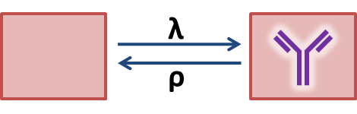
Age stratification allows interpretation of long lived responses
Prevalence of antibodies increases with age
The seroconversion rate (λ) reflects transmission intensity

Slide 10
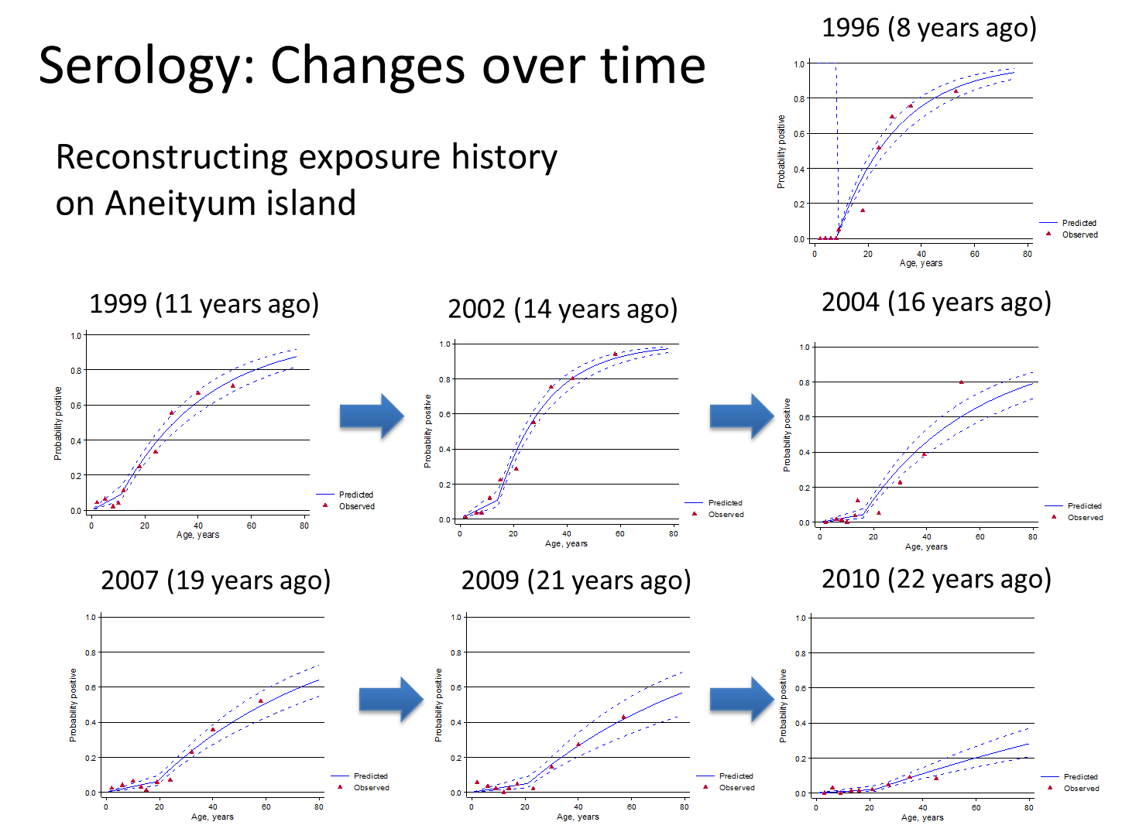
Changes in SCR reflect changing transmission
Notes:
Dramatic shifts apparent, but SCR not ideal for recent or gradual changes.
Also, like prevalence need lots of obs for single estimate.
Can we do better?

Slide 11
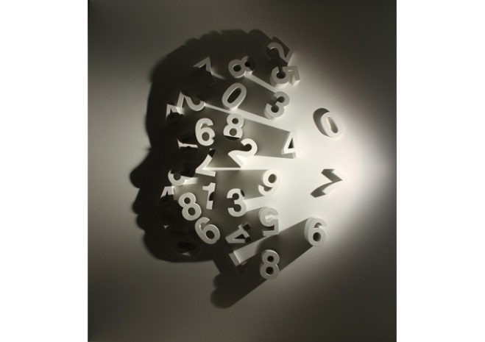
Getting more information from antibodies
~5k proteins in Pf genome, varying immunogenicity
Combined data from abs with different kinetics could provide detailed picture of exposure
10 years
Sculpture by Kumi Yamashita
Notes:
Instead of just looking at responses to 1 or 2 long-lived antibodies

Slide 12
Getting more information from antibodies
~5k proteins in Pf genome, varying immunogenicity
Combined data from abs with different kinetics could provide detailed picture of exposure
10 years
Sculpture by Kumi Yamashita
Notes:
Instead of just looking at responses to 1 or 2 long-lived antibodies…
Allows us to reconstruct the history of exposure, not just whether or not
If we can do this right, it would revolutionize the way we do surveillance

Slide 13

Multiple Antibody Detection Assays for Malaria Surveillance (MADAMS)
Get samples with known history (cohorts)
Measure a lot of antibodies
Pick the good ones
Validate in independent cohorts
Develop final assays with meaningful outcomes
Notes:
So what we need to develop are multiple…
Here is a roadmap for developing
2. … not just the ones that we are familiar with or think apriori will be useful
3. … Let the data tell us
4. … may require some iteration

Slide 14
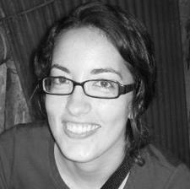
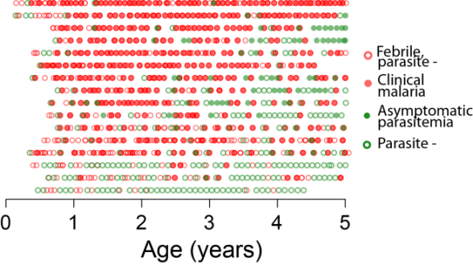
Handful of responses → rich data
Super-learner
Helb et al, PNAS 2015
Notes:
We’ve started doing this, and it seems to work. In our first study, single time point from each of 2 Ugandan cohorts frequent routine sampling and continuous passive surveillance

Slide 15
More accurate for communities, quantitative data for individuals
Helb et al, PNAS 2015
Notes:
We resampled the data to simulate communities of various size and transmission intensity and used CV predictions to get a rough sense of how this would perform…
Nicely illustrates the advantage of getting a continuous prediction for each person (even if noisy) over binary
Map…
Proof of concept that the approach works, information content is there in the plasma, and can be measured with a limited number of analytes

Slide 16
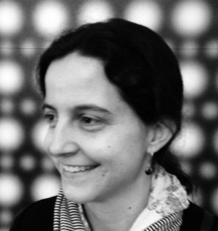
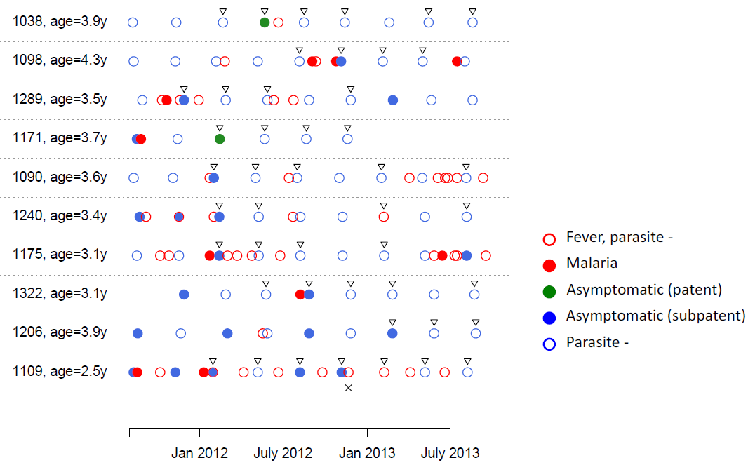
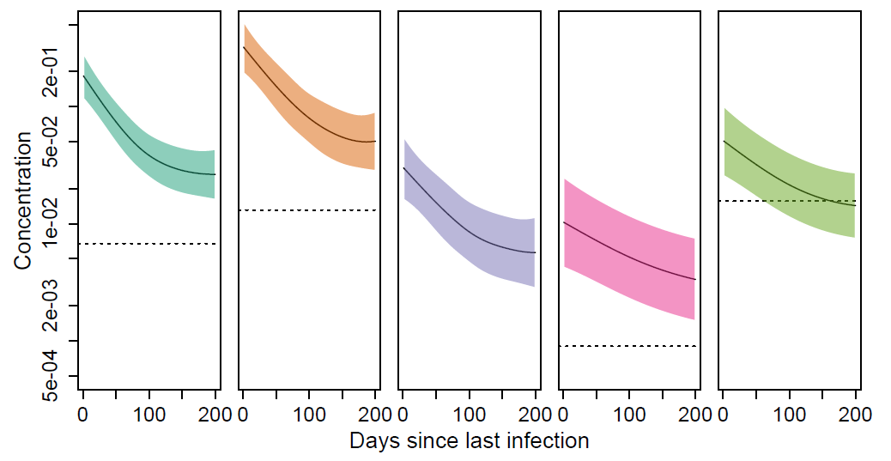
Validation in independent cohorts
GEXP ETRAMP MSP1 GLURP MSP2
Luminex
25 antigens
new and old
Shortest half-life
Highest importance (RF)
Notes:
Produced recombinant antigens for a subset of those ID’d in Danica’s paper put them on beads allowing us to quickly and inexpensively screen larger number of samples.
With long. samples, we can not only do prediction but explicitly measure kinetics and separate within-host vs. between host variation
Reassuringly, of the 25 antigens, 2 with shortest ½ life and var import in predicting infection in the prior 180 days
… including age effects (next slide)

Slide 17
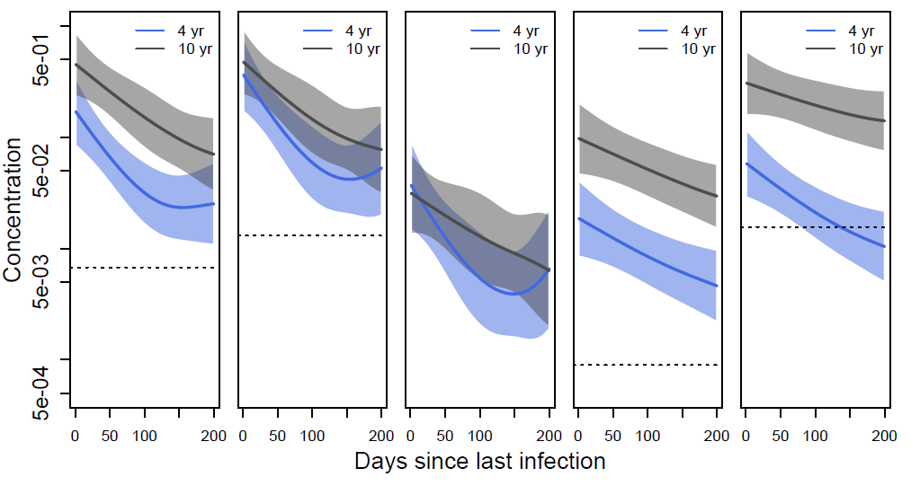
Validation in independent cohorts
GEXP ETRAMP MSP1 GLURP MSP2
Luminex
25 antigens
new and old
Shortest half-life
Highest importance (RF)

Slide 18
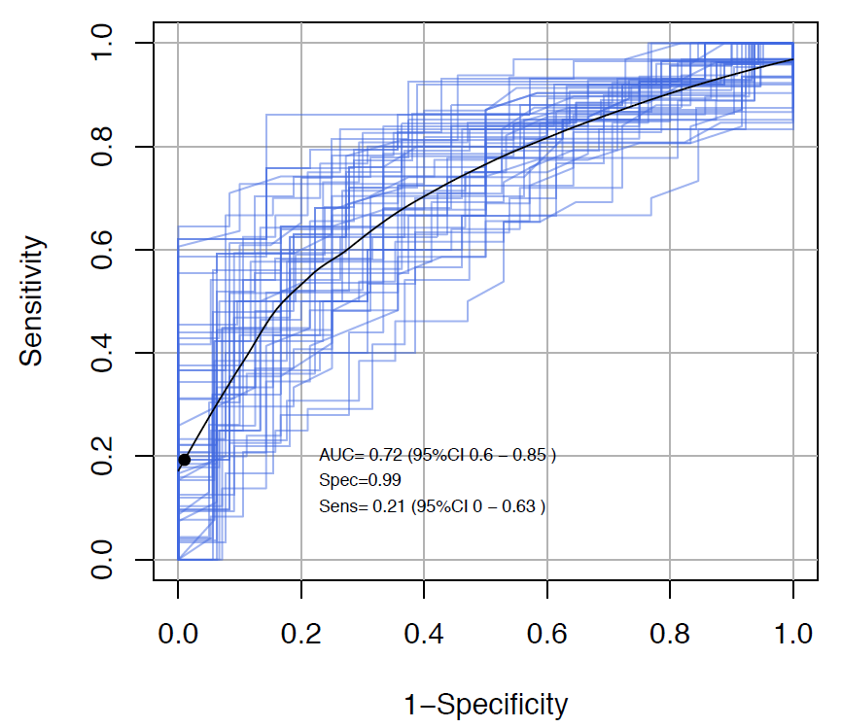
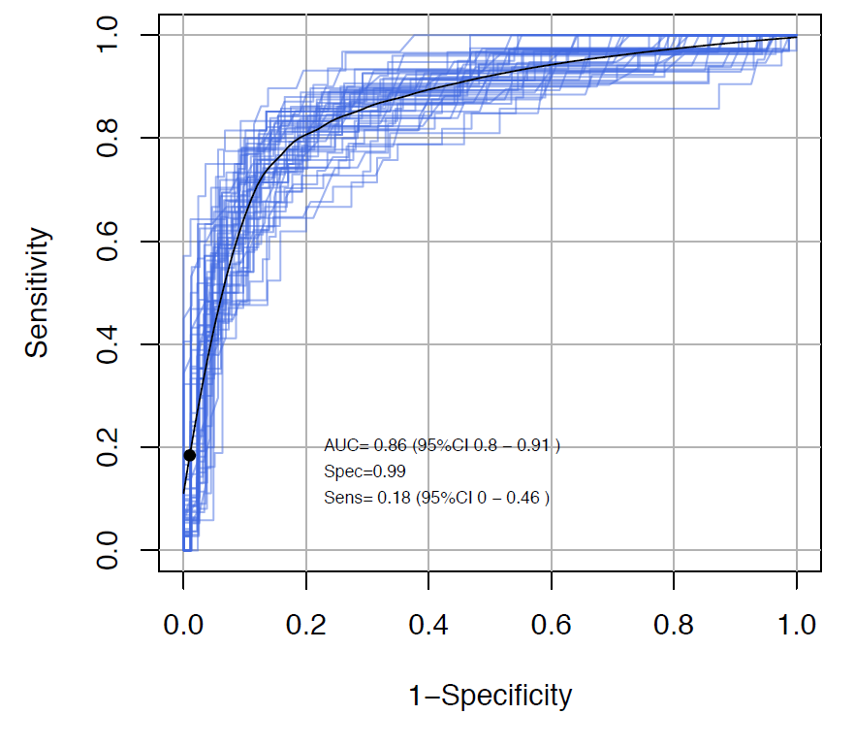
Cross-validated prediction of recent infection
Uganda
The Gambia

Slide 19
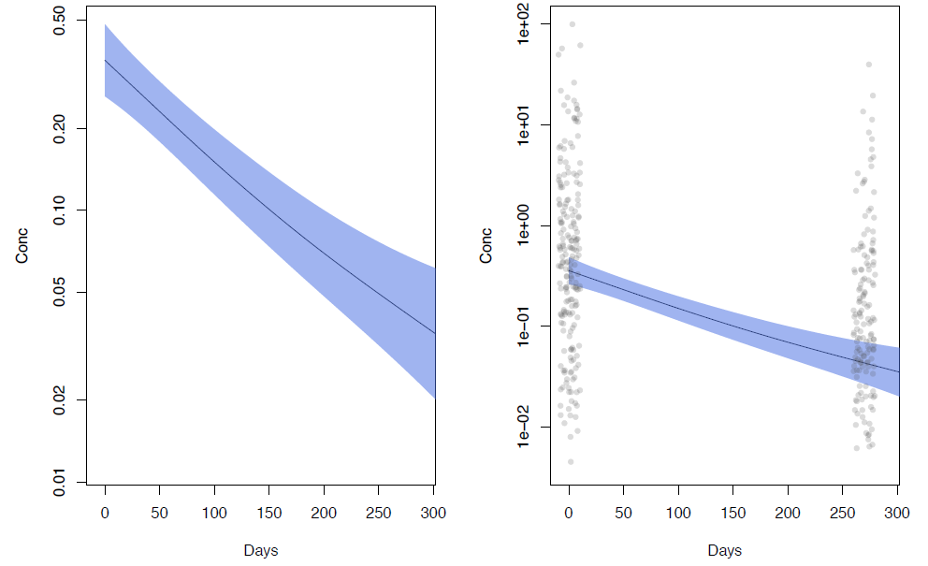
People are different, and that’s ok
Mean responses ≠ individual var.
Overcoming biological variation
Multiple antigens
Age-exposure-ab relationships
Subsets of antigens for specific age/exposure settings
Primary outcomes averaged over population
  vs. binary parasitemia/antibody more information even if
  noisy for individual
Notes:
We need to accept up front that there will be substantial biological variation

Slide 20

MADAMS which are Operationally Relevant, Generalizable, and Not biased
Wide range of cohorts
De novo candidate screen
  Slide-based protein arrays
  Whole-exome Pf variant array (pilot)
  Mosquito salivary proteins
  Pre-erythrocytic, IgG subclasses, avidity
Parametric and machine-learning approaches for candidate selection
Final assay(s)
  Analytes, measurement platform (POC vs. lab) and analytics
  Tradeoff between complexity (# analytes, precision) and information content
Notes:
To do this, most important is HQ cohorts representing a spectrum of epidemiologic settings, including varied co-infection.

Slide 21




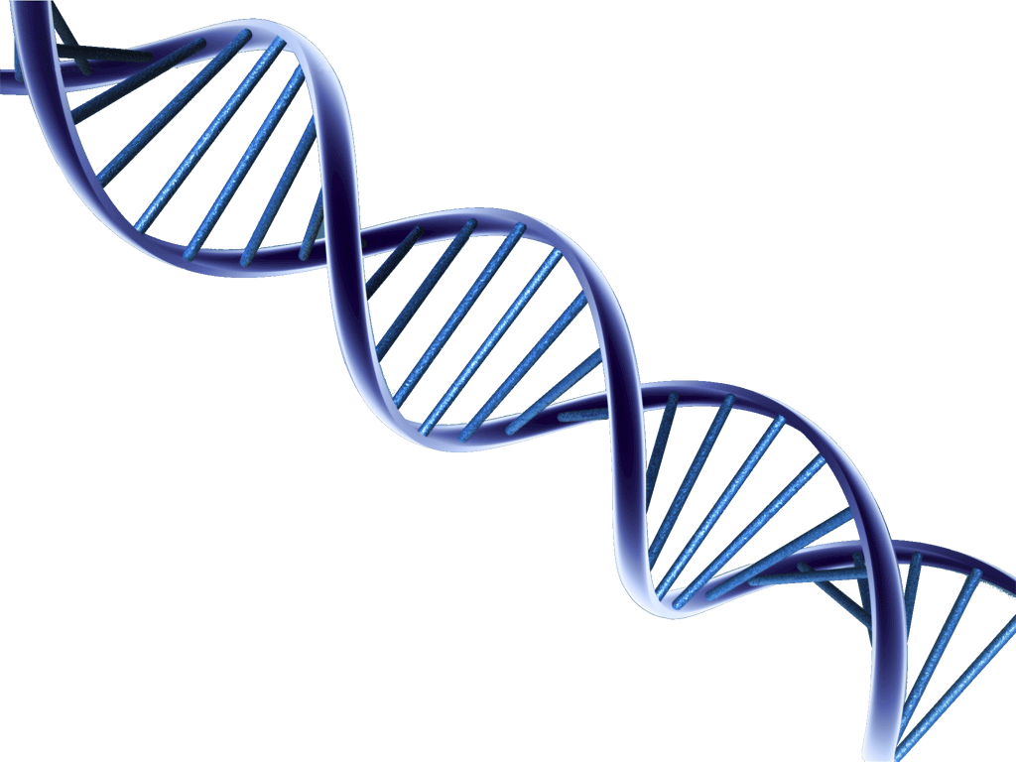





Molecular and computational infectious disease epidemiology
This could be you!
Notes:
Thrilled Isabel is finally joining the faculty at UCSF. We are looking for postdocs to join our group at UCSF and the Chan Zuckerberg Biohub,
where we study transmission epidemiology and immunology of malaria, dengue, and other infectious diseases by combining
high quality field work with laboratory and computational tools

Slide 22



Our team
IDRC, Uganda
Isaac Ssewanyana
Moses Kamya
Harriet Mayanja-Kizza
Emmanuel Arinaitwe
Maxwell Kilama
Jon Rek
Agaba Katureebe
Joaniter Nankabirwa
LSHTM
Chris Drakeley
Kevin Tetteh
UC Irvine
Phil Felgner
Huw Davies
UCSF
Isabel Rodríguez Danica Helb
Grant Dorsey
Phil Rosenthal
Max Murphy
Johns Hopkins
Bill Moss
Tamaki Kobayashi
David Smith (IHME)
Peter Crompton (NIH)
Ivo Mueller (WEHI,
Institute Pasteur)

Slide 23
Extra slides

Slide 24
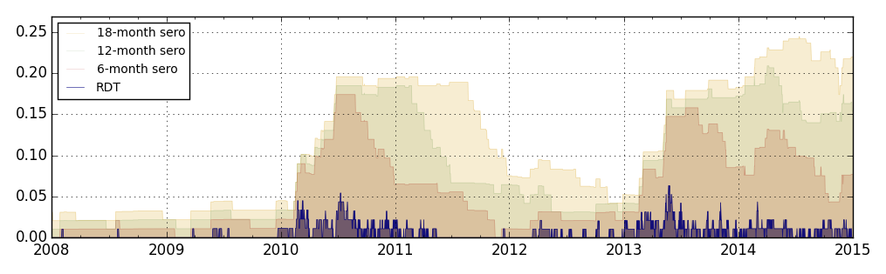
Detecting recent exposure has particular utility for low transmission
Fig. courtesy Edward Wenger

Slide 25
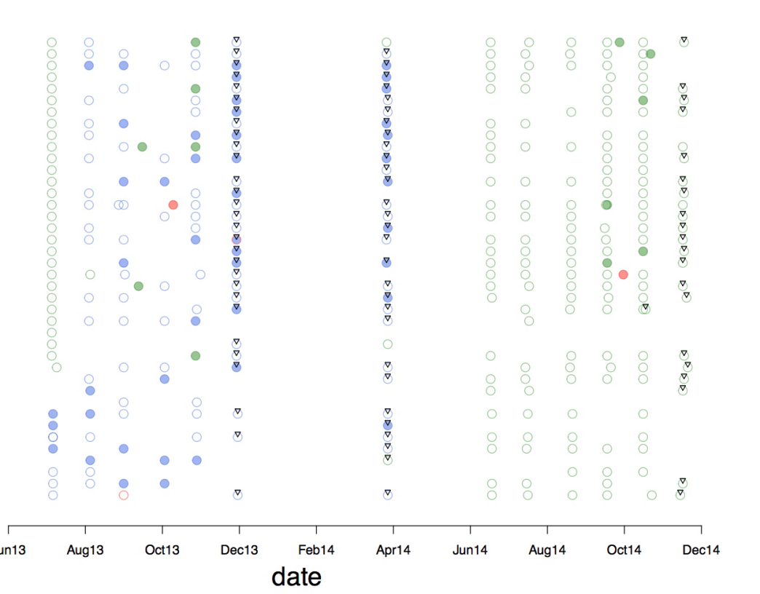
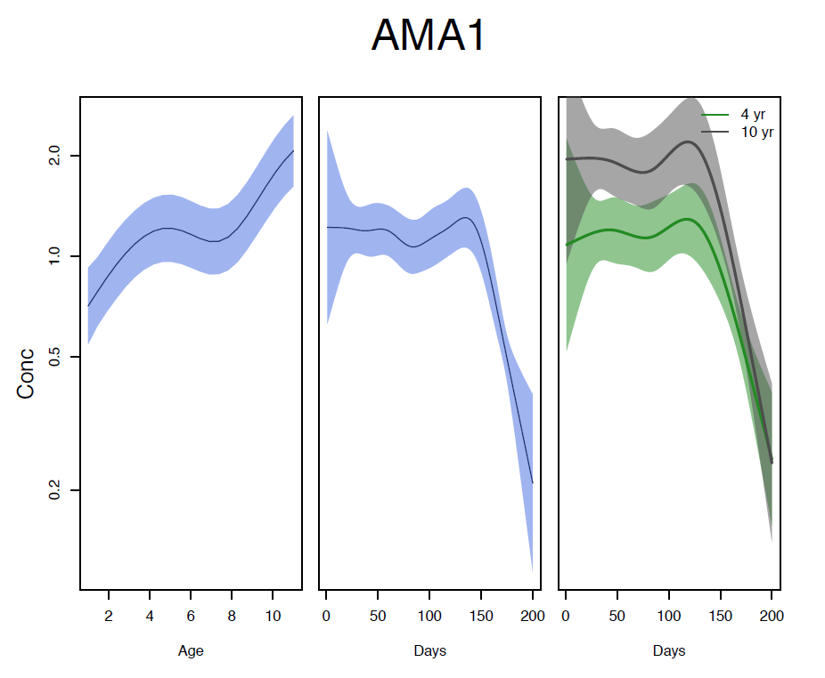

Slide 26
Finding shadows in a drop of blood
Entomological inoculation rate
  Cumbersome, insensitive, not widely used
Parasite prevalence
  Simple, standardized, widely available
  Imprecise at low and high transmission
Incidence of malaria
  Cohort studies (expensive, few)
  Health facility data
    Unknown denominator
    Consistency of diagnostic tests, reporting
    Confounded by immunity
    Useful for very low transmission
Notes:
Or connecting the dots may reveal something completely different, even though incidence data are identical

