Slide 1
Sparse sensing to simplify geographic assignment of P. falciparum genomes
7th Annual Institute for Disease Modeling Symposium
Presented by Kyle Gustafson
Joint work with Edward Wenger led by Joshua L. Proctor
17 April 2019
DISTRIBUTION STATEMENT A: Approved for Public Release. Distribution Unlimited

Slide 2
Public health and the US Navy
500,000 cases of malaria among troops in WWII
65,000 cases in Vietnam War
Naval Infectious Diseases Diagnostic Laboratory (DC)
Naval Medical Research Center – Infectious Diseases Directorate
Naval Medical Research Units (NAMRU)
Cairo/Singapore/Lima/Phnom Penh
Malaria J. (2009): ART/MEF therapy failing in S. Cambodia
– DoD funded, Navy conducted
~$1-2 billion/year DoD funding directly for infectious disease
DISTRIBUTION STATEMENT A: Approved for Public Release. Distribution Unlimited

Slide 3
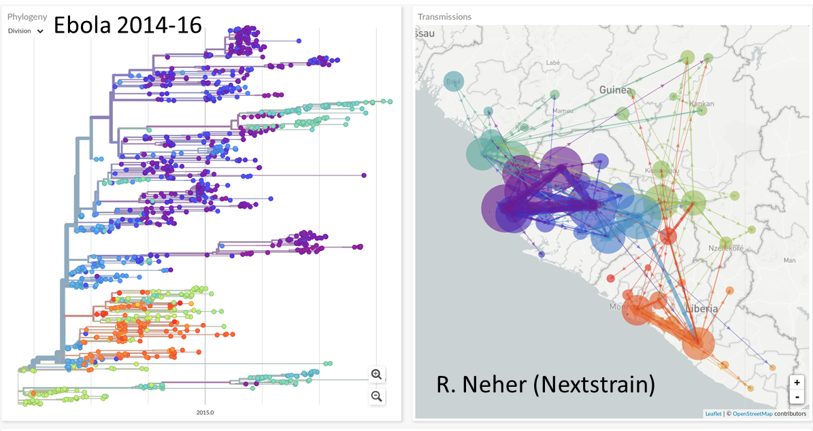
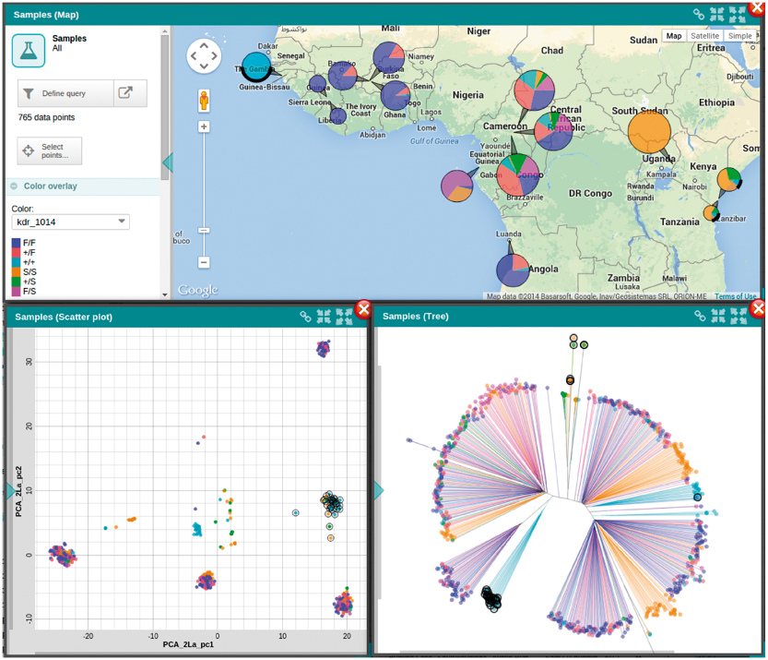
Genomic epidemiology review
The Impact of Genomics on Public Health
(Pang, Am. J. Public Health, 2002)
SARS molecular epidemiology: a Chinese fairy tale (Zhao, Phil. Trans. R. Soc. B, 2007)
A global network for investigating the genomic epidemiology of malaria (MalGen, Nature, 2008)
The Era of Genomic Epidemiology (Traynor, Neuroepidemiology, 2009)
Genomic epidemiology of artemisinin resistant malaria (MalGen, eLife, 2016)
Nextstrain: real-time tracking of pathogen evolution (Hadfield, et al., Bioinf. 2018)
Towards a genomics-informed, real-time, global pathogen surveillance system
(Gardy and Loman, Nat. Rev. Genetics, 2018)
Precision epidemiology for infectious disease control (Ladner, Nat. Med. 2019)
Panoptes
Malaria
DISTRIBUTION STATEMENT A: Approved for Public Release. Distribution Unlimited

Slide 4
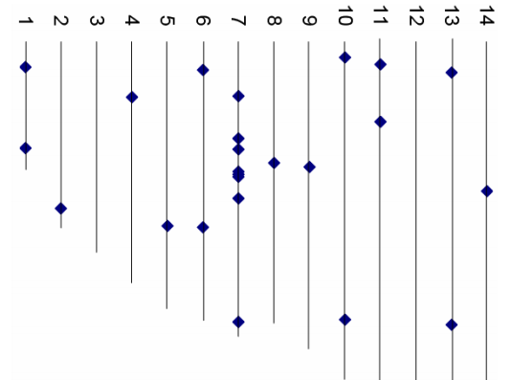
Using barcodes for P. falciparum
A general SNP-based molecular barcode for Plasmodium falciparum identification and tracking
Daniels et al., Malaria Journal, 2008 (24 SNPs)
Development of a single nucleotide polymorphism barcode to genotype Plasmodium vivax infections
Baniecki, et al., PLoS Negl Trop Diseases, 2015 (42 SNPs)
Modeling malaria genomics reveals transmission decline and rebound in Senegal
Daniels et al., PNAS, 2015
Quantifying connectivity between local Plasmodium falciparum malaria parasite populations using identity by descent
Taylor et al. PLoS Genetics, 2017
Characterization of Plasmodium falciparum structure in Nigeria with malaria SNPs barcode
Bankole et al., Malaria Journal, 2018
DISTRIBUTION STATEMENT A: Approved for Public Release. Distribution Unlimited

Slide 5
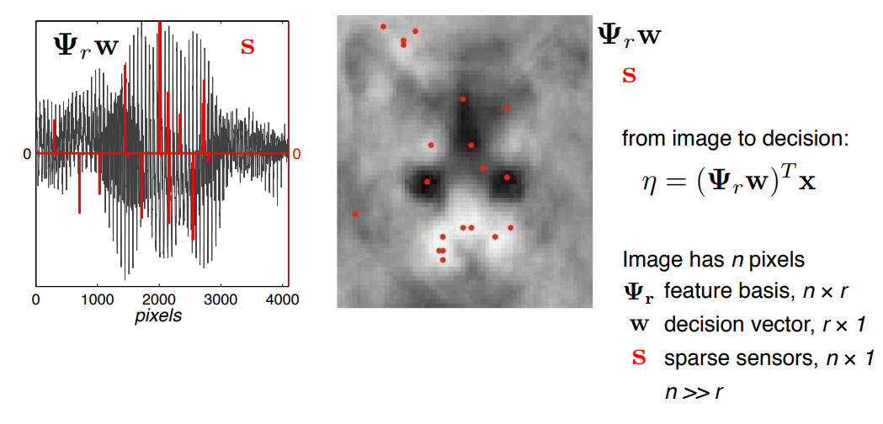
SSPOC
Brunton et al., SIAM J. Appl. Math, 2016
Sparse sensor placement for optimized classification
Sparse means minimal → save time and money
Review on sparse sensing: Manohar, et al. IEEE Control Syst. 2018
DISTRIBUTION STATEMENT A: Approved for Public Release. Distribution Unlimited

Slide 6
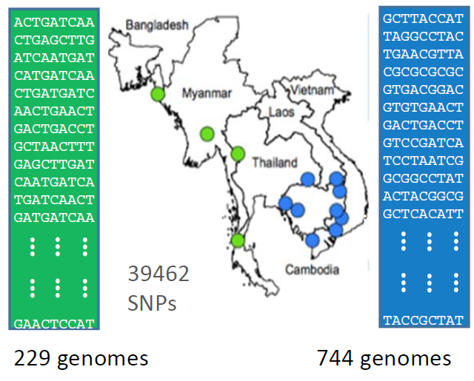
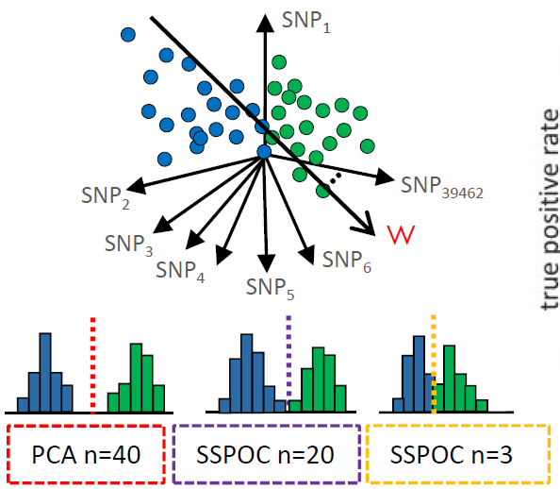
Classification or Discrimination
PCA
LDA
Classify by geographic origin
Many feature spaces might give a good separation between samples – we can choose the best one!
DISTRIBUTION STATEMENT A: Approved for Public Release. Distribution Unlimited

Slide 7
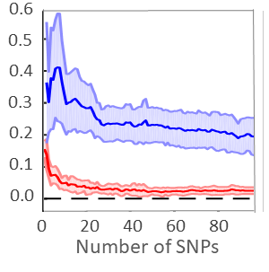
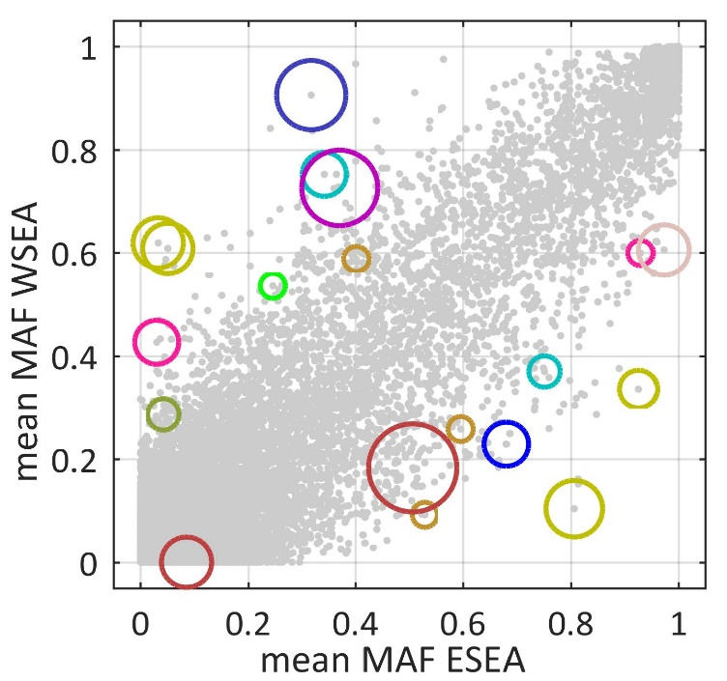
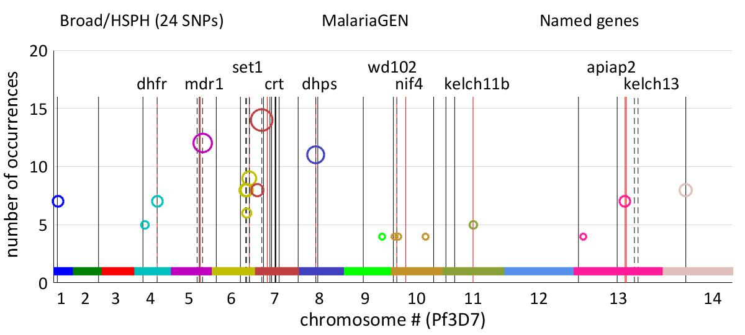
SSPOC for genome localization
W. vs. E. SE Asia
Fewer than 20 SNPs required for classification
accuracy >90% for W. vs. E. SE Asia
Locations of SNPs often correspond to known resistance genes
DISTRIBUTION STATEMENT A: Approved for Public Release. Distribution Unlimited

Slide 8
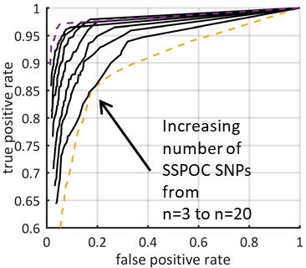
Learned sparsity of sensor placements
Sparsity makes computation faster and assays cheaper to develop and deploy
Requires machine learning from a complete set of SNPs
May create interpretable features, such as proximity to genomic loci, that may generate further hypotheses
W. vs E.
SE Asia
DISTRIBUTION STATEMENT A: Approved for Public Release. Distribution Unlimited

Slide 9
Takeaways
SSPOC is very effective at finding a minimal set of informative SNPs on P. falciparum
SSPOC SNPs can be used to create the most informative assay
Geographic distance scales inversely with the number of SNPs needed to distinguish origin – as expected
Applications such as tracking imported cases, targeting drug molecules, and pacing evolution could benefit
DISTRIBUTION STATEMENT A: Approved for Public Release. Distribution Unlimited

Slide 10
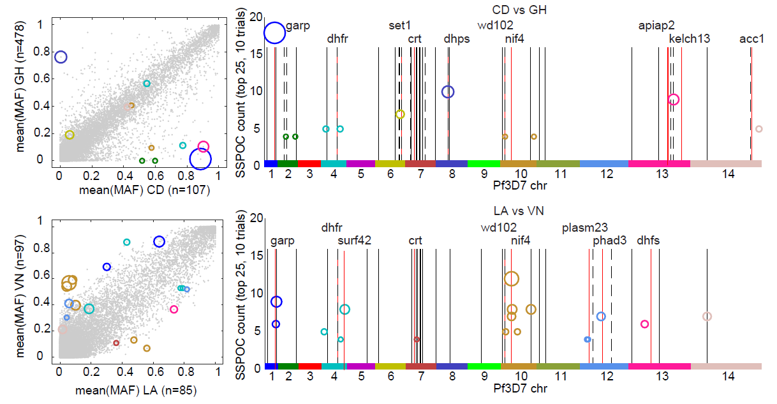
Within Africa and SE Asia
DISTRIBUTION STATEMENT A: Approved for Public Release. Distribution Unlimited

