Slide 1
Value of Environmental Surveillance to Support Vaccination Policy

Slide 2
Content
Why Consider Environmental Surveillance
Costs Depend on Perspective
Analysis Methods
Key Findings
Further Research

Slide 3
Why consider environmental surveillance
Typhoid conjugate vaccines estimated to be cost-effective in evaluated settings (Antillon 2017)
But, most countries have one (or fewer) reporting sites for typhoid: uncertainty in non-surveilled areas
In the absence of expanded blood culture surveillance, can ES allow us to use vaccine more efficiently from a cost/ impact perspective?

Slide 4
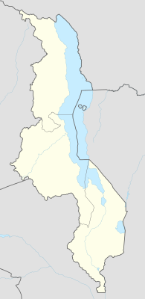
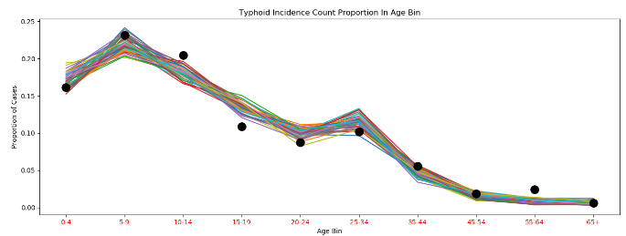
Simulation Model
Example location: Malawi, with reporting site Blantyre
4 heterogenous intra-node transmission groups (HINT) that can be assigned to be either be endemic (i.e. age distribution and incidence pattern follows Blantyre) or non-endemic (incidence ~10-20/100,000)
Model fit to Blantyre age distribution
Environmental diagnostic: ‘samples’ HINT-specific long-cycle shedding reservoir and vaccinates based on # positive samples, threshold

Slide 5
Costing Model
Perspectives
  Program Costs = Surveillance + Vaccination
  Total Health Costs = Surveillance + Vaccination + Treatment
Components
  Environmental Sampling ~$100 per sample
  Vaccination (RI and SIA) ~$1.00 per vaccine + ~$.74 for delivery
  Acute Case Treatment Cost ~$27.08 per case
  Excluded: Lost productivity, caretaking, other indirect costs
  Excluded: Non-acute cases, MDR fraction
Notes:
Need to add references

Slide 6
Considerations
Condition | Simulation Parameter | Simulated Values
Underlying Disease | # of Endemic Locales | 1-4 of 4 locales
ES Coverage | # of Locales with ES | 1-4 of 4 locales
ES Threshold | Threshold for Positives | Low – high
Response Strategy | Response Region | National or Local

Slide 7
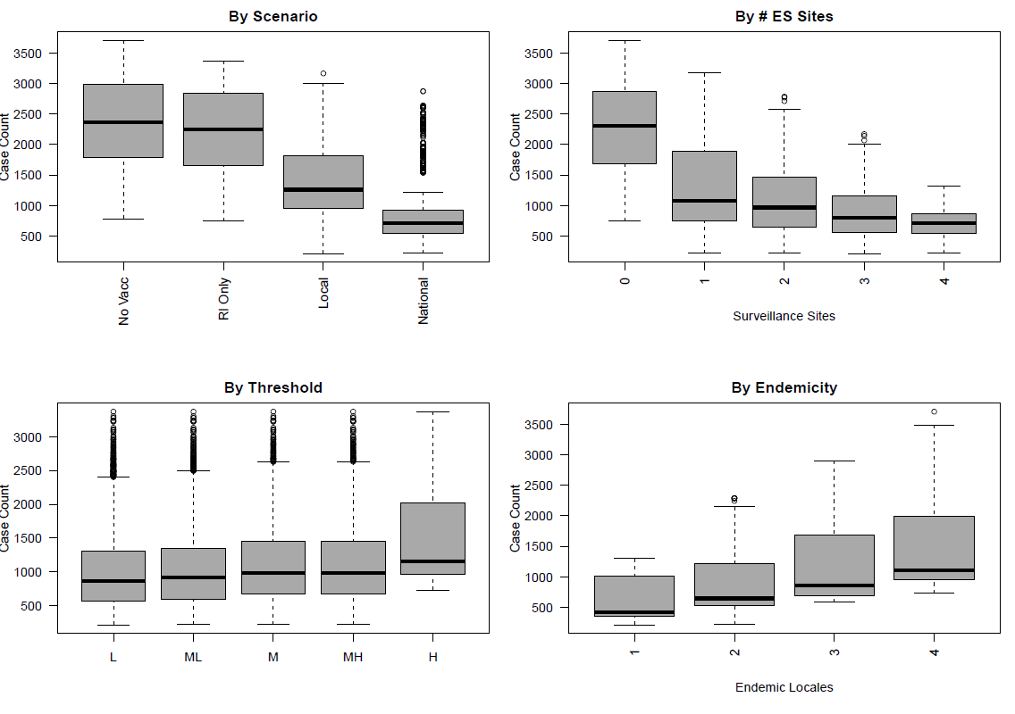
Disease
Burden
To minimize disease burden without cost considerations, national catch-up campaigns based on many ES sites is best.
This guarantees that if there is any disease anywhere, you will respond maximally.

Slide 8
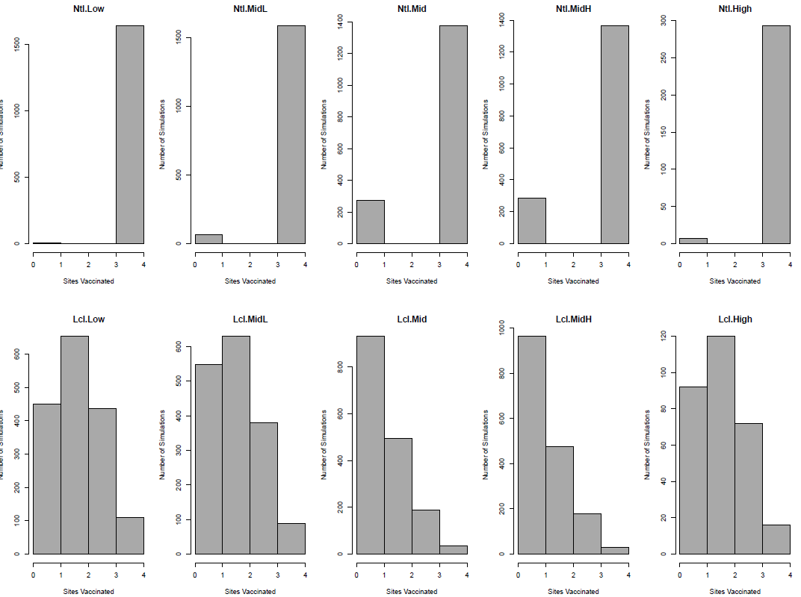
Campaigns Depend on Threshold
Higher thresholds reduce the likelihood of a catch-up campaign.

Slide 9
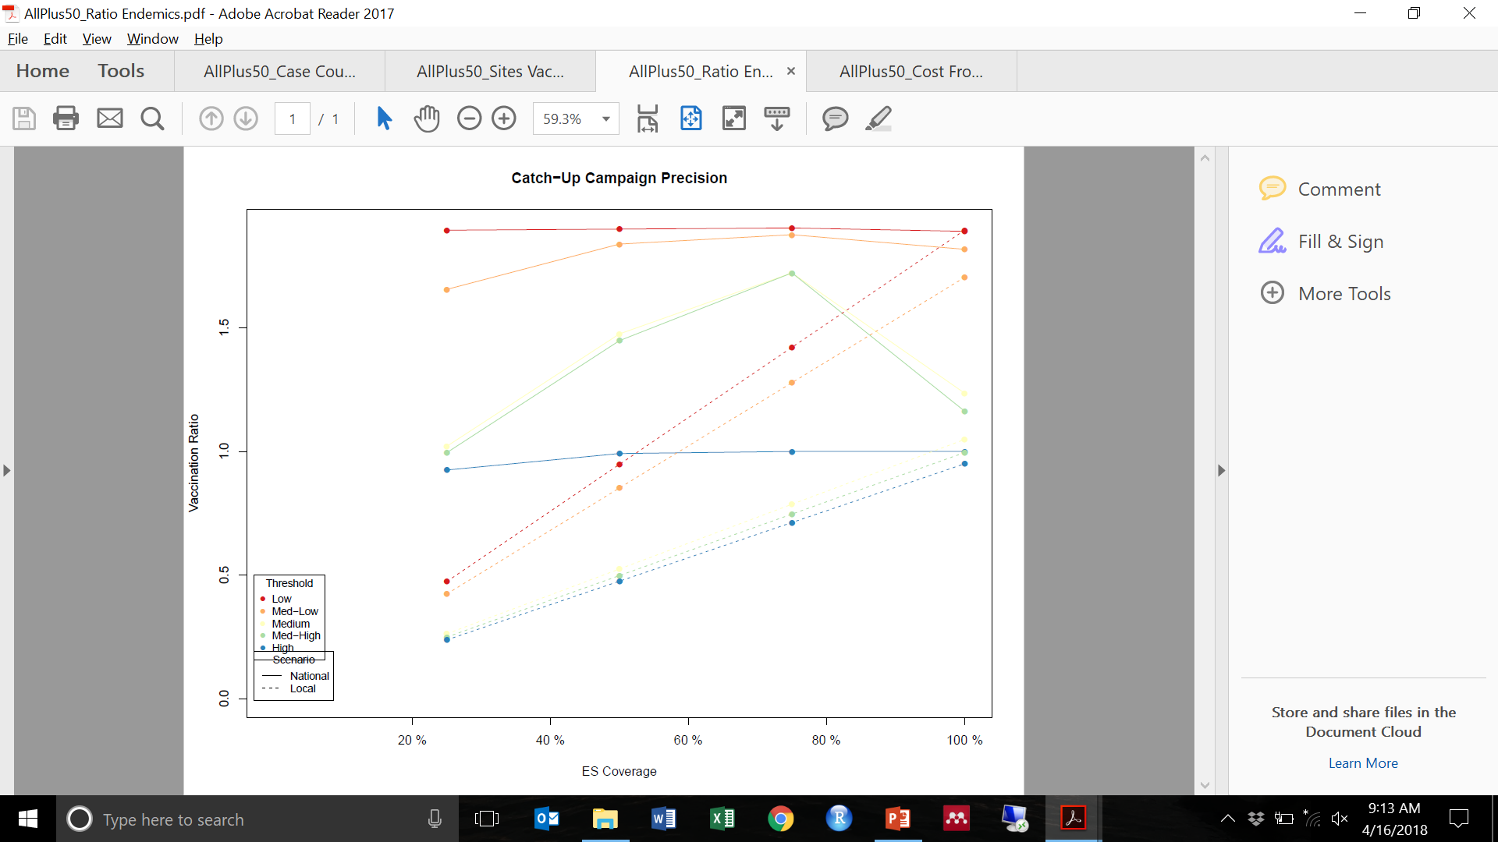
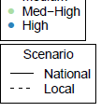
Optimal Targeting
Low (binary) thresholds result in vaccination of low-risk populations.
Higher thresholds are effective at targeting if there is ample ES coverage of the full catchment area.

Slide 10
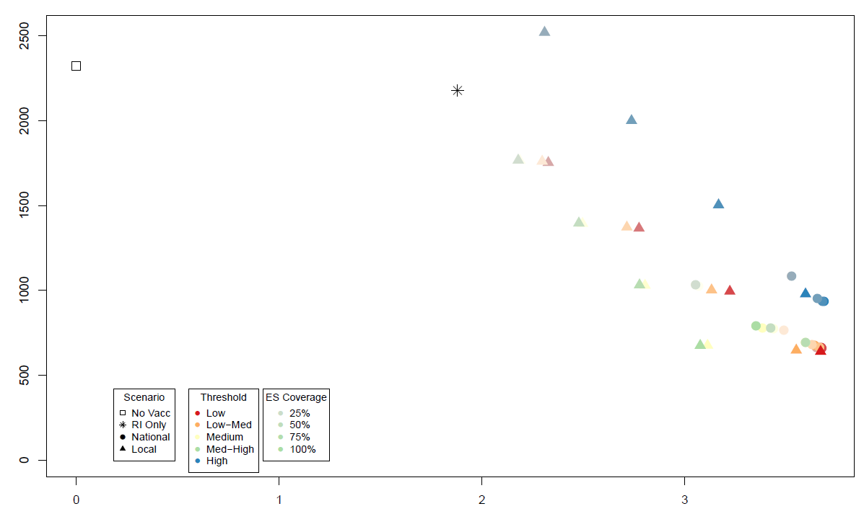
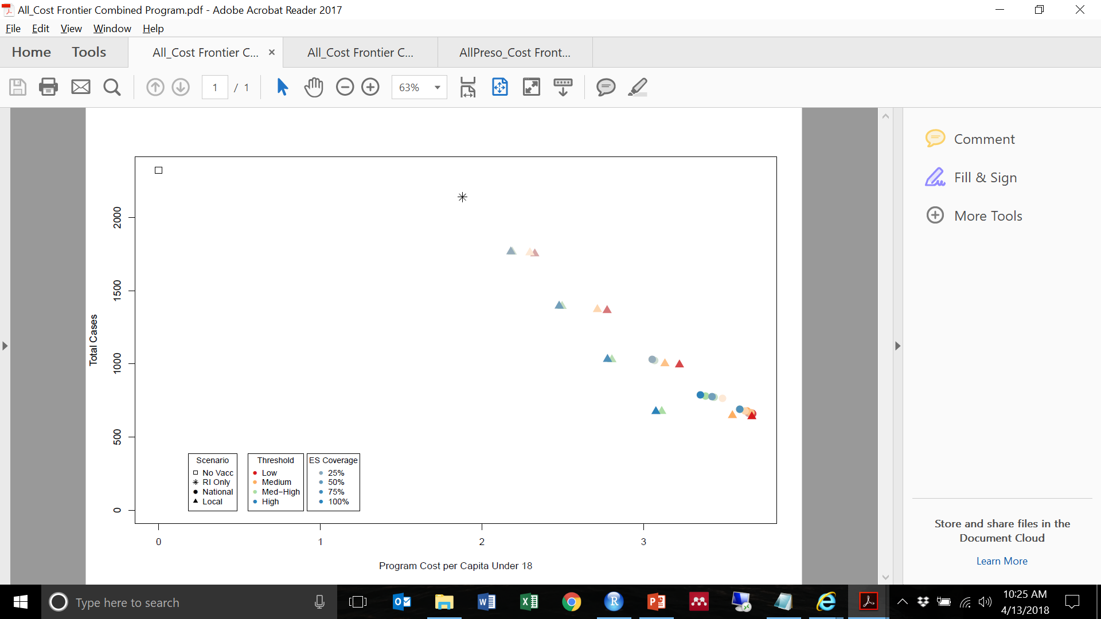
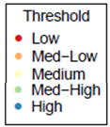
Cost-Efficient Frontier
Fewer cases at lower cost
Locally-targeted catch-up campaigns are more cost-efficient than national.
Higher thresholds, combined with ample ES sites, enable good targeting .
10-year Case Count
Program Cost per Capita Under 18

Slide 11
Findings
Targeting strategies:
  National campaigns maximize burden reduction.
  Locally-targeted campaigns are more cost-efficient.
  Both national and local strategies do better with ample ES catchment area (more sites).
ES sensitivity and coverage:
  Low contagion thresholds generally result in vaccination of low-risk populations.
  Higher thresholds are effective at targeting, as long as there is ES coverage across enough of the catchment area.
These patterns are true regardless of the “patchiness” of the disease prevalence.

Slide 12
Thank You
This work would not have been possible without the support of many IDM collaborators.
Jillian Gauld
Dan Bridenbecker
Chris Lorton
Thomas Fischle
Svetlana Titova
Benoit Raybaud

Slide 13
Appendix

Slide 14
Cost/Economic Model Components
Cost Effectiveness
Total Costs
Cost Vaccination
Cost ES Surveillance
Simulated Cases
Cost per Case Treatment
Vaccine per Dose
Sample Collection
Transport Rate
Testing
Labor
Equipment
PCR Equipment
PCR Consumables
Labor
Labor
Equipment
Supply Chain Rate
Overhead Rate
Delivery per Dose
Vial Price x
Vials
Day rate x
Time spent
Purchase price /
Lifespan
Doses x
Rate per unit
Rate
Day rate x
Time spent
Purchase price /
Lifespan
Samples x
Rate per unit
Purchase price /
Lifespan
Samples x
Rate per unit
Day rate x
Time spent

Slide 15
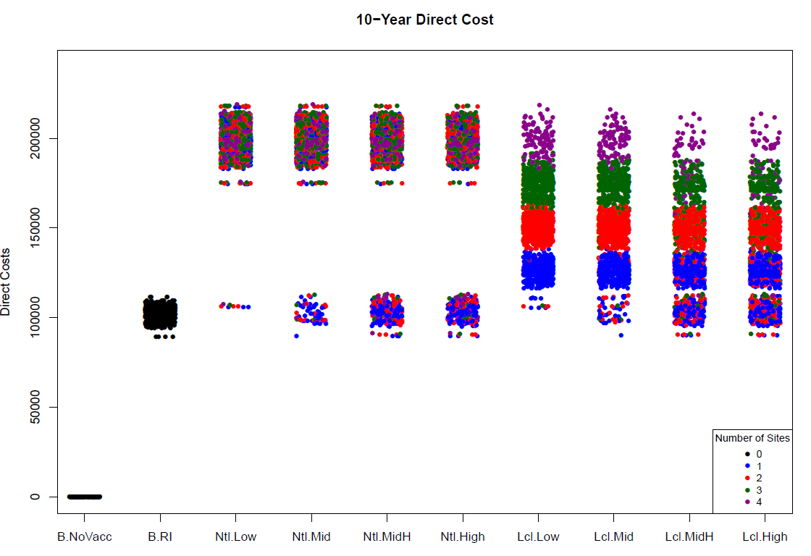
Simulated Direct Costs
Baseline costs for RI only, no catch-up campaigns.

Slide 16
For most locations with endemic typhoid, we have one, or few reporting locations within a country.
One reporting site in Malawi (Blantyre)
Other locations in the country could have similar incidence rates
Or, very different incidence rates

Slide 17
Exploratory simulations
Four HINT (heterogenous intra-node transmission) groups
Assigned to be “like Blantyre” or low transmission (~10/100,000)
‘like Blantyre’ simuations: well fit to age distribution and seasonality
Non-endemic simulations: Cases generated from exportation from endemic HINT groups, little to no endemic transmission

Slide 18
Model Notes
Threshold values (how many positives drive a decision): 1 positive results in a classification of a site to be vaccinated.
Frequency & seasonality of testing: 5 per site, weekly.
Test sensitivity: Tested a limited number of sensitivities thus far.

