Slide 1
The Population Level Impact of Novel, Point-of-Care Screening-Diagnostic Algorithms for Tuberculosis when Administered with Annual HIV Testing in South Africa: A Mathematical Modeling Analysis
Haylea Hannah, MSPH
Bradley G. Wagner
Stewart Chang
Paul W. Drain

Slide 2
Outline
Background
Objectives
Methods
Results
Conclusions

Slide 3
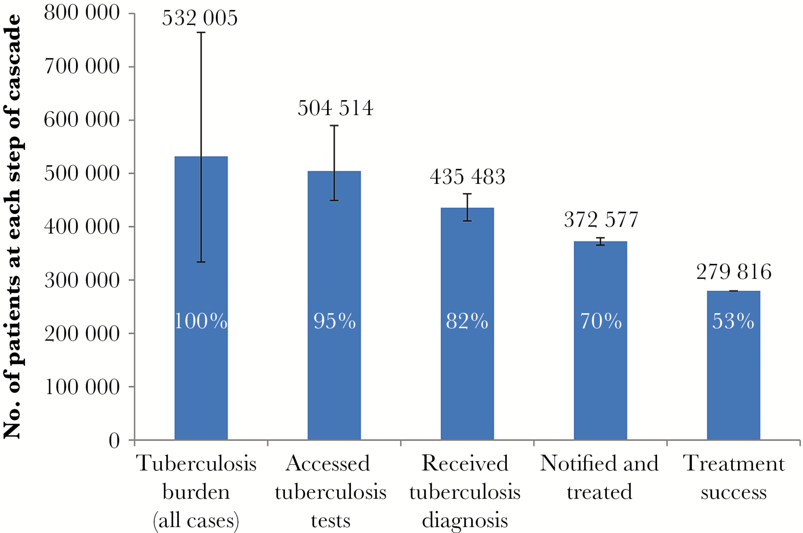
Need for Improved TB Diagnostics
An estimated 20-30% of TB cases go undiagnosed
Approximately 70% missed as a result of diagnostic failures
From: The South African Tuberculosis Care Cascade: Estimated Losses and Methodological Challenges
J Infect Dis. 2017;216(suppl_7):S702-S713. doi:10.1093/infdis/jix335
J Infect Dis | © The Author 2017. Published by Oxford University Press for the Infectious Diseases Society of America.This is an Open Access article distributed under the terms of the Creative Commons Attribution License (http://creativecommons.org/licenses/by/4.0/), which permits unrestricted reuse, distribution, and reproduction in any medium, provided the original work is properly cited.
Notes:
We know that there are 10 million TB cases worldwide, TB is the leading cause of death among persons living with HIV, and that most TB deaths are preventable with early diagnosis and treatment
However, Traditional TB testing algorithms rely on symptom screening and sputum-based diagnostic tests, which are less sensitive among PLHIV and often result in treatment delays and loss to follow-up.
In South Africa alone, an estimated 20-30% of TB cases go undiagnosed, and approximately 70% of these are missed as a result of diagnostic failures.
Understanding which diagnostic algorithms could improve these missed opportunities have important implications for TB prevention and control globally.

Slide 4
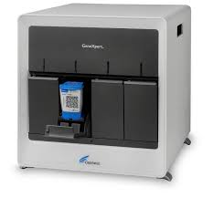
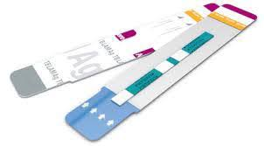
TB Screening and Diagnostics at a Glance
Screening
Diagnostic
Four TB Symptom Screen (4SS)
GeneXpert
C-Reactive Protein (CRP)
Urine lipoarabinomannan (uLAM)
Image Sources: https://microbeonline.com/genexpert-mtbrif-assay-principle-procedure-results-interpretations/ https://sahivsoc.org/Files/20C%20-%20Paul%20Drain%20-%20TB%20diagnosis%20at%20PHC.pdf
Science Photo Library
Notes:
4SS is the recommended screening algorithm by the WHO and is currently considered the standard of care in South Africa
It consists of asking patients for the presence of any cough, weight loss, fever, and/or night sweats
C-Reactive Protein is a broad inflammatory marker that’s been used in clinical practice to screen for inflammation, but it is currently being evaluated as a point-of-care screening tool for TB
In terms of available diagnostics, GeneXpert is widely used as a diagnostic tool for TB and can detect rifampicin resistance. Although it was designed to be used at the point of care, prior research has suggested that in South Africa, it’s being administered in central laboratories resulting in a sometimes nearly one-week delay in receiving the test result.
Urine lipoarabinomannan, which I’ll refer to as uLAM for the remainder of the presentation, is also currently being evaluated as a point-of-care diagnostic tool for TB. The first generation uLAM, developed by Alere, had a low sensitivity among those who are HIV negative and persons living with HIV with a CD4 count greater than 100. As of November 2015, this diagnostic tool is currently only recommended for persons living with HIV who have a CD4 count lower than 100 and/or are “seriously ill”

Slide 5
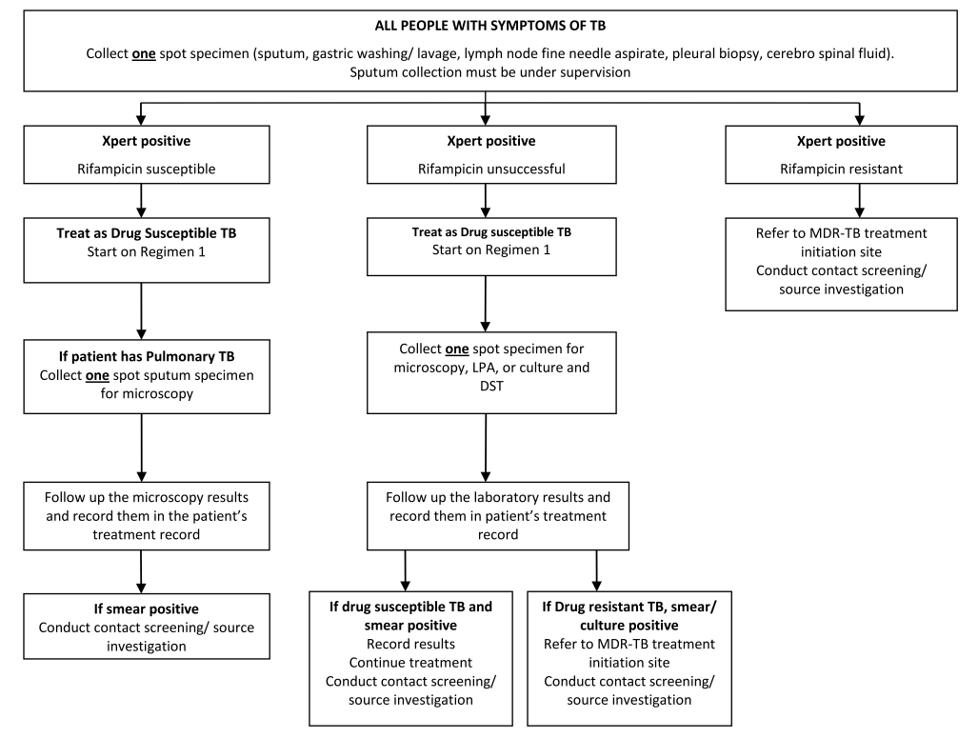
Notes:
These are the most recent South African TB Testing guidelines as of 2014, the main thing I want to highlight here is that current TB testing algorithms rely on TB symptom screening and sputum-based diagnostic tests, which are less sensitive among PLHIV and often result in treatment delays and loss to follow-up since patients have to come back to the clinic to obtain the result

Slide 6
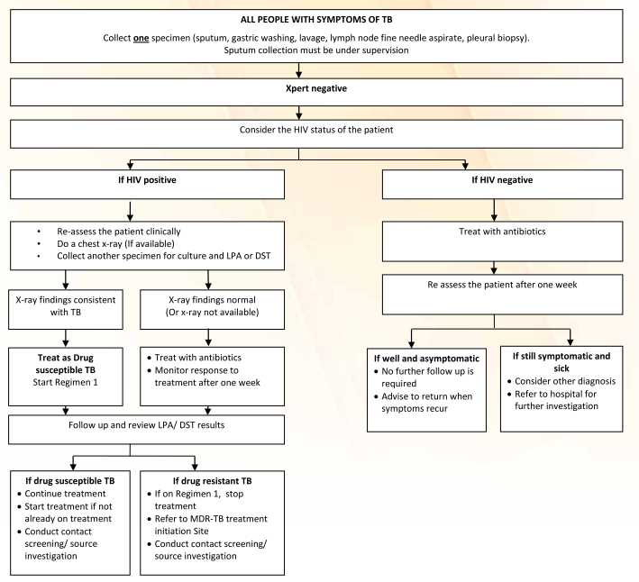
Notes:
This is again a graphic from the South African TB testing Guidelines, and illustrates that these sputum-based tests and current algorithms fail to provide an objective way to reliably diagnose TB among PLHIV. The current guidelines recommend additional tests which may further delay diagnosis and lead to losses to follow-up, ultimately resulting in individuals delaying treatment and developing more advanced disease.

Slide 7
Objectives
Estimate the population-level impact of incorporating POC testing for active pulmonary TB into routine HIV testing
Determine which screening-diagnostic algorithm would result in the greatest impact on future TB incidence, mortality, and annual risk of infection
Evaluate the impact of a second-generation urine LAM test with improved sensitivity and specificity

Slide 8
Methods: Overview
Utilized Epidemiologic Modeling TB Software (EMOD-TB)
Calibrated to historical estimates of South African TB disease incidence and mortality
Modelled TB screening-diagnostic algorithms offered annually with HIV testing beginning in 2016
Test sensitivities and specificities differed by HIV status and CD4 count
Outcomes
Active TB disease incidence
TB disease mortality
Annual risk of infection (ARI)
Notes:
The EMOD-TB is an individual-based, stochastic mathematical model of infectious disease transmission that is calibrated to historical estimates of South African TB disease incidence and mortality, accounts for the natural history of TB and HIV and their associated care cascades, including care seeking behavior, ART initiation and scale-up, and CD4 decline and reconstitution

Slide 9
Methods: Baseline vs. Intervention
BASELINE
INTERVENTION
Exposed and Infected with TB
Symptomatic
Asymptomatic
Seek care
Do not
seek care
Seek care
Receive HIV testing annually
Do not receive HIV testing

Slide 10
Methods: Screening Test Performance
Testing Mechanism | Group | Sensitivity % (95% Confidence Interval) | Specificity % (95% Confidence Interval)
C-reactive Protein (CRP) | HIV-positive, CD4≥100 | 73 (55-87) | 80 (76-84)
 | HIV-positive, CD4<100 | 93 (87-97) | 66 (61-69)
 | HIV-negative | 99 (63-100) | 85 (55-98)
4-Symptom Screening (4SS) | HIV-positive, CD4≥100 | 51 (28-73) | 71 (48-86)
 | HIV-positive, CD4<100 | 89 (83-94) | 28 (19-40)
 | HIV-negative | 64 (56-71) | 62 (61-63)

Slide 11
Methods: Diagnostic Test Performance
Testing Mechanism | Group | Sensitivity % (95% Confidence Interval) | Specificity % (95% Confidence Interval)
GeneXpert (Xpert) | HIV-positive, CD4≥100 | 54 (37-72) | 99 (98-100)
 | HIV-positive, CD4<100 | 79 (59-99) | 99 (98-100)
 | HIV-negative | 86 (76-92) | 98 (97-99)
Urine LAM (uLAM) | HIV-positive, CD4≥100 | 24 (9-45) | 95 (91-98)
 | HIV-positive, CD4<100 | 56 (41-70) | 80 (64-91)
 | HIV-negative | 14 (8-28) | 90 (86-98)
Second-generation uLAM (±20% uncertainty) | HIV-positive, CD4≥100 | 70 (56-84) | 95 (76-100)
 | HIV-positive, CD4<100 | 80 (64-96) | 95 (76-100)
 | HIV-negative | 60 (48-72) | 95 (76-100)
Notes:
All of these tests were modelled at the point-of-care except for GeneXpert, which had a 6 day diagnostic delay based on estimates from a study conducted in South Africa

Slide 12
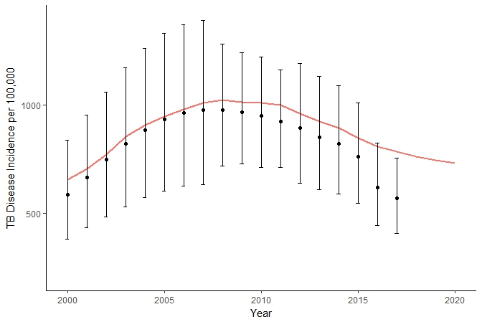
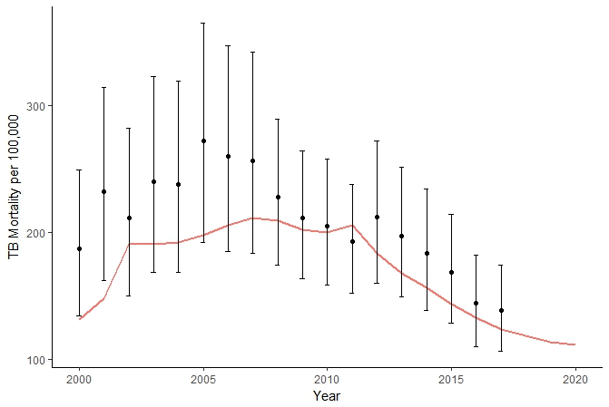
Results: Model Fit for TB Incidence and Mortality
Notes:
I wanted to briefly show the model fit in terms of TB incidence and mortality, although the model doesn’t fit as well to more recent mortality and incidence estimates, it does match the general trend for both the incidence and mortality

Slide 13
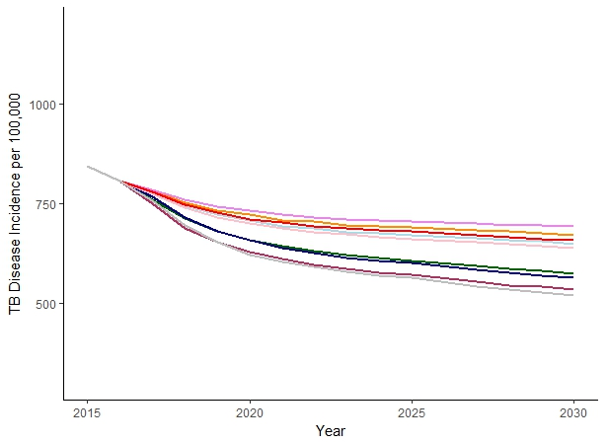
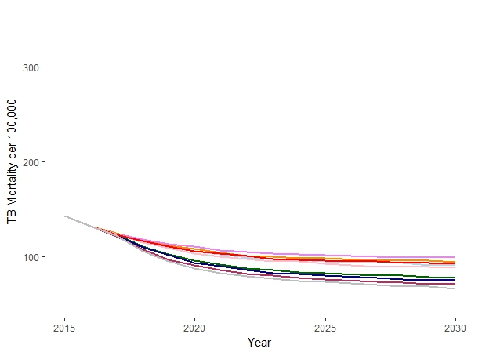
Results: Impact on TB Incidence and Mortality
Notes:
We’ll look at the relative decreases with each of these scenarios from 2016-2035 in comparison to baseline trends in the next slide for some of the highest performing algorithms, but here I mainly want to note that Administering TB testing at the time of annual HIV testing led to reductions in the TB incidence and mortality in South Africa under all screening-diagnostic scenarios compared to baseline trends.
The algorithm that had the greatest impact on the TB incidence and mortality was CRP+GeneXpert, even with realistic diagnostic delays built in.

Slide 14
Results: Impact of 2nd Generation uLAM
Sensitivity
HIV+ <100: 80%
HIV + ≥100: 70%
HIV-: 60%
Specificity
All groups: 95%
25% Incidence
26% Mortality
22% Incidence
24% Mortality

Slide 15
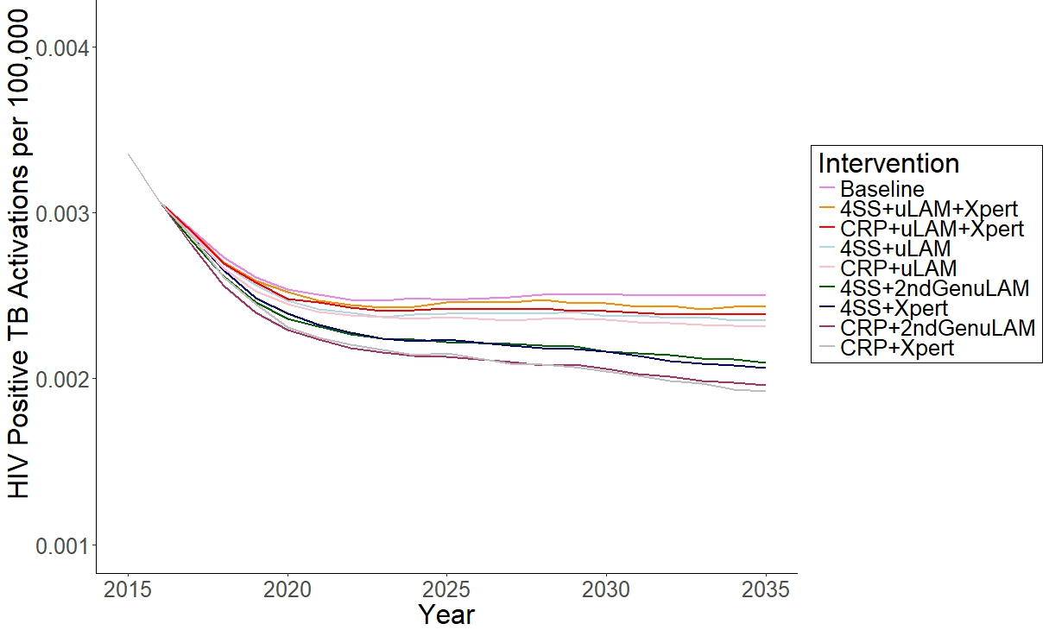
Results: Impact of 2nd Generation uLAM among PLHIV
GeneXpert and 2nd Generation uLAM have nearly identical impact among PLHIV

Slide 16
Results: Annual Risk of Infection
CRP+Xpert
42% reduction compared to baseline trends
CRP+2nd Gen uLAM
37% reduction compared to baseline trends

Slide 17
Conclusions
Administering TB testing at the time of annual HIV testing led to substantial reductions in the TB burden in South Africa under all screening-diagnostic scenarios evaluated
Largest reductions observed when administering CRP+GeneXpert
Greatest relative reduction seen in the ARI
Algorithms with CRP as a screening tool had a greater impact on the TB burden than those using 4SS
A uLAM diagnostic with improved sensitivity and specificity resulted in similar reductions in the TB incidence and mortality as GeneXpert

Slide 18
Acknowledgements
Acknowledgements
Paul Drain and his research team
Rachel Kubiak
Adrienne Shapiro
Kristina Bajema
Institute for Disease Modeling
Brad Wagner
Stewart Chang

Slide 19
Thank you!
Questions?
Haylea Hannah
hahannah@uw.edu

Slide 20
References
Lawn SD, Brooks S V, Kranzer K, et al. Screening for HIV-Associated Tuberculosis and Rifampicin Resistance before Antiretroviral Therapy Using the Xpert MTB / RIF Assay : A Prospective Study. 2011;8(7). doi:10.1371/journal.pmed.1001067.
Steingart KR, Schiller I, Horne DJ, Pai M, Boehme CC, Dendukuri N. Xpert ® MTB / RIF assay for pulmonary tuberculosis and rifampicin resistance in adults ( Review ). 2014;(1). doi:10.1002/14651858.CD009593.pub3.www.cochranelibrary.com.
Getahun H, Kittikraisak W, Heilig CM, et al. Development of a standardized screening rule for tuberculosis in people living with HIV in resource-constrained settings: Individual participant data meta-analysis of observational studies. PLoS Med. 2011;8(1). doi:10.1371/journal.pmed.1000391.
Corbett EL, Zezai A, Cheung B, et al. Provider-initiated symptom screening for tuberculosis in Zimbabwe : diagnostic value and the effect of HIV status. 2010;(March 2009):13-21. doi:10.2471/BLT.08.055467.
Drain PK, Losina E, Coleman SM, et al. Value of urine lipoarabinomannan grade and second test for optimizing clinic-based screening for HIV-associated pulmonary tuberculosis. J Acquir Immune Defic Syndr. 2015;68(3):274-280. doi:10.1097/QAI.0000000000000436.
Shah M, Hanrahan C, Zy W, et al. Lateral flow urine lipoarabinomannan assay for detecting active tuberculosis in HIV-positive adults ( Review ) Lateral flow urine lipoarabinomannan assay for detecting active tuberculosis in HIV-positive adults. 2016;(5). doi:10.1002/14651858.CD011420.pub2.Copyright.
Drain PK, Losina E, Coleman SM, et al. Diagnostic accuracy of a point-of-care urine test for tuberculosis screening among newly-diagnosed hiv-infected adults: A prospective, clinic-based study. BMC Infect Dis. 2014;14(1):1-9. doi:10.1186/1471-2334-14-110.

Slide 21
References
Yoon C, Chaisson L, Patel S, et al. Diagnostic Accuracy of C-reactive Protein for Active Pulmonary Tuberculosis: a Meta-Analysis. Int J Tuberc Lung Dis. 2017. doi:10.3837/tiis.0000.00.000.
Yoon C, Semitala FC, Atuhumuza E, et al. Point-of-care C-reactive protein-based tuberculosis screening for people living with HIV : a diagnostic accuracy study. Lancet Infect Dis. 17(12):1285-1292. doi:10.1016/S1473-3099(17)30488-7.
Hamada Y, Lujan J, Schenkel K, Ford N, Getahun H. Sensitivity and specificity of WHO’s recommended four-symptom screening rule for tuberculosis in people living with HIV: a systematic review and meta-analysis. Lancet HIV. 2018;5(9):e515-e523. doi:10.1016/S2352-3018(18)30137-1.
Minion J, Leung E, Talbot E, Dheda K, Pai M, Menzies D. Diagnosing tuberculosis with urine lipoarabinomannan: Systematic review and meta-analysis. Eur Respir J. 2011;38(6):1398-1405. doi:10.1183/09031936.00025711.
Claassens MM, van Schalkwyk C, Floyd S, Ayles H, Beyers N. Symptom screening rules to identify active pulmonary tuberculosis: Findings from the Zambian South African Tuberculosis and HIV/AIDS Reduction (ZAMSTAR) trail prevalence surveys. PLoSONE. Mar 2017;12(3): e0172881. https://doi.org/10.1371/journal.pone.0172881

Slide 22
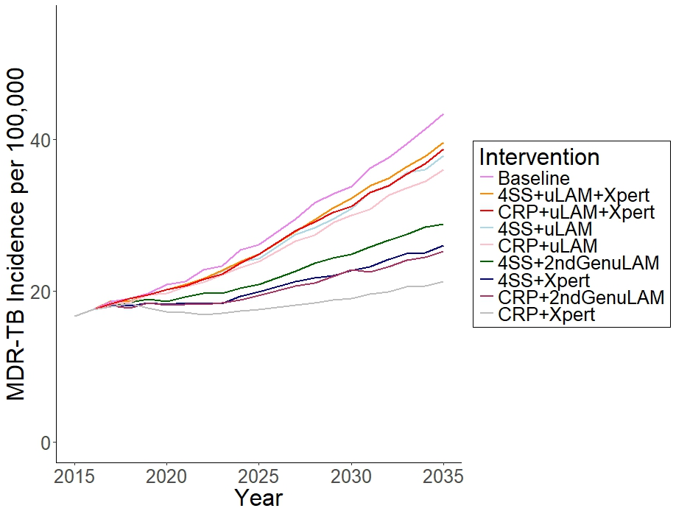
Supplemental: Impact on MDR-TB
Models suggest POC tests will not accelerate incident MDR-TB

Slide 23
Supplemental: Impact on Number of Tests Ordered
92% fewer tests ordered with administration of uLAM before GeneXpert
Screening
algorithm
Notes:
The introduction of uLAM between screening (by either CRP or 4SS) and confirmatory GeneXpert results in a 92% reduction in the number of GeneXpert tests ordered at the time of annual HIV testing

Slide 24
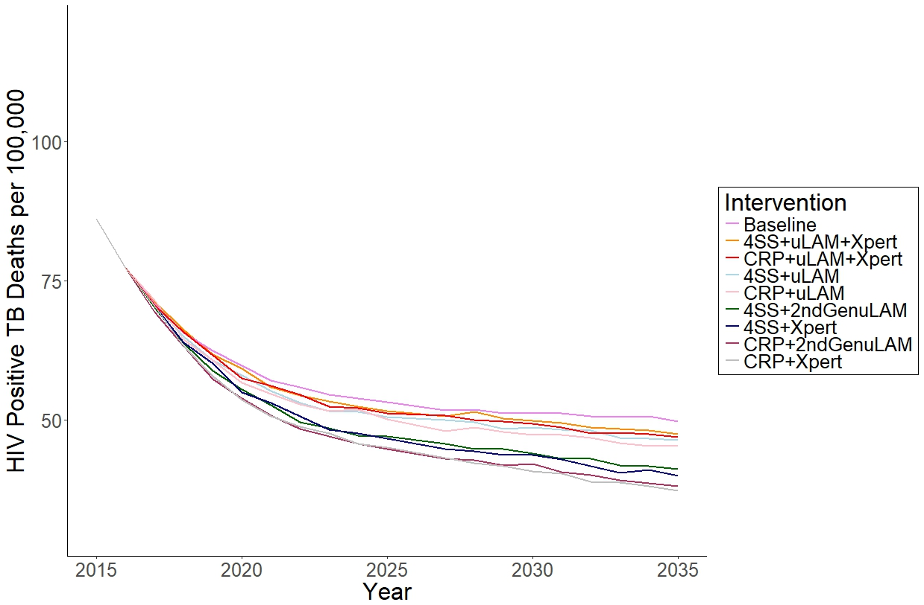
Supplemental: Mortality Impact among PLHIV

Slide 25
Supplemental: Timing of Key Events
Ramp up period
1985
2000
2006
2009
2012
2016
HIV Epidemic Starts
Directly Observed Therapy Starts
Antiretrovirals introduced
Gene Xpert Introduced
Intensified case finding introduced

