Slide 1




Using Prognostic Biomarkers to Target
TB Preventive Therapy
IDM 5th Annual Disease Modeling Symposium
Seattle 2017
Mark Hatherill
South African Tuberculosis Vaccine Initiative (SATVI)
University of Cape Town, South Africa
Notes:
Mark

Slide 2
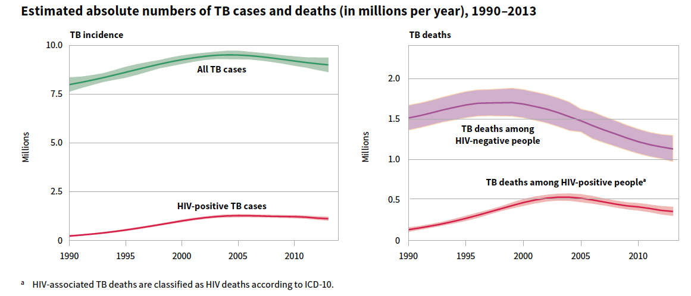
The global TB epidemic has peaked
TB incidence rate falling at 1.5% per year
Not fast enough to meet TB control goals

Slide 3
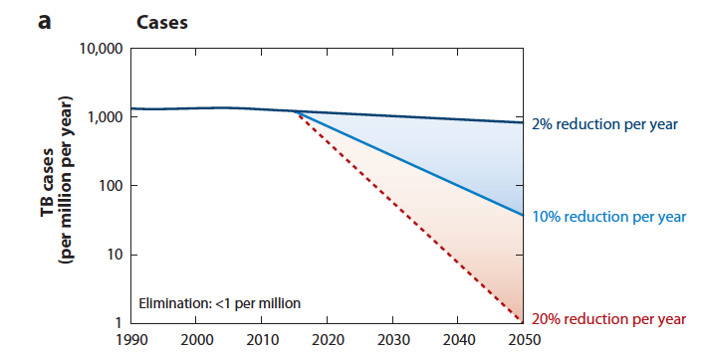
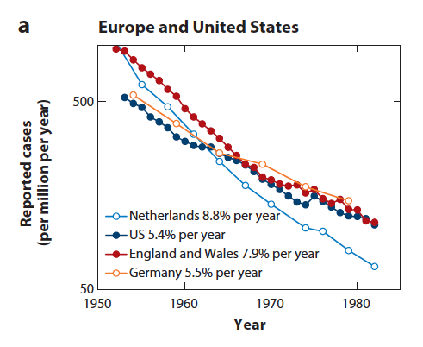
Target for TB elimination: Annual incidence <1 case per million population by 2050
Would need 1,000-fold reduction in 33 years
20% annual reduction is >2x faster than historical examples
Dye, Annu Rev Public Heath 2013

Slide 4
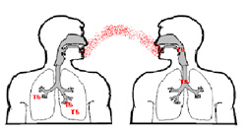
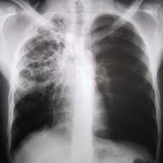
Adapted from Barry 3rd et al,. Nat Rev Micro 2009
Risk Factors
Genetic, Age, HIV, Diabetes, Smoking
Continuum of Infection & Disease
MTB exposure
Quiescent
infection
Subclinical
TB Disease
Clinical
TB Disease
Symptoms
M.tuberculosis
Interferon-gamma release assay (IGRA) +

Slide 5
High TB Incidence Settings
60-80% of adult South Africans infected with M. tuberculosis
IGRA+
IGRA-
TB cases
Mass preventive therapy for IGRA+ would treat most people unnecessarily
Require massive resources
Incomplete/slow coverage
Shift focus from ‘treatment of latent infection’ to ‘targeted preventive therapy’

Slide 6
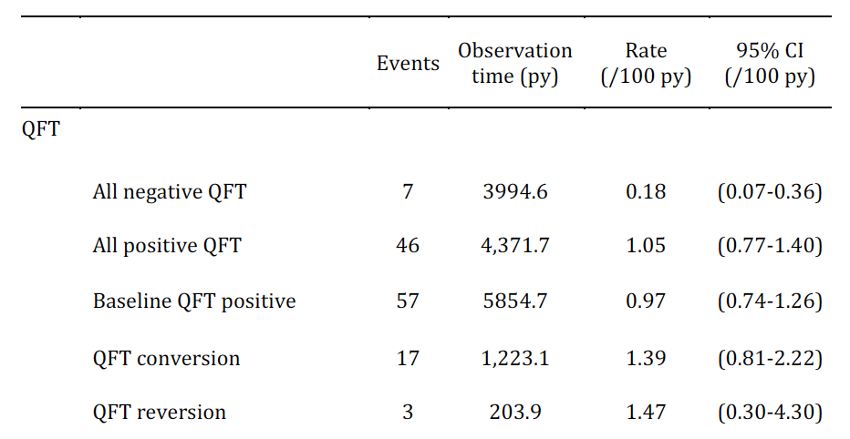

IGRA and Risk for Progression to TB Disease in Adolescents
Andrews, AJRCCM 2016
Recent IGRA+ converters are at highest risk of progression to TB disease (8x)
  Higher quantitative IGRA conversion value?
  (TB Ag – Nil Interferon γ concentration (IU/mL)
  IGRA reversion on serial testing….
Andrews, unpublished
Notes:
MARK
COMMUNITY-BASED IMPLEMENTATION
SCREEN & TREAT STRATEGY
DATA FROM CORTIS
PREVALENT TB
INCIDENT TB
HIV UNINFECTD MAJORITY INCIDENT TB
HIV INFECTED MAJORITY PREVALENT TB (25% NO ART/IPT)

Slide 7
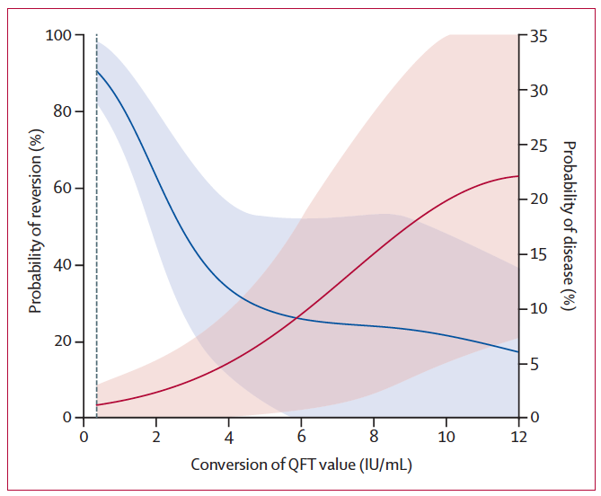
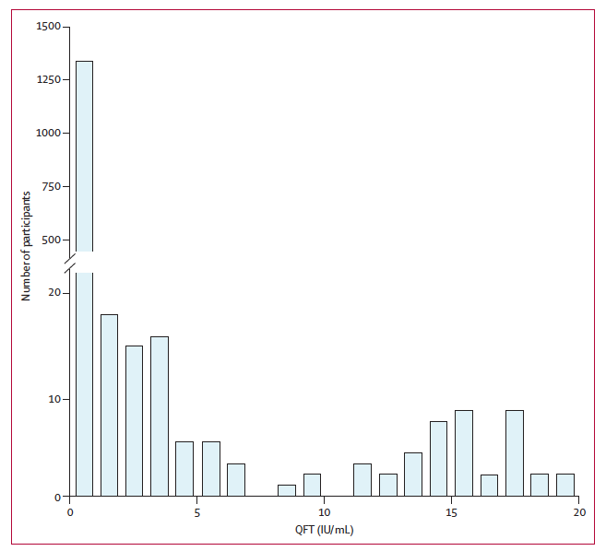
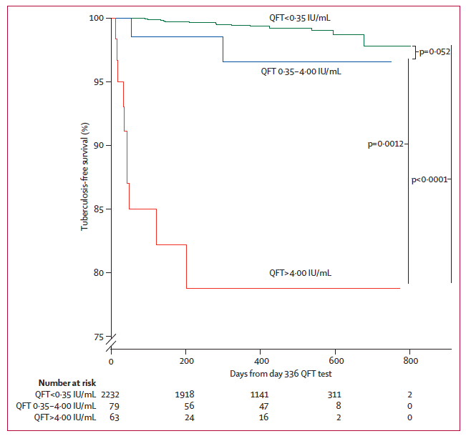
IGRA and Risk for Progression to TB Disease in Infants
Andrews, Lancet Respiratory Medicine 2017
IGRA converters with highest quantitative interferon γ concentration (>4IU/mL)
Less likely to revert on subsequent test
40 x higher TB disease risk than IGRA-
Incipient TB disease?
Notes:
MARK
COMMUNITY-BASED IMPLEMENTATION
SCREEN & TREAT STRATEGY
DATA FROM CORTIS
PREVALENT TB
INCIDENT TB
HIV UNINFECTD MAJORITY INCIDENT TB
HIV INFECTED MAJORITY PREVALENT TB (25% NO ART/IPT)

Slide 8
Adapted from Barry 3rd et al,. Nat Rev Micro 2009
How to identify incipient TB before progression to infectious active disease?
Continuum of Infection & Disease
MTB exposure
Quiescent
Infection
Incipient TB
Subclinical TB Disease
Clinical TB Disease
Symptoms
M.tuberculosis
Interferon-gamma release assay (IGRA) +

Slide 9
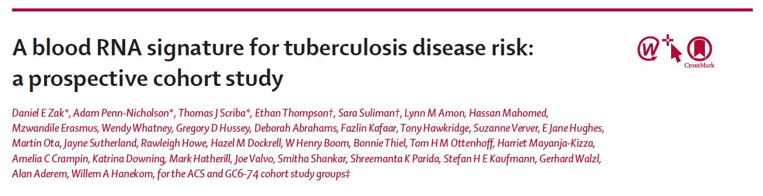
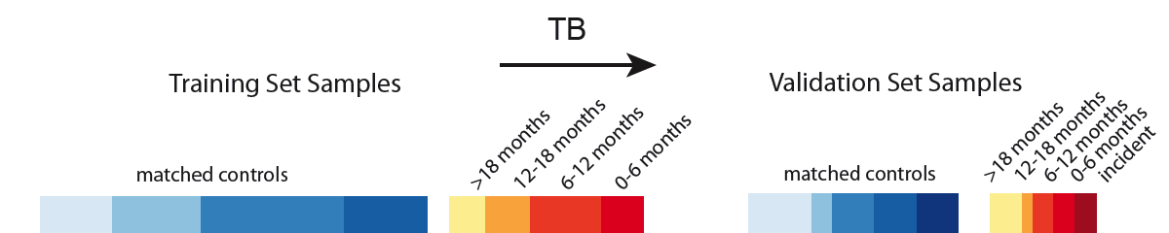
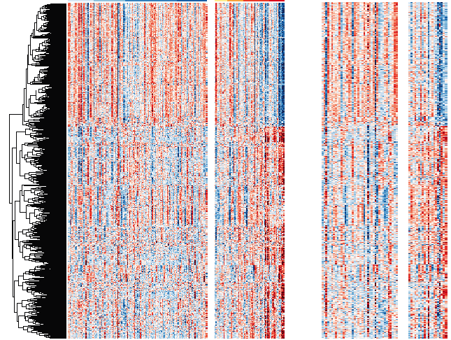
2,515 genes differentially expressed
TB progressors vs controls
Controls
Cases
Controls
Cases
Red = Higher expression
Blue = Lower expression
*Also validation in household contacts (Walzl, GC6)
Notes:
Figure 1: Whole blood gene expression is different in cases and controls. Over 2000 significantly differentially expressed genes were identified between cases and matched controls in the training set samples across time approaching TB disease diagnosis. These genes were used in constructing models to classify cases and controls using support vector machine learning algorithms and junction-junction pair selection in various analysis windows spanning 3 years before TB diagnosis to time of TB diagnosis. These genes are about equally split between those with higher expression in cases and those with lower expression in cases, compared with controls. Shown are expression differences between cases and controls in a variety of analysis windows. Red/blue on the heat map indicates enhanced/impaired expression in cases compared with controls. The colour scale above the heat map is indicative of 6 month windows of time approaching TB diseased diagnosis (yellow to red for cases, and blue for matching controls) Courtesy: Dan Zak.

Slide 10
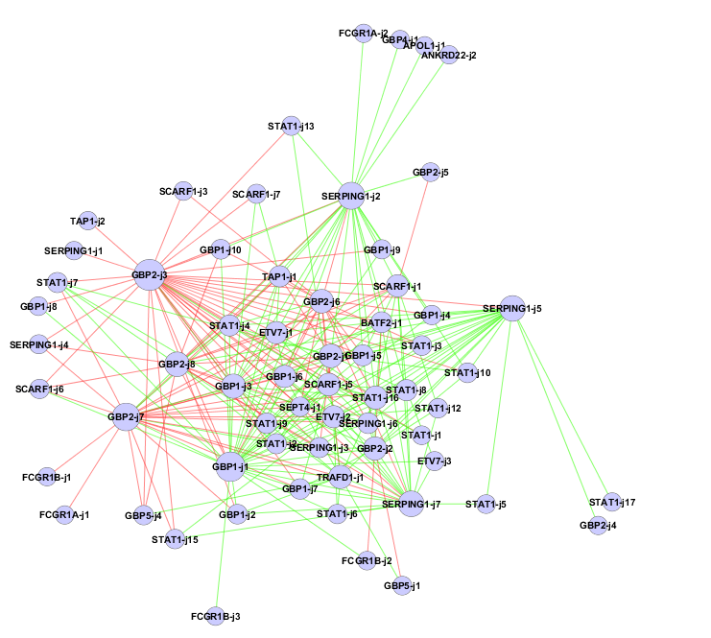
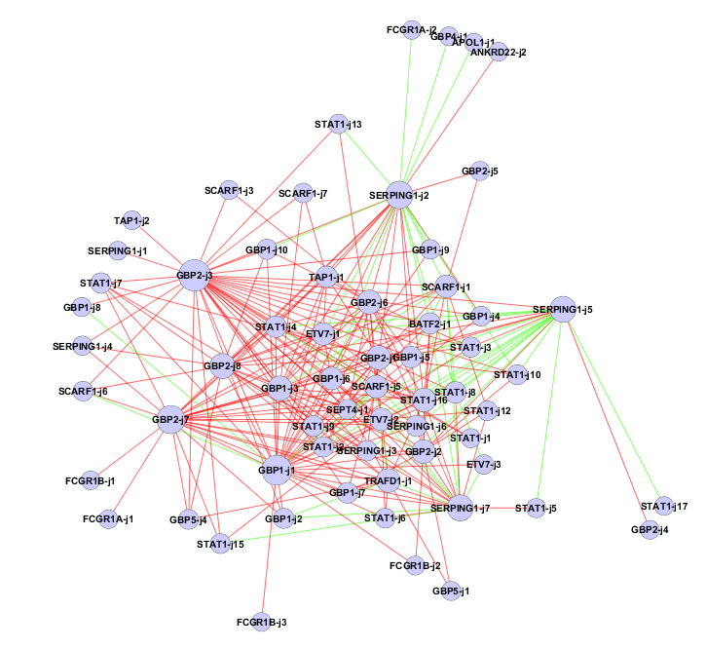

TB risk classification model based on transcript ‘voting pairs’
Red edges vote as progressors
Green edges vote as non-progressors
247 transcript pairs
47 PCR primers
16 genes
A sample predicted to be a progressor
A sample predicted to be a non-progressor

Slide 11
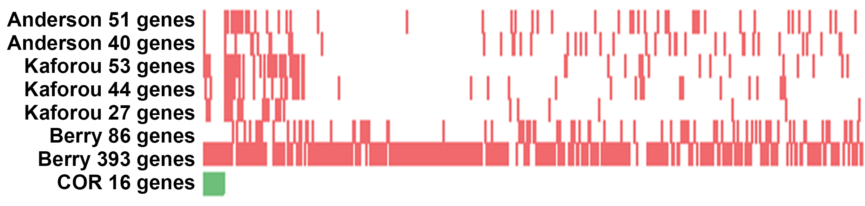
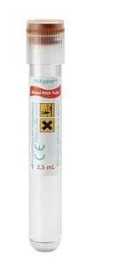
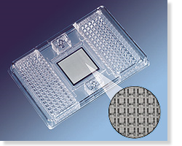
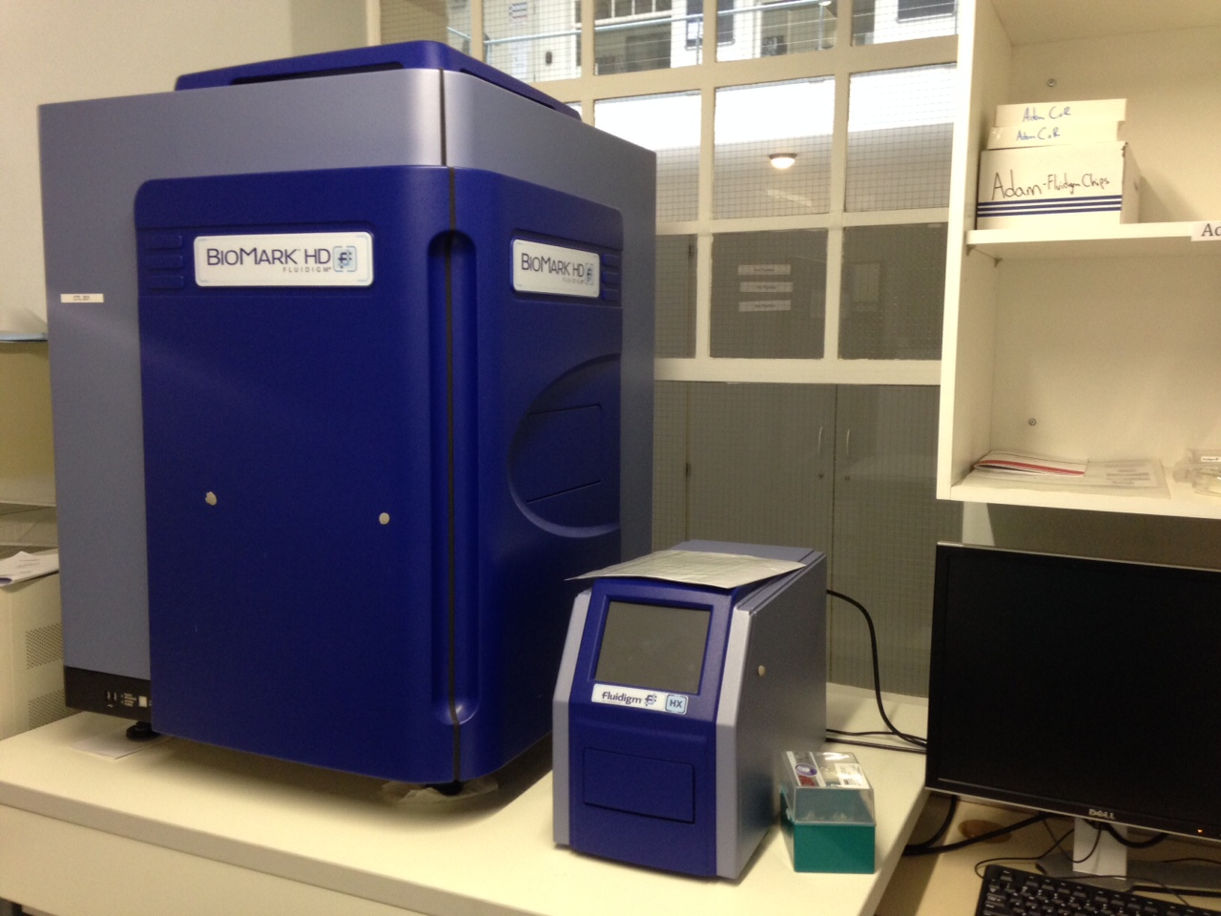
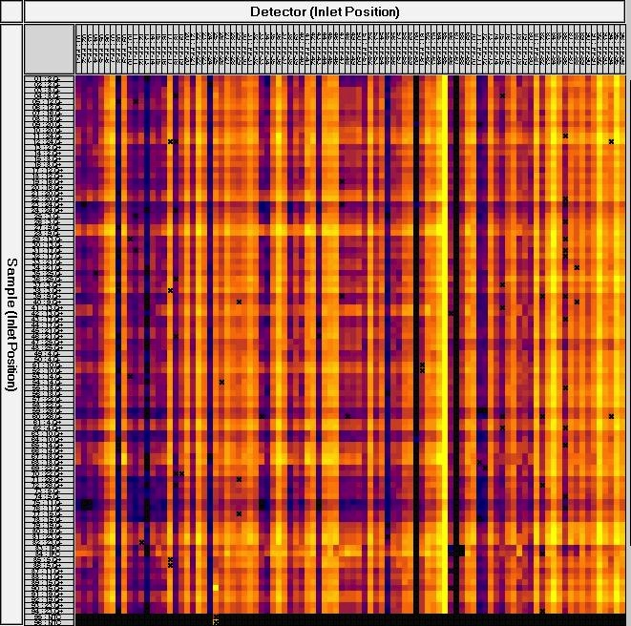
RNA-Seq not practical for screening in high TB burden countries
  Biomark Fluidigm qRT-PCR platform (test 96 genes, 46 duplicate) → COR result in 2 days
  Maximum capacity approximately 400 samples per week
Y
N

Slide 12
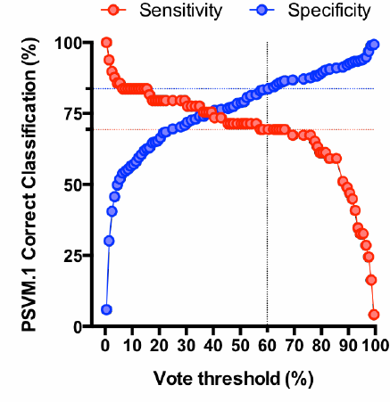
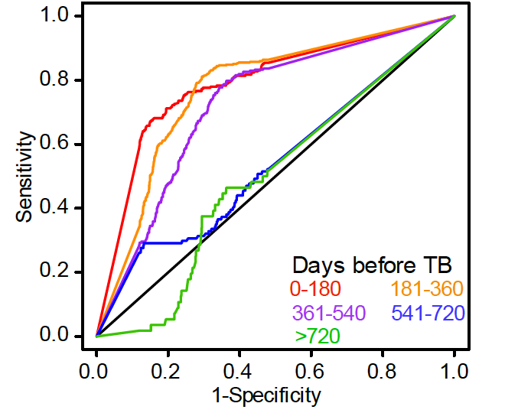
16-gene COR prognostic performance
Discriminates TB cases from controls up to 18 months before diagnosis
COR 12-month Prognostic Performance
70% Sensitivity and 88% Specificity
HIV uninfected South African adults (unpublished)

Slide 13
NDWG Stop TB Partnership
Target Product Profile – Prognostic Biomarker for TB disease
Optimal Test Profile
Predict progression to TB disease
Rule out active disease
Revert to negative with Rx
>90% sensitivity*
>90% specificity*
PPV >16%
NNT <13
*Sens/Spec may be adjusted to achieve PPV / NNT target profile
Minimal Acceptable Test Profile
Predict progression to TB disease
Need to screen out active disease
>75% sensitivity*
>90% specificity*
PPV >6%
NNT <40
Goal: “Better than IGRA”
78% sensitivity
58% specificity
PPV 3.7%
NNT 69
RR 2-3

Slide 14
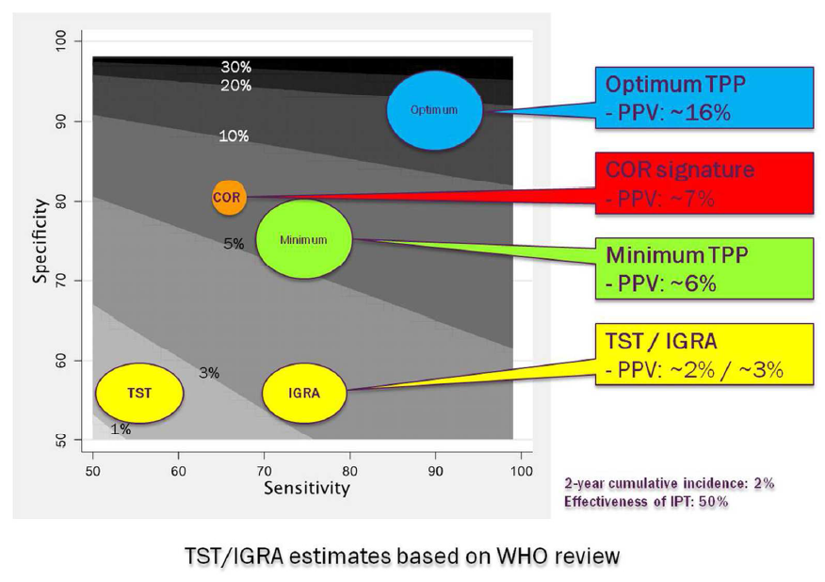
Goletti et al, ERJ 2016

Slide 15
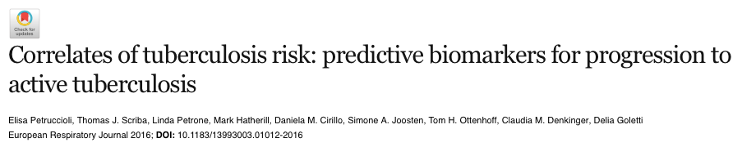
NDWG prognostic test TPP
vs
16-gene COR
10
Optimum TPP
- NNT: ~13
20
Optimum
30
COR signature
- NNT: ~37
40
50
COR
Minimum
Minimum TPP
- NNT: ~40
75
100
150
TST / IGRA
- NNT: ~250 / ~85
250
TST
IGRA
Cumulative 2 year incidence: 2%
Effectiveness of IPT: 50%
Notes:
TOM
FIELD ANY QUERIES ABOUT COR PERFORMANCE, VALIDATION
MARK
FIND/NDWG TARGET PRODUCT PROFILE FOR NEW PROGNOSTIC TESTS FOR TB
MINIMAL GOAL (75/75%) TO DOUBLE PVV AND HALVE NNT (80→40) COMPARED TO IGRA
‘OPTIMAL’ 90/90 LIKELY UNACHIEVABLE FOR PROGNOSTIC TEST
CONTINUUM OF TB RUNS IN BOTH DIRECTIONS
SERIAL SCREENING TO ASSES CONVERSION, REVERSION, EFFECT OF THERAPY

Slide 16
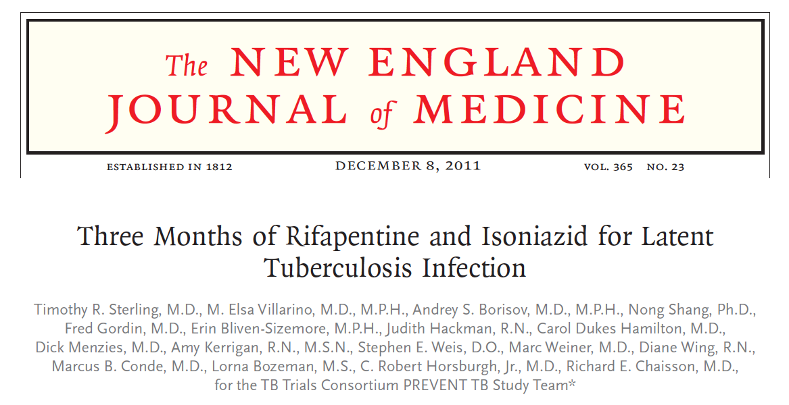

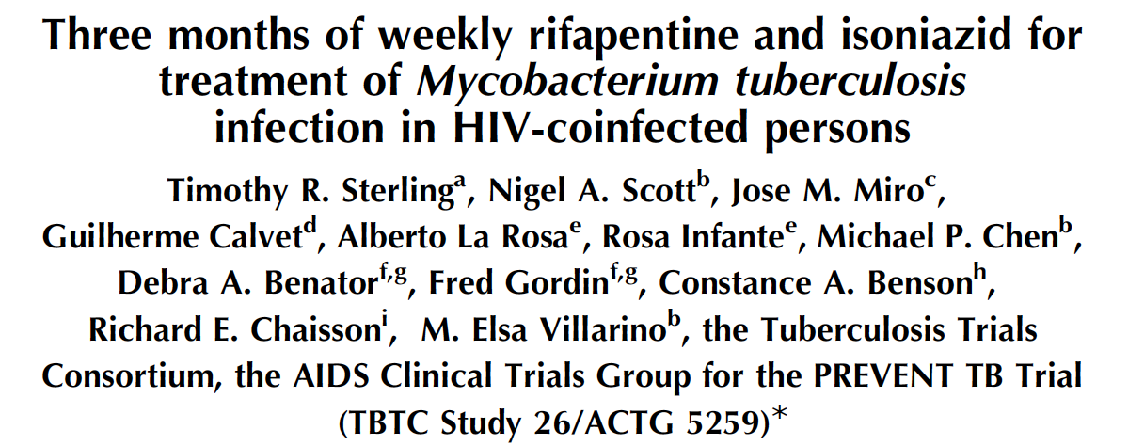
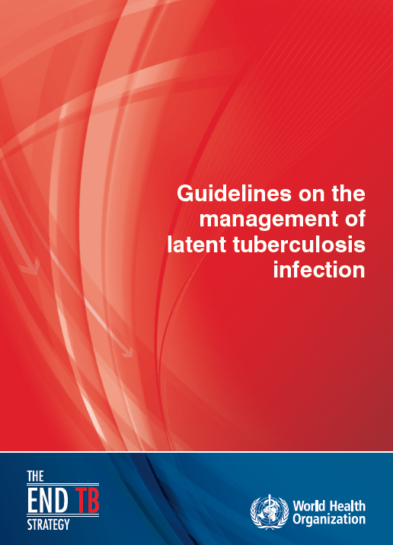
The landscape of TB preventive therapy has changed
HIV uninfected
Effectiveness 3HP non-inferior to 9H
Higher treatment completion
Lower hepatotoxicity
HIV infected
Effectiveness 3HP non-inferior to 9H
Higher treatment completion
Similar tolerability
→ A 12-dose, once-weekly, 3-month DOT preventive therapy regimen

Slide 17
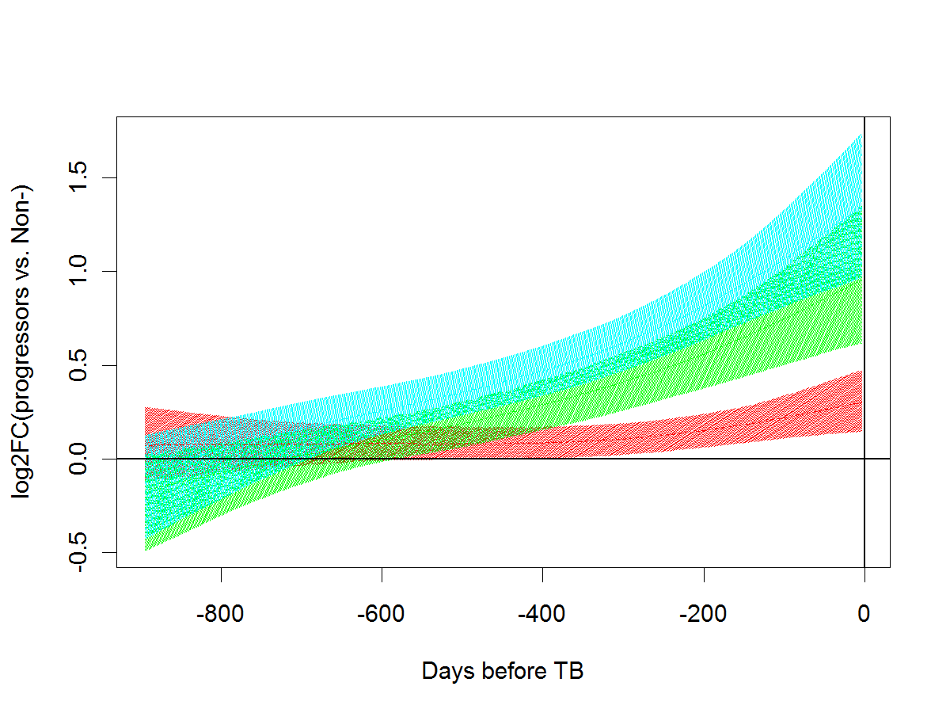
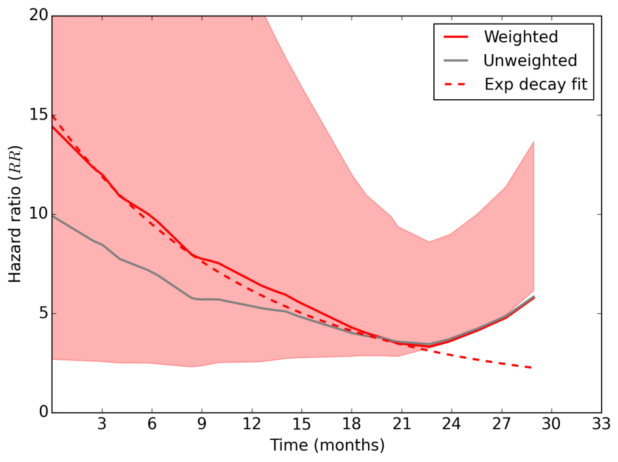
16-gene COR predicts incipient TB disease >1 year before diagnosis
Performance maximal at diagnosis
CoR genes
Interferon module
Inflammation module
Scriba, Penn-Nicholson, Hanekom, Suliman, Kimbung & many others
Gartland, Self & others
Can the 16-gene Correlate of Risk be used as a triage test
to target curative and preventive therapy?
Notes:
TOM
RE-EMPHASIS 16-GENE COR PROGNOSTIC PERFORMANCE

Slide 18
Does the 16-gene COR have diagnostic potential as a triage test for undiagnosed TB?
COR Diagnostic Performance
87% sensitivity
97% specificity
(re-parameterized to published microarrary data)
AUC
0.909
0.862
0.985
0.937
0.997
0.991
0.945
0.911

Slide 19
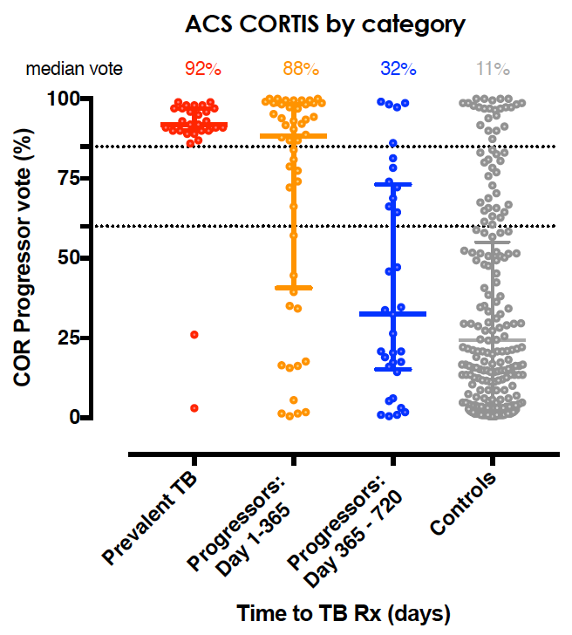
A 16-gene COR-targeted Screen & Treat Strategy for TB?
Manipulate COR sensitivity % specificity for different purposes
80% COR vote threshold
Investigation for Active TB
Curative/Preventive Therapy
60-80% COR vote threshold
Preventive Therapy
<60% COR vote threshold
No intervention
Scriba, Penn-Nicholson, Suliman, Darboe, Kimbung, many others
Notes:
MARK
COMMUNITY-BASED IMPLEMENTATION
SCREEN & TREAT STRATEGY
DATA FROM CORTIS
PREVALENT TB
INCIDENT TB
HIV UNINFECTD MAJORITY INCIDENT TB
HIV INFECTED MAJORITY PREVALENT TB (25% NO ART/IPT)

Slide 20
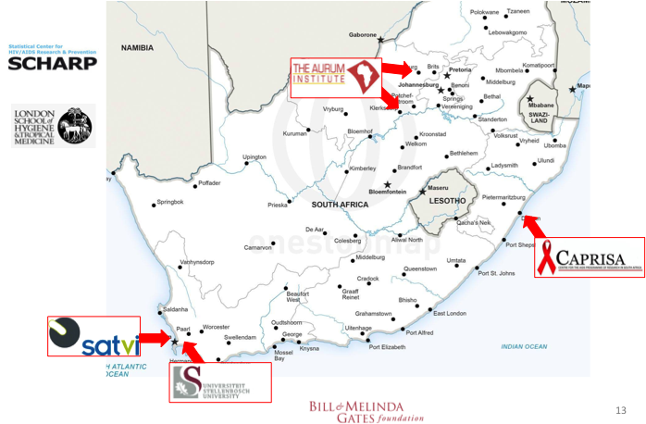
The Correlate of Risk Targeted Intervention Study (CORTIS)
ClinicalTrials.gov NCT02735590
A Randomized, Partially-blinded, Clinical Trial of Isoniazid and Rifapentine (3HP) Therapy to Prevent Pulmonary Tuberculosis in High-risk Individuals Identified by a Transcriptomic Correlate of Risk
Screen >10,000 HIV uninfected SA adult volunteers
TB endemic communities
Randomize on 16-gene COR+/- result
Enrol 3,200 participants (1,500 COR+ and 1,700 COR-)
Primary Aims
1: Test whether preventive therapy (3HP) reduces the rate of incident TB disease, compared to standard of care (active surveillance), in COR+ persons
2: Test whether COR status differentiates persons with cumulative prevalent or incident TB disease from persons without TB disease

Slide 21
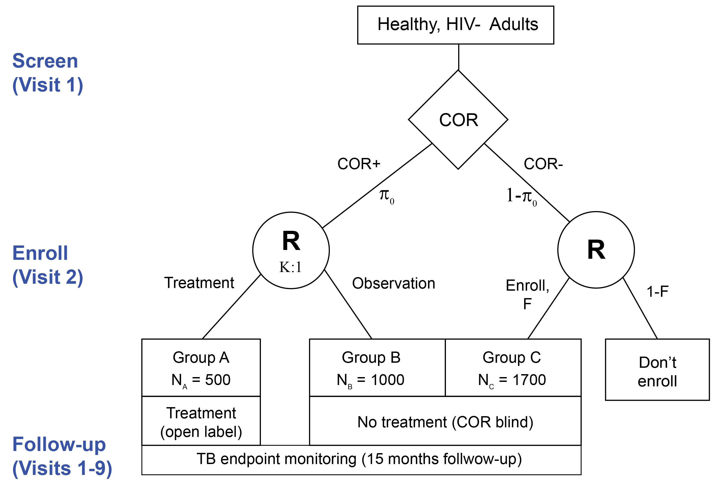
The Correlate of Risk Targeted Intervention Study (CORTIS)
ClinicalTrials.gov NCT02735590
COR+ Treatment Arm: open-label high dose INH and Rifapentine (12 weekly DOT doses)
Blinded COR+ and COR- Observation Arm: active TB surveillance
Investigation for TB disease at baseline, symptom-triggered, end of 15 months follow up

Slide 22
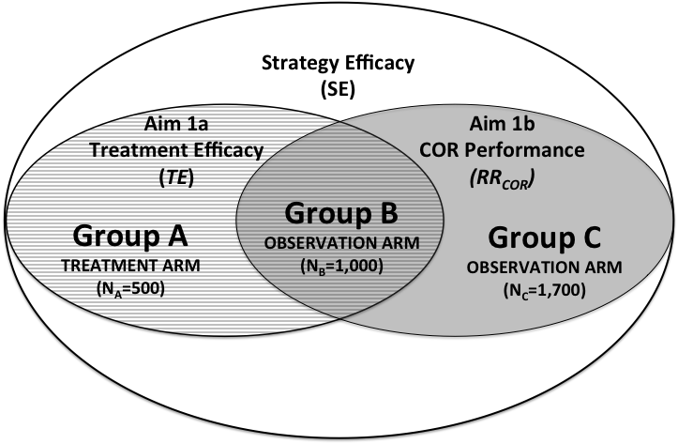
The Correlate of Risk Targeted Intervention Study (CORTIS)
ClinicalTrials.gov NCT02735590
COR+ Treatment Arm: open-label high dose INH and Rifapentine (12 weekly DOT doses)
Blinded COR+ and COR- Observation Arm: active TB surveillance
Investigation for TB disease at baseline, symptom-triggered, end of 15 months follow up
Group A
COR+ Treated
(open label)
Group C
COR- Observation
(blinded)
Group B
COR+ Observation
(blinded)

Slide 23
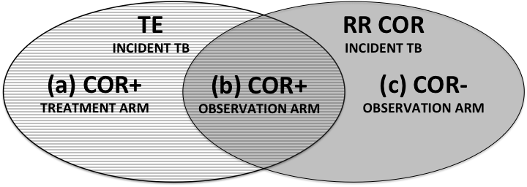



The Correlate of Risk Targeted Intervention Study (CORTIS)
TE = Treatment Efficacy 3HP (a) vs (b)
RR COR = Relative Risk for incident TB in COR+ vs COR- (b) vs (c)
80% power to reject the null-hypothesis, H₀: TE(15) <= 20% under the simulated design hypothesis, TE(15) = 80%, with a one-sided alpha of 0.05
90% power to reject the null-hypothesis, H₀: RR_{COR}(15) <= 2, with a one-sided alpha of 0.025.

Slide 24
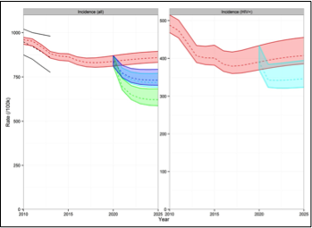

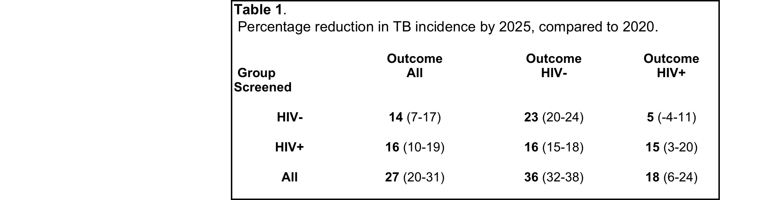
Validation of Correlates of Risk of TB Disease in High Risk Populations (CORTIS-HR)
Modeling of COR targeted ‘screen & treat’ strategy in South African TB epidemic suggests 5-year impact optimal only if includes HIV infected persons
Figure: Epidemic trajectories with screen and treat strategies.
Left panel: comparison of impact of strategies on overall TB incidence.
Median and 95% range of model predictions for: Red – baseline; Blue – COR strategy in HIV uninfected population only; Green – COR strategy in HIV uninfected and HIV infected population; Cyan – COR strategy in HIV infected population only. Black lines show WHO estimates for South Africa.
Right panel: predicted impact of COR HR strategy on HIV+ TB.
Sumner, White, unpublished

Slide 25

Does the 16-gene COR have diagnostic potential in HIV infected people?
No prognostic data yet
Risk for TB (CoR)
Healthy
LTBI
TB disease
Scriba, Penn-Nicholson, Suliman, Darboe, Kimbung, many others
N=60
N=40

Slide 26
Association between HIV viral load and
16-gene COR % vote
All samples
Samples with only detectable pVL
Scriba, Penn-Nicholson, Suliman, Darboe, Kimbung, many others

Slide 27
Validation of Correlates of Risk of TB Disease in High Risk Populations
(CORTIS-HR)
Observational companion study of CORTIS
Starting March 2017
Enrol 860 HIV infected SA adults
Same TB endemic communities
Diagnostic performance 16-gene COR
for undiagnosed prevalent TB disease
Prognostic performance 16-gene COR
for incident TB disease over 15 months follow up
Examine effect of IPT, cART and changes in CD4 count, HIV viral load on COR performance
Notes:
80% power to detect TE > 20%, one-sided alpha 0.05 (alternative hypothesis TE=80%)
90% power to detect RR > 2, one-sided alpha 0.025 (alternative hypothesis RR=5)

Slide 28
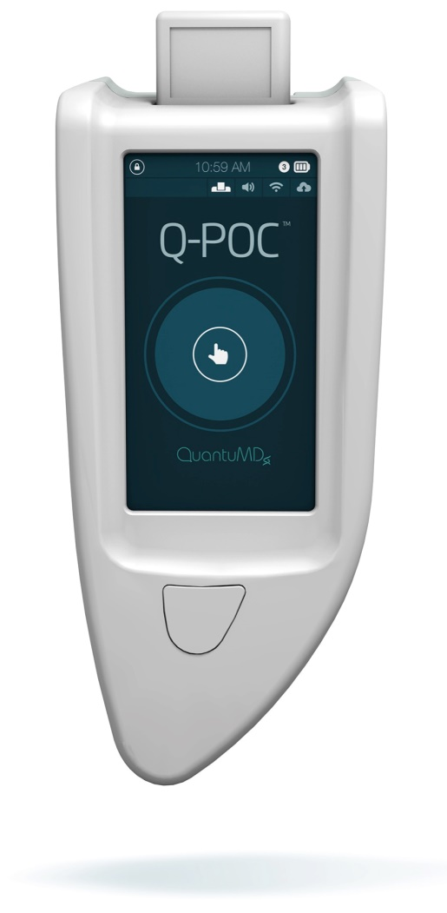
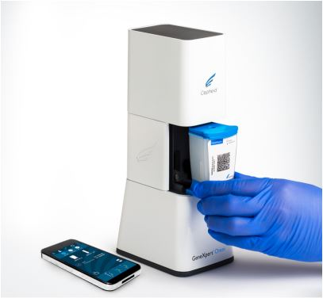


Translation to Point of Care: Battery-operated qRT-PCR?
POC TB testing critical for mass screen & treat campaigns

Slide 29

Success of a COR-targeted Screen & Treat Strategy Dependent on….. Speed and Extent of Coverage
TB disease incidence (per 100k)
TB mortality (per 100k)
Adult latent prevalence (proportion)
10% pop / yr
30 % pop / yr
50% pop / yr
Rapid initial decline in TB incidence
Depending on % coverage, incidence declines toward 2025 global targets
Rebound TB incidence after program end
Reduction in prevalence of M.tb (latent) infection
Data Courtesy of Wagner, Chang, unpublished
Notes:
80% power to detect TE > 20%, one-sided alpha 0.05 (alternative hypothesis TE=80%)
90% power to detect RR > 2, one-sided alpha 0.025 (alternative hypothesis RR=5)

Slide 30
Success of a COR-targeted Screen & Treat Strategy Dependent on…Duration of Program
TB disease incidence (per 100k)
Rebound in TB incidence related to size of M.tb infected pool
Prolonged, sustained program >10 years needed to minimize rebound at program end
Adult latent prev (proportion)
Blue line = baseline
Dashed line = 10-years
Solid line = 40 years
Data Courtesy of Wagner, Chang, unpublished
Notes:
80% power to detect TE > 20%, one-sided alpha 0.05 (alternative hypothesis TE=80%)
90% power to detect RR > 2, one-sided alpha 0.025 (alternative hypothesis RR=5)

Slide 31
RNA diagnostic and prognostic biomarker = test of incipient TB disease
New, short-course TB preventive
therapy regimens
Next steps…
CORTIS (HIV uninfected) performance and efficacy data 2019
Validate smaller 6-gene COR model...ongoing
Transfer COR to point of care, handheld PCR device...ongoing
CORTIS-HR (HIV infected) performance data 2019
Test COR-targeted Screen & Treat Strategy for HIV infected patients?
Trigger cycles of short-course preventive therapy?
Notes:
MARK
IMPORTANCE OF INCLUDING HIV INFECTED PEOPLE IN SCREEN & TREAT STRATEGY
CHALLENGES OF TESTING AND IMPLEMENTING 3HP/1HP IN SA (CONTINUOUS IPT)
WHO SHORTER TREATMENT GUIDELINES
ROLE OF COR FOR TARGETING AND TRIGGERING
ROLE OF POC TEST
NEED FOR LOCAL CLINIC-BASE TESTING USING HIV STRUCTURES

Slide 32















Acknowledgements
COR & CORTIS & CORTIS-HR
Participants
Collaborators
Funders
Dan Zak
Ethan Thompson
Lynn Amon
Gerhard Walzl
Andre Loxton
Jayne Sutherland
Alan Aderem
GC6 Team
Gavin Churchyard
Kogie Naidoo
Andrew Gartland
Steve Self
Richard White
Tom Sumner
Bradley Wagner
Stewart Chang
Tom Scriba
Adam Penn-Nicholson
Willem Hanekom
Elisa Nemes
Sara Suliman
Mbandi Kimbung
Fatoumatta Darboe
Mbandi Kimbung
Chris Hikuam
Kate Hadley
Notes:
Alex Sette and Denise Baker – La Jolla Institute of allergy & immunology
Holden Maecker and Mark Davis - Stanford

