Slide 1
Quantitative, model-based estimates of variability in the temporal and spatial scales of Plasmodium falciparum malaria transmission
John Huber
jhuber3@nd.edu

Slide 2
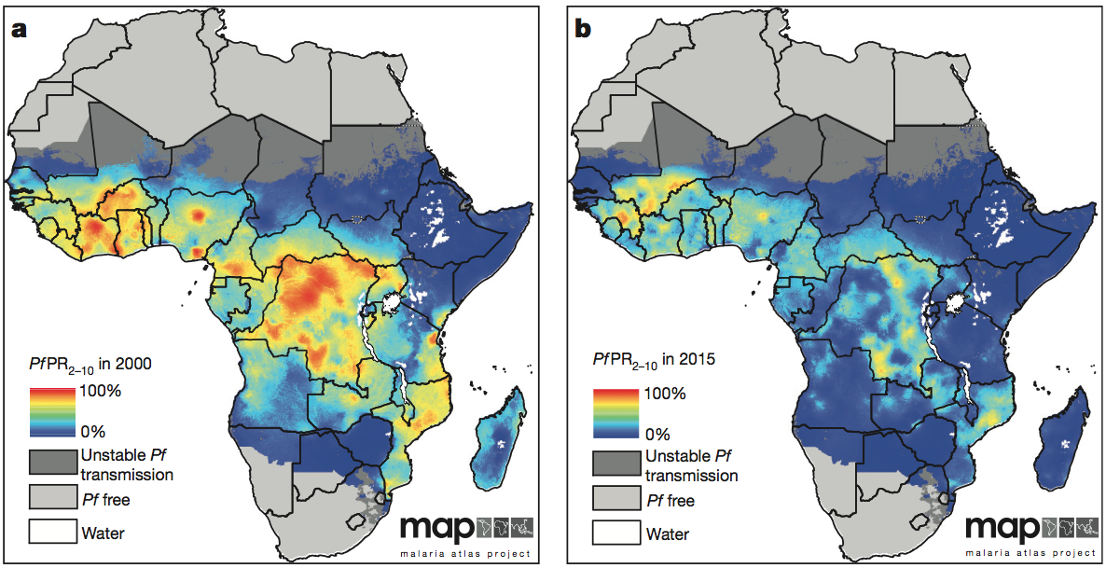
Pf malaria: the map is shrinking
Bhatt, Weiss, Cameron et al. 2015 Nature

Slide 3

When can we declare mission accomplished?
Elimination
“A reduction to zero of the incidence of infection caused by human malaria parasites in a defined geographical area as a result of deliberate efforts. Continued measures to prevent re-establishment of transmission are required.”

Slide 4
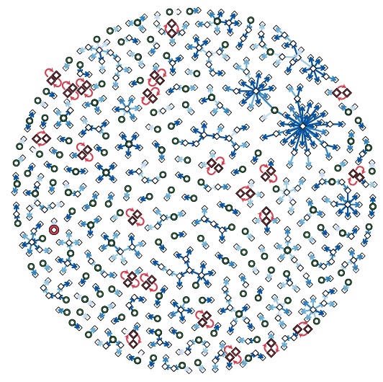
Ignore space at your own peril
We may be nearing zero some places but not others
  Hotspots need to be targeted to progress towards elimination
  Danger that hotspots could fuel resurgence
  Need to infer
  transmission
  chains to
  gain insight
  about this
Reiner et al. 2015 eLife

Slide 5
Data for inferring transmission chains
Temporal
  Given two case present at time t₁ and t₂, how likely is it that one is attributable to the other?
Spatial
  Given two cases present at locations x and y, how likely is it that one is attributable to the other?

Slide 6
Data for inferring transmission chains
Temporal
  Given two case present at time t₁ and t₂, how likely is it that one is attributable to the other?
Spatial
  Given two cases present at locations x and y, how likely is it that one is attributable to the other?

Slide 7
Defining the serial interval
Serial Interval: Time between detection of two cases
SI
GI
IDP
IDP
LEP
HMTP
EIP
MHTP
Primary case
infected
Primary case
detected
Secondary case infected
Secondary case detected

Slide 8
Components of the serial interval
LEP = 6 days
Infectivity measured as non-linear function of gametocyte density (Johnston et al., 2013)
  Immune response and treatment with anti-malarial drugs govern dynamics
Simulations fit to individuals with no prior immunity
  Interpret as upper bound for HMTP
IDP
IDP
LEP
HMTP
EIP
MHTP
Primary case
infected
Primary case
detected
Secondary case infected
Secondary case detected
Huber et al. 2016 Malaria Journal

Slide 9
Components of the serial interval
Assumed normally distributed
  Mean taken from four sites (Killeen et al.)
  Standard deviation of 2.47
Upper bound of 17 days captures 99% of possible EIPs
IDP
IDP
LEP
HMTP
EIP
MHTP
Primary case
infected
Primary case
detected
Secondary case infected
Secondary case detected
Huber et al. 2016 Malaria Journal

Slide 10
Components of the serial interval
Modeled as geometric random variable with probability set to mortality rate
Assumptions:
  No senescence
  No correlation between feeding behavior and lifespan
  No effect of age on infectiousness
IDP
IDP
LEP
HMTP
EIP
MHTP
Primary case
infected
Primary case
detected
Secondary case infected
Secondary case detected
Huber et al. 2016 Malaria Journal

Slide 11
Components of the serial interval
Quantifying the SI requires incorporating time-to-detection
Comes in multiple flavors:
    Clinical presentation for symptomatics (IDP_{S})
    Active surveillance for asymptomatics (IDP_{A})
IDP
IDP
LEP
HMTP
EIP
MHTP
Primary case
infected
Primary case
detected
Secondary case infected
Secondary case detected
Huber et al. 2016 Malaria Journal

Slide 12
Computing the serial interval
Convolving the GI with IDP under different scenarios results in different SI distributions
24.5% of symptomatic secondary cases presenting clinically are expected to do so before active detection of asymptomatic primary case
Huber et al. 2016 Malaria Journal

Slide 13
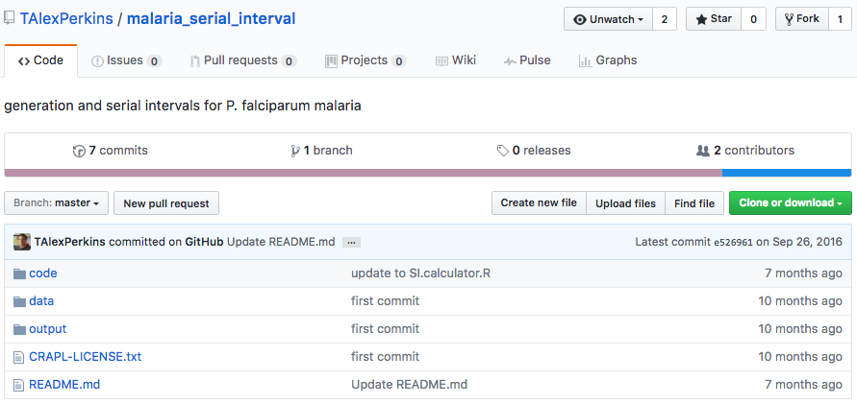
Calculator for computing SI
https://github.com/TAlexPerkins/malaria_serial_interval

Slide 14
Data for inferring transmission chains
Temporal
  Given two case present at time t₁ and t₂, how likely is it that one is attributable to the other?
Spatial
  Given two cases present at locations (x₁ , y₁) and (x₂ , y₂), how likely is it that one is attributable to the other?

Slide 15
Data for inferring transmission chains
Temporal
  Given two case present at time t₁ and t₂, how likely is it that one is attributable to the other?
Spatial
  Given two cases present at locations (x₁ , y₁) and (x₂ , y₂), how likely is it that one is attributable to the other?

Slide 16
Defining the spatial likelihood
For a given GI, what is the proximity of the parent to the offspring?

Slide 17
Defining the spatial likelihood
How can we relate a given GI to a given SI?

Slide 18
Spatial variance as a function of SI

Slide 19
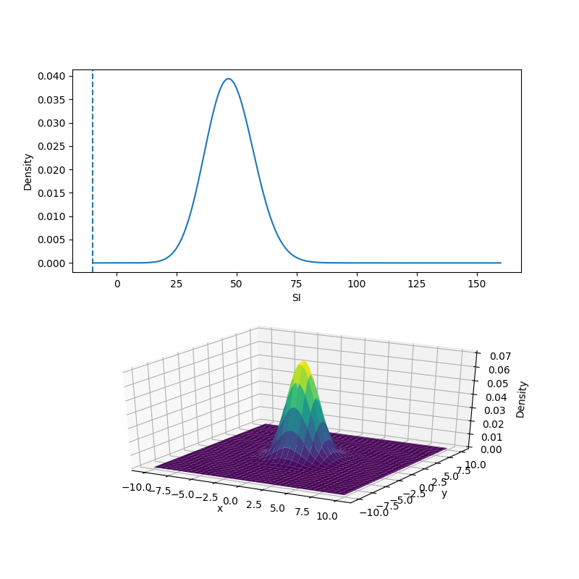
Spatial variance as a function of SI
We can extend our spatial likelihood to accommodate location in two dimensions
  Model as isotropic bivariate normal
As SI increases, σ²(SI) increases and we expect to find linkages more separated in space

Slide 20
Summary
Substantial variability in SI distribution results from substantial variability in its components.
The SI can be quite different from the GI.
  SI can be negative if 2º case is detected first.
The spatial likelihood of a transmission linkage depends not just on space but also on time.
  Because spatial likelihood uses GI but we don’t know GI, we have to think probabilistically.
For both temporal and spatial likelihood of a transmission linkage, it is important to think through both transmission and surveillance processes.
  There are big differences in both for different infection types.

Slide 21
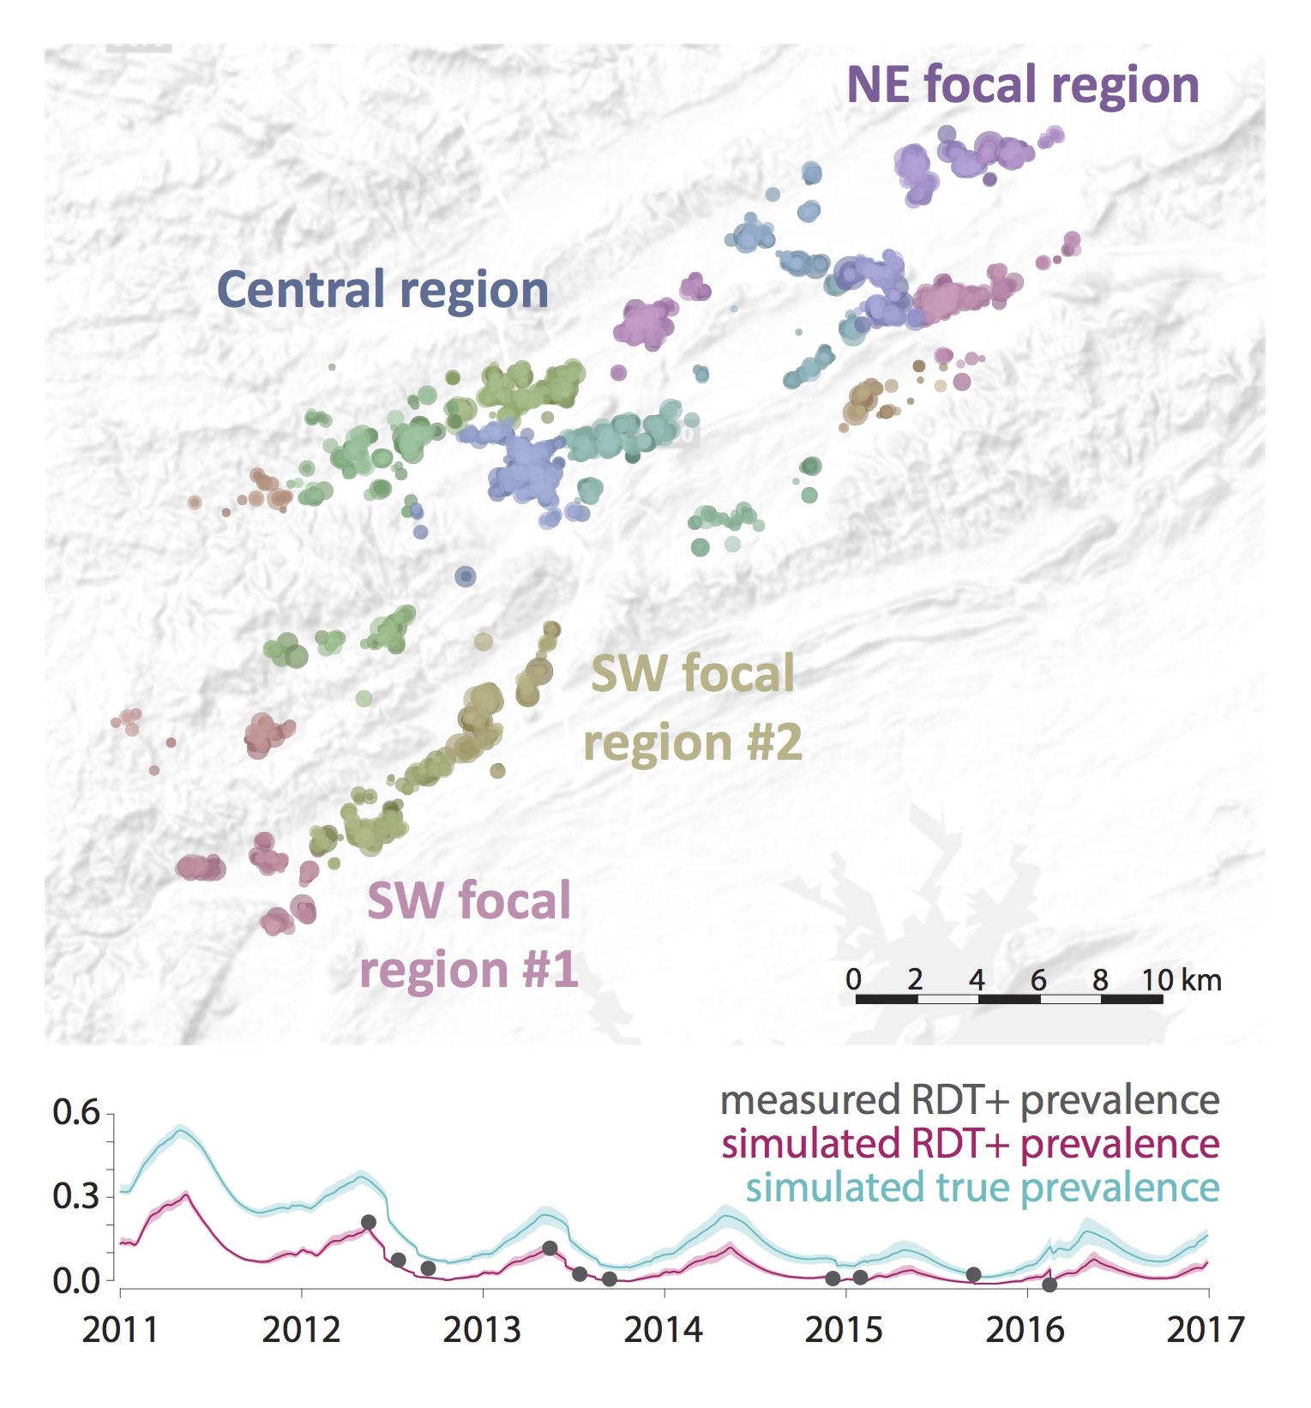
Ongoing work
Incorporate these temporal and spatial likelihoods into Bayesian transmission network inference framework
Test the accuracy of the transmission network inference framework using data simulated with EMOD
Alex Perkins & Bryan Greenhouse
Edward Wenger, IDM

Slide 22
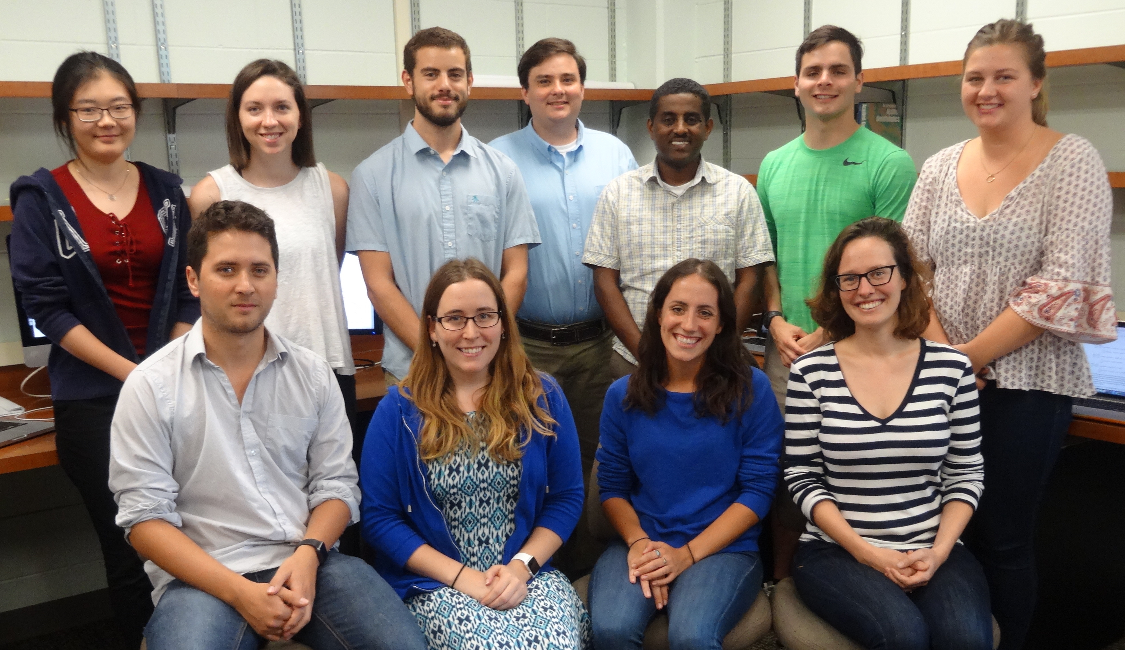

Acknowledgments
PI – Alex Perkins
Perkins Lab
Collaborators
  Bryan Greenhouse, UCSF
  Geoffrey Johnston, Apple
  David Smith, IHME
  Edward Wenger, IDM
Institute for Disease Modeling
University of Notre Dame College of Science

