Slide 1


IDM Software Overview
6th Annual IDM Symposium, 2018
Mandy Izzo

Slide 2
Outline
IDM overview
Core modeling tools:
  Epidemiological MODeling software (EMOD)
  COmputational Modeling Platform Service (COMPS)
  DTK-Tools (Disease Transmission Kernel)
Additional software
  QuickStart
  Compartmental Modeling Software (CMS)
  Vis-Tools
  Risk Map
Contact information

Slide 3
Outline
IDM overview
Core modeling tools:
  Epidemiological MODeling software (EMOD)
  COmputational Modeling Platform Service (COMPS)
  DTK-Tools
Additional software
  QuickStart
  Compartmental Modeling Software (CMS)
  Vis-Tools
  Risk Map
Contact information
Benoit Raybaud, Wed at 9
Breakout session (Intro to ABMs), today at 11
Breakout session Tuesday at 11
Sessions on Tuesday at 9 – 10:30, 11 - 1 (Qinghua Long, 12:30)
Software best practices breakout session, today at 11
Software open forums, Mon 5-6, Wed 3:30-4:30

Slide 4






About IDM
IDM’s mission is to utilize and promote quantitative analysis to inform and guide global efforts to control and, in particular, to eradicate infectious disease.

Slide 5

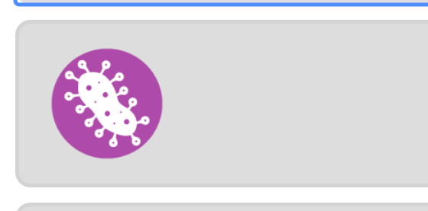

IDM overview
The research and modeling team at IDM is focused on providing support to disease eradication programs and other global health endeavors through a variety of modeling and statistical approaches. We build mechanistic agent-based models in order to understand model assumptions and input data, examine the effects of population-level and within-host phenomena, and stimulate the impact of combined interventions, especially for all phases of an eradication effort.
APPLIED MATH
HIV
EPIDEMIOLOGY
POLIO
TUBERCULOSIS
MALARIA

Slide 6
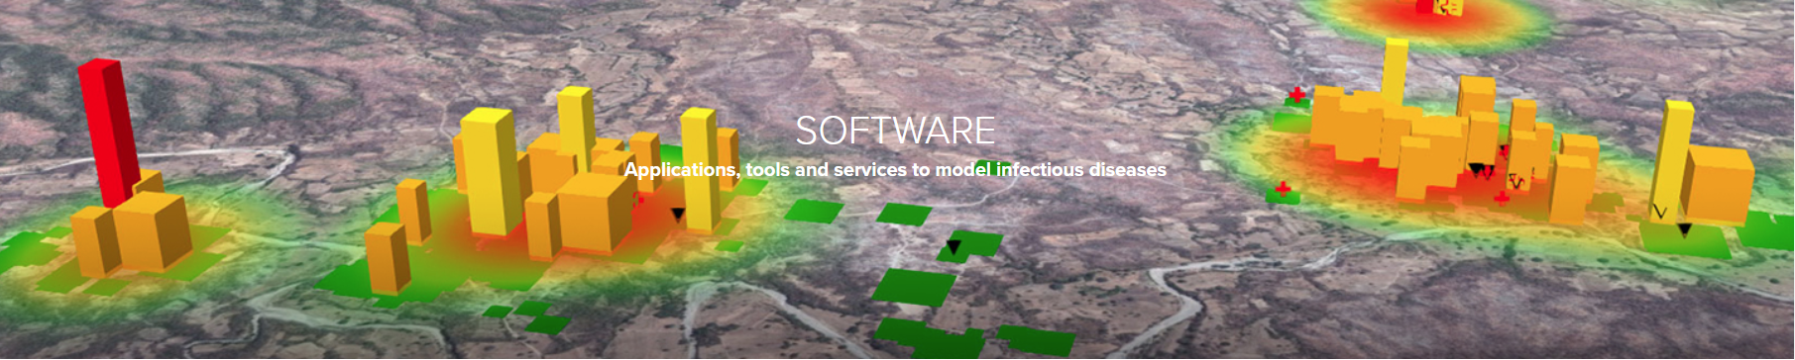






IDM overview
Inspired by a collaborative and multidisciplinary effort from the scientific community, IDM’s innovative software tools provide a qualitative and analytical means to model infectious disease. We provide our tools to the scientific community to accelerate the exploration of disease eradication through the use of computational modeling.
EMOD
RISK MAP
DTK-TOOLS
QUICKSTART

Slide 7
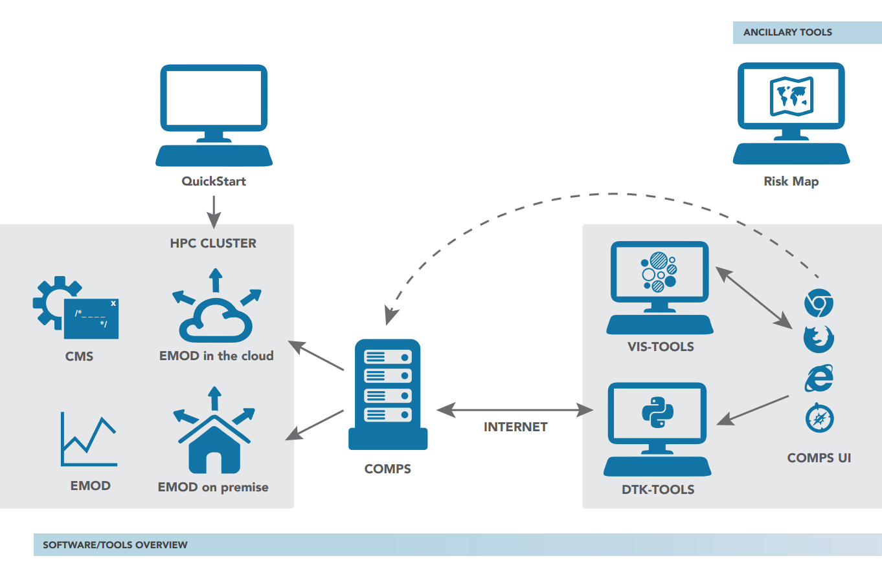


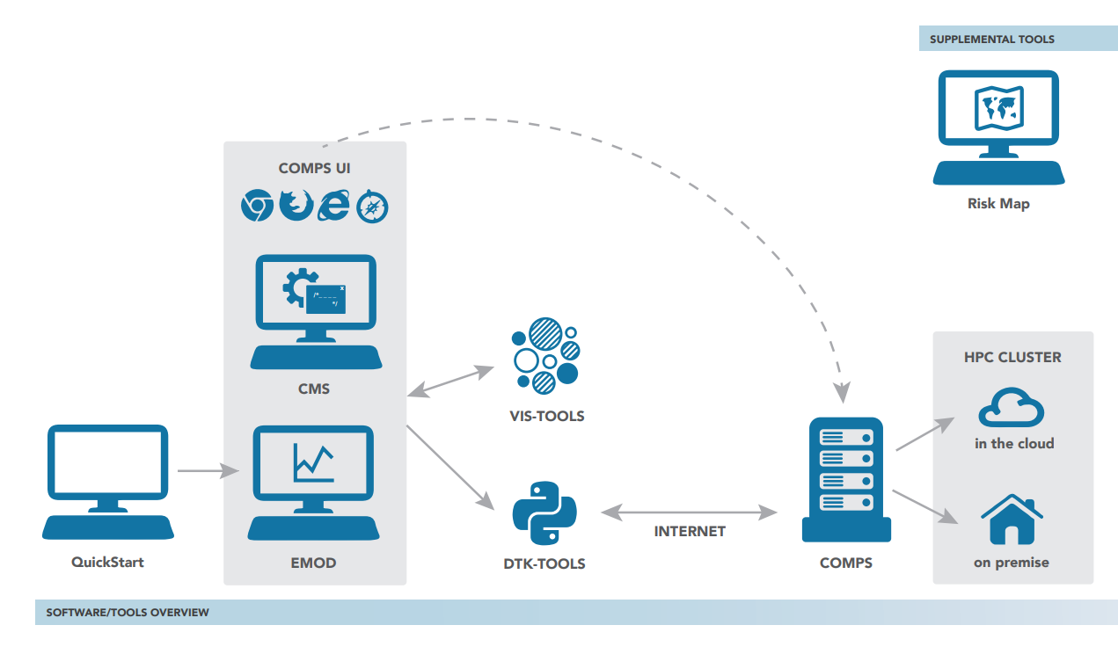



IDM software
Dis
Dis
Manage simulations
Create, calibrate, run simulations
COMPS UI
DTK-Tools
COMPS
Model disease
Analyze data
Dis
Visualize data
Dis
DTK-Tools
Vis-Tools
EMOD
CMS
Dis
Dis
Create risk maps
Learn the model
QuickStart
Risk Map

Slide 8
Core modeling tools
Dis
Dis
Manage simulations
Create, calibrate, run simulations
COMPS UI
DTK-Tools
COMPS
Model disease
Analyze data
Dis
Visualize data
Dis
DTK-Tools
Vis-Tools
EMOD
CMS
Dis
Dis
Create risk maps
Learn the model
QuickStart
Risk Map

Slide 9
Core modeling tools
Dis
Dis
Manage simulations
Create, calibrate, run simulations
COMPS UI
DTK-Tools
COMPS
Model disease
Analyze data
Dis
Visualize data
Dis
DTK-Tools
Vis-Tools
EMOD
CMS
Dis
Dis
Create risk maps
Learn the model
QuickStart
Risk Map

Slide 10



















A brief history of EMOD
DTK
∑
EMOD
Institute for Disease Modeling

Slide 11
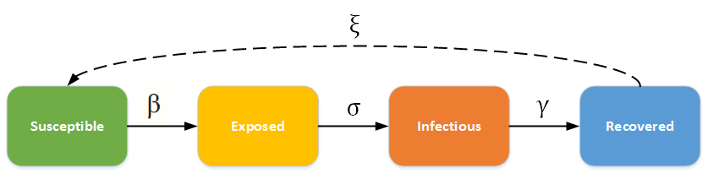
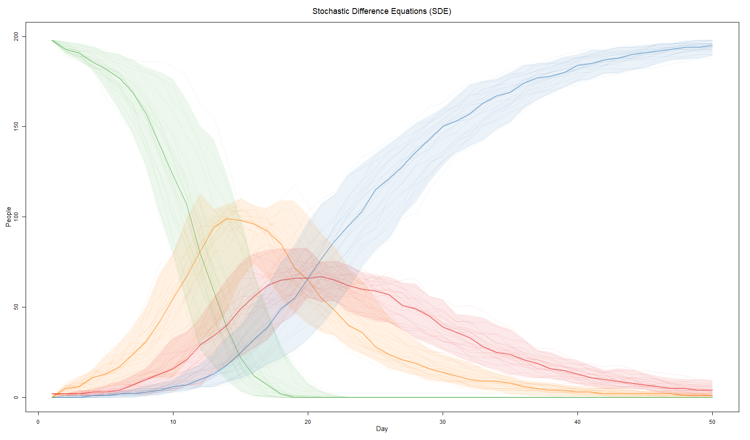








EMOD: Epidemiological MODeling software
S
E
I
R
Model available for download: https://github.com/InstituteforDiseaseModeling/EMOD/releases

Slide 12
EMOD
Generic SEIRS
Environmental
Airborne
Vector
STI
Tuberculosis
+ Coinfection
Malaria
HIV
Polio
Typhoid
Dengue
Documentation available: http://idmod.org/documentation

Slide 13
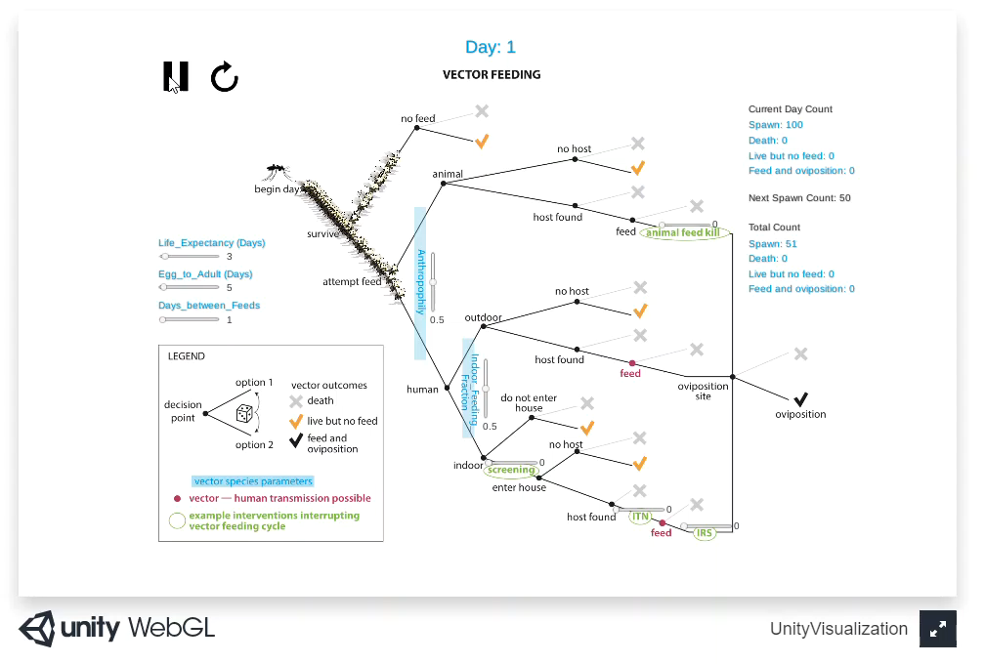
EMOD

Slide 14















Features of EMOD: interventions
+
-
?
?

Slide 15
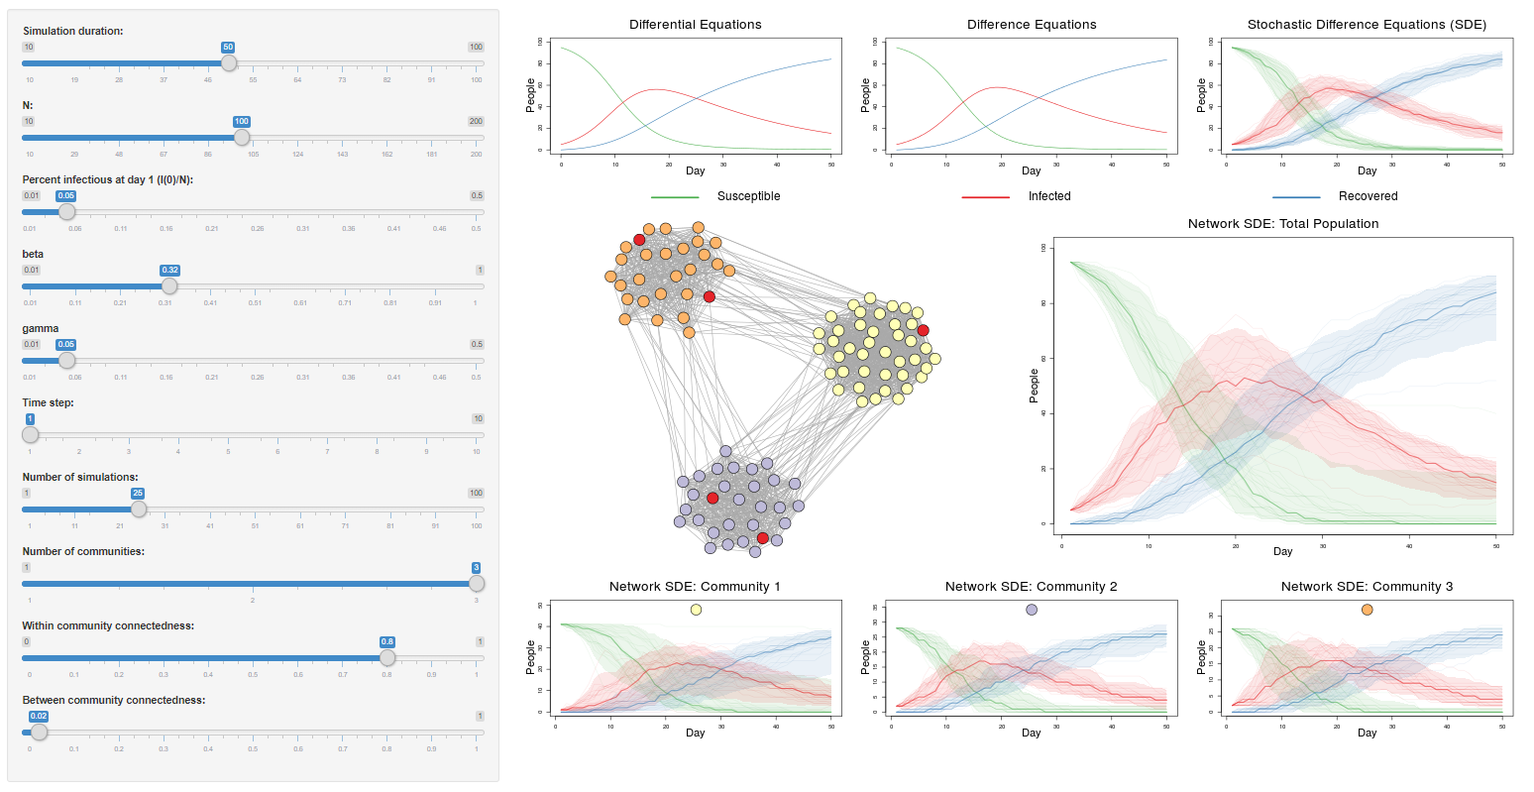

















Features of EMOD: individual properties, heterogeneity, migration

Slide 16
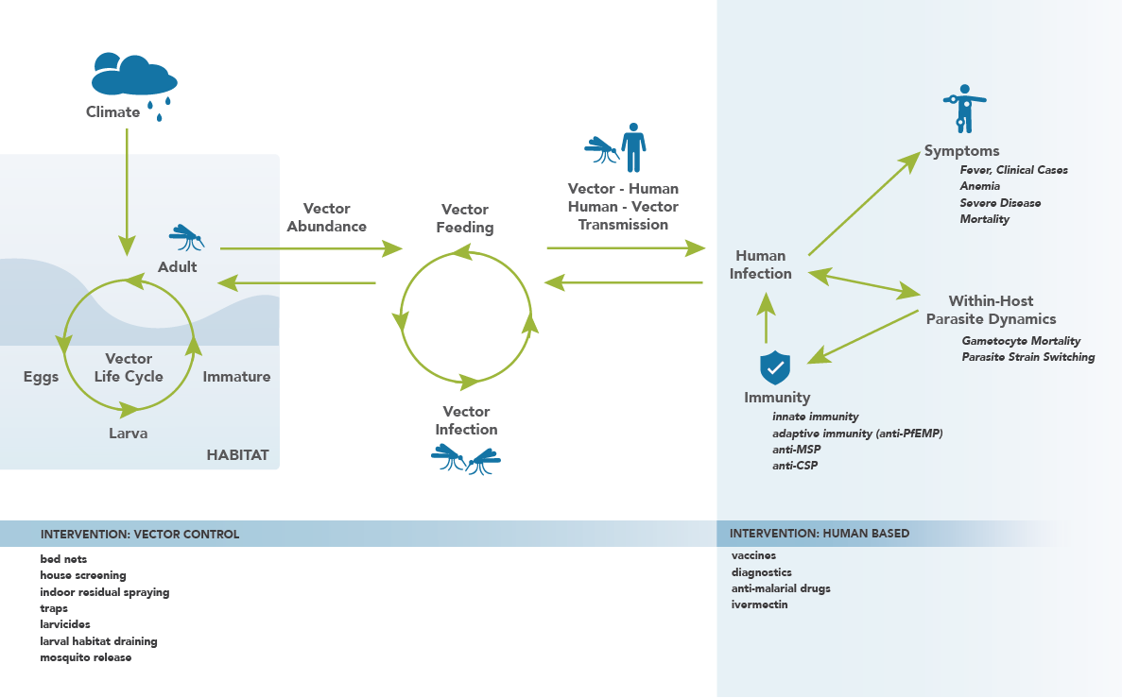
Features of EMOD: disease-specific functionality

Slide 17
Core modeling tools
Dis
Dis
Manage simulations
Create, calibrate, run simulations
COMPS UI
DTK-Tools
COMPS
Model disease
Analyze data
Dis
Visualize data
Dis
DTK-Tools
Vis-Tools
EMOD
CMS
Dis
Dis
Create risk maps
Learn the model
QuickStart
Risk Map

Slide 18
DTK-tools
DTK-tools is a set of Python tools and helpers used to commission, manage, and analyze simulations. DTK-tools uses scripting as the means to interact with the model.
Scripting has advantages:
Reusable and shareable
Speeds up the creation of large experiments
Scripts are available to aid in configuration file creation, model calibration, output visualization, and data analysis
dtk run example_sim.py --HPC

Slide 19









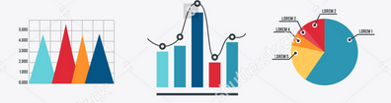
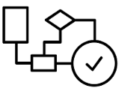
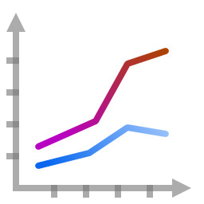
DTK-tools
cb = DTKConfigBuilder.from_defaults(‘VECTOR_SIM’)
configure_site(‘Namawala’)
run_sim_args = {
‘config_builder’: cb,
‘exp_name’: ‘My first experiment’
}
Study Site
EMOD Model
Demographics data
Climate data
Disease specifics
Reference data
Climate files
Demographics files
Parameters
Produces outputs
New parameters
Create input files
Likelihoods
Output visualizations
Next point state
Next point algorithm
Sim
Sim
Sim
Sim
Compare
Analyzer
Output files
Filter
OP
OP
OP
Apply
Calibration
Analyzers
Combine
Finalize
Plot

Slide 20
DTK-tools
cb = DTKConfigBuilder.from_defaults(‘VECTOR_SIM’)
configure_site(‘Namawala’)
run_sim_args = {
‘config_builder’: cb,
‘exp_name’: ‘My first experiment’
}
Study Site
EMOD Model
Demographics data
Climate data
Disease specifics
Reference data
Climate files
Demographics files
Parameters
Produces outputs
New parameters
Create input files
Likelihoods
Output visualizations
Next point state
Next point algorithm
Sim
Sim
Sim
Sim
Compare
Analyzer
Output files
Filter
OP
OP
OP
Apply
Calibration
Analyzers
Combine
Finalize
Benoit Raybaud, Wed at 9 am
Plot

Slide 21
Core modeling tools
Dis
Dis
Manage simulations
Create, calibrate, run simulations
COMPS UI
DTK-Tools
COMPS
Model disease
Analyze data
Dis
Visualize data
Dis
DTK-Tools
Vis-Tools
EMOD
CMS
Dis
Dis
Create risk maps
Learn the model
QuickStart
Risk Map

Slide 22
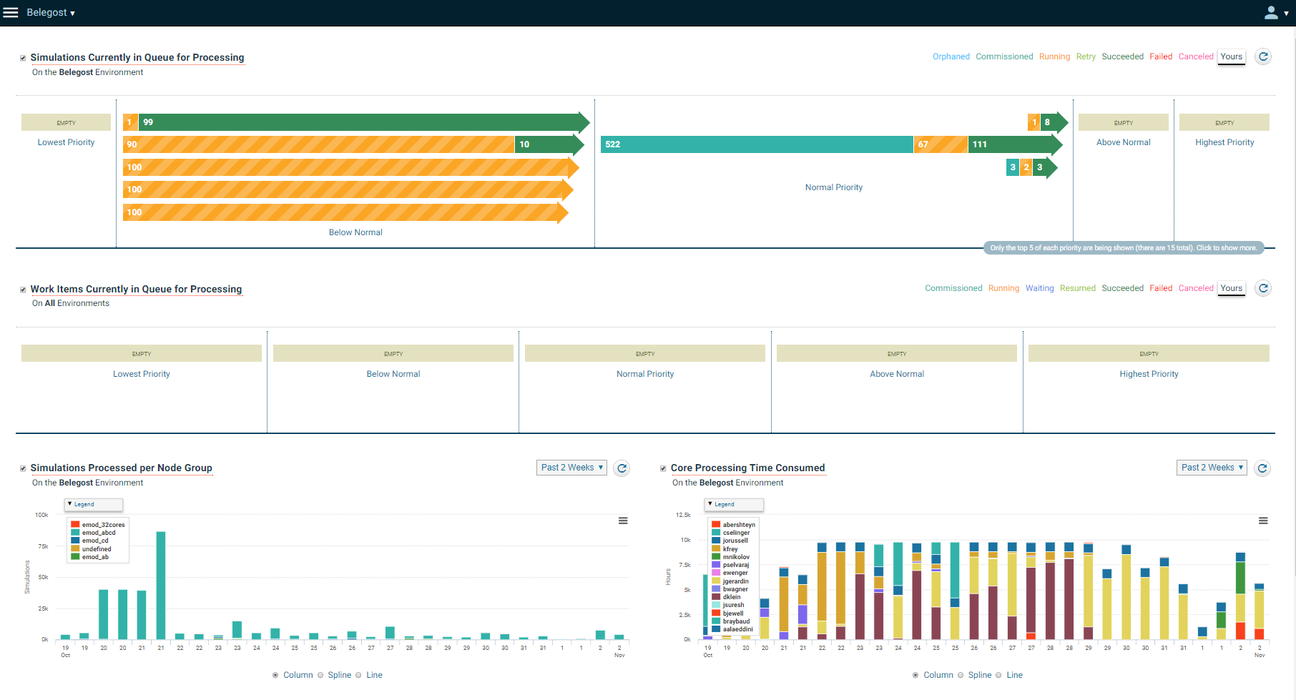
COMPS
The COmputational Modeling Platform Service (COMPS) is a suite of services that facilitates scientific research by providing access to high-performance computing environments.

Slide 23
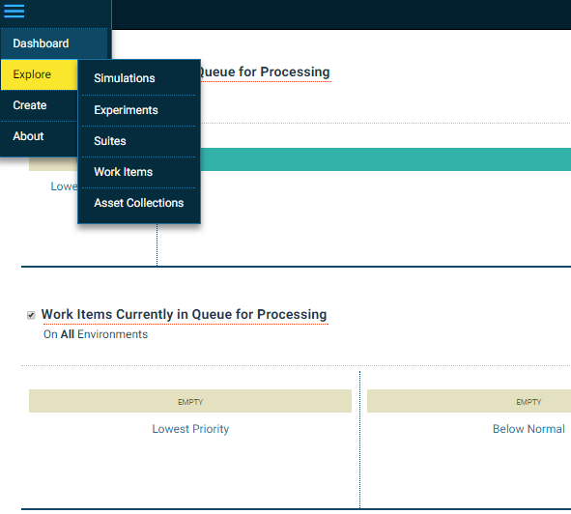
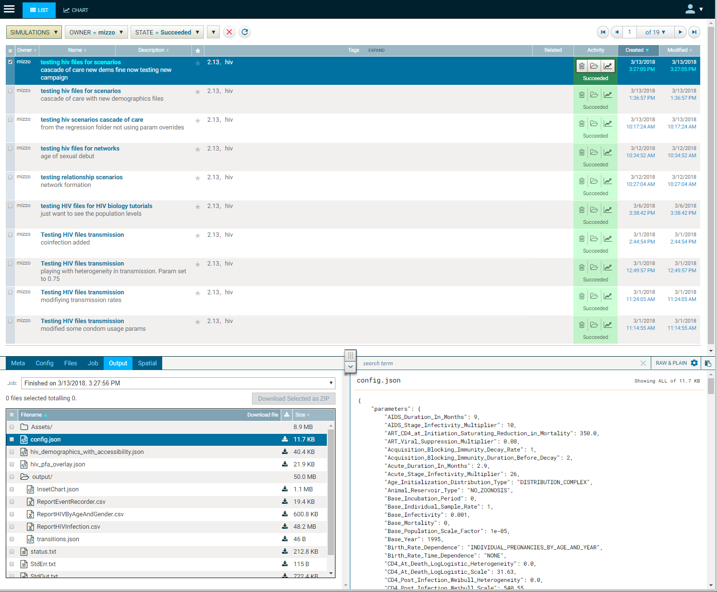
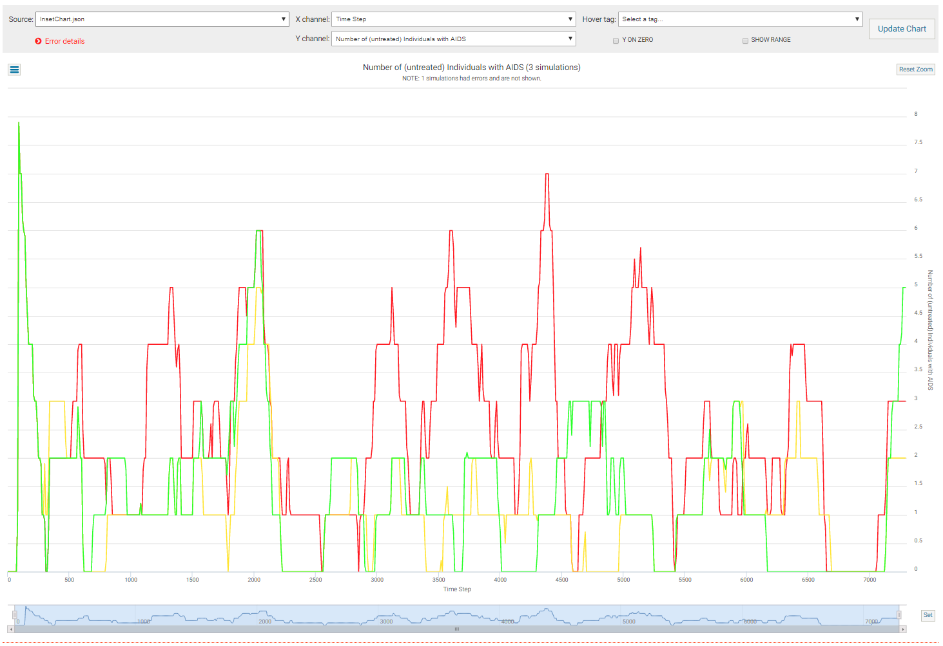
COMPS

Slide 24
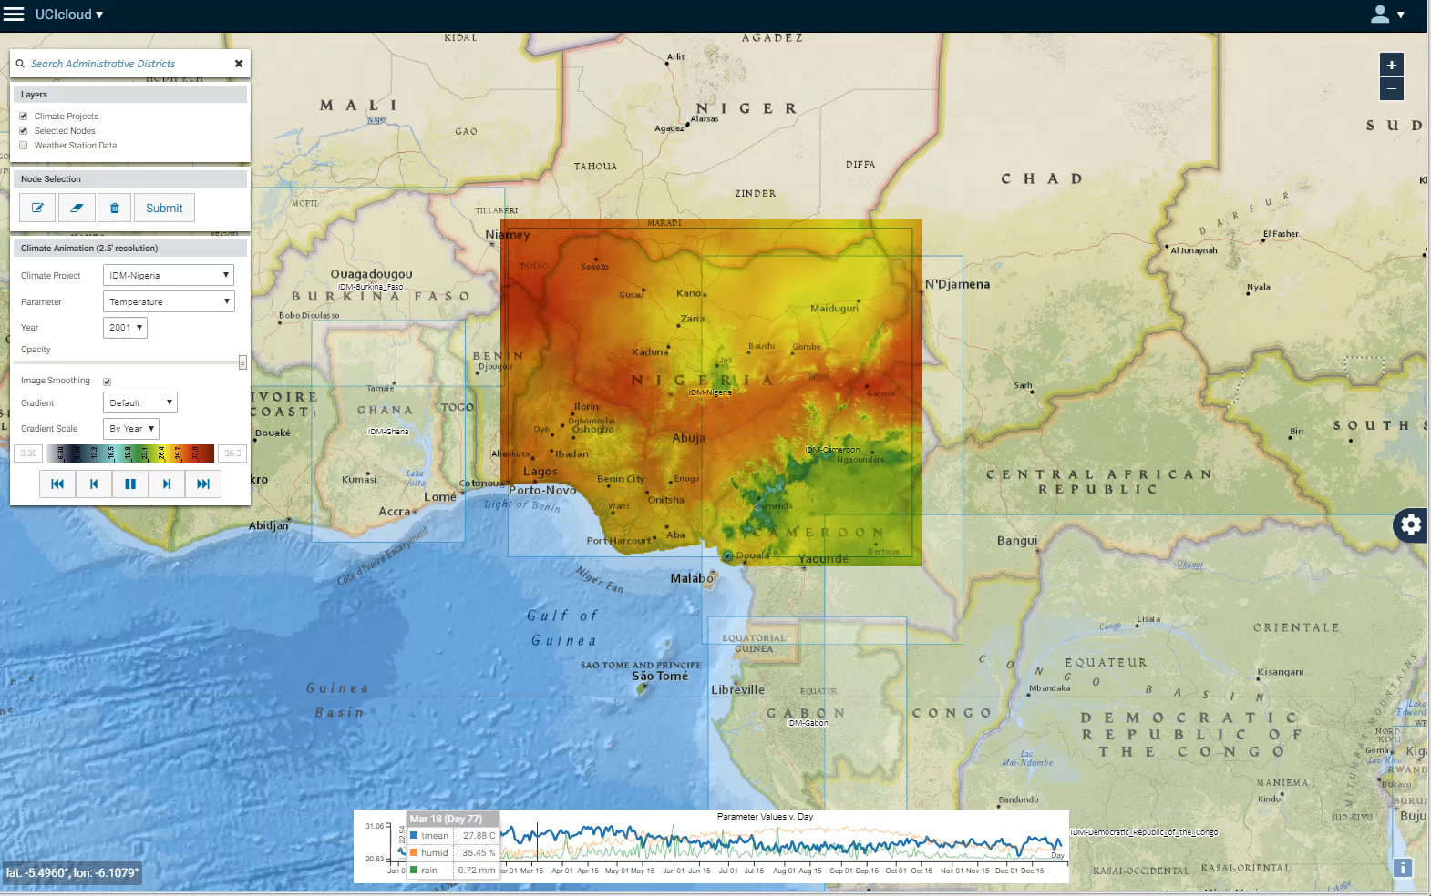
COMPS

Slide 25
Additional tools
Dis
Dis
Manage simulations
Create, calibrate, run simulations
COMPS UI
DTK-Tools
COMPS
Model disease
Analyze data
Dis
Visualize data
Dis
DTK-Tools
Vis-Tools
EMOD
CMS
Dis
Dis
Create risk maps
Learn the model
QuickStart
Risk Map

Slide 26
Additional tools
Dis
Dis
Manage simulations
Create, calibrate, run simulations
COMPS UI
DTK-Tools
COMPS
Model disease
Analyze data
Dis
Visualize data
Dis
DTK-Tools
Vis-Tools
EMOD
CMS
Dis
Dis
Create risk maps
Learn the model
QuickStart
Risk Map

Slide 27
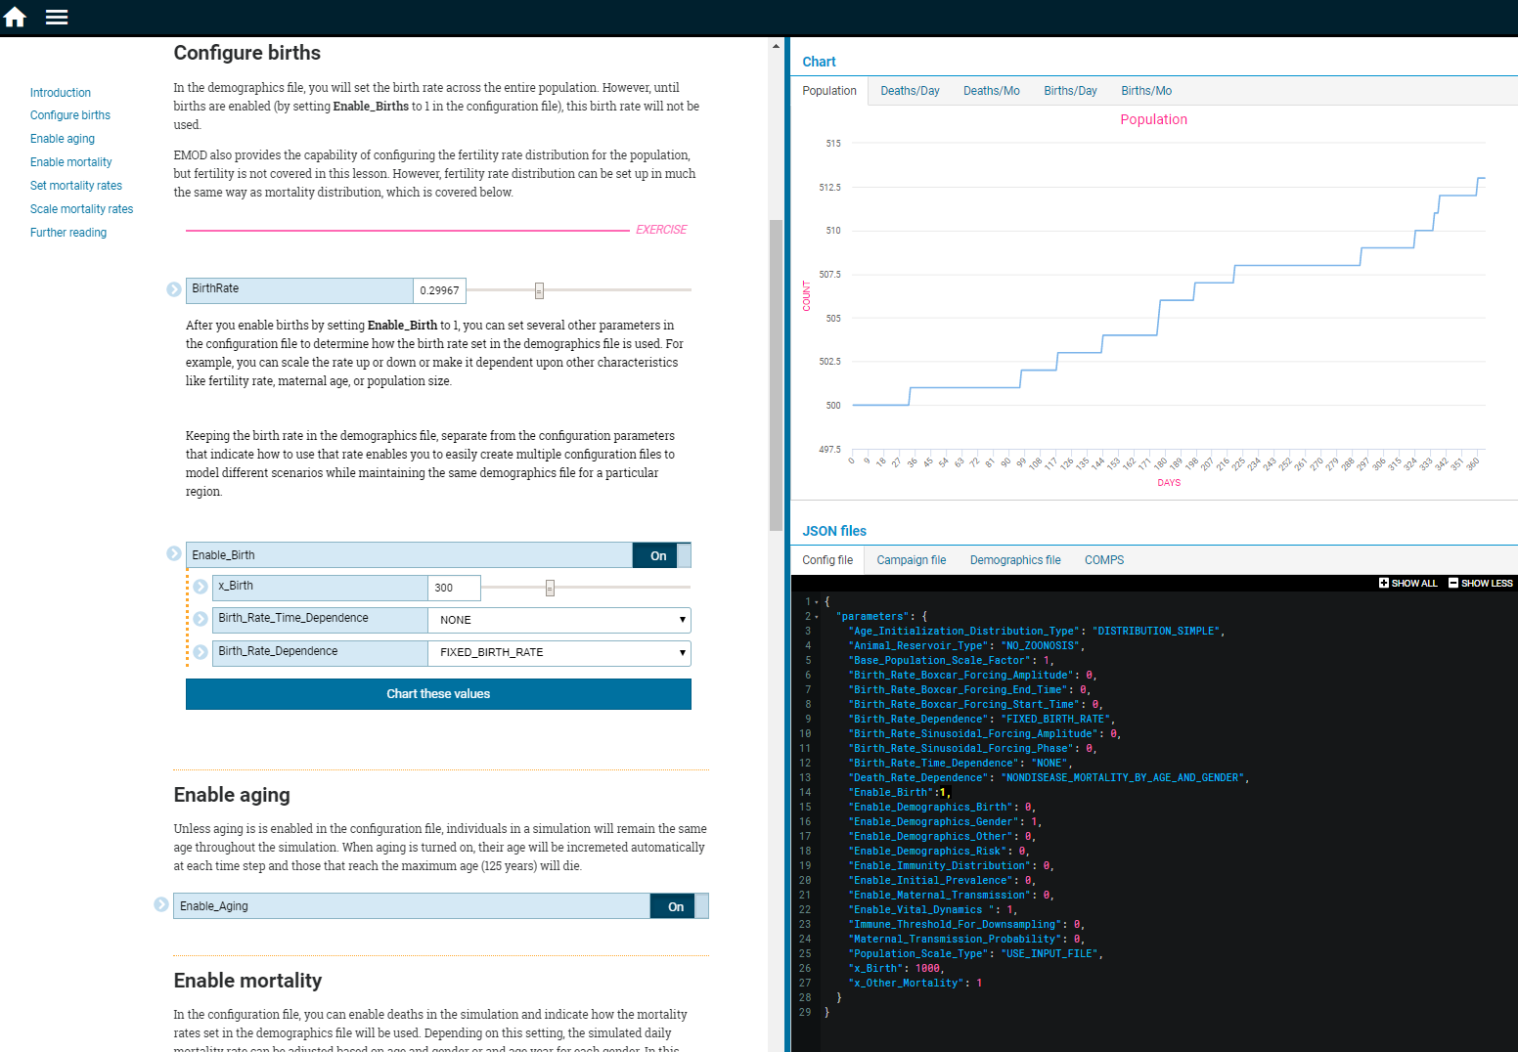
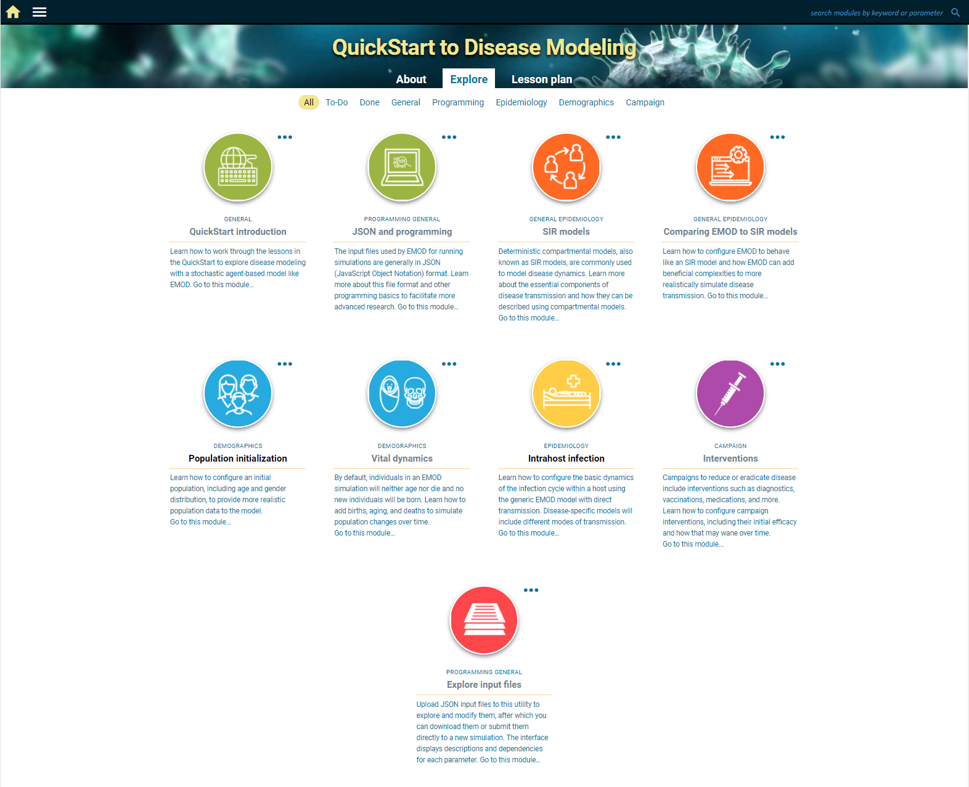
QuickStart
Graphs update dynamically
JSON input files update dynamically
Explore the function of related sets of parameters

Slide 28
QuickStart
Graphs update dynamically
Breakout session, today at 11
Explore the function of related sets of parameters

Slide 29
Additional tools
Dis
Dis
Manage simulations
Create, calibrate, run simulations
COMPS UI
DTK-Tools
COMPS
Model disease
Analyze data
Dis
Visualize data
Dis
DTK-Tools
Vis-Tools
EMOD
CMS
Dis
Dis
Create risk maps
Learn the model
QuickStart
Risk Map

Slide 30
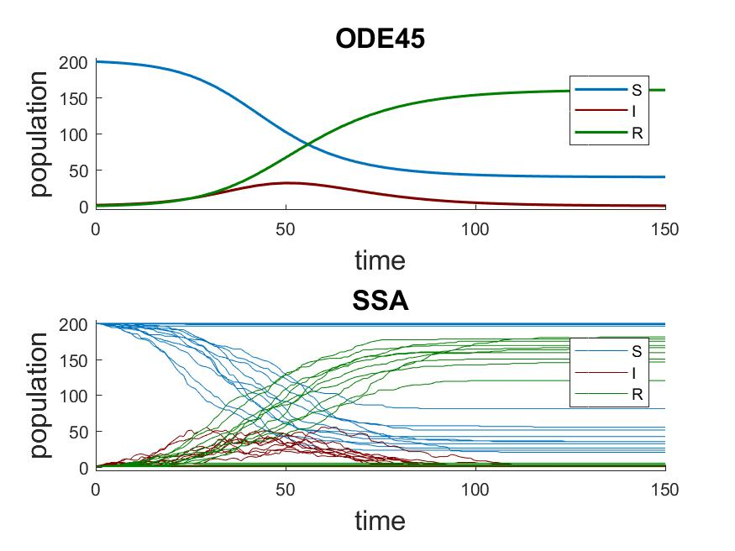
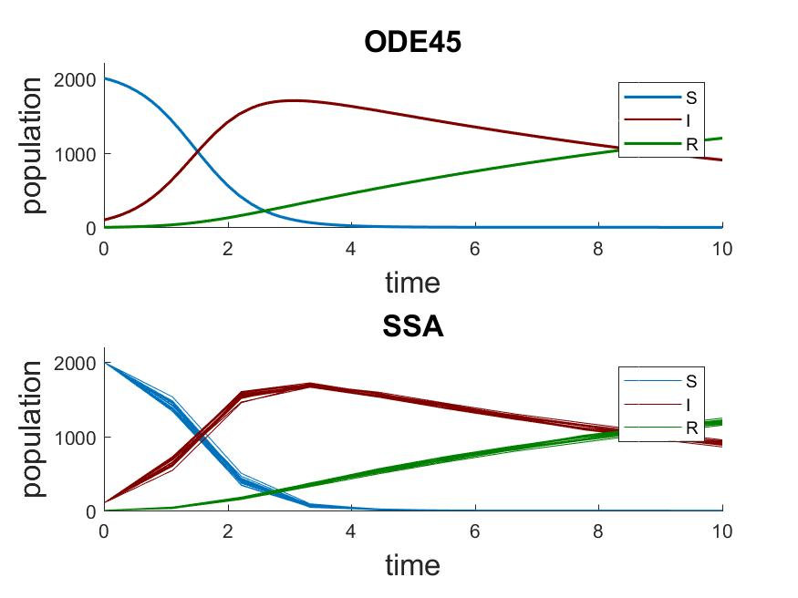
Compartmental Modeling Software (CMS)
https://github.com/InstituteforDiseaseModeling/IDM-CMS
Documentation: http://idmod.org/documentation

Slide 31
Compartmental Modeling Software (CMS)
Breakout session, Tues at 11 am
https://github.com/InstituteforDiseaseModeling/IDM-CMS
Documentation: http://idmod.org/documentation

Slide 32
Additional tools
Dis
Dis
Manage simulations
Create, calibrate, run simulations
COMPS UI
DTK-Tools
COMPS
Model disease
Analyze data
Dis
Visualize data
Dis
DTK-Tools
Vis-Tools
EMOD
CMS
Dis
Dis
Create risk maps
Learn the model
QuickStart
Risk Map

Slide 33
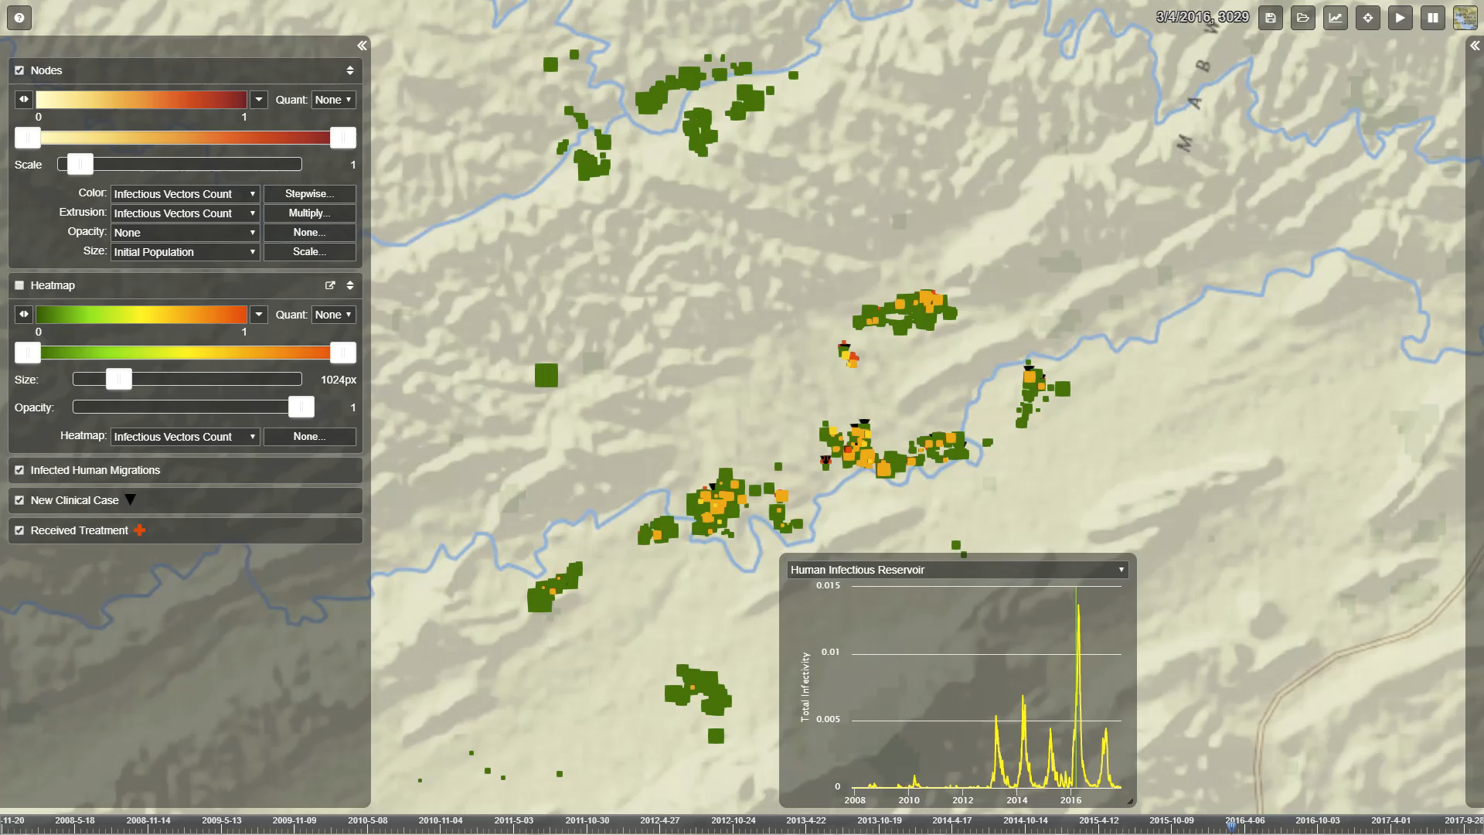
Vis-tools
Transport controls
Nodes layer controls
Bindings
Node info (when selected)
Heatmap layer controls
Other layers
Per-node inset charts (when selected)
Data summary graphs
Timeline

Slide 34
Additional tools
Dis
Dis
Manage simulations
Create, calibrate, run simulations
COMPS UI
DTK-Tools
COMPS
Model disease
Analyze data
Dis
Visualize data
Dis
DTK-Tools
Vis-Tools
EMOD
CMS
Dis
Dis
Create risk maps
Learn the model
QuickStart
Risk Map

Slide 35
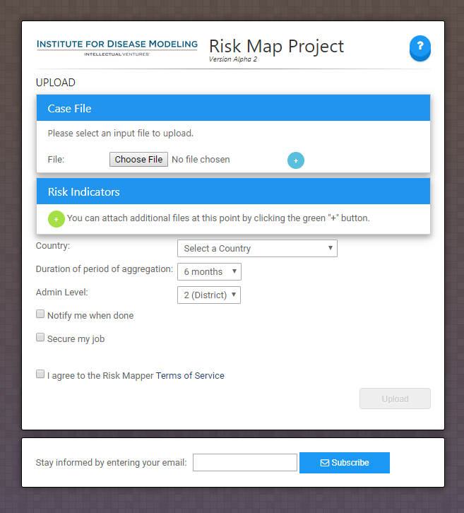
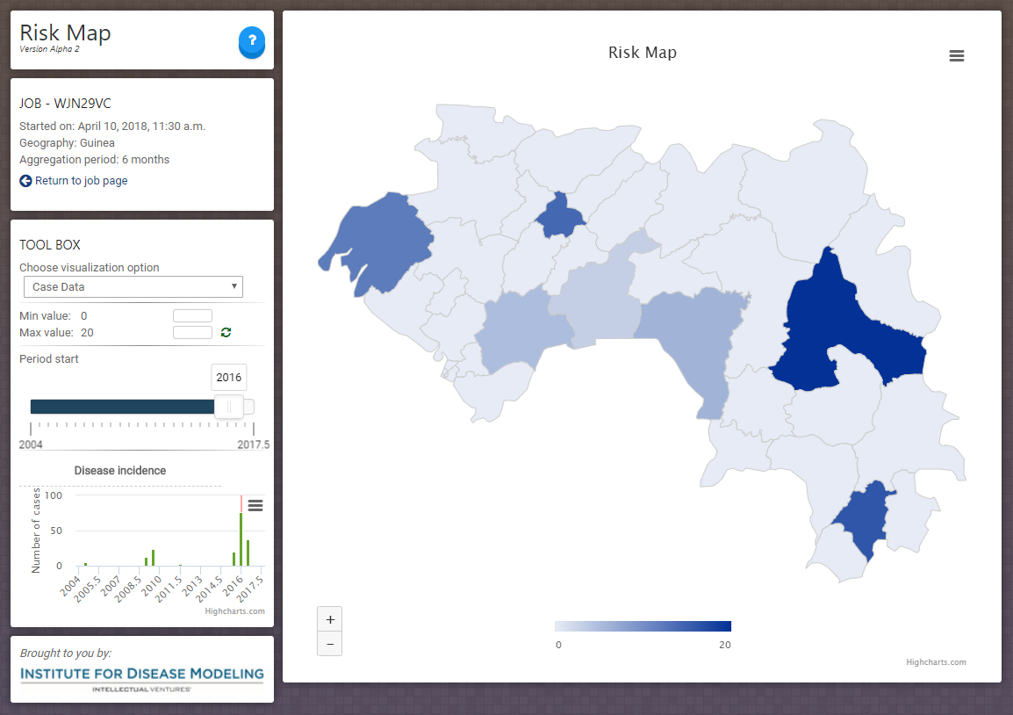
Risk Map
https://riskplus.idmod.org

Slide 36
Risk Map
Sessions on Tuesday at 9 – 10:30, 11 - 1 (Qinghua Long, 12:30)
https://riskplus.idmod.org

Slide 37


IDM has numerous online resources to help answer questions and solve problems.
Website: http://idmod.org
Support: support@idmod.org
For more information on collaborating with IDM, contact idm@idmod.org

