Slide 1


Introduction to Agent-Based Models
IDM breakout session
Mandy Izzo, Jen Schripsema

Slide 2
Outline
Introduction
SIR models
  Adding in heterogeneity
  From SIR to agent-based models (ABMs)
Considerations of ABMs
  Levels of complexity
  Parameterization
  Computational burden
  Emerging properties
Summary of ABM benefits
Applications
EMOD
QuickStart access!

Slide 3


Introduction: What is an agent-based model?

Slide 4
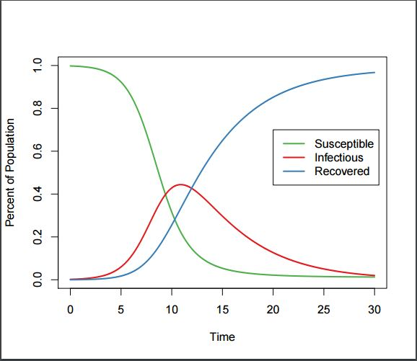



SIR models
Susceptible
$$β$$
Infectious
$$γ$$
Recovered
$$\frac{dS}{dt}=−βSI \\ \frac{dI}{dt}=βSI −γI \\ \frac{dR}{dt}=γI$$

Slide 5


SIR models: adding in heterogeneity
Children
Susceptible
Infectious
Recovered
Adults
Susceptible
Infectious
Recovered
$$\frac{dS_{c}}{dt}=−S_{c}\left(β_{cc}I_{c}+β_{ac}I_{a}\right)−δS_{c} \\ \frac{dI_{c}}{dt}=S_{c}\left(β_{cc}I_{c}+β_{ac}I_{a}\right)−γ_{c}I_{c}−δI_{c} \\ \frac{dR_{c}}{dt}=γ_{c}I_{c}−δR_{c}$$
$$\frac{dS_{a}}{dt}=−S_{a}\left(β_{ca}I_{c}+β_{aa}I_{a}\right)+δS_{c} \\ \frac{dI_{a}}{dt}=S_{a}\left(β_{ca}I_{c}+β_{aa}I_{a}\right)−γ_{a}I_{a}+δI_{c} \\ \frac{dR_{a}}{dt}=γ_{a}I_{a}+δR_{c}$$

Slide 6





SIR models: increasing heterogeneity…
Age 1
Susceptible
Infectious
Recovered
$$⋮$$
$$⋮$$
$$⋮$$
$$⋮$$
Age n
Susceptible
Infectious
Recovered
$$\frac{dS_{i}}{dt}=δS_{i−1}−δS_{i}−S_{i}∗\sum_{j=1}^{n}{β_{j,i}}I_{j} \\ \frac{dI_{i}}{dt}=δI_{i−1}−δI_{i}+S_{i}∗\sum_{j=1}^{n}{β_{j,i}}I_{j}−γ_{i}I_{i} \\ \frac{dR_{i}}{dt}=δR_{i−1}−δR_{i}+γ_{i}I_{i}$$

Slide 7


From SIR models to agent-based models
p(S→I) =f(age) with bins was getting complex…
what if:
p(S→I) =f(time, age, individual-level risk, individual properties, etc…)

Slide 8




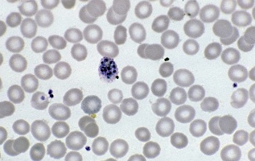


Considerations of ABMs
Levels of complexity

Slide 9


Considerations of ABMs
Levels of complexity
Input
…output…

Slide 10
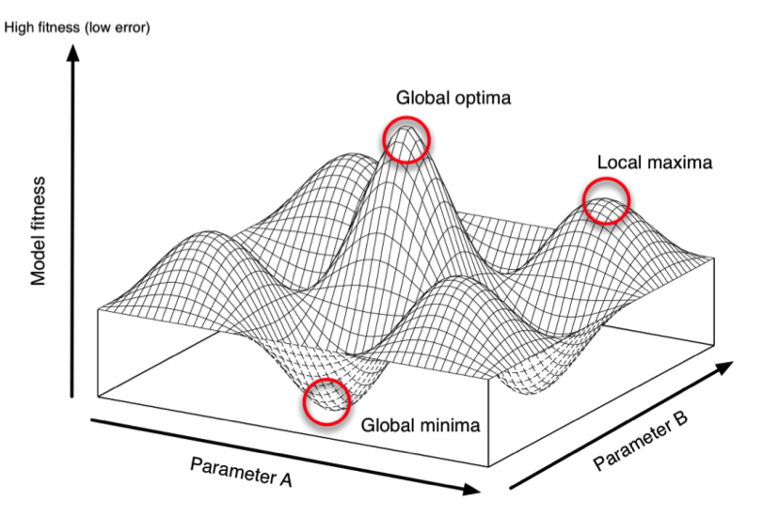
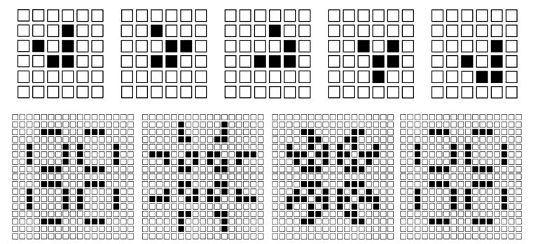
Considerations of ABMs
Parameterization

Slide 11
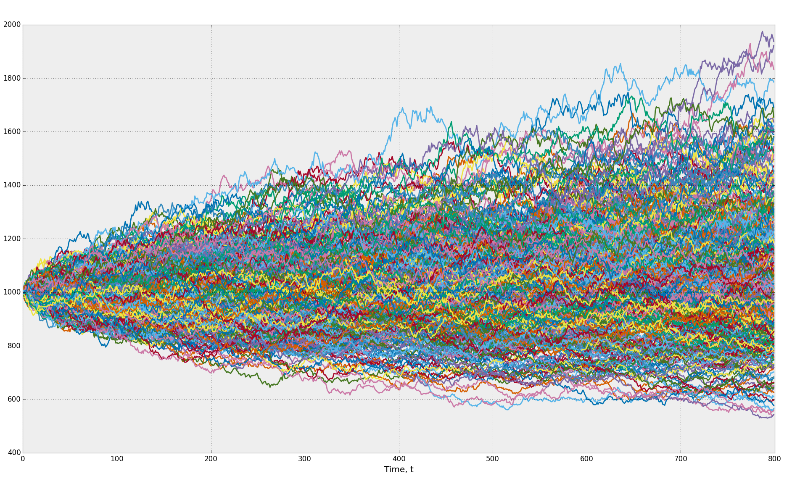

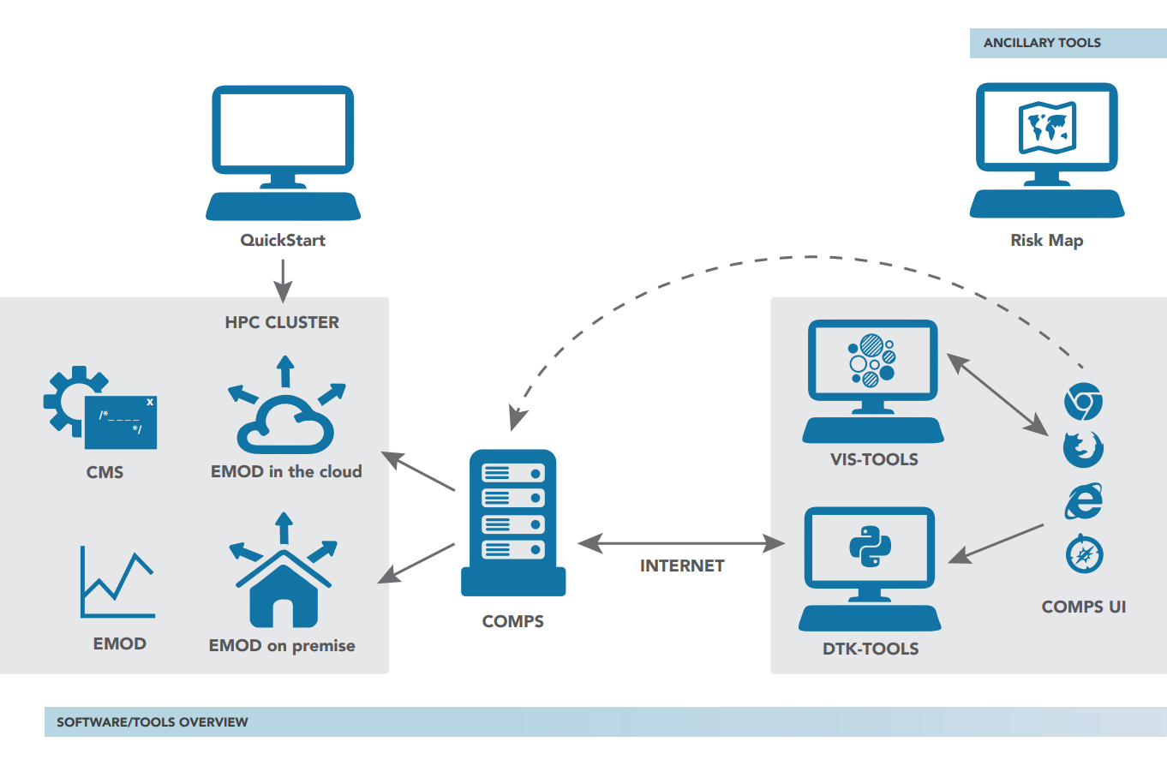
Considerations of ABMs
Computational burden

Slide 12
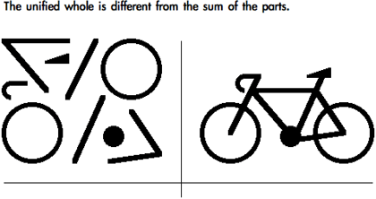
Considerations of ABMs
Emergent properties

Slide 13
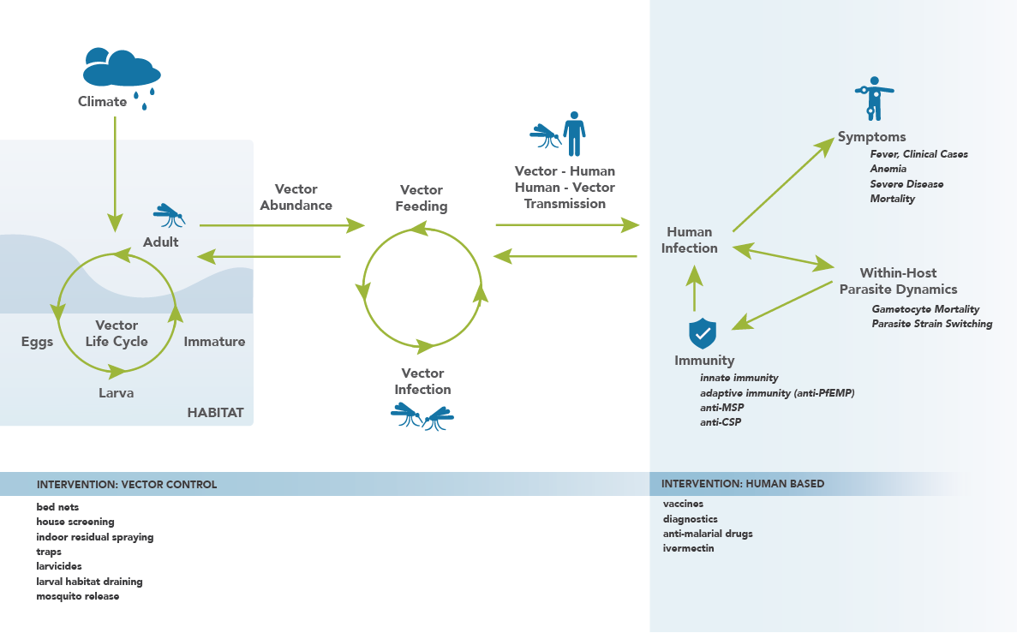
Benefits of ABMs

Slide 14

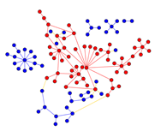
Applications of ABMs

Slide 15
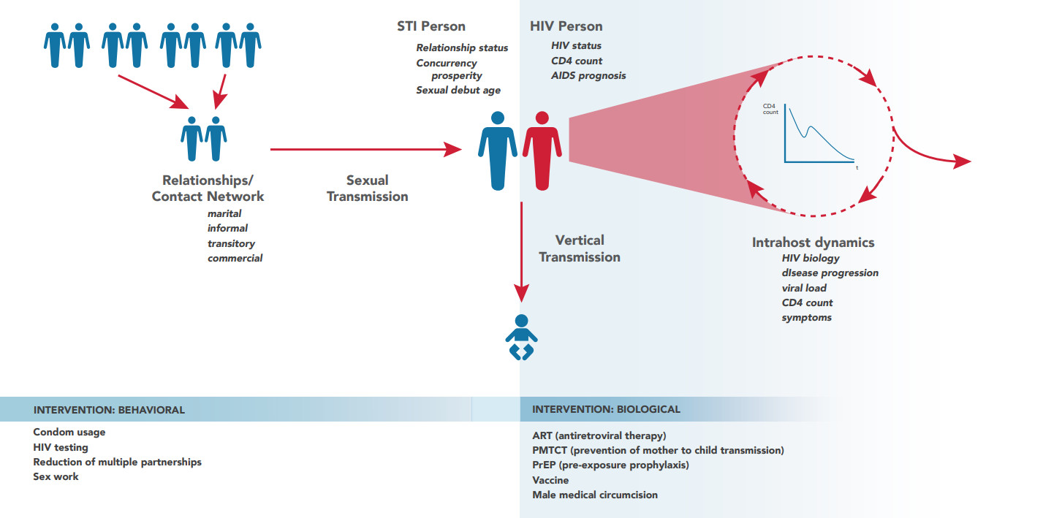
EMOD!
HIV model

Slide 16
EMOD overview
Discrete time steps (computationally and practically simpler)
Stochastic: randomness is built in
Agent-based
  Individual state transitions
  Heterogeneity in transmission/infectiousness
    Networks and network dynamics
    Individual and geographic variability
  Include relevant climate or demographic data
Include interventions
  Routine health care
  Disease campaigns

Slide 17
EMOD disease support
Generic SEIRS
Environmental
Airborne
Vector
STI
Tuberculosis
+ Coinfection
Malaria
HIV
Polio
Typhoid
Dengue
Documentation available: http://idmod.org/documentation

Slide 18
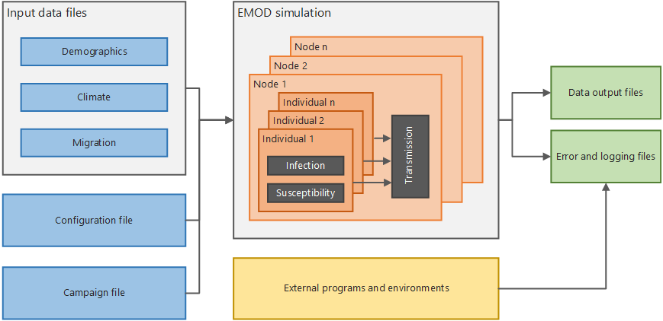
EMOD architecture

Slide 19
EMOD input files
Primary files
  Configuration
  Campaign
  Demographics
Use JSON (JavaScript object notation) syntax
  All data is key/value pairs, separated by commas
  Keys (parameters) are case-sensitive
  Curly braces hold objects
  Square brackets hold arrays
  Data can be hierarchically organized in nested objects or arrays

Slide 20
EMOD demographics file
Population size
Age and gender distribution
Immunity, prevalence, migration rates
Assign properties to individuals and geographic regions to target particular interventions or add heterogeneous mixing
Can use multiple files: one as a “base layer” and one with parameter overrides (“overlay” layer)

Slide 21
EMOD configuration file
Mostly flat list of key:value pairs
Additional files to use
Enable and disable features
Simulation length, time step, etc.
Output reports to create
Disease dynamics
  Infectivity
  Incubation period
  Mortality
  Immunity

Slide 22
EMOD campaign file
Disease interventions
  When, how, and who to test for disease
  When, how, and who to provide treatment
  What types of diagnostics and treatments to use
Nested file structure
  Campaign event (when/where)
  Event coordinator (who)
  Intervention (what)

Slide 23
EMOD QuickStart
Web-based, no downloads or software requirements
Focused, modular lessons on EMOD fundamentals and how agent-based models differ from compartmental models
Gain the foundational knowledge to begin using EMOD for disease modeling research
Introduction to JSON syntax and EMOD files
View descriptions of each parameter with dependencies and hierarchies
Dynamically updated JSON files and output graphs based on your input
Upload complete JSON files and explore the parameters they contain

Slide 24
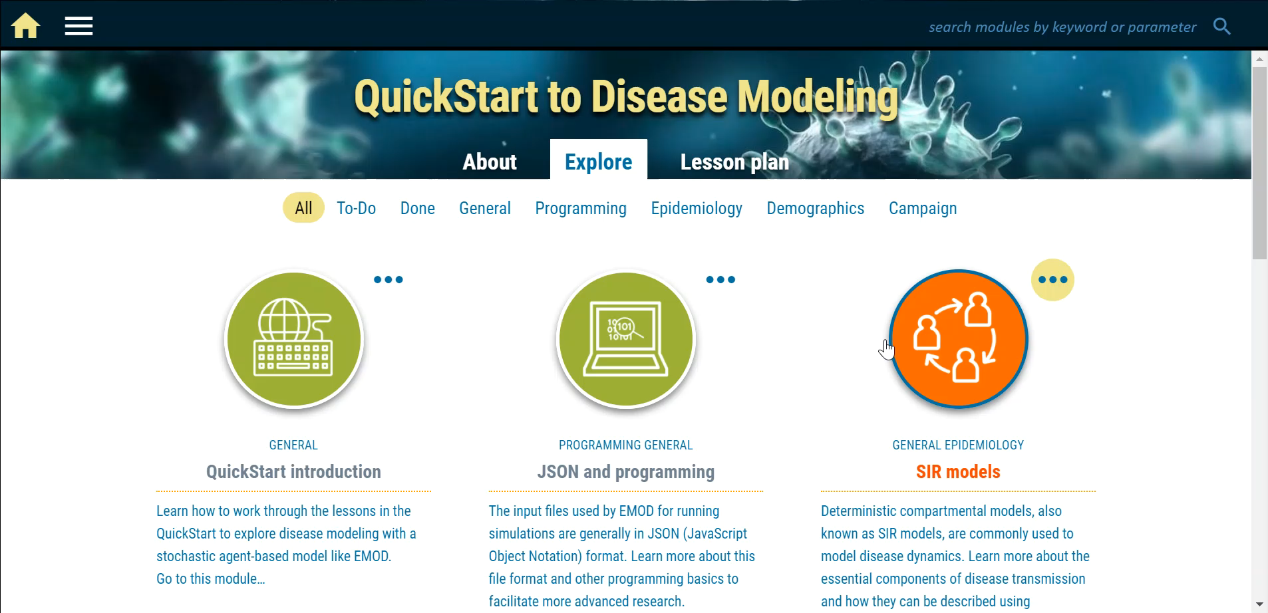
EMOD QuickStart

Slide 25
IDM’s QuickStart
https://quickstart.idmod.org (use Chrome)
Logging on:
  Symposium attendees:
    Username: QSDemo
    Password: IDM@Symposium18
  IDM employees: use your COMPS info (change password on COMPS if necessary)
Additional resources:
  www.idmod.org/documentation
  support@idmod.org
QuickStart public debut: ASTMH pre-meeting modeling workshop! Oct 27, 2018
Notes:
Game of Life: https://www.youtube.com/watch?v=C2vgICfQawE

