Slide 1
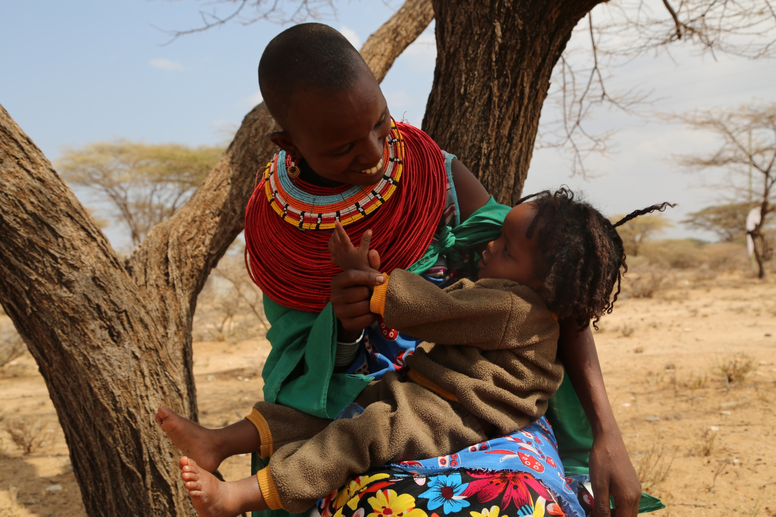

Institute for Disease Modelling
Symposium
Hyatt Regency Hotel, 16th- 18th April 2018
www.amref.org

Slide 2
Spatial distribution of healthcare workers in malaria endemic zones in Kenya: health system readiness for malaria pre-elimination
Mable Jerop
Amref Health Africa, Nairobi, Kenya
www.amref.org

Slide 3
Malaria endemic zones in Kenya
Malaria Mapping 1990-2010
Showing reduction in prevalence with use of interventions-Case management, FANC, IMCI
www.amref.org

Slide 4
Malaria endemic zones in Kenya
Estimation of prevalence according to Kenya Malaria indicator Survey, 2015
Review of policies such as test and treat, introduction of community case management of Malaria, Intensification of IRS and LLIN distribution between 2010 to present
Highland epidemic
3%
Semi-arid, seasonal
1%
Lake endemic
27%
Low risk
<1%
Coast endemic
8%
www.amref.org

Slide 5
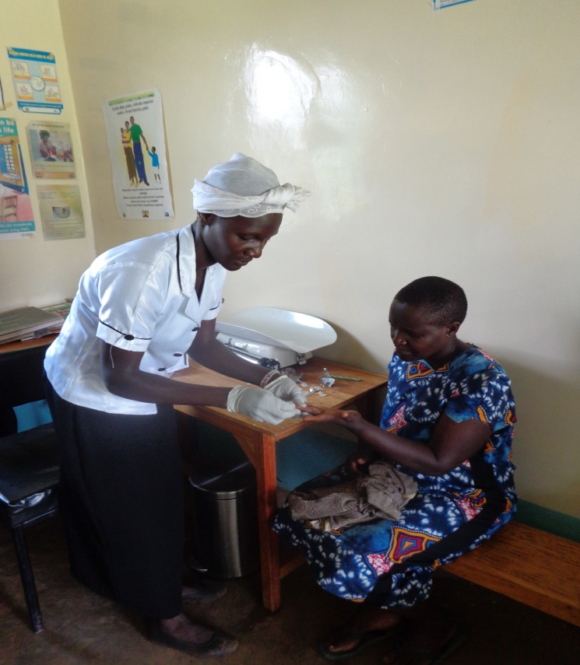
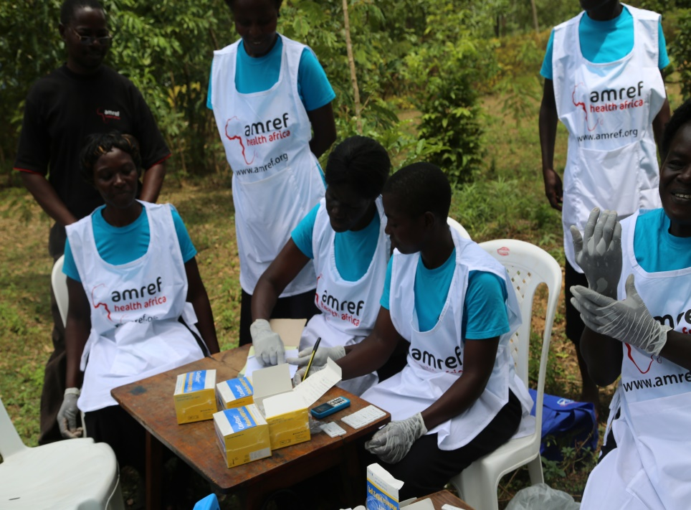
Case management strategy 2009- 2018
To have 100% of all suspected malaria cases presenting to a health provider managed according to the national malaria treatment guidelines by 2018
www.amref.org

Slide 6
Background
Available resources for health care are still a crisis in developing countries as global efforts in the fight against malaria continues towards elimination.
Sub Saharan Africa accounts for the highest malaria burden globally- limited access to health care providers
Sustaining previous gains requires continued readiness to deliver malaria services in response to actual disease burden, which in turn contributes to health systems strengthening.
www.amref.org

Slide 7
Objective
This paper seeks to give a cross sectional description of the distribution of healthcare workers at facility and community levels and simulate the ideal quantity and distribution of health workers considering factors as malaria prevalence and accessibility to care in order to achieve the target to pre-elimination in the near future.
www.amref.org

Slide 8
Purpose of the paper.
Demonstrates use of existing data sources to evaluate health system performance and to identify within country variations
www.amref.org

Slide 9
Specific objectives of the paper
Mapping the distribution of health facilities, healthcare workers and CHVs in relevance to the catchment population in malaria endemic zones in Kenya
Quantitatively analyzing malaria case management outcomes based on the routine surveillance of data from health facilities and communities
Predict the ideal coverage of healthcare workers per population unit to enable the country achieve its pre elimination targets for case management
www.amref.org

Slide 10
Materials, methods and data analysis
Study area: The study area will focus on endemic region in Kenya according epidemiological classification of malaria burden in Kenya
Data sources: Demographic health information system (DHIS 2), Community Health Information System (CHIS), Malaria Surveillance data, KEMRI Welcome Trust data base of health facilities
Data analysis: ArcGIS software together with R software will be used for additional quantitative data management and analysis
Parameters: Name of health facility, MFL code, location, type of health facility, number of health care workers, presence of community health unit, catchment population, number of Malaria cases treated monthly from 2014 to 2017, number of Malaria cases treated at community level monthly from 2014 to 2017
www.amref.org

Slide 11
Next steps
Engagements with National Malaria control programme, IDM and Malaria Atlas project, Oxford University to review the layout of the paper and support in development of an appropriate modelling strategy
Data management, data analysis and manuscript development
Review from various stakeholders
Publication
www.amref.org

Slide 12
Acknowledgments
Amref Health Africa
National Malaria Control Programme, Kenya
Institute of Disease Modelling, USA
Malaria Atlas Project, Oxford University
www.amref.org

