Slide 1
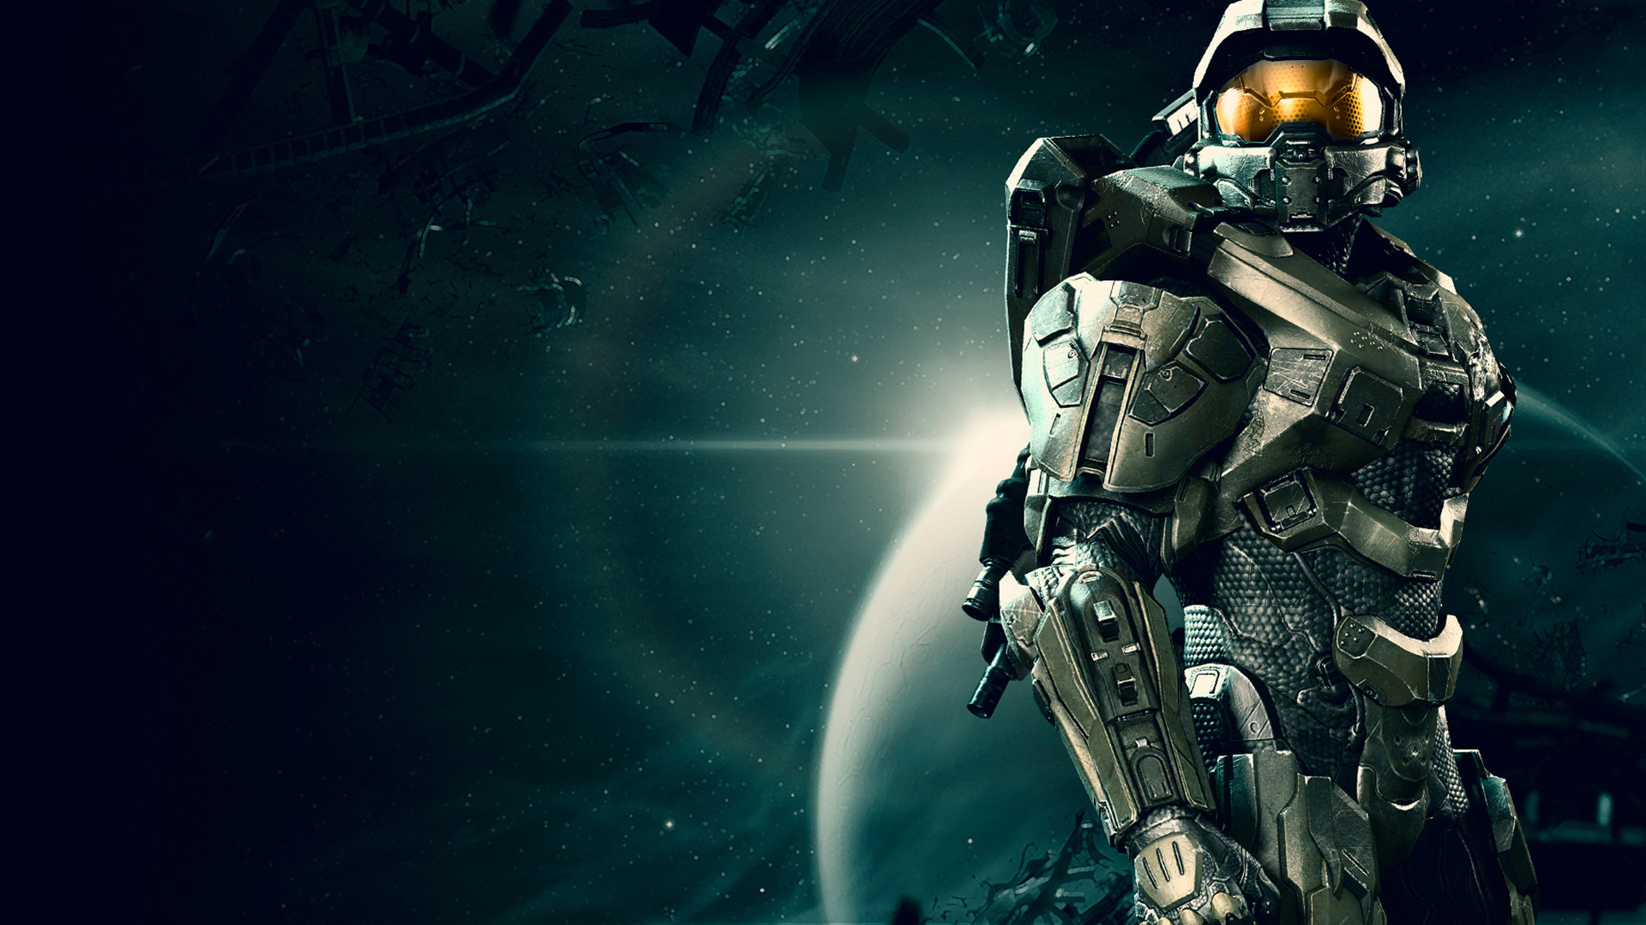
SERIOUS GAMING
Notes:
When we talk about games

Slide 2
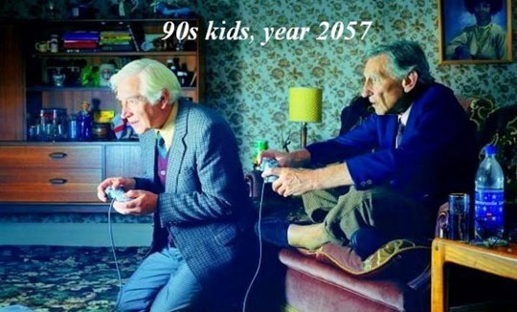
Notes:
3We generally associate them with fun.

Slide 3
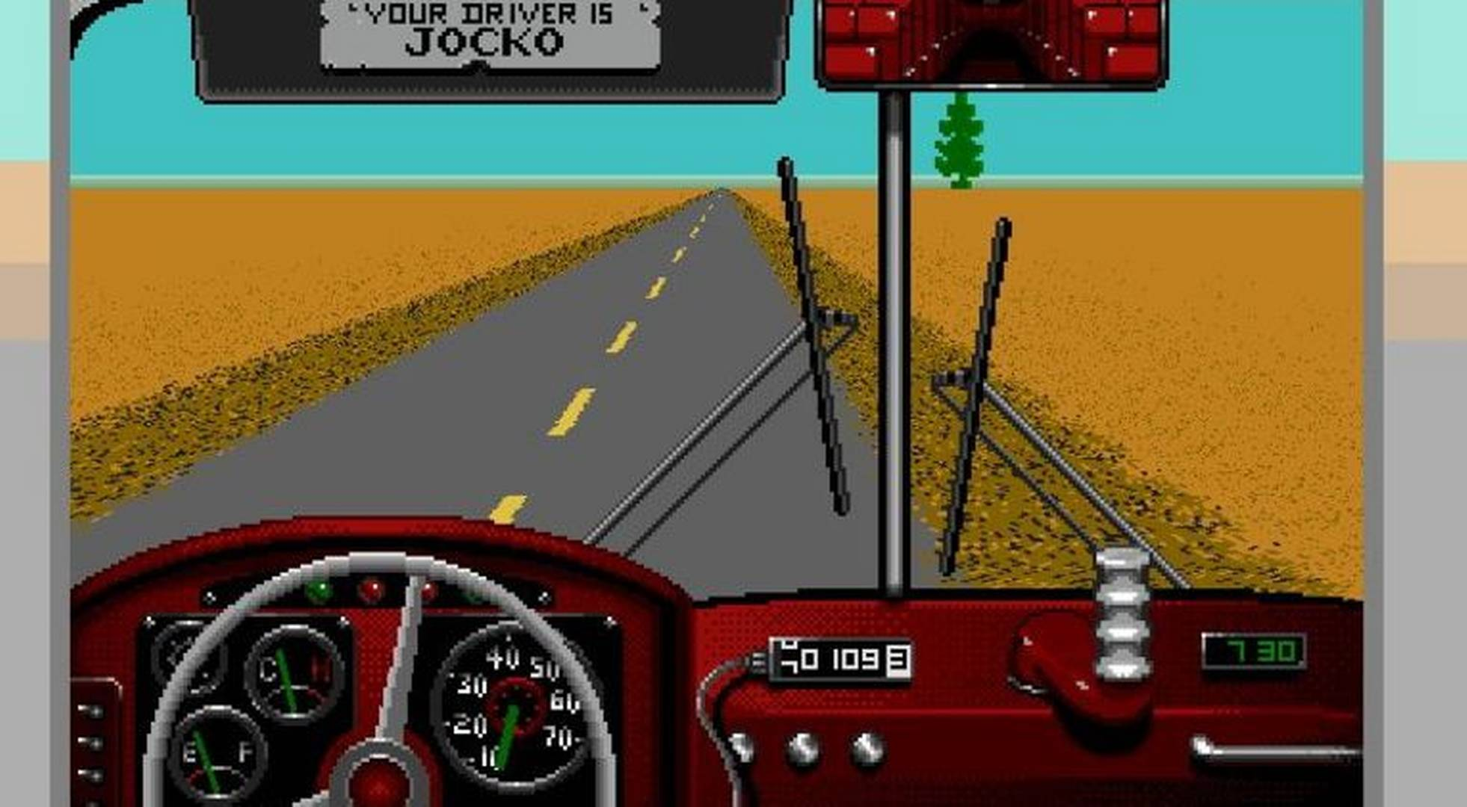
Notes:
Serious Games however are perceived to have an objective other than pure entertainment.
In Desert Bus for example, finishing a single leg of a trip requires eight hours of considerable stamina and concentration in the face of arch boredom as the vehicle constantly pulls to the right so players cannot take their hands off the virtual wheel.
The bus carries no virtual passengers to add human interest and there's no traffic to negotiate.

Slide 4
Notes:
That of course frustrates the player

Slide 5
Notes:
As games are inherently also meant to be fun.
And all age groups should be able to enjoy them.

Slide 6
SERIOUS GAMING
“Serious games are games designed with intended purposes within the context of real-world problems.”
Notes:
So, what is Serious Gaming?
Serious games are games designed with intended purposes within the context of real-world problems.

Slide 7
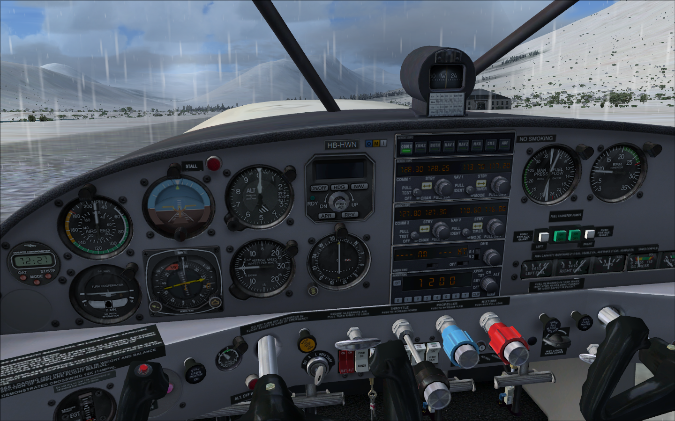
Notes:
Flight simulator is a good example of a serious game used as training tool for pilots.
They are still video games.

Slide 8
Notes:
And people who play them are not getting hit over the head with serious knowledge

Slide 9
Notes:
rather the educational element is coming in passively

Slide 10
Notes:
while they're entertained in the foreground

Slide 11
Notes:
A videogame neglecting the importance of fun and entertainment is not a game anymore
But more a simulation or an interactive documentary story.

Slide 12
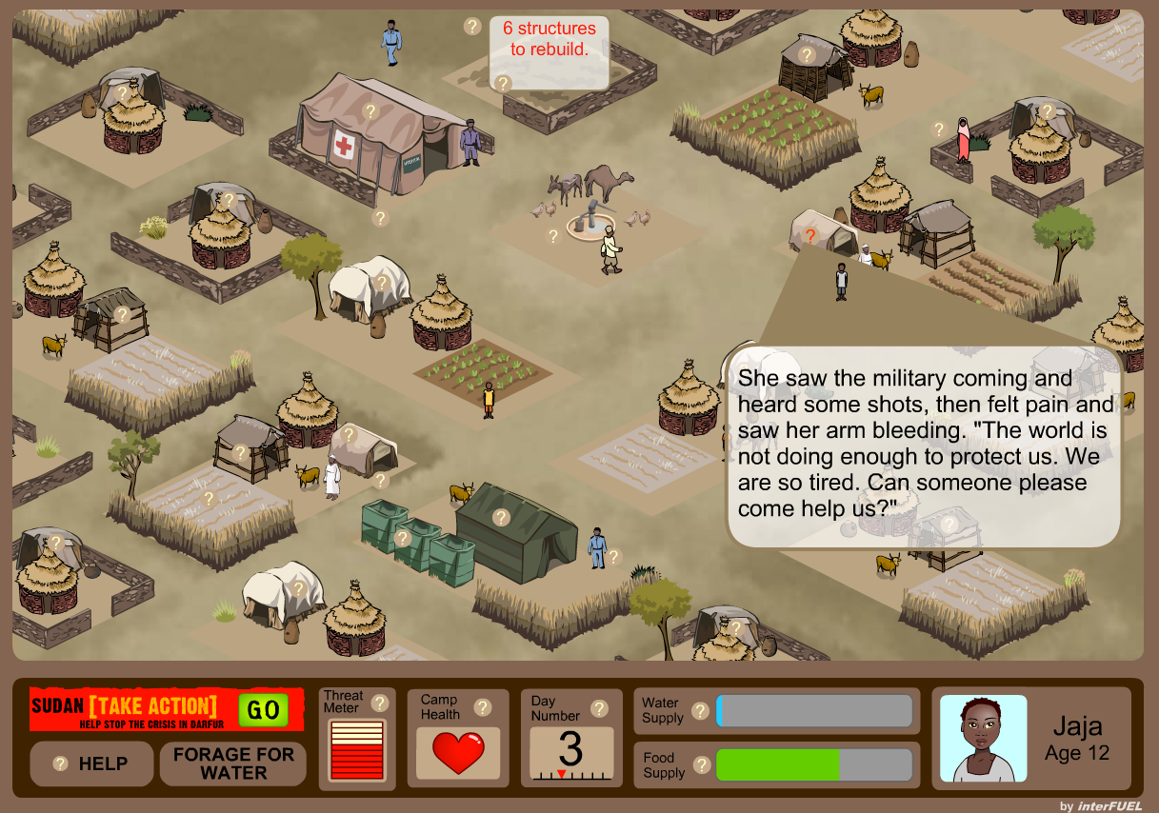
Notes:
Darfur is dying for example, is a narrative-based simulation where the user, from the perspective of a displaced Darfurian, negotiates forces that threaten the survival of their refugee camp.
It offers a faint glimpse of what it's like for the more than 2.5 million who have been internally displaced by the crisis in Sudan.
Now, anything that may spark debate on Darfur and issues surrounding it is a clear win
But critics argue that the game oversimplified a complex situation and thus failed to address the actual issues of the conflict
In either case, it is difficult to determine success for a game with a social goal

Slide 13
Notes:
Any game should be fun by definition.
Many consider “The Oregon Trail,” the first serious game for education.
It was conceived to teach geography and history
And was initially text-only and played on a teletype machine.
The game didn't blow you away with graphics, but had fun game play elements that sort of tricked you into learning.

Slide 14
Notes:
Simcity is a game about how everything in a city interconnects and intertwines
We’ve learned more about urban planning from SimCity than we ever learned about arithmetic from Math Blaster --
mainly because we kept playing SimCity long after Math Blaster got donated to the secondhand store.
In other words: you can lead a player to an educational game, but you can't make them play. They have to want to do that.

Slide 15
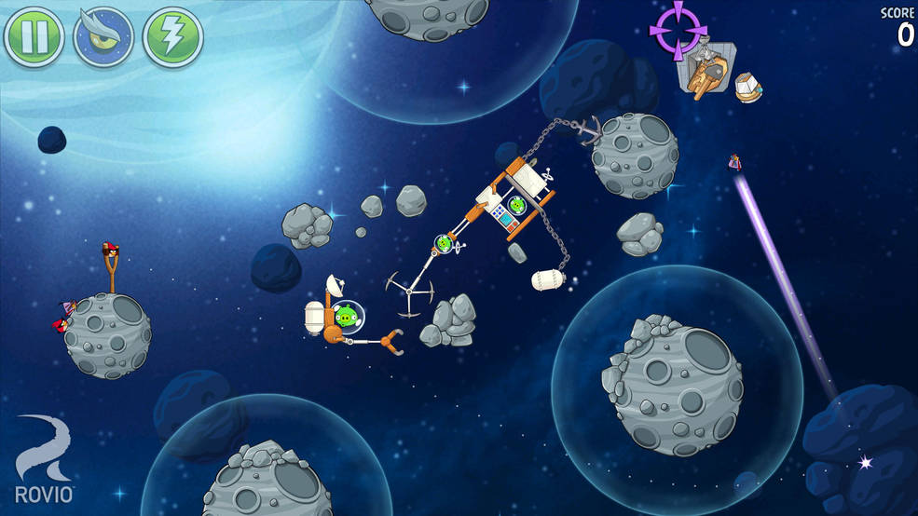
Notes:
A recent example of blending entertainment and education is Angry Birds Space.
The game used a fictional universe to point players to real information about
- Asteroids
- Why NASA studies them
- And how they fit into our exploration path to Mars
It was a great opportunity for NASA to educate, inform, and even inspire players about space exploration, all while playing one of the most popular interactive games ever created.

Slide 16
Notes:
Coming back to the real world
Let’s look at gaming in the context of real world issues

Slide 17
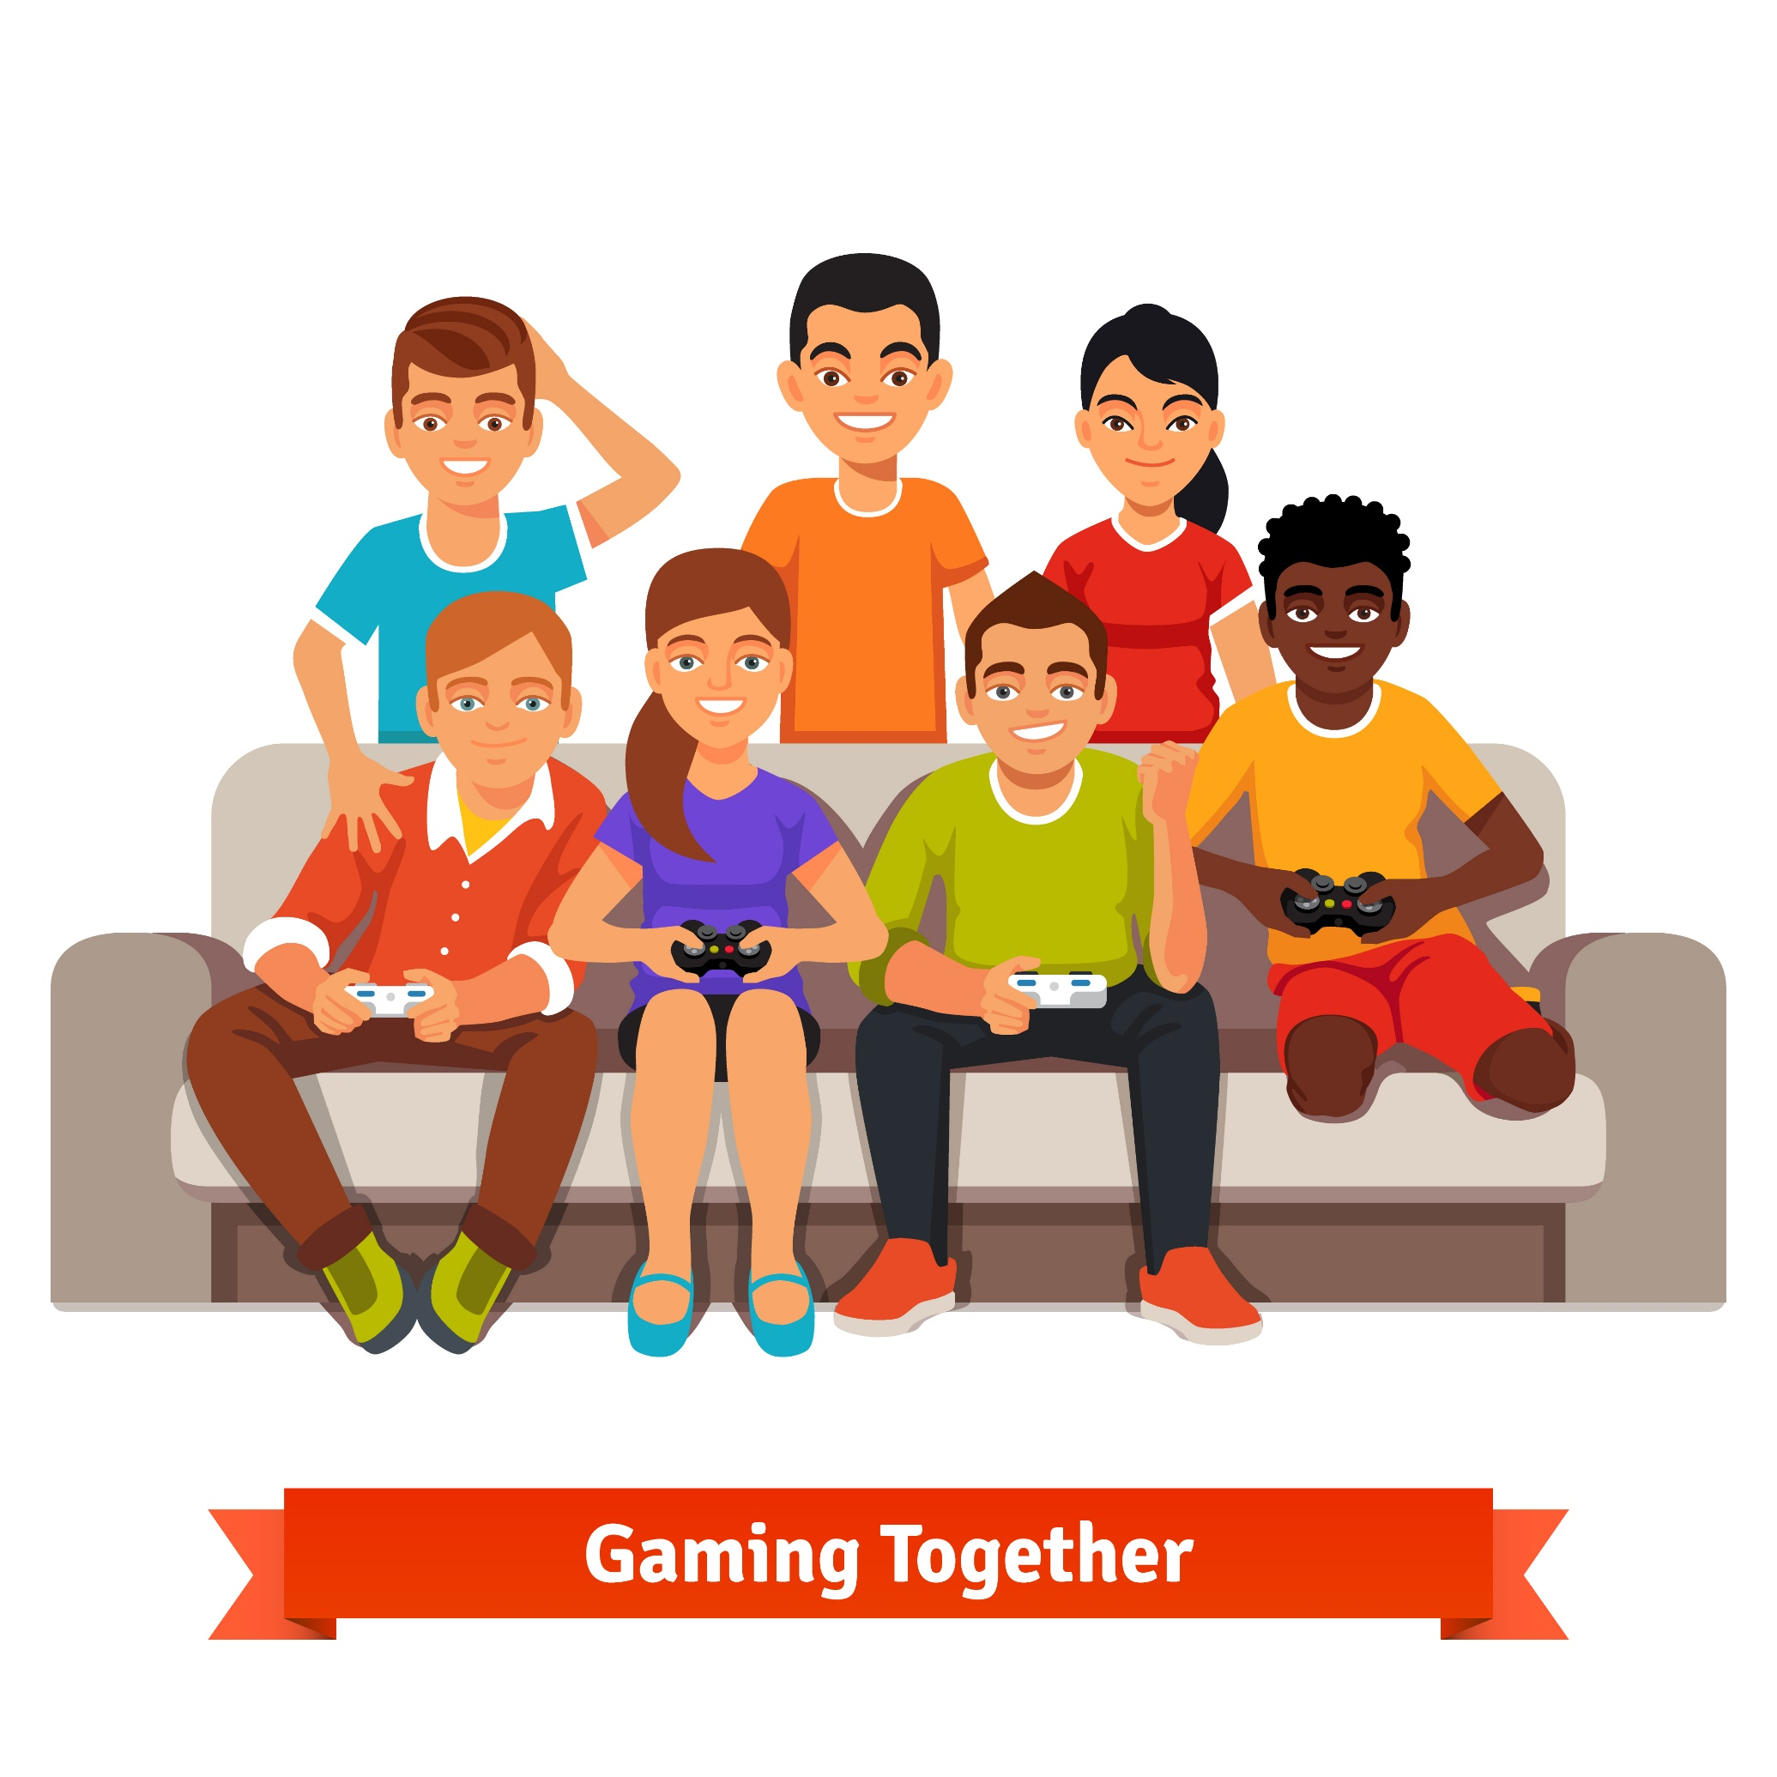
Notes:
In December 2010, gamers helped…

Slide 18
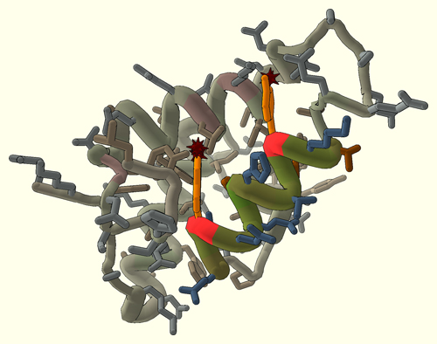
Notes:
decipher the crystal structure of the Mason-Pfizer monkey virus

Slide 19
Notes:
This virus has been known to cause AIDS in rhesus monkeys, and its understanding was considered of major importance to curing disease.

Slide 20
Notes:
With the given 3D models…

Slide 21
10 DAYS DECIPHER THE PROTEIN
Notes:
players took less than ten days to decipher the protein

Slide 22
Notes:
a feat scientists had been working on…

Slide 23
15 YEARS
Notes:
for over 15 years!

Slide 24
Notes:
To find the best solution,
scientists created a scoring function that returned a number for how well the protein was folded.
They took results from the highest scoring functions and gave them back to the biochemists.
Which helped them accelerate their research

Slide 25
Notes:
This game was called Foldit
It was an engaging and fun crowd-sourced game that caught on quickly.
There were 57,000 players who played it and four of them found the best solutions in 10 days
It is a good example of how serious gaming has been proven to solve real world problems

Slide 26
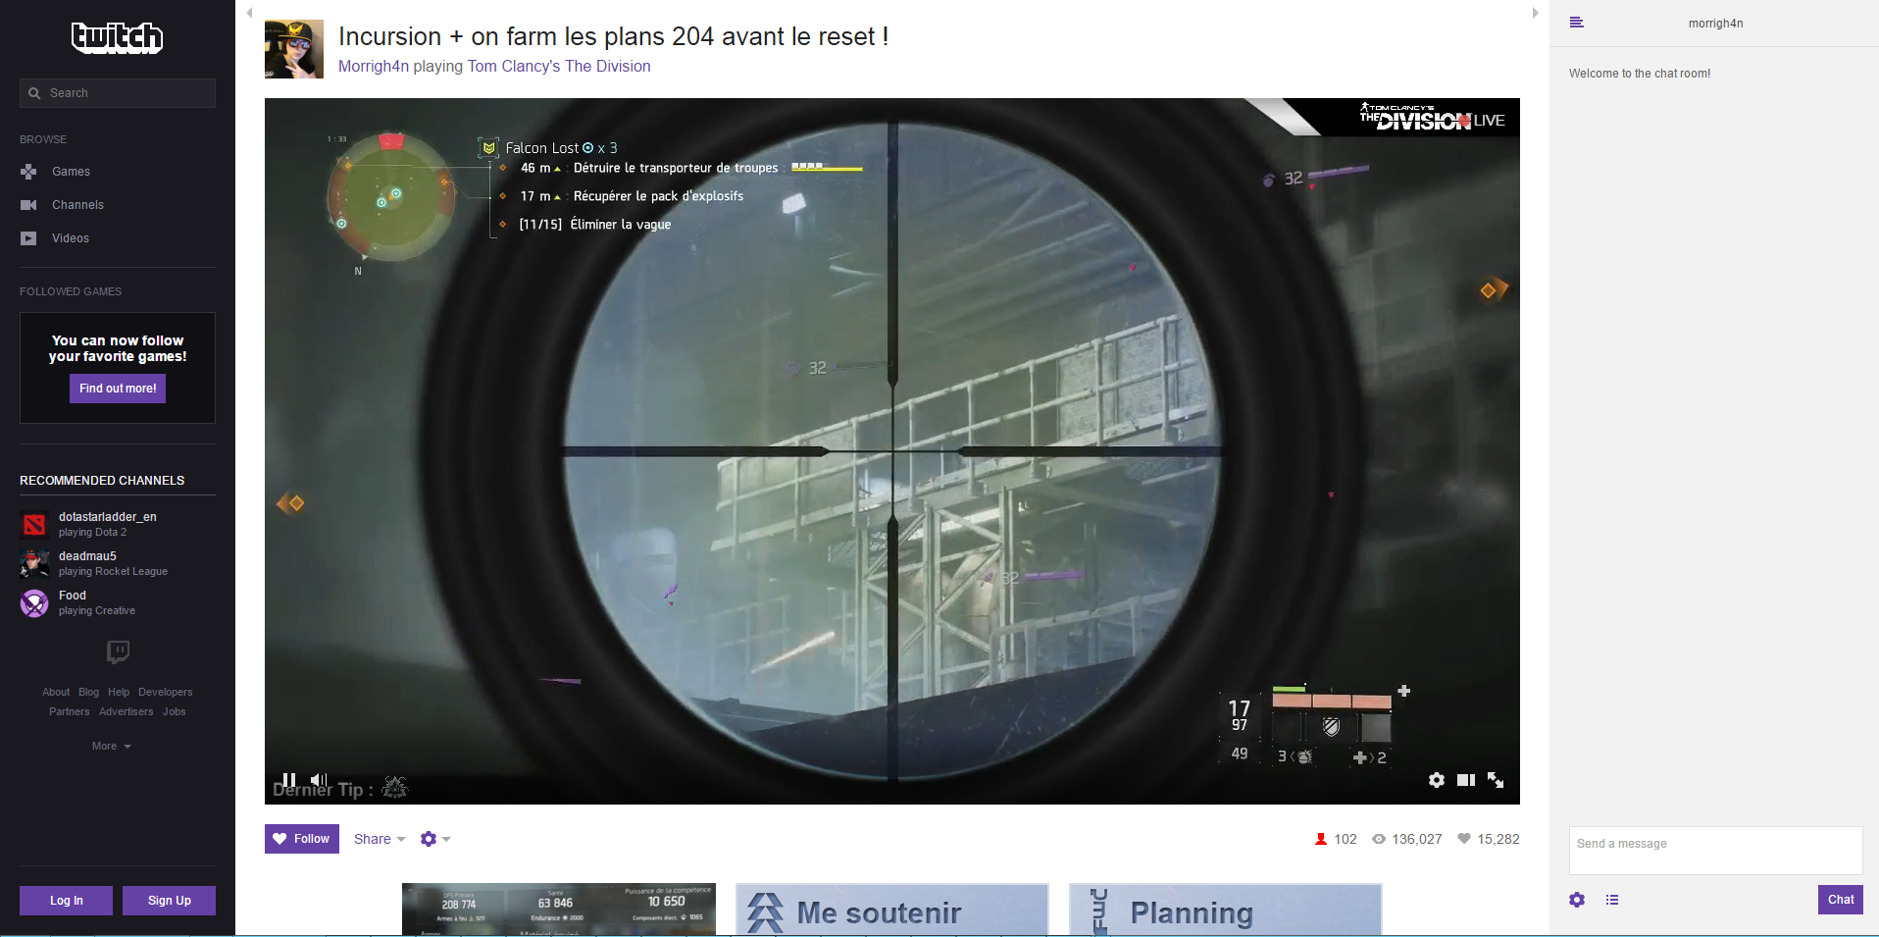
Notes:
Many kids are spending an increasing amount of time watching
narrated videos of other people’s gameplay
that are peppered with humor and personal observation.
rather than actually play those games.
When it comes right down to it,
the phenomenon is no different than watching
someone play golf, tennis, poker or any other professional sport on TV.

Slide 27
Notes:
In 2015, League of Legends Pro championship had 36 MILLION unique people watching the online stream

Slide 28
14 MILLION LEAGUE OF LEGENDS
Notes:
with 14 million concurrent peak views.
Which is a record-breaking high for any esports event

Slide 29
8 MILLION SPACE JUMP
Notes:
The previous best was the live stream of the space jump in 2012 which had over 52 million views and 8 million concurrent visitors

Slide 30
Notes:
This is serious gaming in the form of competitive gaming
It appears to be a very popular activity and draws large audiences
It can be a great teaching aid because people love learning by watching others
Imagine if only 1% of this audience learned something new, it will have facilitated learning for 320,000 people

Slide 31
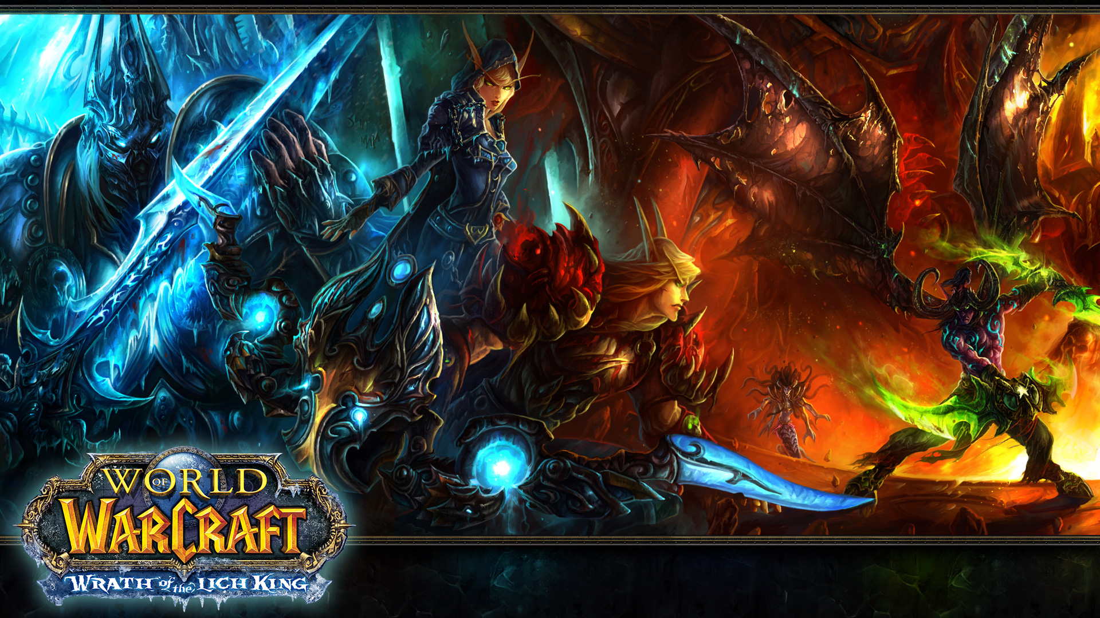
Notes:
In the game, World of Warcraft

Slide 32
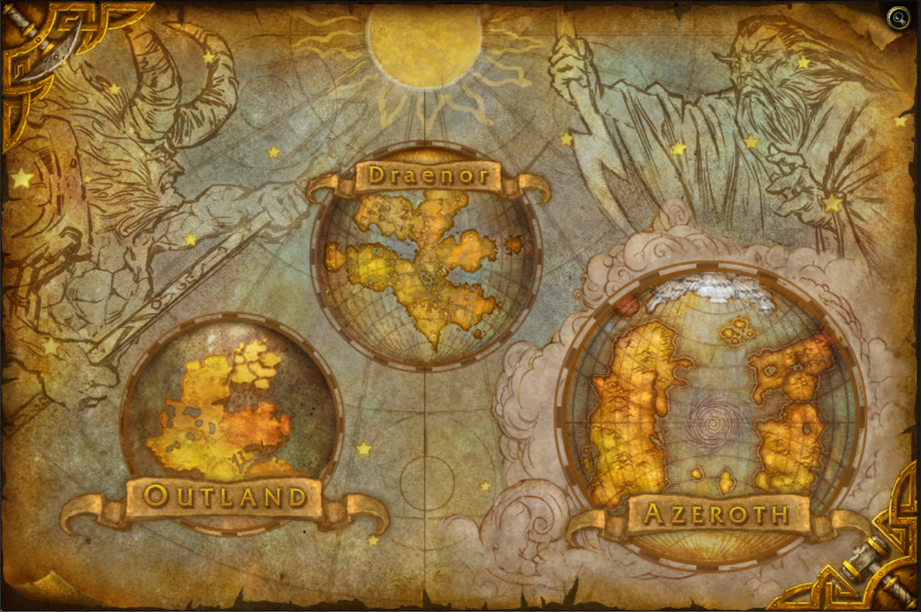
Notes:
Players have spent approximately 6 million years solving problems in azeroth

Slide 33
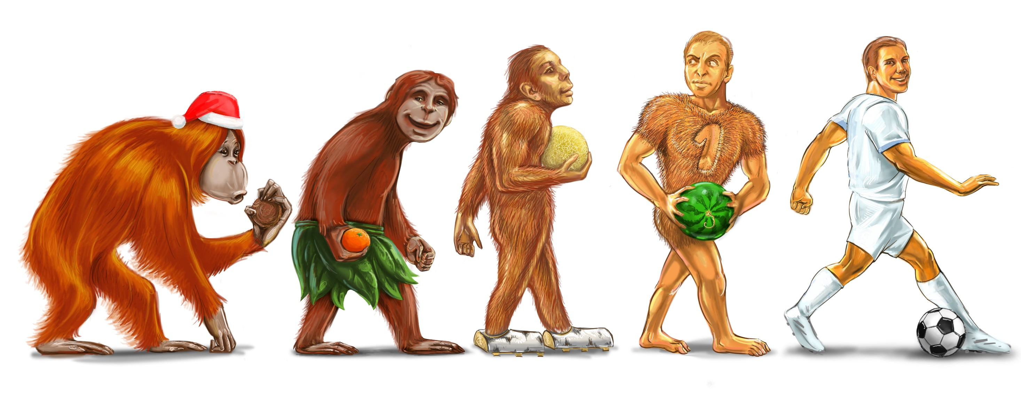
6 MILLION YEARS
HUMAN EVOLUTION
Notes:
That’s the time at the magnitude of human evolution

Slide 34
Notes:
Gamers are willing to work hard.

Slide 35
5 MILLION PEOPLE
WORLD OF WARCRAFT WIKI
Notes:
And here’s a good example: The second biggest wiki in the world is the World of Warcraft wiki.
It has contributions from 5 million people.
The fact is that they’re self-motivated, willing to learn and share their knowledge

Slide 36
Notes:
In 2008, a study at Carnegie Mellon University showed that kids will spend

Slide 37
10,000 HOURS
ONLINE GAMES BY AGE 21
Notes:
10,000 hours playing online games by the age of 21

Slide 38
10,080 HOURS 5TH GRADE TO HIGH-SCHOOL GRADUATION
Notes:
If you take this number and put it into perspective
10,080 hours is the average time spent in school from 5th grade through high-school graduation

Slide 39
Notes:
This means that there’s a parallel track where kids have the potential of learning things they are interested in.
People assimilate information better when they are studying topics they’re interested in rather than begin forced to learn something they don’t want.
Video games have a huge advantage as we inherently care about what we do here.
The enthusiasm is already there.
We just have to channel it.

Slide 40
Notes:
Winston Churchill once said, personally I’m always ready to learn, although I do not always like being taught
This quote got me thinking about the learning process.
What is the difference between learning something and being taught something?
What is better?
does it depend on what it is we learn
or who it is that we learn from?
I want to quickly touch upon three other styles of learning through games.

Slide 41
“Tangential Learning is not what you learn by being taught rather it’s what you learn by being exposed to things in a context with which you’re already engaged in.”
Notes:
Some portion of your audience will self-educate if you can introduce them to topics in a context they already find exciting and engaging.
//Anyone looking to look up what the XYZ means after this talk, you know //Tangential learning works!

Slide 42
“Gamification is the idea of adding game elements to a nongame situation.”
Notes:
It uses game mechanics, feedback loops, and rewards to spur interaction and boost engagement, loyalty, fun and/or learning

Slide 43
“Game-based learning is a type of game play that has defined learning outcomes. “
Notes:
Generally, game-based learning is designed to balance subject matter with gameplay and the ability of the player to retain, and apply said subject matter to the real world.
//Regardless of the term used, gamification, game-based learning and serious //games are all focused on one thing – securing engagement

Slide 45
Notes:
A good game, like a good movie, has a gripping storyline.
When creating a serious game, the game’s story can be used to reinforce the issues and add an additional level of learning.

Slide 46
Notes:
Game mechanics provide an element of interactivity that keeps the learner involved throughout the whole process.

Slide 47
Notes:
Rules provide the framework that differentiates a fun game from utter chaos.
This is another interactive element that subliminally delivers a learning objective.
In life, our most profound lessons come from failures.
When a learner breaks a rule in a serious game, they will incur a penalty.
This leads them to change their behaviour in order to avoid breaking that rule again.

Slide 48
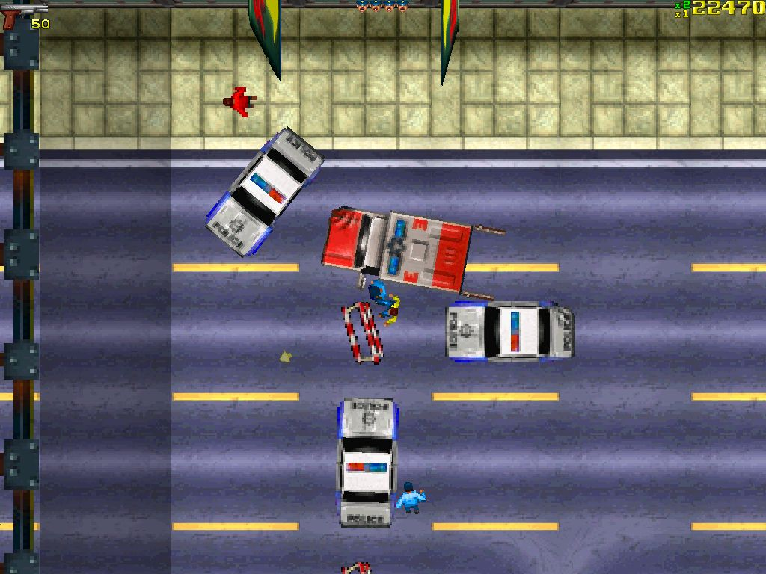
Notes:
Some of the most successful games were graphically unimpressive.
For casual games, the gameplay itself usually wins out over how pretty it is.
Although a serious game can be created without immersive graphics,
most of them have a user interface that represents and reinforces the learning objective.

Slide 49
Notes:
Most games involve an element of challenge and competition.
At its simplest form, the player’s main challenge is to beat their high score.
As the internet blossomed, a new breed of multiplayer games dominated the world.
Serious games with a social element allow learners to challenge each other.
This element of friendly competition is another way to boost engagement

Slide 50
Notes:
Serious games provide a risk free environment to practice essential skills.
This is one of the key benefits for a number of industries including aerospace, defense and medical.
In these sectors, the cost of failure is always high, which means that virtual simulations become a practical necessity.

Slide 51
Notes:
When the object of a game is to teach, it’s natural to want to guide players’ behavior from the very beginning toward that goal.

Slide 52
Notes:
But play, by its very nature, is an unstructured activity

Slide 53
Notes:
Intent is important when designing a game,
but it’s better to allow players to arrive at that intent organically,
rather than wave it in their faces.

Slide 54
Notes:
Measuring player behavior in the game could be as simple as pressing a start button
or as complex as completing a specific quest on a specific day

Slide 55
Notes:
It is essential that the number of tasks for players to complete within a given time period is calibrated to introduce challenge.
If it's too hard, people won't play.

Slide 56
Notes:
We run on a tight budget and
video games aren’t cheap to develop.

Slide 57
Notes:
With such basic conflicts in place,
it makes sense to overlook the development of serious games.

Slide 58
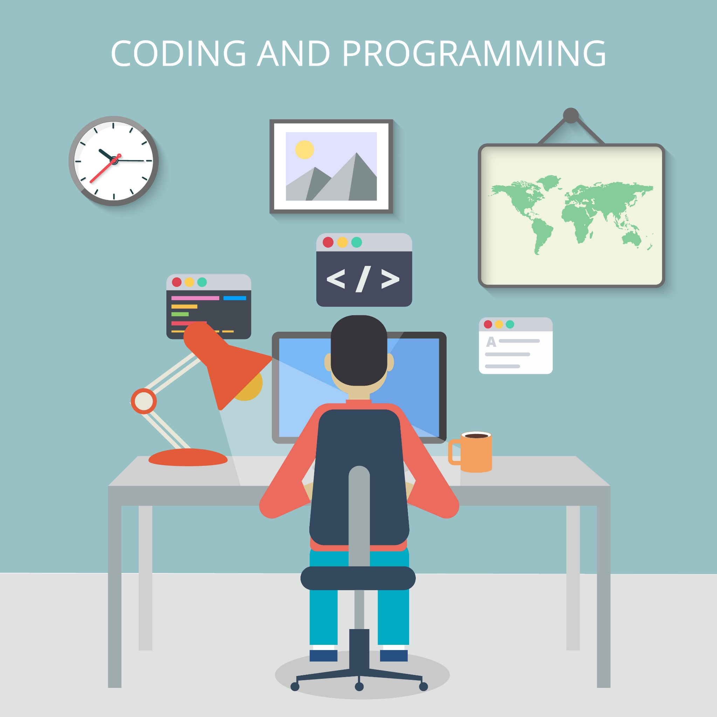
Notes:
But, there’s no way around the inherent risks of software development.
We need to hedge our bets the same way commercial video game developers do by hiring experienced game designers.

Slide 59
Notes:
Serious gaming is a train that's already moving,
so people don't have to change their behaviors.

Slide 60
Notes:
What if our industry harnessed the power of serious gaming and the brain-power that comes with it

Slide 61
Notes:
If people were engaged in solving real-world problems,
Then, problems that took us years to accomplish could have the potential to be accelerated by leaps and bounds.

Slide 62
Key Takeaway
Serious gaming has been proven to solve real-world problems. The enthusiasm is already there - we just have to channel it. Serious gaming isn’t just a technological craft. It’s a twenty-first-century way of thinking and leading.

Slide 63
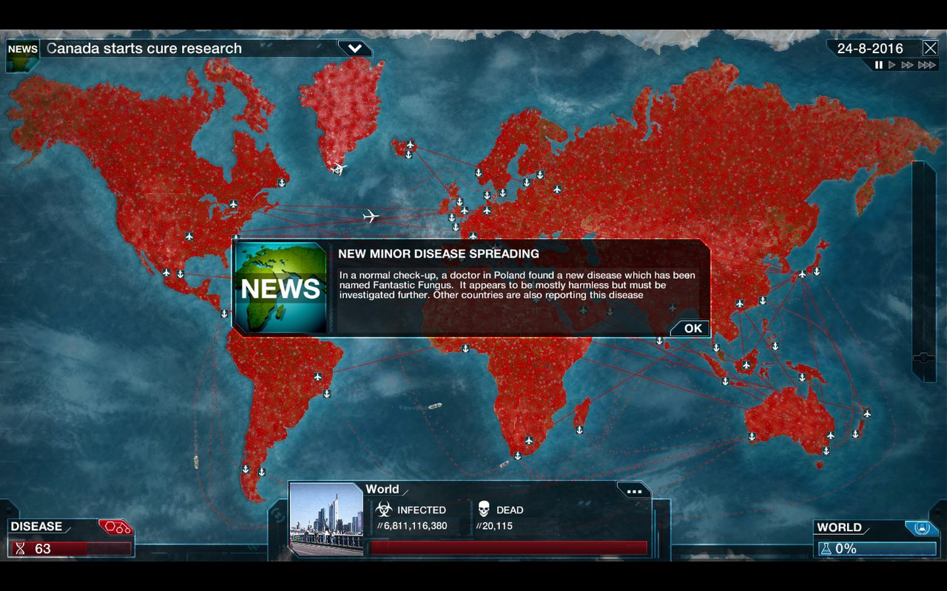
Notes:
What if we could transition from saving the world in games

Slide 64
WHAT IF WE COULD TRANSITION FROM SAVING THE WORLD IN
GAMES
TO SAVING THE WORLD IN
REAL-LIFE?
Notes:
to saving the world in real life?

Slide 65
Reference List
Anderson, J., & Rainie, L. (2012, May 18). The Future of Gamification. Retrieved April 12, 2016, from http://www.pewinternet.org/2012/05/18/the-future-of-gamification/
Ault, A. (2016, February 2). Video Games and Learning. Retrieved April 12, 2016, from http://library.cqpress.com/cqresearcher/document.php?id=cqresrre2016021203
E. (2012, May 10). Extra Credits: Metrics. Retrieved April 11, 2016, from https://www.youtube.com/watch?v=nqGcXOksFGg
Kellogg, J. (2012, October 14). Millions Watch as Felix Baumgartner Makes Record-Breaking Space Jump. Retrieved April 15, 2016, from http://www.hollywoodreporter.com/news/millions-watch-as-felix-baumgartner-378859
Kelly, K. (2007, March 19). SXSW: Serious Games: Can Learning Be Hard Fun? Retrieved April 15, 2016, from http://www.engadget.com/2007/03/19/sxsw-serious-games-can-learning-be-hard-fun/
McGonigal, J. (2016, March 09). SXSWedu Keynote | How to Think (and Learn) Like a Futurist. Retrieved April 12, 2016, from https://www.youtube.com/watch?v=CKvMmtclUBA
M. (2015, December 9). Worlds 2015 Viewership. Retrieved April 12, 2016, from http://www.lolesports.com/en_US/articles/worlds-2015-viewership
Ma, M., Oikonomou, A., & Jain, L. C. (2011). Serious games and edutainment applications. London: Springer.
Master Chief [Digital image]. (n.d.). Retrieved from http://mousenjoypad.com/reviews/xbox-one/halo-master-chief-collection-review/
Samari, N. (2015, January 27). The growing importance of Serious Games. Retrieved April 12, 2016, from http://www.bunnyfoot.com/blog/2015/01/the-growing-importance-of-serious-games/
Scimeca, D. (2014, August 17). Why Oregon Trail still matters. Retrieved April 15, 2016, from http://kernelmag.dailydot.com/issue-sections/features-issue-sections/10021/the-lasting-legacy-of-oregon-trail/
T. (2013, May 14). Games Are Serious Fun: Mark Rein-Hagen at TEDxTbilisi. Retrieved April 11, 2016, from https://www.youtube.com/watch?v=KSo0OeHObo8
The Gamification of Scientific Discovery | Big Fish Blog. (n.d.). Retrieved April 15, 2016, from http://www.bigfishgames.com/blog/stats/the-gamification-of-scientific-discovery/
Von Ahn, L., & Dabbish, L. (2008, Aug). Designing Games With A Purpose. Retrieved April 15, 2016, from https://www.cs.cmu.edu/~biglou/GWAP_CACM.pdf

Slide 66
