Slide 1


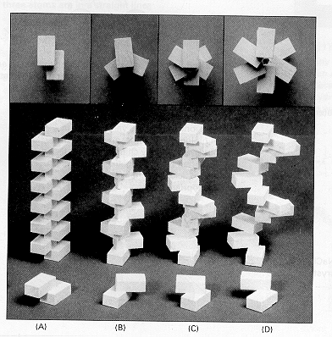
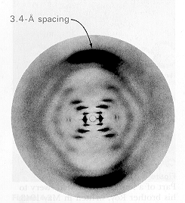


Simple, accessible, illustrative models for bridging the gap between specialist modelers and
field surveillance practitioners
Gerry Killeen
Notes:
additionally to do:
overall implementation plan (1 slide)
process management (1 slide draft of possible process map, 1 slide explaining process management)
risks of project (1 slide)
success factors for Project OpEx (1 slide)

Slide 2
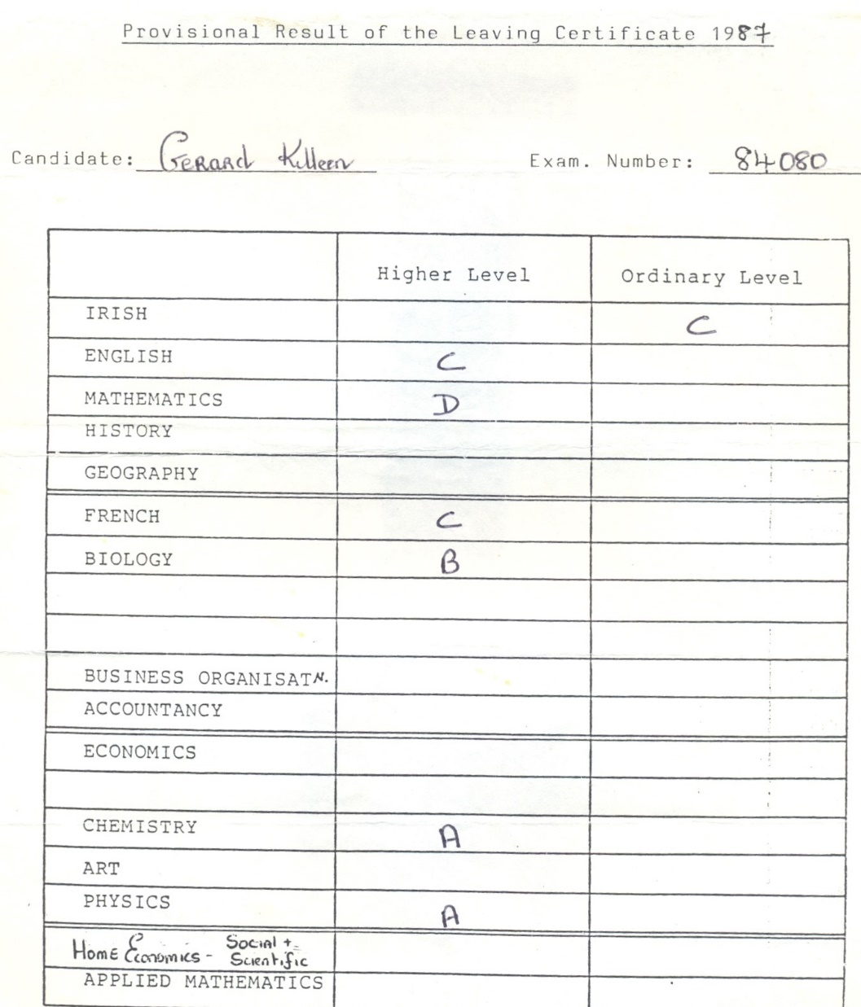

Slide 3
Smith et al. 2013 Phil Trans Roy Soc B 368: 20120145

Slide 4
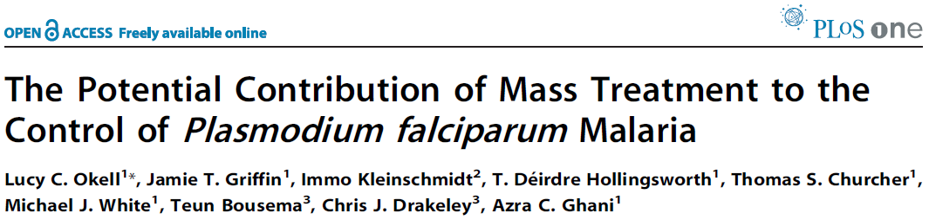
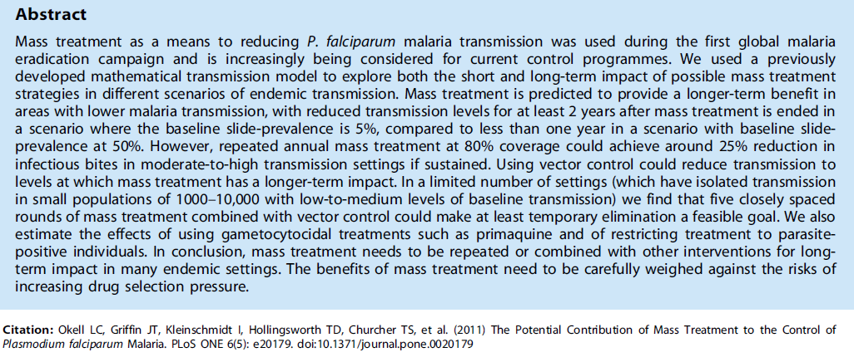

Slide 5
Griffin et al. 2010 PLoS Medicine 7: e1000324

Slide 7
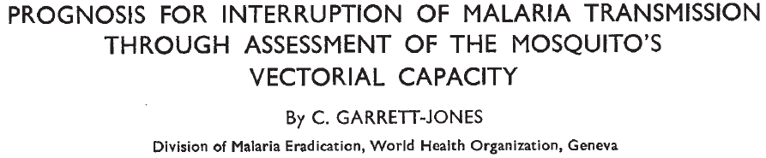
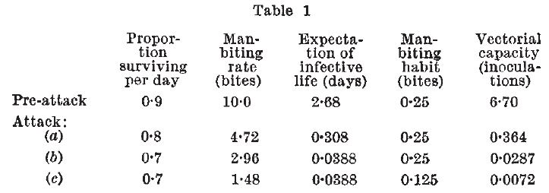

Slide 8
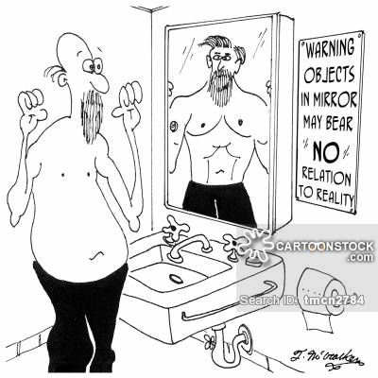

Slide 9
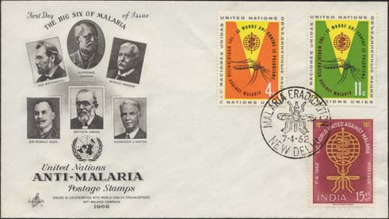

Slide 10
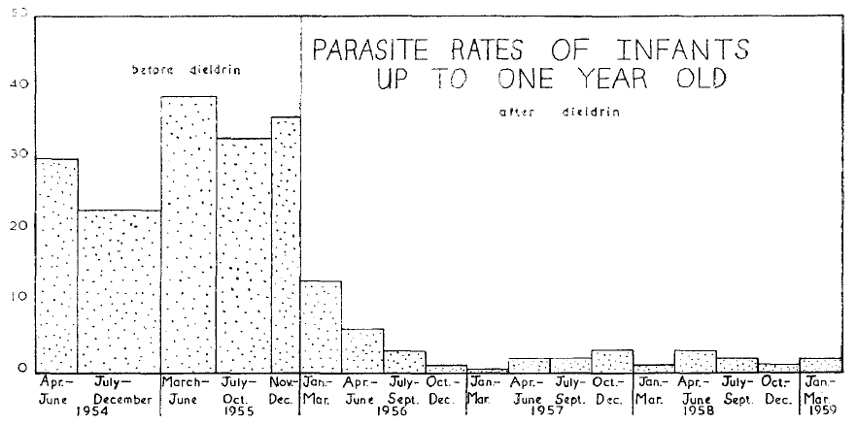
Draper & Smith 1960 TRSTMH 54: 342

Slide 11
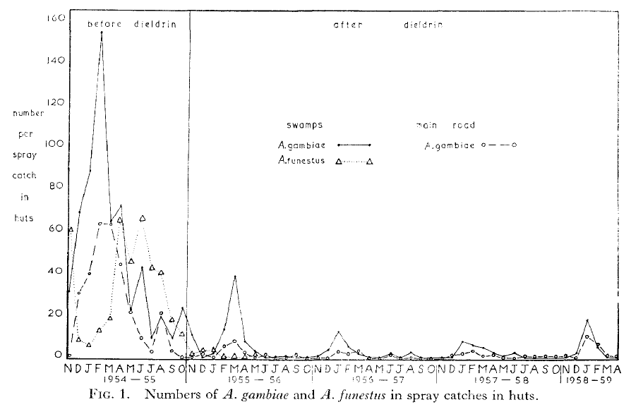
Draper & Smith 1960 TRSTMH 54: 342

Slide 12
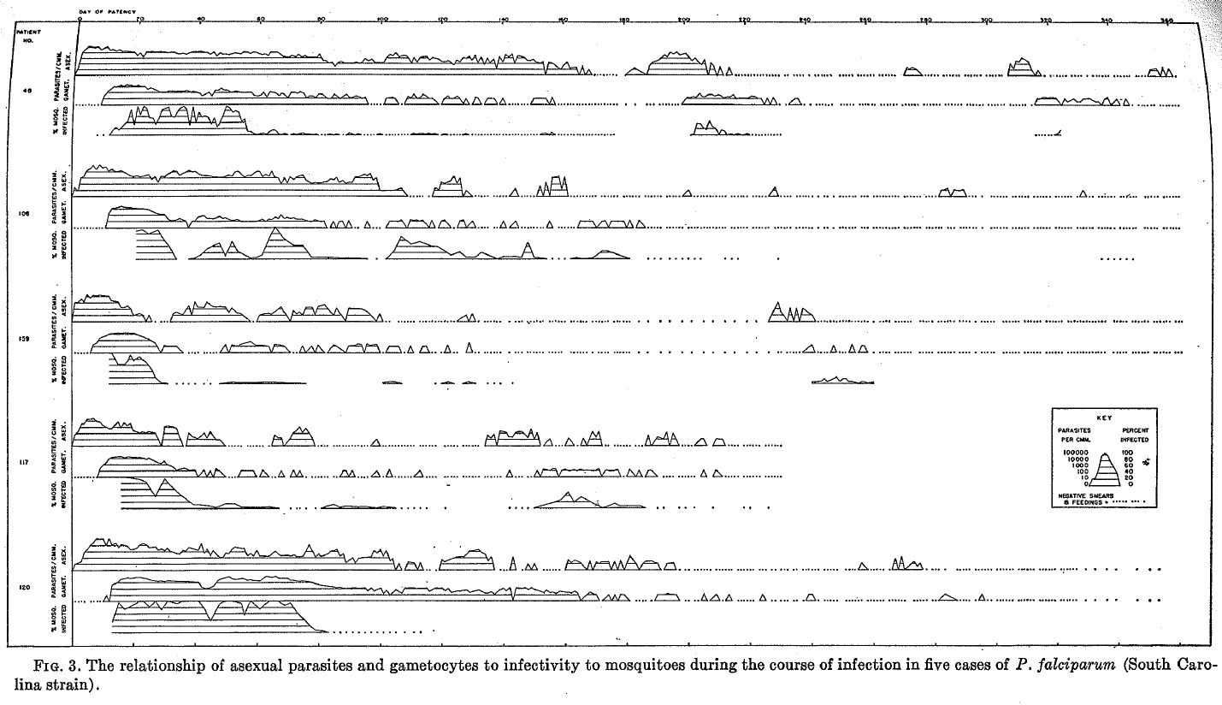
Jeffreys & Eyles 1955 AJTMH 4: 781

Slide 13
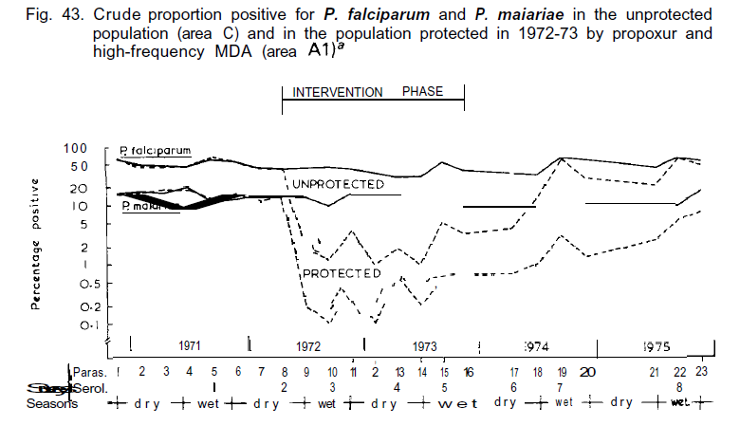
Molineaux & Gramiccia (1980) The Garki Project WHO Monograph

Slide 14
The Garki Project
It was essential to know what could or could not be achieved and, as far as possible, to find out why that was so; and it was therefore considered justified to apply control measures and methods of supervision that were more expensive than would be acceptable in a control program
Lepes (1980) Foreword In: The Garki Project by:
Molineaux & Gramiccia, WHO, Geneva, p.p. 11-14

Slide 15
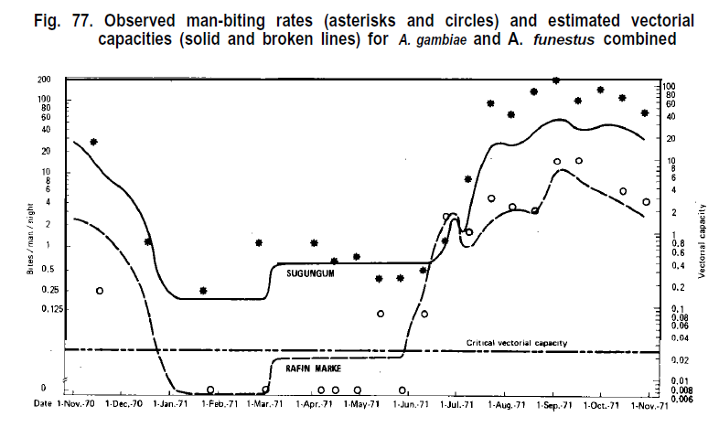
Molineaux & Grammicia 1980 The Garki Project WHO Monograph

Slide 16
MOSQUITOES DON’T TAKE DRUGS
SO MALARIA PARASITES CAN “LEAP-FROG” MASS DRUG ADMINISTRATION CAMPAIGNS
Killeen 2013 AJTMH 88: 809

Slide 17
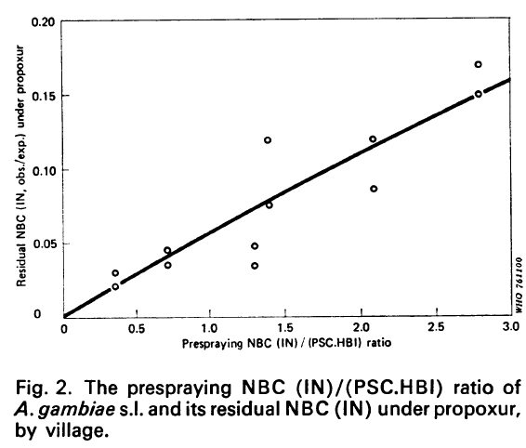
Bull WHO (1976) 54: 3530

Slide 18
CAUSES OF PERSISTING RESIDUAL TRANSMISSION
Malaria Journal (2014) 13: 330

Slide 19
Killeen (2014) Malaria Journal 13: 330

Slide 20
TRANSMISSION ECOLOGY OF A TYPICAL ANTHROPONOSIS
PREVALENCE (%)
0
0
TRANSMISSION CAPACITY

Slide 21
∞
100
Saturation point
Tipping
point
TRANSMISSION ECOLOGY OF A HOLOENDEMIC ANTHROPONOSIS
PREVALENCE (%)
0
∞
0
TRANSMISSION CAPACITY

Slide 22
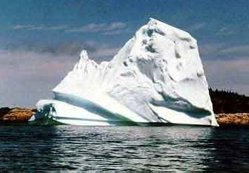
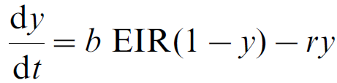
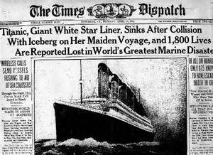
MacDonald 1952 Trop Dis Bull 49: 813
Beier et al. 1999 Am J Trop Med Hyg 61:109-113

Slide 23
Jeffreys & Eyles 1955 AJTMH 4: 781

Slide 24
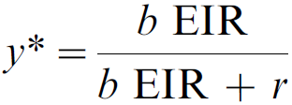
MacDonald 1952 The analysis of equilibrium in malaria. Trop Dis Bull 49: 813

Slide 25
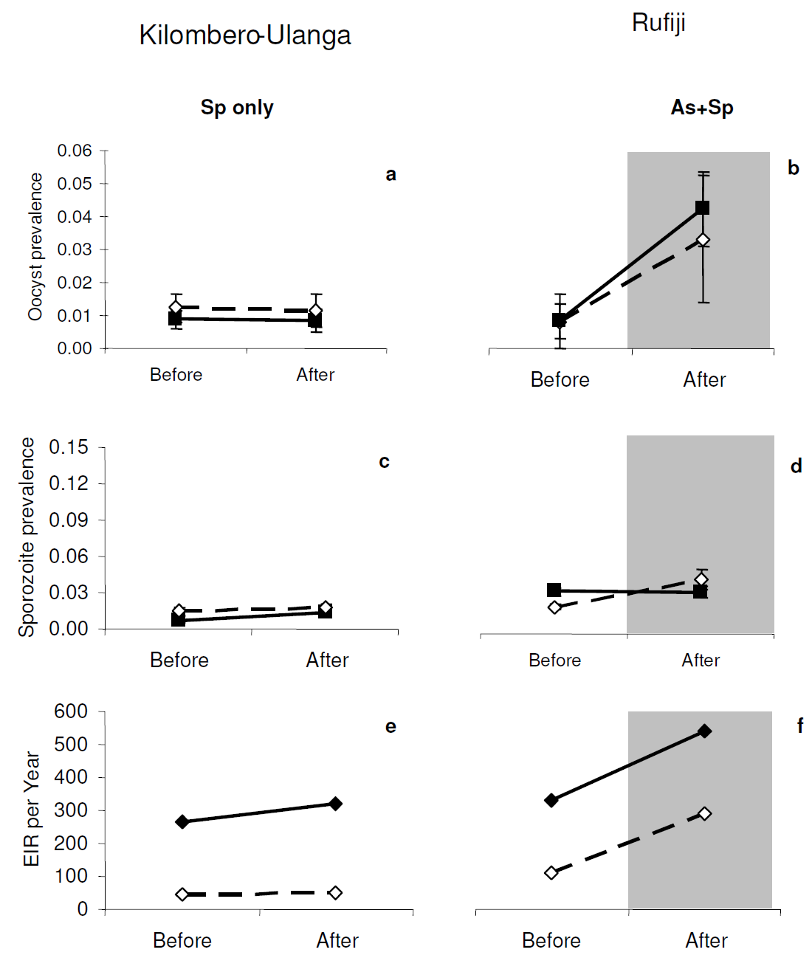
ACTS HAVE LITTLE IMPACT UPON HOLOENDEMIC LEVELS OF TRANSMISSION BECAUSE MOSQUITOES DON’T TAKE DRUGS
Huho 2012 Malaria Journal 11: 118

Slide 26
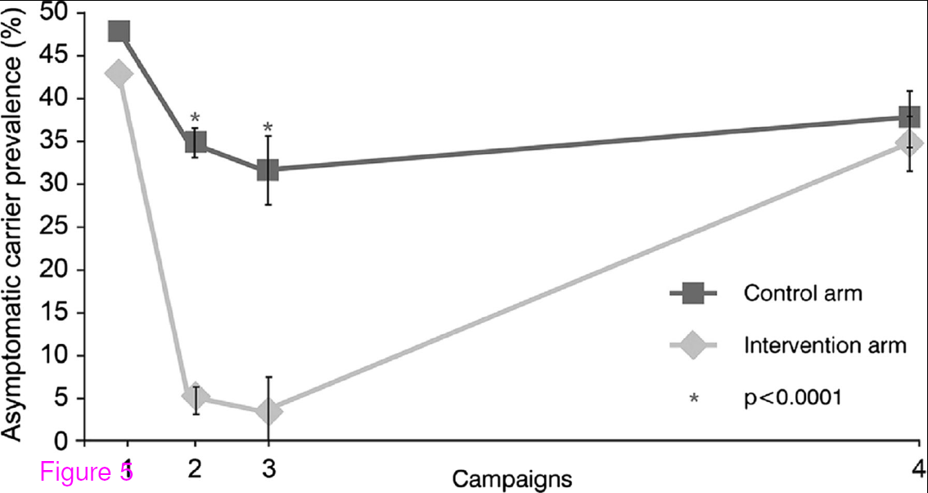

Slide 27
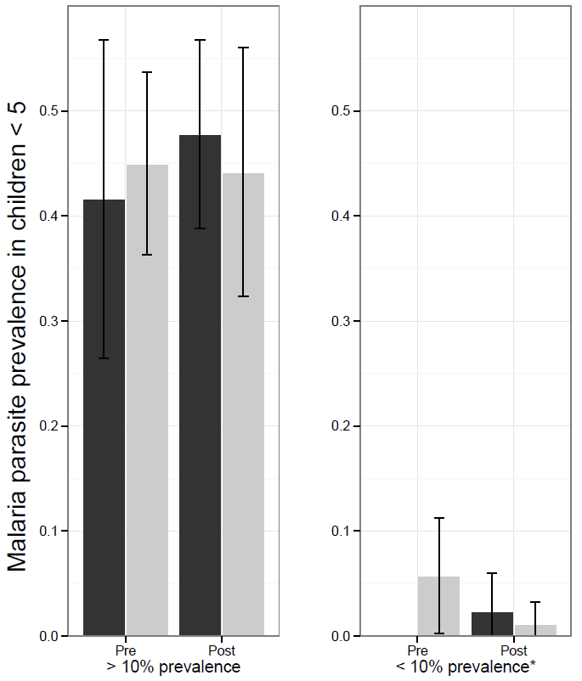
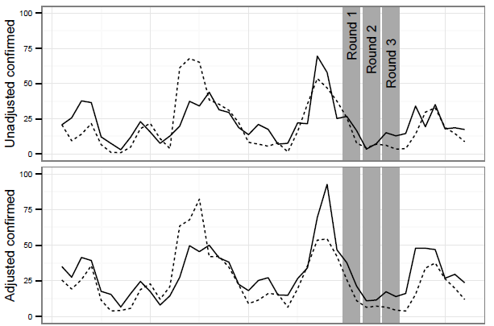


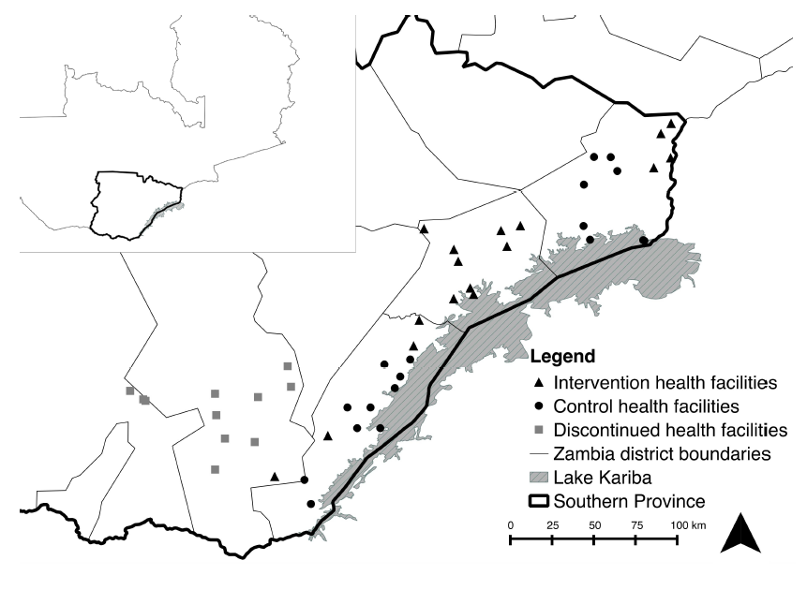
Larsen 2015 AJTMH 92: 913

Slide 28
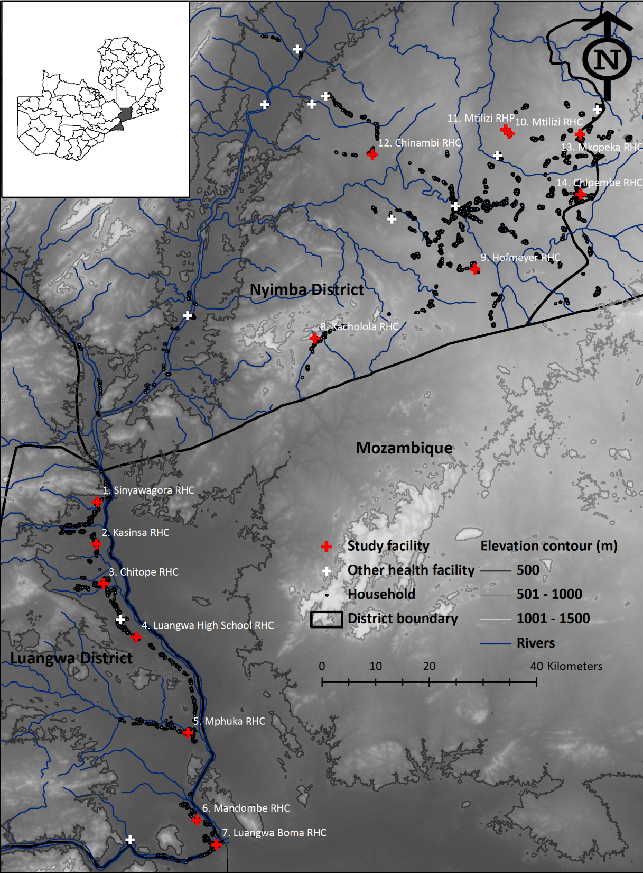
Sikaala 2014 Malar J 13: 225

Slide 29
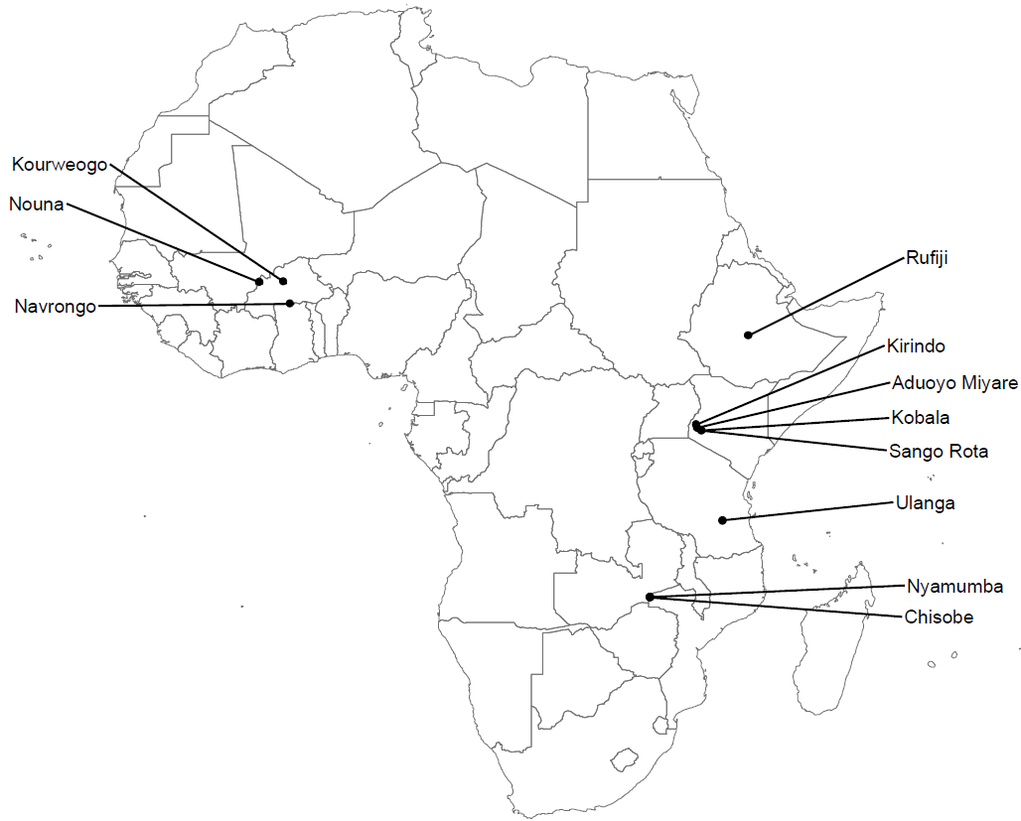
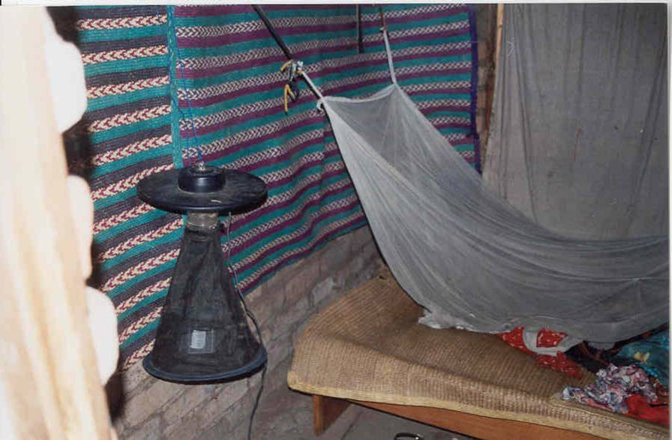
Briet 2015 Malar J 14: 247

Slide 30
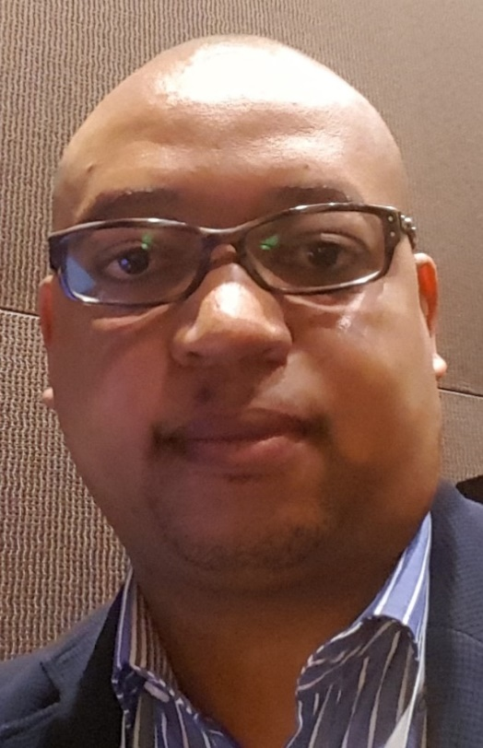
Hamainza 2014 Malar J 13: 128

Slide 31
MacDonald 1952 The analysis of equilibrium in malaria. Trop Dis Bull 49: 813

Slide 32
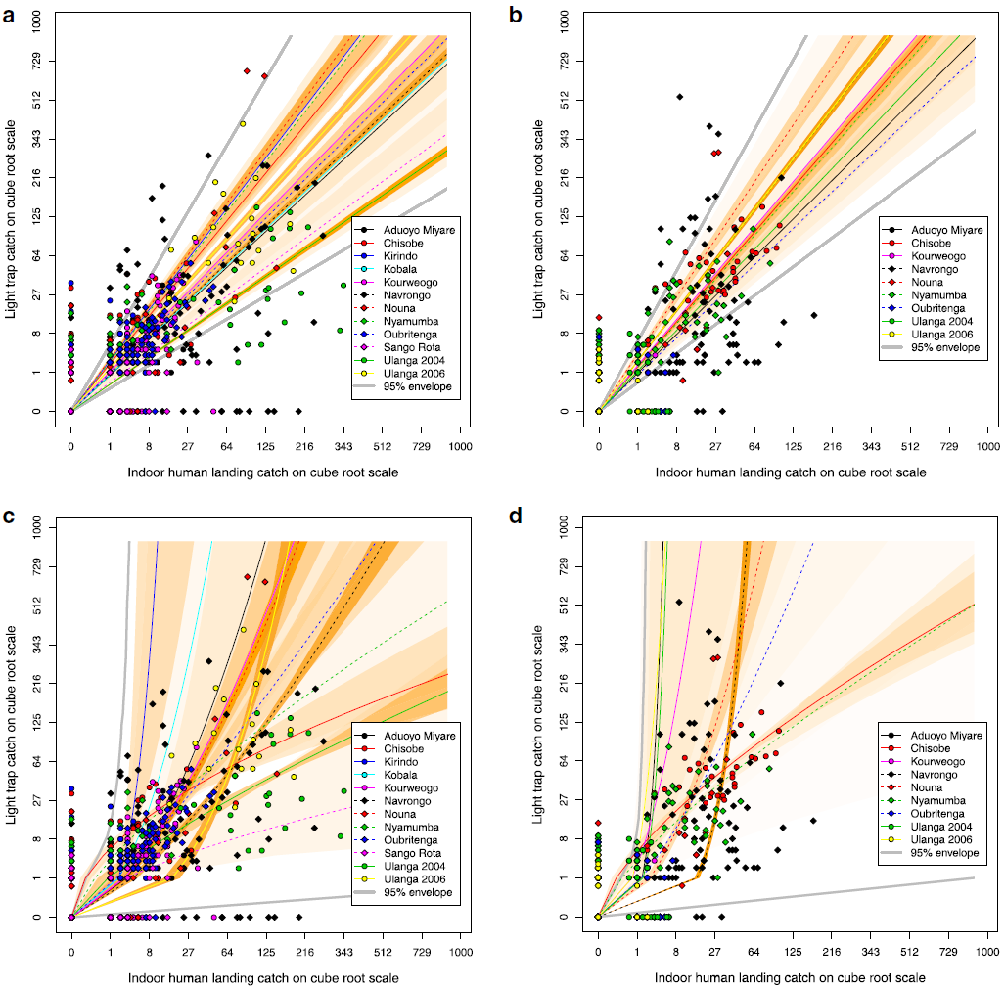
Briet 2015 Malar J 14: 247

Slide 33
Killeen (2014) Malaria Journal 13: 330

Slide 34
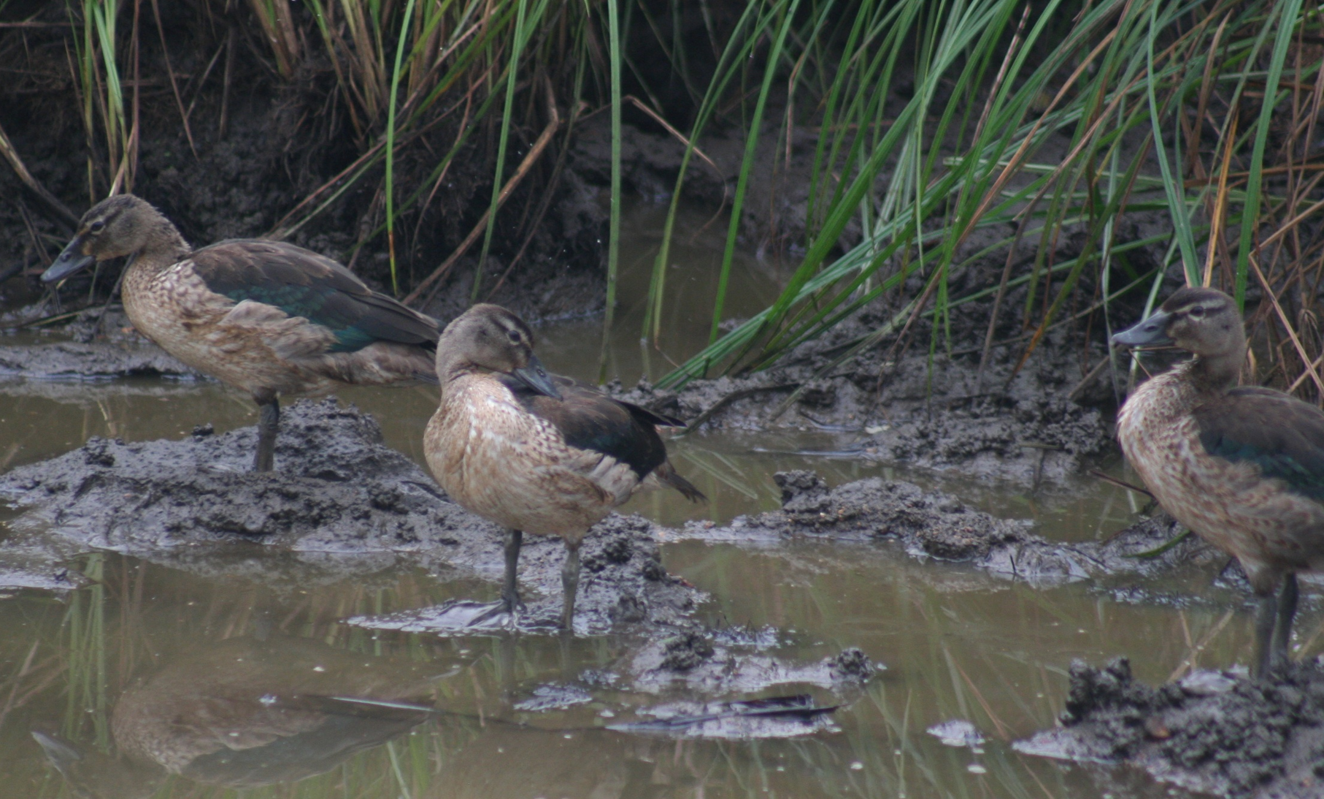
THE ANALOGY BETWEEN MALARIA CONTROL AND HUNTING DUCKS

Slide 35
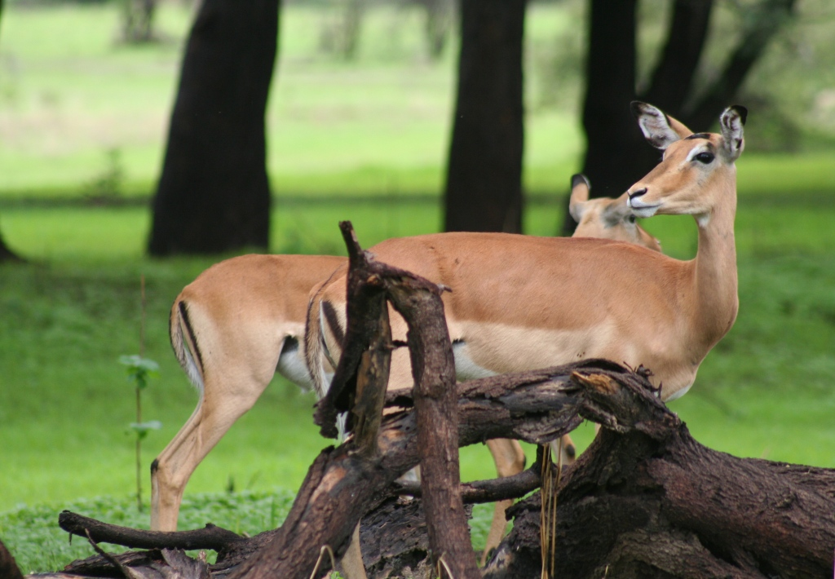
HAVE I BROUGHT THE RIGHT GUN?

Slide 36
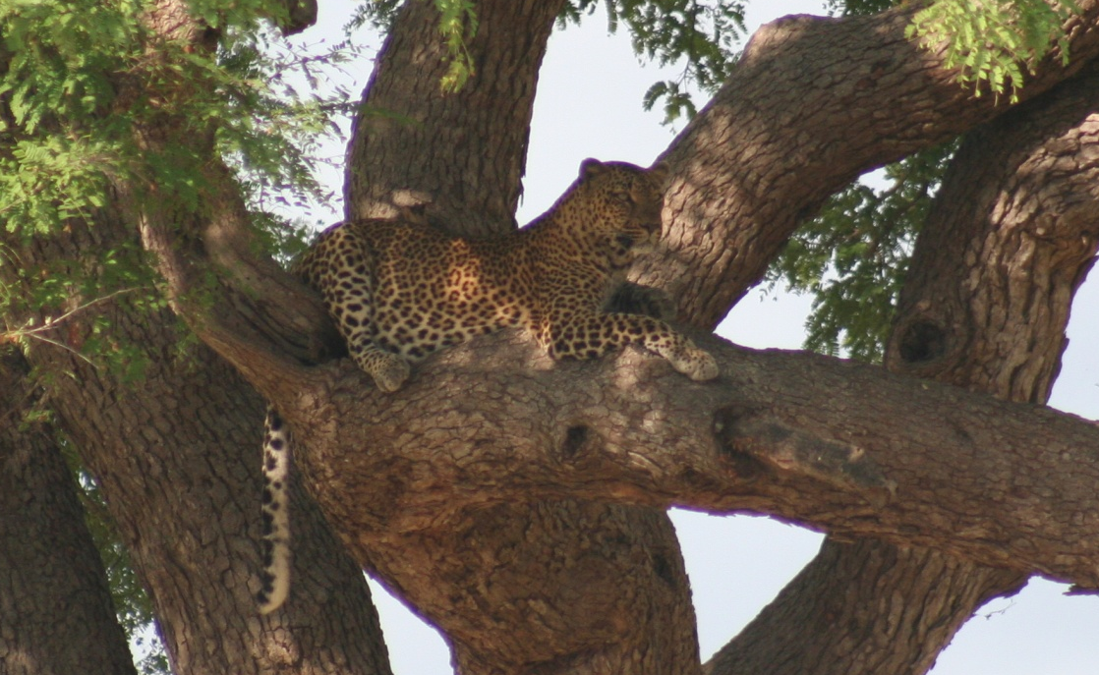
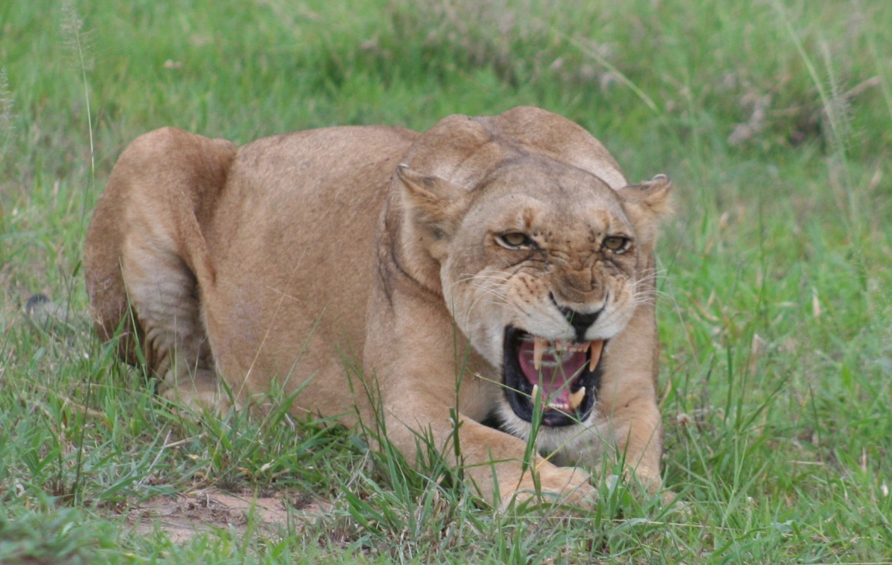
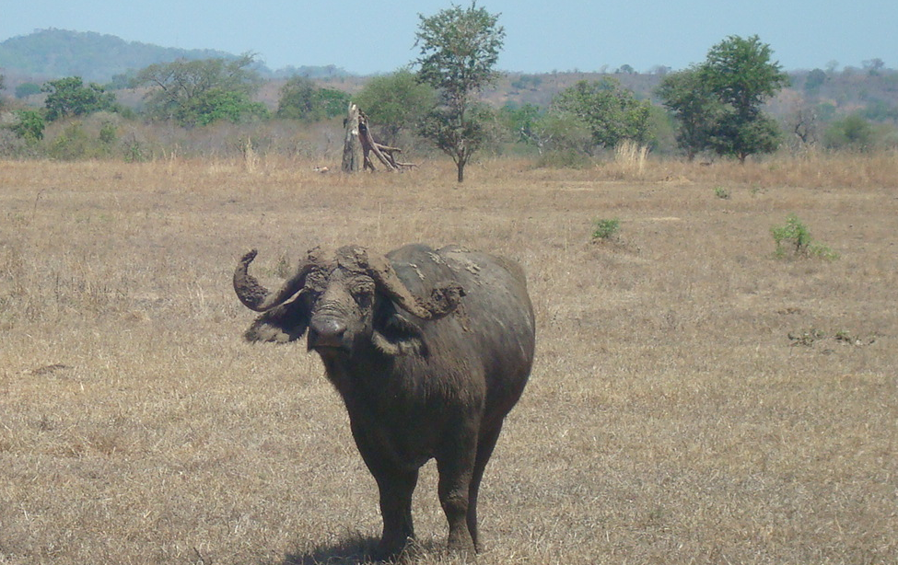
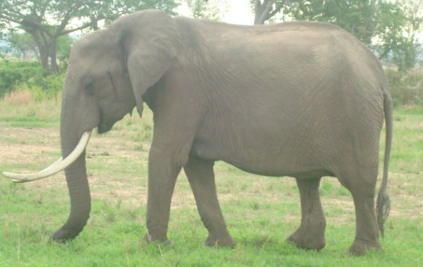
HOW CONFIDENT AM I THAT
I REALLY BROUGHT THE RIGHT GUN?

Slide 37
The Garki Project
It was essential to know what could or could not be achieved and, as far as possible, to find out why that was so; and it was therefore considered justified to apply control measures and methods of supervision that were more expensive than would be acceptable in a control program
Lepes (1980) Foreword In: The Garki Project by:
Molineaux & Gramiccia, WHO, Geneva, p.p. 11-14

Slide 38
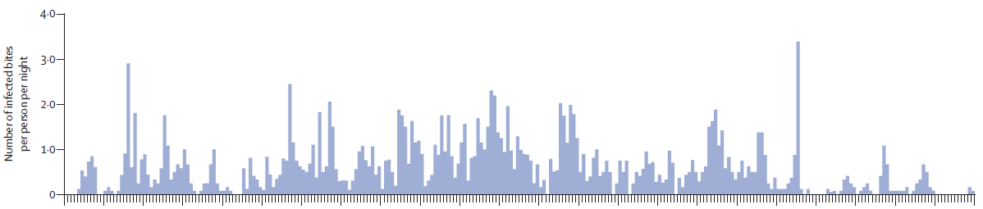
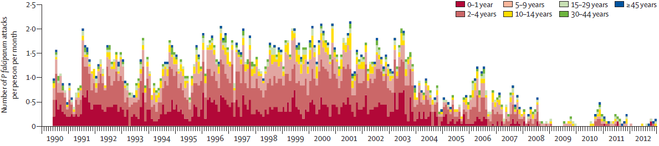
Trape et al 2014 Lancet Infect Dis 14: 476

Slide 39
Killeen et al. Unpublished, using data from Massey et al 2016 Sci Data 3: 160014

Slide 40
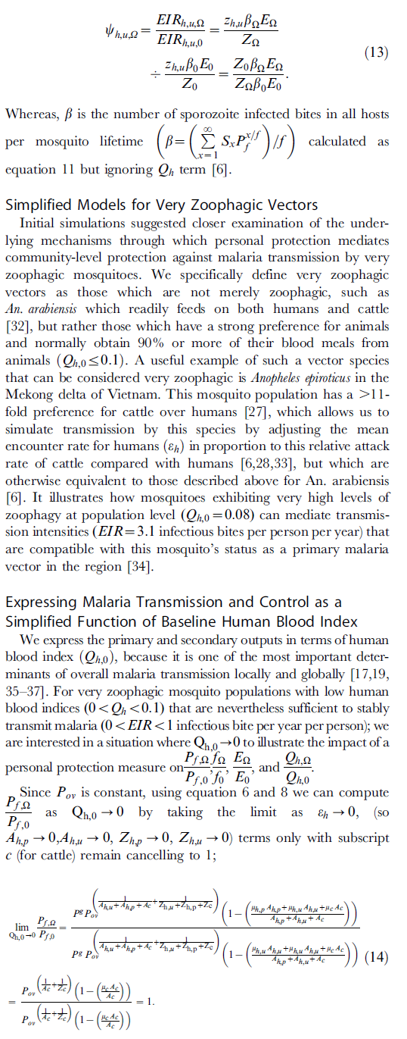
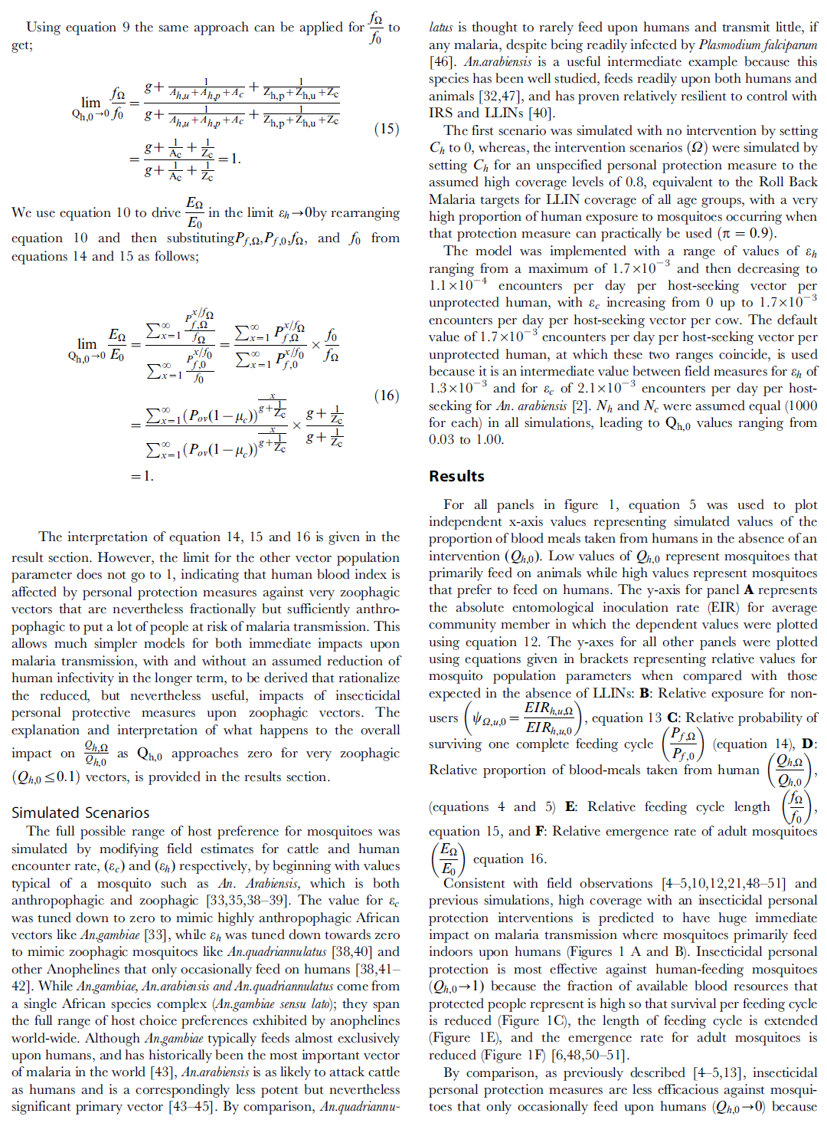
Kiware, Chitnis et al. 2012 PLoS One 7: e37661

Slide 41
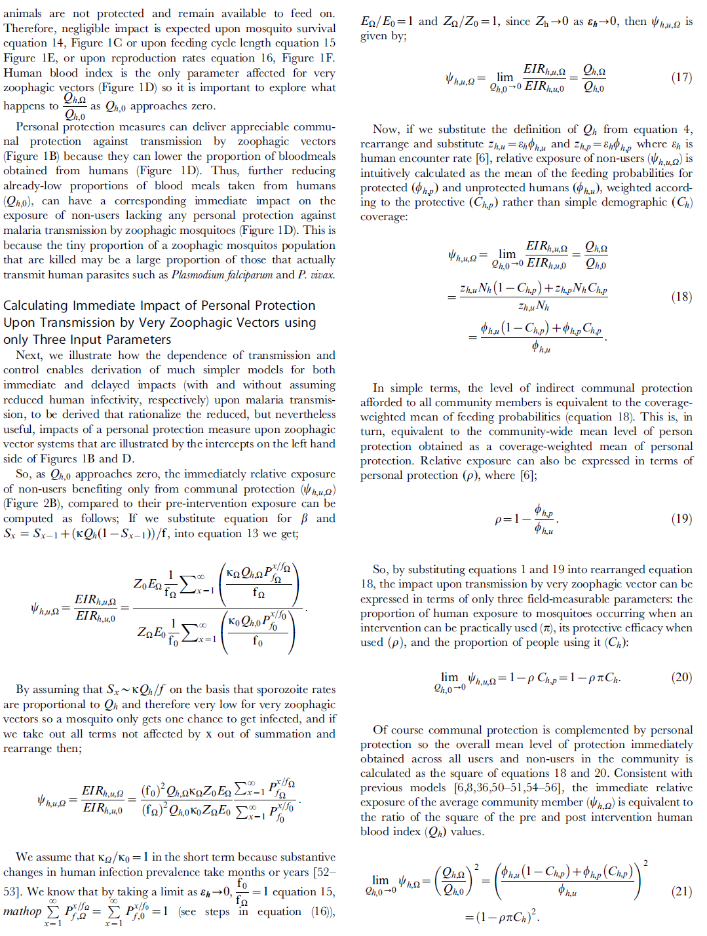


Slide 42
Killeen et al. Unpublished

Slide 43
Killeen et al 2011 Malaria Journal 10: 2017

Slide 44
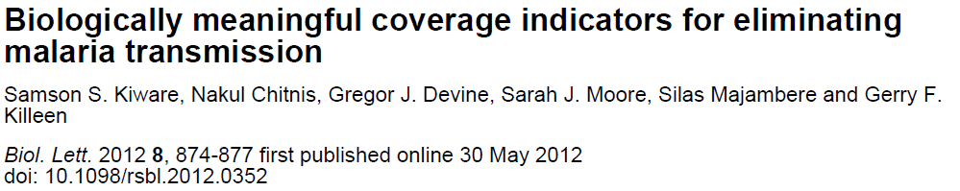


Slide 45
BIOLOGICAL COVERAGE OF BLOOD RESOURCES
Malaria Journal (2014) 13: 330

Slide 46
BIOLOGICAL COVERAGE OF BLOOD RESOURCES
Malaria Journal (2014) 13: 330

Slide 47
Huho et al 2013 Int J Epidemiol 42: 235

Slide 48

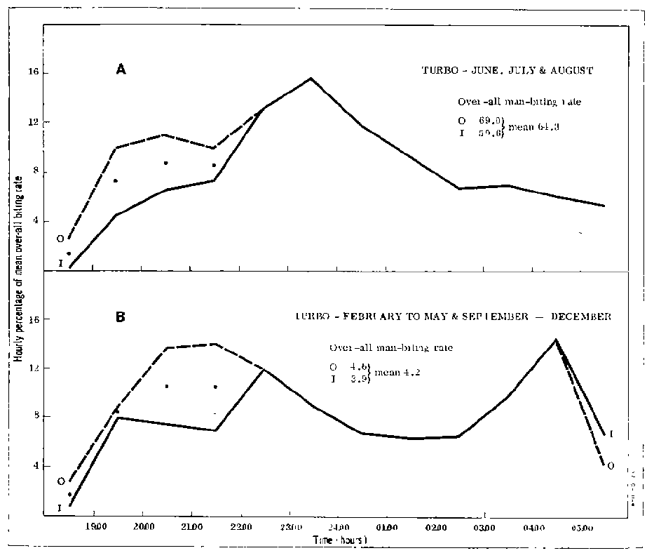
Notes:
additionally to do:
overall implementation plan (1 slide)
process management (1 slide draft of possible process map, 1 slide explaining process management)
risks of project (1 slide)
success factors for Project OpEx (1 slide)

Slide 50
SOLUTIONS TO PERSISTING RESIDUAL TRANSMISSION
Malaria Journal (2014) 13: 330

Slide 51

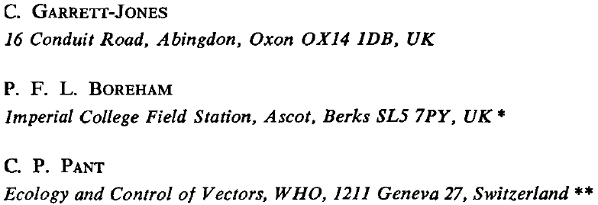
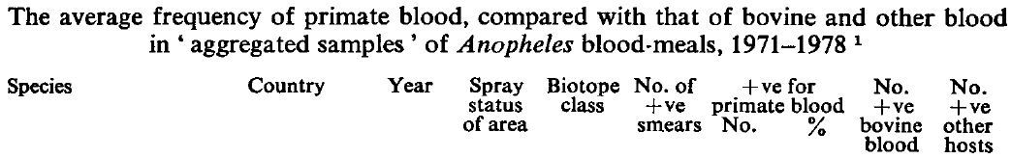

Slide 52
Malaria Journal (2014 ) 13: 146

Slide 54
Malaria Journal (2014) 13: 330

Slide 55
STEREOTYPICAL AFRICAN BASELINE SCENARIO
Killeen et al. unpublished

Slide 56
SO INTRODUCE LONG LASTING INSECTICIDAL NETS
Killeen et al. unpublished

Slide 57
SO INTRODUCE VAPOR-PHASE INSECTICIDE EMANATORS
Killeen et al. unpublished

Slide 58
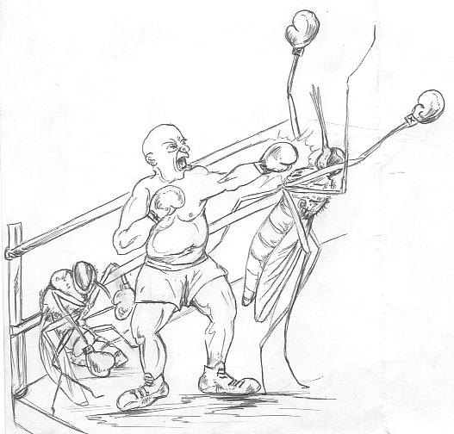
AND THEN VETERINARY INSECTICIDES
Courtesy of Louis Gouagna
Killeen et al. unpublished

Slide 59

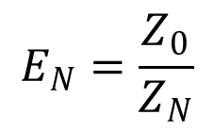
$$E_{N}=\frac{Z_{0}}{Z_{N}}$$
$$F_{x,N}=1−e^{−x {(E}_{N}−1)}$$
Killeen et al. 2016 Malaria Journal. 15: 225

Slide 62
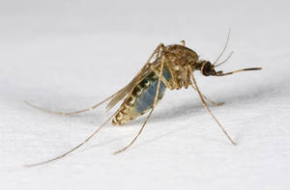

$$P_{∝_{R,c}}=e^{{−μ}_{R,c}α_{R,c}}$$
RATE AT WHICH
COVERED SUBSET IS UTILIZED
LETHALITY OF COVERED RESOURCE SUBSET
SURVIVAL

Slide 63
Killeen et al 2014 Malar J 13: 338

Slide 64
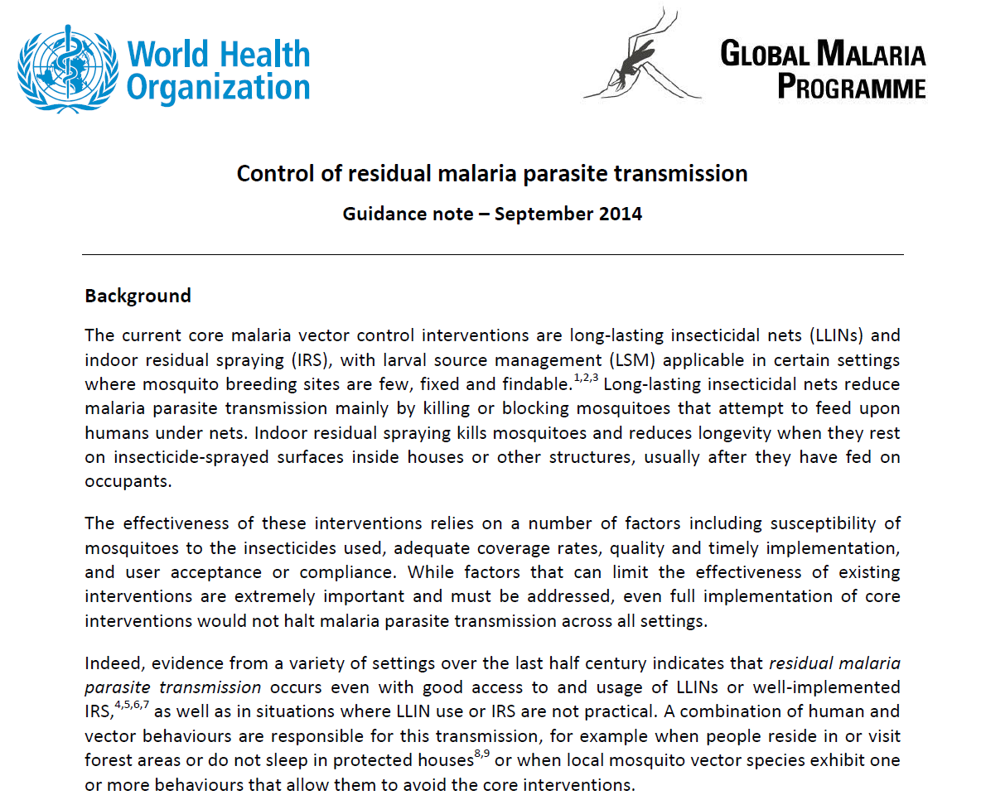

Slide 65

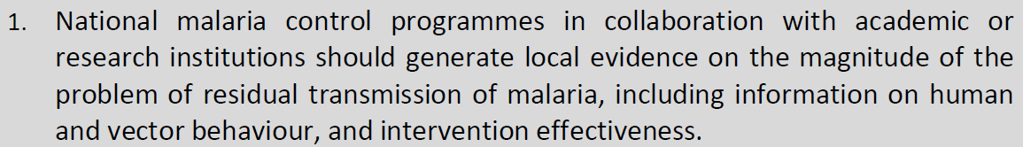
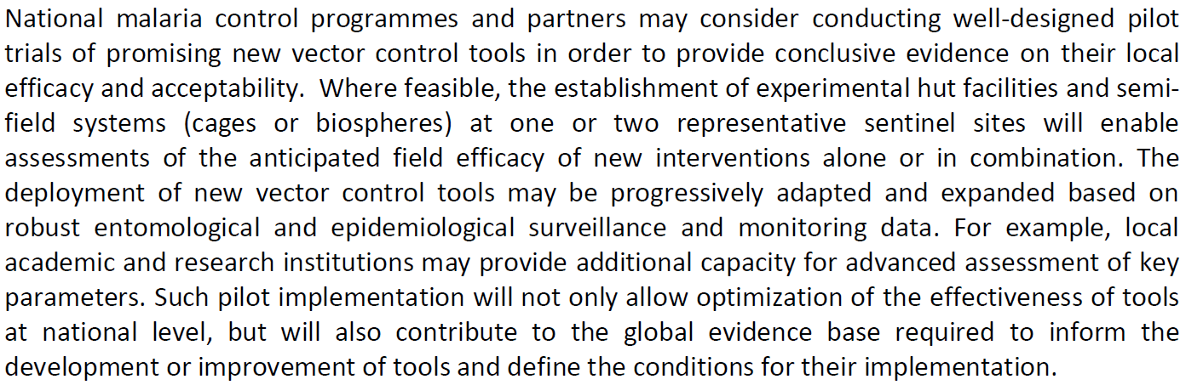

Slide 66


José Najerá
Before DDT, malariologists were trained to be problem solvers;
after DDT malariologists were trained to be solution implementers

Slide 68
MODELLERS WITH
QUANTITATIVE SKILLS
IN OR FROM
DEVELOPED COUNTRIES
DATA
EVIDENCE
SURVEILLANCE PRACTITIONERS
WITH FIELD SKILLS
IN DEVELOPING COUNTRIES

Slide 69
THE FUTURE
WELL-BALANCED, INTERACTIVE, OVERLAPPING COMMUNITIES
MODELLERS
QUANTITATIVE SKILLS
FIED SKILLS
SURVEILLANCE PRACTITIONERS

Slide 70




Slide 71

SUPPORT
STRENGTHENING
SUBSTITUTION
DEPENDENCE
DEVELOPMENT
DOMINANCE

Slide 72

Notes:
We are also excited by the work of other candidates who are very good and have won fellowships from Wellcome and other sponsors.
Victoria Mwakalinga got the highest score in her CARTA fellowship application round.
It is this level quality that we are looking for.

Slide 73




Asanteni sana!

Slide 74







