Slide 1





Geographical linkage of HIV transmission in conjugal heterosexual couples in rural KwaZulu-Natal, South Africa
17 April 2019
Hae-Young Kim
Post-doctoral Research Fellow
Africa Health Research Institute

Slide 2
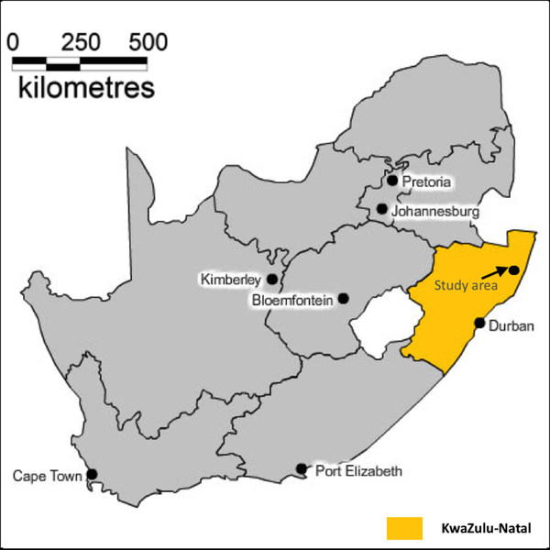
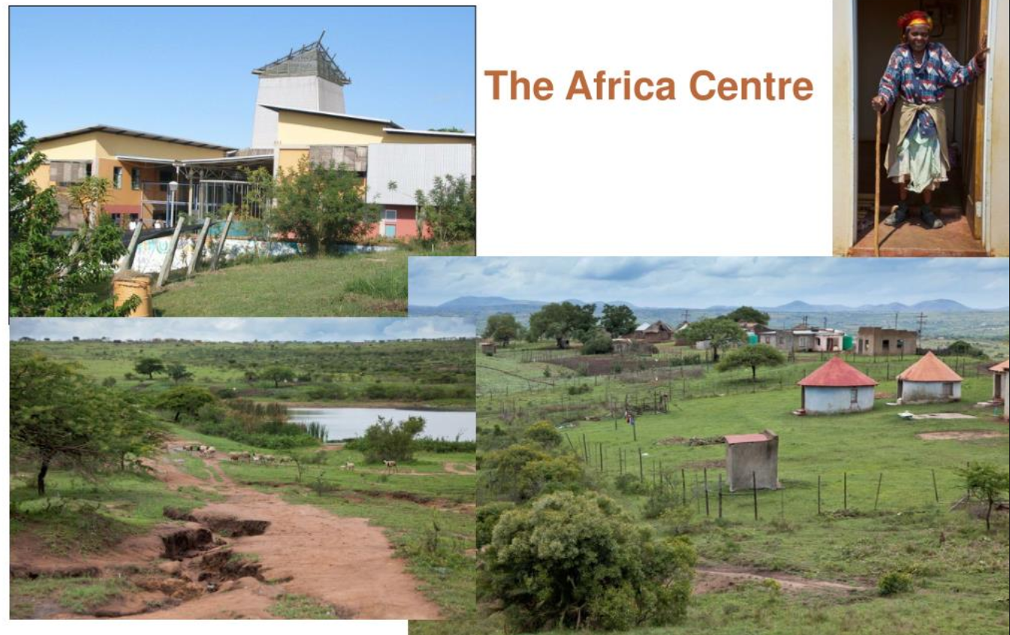
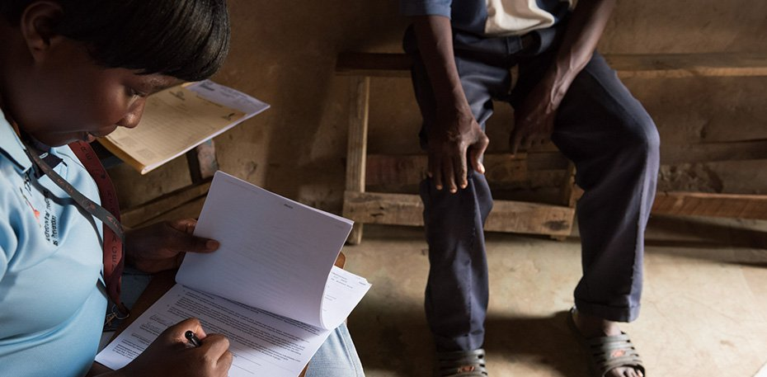
Population Intervention Platform Study Area, South Africa
Background
Tlou et al., PLoS One (2017)

Slide 3
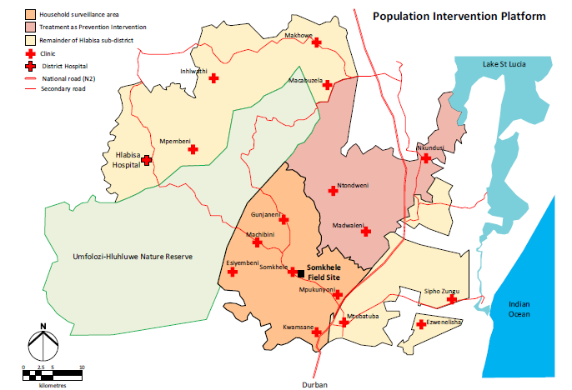
Population Intervention Program Study Area

Slide 4
1) High HIV incidences in young females
young female
7.5 per 100 PY
In rural South Africa, HIV incidence rates remain unacceptably high, especially among women aged 20-30 years.
Interventions such as voluntary male circumcision and ART coverage have been sub-optimal.
Tanser et al., IJE (2018)

Slide 5
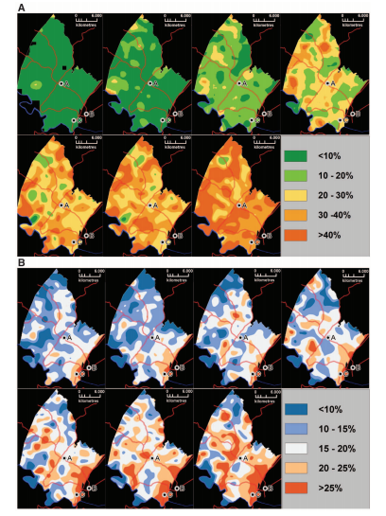
2) Spatial heterogeneity of decline in the risk of HIV acquisition
ART Coverage
HIV Prevalence
Tanser et al., Science (2013)

Slide 6
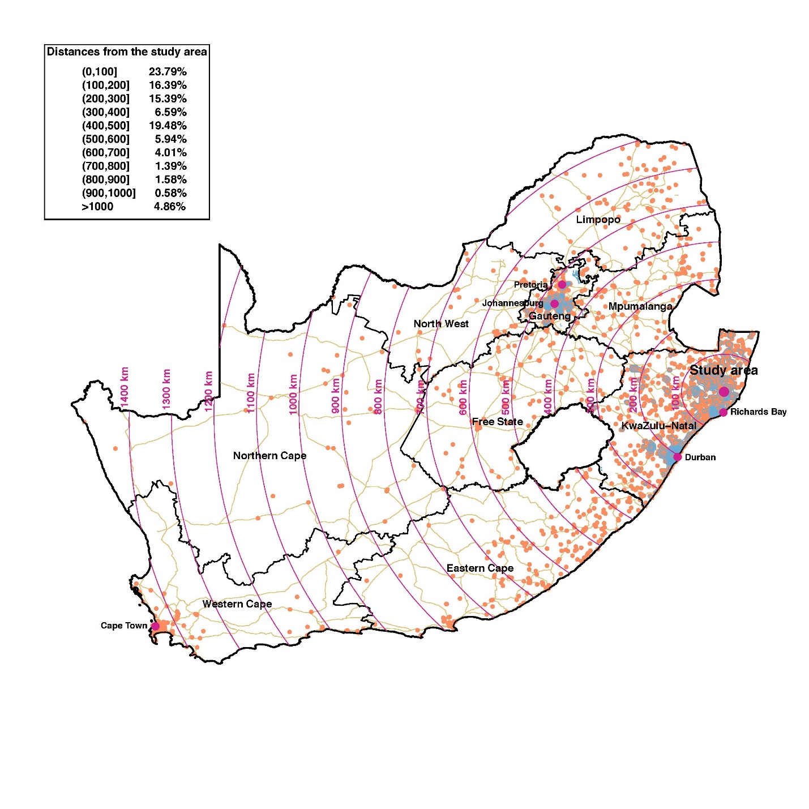
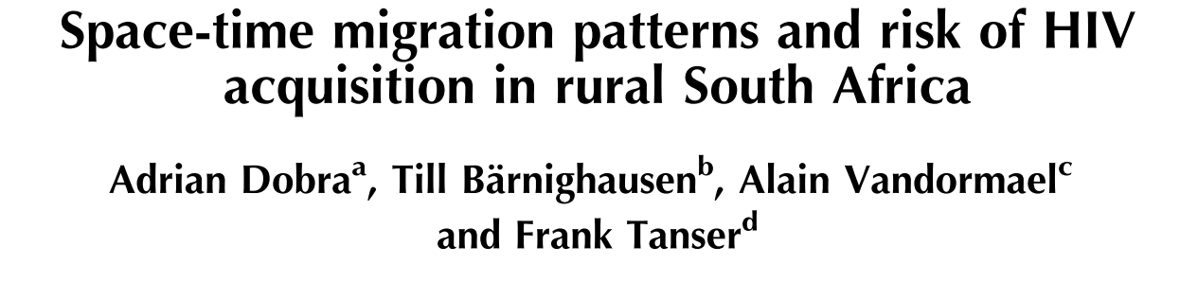
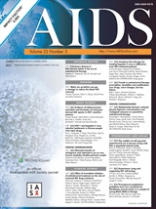
3) High migration across the surveillance area

Slide 7
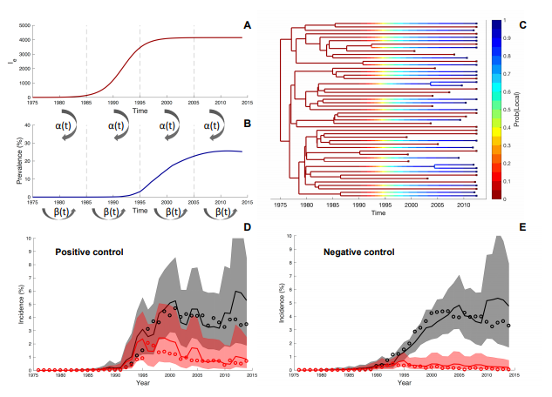
Internal vs external introductions
Rasmussen et al., BioRxiv (2017)

Slide 8
Research Questions
Can we understand the sexual network configuration geospatially?
Can we estimate geographical HIV transmission using both demographic information for sexual partnership formation and phylogenetic links?

Slide 9
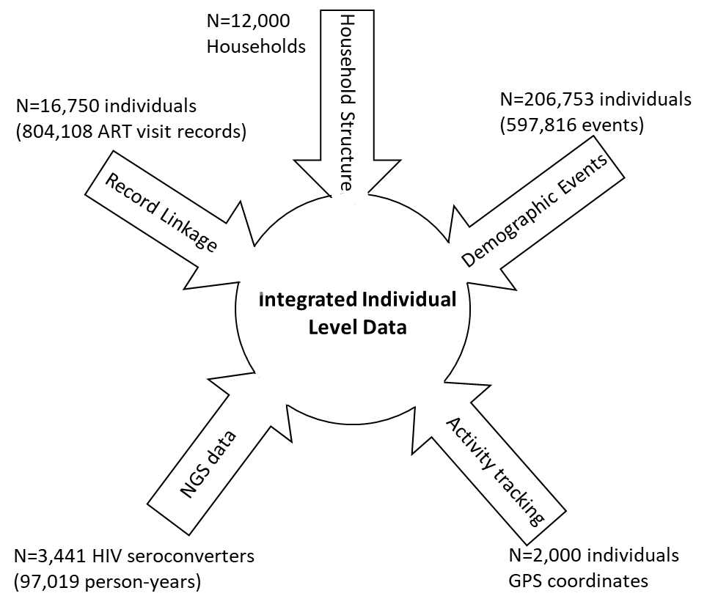



Integrated individual level data system

Slide 10
Sexual partnerships
Self-reported number of partners and their relationship types
Conjugal relationships
  Relationships to regular partners including marital relationships, in which both partners belong to the same household.
  38% in age 30-34 group and >50% in people aged > 45 years are in conjugal relationships
  Reported start and end dates of relationships

Slide 11
Spatial network configuration of conjugal partnerships
Look at all new conjugal sexual partnership formation from 2004 to 2014
Trace back each partner’s location at the time of starting relationships
  Internal migration
  External migration into the surveillance area
  Circular migration

Slide 12
Conjugal partnerships by their origins of movements
1371 new conjugal heterosexual partnerships formed in 2004-2014
 | Male
Female | Internal migration | External migration | Circular migration
Internal migration | 293 | 86 | 85 | 464 (34%)
External migration | 292 | 197 | 111 | 600 (44%)
Circular migration | 190 | 58 | 59 | 307 (22%)
 | 775 (57%) | 341 (25%) | 255 (19%)
Only 21% were internally moved

Slide 13
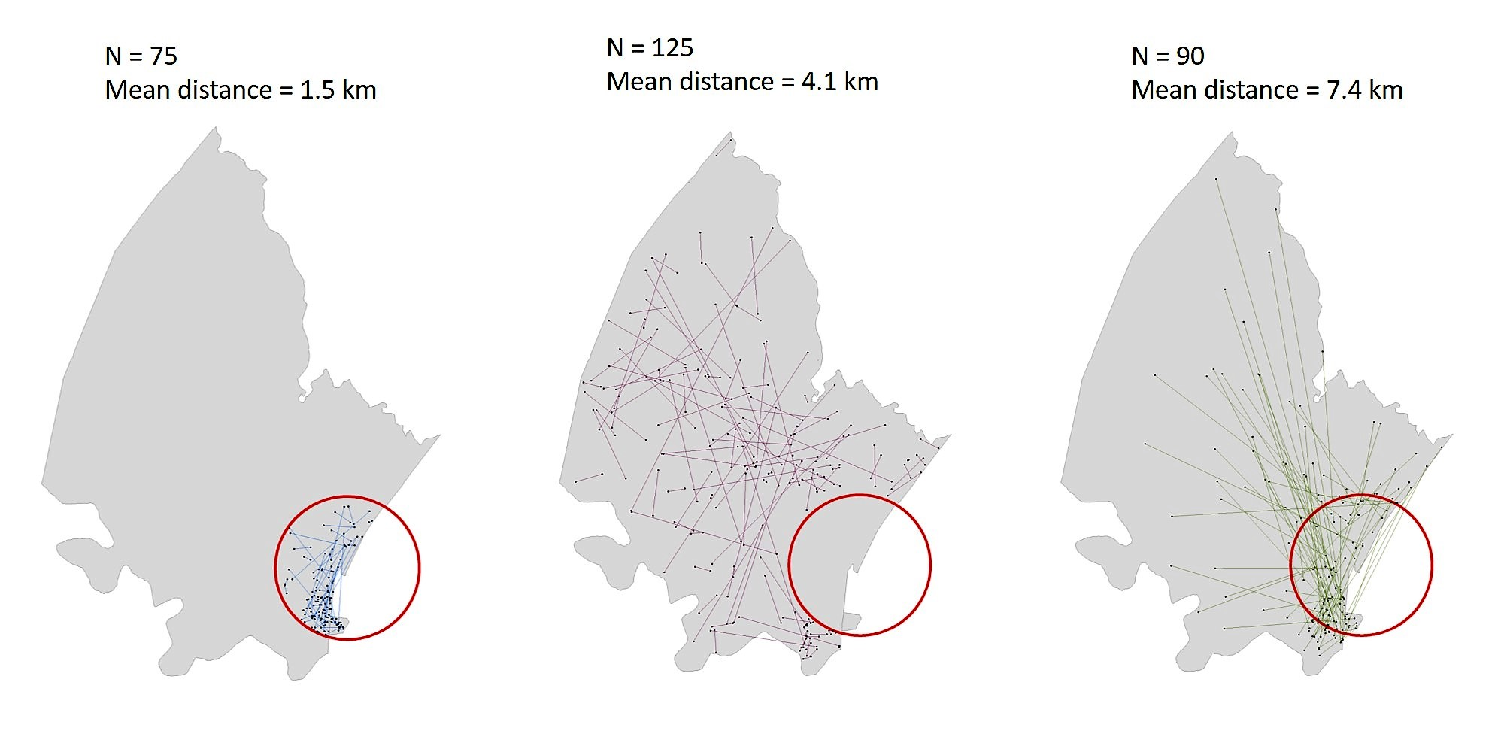
Spatial network of conjugal partnerships
Linked to the hot-spot area
N= 165 (57%)

Slide 14



Sequence data and phylogenetic analysis
Sequences data: 5,624 individuals tested HIV-positive in 2011 – 2014
HIV-1 partial Pol gene sequencing
Sequencing was prioritized from samples with >10,000 RNA copies/ml and subtype C (~98% of SA HIV epidemic)

Slide 15
Sampling flowchart
HIV-positive individuals
in 2011-2014
n=5,624
Sub-type C with > 10,000 VL
n=1,426
Linked with geo-location
n=1,222
Transmission linked
n=700 (350 pairs)
Global AIDS Update (2018)
Cuadros DF. Assessing the role of geographical HIV hot-spots in the spread of the epidemic. In: CROI 2018

Slide 16
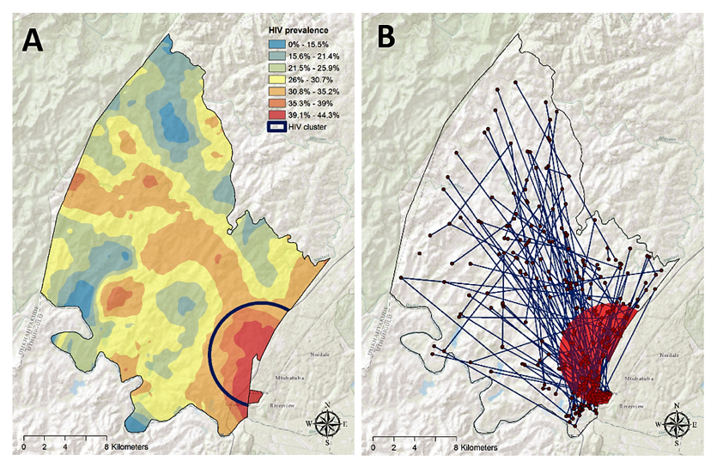
Geolocation of linked HIV transmission pairs
Linked to the hot-spot area
N= 254 (73%)
Outside the hot-spot area
N=96 (27%)
Cuadros DF. CROI 2018
In preparation

Slide 17
Spatial network of conjugal partnerships
Linked to the hot-spot area
N= 165 (57%)

Slide 18
Linkage among conjugal relationships
26% (90/350) were in conjugal relationships.
However, only 11% (10/90) had HIV transmission links among conjugal relationships.

Slide 19
Next steps
Incorporating spatial configuration of sexual network, internal and external migration into EMOD HIV models
More sequencing of samples and simulation to improve the sampling framework
Understanding more about the impact of external migration into the surveillance area and hot-spot area

Slide 20
Conclusion
Direct linkage of phylogenetic sequence data and conjugal partnerships was around 10%.
However, both phylogenetic analysis and spatial network of conjugal partnerships implicate high linkage (>50%) into hot-spot area.
Incorporating such spatial configuration may improve understanding epidemics and prediction of future interventions.

Slide 21


Acknowledgements
AHRI
Frank Tanser
Till Bärnighausen
Diego Cuadros
Alain Vandormael
Andrew Tomita
Guy Harling
IDM
Adam Akullian
Anna Bershteyn
Tulio de Oliveira
Eduan Wilkinson
AHRI support staff
Kobus Herbst
Thobeka Mngomezulu
Dickman Gareta
Siyabonga Nxumalo
Jeeten Singh
Sheryll Veerajoo
Sashin Harilall
Funding
NIH R01 6R01AI124389-02
Ethics approval
IRB ethical approval – UKZN #BE290/16
Study Participants &
Communities in the Population Intervention Study Platform Area
Field staff
KRISP

