Slide 1
A Simple Optimization Algorithm for Stochastic (Epi) Objective Functions
Dan Klein, IDM Symposium, 4/18/2017

Slide 2
A First-Order Optimization Method for DTK
Overview
Direction from Numerical Derivative
State in a D-dimensional box
User provides initial guess, x₀
f
Choose ascent direction, dx
Update state:
x ← x + k dx
x₂
Line search, pick k
x₀
ε-ball
x₁

Slide 3
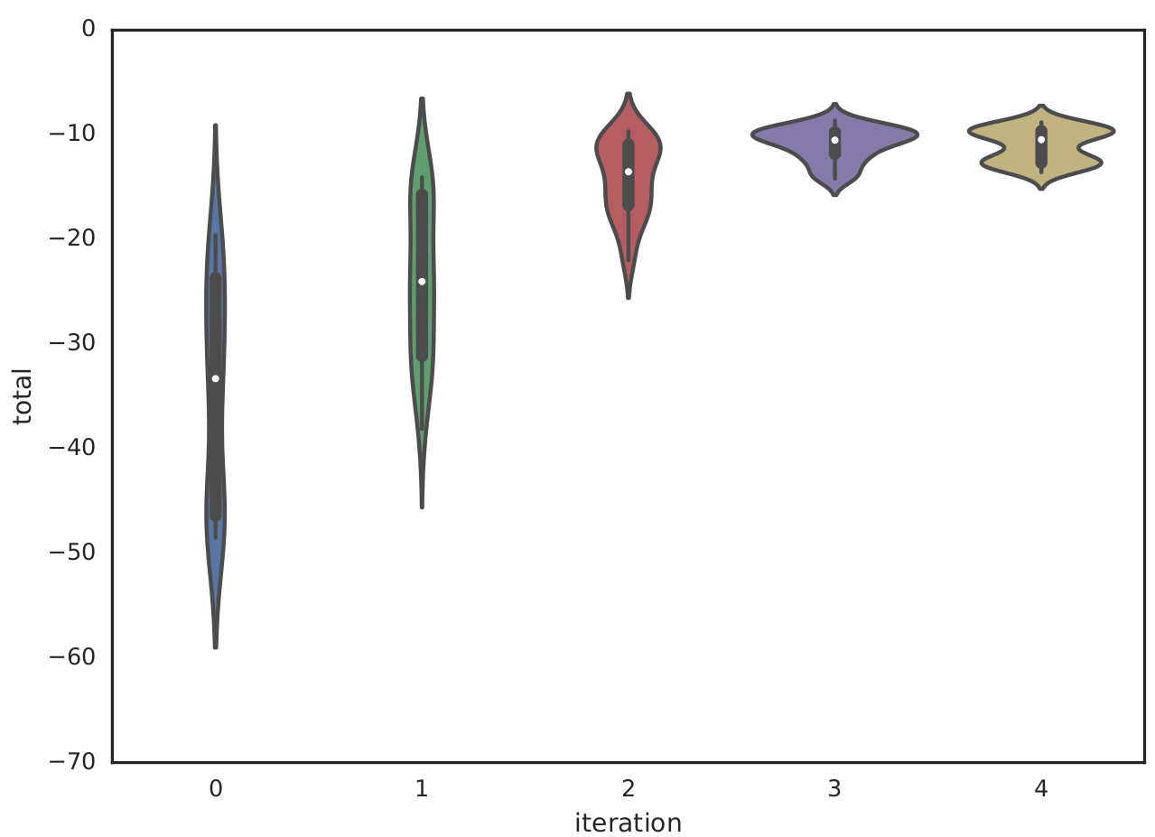
Applications and Implementation
Applications (9x, max likelihood)
HIV-Zimbabwe: VMMC, PrEP (Dan)
HIV-Kenya: VMMC, PrEP (Adam)
HIV-Nyanza: VMMC, PrEP (Anna)
HIV-South Africa: Vaccine (Christian)
HIV-Uganda: SEARCH trial (Britta)
Typhoid-Santiago: Vaccine (Jillian)
LSHTM and Avenir soon!
Likelihood
Implementation
Algorithm now in dtk-tools
Runs locally or via COMPS
Iteration

Slide 4
Computational Modeling Platform Service (COMPS)
Web
Databases
Web
Databases
Workers
HPC Clusters
Workers
User Interface
( Dashboard, Search, Output Data Visualization, Geospatial Visualization, Input Data Visualization )
User Interface
Input File Creation Workers
Job, Asset, Suites, Experiments, Simulations, Work Items
Input File Creation
Simulation Data Storage
Demographics
Simulation Building
Clients
RESTful API
Merge Nodes
On Premise
Search Service
SQL Server
( Fail Over )
Nan Check
Asset Service
HPC Job Scheduling
RESTful API
Builder Worker
Input File Creation
Iterative Algorithms
Authentication
HPC Job Scheduling Worker
Usage Metrics
Climate Data Storage
Climate Data Storage
Clean up Worker
Clean up
Work Items
Worker Hosting Service
CAGE
Postgres SQL
High Performance Storage Area Network

Slide 5
Stochastic Gradient Optimization Demo?

Slide 6
Available Software Tools for Model Optimization
Stochastic gradient ascent
  Code is ready to go and available in dtk-tools
  Visit the software panel session this afternoon
  Visit the software session tomorrow
  Come talk to Dan Klein, or email dklein@idmod.org
More advanced algorithm (Dr. Atiye Alaeddini, IDM)
  Parallel Simultaneous Perturbation Optimization (PSPO)
  Uncertainty quantification around optimal point
Implementing global optimization later this year with TingYu Ho, student of Prof. Zabinsky

