Slide 1
Algorithms & Tools for Stochastic Models
6th Annual IDM Modeling Symposium
Daniel J. Klein, Ph.D.
Daniel.Klein@gatesfoundation.org
Senior Program Officer, Global Development, Strategy, Data, & Analytics (SDA), BMGF
On sabbatical leave from IDM

Slide 2
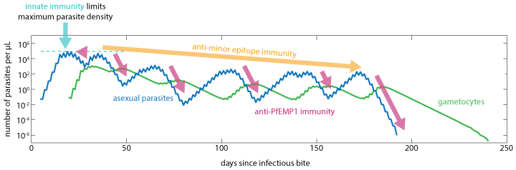
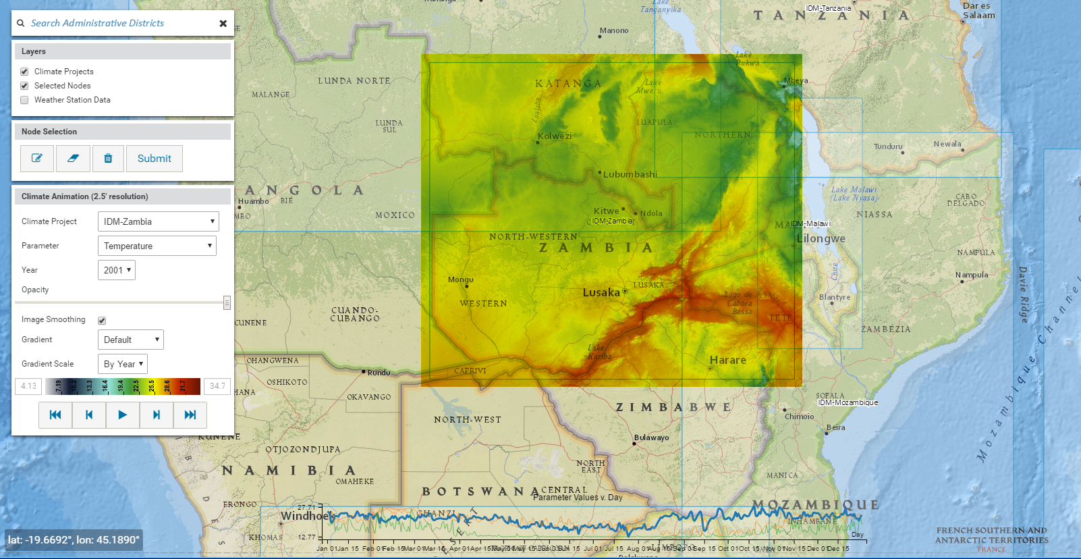
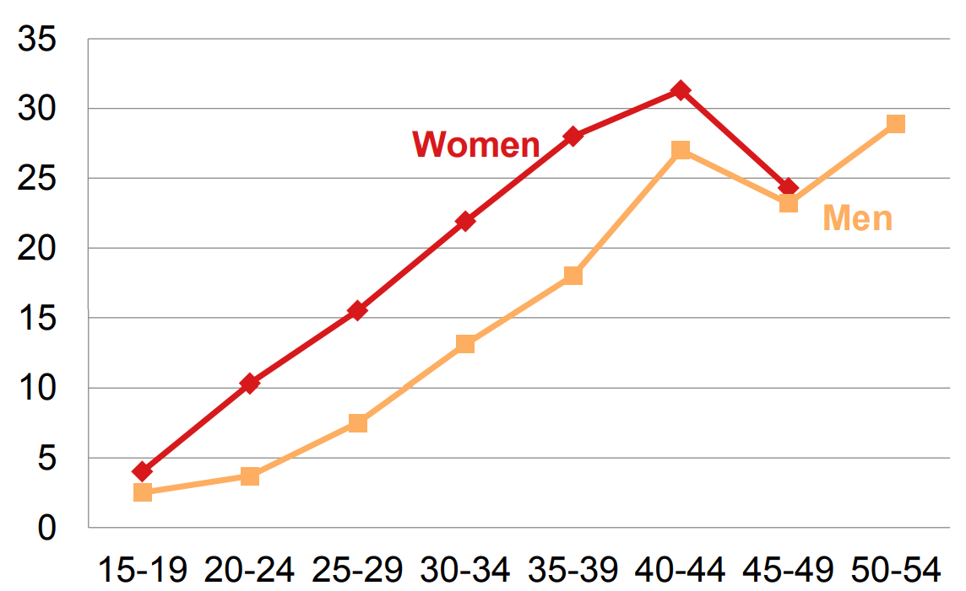
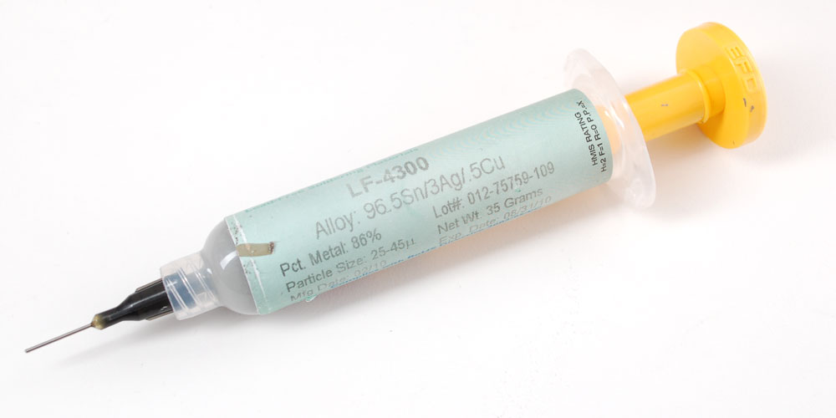
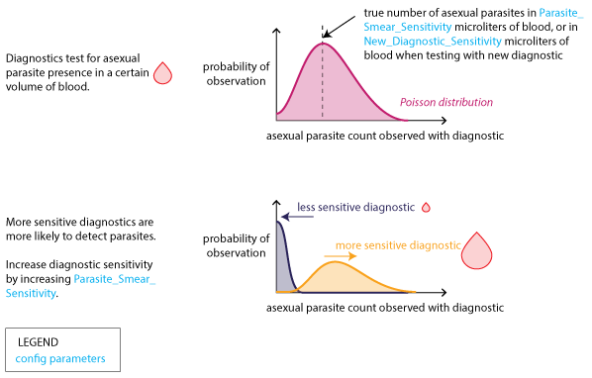
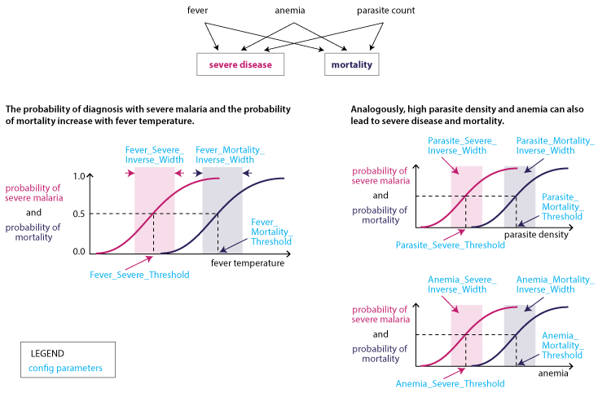
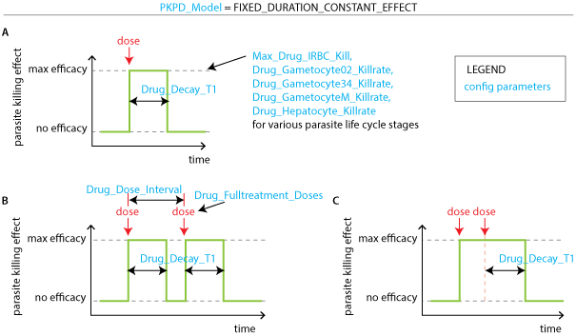
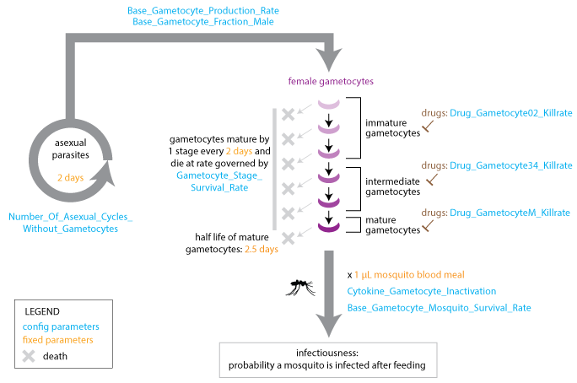
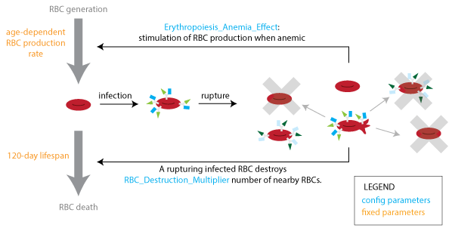
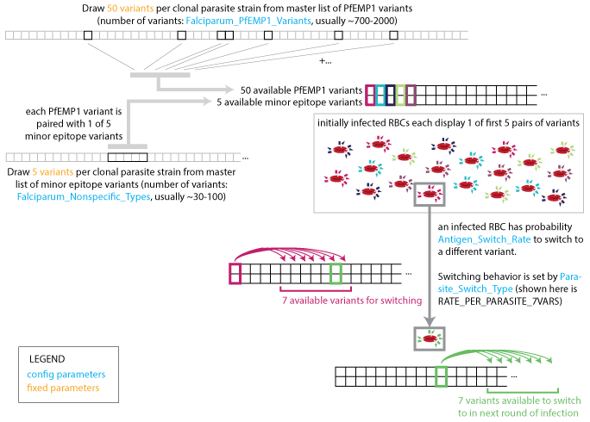
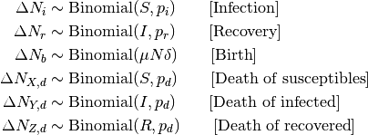
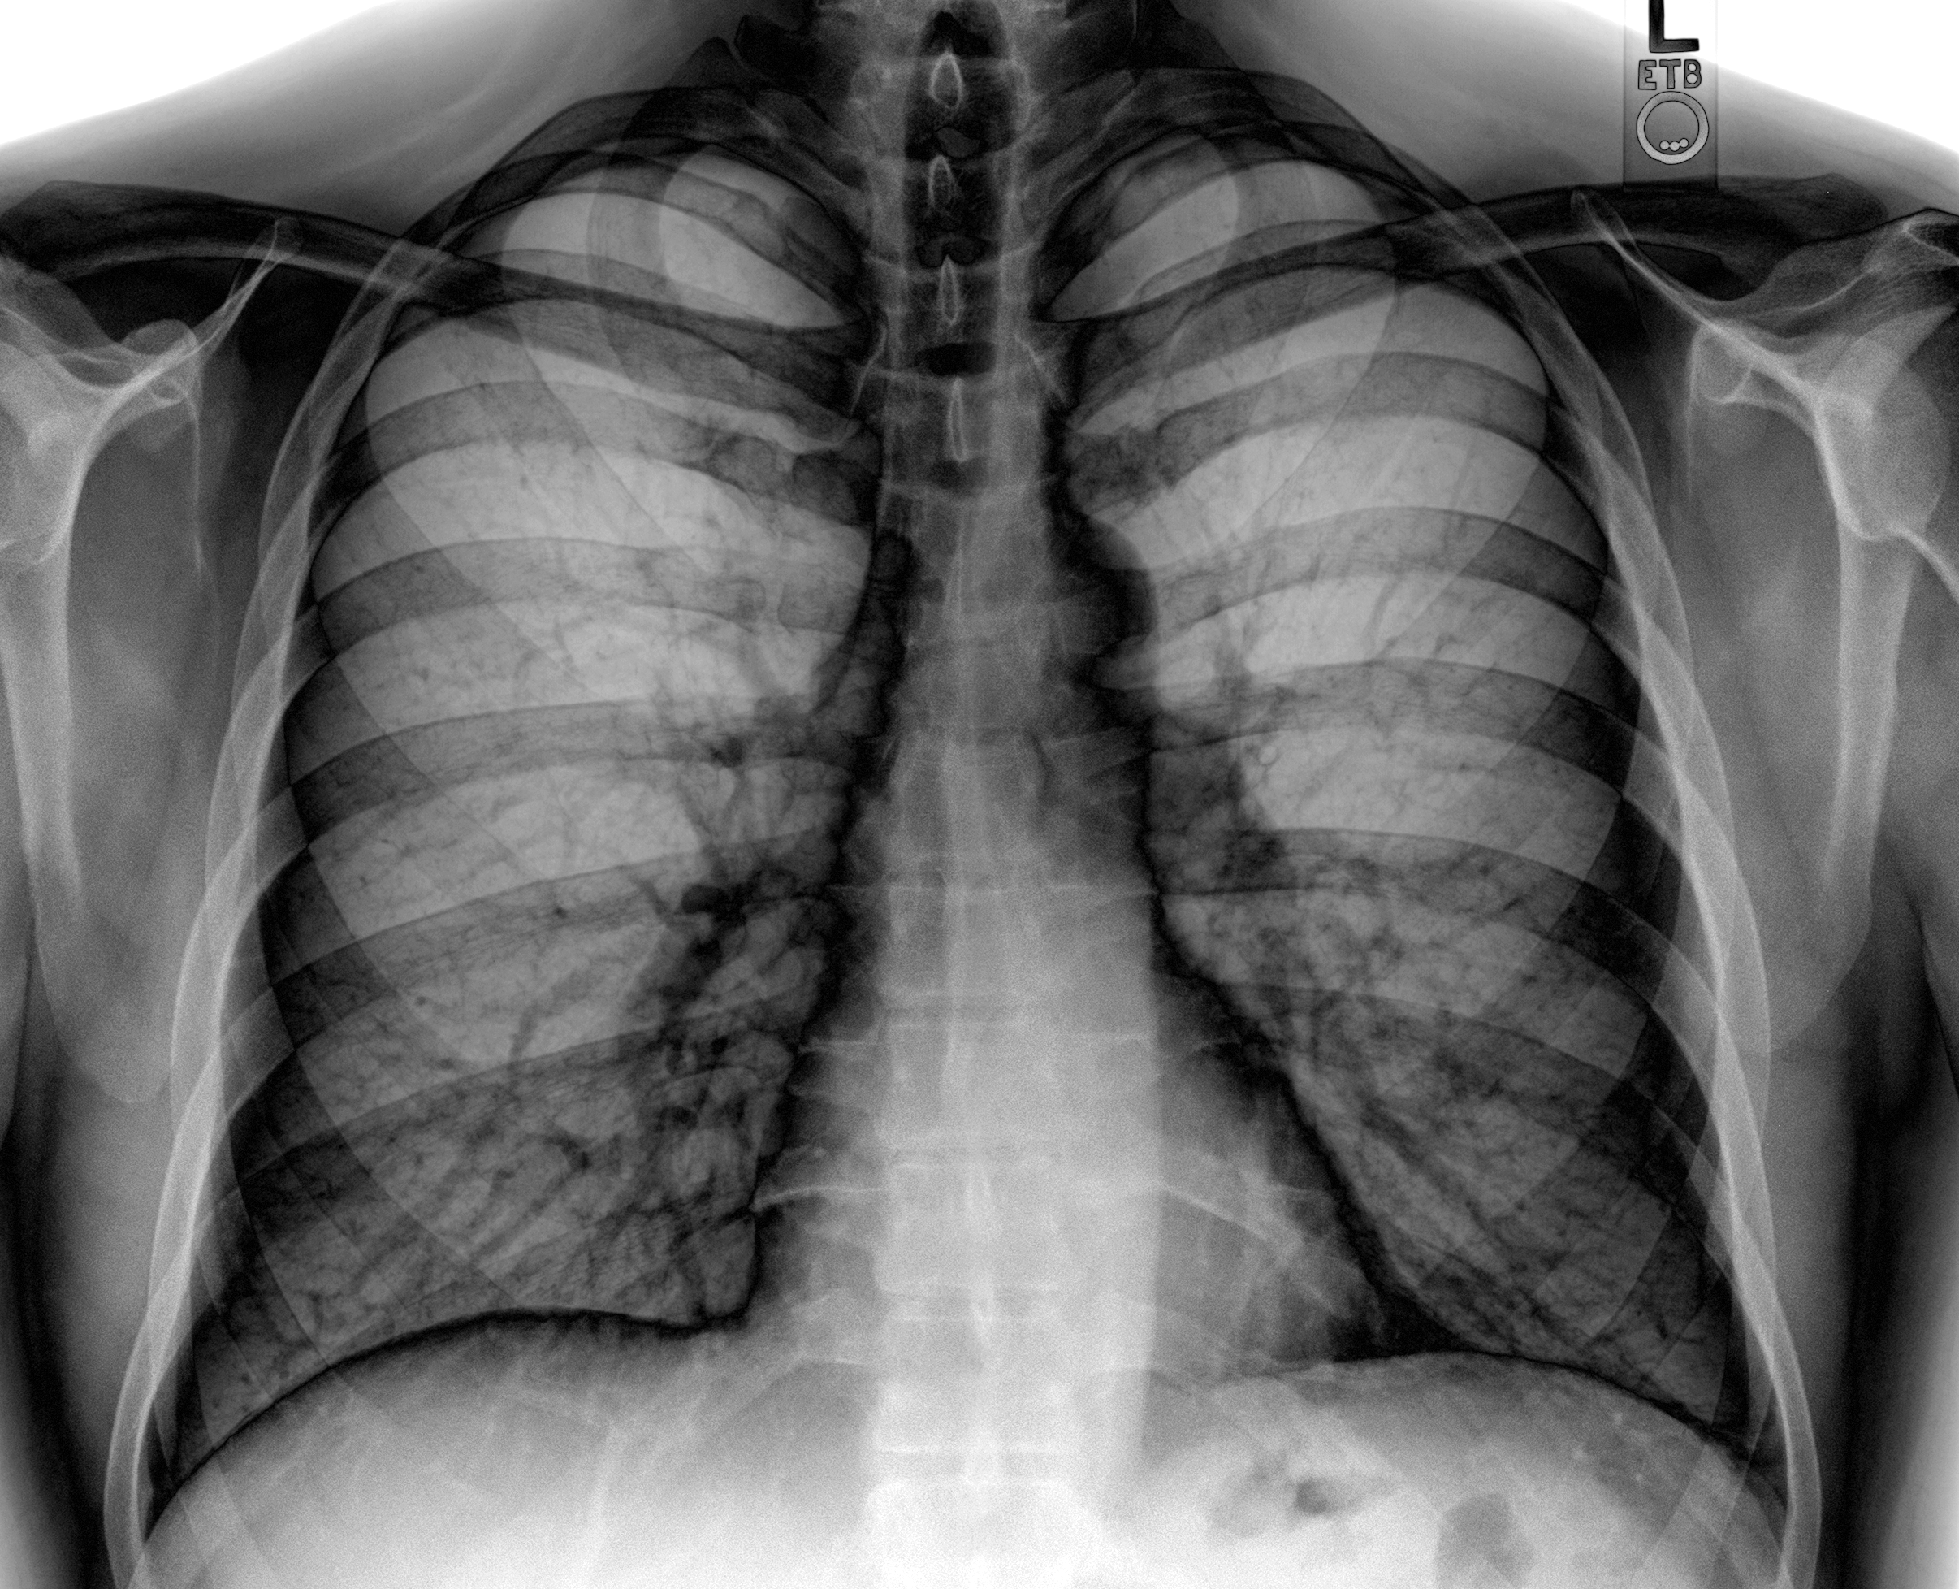
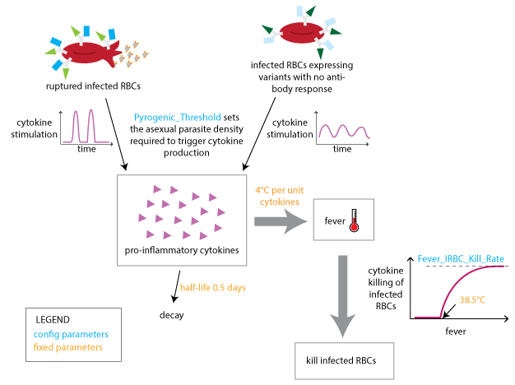

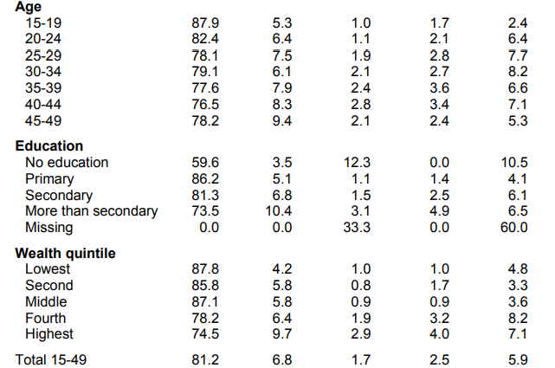
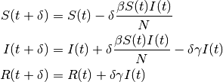
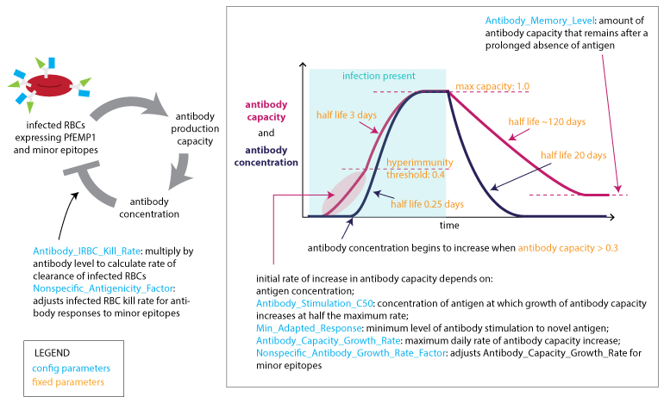
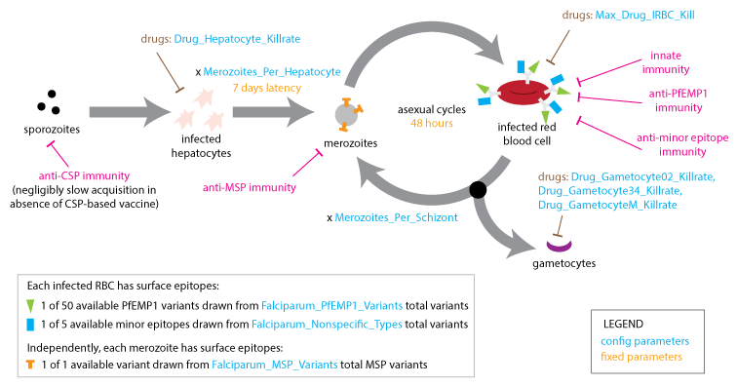
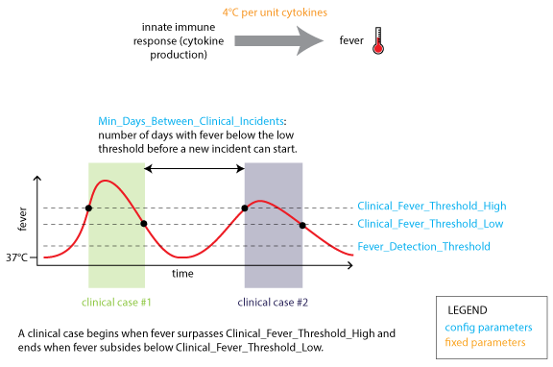
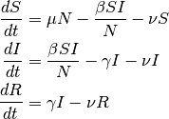
{ "Malaria_Drug_Params": { "Artemether_Lumefantrine": { "Drug_Cmax": 1000, "Drug_Decay_T1": 1, "Drug_Decay_T2": 1, "Drug_Dose_Interval": 1, "Drug_Fulltreatment_Doses": 3, "Drug_Gametocyte02_Killrate": 2.3, "Drug_Gametocyte34_Killrate": 2.3, "Drug_GametocyteM_Killrate": 0, "Drug_Hepatocyte_Killrate": 0, "Drug_PKPD_C50": 100, "Drug_Vd": 10, "Max_Drug_IRBC_Kill": 4.61, "Bodyweight_Exponent": 0 }, "Artemisinin": {}, "Chloroquine": {}, "GenPreerythrocytic": {}, "GenTransBlocking": {}, "Primaquine": {}, "Quinine": {}, "SP": {}, "Tafenoquine": {} } }
Inputs
Outputs
Interventions
Past
(Future)
Historical
Data
The Model
https://institutefordiseasemodeling.github.io/Documentation

Slide 3
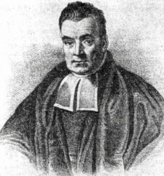

14,411 ft
Public Domain, https://commons.wikimedia.org/w/index.php?curid=14532025
Walter Siegmund - Own work, CC BY 2.5, https://commons.wikimedia.org/w/index.php?curid=574735

Slide 4
Bayesian History Matching

Slide 5
Bayesian History Matching
X
X
X
X
Model calibration done right!
Ingredients
It’s not Bayesian
Params from box
Likelihood free
Emulation
Multi-scale
Discrepancy
Gavalas, G. R., P. C. Shah, and John H. Seinfeld. "Reservoir history matching by Bayesian estimation." Society of Petroleum Engineers Journal 16.06 (1976): 337-350.
Vernon, Ian, Michael Goldstein, and Richard Bower. "Galaxy formation: Bayesian history matching for the observable universe." Statistical Science 29.1 (2014): 81-90.
Andrianakis, Ioannis, et al. "Bayesian history matching of complex infectious disease models using emulation: a tutorial and a case study on HIV in Uganda." PLoS computational biology 11.1 (2015): e1003968.

Slide 6

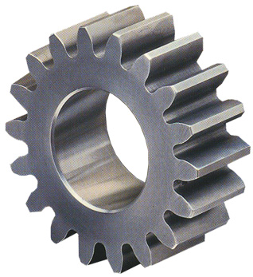
HISTORY MATCHING PROCESS
Choose inputs uniformly
Choose subset of model inputs for emulator
Run simulations
Choose an output to match to data
Fit & test emulator
Choose new inputs uniformly across non-implausible space
Compute implausibility & volume reduction

Slide 7
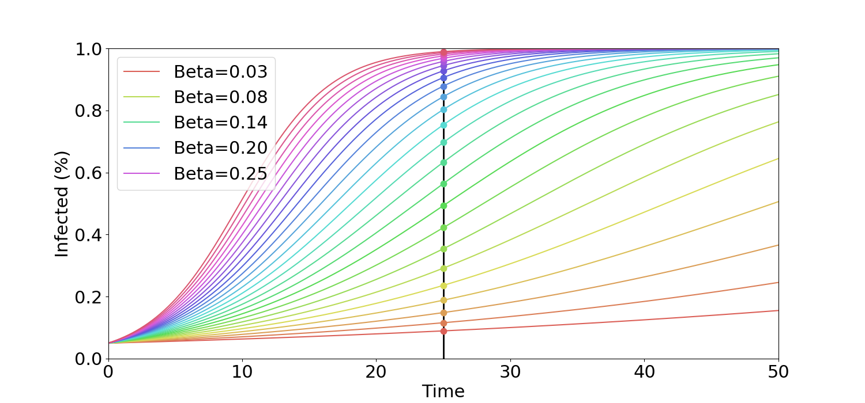
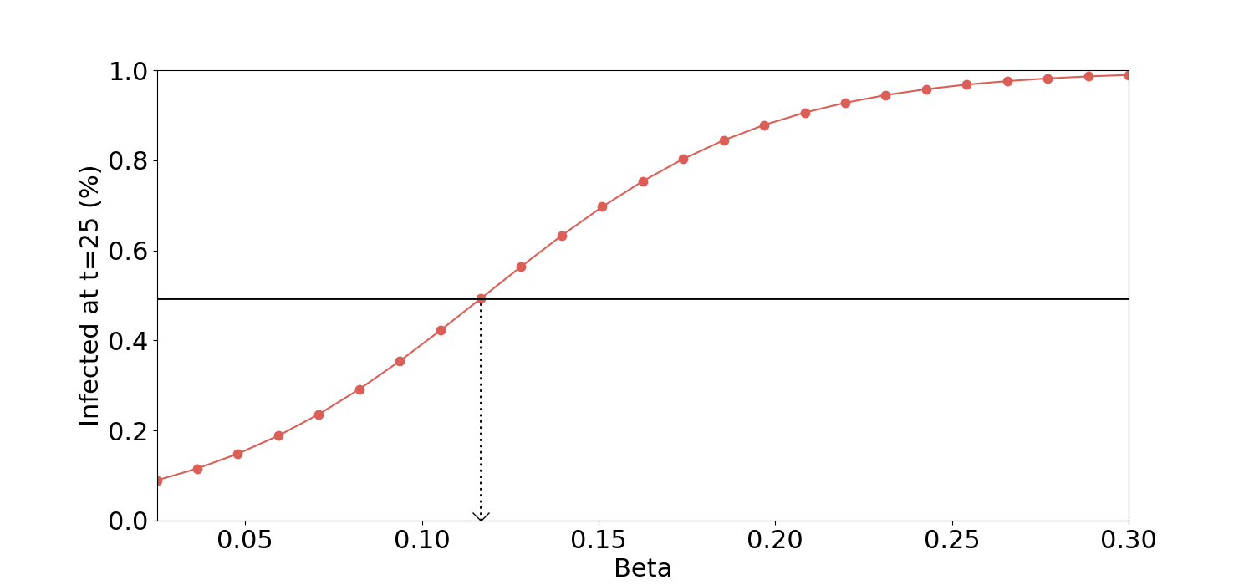

SIR EXAMPLE PROBLEM
$$\dot{S}=−βSI$$
$$\dot{I}=βSI$$
+
+
+
Noisy Simulation
+
Survey
Data
Infected (%)
Infected at time 25 (%)
+
+
+
Time
Beta
Observation

Slide 8
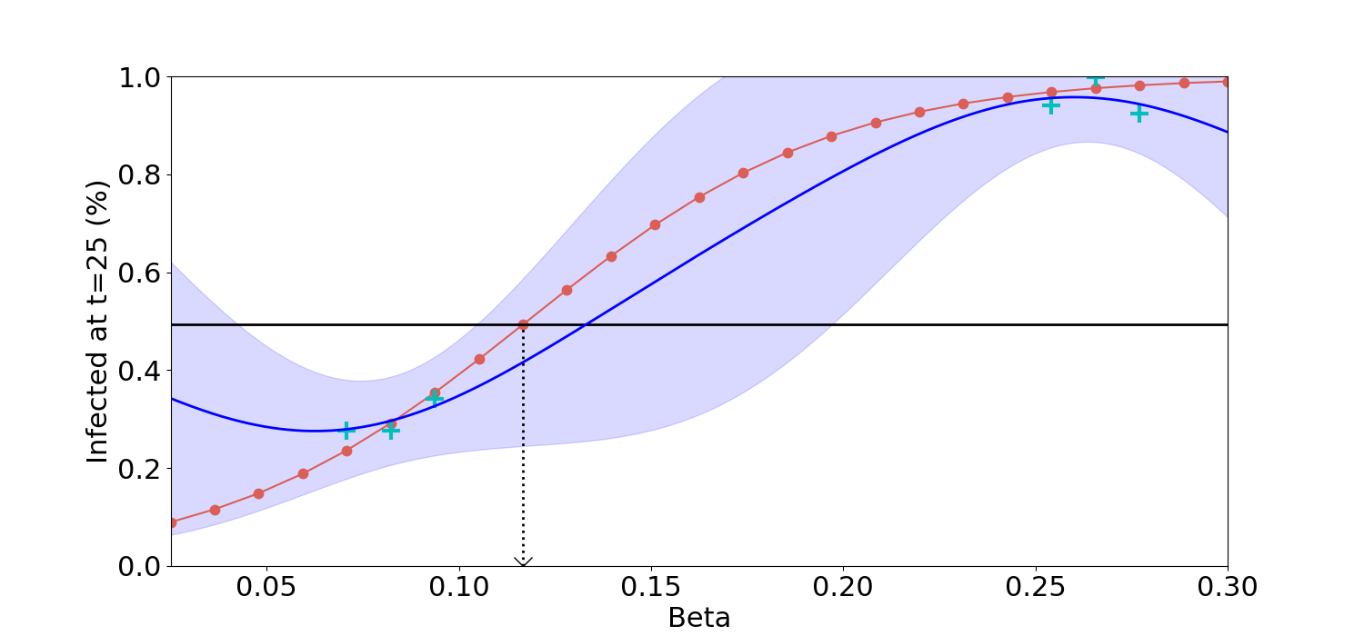

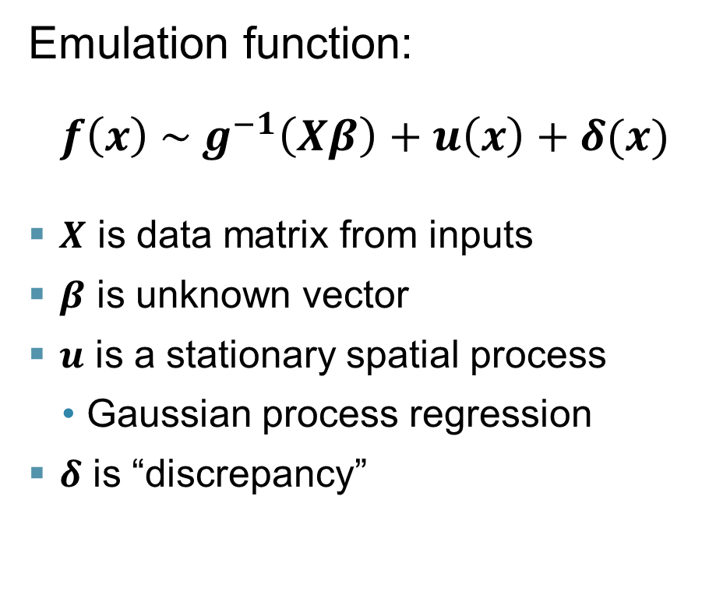
Emulation
Emulation function:
$$f\left(x\right) \sim g^{−1}\left(Xβ\right)+u\left(x\right)+δ(x)$$
  $X$ is data matrix from inputs
  $β$ is unknown vector
  $u$ is a stationary spatial process
    Gaussian process regression
  $δ$ is “discrepancy”
Fitting is challenging
  Test/train split
  LOO cross-validation
  GPU computing
  pyCUDA, scikit.cuda

Slide 9
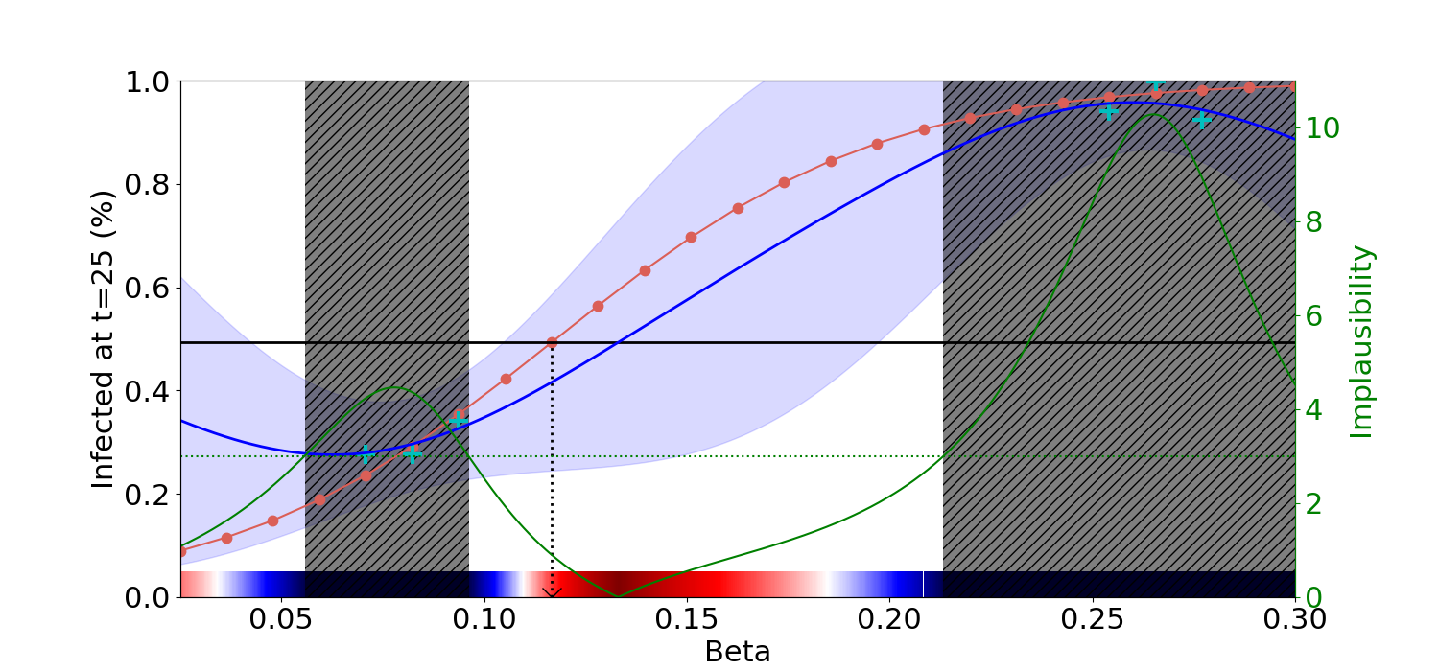

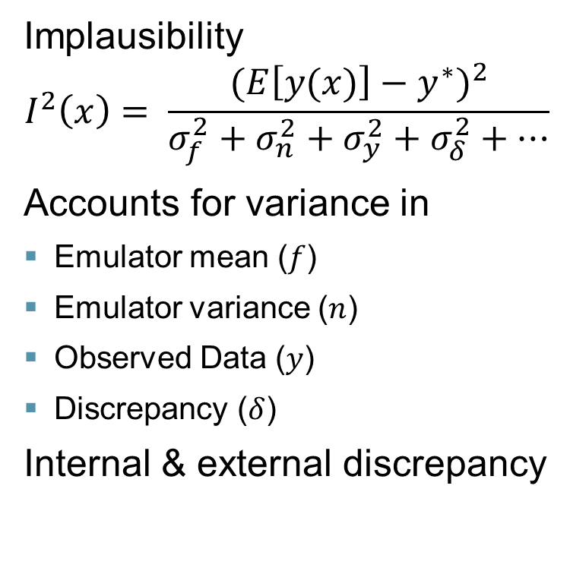
Implausibility
Eliminate point if highly implausible$I\left(x\right)>T$
Typically, $T=3$ or more (Pukelsheim’s theorem)
Combine many of independent “cuts”
N.B. Model is inconsistent with data if all of parameter space is eliminated
Implausibility
$$I^{2}\left(x\right)= \frac{{(E\left[y(x)\right]−y^{∗})}^{2}}{σ_{f}^{2}+σ_{n}^{2}+σ_{y}^{2}+σ_{δ}^{2}+…}$$
Accounts for variance in
  Emulator mean ($f$)
  Emulator variance ($n$)
  Observed Data ($y$)
  Discrepancy ($δ$)
Internal & external discrepancy

Slide 10
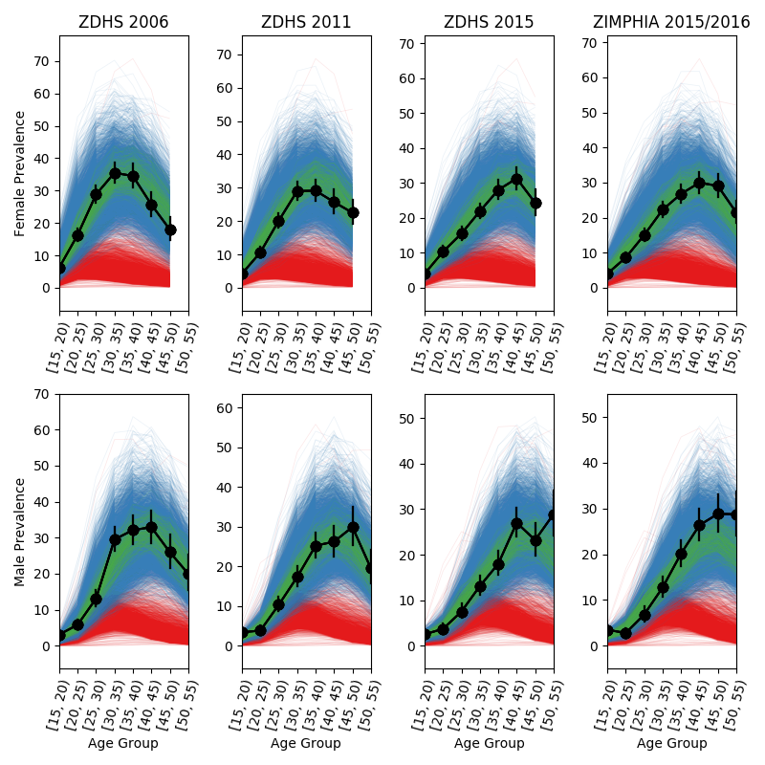
Example
EMOD-HIV, 46 parameters
Zimbabwe data
DHS, ZIMPHIA, program
Prevalence by age/gender/year
# on ART
Testing
Waves 1 and 11
Simple trajectory selection

Slide 11
WHY DOES HISTORY MATCHING WORK SO WELL?
It’s not Bayesian
It remembers implausible regions forever
Emulators don’t need to fit perfectly
Iterative: start simple with low-dimensional first-order trends
Emulation gets easier as non-implausible volume shrinks
Uncertain regions are retained
Clear stopping point when all of parameter space is implausible

Slide 12

Optimization
14,411 ft

Slide 13
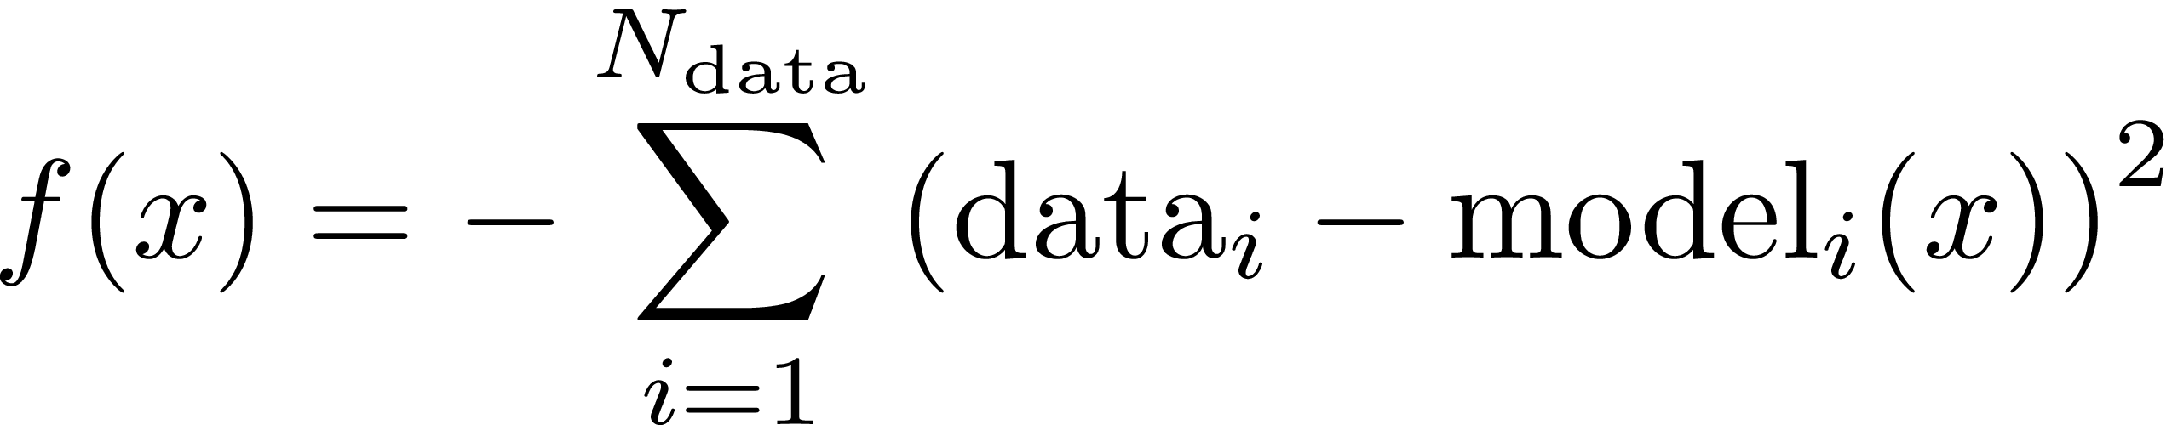
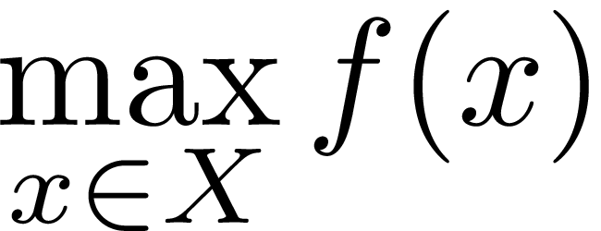
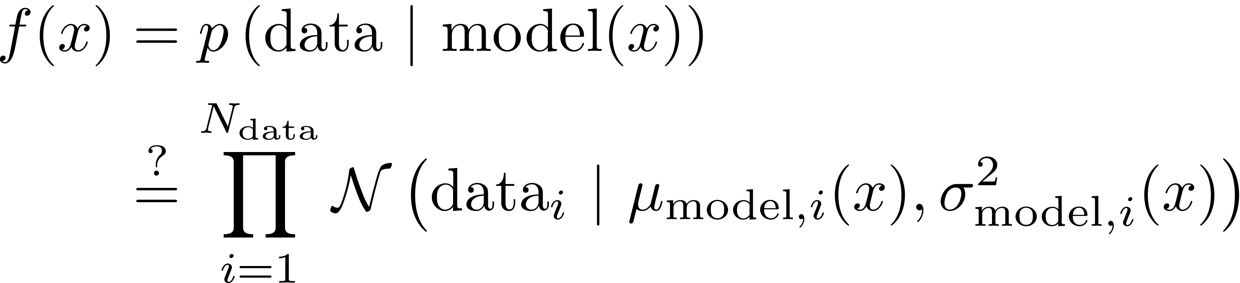
Optimization
x is the model inputs (the parameters)
X is the domain (parameter ranges)
f(x) is the objective function

Slide 14
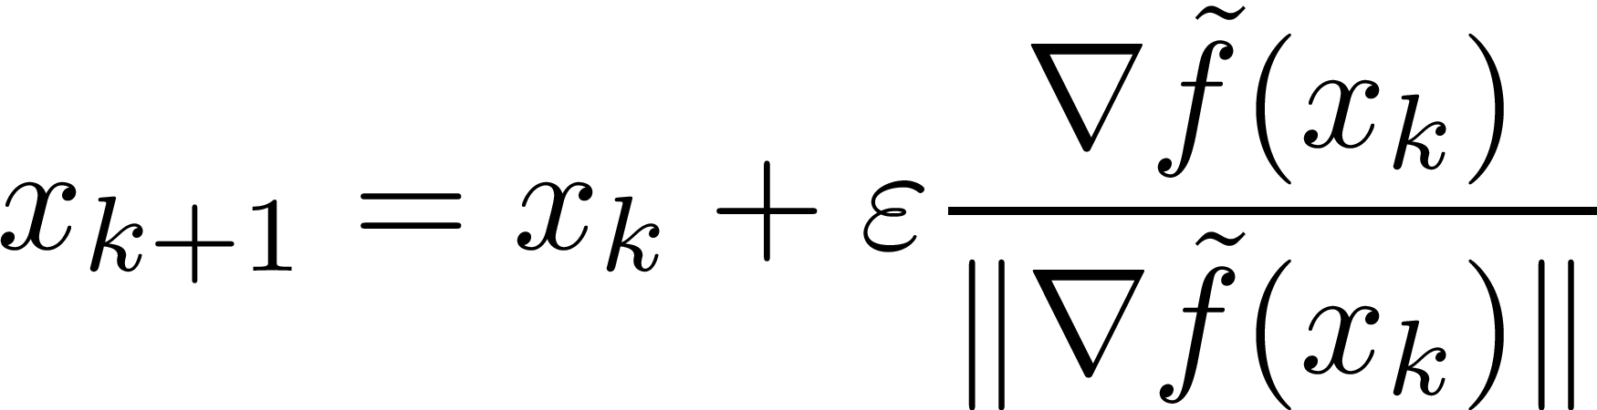
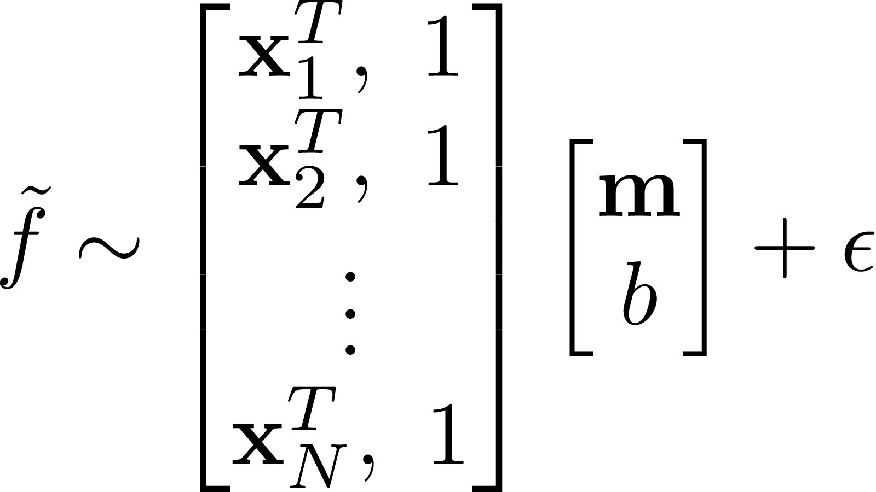
Stochastic Gradient Ascent
(Optimtool)
Direction from Numerical Derivative
f
x₂
x₀
ε-ball
x₁

Slide 15
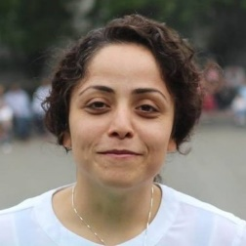
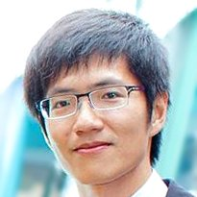

Smarter Optimization
Atiye Alaeddini
TingYu Ho
Prof. Zelda
Zabinsky
Second-Order Optimization using
Parallel Simultaneous Perturbation
Global Optimization using
Probabilistic Branch and Bound
H. Huang and Z. Zabinsky. “Multiple objective probabilistic branch and bound for Pareto optimal approximation,” In Proceedings of the 2014 Winter Simulation Conference, 2014.
A. Alaeddini and D. J. Klein. “PSPO: Parallel Simultaneous Perturbation Optimization,” Submitted to J. Optimization Theory and Applications, 2018.

Slide 16
Software Tools
Optimization
Available in dtk-tools
See the Examples
Gradient ascent extensively tested
Other optimization algorithms implemented, need users
History Matching
First software package for HM
Python-based toolkit
    CUDA-based linear algebra and kernel calculations on GPU
    Leave-one-out cross-validation with closed-form gradient
    Einstein-based variance calculations
Human intervention required
Outside dtk-tools, model agnostic
Rollout to IDM, then external

Slide 17
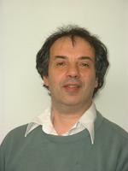
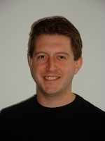

Thanks!
Prof. Michael Goldstein
Prof. Ian Vernon
Daniel.Klein@gatesfoundation.org

