Slide 1
Calibration and Optimization Methods for Stochastic Epi Models
Dan Klein, Chair of Applied Math, IDM
IDM Symposium, 4/18/2017

Slide 2
Algorithms for Stochastic Epidemiological Models
Motivation and Challenges
Optimization and Calibration
To effectively use stochastic models, need tools to
  Fit model to data
  Find the best interventions
Challenges include
  Individual-based models are stochastic
  DTK is an expensive function to evaluate
  Mechanisms have many input parameters
  HPC is parallel, cannot do many serial iterations
  Many parameters are coupled, need to work in “high” dimensional input spaces
Optimization: Find one parameter configuration that minimizes cost
  Local methods, e.g. gradient-based
  Global methods
Calibration: Find many parameter configurations, distributed according to the posterior probability density.

Slide 3
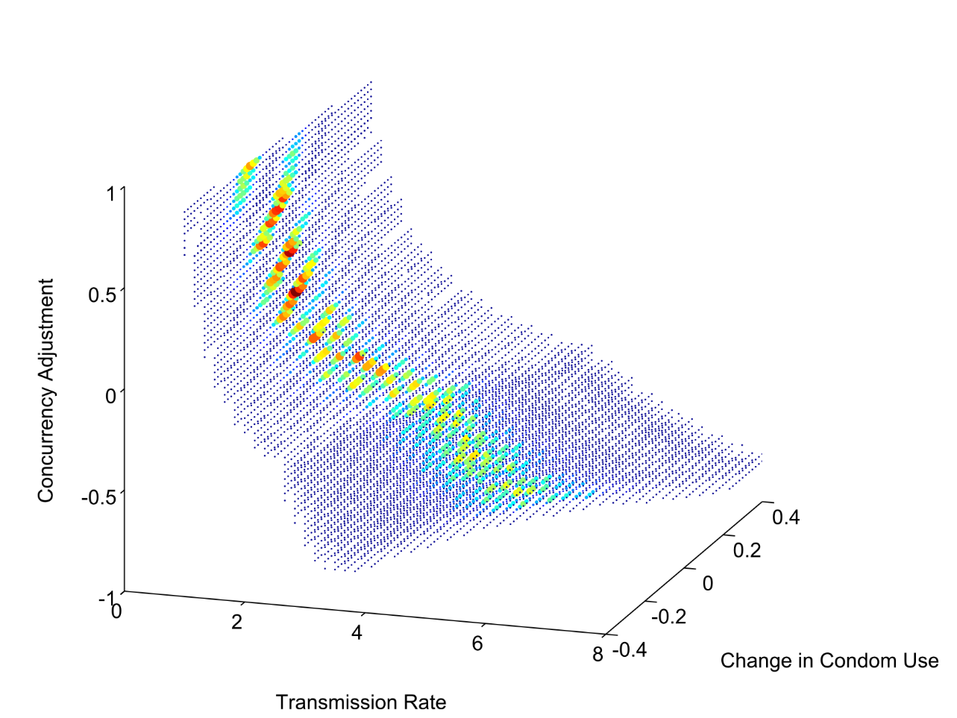
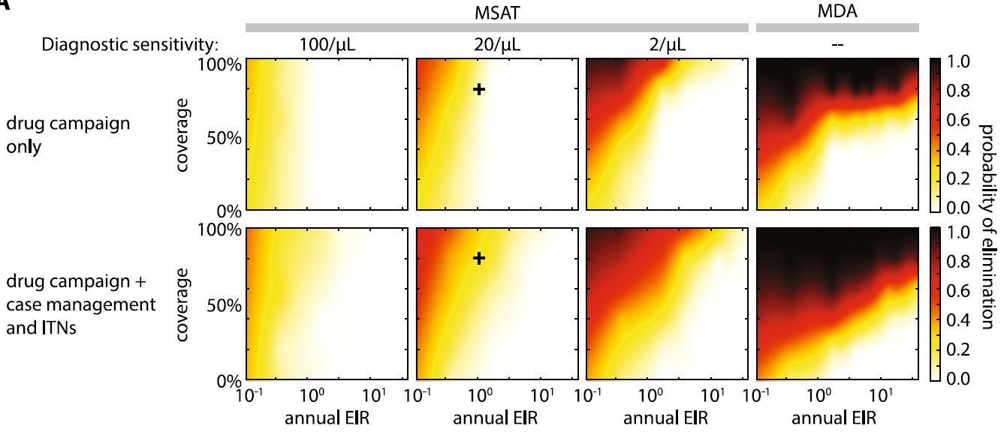
Grid-Based Exploration
Valuable for initial exploration, range checking
Works for a few dimensions
Does not scale
Fills up the cluster
Used at scale, represents lack of confidence or familiarity with more sophisticated algorithms
Bershteyn, Anna, Daniel J. Klein, and Philip A. Eckhoff. "Age-dependent partnering and the HIV transmission chain: a microsimulation analysis." Journal of the Royal Society Interface 10, no. 88 (2013): 20130613.

Slide 4
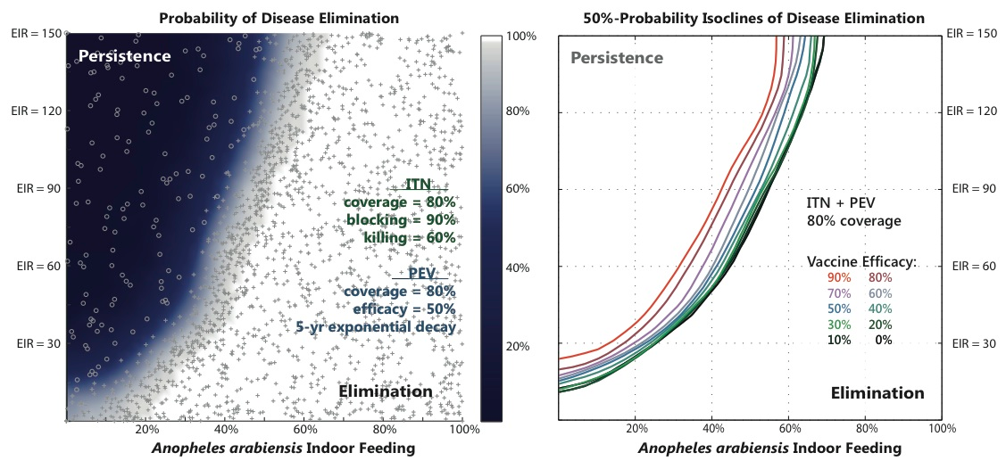
Separatrix Example: Malaria Vaccines
Wenger, Edward A., and Philip A. Eckhoff. "A mathematical model of the impact of present and future malaria vaccines." Malaria journal 12.1 (2013): 1.
Notes:
Figure 4 - Regions of disease elimination and persistence after PEV and ITN distribution
Left panel: The separatrix between the regions of parameter space with disease persistence (dark blue) and local disease elimination (white). Individual simulations are marked either with a cross (for successful elimination) or a circle (disease persistence). ITNs and 50%-efficacy pre-erythrocytic vaccines (PEV) are distributed independently at 80% coverage.
Right panel: The location of the separatrix (50% probability isocline) between regions of parameter space with disease persistence for PEV efficacy values ranging from 0% to 90%.

Slide 5
OptimTool: Stochastic Gradient Ascent
Overview
Direction from Numerical Derivative
State in a D-dimensional box
User provides initial guess, x₀
f
Choose ascent direction, dx
Update state:
x ← x + k dx
x₂
Line search, pick k
x₀
ε-ball
x₁

Slide 6
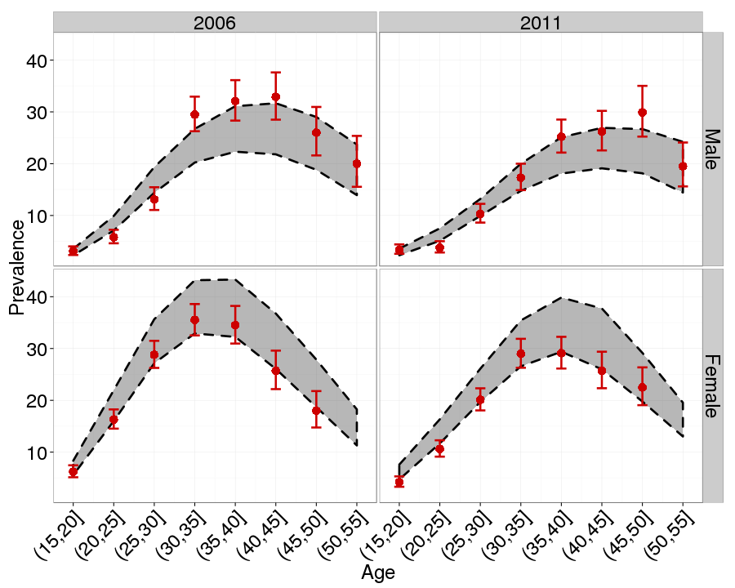
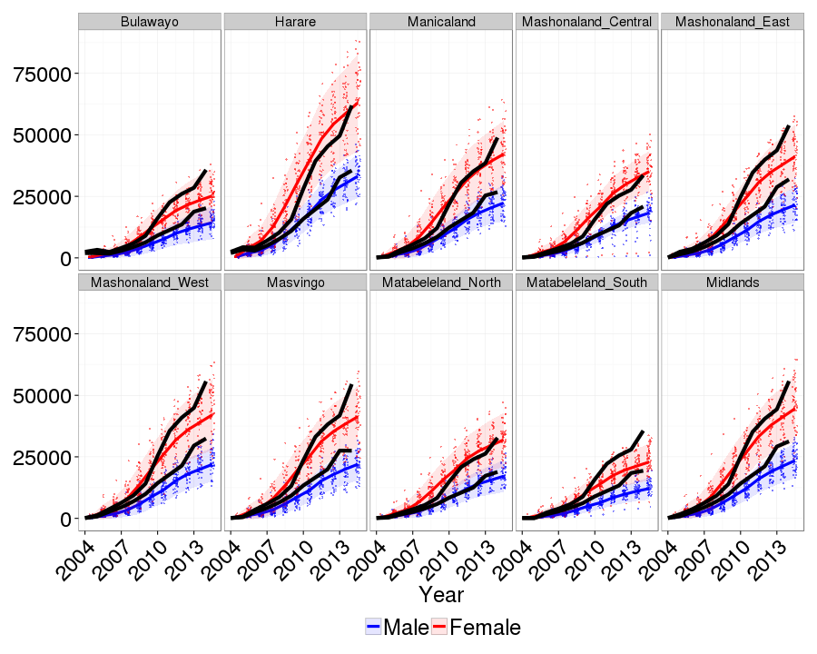
OptimTool: Maximizing HIV-Zimbabwe Likelihood
Age-Specific Prevalence
Number on ART
ZDHS
Model
ZDHS
Model: Male
Model: Female
Likelihood components not shown: 1) ANC prevalence, 2) provincial prevalence 15-49 by gender, and 3) ever tested for HIV by gender.

Slide 7
Incremental Mixture Importance Sampling (IMIS)
Initial points sampled from prior
Bayesian approach
  Prior distribution
  Likelihood function
Want: posterior samples
Using Incremental Mixture Importance Sampling (IMIS) [1]
Evaluate likelihood & multiply importance weights
Choose new points from Gaussian at MAP
Update weights
Resampling
[1] Adrian E. Raftery and Le Bao. Estimating and Projecting Trends in HIV/AIDS Generalized Epidemics Using Incremental Mixture Importance Sampling, Biometrics, 2010.

Slide 8
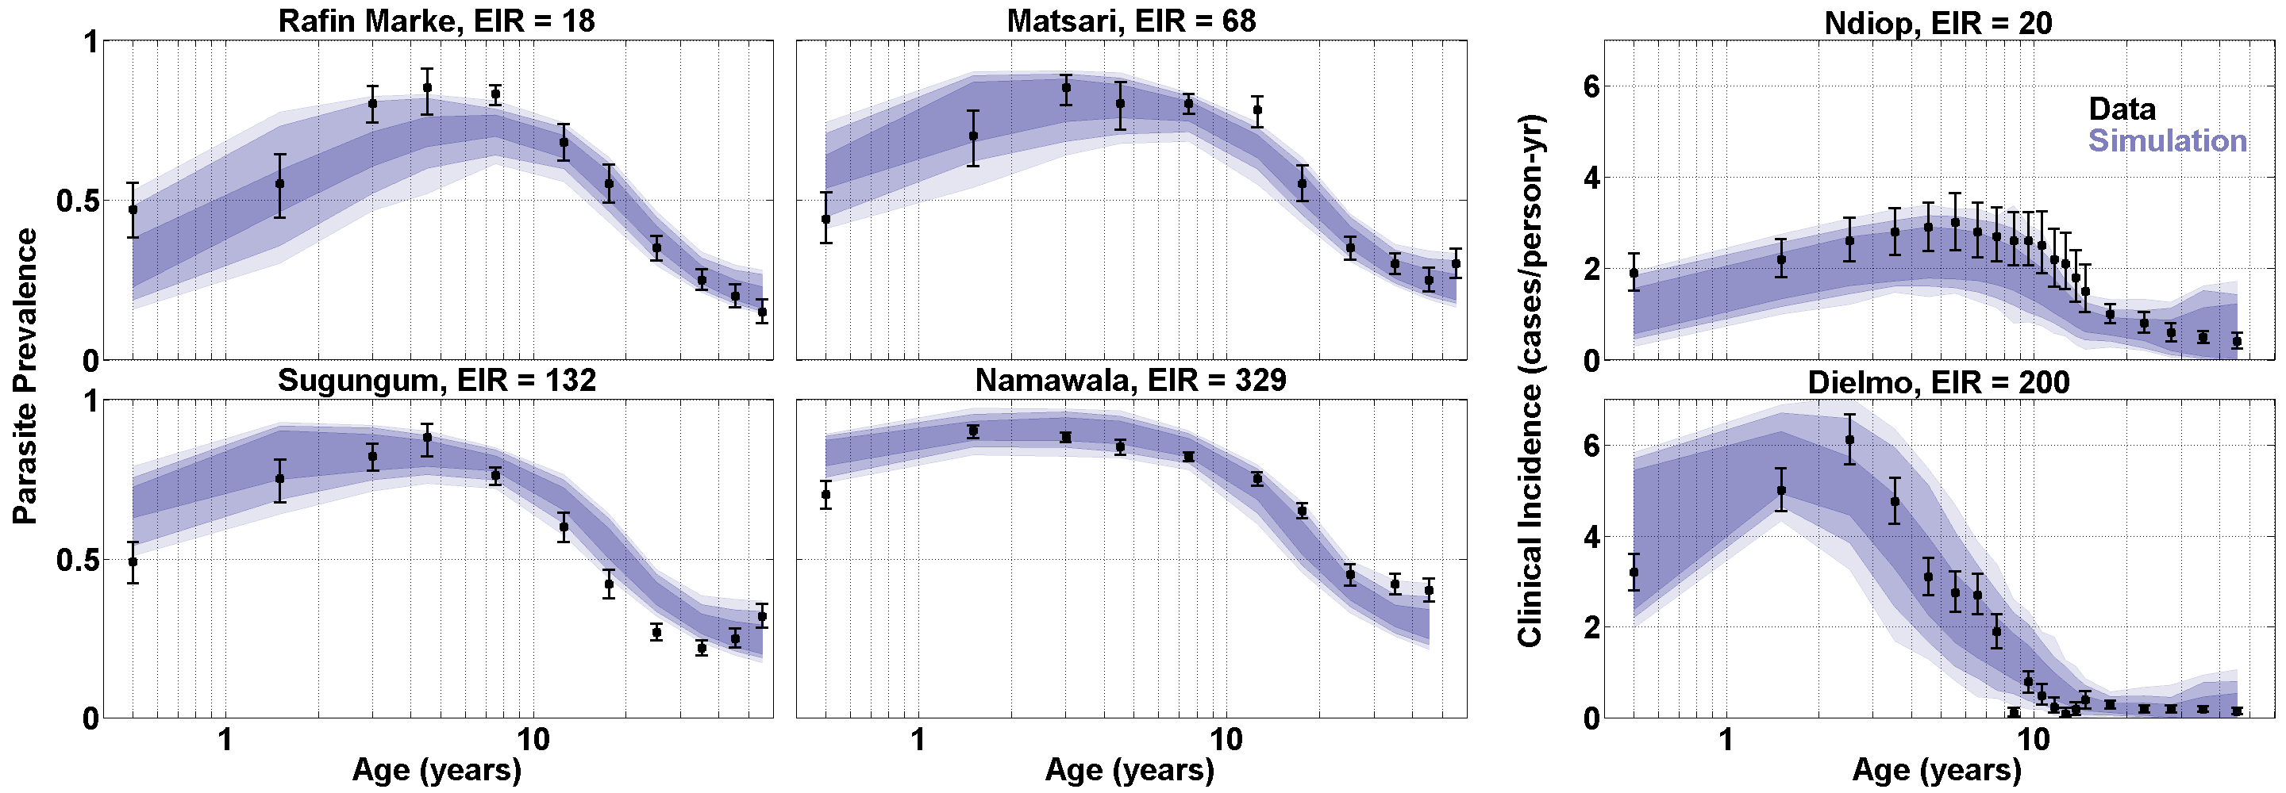
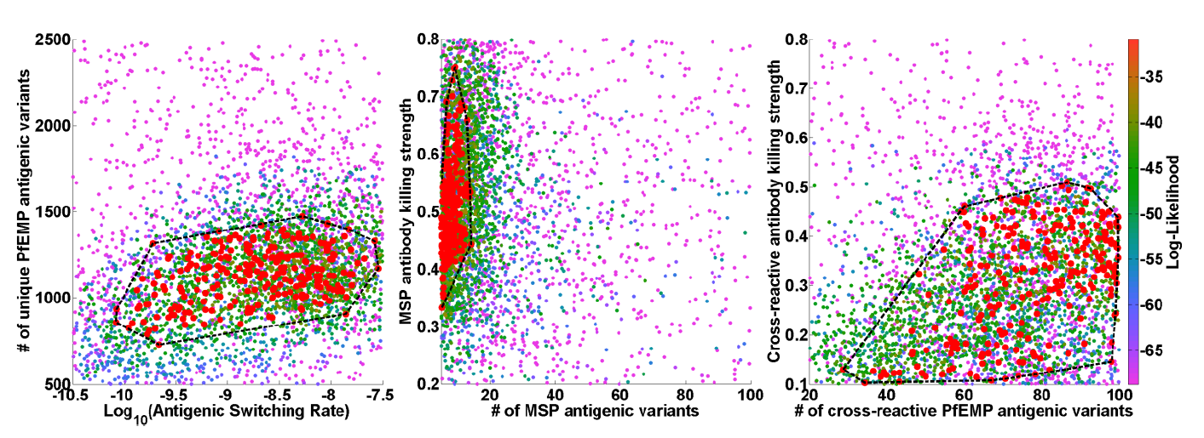
Malaria: Intrahost Calibration for RTS,S and More
6+6 DOF
Data (Immunity)
Parasite prevalence
Clinical incidence
NIE, TZN, KEN
EIR range
Parameters (6x)
# antigenic variants (3x)
Killing rates (2x)
Antigenic switching rate
McCarthy, Kevin A., Edward A. Wenger, Grace H. Huynh, and Philip A. Eckhoff. "Calibration of an intrahost malaria model and parameter ensemble evaluation of a pre-erythrocytic vaccine." Malar J 14, no. 6 (2015).

Slide 9
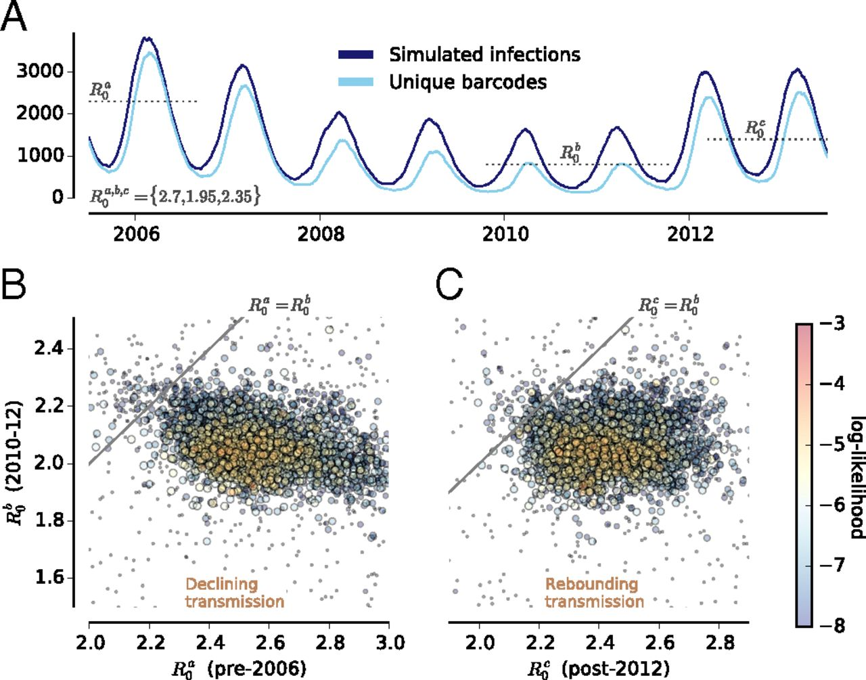
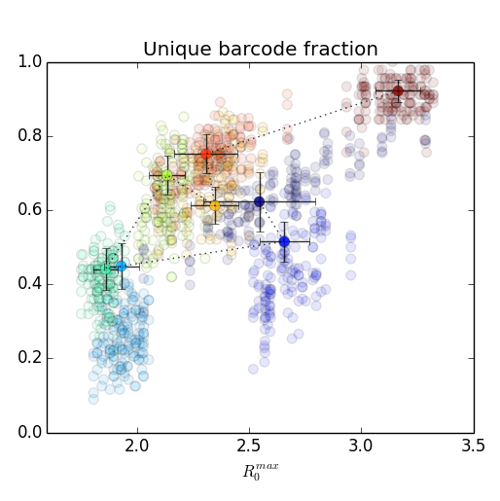
Malaria: Understanding Transmission via Genomics
Daniels, Rachel F., Stephen F. Schaffner, Edward A. Wenger, Joshua L. Proctor, Hsiao-Han Chang, Wesley Wong, Nicholas Baro et al. "Modeling malaria genomics reveals transmission decline and rebound in Senegal." Proceedings of the National Academy of Sciences 112, no. 22 (2015): 7067-7072.

Slide 10
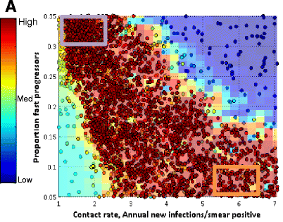
Tuberculosis: 2035 Targets in China
Data
Prevalence (overall / by age)
Mortality, MDR
Parameters (3x)
Infectiousness
Proportion fast
Slow to active progression rate
Iteration
1000 lhs + 100/iter * 60iter
Huynh, Grace H., Daniel J. Klein, Daniel P. Chin, Bradley G. Wagner, Philip A. Eckhoff, Renzhong Liu, and Lixia Wang. "Tuberculosis control strategies to reach the 2035 global targets in China: the role of changing demographics and reactivation disease." BMC medicine 13, no. 1 (2015): 1.
Notes:
Figure 3 The calibration parameter space and impact on future estimate of TB burden. A. The sampled points of the calibration, colored by log-likelihood. Red points have the highest likelihood (see fit in B-F), while blue points result in trajectories which differ substantially from the data. The orange and purple lines in B-F are drawn using only sampled calibration points from within the boxes drawn on A, where orange represents calibration points with a higher contact rate and lower proportion of fast progressors, while purple represents a lower contact rate and a higher proportion of fast progressors. B. Proportion of the population latently infected is higher when a higher contact rate and lower proportion of fast progressors is used. C, E, F. The projected decline in incidence is lower when a higher contact rate is used. The higher absolute incidence is driven by reactivation from the latent reservoir as shown in E and F. D. The trend in mortality follows incidence. Gray shaded area is 95% credible interval.

Slide 11
Agenda for Today
On the value of calibration / Does it matter?
Graham Medley, LSHTM
Global optimization
Zelda Zabinsky, Univ. of Washington
OptimTool overview/demo
Dan Klein, IDM
Calibration using History Matching
Ian Vernon and Michael Goldstein, Durham University
History Matching package
Dan Klein, IDM

