Slide 1
History matching @ IDM
Dan Klein, IDM Symposium, 4/18/2017

Slide 2
History Matching Software!
About
  history_matching packing written in Python
  LASSO regression for variable selection
  Uses statsmodels for GLM
  Custom GPR with GPU acceleration and cross-validation (Nvidia CUDA)
  Compatible with EMOD, takes sim inputs/results from Excel files
Work in progress
  More efficient input selection
  Cross-validation gradient for faster optimization
  Documentation and usability improvements
  Use OpenCL instead of CUDA
Looking for a few dedicated early adopters, let me know if interested

Slide 3
History Matching: Process
Select initial inputs (LHS), run sims, analyze results
For each “cut”:
  Select basis
  Generalized linear modeling for mean
  Gaussian process regression
  Evaluation and validation
Choose sims for next iteration, run, analyze, GoTo 2A
Finally, resample

Slide 4

Example Problem
Two parameters
  First Parameter (x1, -50 to 50)
  Second Parameter (x2, -100 to 100)
$Y \sim \sqrt{x_{1}^{2}+x_{2}^{2}}+N(0,1)$
Desired value: 15
Discrepancy stdev: 1.5
First Parameter
Second Parameter

Slide 5
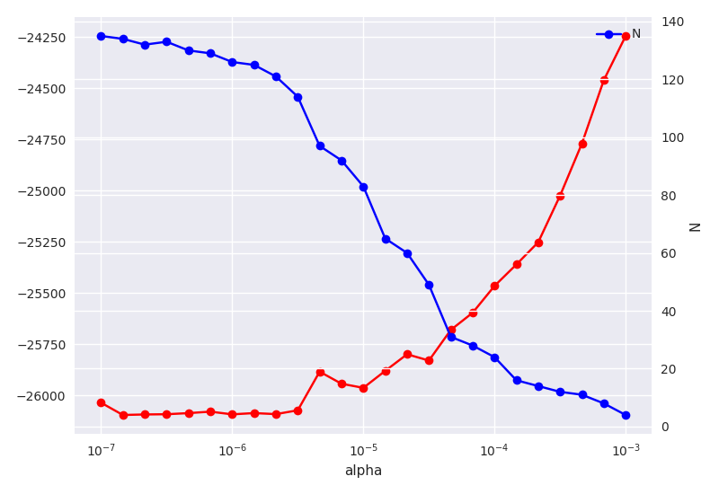
A. Basis Selection
Manual selection
Start with large basis
  GLM: 2nd order polynomial
  GPR: 1st order terms
Penalized regression
Num Params (N)
Bayesian Information (BIC)
Alpha

Slide 6
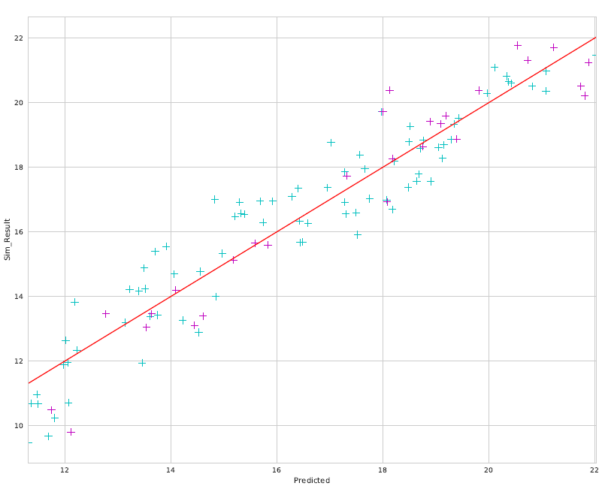
B. Generalized Linear Modeling
Standard GLM
  Poisson or Gaussian link family
  Using statsmodels
Data
  75% training (cyan)
  25% test (magenta)
Model Output
Predicted

Slide 7
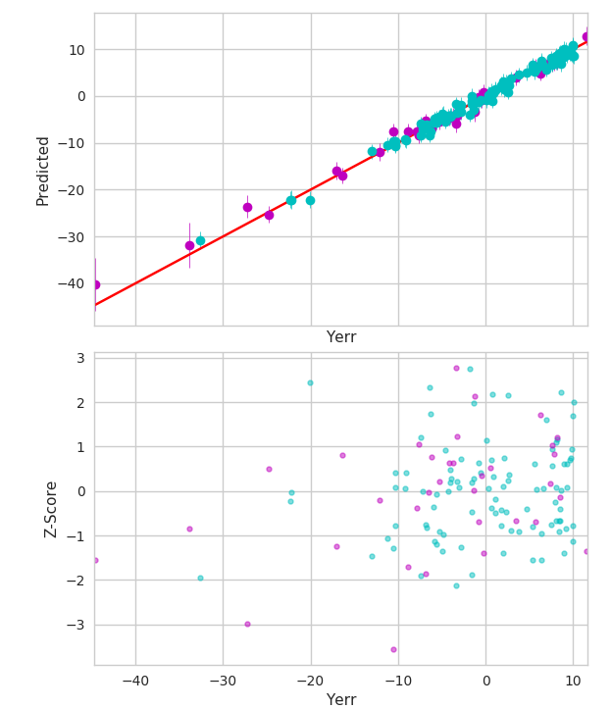
C. Gaussian Process Regression
Train GPR on residual error between GLM and data
Not much signal left, but main purpose is to quantify uncertainty
Training
  Use BFGS to maximize 5- or 10-fold cross validation likelihood
  GPU accelerated (Nvidia CUDA)

Slide 8
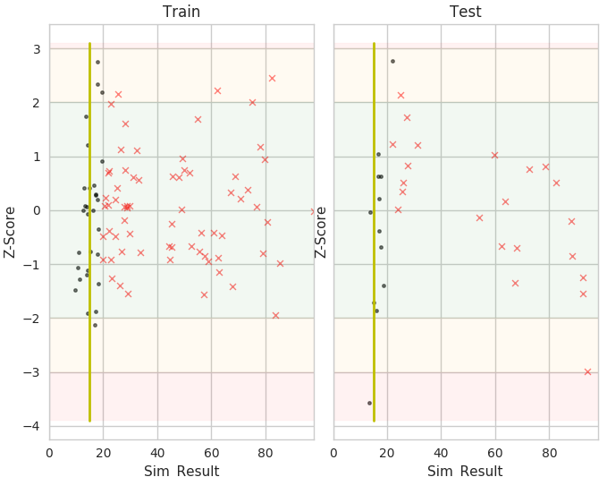
D. Evaluation and Validation
Check that the composite model fits the data
Make sure no “good” points are begin marked incorrectly
  Black o (plausible)
  Red X (implausible)
  Yellow bar is target
Update models or add new simulations to correct errors

Slide 9
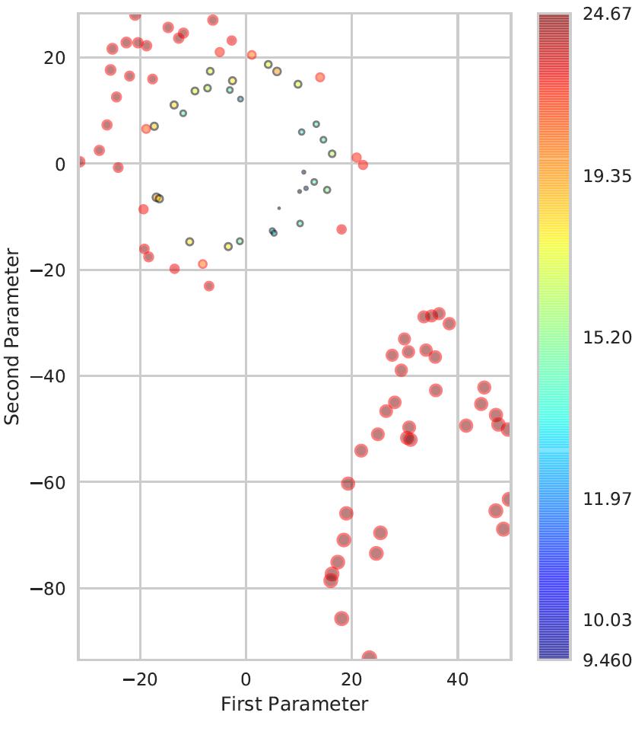
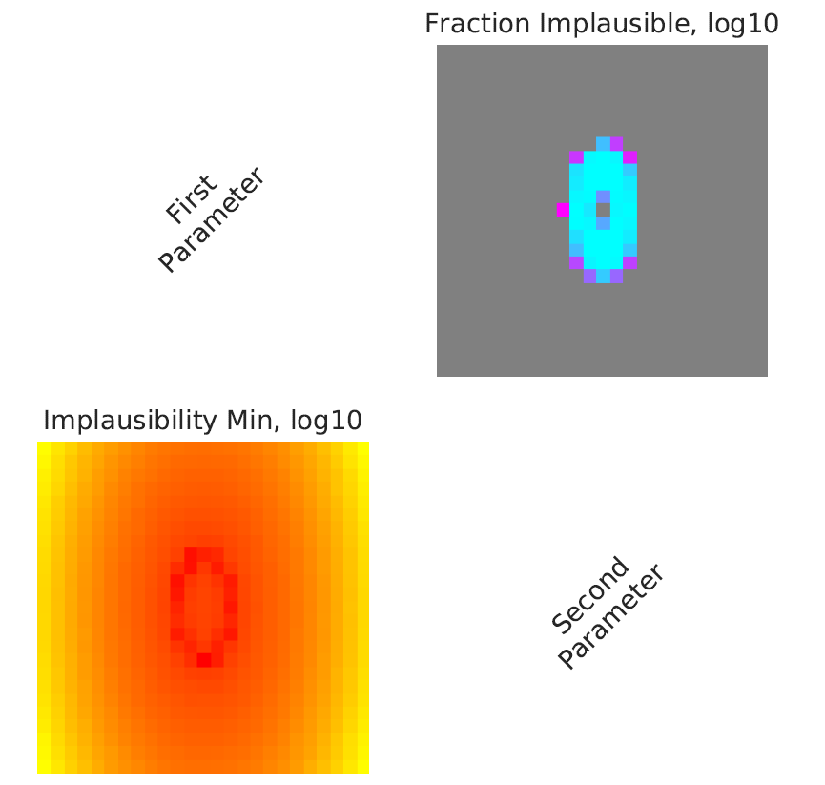
Plotting

