Slide 1


Dengue evolution of virulence
Should we expect dengue virulence evolution in response to Dengvaxia® vaccination?
Katia Koelle
Department of Biology
Duke University
Rotem Ben-Shachar
Department of Integrative Biology
Division of Infectious Diseases
UC Berkeley
April 20, 2017
IDM Symposium, Bellevue, WA

Slide 2
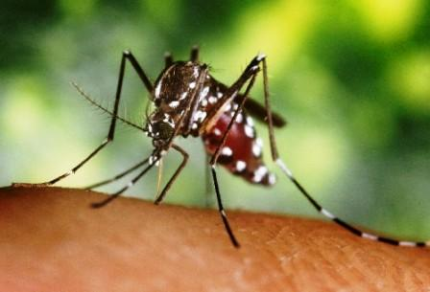
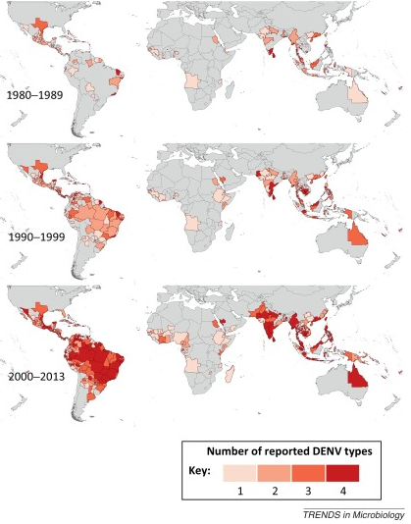
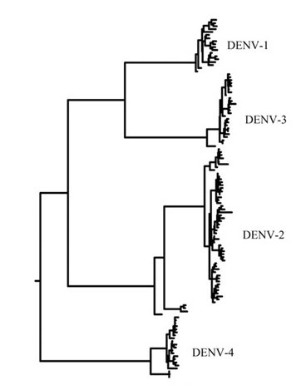
Figure 5
Vectorborne viral infectious disease
≥400 million infections annually
Bhatt et al. (2013) Nature
Messina et al. (2014) Trends in Microbiology

Slide 3
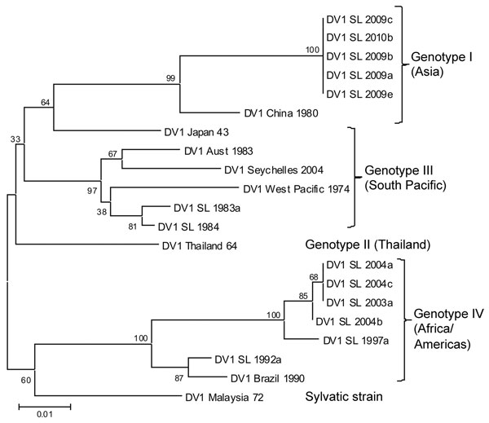
Genetic structure of dengue virus
Tissera et al. (2011) EID

Slide 4
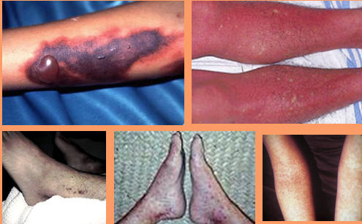
Dengue infections: spectrum of clinical manifestation
Dengue shock syndrome
Dengue hemorrhagic fever (DHF)
Dengue (“breakbone”) fever (DF)
High fever, severe headache, muscle and joint pains, retro-orbital pain
Kyle & Harris (2008) Annu. Rev. Microbiology
Secondary infections more likely to result in severe dengue (DHF)
Serotype and genotype differences in probability of developing severe disease
  (strain differences in virulence)

Slide 5
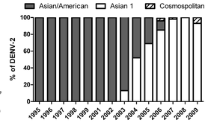
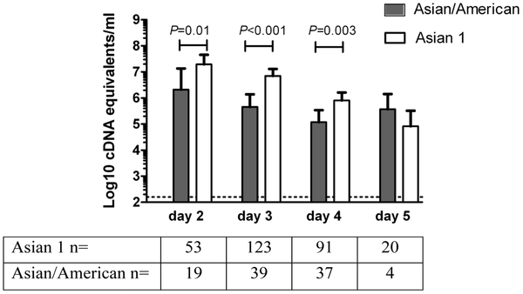
Dengue genotypes have been shown to differ in virulence
DENV-2 Asian-1 genotype replaced resident DENV-2 Asian-American genotype (here, in Viet Nam). Emergence was associated with higher number of hospitalized dengue cases
Infection with Asian-1 genotype results in higher peak viremia
day of patient illness
Hang et al. (2010) PLoS NTD

Slide 6

Within-host dynamics
death
Uninfected cells (X)
NK cells (N)
NK cell activation (q)
viral infectivity (β)
Infected cells (Y)
NK killing of
infected cells (α)
T-cell killing
of infected cells (δ_{T})
production (ω)
T-cell activation (q_{T})
Virus (V)
T cells (T)
clearance
death
Ben-Shachar & Koelle (2015) Journal of the Royal Society, Interface

Slide 7
Viral load data from infected individuals (n = 228)
-3
Data made available in Clapham et al. (2014) Interface

Slide 8
Fit of model to viral load data from infected individuals
Bayesian MCMC approach, with random effect on individuals’ incubation periods
Ben-Shachar, Schmidler, & Koelle (2016) PLOS Computational Biology

Slide 9
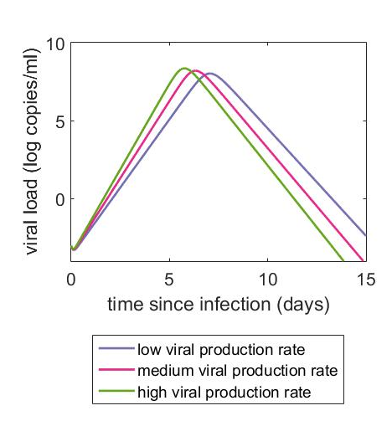
Examining virulence evolution in primary dengue infections
Set within-host parameters, vary one of them (viral production rate ω)
Viral production rate ω
copies/cell/day
Virulence depends on viral production rate
Where is viral fitness (R₀ ) maximized?

Slide 10
Examining dengue virulence evolution
Component of R₀: probability of transmission from infected human to mosquito
Probability of transmission to mosquito
Viral load (log₁₀)
Nguyen et al. (2013) PNAS

Slide 11
R₀ is maximized at intermediate virulence
Primary infections
Secondary infections
x
Ben-Shachar & Koelle (in review)

Slide 12
R₀ is maximized at intermediate virulence
Secondary
Primary
Post-secondary
x

Slide 13
Optimal virulence depends on epidemiological context
p₁ = proportion of infected individuals experiencing a primary infection
p₂ = proportion of infected individuals experiencing a secondary infection
1 - p₁– p₂ = proportion of infected individuals experiencing a post-secondary infection
Increasing virulence
Optimal virulence is higher in epidemiological contexts where either:
Only one serotype is circulating
Dengue is hyperendemic (4 serotypes circulating)
More generally, when there are higher proportions of primary and post-secondary cases
x

Slide 14
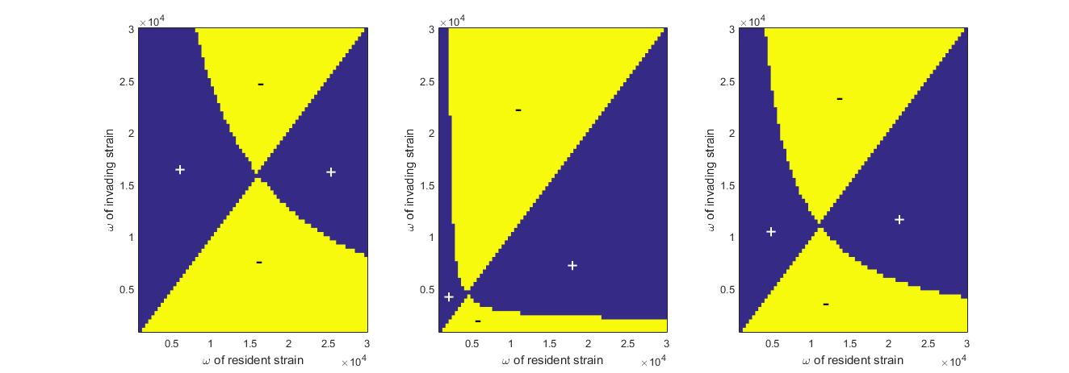
Pairwise invasibility plots
One circulating serotype
Two circulating serotypes
Four circulating serotypes
higher virulence
Transition from 2 circulating serotypes to hyperendemism selects for viral strains that are more virulent
This may be relevant for understanding observed genotype replacement dynamics in areas with increasing dengue serotype circulation

Slide 15
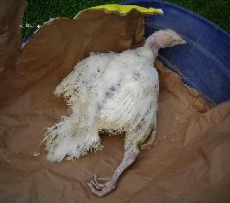
Evolution of virulence in response to Dengvaxia®?
Marek’s disease
Existing examples of virulence evolution as a consequence of vaccination
Vaccines against Marek’s disease select for ‘hot’ viruses
Read et al. (2015) PLoS Biology

Slide 16

Comparative modelling exercise on impact of Dengvaxia®
Primary Aim: To inform World Health Organization’s Strategic Advisory Group of Experts (SAGE) on immunization recommendations about dengue vaccination. Analyses: April 2015 – March 2016
Objectives: To understand the potential long-term population impact of Dengvaxia® in order to inform global and national vaccine policy. To identify areas of consensus and drivers of differences between predictions from different modelling approaches.
PLOS Medicine (2016)

Slide 17
Groups and models
8 groups
Significant model differences
Flasche et al. (2016) PLOS Medicine

Slide 18
Common assumption on mode of vaccine action
Vaccination is thought to act like a silent natural infection
Ferguson et al. (2016) Science
Flasche et al. (2016) PLOS Medicine

Slide 19
Predicted epidemiological impacts of Dengvaxia®
Increasing transmission intensity
Symptomatic
cases
Hospitalized
cases
Flasche et al. (2016) PLOS Medicine
In high transmission intensity regions, vaccination can reduce # of symptomatic cases and # hospitalized cases. But does the vaccine put selection pressure on dengue virus to evolve virulence?

Slide 20
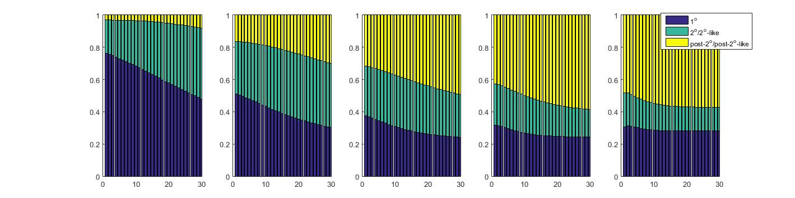
Predicted epidemiological impacts of Dengvaxia®
Proportion of infections
Years post Dengvaxia® introduction
In high transmission intensity settings, expect a decrease in the proportion of secondary/secondary-like infections (responsible for + epidemiological impact)

Slide 21
Predicted evolutionary impact of Dengvaxia®
Increasing virulence
Proportion of infections
Years post Dengvaxia® introduction
This is expected to put selection pressure on dengue virus to increase virulence
Ben-Shachar & Koelle (in prep.)

Slide 22
Conclusions
Through a joint analysis of within-host viral load data and data on transmission probability to mosquitoes, we have shown that R₀ is maximized at intermediate virulence levels for dengue virus
Secondary dengue infections are expected to select for lower virulence viral phenotypes than primary dengue infections or post-secondary dengue infections
Given this, we expect transition from 2 circulating serotypes to hyperendemism to result in selection for dengue strains with higher virulence
By reducing the number of secondary/secondary-like infections, Dengvaxia® may put evolutionary pressure on dengue virus to evolve higher virulence.

Slide 23
Acknowledgments
Rotem
Ben-Shachar

Slide 24
Examining dengue virulence evolution
Component of R₀: probability of transmission from infected human to mosquito
Nguyen et al. (2013) PNAS

Slide 25
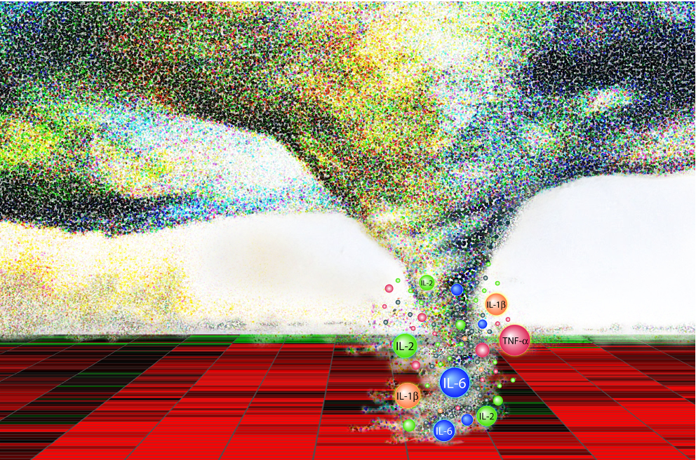

Development of severe dengue disease: immunopathology
Virulence evolution can theoretically occur in diseases caused by immunopathology
Day et al. (2007) Proc B
DHF arises by means of a cytokine storm, where cytokine release occurs by infected host cells (and T-cells)
virulence $∝$ peak viral load

Slide 26
R₀ is maximized at intermediate virulence
Post-secondary infections
Less likely to develop disease
Consistent with lower viral peak
Considered two different within-host scenarios. Primary regulation of viral dynamics by:
    Antibodies
    T-cells
    R₀ peaks at viral production rates +/- optimal viral production rates in primary infections
x
Ben-Shachar & Koelle (in revision)

Slide 27
Optimal virulence depends on epidemiological context
Post-secondary infection scenario 1
Post-secondary infection scenario 2
Increasing virulence
p₁ = proportion of infected individuals experiencing a primary infection
p₂ = proportion of infected individuals experiencing a secondary infection
1 - p₁– p₂ = proportion of infected individuals experiencing a post-secondary infection
Optimal virulence is higher in epidemiological contexts where either:
Only one serotype is circulating
Dengue is hyperendemic (4 serotypes circulating)
More generally, when there are higher proportions of primary and post-secondary cases
x

Slide 28
Predicted evolutionary impact of Dengvaxia®
Increasing virulence
Proportion of infections
Years post Dengvaxia® introduction
Similar (but less significant) effect for second scenario for post-secondary dengue infections

Slide 29
Pairwise invasibility plots
higher virulence

